Slide 1
CSU+
Anya N. Arnold

Slide 2
Summer of Activity
Building an understanding about the differences between ILL and Consortial Resource Sharing.
Policy creation with awareness that all policies are subject to change once we know the implications.
Training and lines of communication.

Slide 3
Summer of Activity
Building an understanding about the differences between ILL and Consortial Resource Sharing.
known vs unknown partners
systems
inventory management
patron patron management
leveraging the collective

Slide 4
Summer of Activity
Policy creation with awareness that all policies are subject to change once we know the implications.
Rota was set at random to collect data
Replacement Costs
Loan Length

Slide 5
Summer of Activity
Training and lines of communication.
Zoom
Email
Slack
websites

Slide 6
July 10

Slide 7
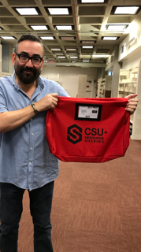
Bags!

Slide 8
Statistics
https://docs.google.com/spreadsheets/d/1ToSiX5mg_2dSVSG6zUdLCrM1SI1V9WSau-6ezjOKsng/edit#gid=1165552898

Slide 9
ulms.calstate.edu

