Slide 1
CSU QuestionPoint Services:
A 2017 Update

Slide 2
Highlights

Slide 3
16 CSU Libraries Participating

Slide 4
QP Academic Cooperative: Over 400 Academic Institutions in Six Time Zones

Slide 5
Some CSU QP User Survey Results
71% of respondents were first time users of the QP service.
26% of respondents had used the service before.
87% of respondents said the librarian was helpful.
83% of respondents were satisfied with the answer to their question.
93% of respondents answered favorably regarding the ease of using the service.
88% would use the service again.

Slide 6
CSU QP Usage
While the actual number of requests declined from 2015 to 2016, more requests were made per campus in 2016 than in any of the previous three years.

Slide 7
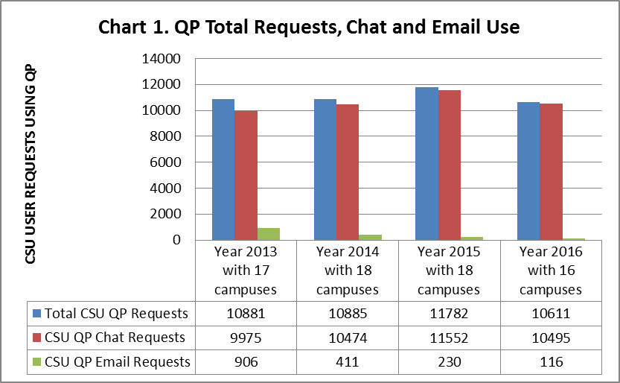

Slide 8
QP contribution percentage
This measure is based on the ratio of total chat sessions accepted by the library group to the total number of chat requests generated from their users.
75% is the Goal
For CSU, Jan. to Aug. 2017,
Contribution Percentage = 56%

Slide 9
In 2016, 57 percent of total CSU user chat requests were received between 8:00 AM and 6:00 PM.
43 percent of CSU chat requests were received between 6:00 PM and 8:00 AM.

Slide 10
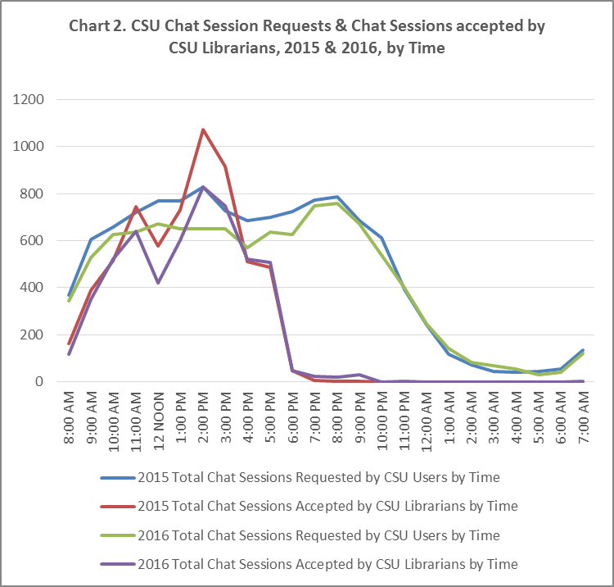

Slide 11
Other Info . . . QP Enhancements Feedback from CSU QP Campus Coordinators

Slide 12
Thank you

