Slide 1

SCELC CSU Shared Print Program
COLD Update
March 12, 2021
Rick Burke -- SCELC Executive Director (rburke@scelc.org)
Linda Frodyma Wobbe – Shared Print Liaison (linda@scelc.org)
Glenn Johnson-Grau – Shared Print Consultant (gjohnson@lmu.edu)
Notes:
Rick

Slide 2
Agenda
Why Shared Print?
North American Shared Print context
Why SCELC Shared Print?
Overview of GreenGlass
Review of the SCELC/CSU Shared Print Program
Program documentation review
Discussion / Questions
Notes:
Rick
Audience today represents both the seven CSUs in the initial cohort and prospective members.
We will quickly cover the “Why SCELC Shared Print” and how to participate for new libraries.

Slide 3
Why Shared Print?
Libraries finding solutions for modernizing spaces, services, collections
  If deselecting, how to weed with confidence?
Regional partnership building a collective collection
  CSU emerging notion of “one collection”
  SCELC program mirrors other regional programs
    MI-SPI involves 14 state universities across Michigan
    Or like WEST but for monographs
    Geographic focus in Western U.S.
Notes:
Weeding/deselection tends to get noticed, so we need confidence that we are making evidence-based decisions.
Regional collaboration
MOU to bind regional partners

Slide 4
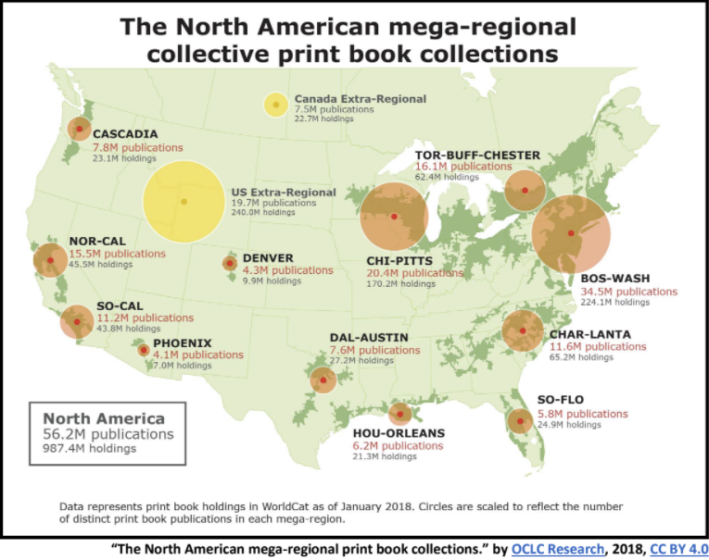
Notes:
Rick

Slide 5
Partnership for Shared Book Collections
SCELC a founding member of the Partnership
Federation of monograph shared print programs in U.S. and Canada
Partnership priorities:
  Advance collaboration and coordination of collective collections
  Develop infrastructure, operating practices, and business model(s) to support coordination, prioritization, and focus of collaborative efforts
Working groups
    Advocacy & Communication • Infrastructure
    Best Practices • Research & Network Level
Notes:
Rick
SCELC has a role in shaping the future of shared print
CSU can also shape shared print as part of SCELC
Linda chair of Infrastructure Working Group
Glenn participant in Best Practices Working Group

Slide 6
Why SCELC Shared Print?
SCELC is pioneer in shared print
  Founding member of WEST and the Partnership
Three active cohorts with 35 participating libraries
We are focused on growing and deepening collaboration
  MOU provides 15-year commitment to provide continuity
    Requires registering commitments with WorldCat
  Resource sharing built into program
Governance model and operational infrastructure in place
  Shared Print Committee (SPC) includes CSU representation
    Additional CSU Cohort working group
    Network of CSU colleagues able to support new participants
Notes:
Rick
MOU requires that retentions are from circulating collections and can circulate via existing ILL networks

Slide 7
SHARED PRINT GROUP | Monograph Holdings Committed
HathiTrust Print Monographs Archive | 18,418,030
Eastern Academic Scholars Trust (EAST) | 8,462,981
Washington Research Library Consortium (WRLC) | 2,862,344
SCELC Shared Print Program | 2,208,402
Academic Libraries of Indiana (ALI) | 1,701,374
Maine Shared Collections Cooperative (MSCC) | 1,408,737
Council of Prairie and Pacific University Libraries (COPPUL) Shared Print Archive Network | 1,147,232
Connect New York | 852,205
Michigan Shared Print Initiative (MI-SPI) | 774,173
University of Maryland and Affiliated Institutions (USMAI) | 643,960
Tri-University Group (TUG) | 340,279
Central Iowa Collaborative Collections Initiative (CI-CCI) | 152,553
CALD Cooperative Collection Management Program | 270,211
Notes:
Rick
This is GreenGlass data
SCELC #4 on list
MI-SPI much smaller
CSUs Cohort 1 brought 600K volumes, almost as many as all of MI-SPI

Slide 8
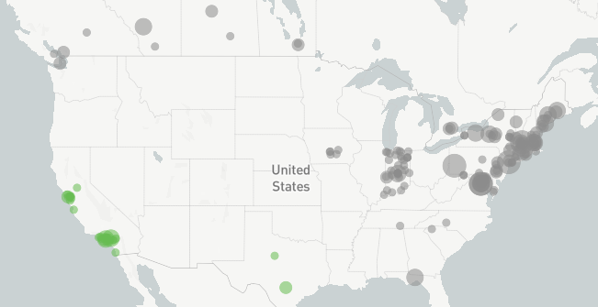
North American Retention Commitments
Green dots are SCELC’s 2.2M retention commitments
Notes:
Rick
Green dots are SCELC’s 2.2M retention commitments

Slide 9
Why do participants value SCELC Shared Print?
Two surveys (incl. Dec. 2020) indicate participants value:
  Ensuring future access
  Sharing responsibility for stewardship
  Strengthening relationships among participating libraries
  Deselecting based upon data recognizing the larger collection context
  Gaining knowledge of the local collection for improved collection development/management
  Informing campus discussion of deaccessioning books knowing of availability at partner libraries
  Encouraging collaborative collection development
Notes:
Rick
Surveys in 2018 and December 2020

Slide 10
SCELC/CSU Shared Print Collaboration
2012-2013 -- Initial SCELC planning and CA conversations
  Included UC, CSU, and OCLC representatives
2016 -- SCELC Shared Print Cohort 1 goes live
April 2018 – Initial SCELC presentation to COLD
Dec 2018 -- COLD SPIRIT resolution
  Recommended participation in the SCELC program establishing a cooperative intersystem initiative for responsible print retention and reduction
Sept 2020 -- CSU Cohort 1 goes live
Notes:
Rick

Slide 11
CSU Impact on Retention Model
COLD approved the SCELC retention model and requested greater duplication in future iterations
  SCELC Model
    Retain all of Uniquely Held
    Retain 1 of Widely Held
  COLD consulted for CSU Cohort 1 retention model
    Agreed that >40% retentions was not feasible for first cohort
  Future CSU cohorts will consider how best to support COLD SPIRIT resolution
    When two or more copies identified and at least one copy is at a CSU library, a CSU library will retain at least one copy
Notes:
Rick
We collaborated with COLD to modify the COLD SPIRIT retention model once CSU libraries determined the model was not feasible.
Glenn
SCELC model requires us to retain:
Uniquely held at each institution
1 copy of widely held
CSU addition: 1 copy of SCELC retentions would be duplicated at a CSU

Slide 12
GreenGlass: Data for Analysis
GreenGlass provides data at the collection and title level
  Powerful “query builder” to run reports that include:
    Holdings, usage, and peer groups analysis
Data-driven deselection
  Two common barriers to weeding projects: data and time
  Superior to local ILS queries + comparator data in the same reports
Data-driven collection assessment
  Analysis for local strengths (and gaps)
  Local projects: Special Collections, new academic programs
  Comparator analysis for both local and system-wide coll. dev.
Notes:
Glenn
Libraries, including LMU, then make withdrawal decisions for volumes we are not required to retain.

Slide 13
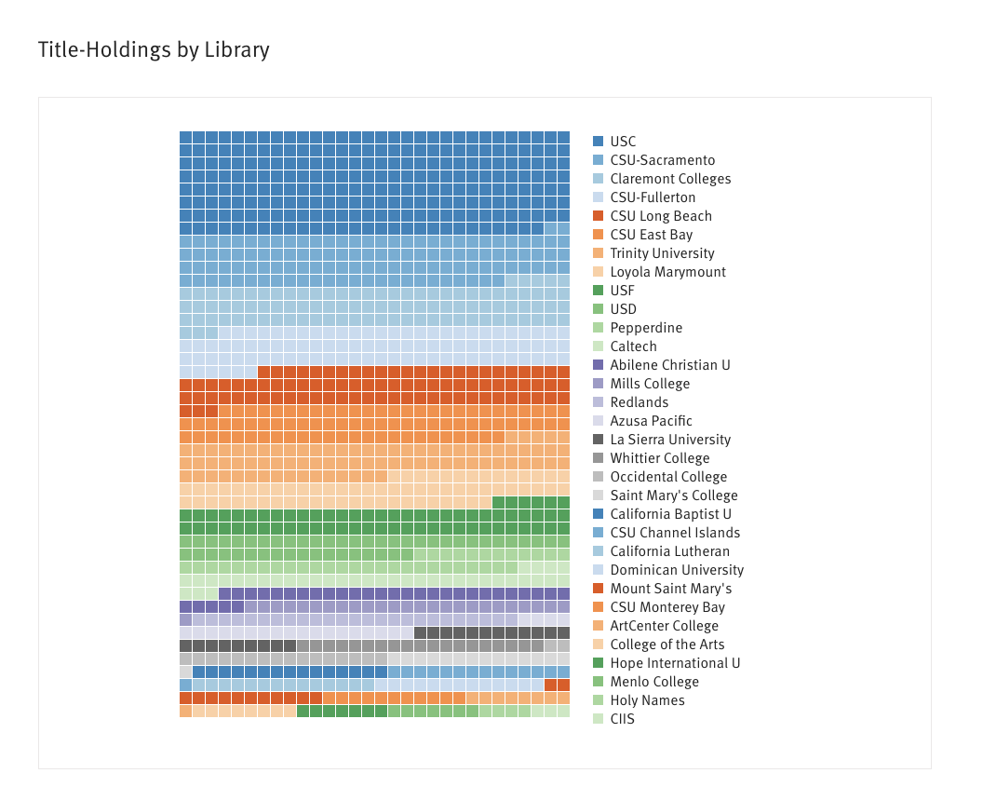
SCELC/CSU Shared Print Title Holdings
Notes:
Glenn
Initial six CSUs
Strengthen the shared collection
Are represented at levels throughout the participants.

Slide 14
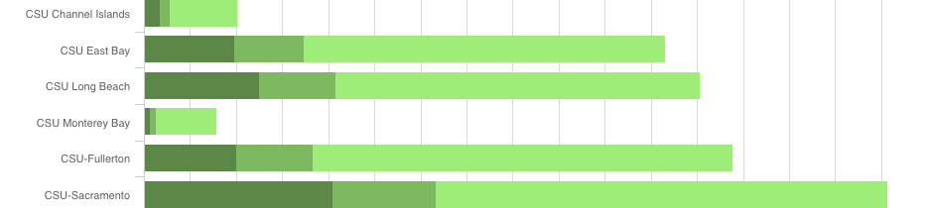
First CSU Cohort Holdings
Compared to the entire group of SCELC participants
  Uniquely held (dark green); widely held (lightest green)
  All libraries add valuable titles
  All libraries also have a lot of widely-held titles
Notes:
Glenn
CSU adds valuable unique titles AND
Each CSU has lots of candidates eligible for consideration for withdrawal.

Slide 15
Cost with Savings for CSUs
SCELC negotiated special pricing, lower than other SCELC participants
Deadline to order June 30th, 2021
  Can be paid in current FY, next FY, or split
Three cost factors:
    Set up fee SCELC CSU Only = $3,750 (down from standard fee of $5,000)
    Per record charge:
      SCELC CSU Only = $.02/record up to 1M (down from $.03/record)
      Greater than 1M records = $.015/record
    SCELC Group Project fee was reduced to 10% (down from 20%)
    SCELC Fees
      SCELC surcharge = $187
      SCELC SSP = $150
      SCELC Membership equivalency fee (varies by institution) up to maximum of $750
Notes:
Linda

Slide 16
Quotes
Number of bibliographic records to be included:
  Fill out OCLC Collection Inquiry Form
    Circulating print monographic materials only
    Including juvenile literature and music scores, if circulating
    Excluding serials, microformats, government documents, reference books, special collections, e-Books, lost/withdrawn items, theses/dissertations, maps
  Local analysis
    Optionally can include reference books, special collections, etc that are not included in the group project
Choice reviews ($550 flat fee)
  Optional - flags for books reviewed in Choice
eBooks (priced at a discount to bibliographic records)
  Optional - Flag can be set for eBooks that duplicate print books
Notes:
Linda

Slide 17
Quotes
Complete the interest form:
https://scelc.org/libraries/member-library-benefits/shared-print-program/shared-print-interest-form
Or email Quotes@SCELC.org
Notes:
Linda

Slide 18
Documentation
SCELC CSU Shared Print
MOU
FAQ
Policies & Guidelines
Master Timeline
  Steps in the process including links for documentation and training videos
Notes:
Linda

Slide 19
Questions?
Contact rburke@scelc.org, linda@scelc.org, gjohnson@lmu.edu
Notes:
Rick

