Slide 1
CONTROLLED Digital Lending What is it and is it even Legal?
Presented by the
Systemwide Technology Initiatives management Committee (STIM)

Slide 2
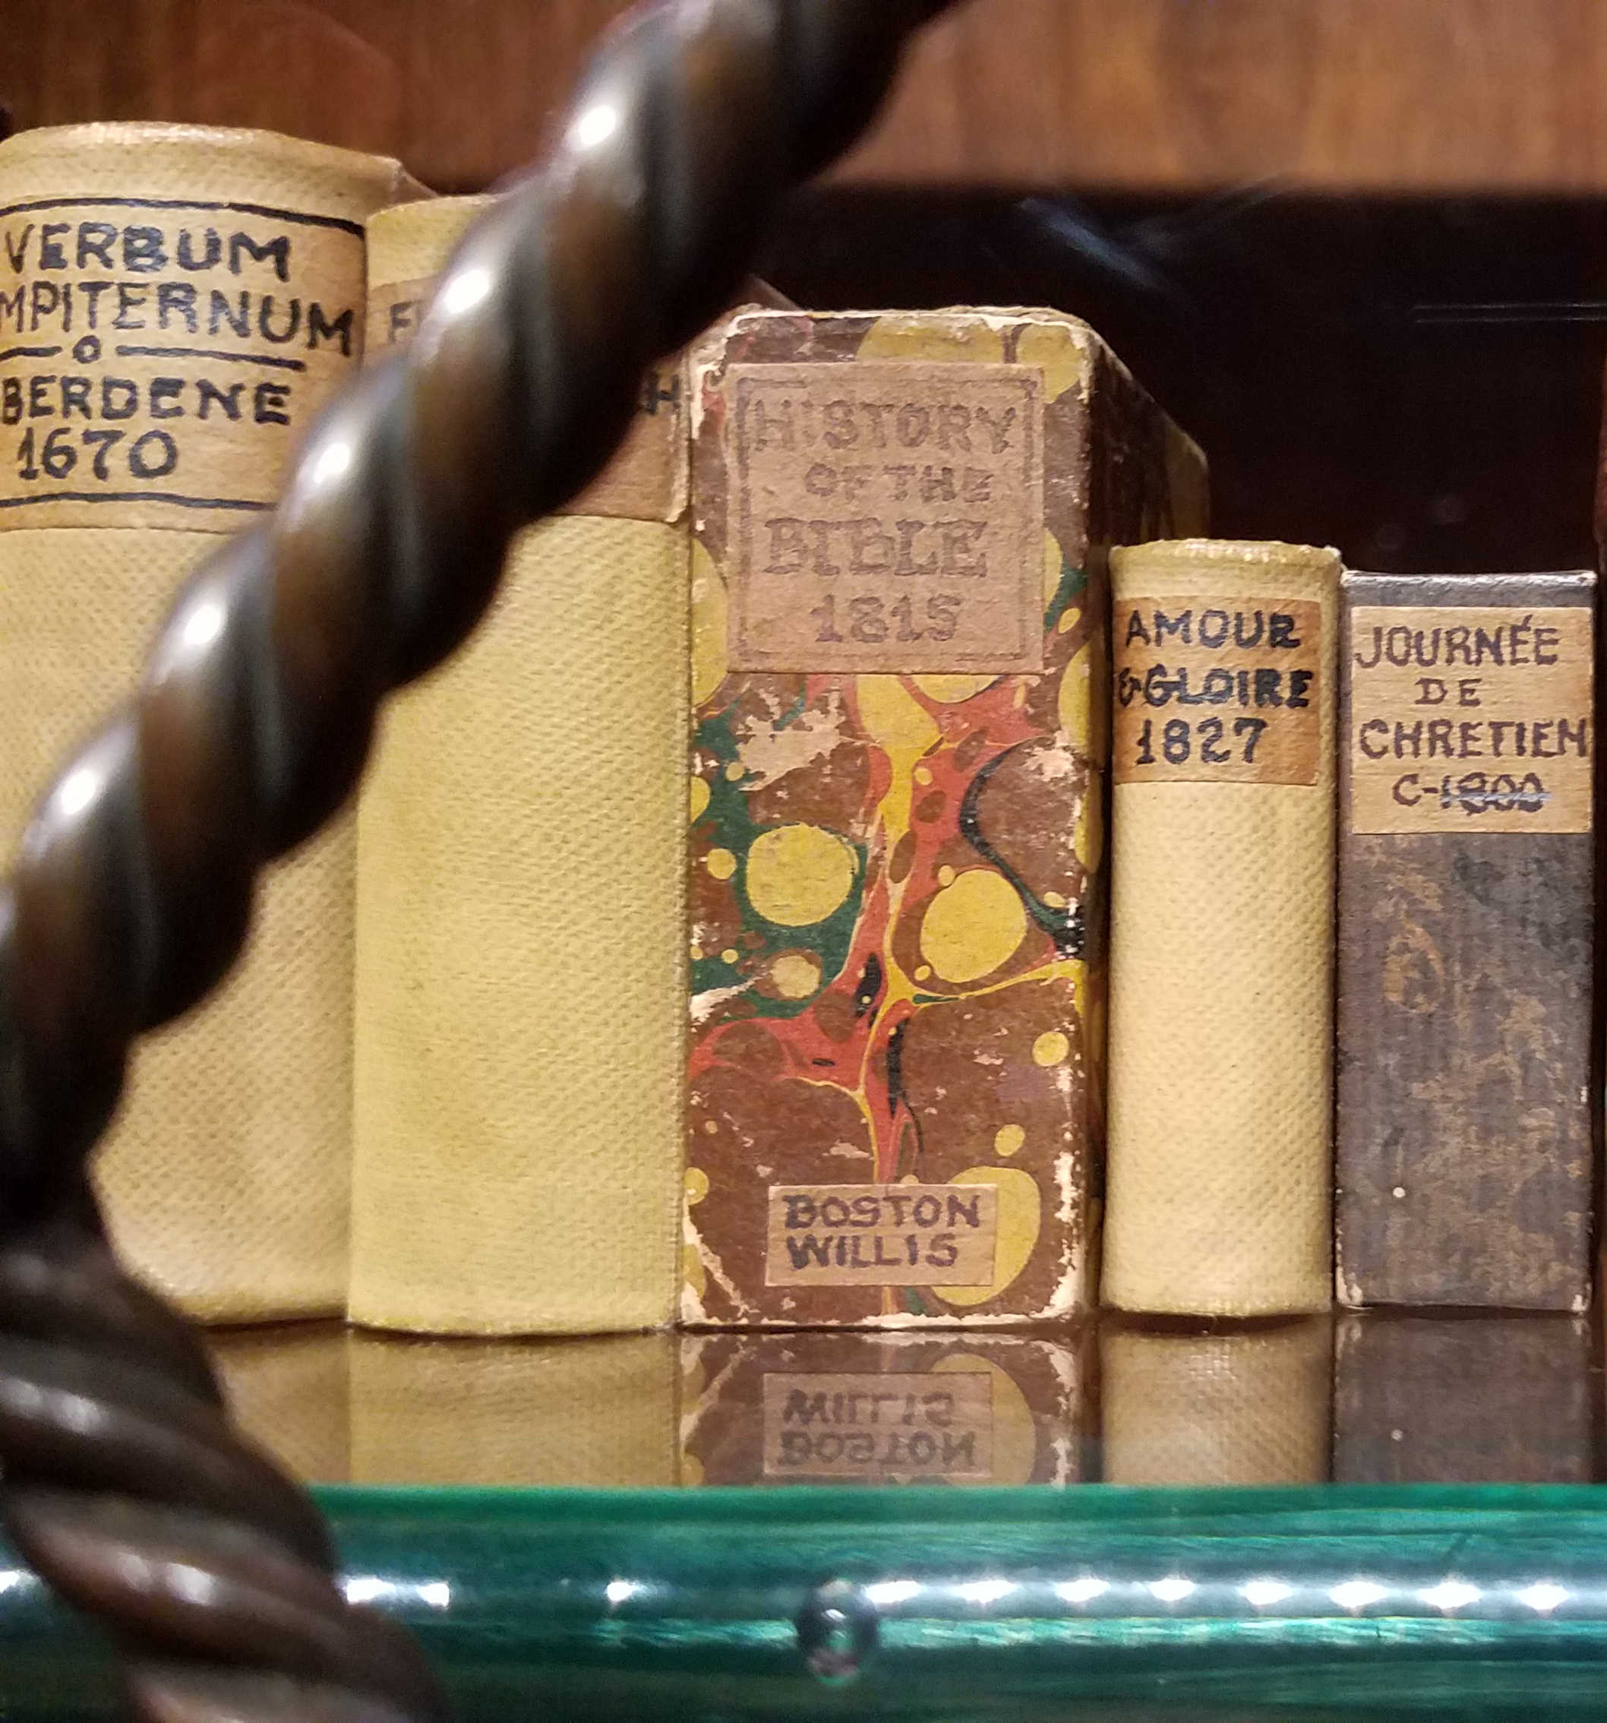
CDL is…
Controlled Digital Lending (CDL) refers to the practice of lending a digital surrogate in place of a physical copy of an item that a library has purchased and owns.
The digital surrogate is treated the same as the physical copy: loaned to one patron at a time for a defined period of time with restrictions placed on copying and distributing.
With digital surrogate circulating in its place, physical copy is withdrawn from use.

Slide 3
How is CDL used?
Course Reserves
01
Interlibrary Loan
02
Preservation
03
CDL is ideal for short-term checkouts because item status can be changed automatically with no delay between loans.
CDL is a boon for resource
sharing, allows libraries to
exchange items with no
transportation costs or delays.
CDL can be used as a sub-
stitute for circulating fragile or damaged copies of an item.

Slide 4
History of CDL
2010 - Internet Archive founds Open Libraries
2011 - Michelle Wu publishes “Building a Collaborative Digital Collection: A Necessary Evolution in Libraries”
2015 – Google Books Lawsuit (Authors Guild, Inc v. Google, Inc.)
2020 – Georgia State University E-reserves Lawsuit (Cambridge University Press et al v. Patton et al

Slide 5
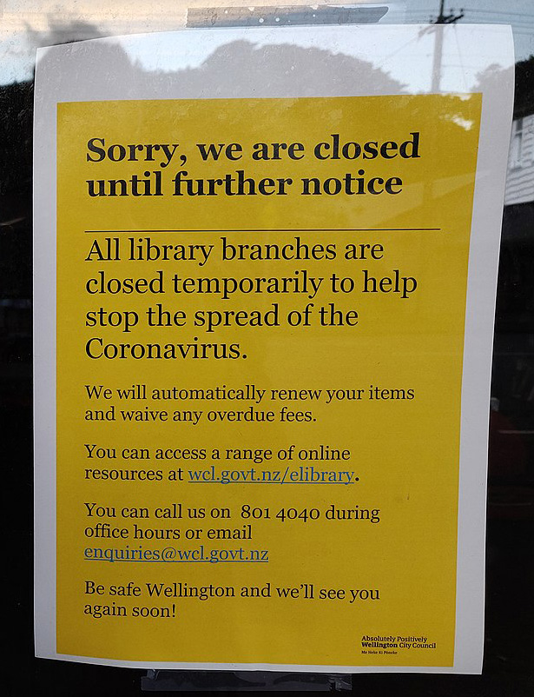
Course Outline
CDL In the Time of COVID
CDL Implementers Group: https://sites.google.com/view/cdl-implementers
CDL Information & Recommendations Cooperative (CIRC): https://www.cdlproject.org/
HathiTrust’s Emergency Temporary Access Service: https://www.hathitrust.org/ETAS-Description
Internet Archive’s Open Library: https://openlibrary.org/
By Ballofstring - Own work, CC BY-SA 4.0, https://commons.wikimedia.org/w/index.php?curid=88640931

Slide 6
National Emergency Library and the Internet Archive lawsuit
In March 2020, at the start of the quarantine in the US, Internet Archive made OpenLibrary.org collection available to everyone, everywhere, all at the same time, with no waitlists.
Several major publishers sued Internet Archive for copyright infringement.
Case is scheduled to go before the Southern District Court of New York in November 2021.
https://thevintagent.com/2020/03/26/national-emergency-library/

Slide 7
Project analysis slide 3
LEGAL JUSTIFICATION FOR CDL
FIRST SALE DOCTRINE
FAIR USE, Educational Purpose
FAIR USE, Market Harm
FAIR USE,
Nature of work
Allows the owner of a copy to “sell or otherwise dispose” of the copy. Principle by which libraries are allowed to lend copies.
CDL is explicitly non-commercial. Edu- cational fair use should apply; how-ever, there are few cases related to educational use and so the doctrine is untested.
Probably CDL’s most persuasive argument: since the library lending pro-cess is replicated, there should be no change in library purchasing or con-sumer behavior.
Nature of the Work fair use arguments are “rarely found to be determinative.” With CDL, reproduction of out-of-print or orphan works could be protected.

Slide 8
Risk Mitigation
Risk is unavoidable. The benefit of CDL is worth the risk.
There are precautions libraries can take to reduce the risk of a lawsuit
Replicate existing circulation methods as closely as possible.
Govern the process with policy.
Limit the community of users that can access the service.
Consider the litigiousness of the copyright holder.
Limit to older works whose copyright has not been renewed.

Slide 9
Is Controlled Digital Lending Even Legal?

