Slide 1
COLD Student Success Study
Status Report
Lili Luo
Tracy Elliott
Jennifer Fabbi
Dec 2020

Slide 2
Outline
Project progress
Highlights of findings
Next steps

Slide 3
Project Progress
Adjusted Study Objectives/Deliverables due to COVID-19 Disruptions
Research questions
What effect does IL instruction have on students’ academic success?
What effect does a specific teaching method/characteristic used in IL instruction have on students’ academic success?
Deliverables:
A multi-institutional analysis examining the impact of IL instruction on students’ academic success, based on data about the 2019-2020 first year students from summer (if applicable) and fall 2019
A comparative analysis of how IL instruction practices changed across all participating libraries in fall 2019 and spring 2020
A detailed documentation of the methodology

Slide 4
Project Progress
17 Participating Institutions
California State University, Bakersfield
California State University Channel Islands
California State University, Chico
California State University, East Bay
California State University, Fresno
Humboldt State University
California State University, Long Beach (partial participation)
California State University Maritime Academy (partial participation)
California State University, Monterey Bay
California State University, Northridge
California State Polytechnic University, Pomona
California State University, Sacramento
California State University, San Bernardino
San Diego State University
San Francisco State University
San José State University
Sonoma State University

Slide 5
Highlights of Findings
About 29% of the 2019-2020 first-year students in all participating campuses took courses in fall 2019 (and summer 2019 if applicable) where IL instruction was provided.
Overall, the effect of IL instruction on students’ academic success, measured in their earned credits and GPA, was negligible.
As for the specific teaching methods and characteristics used in the IL instruction, some had positive effects and some had negative effects on students’ earned credits and GPA, and the effect size was mostly small to negligible.
Among the individual institutions that participated in the project, there was notable variation in terms of the direction and size of the effect of IL instruction or the teaching methods/characteristics on students’ earned credits or GPA. Still, there was no statistically significant effect size that would be considered large.

Slide 6
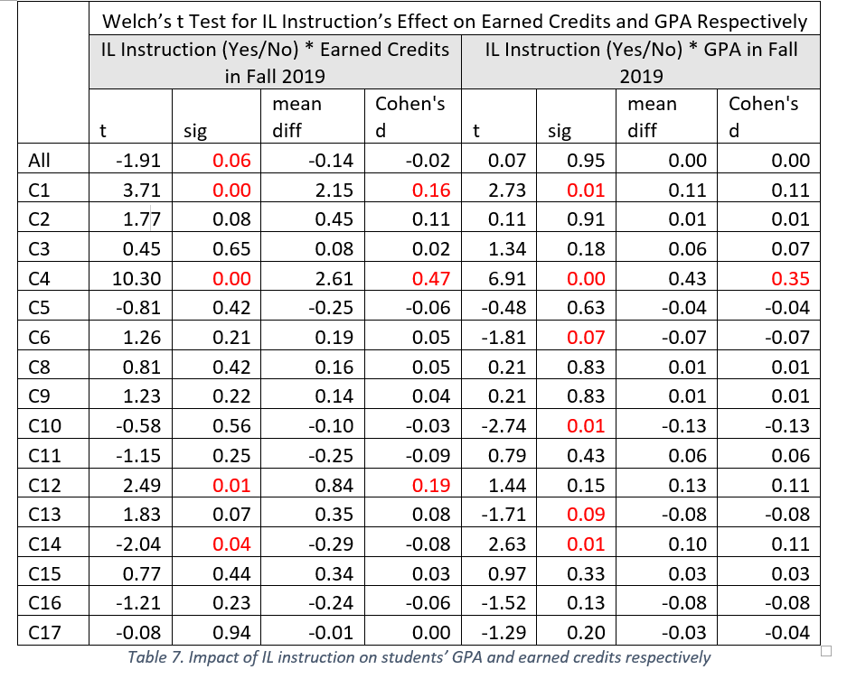
t Test results – measuring the impact of IL instruction on earned credits and GPA separately

Slide 7
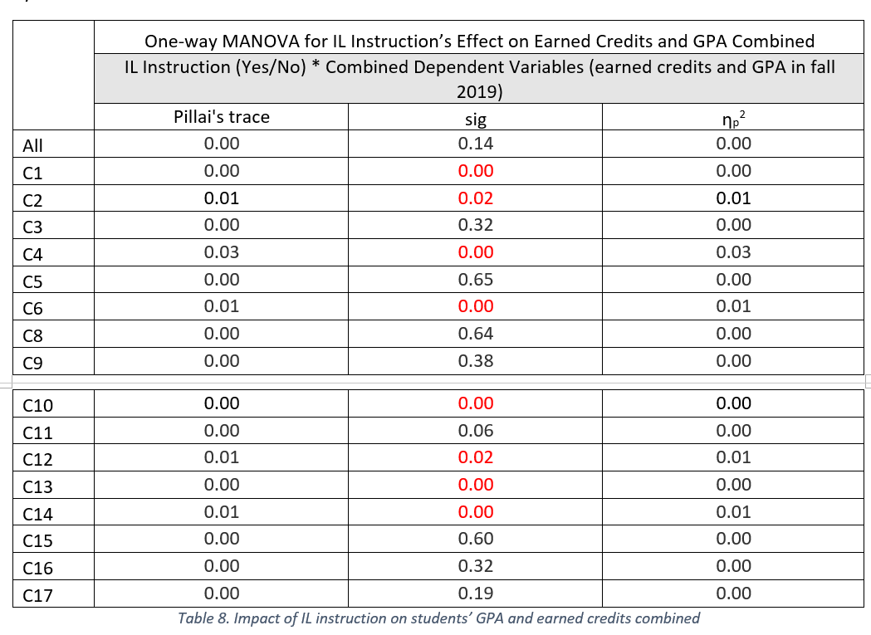
MANOVA results – measuring the impact of IL instruction on earned credits and GPA combined

Slide 8
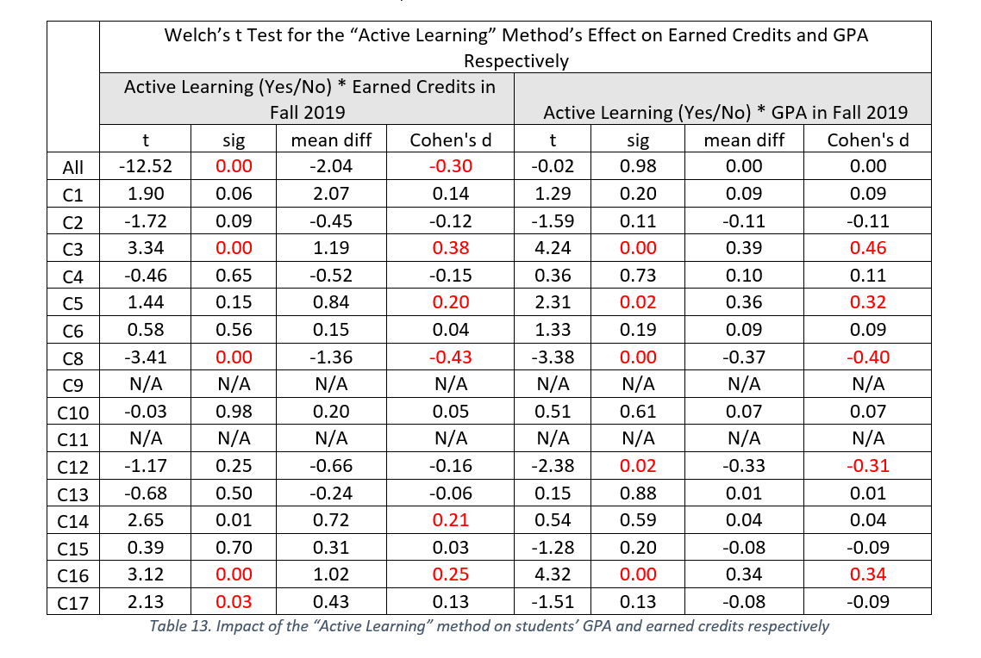
t Test results – measuring the impact of “Active Learning” on earned credits and GPA separately

Slide 9
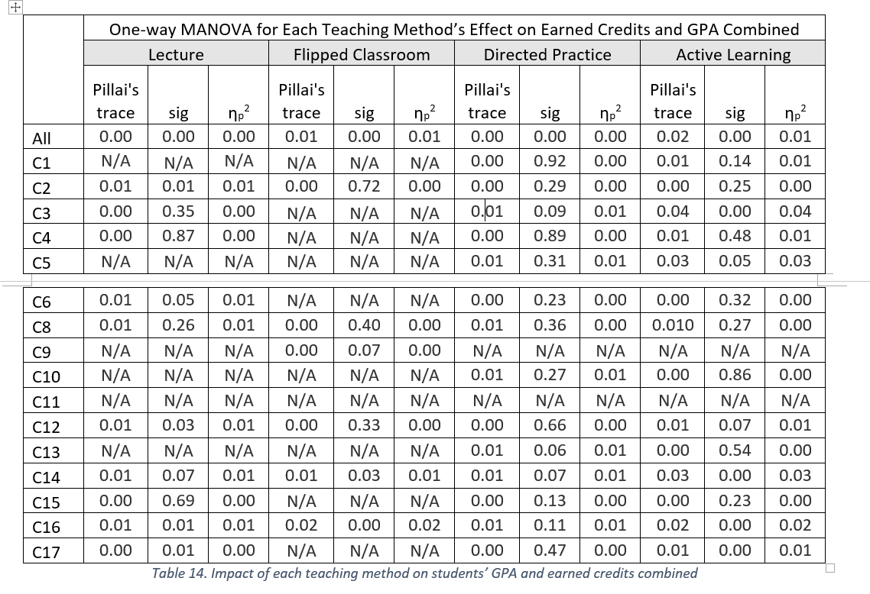
MANOVA results – measuring the impact of each teaching method on earned credits and GPA combined

Slide 10
A comparative view – the number of courses for which IL instruction was provided in fall 2019 vs. spring 2020

Slide 11
Highlights of Findings
Project Progress
Results of the analysis may be limited by the following factors 1) the data set was primarily from fall 2019, instead of the entire AY 2019-2020 due to the disruptions of COVID-19; so it was smaller than anticipated; 2) there was diversity across the participating institutions with regards to student data and practices of IL instruction.
A baseline for future longitudinal research
A tremendous team effort – all participating institutions were supportive in the data collection process
Positive relationship between the library and the Office of Institutional Research

Slide 12
Next Steps
The project report has been submitted to Jen and Tracy for review. Their feedback will be addressed before the report is released to the entire COLD group.
Each participating institution will receive the following information:
The anonymized ID for their campus used in the final project report
Data from their institution that was cleaned up and used in the analysis
All the SPSS analysis files associated with their institution
Questions about the data analyses can be sent to lili.luo@sjsu.edu

Slide 13


