Slide 1
Goal:
  develop concrete goals and priorities to inform negotiation in shared (CA-wide) agreements
Task force formed at December COLD
  Members: Amy, Cyril, Emily, Tracey

Slide 2
From California Library Collaboration framing document
Our aims:
The California Library Collaboration directs the power of
successful multi-campus systems and library consortia towards common
aims: to make California's research and scholarship available to the world, and to promote greater access to information resources at an affordable and sustainable cost. We seek to explore and engage in joint agreements that meet these aims.
Notes:
Note that any potential agreement needs to be mutually beneficial for all parties, therefore, what are CSU’s highest priorities?

Slide 3
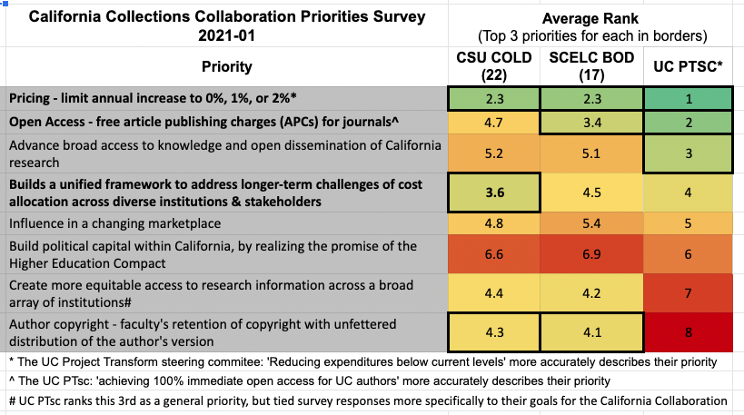
Results from "California Collections Collaboration Priorities Survey 2021-01"
Notes:
The lower the number, the higher the priority, green highest priority, red lowest
All parties agree that pricing is highest priority, diverges after that

Slide 4
CSU priorities according to survey

Slide 5
Potential OA options and implications for library operations
Author retention of copyright (CSU #3 on survey):
  Focus on authors making content openly available through other means (e.g. ScholarWorks)
Create more equitable access to research information across a broad array of institutions (CSU #4 on survey):
  Potential solution is Subscribe to Open model: Committing to subscribe even when content is fully open
Free article publishing charges (APCs) for journals (CSU #5 on survey):
  Working with authors to understand workflow and potential payment options

Slide 6
Next steps for task force
Continue with priorities as ranked in 2021 survey?
Additional items to consider?

