Slide 1
EQUITABLE ACCESS
COLD
September 28, 2023

Slide 2
Access Program Options
EQUITABLE ACCESS: CAMPUS WIDE
INCLUSIVE ACCESS: COURSE BY COURSE
All Required Materials to All Students
Per Term Flat Rate
Digital 1st, Physical if Digital Unavailable
Includes eBook, Courseware, Open Educational Resources (OER) & Faculty Content
Faculty Choose Content
Opt-Out at Program Level Each Term
Required Materials at Section Level
Pricing Variable Per Title
Required Materials at Section Level
Digital Only
Includes eBook & Courseware
Pilot Opportunity to Test Program Success
Faculty Choose Content
Opt-Out at Section Level Each Term

Slide 3
Open Educational Resources (OER)
OER IN EQUITABLE ACCESS DRIVES AFFORDABILITY
EQUITABLE ACCESS SUPPORTS OER INITIATIVES & STUDENT SUCCESS
Convenience & Availability
Low-Cost or Free Materials
Quality, Digital Content
10% of High Enrollment Courses and 5 % of Standard Enrollment Courses Use OER
Studies show OER improve Student Success
Course Completion
Passing with a C or better
Enrollment Intensity
Source: study of 16k students and 130 instructors at 10 institutions
“A multi-institutional study of the impact of open textbook adoption on the learning outcomes of post-secondary students” http://link.springer.com/article/10.1007/s12528-015-9101-x/fulltext.html

Slide 4
Open Educational Resources (OER)
FOLLETT ACADEMIC TECHNOLOGIES DELIVER OER CONTENT
Faculty can search, view and adopt OER content in Follett Discover
Students can access OER materials in the LMS
OER can be delivered to students before Day One of class in Equitable Access

Slide 5
Common Misconceptions
Instructors have the freedom to choose their materials as they do today.
Opt-Out is not limited. We can even automatically opt students out of EA if they are enrolled in all courses with OER/free content or no course materials at all
Instructors lose the academic freedom to choose the course materials for their class
EA Programs include print materials. We now price EA programs for students to keep print materials and negotiate with publishers to increase purchase/lifetime access for digital materials
Opt-Out is limited to a certain number of students/the price will increase if too many students op—out
Equitable Access Programs eliminate the print book/Students can’t keep their materials
EA programs can enhance OER/ZTC initiatives and can support the use of library resources too
Equitable Access Programs cannot coexist or support OER/ZTC initiatives
Digital commitment that every student can acquire the same information, engage in the same interactions & enjoy the same services with substantially equivalent ease of use
Digital Materials are not accessible for students

Slide 6
The Issue: Publishers, Third Parties and others
Policies, Campus Privacy Concerns and FERPA Requirements
Protection of Student Data
FERPA third party use of data
Sale of data to other organizations

Slide 7
Who Does this on Campus?
The Campus store provides materials information:
to the class schedule office in compliance with HEOA requirements, and
to security and technology departments responsible for privacy requirements
Everyone should review their campus policies on cybersecurity to ensure course materials are in compliance with privacy and accessibility.

Slide 8
The Culprit is Disintermediation
When students go directly to the vendor missing the campus vetting process.
When the process is followed, payment collection only goes to the campus, not the vendor.
Providing data to faculty on their student’s progress is important to help improve student outcomes.
When routed through the store, this important data is safe for the students

Slide 9
Equitable Access program available to all Undergraduates -- Fall 2024

Slide 10
Equitable Access Program Goals
Affordability
Supports OER and ZTC Initiatives
Access to all Required Course Materials on the First Day of Class
Convenience, Easy for Students to Access
Increased Sustainability
Can Access also help:
Improve Grades?
Increase Retention?
Reduce the Equity Gap?

Slide 11
CSU’s with/or Plans for Equitable Access
San Diego State implemented EA for all Undergraduates Fall 2022
Cal Poly Pomona and Sonoma State implemented EA Fall 2023
CSUN, CSULB and CSUSB are preparing or considering EA for Fall 2024

Slide 12
UC Davis – Equitable Access Program
Designed to help reduce inequity among students and increase access and affordability.
Before Equitable Access only 30% of their students had all their learning materials
Now more than 80% have all their learning materials
Pablo Reguerin, Vice Chancellor, Student Affairs

Slide 13
CSUN’s Immediate Access Program Student Survey
89% affirmed that having course materials provided on day one better prepared them for class (8% were neutral).
76% said that they are satisfied with IA’s method of receiving course materials (18% were neutral).

Slide 14
Immediate Access - Faculty Survey
93% said that Immediate Access is better than other methods of obtaining course materials for their students.

Slide 15
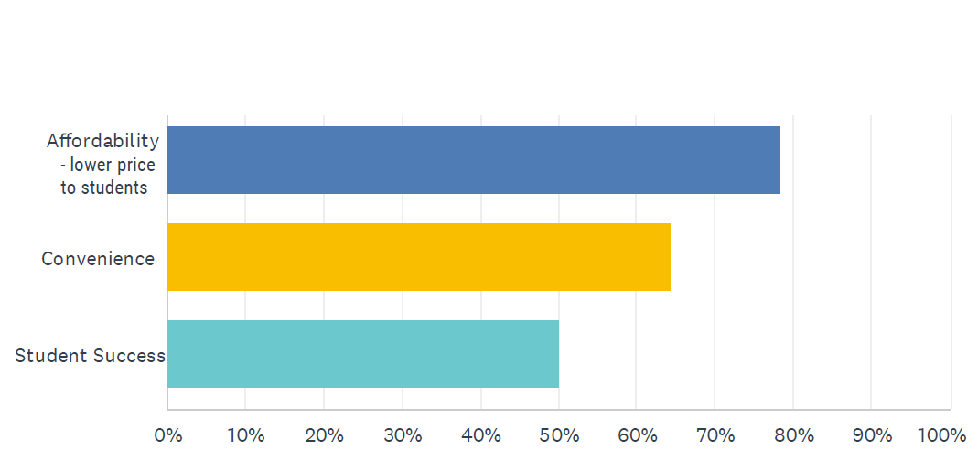
Immediate Access - Faculty Survey

Slide 16
Cost of Materials at CSUN:
$93 average cost per course
$465 for 15 units
Current Equitable Access estimate is $17.50 per credit unit (or less)
15 units = $262

Slide 17
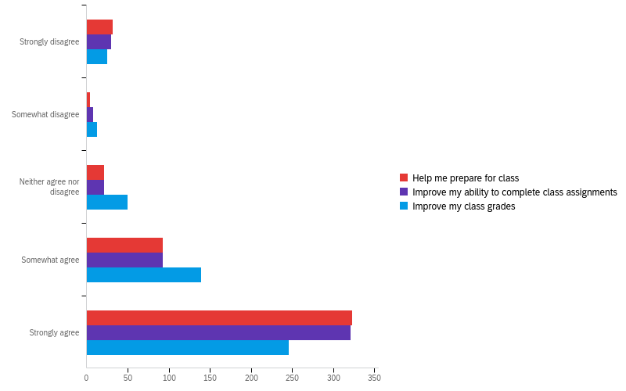
Fall 21 CSUN Survey
“CSUN Ready: Free Course Materials for FTF:"

Slide 18
Introduction: Mike Moore, Ed.D.
Academic Researcher
13 Years in the Bookstore Industry

Slide 19
Studies Completed
Inclusive Access Studies Inclusive Access Course Materials: The Impact on Student Outcomes – March 2021
Inclusive Access Course Materials: An Analysis of Waukesha County Technical College’s Inclusive Access Program – March 2022
Equitable Access Studies Equitable Access: A Participant v. Non-Participant Course Completion Analysis from 2-Year Institutions – July 2022
Equitable Access: A Course Completion Analysis from a 4-Year Institution – February 2023

Slide 20
Theoretical Underpinning
Expectancy Theory (Vroom) & Self-Efficacy (Bandura)
Expectancy:
Effort (E)→Performance (P)

Slide 21
Three Outcomes of EA
Reduced Costs
Increased Access
Increased Student Outcomes

Slide 22
4Y EA – Pre/Post Analysis
Difference in Course Completion Rate - Pre/Post
N = 48,967
Pre – 21,735
Post – 27,121
URM 2.5-40x
Greater benefit

Slide 24
2Y EA – PvNP Analysis
Difference in Course Completion Rate - PvNP
N = 23,425
23% Opt-Out Rate
Participants
+15.56%

Slide 27
All undergrads are pre-enrolled in a, flat-rate course materials program, Equitable Access (EA).
Provides each student access to all of their required course materials before the first day of class, for one low rate of $19.75 per unit / credit
Students can opt out of the program up until the add/drop date, September 1, 2023.
This program was designed to benefit all undergraduate students and to support student success.
More info: shopaztecs.com/equitableaccess -OR- ea@sdsu.edu

Slide 28
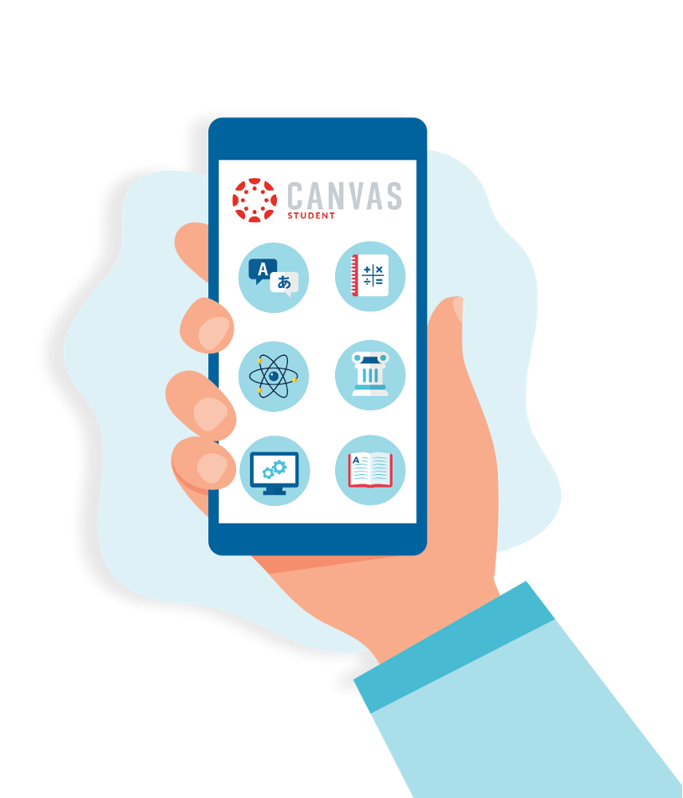
How to view course materials
Students receive an email from the SDSU Bookstore to their SDSU email account with a link.
Digital materials are accessed through Canvas.
Print can be picked up or ordered to ship home.
Booklist available on July 26, 2023

