Slide 1
ULMS – A Dean’s view
Or the view of a former Electronic resources/Technical services librarian …

Slide 2
Antecedents of the ULMS
Real (from least to MOST SUCCESSFUL)
  Pharos
  Mango
  Metalib
  Xerxes/summon
  Sfx
Imaginary
  CSU Shared erms (electronic resources management system)

Slide 3

Pharos – Shared Catalog
Before my time in the csu, maybe before its time
Difficult to synchronize

Slide 4
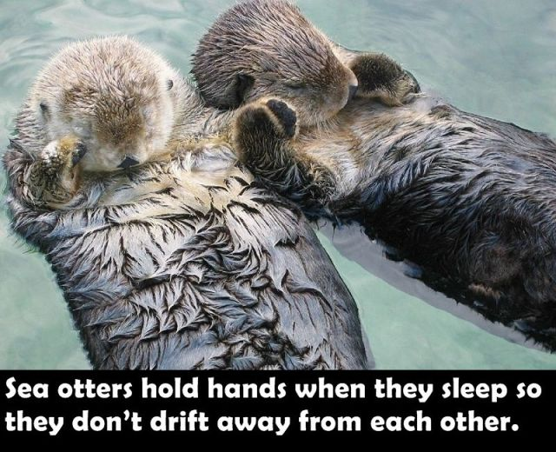
Mango – shared CSU catalog built on Oclc Data
Provided Interesting information of limited utility
No (or limited) services
SFSU patron/librarian more interested in books at UNLV or SFPL than at Humboldt or Northridge – LINK+ easier to use than ILL

Slide 5

Metalib – Ex Libris Federated Search
Federated search -- the Neanderthal man of library technology
Lost the evolutionary race to unified indexes -- summon, primo, ebsco Discovery services (EDS), Google Scholar
Still – CSU’s implementation often useful and effective through dave walker’s customization
By Tim Evanson - http://www.flickr.com/photos/23165290@N00/7283199754/, CC BY-SA 2.0, https://commons.wikimedia.org/w/index.php?curid=20187477

Slide 6

Xerxes/summon – Csu shared discovery system
Successful and widely adopted – 19 of 23 campuses
Central support for customizing interface through xerxes
Central support for knowledge-base maintenance (unfortunately, different knowledge-base than sfx)

Slide 7
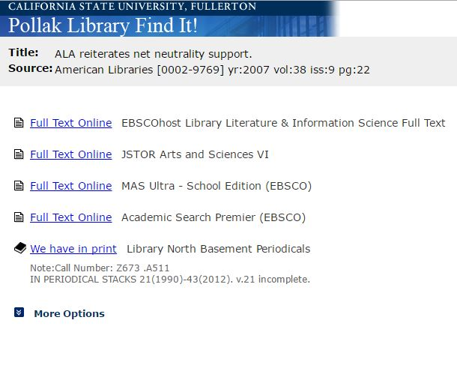
sFx – Ex Libris OpenURl resolver
Universally adopted by CSU libraries – much of the support centralized and standardized
Ex libris’s implementation of Openurl (as opposed to Iii’s Webbridge) took advantage of the fact that many libraries licensed the same electronic resources (unlike iii, EL reduced redundant work for libraries)
Csu’s shared infrastructure leveraged the collaborative possibilities of the Sfx system

Slide 8
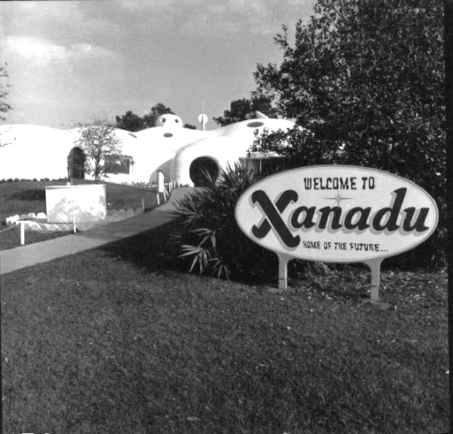
Csu shared Electronic resources management system (ERMS)
I remember discussions with lisa moske about a shared erms … but it didn’t happen
Some csu’s have erms (sfsu, sjsu) others don’t (CSUEB)
III’s erm (which made sense for many csu’s at campus level) -- like Iii’s Webbridge -- didn’t lend itself to collaboration (III’s single library ILS focus)
By Original photo: Randall G. ProphetModified by Gazebo on December 31, 2015 with lossless optimization, the removal of thumbnail image and Photoshop thumbnail metadata, and the addition of comment metadata. - Entrance to the Xanadu futuristic attraction - Kissimmee, Florida (image #C821308) at the Florida Memory Project, Public Domain, https://commons.wikimedia.org/w/index.php?curid=46018183

Slide 9
Lessons learned
Collaborate early (and often?)
Find systems that facilitate collaboration, then leverage Csu’s shared infrastructure and resources
Provide shared services, and shared practices, not just shared information

Slide 10
Collaborate early
It is easier to build collaborative workflows, staffing levels, and expectations from the beginning than to impose standardization and centralization after localized practices, staffing levels, and work cultures have been established
The ulms is kind of in the middle on this:
  By replacing existing Ils and erms systems, the ULMs will disrupt workflows, cultures, practices
  But we’re getting in on the ground floor with a collaborative urms (uniform resource management system) – most individual campuses would migrate from ils to urms at some point anyway

Slide 11
Find systems that facilitate collaboration, then leverage Csu’s common infrastructure and resources
Community zone
Network zone
Knowledge-base
Peoplesoft?

Slide 12
Provide shared services and practices, not just shared information
Resource Sharing
Shared collections
Shared assessment and evaluation
Sounds familiar … I remember reading something like this in a strategic plan somewhere
“We can expect this trend toward large-scale systems to continue and to accelerate as libraries seek opportunities to operate more efficiently…and to leverage technology to strengthen strategic cooperative initiatives.”
--- Marshall Breeding, Library Systems Report 2014

Slide 13
Cold ULMs History
December 2012 – dave walker gives presentation to cold about URMS, says “I think that Unified Library Management systems are an important trend in library technology, and represent a real opportunity for the CSU.”
November 2013 – cold passes the Motion: “In principle, all attending COLD members support the adoption of a Unified Library Management System to be shared by all CSU campuses.”
October 2014 -- ULMS RFP released
March 2015 – “COLD voted unanimously to approve a negotiating committee to finalize a ULMS contract with Ex Libris and to adopt the contract if negotiations are successful”
September 2016 – today, working on implementation

Slide 14
the campus dean’s role
Ten Guiding Principles for Those Managing ERP Projects (courtesy of anna kircher)
Ensure you have your senior executive’s strident sponsorship and support before proceeding with an ERP initiative. No one should doubt the level of executive commitment to the project.
Make any ERP initiative a business transformation project; not an “IT” project.
Find the most talented business-oriented manager within your organization and appoint them as project manager. The project can not succeed without a strong, talented project manager that garners respect in the organization.
Decide issues quickly and decisively. Unresolved issues are the quicksand of ERP projects.

Slide 15
Communicate, communicate, communicate, and then communicate even more. The importance of sharing quality and timely information with those impacted by ERP cannot be overstated.
Ensure the organization’s infrastructure (PCs, telecommunications networks, printers, etc.) is sufficiently robust before implementing ERP. Upgrading infrastructure on the fly isn’t an option.
Never change ERP program source code. Change the business process instead. Even a minor change can have enormous ramifications downstream when upgrading to new versions of ERP software.
Test the configured ERP software until exhaustion. The effort to correct problems post implementation grows exponentially.
Plan user training, multiply by 10, and then hope it is sufficient. Quality training delivered just-in-time helps mitigate the challenge of change.
Set reasonable user and executive expectations before implementation. To get from here to there necessarily requires a period of consternation. Accept is as fact.

Slide 16
Can we help each other?
any questions/concerns about what we need to do as deans/direcors to make the implementation successful:
Maintaining Staff morale?
Managing staff workload?
Providing training?
Communication strategy – with students, faculty, administration?
Managing expectations – with students, faculty, administration?

