Slide 1
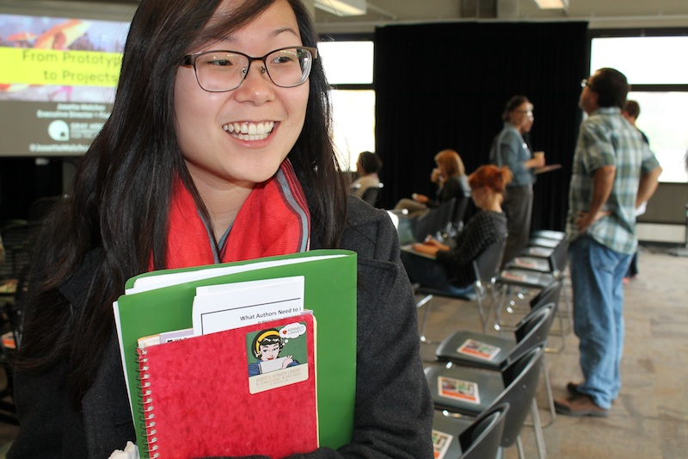
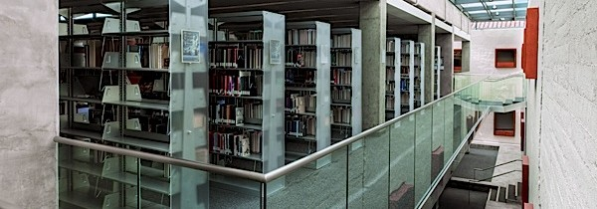
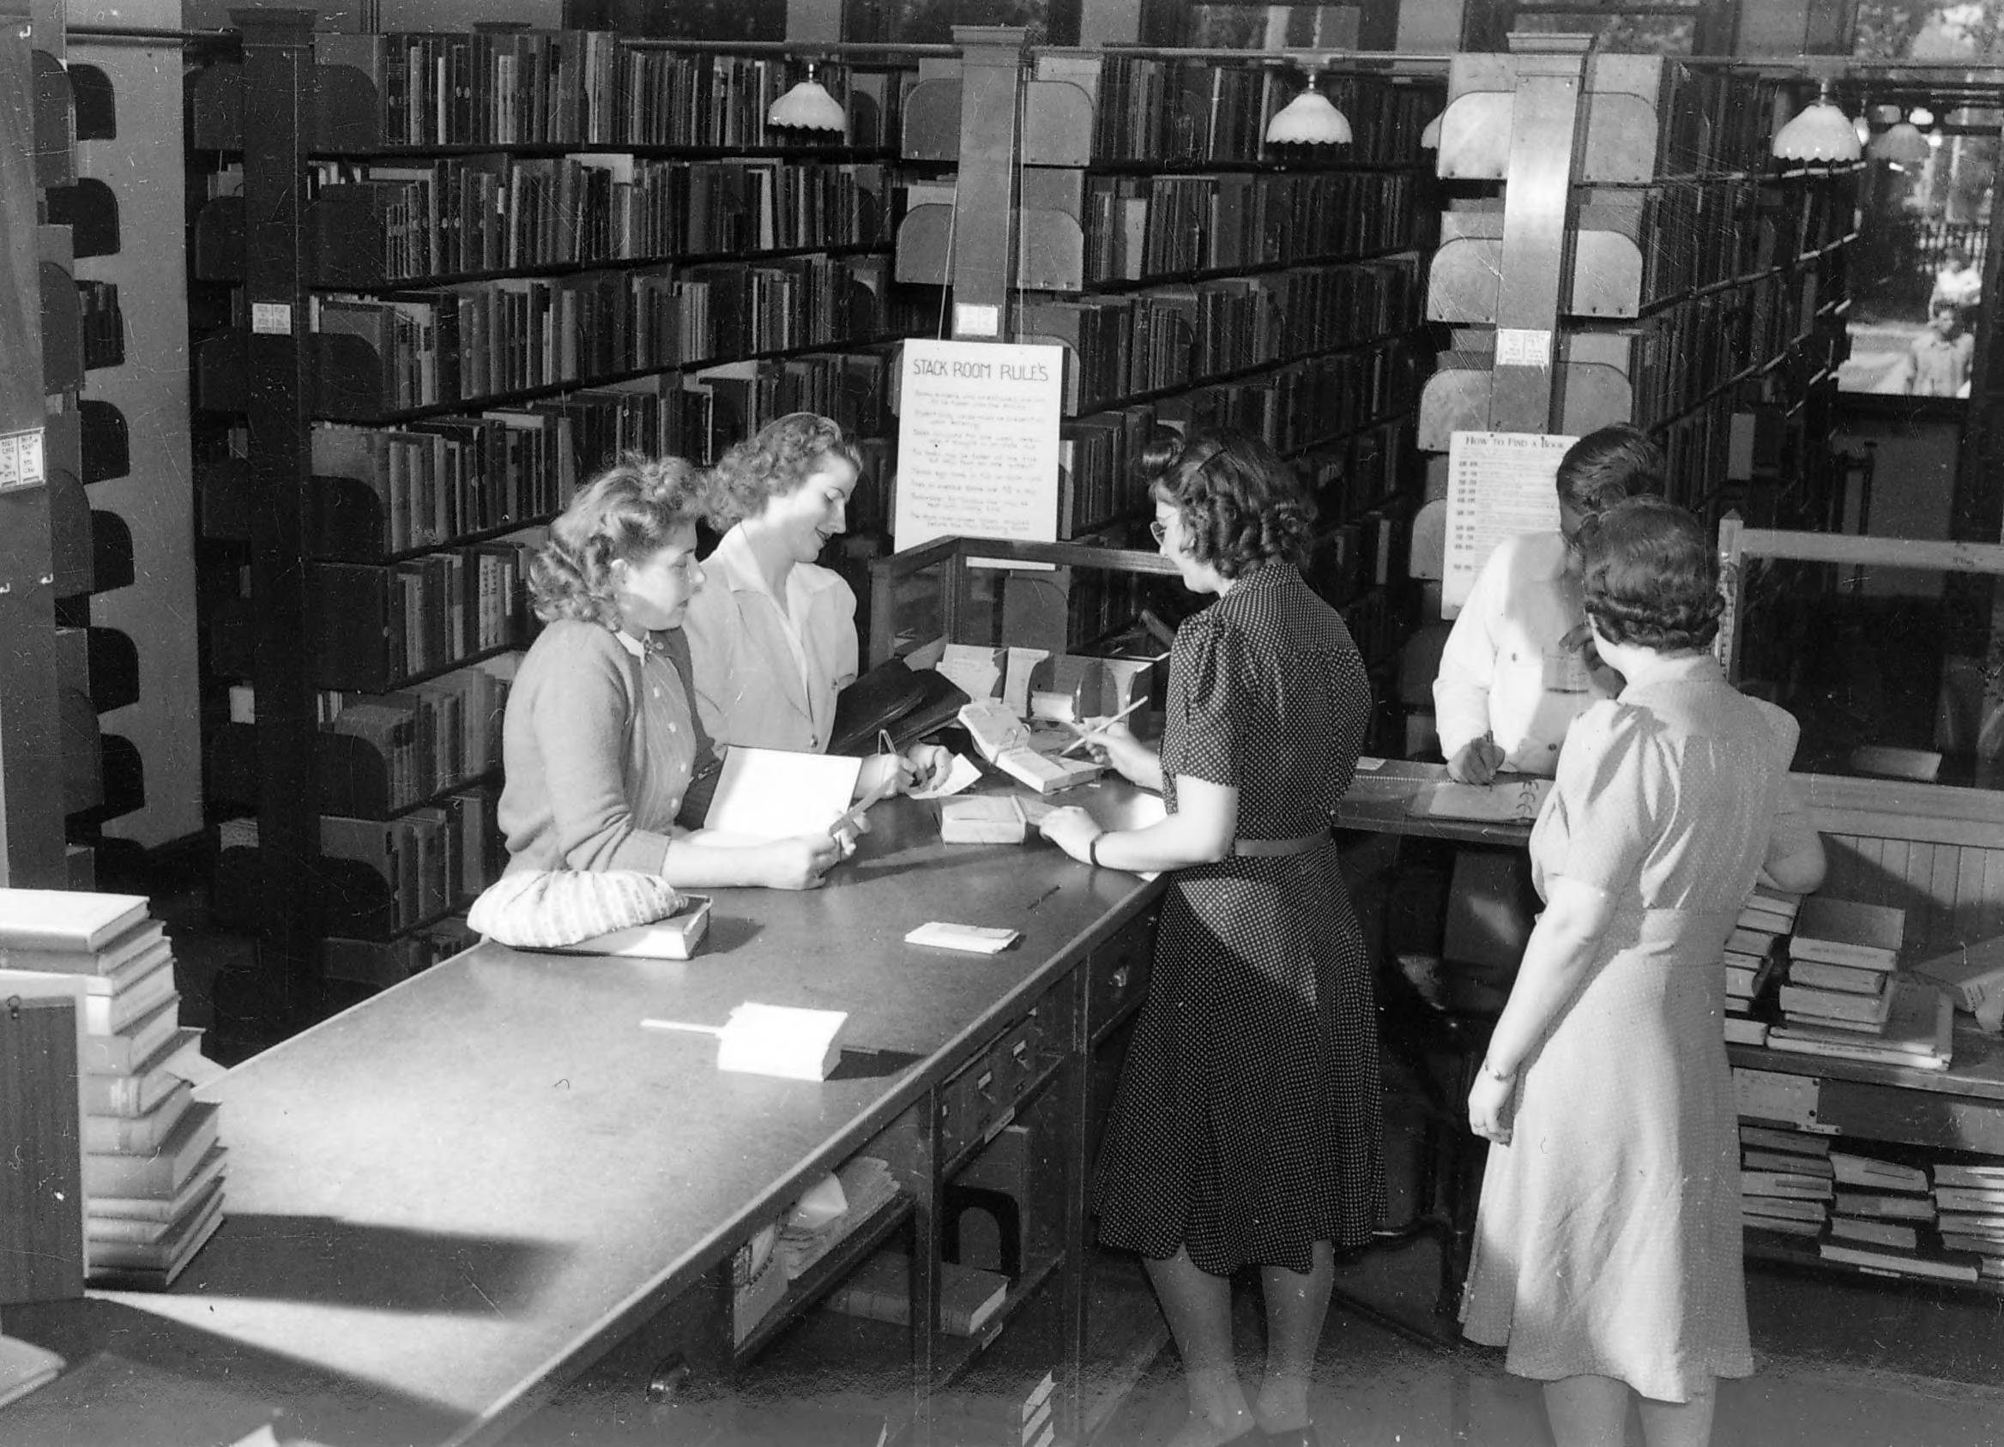
Council of Library Deans (COLD)
ASCSU Meeting: September 15, 2016
John Wenzler
Dean of Libraries, CSU East Bay (COLD Chair 2016-17)

Slide 2
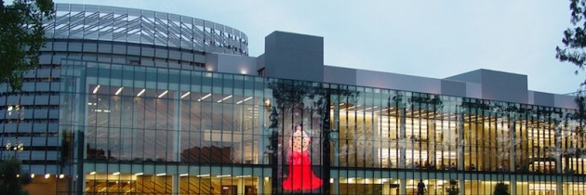
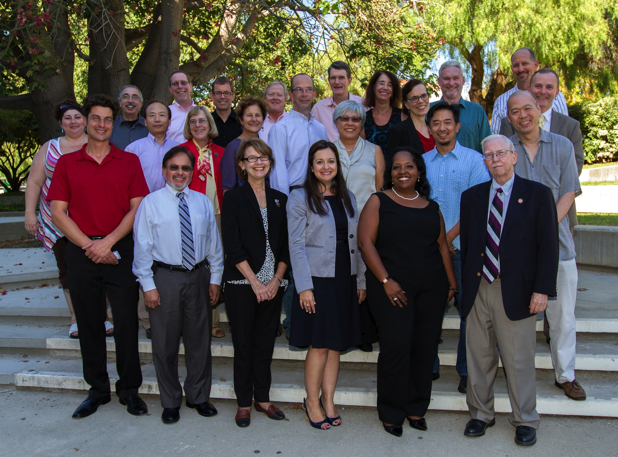
What is COLD
CHARGE 2014 :
The Council of Library Deans (COLD) will develop plans for systemwide library initiatives and programs, and, in partnership with the Chancellor’s Office, manage any systemwide central budget allocations for CSU libraries in support of … systemwide library collaborative activities.
MEMBERSHIP:
The Deans of the 23 campus libraries
A representative of the ASCSU (currently Susan Gubernat, CSUEB)
A representative from the Academic Council of Provosts (currently vacant)
CO Ex Officio representatives
Assistant Vice Chancellor, Academic Technology Services (Currently Gerry Hanley)
Director, Systemwide Digital Library Services (Currently David Walker)
Director, ATS Contracts Management (Currently Eddie Choy)

Slide 3
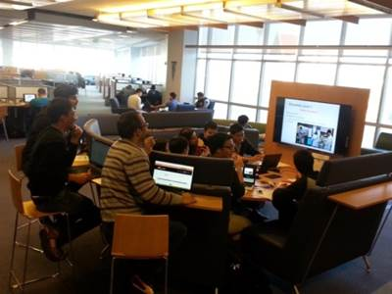
Vital to Student and Faculty Success
CSU Libraries Facts: 2014-2015
800,000 students visit the CSU libraries every week
21 Million full text downloads from CSU library electronic resources
1 million books circulated
9,300 Information Literacy classroom sessions serving 237,000 students
Five of the top ten most visited websites at the Chancellor’s Office are CSU library systems

Slide 4
COLD Initiatives
Electronic Core Collection (ECC)
Systemwide Digital Library Subscription Licenses
Unified Library Management System (ULMS)
Scholarworks – Systemwide CSU Institutional Repository

Slide 5
Electronic Core Collection (ECC)
The ECC is defined as that part of the E-Resource collection that is program-driven, used actively for instruction, and in high demand. ECC content is purchased centrally and available at all CSU campuses:
Current budget: $5,000,000 a year
Currently includes 43 resources:
JSTOR
Biological Abstracts
MLA
Safari Tech Books
… complete List: https://csyou.calstate.edu/Tools/SDLC/eresources/Pages/electronic-core-collection.aspx

Slide 6
Systemwide Library Subscription Licenses
Centrally negotiated but not centrally purchased
CSU Libraries gain leverage with vendors by negotiating jointly – saves $12 million every year
Nearly 100 resources:
Web of Science
IEEE
Academic Search Premier
Elsevier Science Direct
… subscription memo List: https://csyou.calstate.edu/Tools/SDLC/Memos/Pages/default.aspx

Slide 7
Unified Library Management System (ULMS)
ULMS is a next generation digital platform for providing library services across the California State University. It will go live in June 2017
“We can expect this trend toward large-scale systems to continue and to accelerate as libraries seek opportunities to operate more efficiently…and to leverage technology to strengthen strategic cooperative initiatives.”
--- Marshall Breeding, Library Systems Report 2014
Fact Sheet: http://libraries.calstate.edu/wp-content/uploads/2015/09/factsheet_ulms.pdf

Slide 8
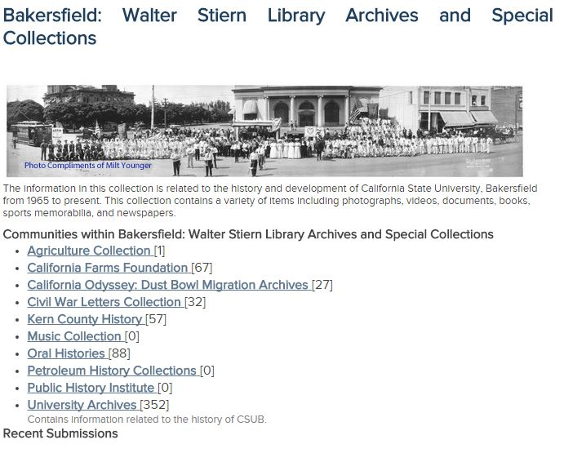
ScholarWorks
Shared System for Archiving Digital Campus Resources
Each Campus creates local look and feel
Faculty Publications
Student Theses
Archives
Other Campus Resources – newsletters, syllabi …

Slide 9
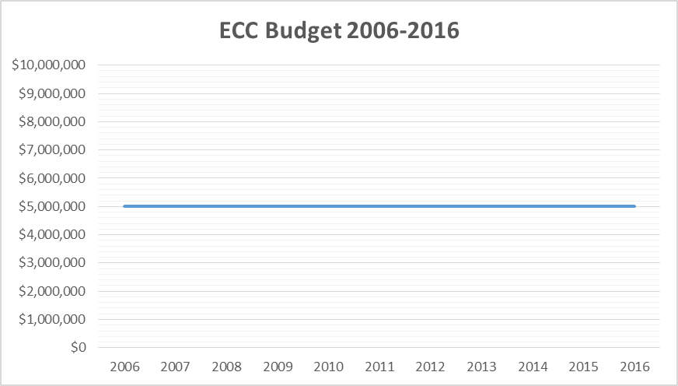
A challenge – the cost of Scholarly Resources

Slide 10
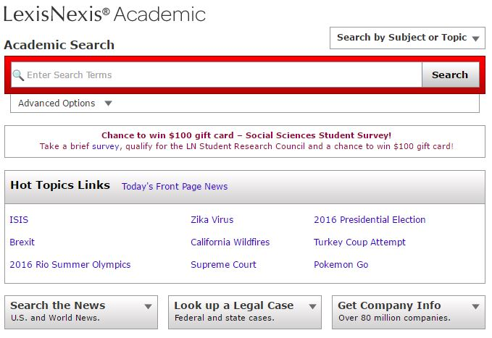
Consequences – Lexis-Nexis
Lexis-Nexis was included in ECC for many years
Cut from ECC in 2016, in part due to ECC budget shortfalls
If ECC budget stays flat additional resources will have to be cut

Slide 11
Consequences – Wiley Online Journals
Wiley publishes 2,837 Academic Journals
Wiley wasn’t included in the ECC, but through 2014 the CSU Libraries shared a contract with Wiley for a core collection of journals
Since 2014, CSU negotiations with Wiley have been unsuccessful due subscription price increases requested by Wiley
Now, many CSU students and faculty have significantly reduced access to the current journals published by Wiley

Slide 12
Questions?
Mine:
How do COLD and ASCSU collaborate to achieve our common ends?
How do we continue the dialogue?
Yours …

