Slide 1
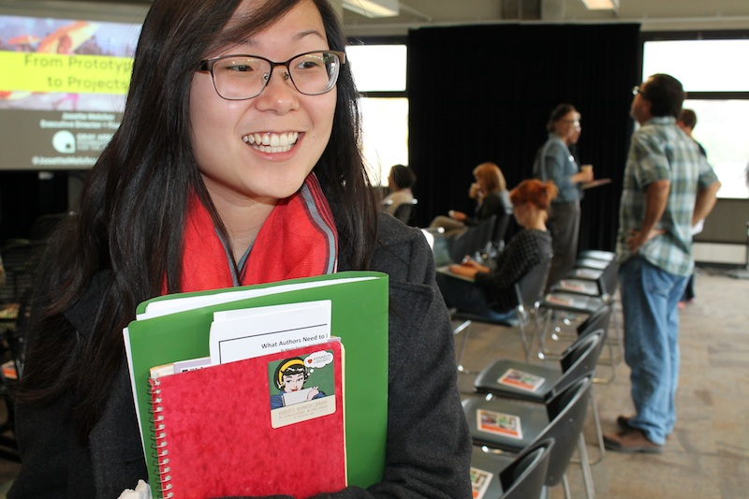
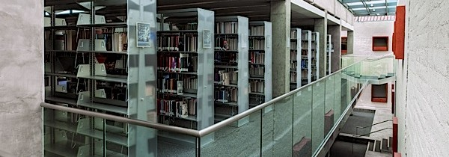
Council of Library Deans (COLD)
ASCSU Meeting: September 15, 2016
John Wenzler
Dean of Libraries, CSU East Bay (COLD Chair 2016-17)

Slide 2
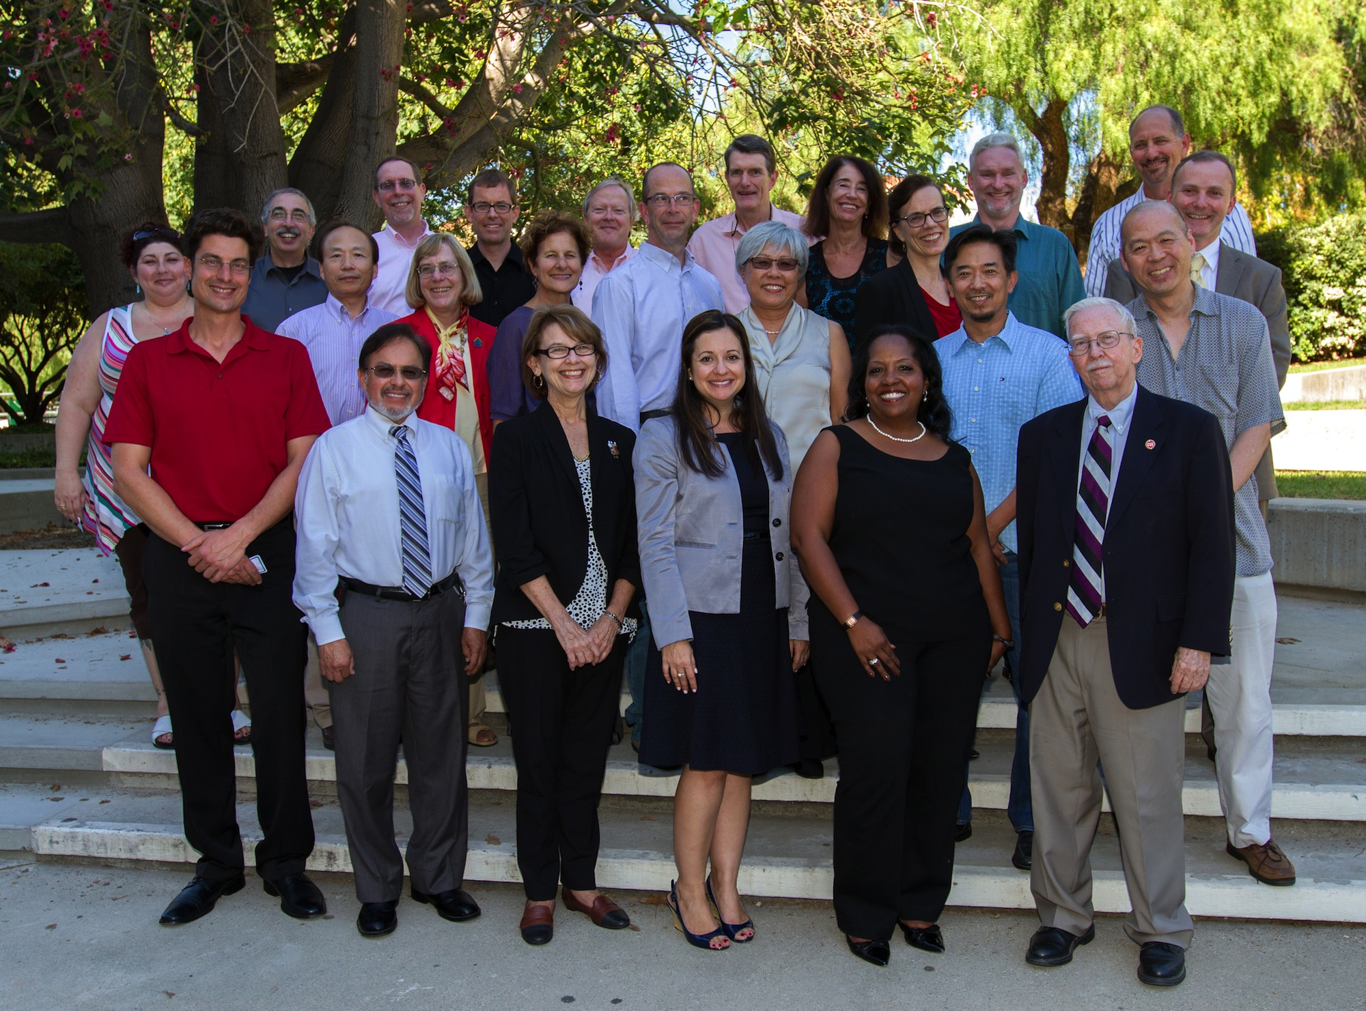
COLD Charter -- 2014
CHARGE :
The Council of Library Deans (COLD) will develop plans for systemwide library initiatives and programs, and, in partnership with the Chancellor’s Office, manage any systemwide central budget allocations for CSU libraries in support of … systemwide library collaborative activities.
MEMBERSHIP:
The Deans of the 23 campus libraries
A representative of the ASCSU (currently Susan Gubernat, CSUEB)
A representative from the Academic Council of Provosts (currently vacant)
CO Ex Officio representatives
Assistant Vice Chancellor, Academic Technology Services (Currently Gerry Hanley)
Director, Systemwide Digital Library Services (Currently David Walker)
Director, ATS Contracts Management (Currently Eddie Choy)

Slide 3
Committees & Task Forces
Executive Committee
Electronic Access to Information Resources (EAR) – shared acquisitions of electronic resources
Systemwide Technology Initiatives Management (STIM) – shared technology initiatives to enhance faculty and student access to information
COLD Assessment Team (CAT) – assessment of shared CSU Library Services
Resource Sharing Task Force – studying options for sharing print and electronic resources systemwide
Unified Library Management System (ULMS) Task Force – implementing systemwide shared management system
Communications Team – shares information about the accomplishments and initiatives of the CSU Libraries: http://libraries.calstate.edu/

Slide 4
Initiatives
Electronic Core Collection (ECC)
Systemwide Digital Library Subscription Licenses
Unified Library Management System (ULMS)
Scholarworks – Systemwide CSU Institutional Repository

Slide 5
Electronic Core Collection (ECC)
The ECC is defined as that part of the E-Resource collection that is program-driven, used actively for instruction, and in high demand. ECC content is purchased centrally and available at all CSU campuses:
Current budget: $5,000,000 a year
Currently includes 43 resources:
JSTOR
Biological Abstracts
MLA
Safari Tech Books
… complete List: https://csyou.calstate.edu/Tools/SDLC/eresources/Pages/electronic-core-collection.aspx

Slide 6
Systemwide Library Subscription Licenses
Centrally negotiated but not centrally purchased
CO negotiates license terms and costs; campuses opt-in or opt-out
CSU Libraries gain leverage with vendors by negotiating jointly
Nearly 100 resources:
Web of Science
IEEE
EBSCO Databases
Elsevier Science Direct
… subscription memo List: https://csyou.calstate.edu/Tools/SDLC/Memos/Pages/default.aspx

Slide 7
Unified Library Management System (ULMS)
ULMS is a next generation digital platform for providing library services across the California State University. It will go live in June 2017. It:
Aids Discovery
Unites Resources
Empowers Analytics
Simplifies Workflow
“We can expect this trend toward large-scale systems to continue and to accelerate as libraries seek opportunities to operate more efficiently…and to leverage technology to strengthen strategic cooperative initiatives.”
--- Marshall Breeding, Library Systems Report 2014
Fact Sheet: http://libraries.calstate.edu/wp-content/uploads/2015/09/factsheet_ulms.pdf

Slide 8
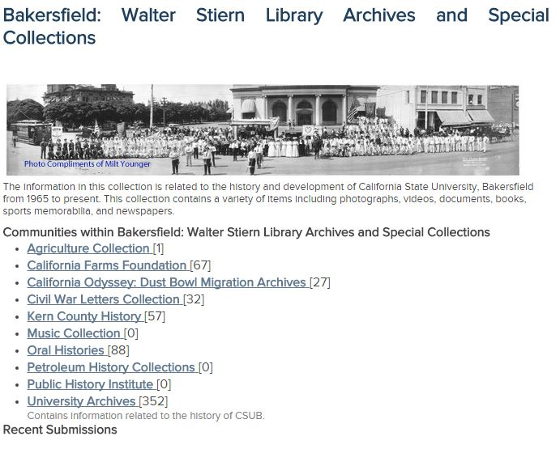
ScholarWorks
Shared System for Archiving Digital Campus Resources
Each Campus creates local look and feel
Faculty Publications
Student Theses
Archives
Other Campus Resources – newsletters, syllabi …

Slide 9
COLD Draft Strategic Plan -- 2016
Vision
The CSU Libraries will be a universal library for the CSU community.
Mission
The CSU Libraries collaborate, innovate, and leverage opportunities to advance learning, discovery, knowledge creation, and the public good through the provision of equitable services, expertise, and information resources.
Goals
Digital Collection of CSU works
Assessment
Resource Sharing
Shared Collections
ULMS

Slide 10
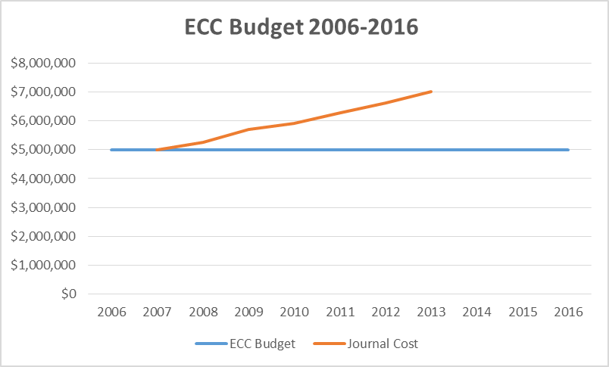
A Challenge – Scholarly Resources (even online) are Expensive

Slide 11
Et Tu Harvard?
Harvard Library Budget 2013-14: $123,000,000
CSU East Bay Library Budget 2013-14: $3,600,000 (about 2.9% of Harvard’s)
Total Budget of the 23 CSU Libraries 2013-14: $109,000,000 (about 89% of Harvard’s)
Harvard’s Complaint in 2012:
“The system is absurd, and it is inflicting terrible damage on libraries. One year's subscription to The Journal of Comparative Neurology costs the same as 300 monographs. We simply cannot go on paying the increase in subscription prices … journal subscriptions are now so high that to continue them ‘would seriously erode collection efforts in many other areas, already compromised.’“
---theguardian, “Harvard University says it can't afford journal publishers' prices,” https://www.theguardian.com/science/2012/apr/24/harvard-university-journal-publishers-prices

Slide 12
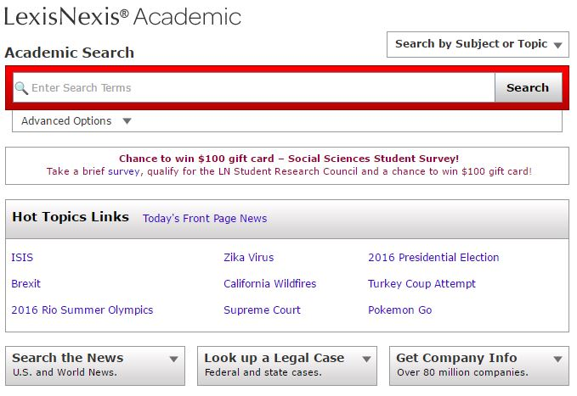
Consequences – Lexis-Nexis
Lexis-Nexis was included in ECC for many years
Cut from ECC in 2016, in part due to ECC budget shortfalls
If ECC budget stays flat additional resources will have to be cut

Slide 13
Consequences – Wiley Online Journals
Wiley publishes 2,837 Academic Journals
Wiley wasn’t included in the ECC, but through 2014 the CSU Libraries shared a contract with Wiley for a core collection of journals
Since 2014, CSU negotiations with Wiley have been unsuccessful due subscription price increases requested by Wiley
Now, many CSU students and faculty have significantly reduced access to the current journals published by Wiley

Slide 14
CSU/COLD Library Strategies
Advocate for Increased Resources
Manage Available Resources Efficiently
Advocate for Open Access

Slide 15
Advocate for Increased Resources
Assess and demonstrate the Value of Library Services & Resources
Emphasize Libraries Role in Student Retention & Graduation
CSU Libraries Fact Sheet 2014-2015:
21 Million full text downloads from CSU library resources
1 million print books circulated
9,300 Information Literacy classroom sessions serving 237,000 students
Five of the top ten most visited websites at the Chancellor’s Office are CSU library systems.
800,000 students visit our CSU libraries every week

Slide 16
Manage Available Resources Efficiently
Campuses save 12 million dollars every year through shared purchasing and licensing of library resources
Sharing books and articles across the system (ILL) increases access to a diversity and range of library resources
Shared technology systems such as the ULMS reduce infrastructure, management, and maintenance costs
Using statistics and analytics to identify the least used resources when cuts have to be made

Slide 17
Advocating For Open Access to Scholarly Communication
“Open Access is the free, immediate, online availability of research articles coupled with the rights to use these articles fully in the digital environment. Open Access ensures that anyone can access and use these results—to turn ideas into industries and breakthroughs into better lives.”
-- SPARC (the Scholarly Publishing and Academic Resources Coalition)
COLD OA Statement
Educating Faculty and Administrators on Alternatives to Subscription Journals
Open Educational Resources (OER)
Affordable Learning Solutions
Institutional Repositories

Slide 18
Questions?

