Slide 1
SCELC Shared Print Program and the CSU Libraries
COLD Meeting
San Diego State University
April 12, 2018

Slide 2
Why Shared Print for SCELC?
2012-2015 Strategic Plan included the following objective:
“to make concerted efforts to develop shared print programs that provide for preservation of a reasonable number of copies within defined networks, as well as mechanisms for identifying unique copies, prevalent copies, and processes to share books among member libraries.”
This goal was reiterated and revised in our strategic plan adopted for 2015-2018 under the broader goal to “Promote broad availability and long-term sustainability of library collections.”
Currently SCELC’s program is the only active shared print for monographs program with established retention holdings in the west

Slide 3
Further Background
A 2013 Survey revealed interest in shared print from SCELC as well as some CSU and UC libraries
A pilot program was initiated with ProQuest, using Intota to analyze data from 9 pilot libraries in 2014-2015
In 2016 the freshly budgeted and approved Shared Print program was initiated
SCELC moved to recruit Cohort One of the formal shared print program
All of the pilot libraries plus a several additional libraries (for a total of 14 libraries) participated in Cohort One of the SCELC program
A Shared Print Operations Group of four of the libraries was formed, which later morphed into our current Shared Print Committee, a new permanent advisory committee
GreenGlass was used in place of Intota (see “Costs” below)
A second cohort of 12 libraries has been recruited recently to begin a second phase of the shared print program
Notes:
Add notes from feasibility study

Slide 4
SCELC Board role in Shared Print
Feasibility Study was submitted to the board with results from the pilot program
SCELC Board unanimously approved going forward with a more comprehensive shared print program
The pilot project was financed from a separate grant fund previously established by SCELC
The approved Shared Print program was approved by the board to become a budget line item going forward

Slide 5
SCELC Consultants and Expertise
For the initial pilot project SCELC hired Lizanne Payne, currently at Hathi Trust, as our principal consultant and project coordinator
Bob Kieft, then Library Director at Occidental College, was the local SCELC consultant and assisted Lizanne in guiding the pilot project
Subsequent to his retirement from Occidental, Kieft was hired as the official SCELC shared print consultant
Linda Wobbe, SCELC staff member, has provided internal staff support for the SCELC shared print program as it has expanded to recruit a new Cohort 2 in winter 2018

Slide 6
Cost with Savings
SCELC is in its second contract with OCLC for SCS GreenGlass
Three cost factors:
Set up fee: Standard fee of $5,000
SCELC = $3750
Per record charge: Standard fee of $.03/record, no cap
SCELC = $.02/record capped at 1M records (e.g. USC)
Group project fee: 8%-20%
The Group Project fee was reduced to 10% of the sum of the Setup fee and Per-record charge for each library

Slide 7
GreenGlass
As previously noted, after Intota pilot SCELC successfully negotiated discounted pricing with SCS for GreenGlass (prior to OCLC’s acquisition of SCS)
GreenGlass has been a major selling point for libraries to join the shared print project
It provides superior analysis tools including usage analysis with aggregate use across the group
Allows for comparison between peer libraries and groups of libraries
Thus, SCELC selected six comparator groups for Cohort 1
Notes:
For Cohort 2 OCLC retained all SCELC discounted pricing
We were unable to negotiate discounted SCS pricing for the pilot project
Each Cohort gets a two-year “subscription” to GreenGlass
Comparators were: Orbis, GWLA, UC, CSU, All of SCELC, Link+ libraries. Automatically include CA, US and Hathi Trust both in and out of copyright.

Slide 8
Other Collection Analysis and Retention Tracking Options
Other collection analysis tools may be deployed in future phases of the shared print program
Some form of mapped export-import of data would need to be developed to share retention commitments on a common discovery and access platform
One possible option is a new open source platform developed at the VIVA consortium
The recent EAST Summit will be researching other options for tracking retention holdings across libraries
… and OCLC’s registration system for retention holdings is in the wings
Notes:
CSUs; use Alma

Slide 9
SCELC Shared Print Governance
Cohort 1 of SCELC shared print developed two documents to govern and guide the shared print program: an MOU and an FAQ
Both documents are available for download from the SCELC website at https://scelc.org/libraries/shared-print/documentation
SCELC’s Shared Print Committee has reviewed and revised these documents recently and is in the process of developing further workflow and processing documentation
The Shared Print Committee also provides the principal forum for governance and policy decisions, as well establishing occasional meetings of the shared print participants when mutual decisions need to be made

Slide 10
Cohort 1 Shared Print Participants
Azusa Pacific University
California Lutheran University
California Institute of Technology
Claremont Colleges Library
Holy Names University
Loyola Marymount University
Mount St. Mary's University
Occidental College
Pepperdine University
Saint Mary's College of California
University of Redlands
University of San Diego
University of San Francisco
University of Southern California

Slide 11
Cohort 2 Shared Print Participants
Abilene Christian University
ArtCenter College of Design
California Baptist University
California College of the Arts
California Institute of Integral Studies
Dominican University of California
Hope International University
La Sierra University
Menlo College
Mills College
Trinity University
Whittier College

Slide 12
Summary of SCELC Shared Print Libraries
26 total libraries in both cohorts
USC and Caltech were two research-intensive institutions in Cohort 1
Many of the Cohort 2 libraries are smaller libraries but there are some notable mentions here also
We have our first two Texas participants, Trinity University and Abilene Christian University
Two of California’s major academic art institutions are in Cohort 2: California College of the Arts and Art Center College of Design

Slide 13
Why a SCELC-CSU Partnership
We would welcome expansion of the SCELC Shared Print program to include libraries outside of SCELC membership, particularly in California
CSU is a natural partner for SCELC
We have a long history of working with CSU going back to the days of SEIR and Evan Reader, where we began collaborating on shared contracts to maximize discounts for licensing e-resources
SCELC has an MOU with the CSU Chancellor’s Office to allow for individual campuses to license e-resources through SCELC
All 23 CSU campuses have been SCELC Affiliates for many years and actively license electronic resources through SCELC
Additionally, we have been collaborating with the CSU EAR committee by hosting their March meeting prior to SCELC Vendor Day and subsequently gaining increased attendance by CSUs at Vendor Day
Notes:
From the 2013 survey, 65% of SCELC libraries were interested in collaborating on a shared print project with the CSUs

Slide 14
What CSUs Gain from Participating
Access to SCELC discounted pricing for SCS GreenGlass
Vetted MOU and FAQ documentation to help guide the process
An established workflow and decision-making process upon which the CSU could build and adapt
An existing governance structure to which the CSU would be invited to participate
With its large and diverse print collections, but presumably with some space limitations, CSUs could benefit from another resource sharing arrangement built upon shared print and preserving the scholarly monographic record
Notes:
All libraires are under pressure to repurpose their spaces for more student space, group study, info commons etc. Plus space for new print as purchased

Slide 15
What CSUs Gain from Participating (2)
SCELC's Shared Print retention commitments are the first monographic retention program in the west
Join a program with existing retention commitments
No need to retain titles already committed
Large base of over 1.2M retention commitments from the first cohort and more to be determined from the second cohort of SCELC participants
Participate in a larger effort to retain the scholarly record, and assure a West Coast program as efforts expand nationally

Slide 16
Mega Regions of Print Holdings
OCLC's Constance Malpas 2013 report defining Mega-Regions of library holdings outlined how west coast holdings would complement and enrich the larger national shared print arena
Aggregated west coast holdings constitute the second largest collection in the US!
Expanding the SCELC program to include the libraries of the CSU (and perhaps other partners such as the Orbis Cascade Alliance) would help us expand the scope of west coast shared print
The CSU libraries could help build a bridge to the various regional shared print programs
And, help move libraries towards a more coordinated national program (similar to cooperative cataloging’s roots in Ohio becoming global)

Slide 17
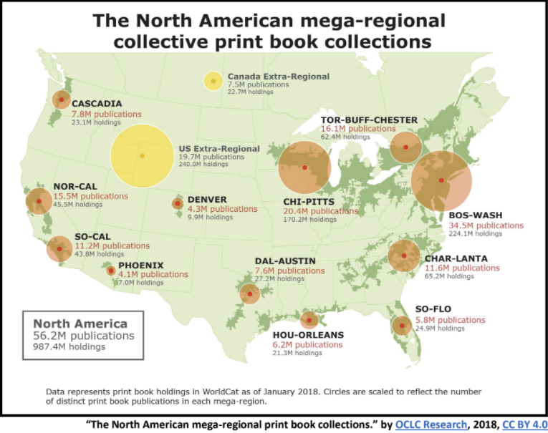

Slide 18
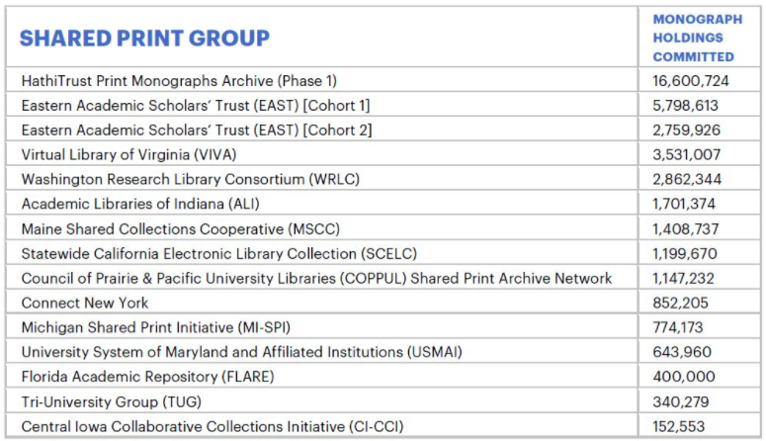

Slide 19
A National Program & Future Plans for SCELC Shared Print
Deeper collaboration with California academic institutions, beginning with interested CSU libraries
Participation in collaborations at the national and regional levels as a result of recent discussions at the EAST shared print summit
Interest in developing a federation of shared print programs to share best practices, develop standards and set priorities
Five task forces will be reporting back to the PAN meeting at ALA in New Orleans
CRL may play a role as last resort for retention when libraries are unable to fulfill their retention commitments
Thus, other consortia might be able to join CRL for this purpose, which would be a change in CRL’s mission
Notes:
Two SCELC reps were at the table at last week’s EAST Summit

Slide 20
National Shared Print task forces
Task forces formed at last week’s EAST Summit:
Standards: Establish shared print standards (work with NISO or ALCTS on this)
Research: Establish a research agenda to determine what collections and materials are at risk
Discovery: Develop a platform to share and discover retention commitments across programs, with the ability to analyze data. Goal to have an open and transparent record of collective commitments (Most popular task force!)
Resource sharing: develop a mechanism for accessing and sharing retained materials
Organizational structure: How this federation will be structured and operate going forward
For example, using PAN’s list for future communications

Slide 21
Next steps
SCELC is ready to collaborate
Five years ago in our 2013 survey 65% of SCELC libraries were in favor of working with CSU libraries on shared print
That percentage is likely higher today now that our shared print program is a reality
We are on the cusp of achieving greater collaboration among academic libraries in California
SCELC looks forward to further discussion of this important effort!

