Slide 1
ScholComm Committee: Digital Publishing, OA policy & ORCID Survey Results – Preliminary analysis
August 7, 2019
Adriana Popescu | Kyle Morgan| Patrick Newell | Jayati Chaudhuri | Keven Jeffery | Andrew Weiss

Slide 2
Preliminary results | simple analysis | Digital Publishing / Open Access Initiatives / ORCID
Context:
ScholComm committee’s first year; looking to establish goals & ways to meet CSU-wide needs in area of Scholarly Communications;
What:
Examining state of CSU campus attitudes about:
Digital publishing & IR deposit practices/workflows (broadly speaking)
Open access policy implementation across the CSU
Awareness of / interest in ORCID (unique researcher ID #s)
Why:
Want to gauge perceptions of digital publishing practices and the usefulness of an open access policy;
Get a sense of perceived obstacles and opportunities, and what reasons may prevent implementation and what might spur success.
ScholComm committee can inform COLD as well as ScholarWorks steering committee of the deeper & broader issues inherent to Scholarly Communication

Slide 3
Preliminary results | simple analysis | Digital Publishing / Open Access Initiatives / ORCID
Survey opened on June 11; closed July 31, 2019
18 of 23 campuses responded
26 Questions:
1-13; 17-18: Digital publishing and “green” OA IR archiving practices
14-16: OA policy – attitudes, awareness of, needs, greatest obstacles faced
19-20: Open ended: (Needs on campus RE:Digital publishing + desired services)
21-26: ORCID – attitudes, awareness, perceived needs

Slide 4
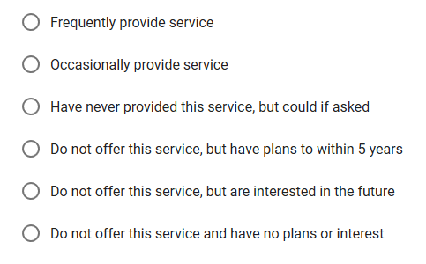
Preliminary results | simple analysis | Digital Publishing & OA survey results
Q1 – Q10: Multiple choice questions [same 6 choices for all]

Slide 5
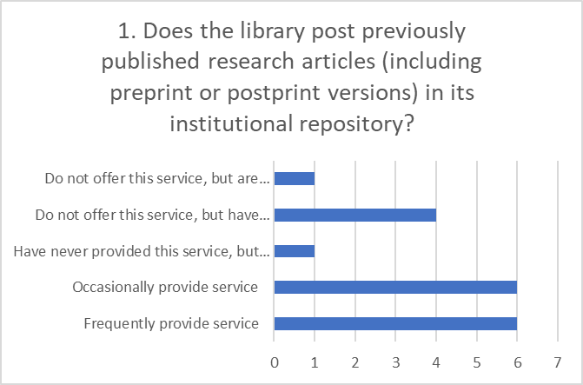
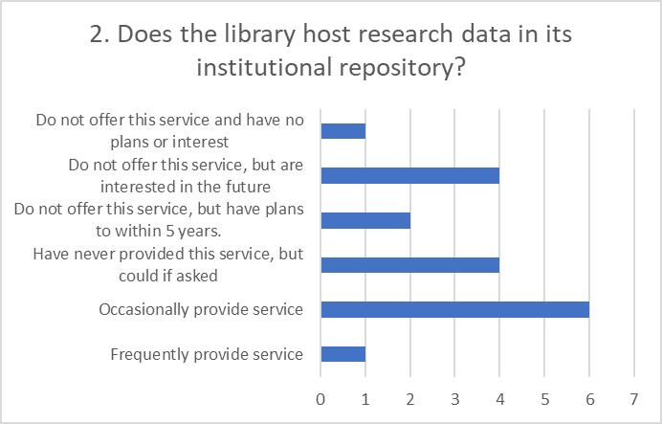
Preliminary results | simple analysis | Digital Publishing & OA survey results [Q1 & Q2]
Q1 – Q10: Multiple choice questions [same 6 choices for all]
12 provide the service; 6 do not / have not (yet) [but
intend to in the future]
7 provide the service; 10 do not / have not (yet);
1 has no plan to

Slide 6
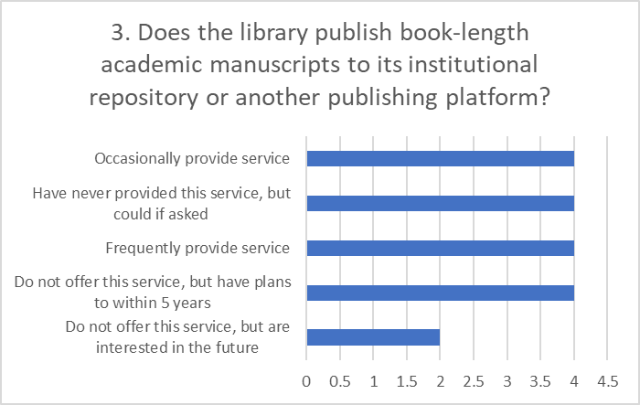
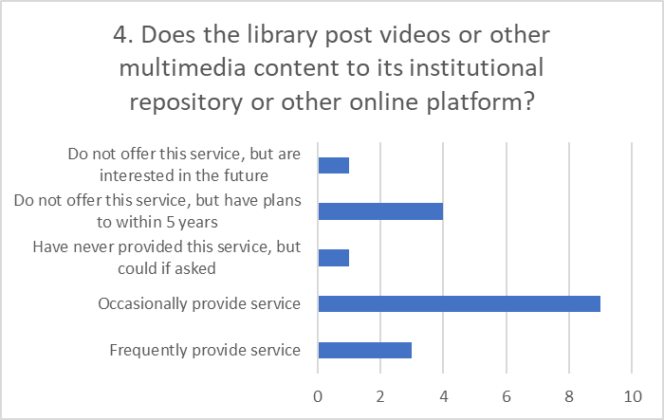
Preliminary results | simple analysis | Digital Publishing & OA survey results [Q3 & Q4]
Q1 – Q10: Multiple choice questions
8 provide the service; 10 do not / have not (yet)
12 provide the service; 6 do not / have not (yet)

Slide 7
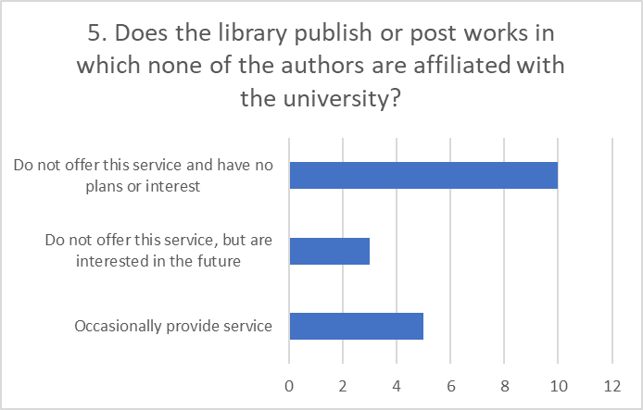
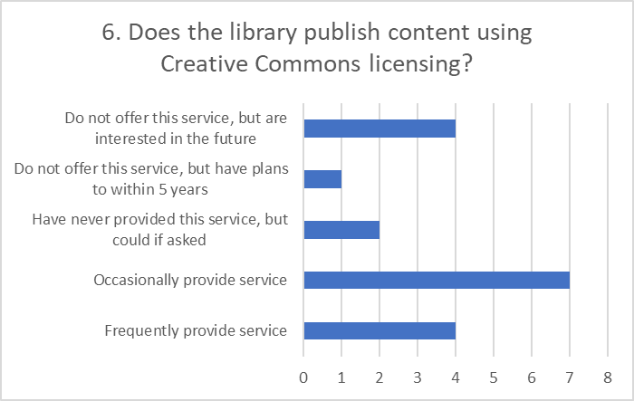
Preliminary results | simple analysis | Digital Publishing & OA survey results [Q5 & Q6]
Q1 – Q10: Multiple choice questions
5 provide the service; 2 do not / have not (yet); 10 no plan to
11 provide the service; 7 do not / have not (yet)

Slide 8
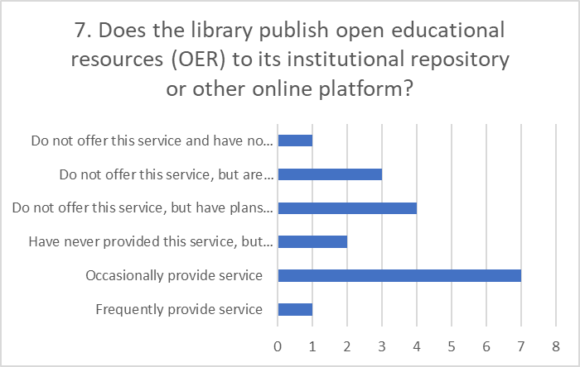
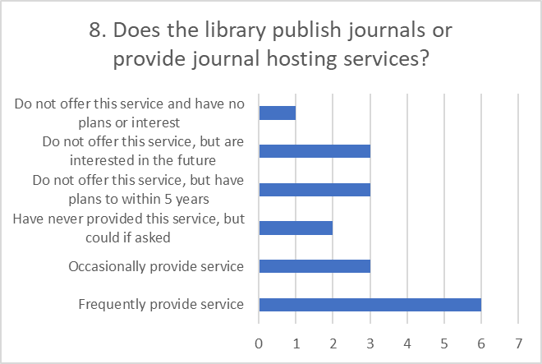
Preliminary results | simple analysis | Digital Publishing & OA survey results [Q7 & Q8]
Q1 – Q10: Multiple choice questions
8 provide the service; 9 do not / have not (yet); 1 no plan
9 provide the service; 8 do not / have not (yet); 1 no plan

Slide 9
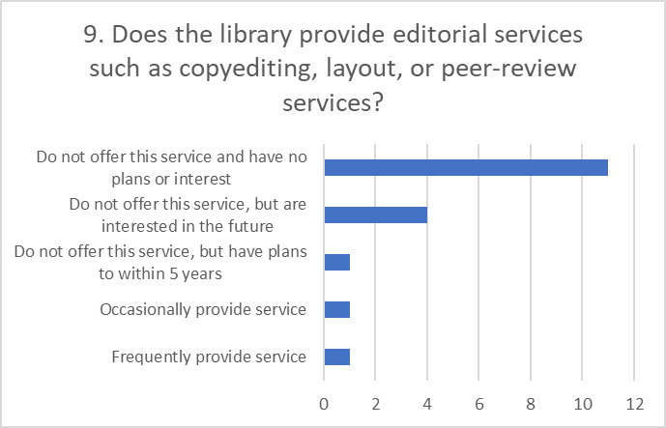
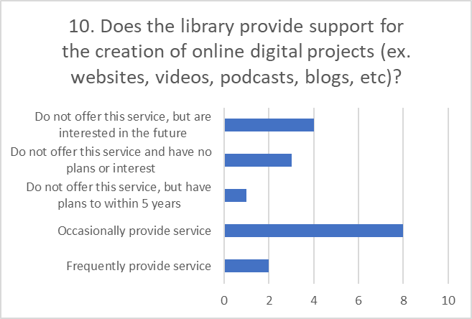
Preliminary results | simple analysis | Digital Publishing & OA survey results [Q9 & Q10]
Q1 – Q10: Multiple choice questions
2 provide the service; 5 do not / have not (yet); 11 no plan
10 provide the service; 5 do not / have not (yet); 3 no plan

Slide 10
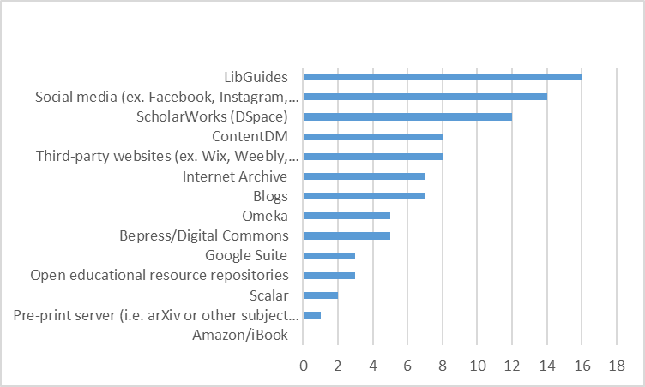
Preliminary results | simple analysis | Digital Publishing & OA survey results [Q11]
Q11-Does the library publish content using any of the following platforms?
Generally, large number of platforms adopted across CSU for content publication. Suggesting: No one platform is suitable for every publishing case.
Top 4 are not surprising: LibGuides /Soc Med / SW / Contentdm
Surprising: Internet Archive and Omeka; OER repository use seems low, especially given Q7 replies
Unpopular: ibook/ebook platforms; pre-print servers (mostly faculty self-archiving anyway)

Slide 11
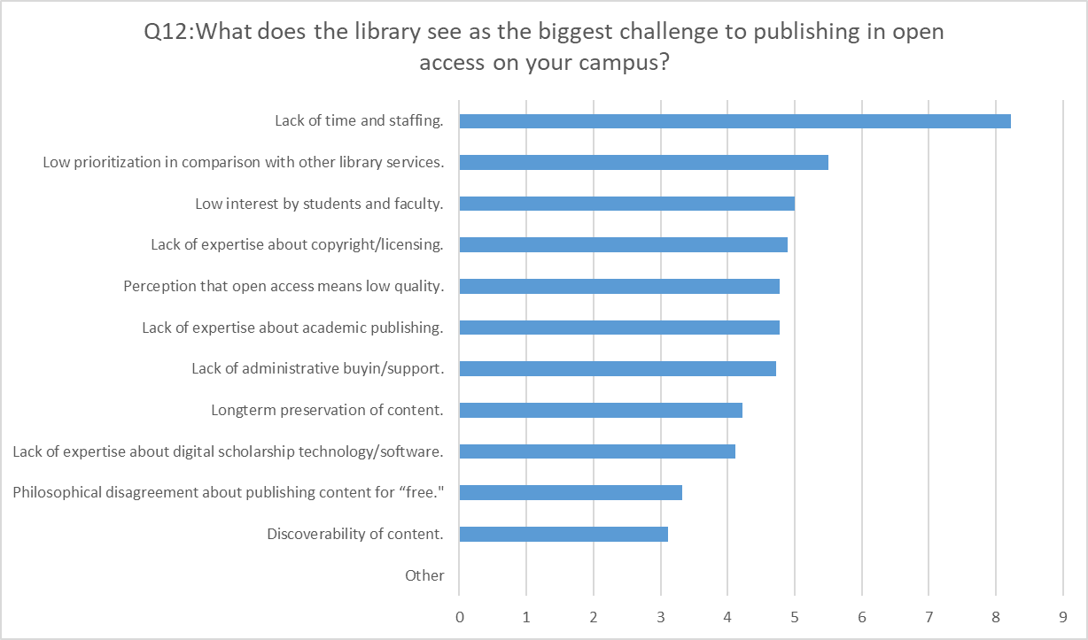
Preliminary results | simple analysis | Digital Publishing & OA survey results [Q12]
LIKERT SCALE
1 = Not a challenge
10 = Biggest challenge
Ranked by avg scores;
Biggest perceived challenge ranked first

Slide 12
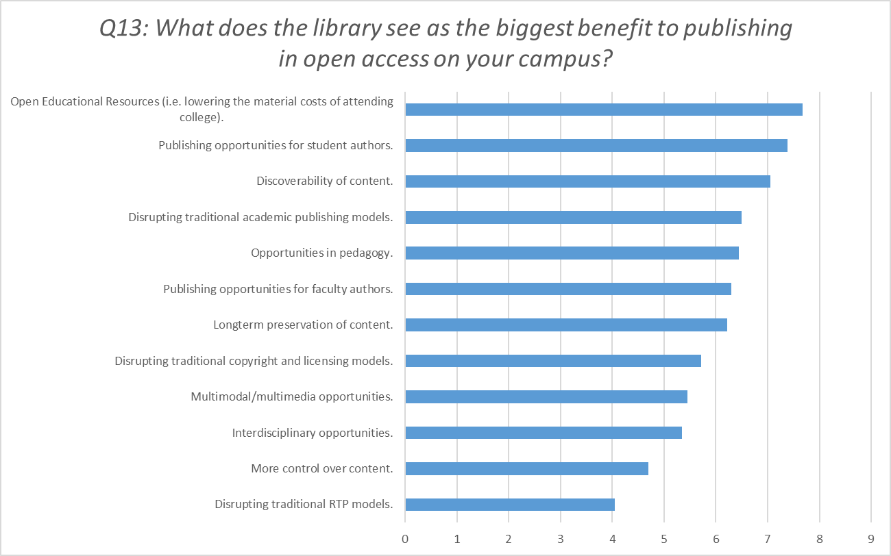
Preliminary results | simple analysis | Digital Publishing & OA survey results [Q13]
LIKERT SCALE
1= Not a benefit
10= Biggest benefit
Ranked by avg scores;
Biggest perceived benefit ranked first
Opportunities to help students seen as biggest benefits;
disruptions somewhat less so.

Slide 13
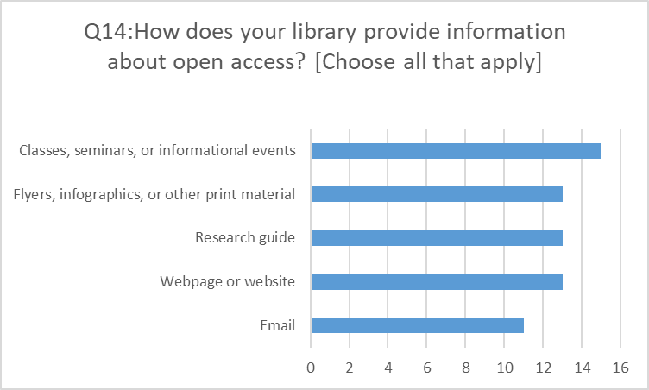
Preliminary results | simple analysis | Digital Publishing & OA survey results [Q14]
RE: Zero ‘None’ replies: Suggests that the message about OA is getting out there at all the respondents’ campuses in one way or another;
Recommend:
focusing on how to better target the message
look at what prevents faculty from participating
devise strategies to overcome obstacles in participation
Webpage or website 13; Research guide 13; Classes, seminars, or informational events 15; Flyers, infographics, or other print material 13; Email 11; None 0; Other: 0

Slide 14
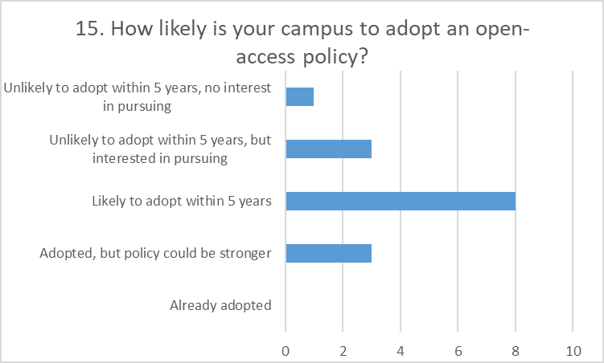
Preliminary results | simple analysis | Digital Publishing & OA survey results [Q15]
Suggests: momentum is building; but obstacles exist;
3 limited opt-in policies are not meeting local goals or needs; recommend further exploration
3 adopted (but limited); 8 likely to; 3 unlikely (but interested); 1 no interest

Slide 15
Preliminary results | simple analysis | Digital Publishing & OA survey results [Q16] part 1
Q16: What obstacles have prevented the campus from adopting an open access policy? [open ended question]
Lack of campus support/interest/time: 8
“The faculty senate on our campus may not support a mandate without a long debate”
“Some disciplinary faculty and campus administration have indicated that they see OA advocacy as the library stepping outside its lane and trying to become involved in disciplinary conversations and matters”
“We have not pursued an OA policy as we've seen this initiative fail at other CSUs and have lukewarm reception when adopted.”
“The campus tried to pass an ‘opt-in’ OA policy a few years ago and it did not go well”
“Lack of staff time to dedicate to this issue.”
“Lack of initiative to introduce to appropriate Academic Senate committees and Academic Affairs leadership”
“Adopting any policy takes a long time.”
Confusion about OA, need more outreach: 5
Confusion about what it means exactly? Philosophical differences about publishing open access.
Lack of knowledge by faculty how often they are signing their copyright away

Slide 16
Preliminary results | simple analysis | Digital Publishing & OA survey results [Q16] part 2
Q16: What obstacles have prevented the campus from adopting an open access policy? [open ended question]
Conflict with RTP model: 3
The existing RTP process is very much based on traditional models
Inhibits publishing: 3:
Concerns from faculty about lack of control about where they are allowed to publish. -Who pays for Author Processing Fees... the benefit goes to Elsevier and rest.
Copyright and intellectual property: 2
Concerns about illegality of OA policies: 2
Pushback from publishers (ex. ACS): 1
Lack of access to pre-print copies: 1
Book publishing: 1
“Some disciplines (ex. history) need to publish books...how do we get content like that in our IR?”

Slide 17
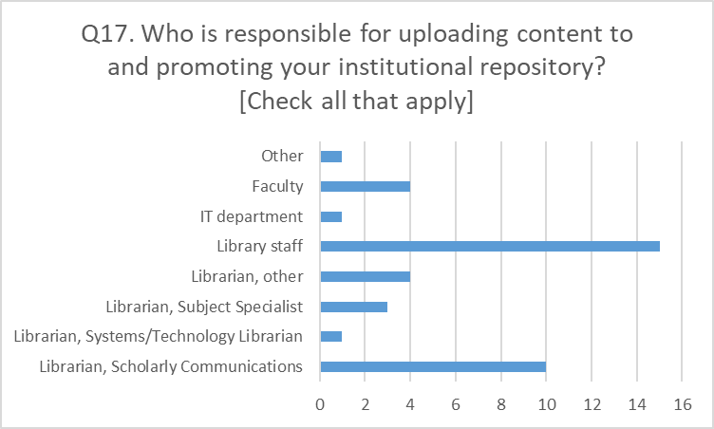
Preliminary results | simple analysis | Digital Publishing & OA survey results [Q17]
Responsibility lies with librarians and library staff, to cover most content submissions;
Few outside of a library are submitting:
faculty at four campuses may be self-archiving
Staff/admin outside of library in one reported campus (are there more?)
Librarians = 18; Library staff = 15; IT department = 1; Faculty = 4; Other: 1 (Staff/administrators outside of library)

Slide 18
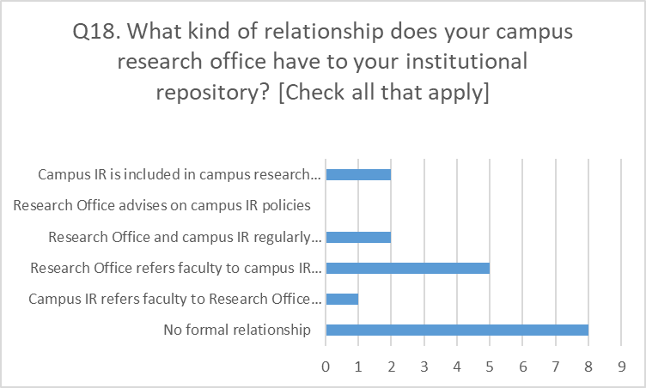
Preliminary results | simple analysis | Digital Publishing & OA survey results [Q18]
No formal relationship among many campuses
Notably: 2 are included in grant writing policies. NOTE: This could be an important way to work w/ research offices, by assisting in federal / state research OA mandate compliance
Also: NO Research offices advise libraries on OA policy, suggesting OA still largely domain of libraries on CSU campuses;

Slide 19
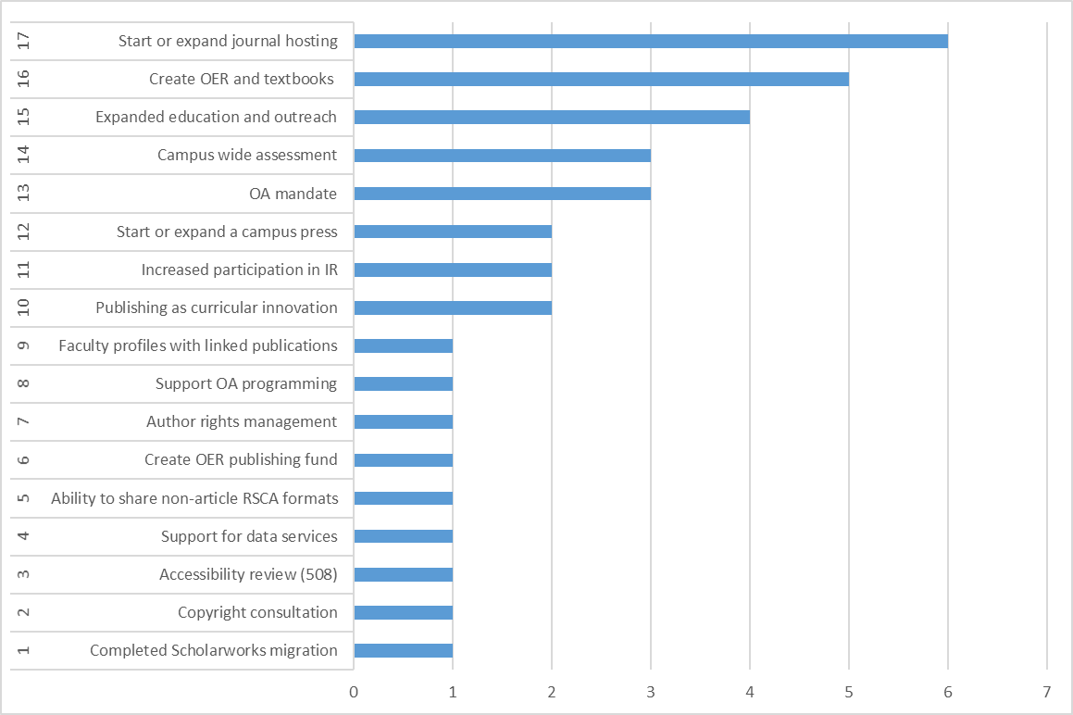
Preliminary results | simple analysis | Digital Publishing & OA survey results [Q19-20]
Q19. What open-access publishing services would meet the greatest needs on your campus? [open ended question]
Q20. What open-access publishing actions would you would most like undertaken on your campus? [open ended question]

Slide 20
Preliminary results | Simple analysis | ORCID
Questions 21-26
What:
Looking for information on awareness of and interest in ORCID at CSU libraries
Why:
Want to gauge perceptions of ORCID & librarians’ sense of perceived obstacles and opportunities.
What reasons may prevent its implementation or spur its success?

Slide 21
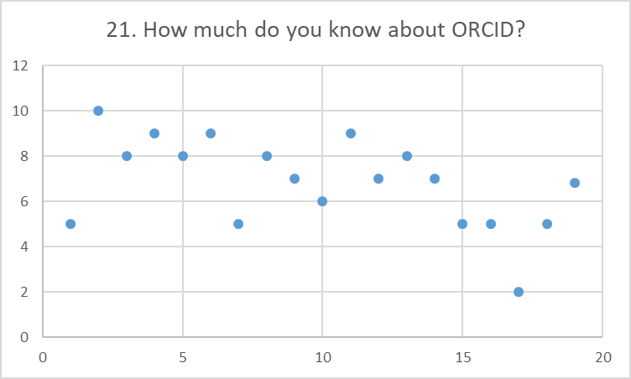
Q21: “How much do you know about ORCID?”
On a Likert scale of 1-10
1 = Nothing; 10 = Expert
10 = 1x
9 = 3x
8 = 3x
7 = 4x
6 = 1x
5 = 5x
4 = 0x
3 = 0x
2 = 1x
1 = 0x
Avg: 6.88
Generally an above-average familiarity with ORCID among respondents; responses clustered in between a general awareness/knowledge of ORCID (5) and expert level (10); only one below 5 threshold (ranked at 2). Adoption of ORCID not an issue of familiarity.

Slide 22
Q22: Is your campus or library considering an institutional membership to ORCID? Please explain.
18 responses
12 say they are not considering it
4 say they are considering it
2 are currently members
Some thoughts on not considering
“Not much interest or knowledge of it outside of the library”
“Can't afford on my own; I would prefer a CSU-wide membership”
“Nope, fine to encourage researchers to independently join”
“No…ORCID is 100% opt-in.” [results in too many obstacles for faculty to participate]
Some thoughts on yes, considering
“Yes we want it but we need certain integrations first: bepress, our version of Interfolio, PeopleSoft”
“We've considered the membership, but it is costly and we don't have a budget designated for this currently. We would consider a cheaper consortial license.”

Slide 23
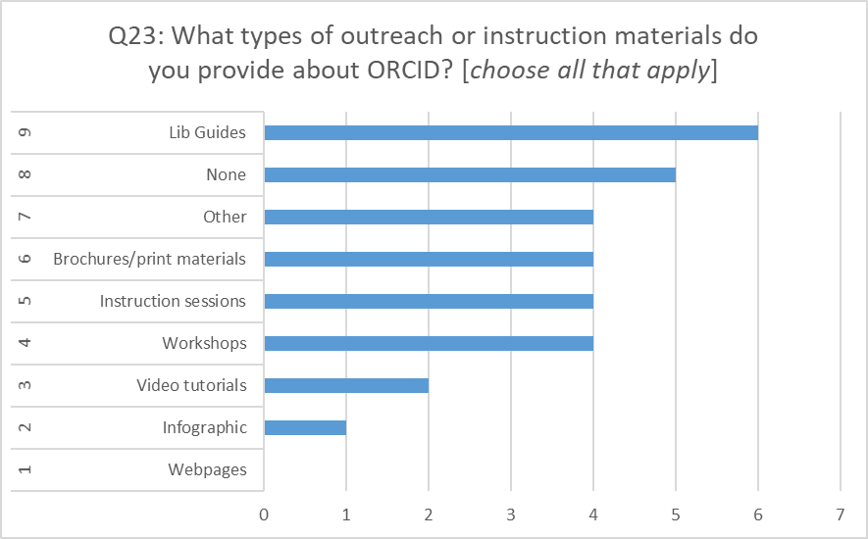
Q23: What types of outreach or instruction materials do you provide about ORCID? [choose all that apply]
Results:
Lib Guides = 6
None = 5
Other = 4
OTHER =sign up events (2); face-to-face (1); Sponsored Programs (1)
Brochures/print mat. = 4
Instruction sessions = 4
Workshops = 4
Video tutorials = 2
Infographics = 1
Webpages = 0

Slide 24
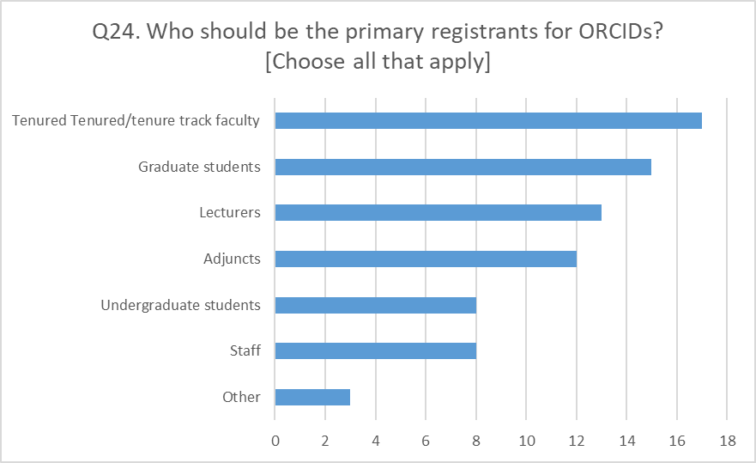
Q24. Who should be the primary registrants for ORCIDs? [Choose all that apply]
Tenured Tenured/tenure track faculty = 17
Lecturers = 13
Adjuncts = 12
Staff = 8
Graduate students = 15
Undergraduate students = 8
Other = 3
“Anyone who is publishing or applying for grants.”
“Everyone.”
“Anyone who wants to!”
Primarily seen as a service for faculty and graduate students, with lecturers/adjuncts considered
to a certain degree; staff and undergrads much less so…tiny but vocal support for “Anyone”.

Slide 25
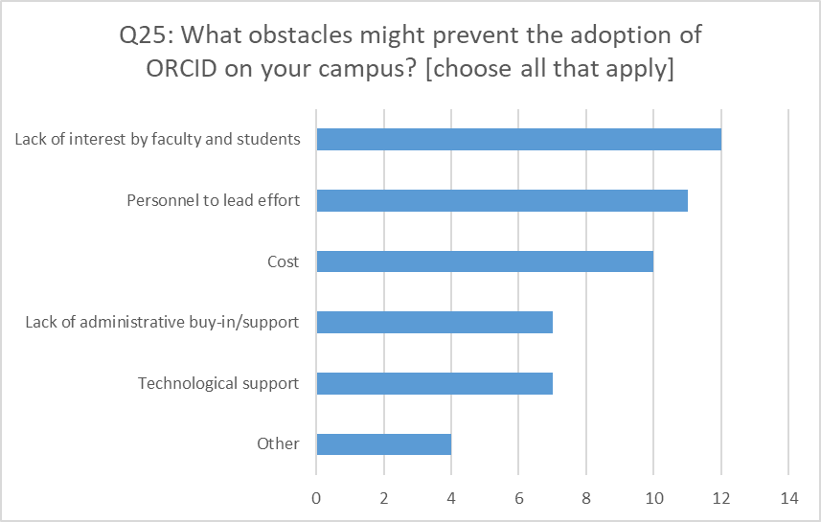
Q25: What obstacles might prevent the adoption of ORCID on your campus? [choose all that apply]
Other obstacles mentioned:
Disciplinary faculty have seen similar systems come and go;
misunderstanding of the benefits of ORCID;
faculty not seeing ORCID as relevant to their publishing milieu (liberal arts, monographs)
Lack of statistics, lack of organizational control.
Lack of data on interest in ORCID, lack of knowledge about ORCID.
Overall some large obstacles raised: mainly cost, personnel, and primary stakeholder interest;

Slide 26
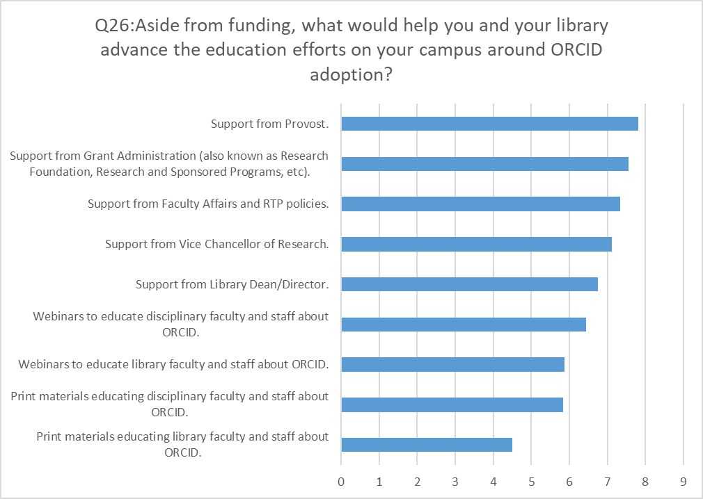
Q26: Aside from funding, what would help you and your library advance the education efforts on your campus around ORCID adoption?
Likert scale
1 = Least helpful
10 = Most helpful
Ranked by avg. scores;
Most helpful ranked first
Clear trends about desire for administrative support
Less interest in physical learning/outreach materials

Slide 27
A few quick takeaways:
Digital publishing:
Librarians are generally interested in offering a platform for publishing,
But, have little interest in managing/offering traditional publishing services (i.e. layout, editing, peer-review, etc...).
Time and labor is the major obstacle; {duh!}
Biggest benefits to digital publishing are seen as educational: i.e.: we really want to help students
Green IR archiving practices:
Librarians DON’T intend to widen scope of repository for non-campus affiliated works;
Libraries primarily handle the work in-house;
Seems to be very little activity in terms of external partnerships;
OA policy:
Still perceived as mainly a library issue in the CSUs; the trouble is getting the message to those outside the library.
ORCID:
Librarians are generally familiar with ORCID; but lack of adoption has little to do with its familiarity;
High amount of overall non-interest among librarians
Associated costs and perceived lack of fac/stu. interest seem to be main reasons
Librarians appear to strongly want administrative support from Deans, Provosts, and Offices of Research &c.

Slide 28
More takeaways?
What do you think?

Slide 29
Discussion
What does this tell us?
What do we do now?
ScholComm committee’s next moves are _______.

