Slide 1
ULMS – A Dean’s view part 2

Slide 2
Lessons learned
Collaborate early (and often?)
Find systems that facilitate collaboration, then leverage Csu’s shared infrastructure and resources
Provide shared services, and shared practices, not just shared information

Slide 3
the campus dean’s role
Ten Guiding Principles for Those Managing ERP Projects (courtesy of anna kircher)
Ensure you have your senior executive’s strident sponsorship and support before proceeding with an ERP initiative. No one should doubt the level of executive commitment to the project.
Make any ERP initiative a business transformation project; not an “IT” project.
Find the most talented business-oriented manager within your organization and appoint them as project manager. The project can not succeed without a strong, talented project manager that garners respect in the organization.
Decide issues quickly and decisively. Unresolved issues are the quicksand of ERP projects.

Slide 4
Communicate, communicate, communicate, and then communicate even more. The importance of sharing quality and timely information with those impacted by ERP cannot be overstated.
Ensure the organization’s infrastructure (PCs, telecommunications networks, printers, etc.) is sufficiently robust before implementing ERP. Upgrading infrastructure on the fly isn’t an option.
Never change ERP program source code. Change the business process instead. Even a minor change can have enormous ramifications downstream when upgrading to new versions of ERP software.
Test the configured ERP software until exhaustion. The effort to correct problems post implementation grows exponentially.
Plan user training, multiply by 10, and then hope it is sufficient. Quality training delivered just-in-time helps mitigate the challenge of change.
Set reasonable user and executive expectations before implementation. To get from here to there necessarily requires a period of consternation. Accept is as fact.

Slide 5
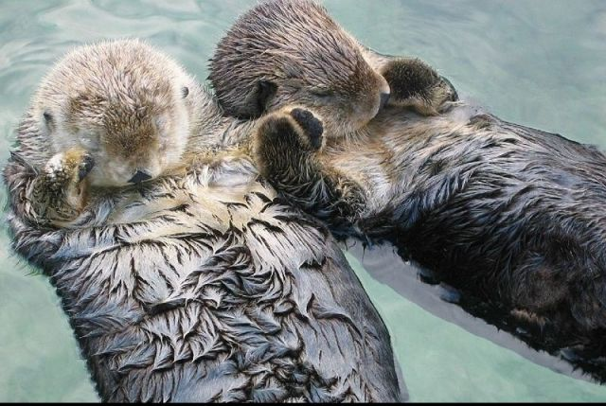
Can we help each other?
any questions/concerns about what we need to do as deans/direcors to make the implementation successful:
Maintaining Staff morale?
Managing staff workload?
Providing training?
Communication strategy – with students, faculty, administration?
Managing expectations – with students, faculty, administration?

