Slide 1
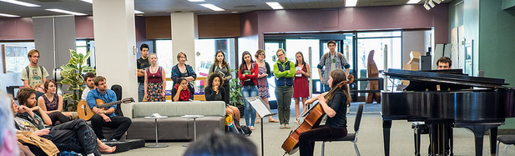

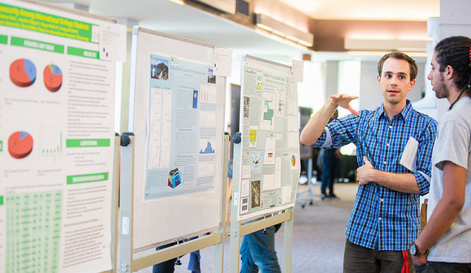
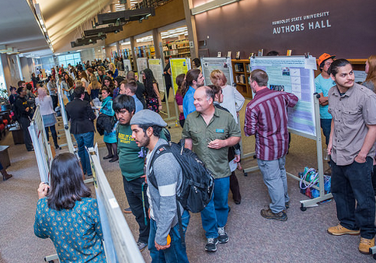
Welcome to HSU Library
HSU Library is committed to its mission of connecting people and ideas, supporting research and scholarship, and inspiring learning through discovery, inquiry, and creativity.
The Library is a place for discovering new ideas and differing worldviews, for sharing perspectives in open, interdisciplinary conversations, and for exploring an abundance of resources as one participates in the scholarly enterprise.
Upcoming event
April 22, 2016 3-5:30pm

Slide 2
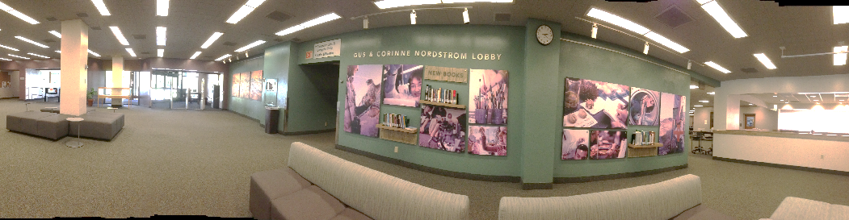
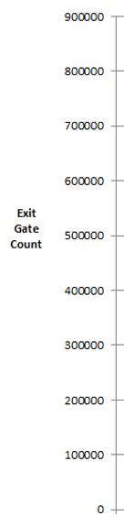
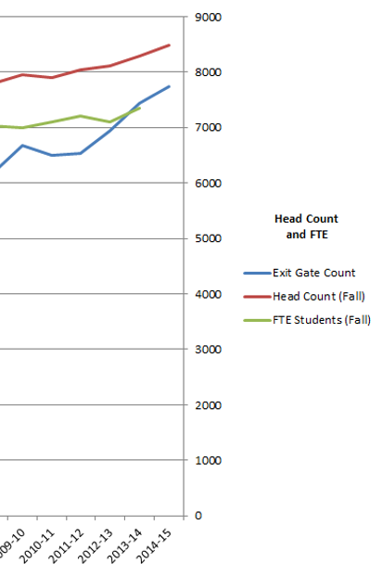
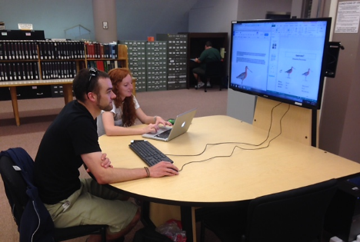
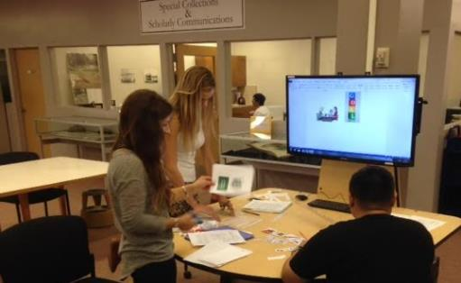
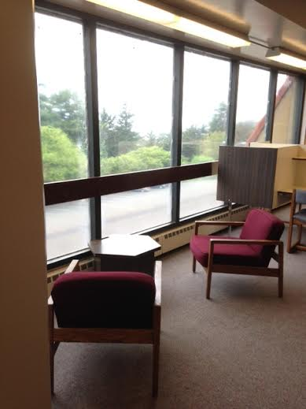
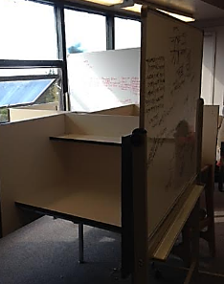
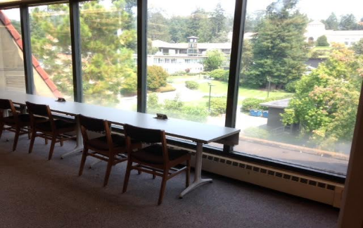
Welcome to HSU Library
The Library provides endless opportunities to explore, learn, be inspired, create, innovate, and problem-solve.
Library expertise and resources are here to help inform, connect, and transform the lives of the people in our community.

Slide 3
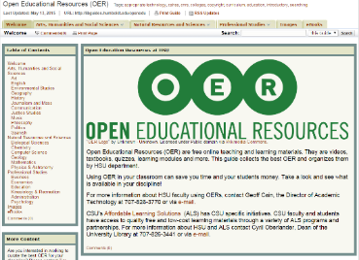
Services to Students
“More books for large classes.”
“I would not have been able to afford school w/o library textbooks. Hands down, no doubt.”
“Please have them for all classes!”
“The more the better!”
HSU Students strongly suggest more computers in the library and textbooks on reserve.
HSU Students recommendations during Univ. Strategic Planning…
  Highest priority recommendation: make college education more affordable by providing needed resources.
Reserve Checkouts
Textbooks checked out:
September 2015: 1,040
October 1-7, 2015: 1,049
Textbooks on Reserve
January 2014 we found over 150 library books on Bookstore list & placed them on Reserves
January 2014 $1,200 donation to purchase 9 textbooks
Checkout increased, 70% in January, 60% in February; total reserve checkout increased from 21K (13/14) to over 26K
Secured additional funding;
  Forever Humboldt raised $770,
  Lottery $4K,
  and Instructional Related Activities $7,500
Fall 2015 Expanded to include Required Resources
Circulating laptops (Pilot)
Graphing Calculators
HSU Sustainable Learning (Library & eLearning)
  19 Faculty using Open Educational Resources to provide 2,500 with free educational resources. Fall 2015

Slide 4
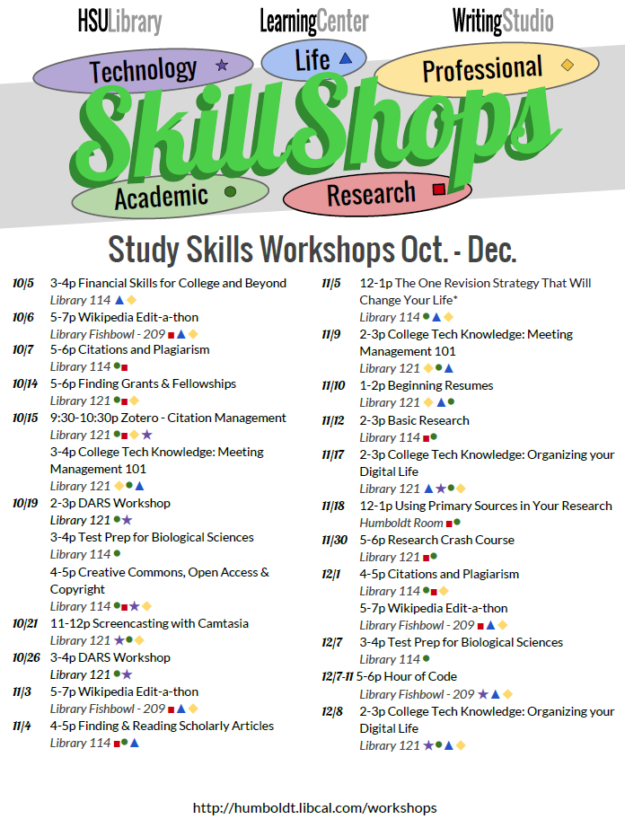
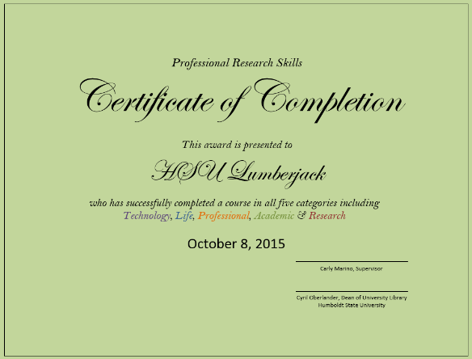
Services to Students, Faculty, Staff & Community
Collaborative
Workshops
offered
@
HSU Library
Library Student Employees are encouraged to attend 5 workshops (while on duty) and receive the following Certificate.

Slide 5
Future of HSU Library
Role for Libraries… to inspire opportunities that empower research, teaching, learning, imagination, and collaboration. Curating engaging services, collections, spaces, and tools for the campus community today and tomorrow…
Empowering connections between teacher and learner, author and reader, and collaborative innovations that are changing the nature of the learning environment, libraries, and the creation and dissemination of knowledge…
  to foster pursuit of knowledge… scholarship, research, innovation…
  to make accessible the world’s intellectual, scientific, creative and cultural heritage
  to promote collaboration within and beyond the campus community
Inspiring spaces focusing on the dynamic needs of learning communities…
  to create high-profile spaces that inspire individual and collaborative research and scholarship
  to leverage, partner, and strengthen the University and collaborations within and beyond the campus community.
Innovating services ranging from traditional information curators and instructors, to emerging scholarship and publishing, explorations in innovation and entrepreneurship services, collaborative strategies, and learning communities…
  to acquire, maintain, refresh, and preserve information meeting needs of our students and faculty
  to publish scholarship and to support new forms of scholarship, in collaboration with campus community

Slide 6
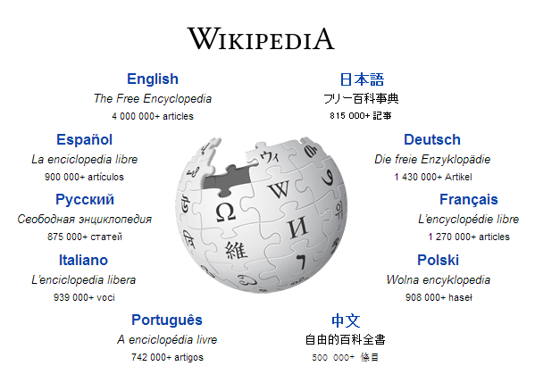
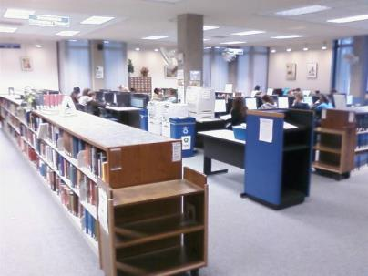
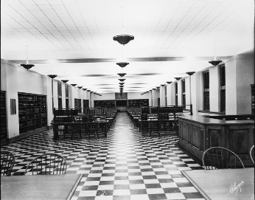
Connecting Learners to Scholarship
Created: 2001 (a teen)
What happened to Print Reference?
Any
Connection?
374M unique visitors monthly (9/2015)
70K+ active contributors / editors
35M articles; 290 languages
What lessons?
Loss of context & seminal scholarship because of convenience
Collaboration & open scholarship are vital
Engaging readers & reducing barriers are essential
Started with staff of 7
  Can History be Open Source? By Roy Rosenzweig http://chnm.gmu.edu/essays-on-history-new-media/essays/?essayid=42
  Finding Context, What Today’s College Students Say about Conducting Research in the Digital Age, Project Information Literacy
Notes:
Most libraries are moving print reference to the main collection…
http://www.wikipedia.org/ about wikipedia; http://en.wikipedia.org/wiki/Wikipedia:About
http://www.ala.org/tools/libfactsheets/alalibraryfactsheet01

Slide 7
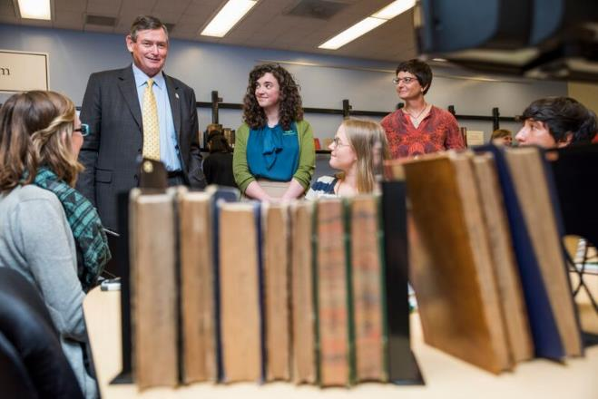
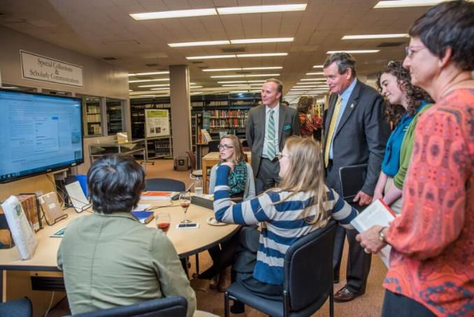
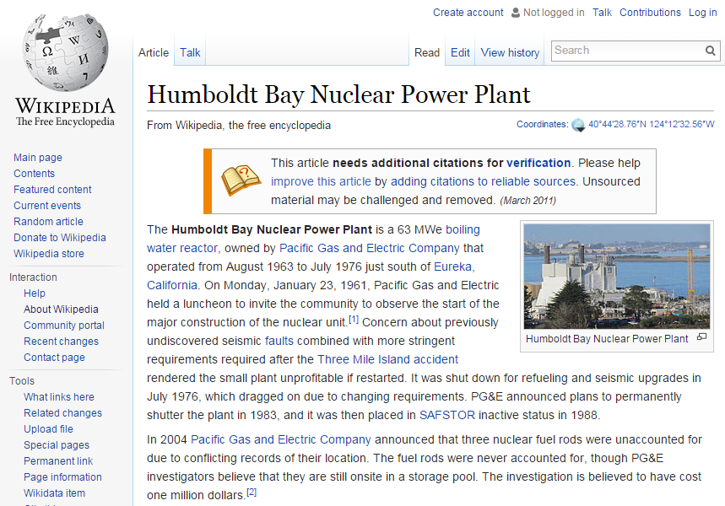
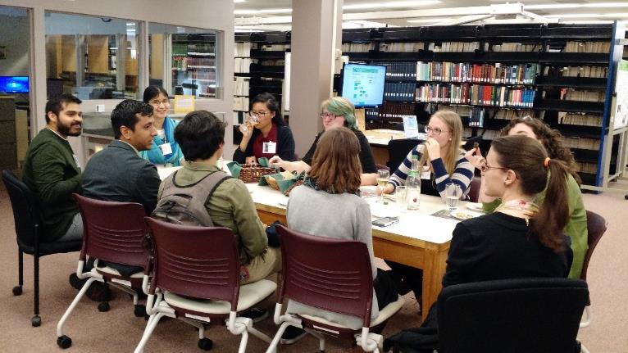
HSU’s Wikipedia Editors & Library Scholar Interns

Slide 8

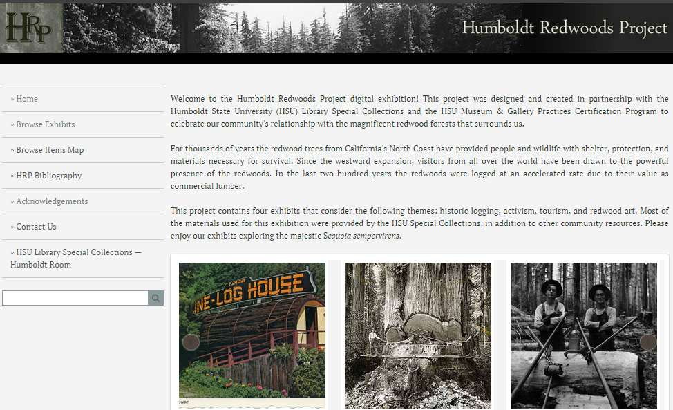
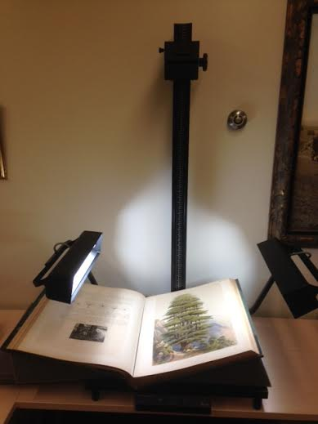
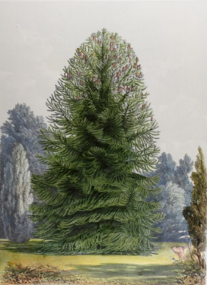
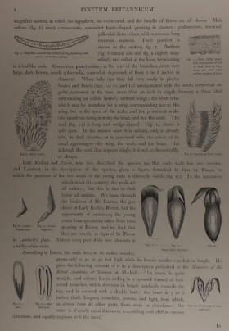
HSU Library Scholar Internships
Thanks to a bequest from Malcolm Buchanan ‘50, HSU Library provides paid credit-based student internships to HSU students. This powerful digital humanities experience with hands-on research and project based learning combines work with archives, manuscripts and rare books. Active learning in special collections, archives, public history, and museum studies enriches students with opportunities to learn; writing for the web, curating exhibits, digitization and digital scholarship, marketing and presenting, preservation, project management skills, and more.
Curating exhibits with global reach
Re-publishing rare books & archival material

Slide 9

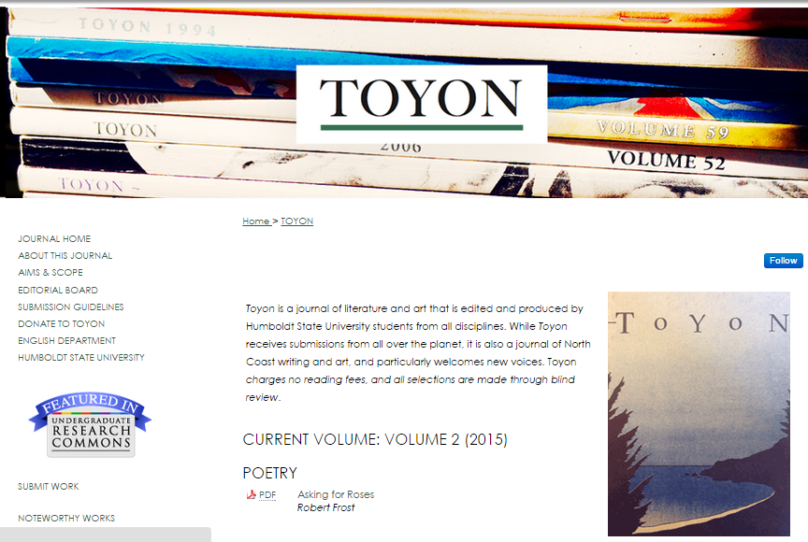

Slide 10
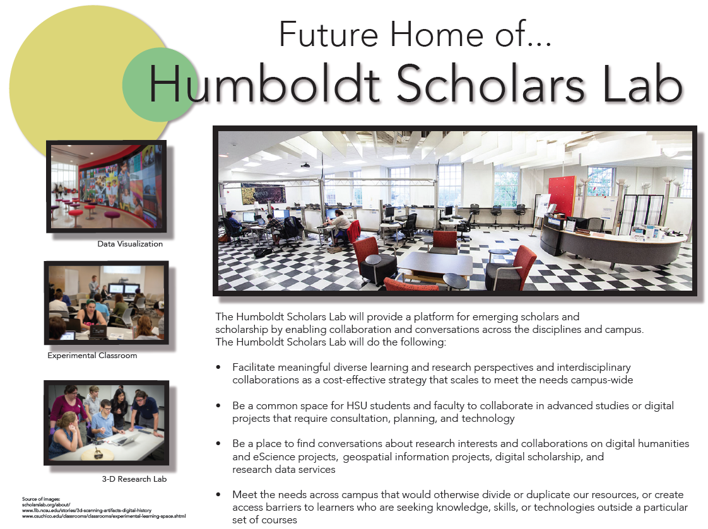

Slide 11
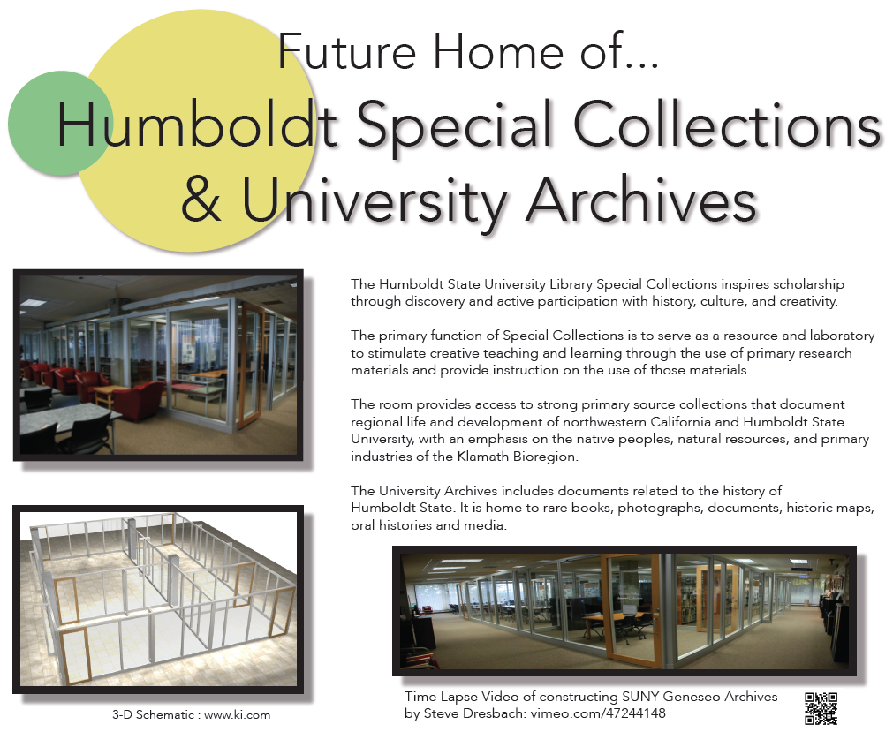

Slide 12
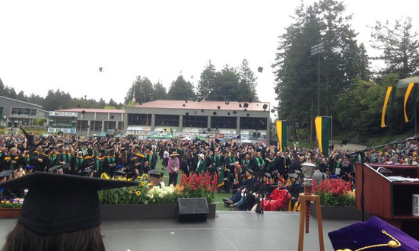
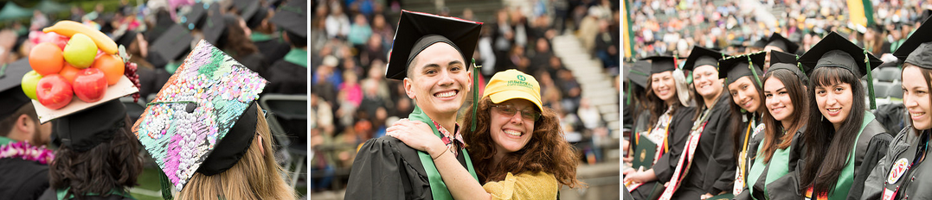
HSU Library & Student Success
HSU Library connect people
Authors to readers, teachers to learners, artists, readers, researchers, scientists, and scuba divers.
HSU Library focuses on the learner
The goal of a learner varies widely as; artist, author, mentor, peer tutor, reader, researcher, scholar, student, teacher, teams, etc. From research papers to scholarly works, to curiosity or creativity, we provide spaces, services, connections and strategies that lead to success.
HSU Library is about the past, present, and future.
Curating and preserving art, information, and knowledge; making them accessible and useful; and transforming the way information is shared.
HSU Library is about opportunities… What are the opportunities you want to explore?

Slide 13
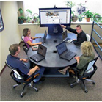
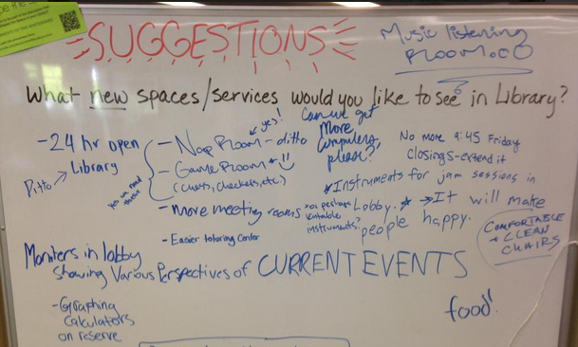
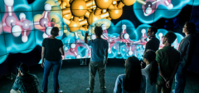
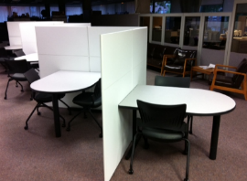
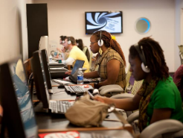
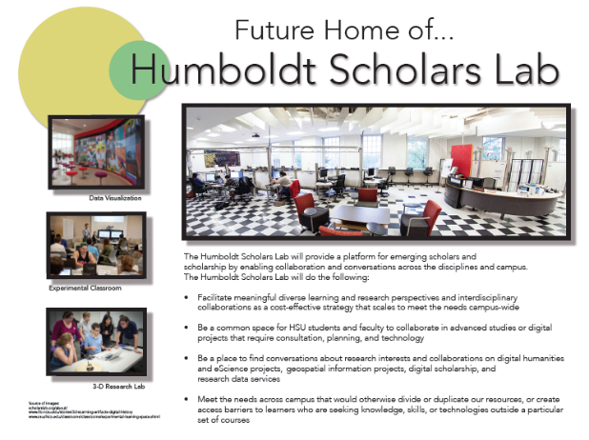
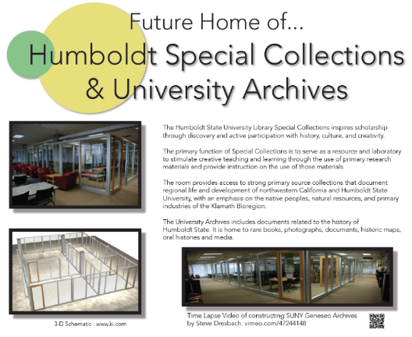
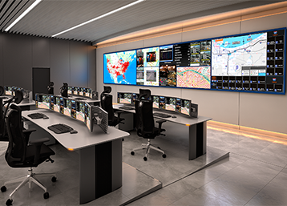
HSU Library appreciate your support
Transformative Services
Textbooks on Reserve
Circulating Laptops & Digital Equipment
Library Scholar Internship
Endowed Collections & Staff
HSU Sustainable Learning
Active Learning Spaces
Collaboration Stations
Information Visualization Panels
Digital Media Lab
Group Study Spaces
Inspiring Learning Spaces
Classrooms, Fishbowl #2, Scholars Lab, Special Collections

Slide 14
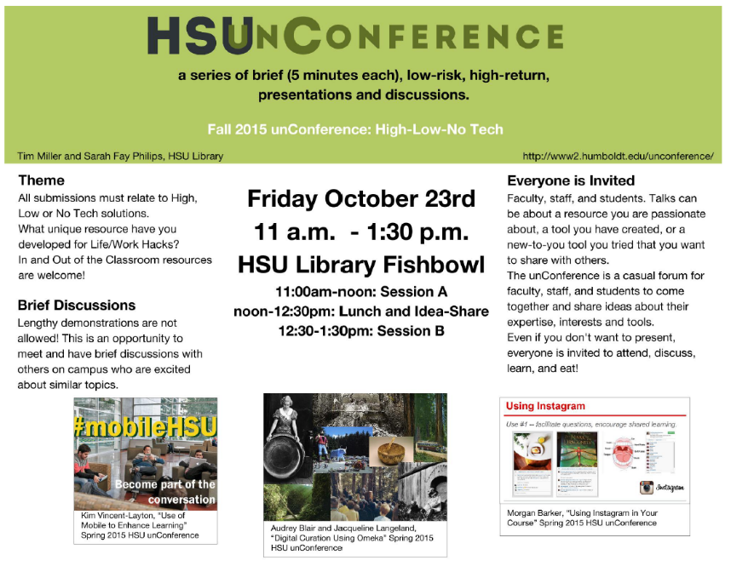
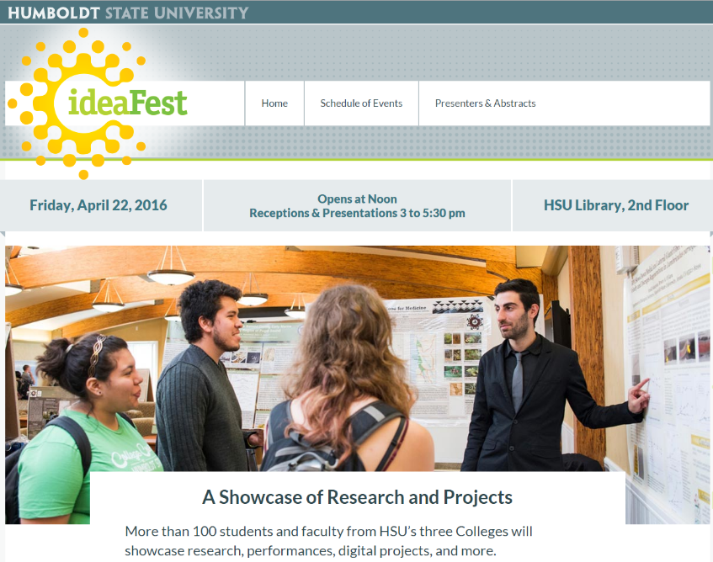
Sincerest thank you for your time today, and the work you are doing in support of this outstanding campus community.
Lastly, HSU Library invites you to participate…
Cyril.Oberlander@Humboldt.edu
Dean of University Library 707-826-3441

