Slide 1
A Tale of Two Mega-regions and Many Systems: The Californias and Shared Print Projects
Print Archive Network Forum
ALA Midwinter
Philadelphia, PA
January 24, 2014
Mark Stover
California State University, Northridge

Slide 2
Shared Print in the California State University (CSU) System
The Numbers
Two Initiatives

Slide 3
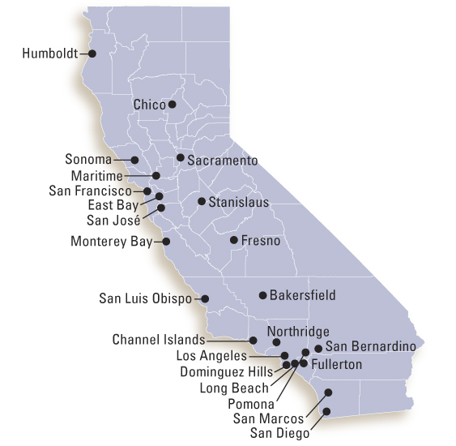
California State University System

Slide 4
CSU Numbers
23 campuses ranging from large (38,000 students) to very small (1000)
430,000 students
Combined Library Budgets: $116 million
Combined total print volumes: 15 million
Largest single library collection is 1.7 million print volumes (San Diego State)
Notes:
Space varies from campus to campus. Some campuses have new libraries with a great deal of empty stack space, and other libraries are stretched beyond their limits.

Slide 5
Automated Storage & Retrieval Systems (ASRS)
4 CSU libraries have an ASRS with a combined capacity of approximately 4 million volumes:
Sonoma: 750,000
Long Beach: 850,000
Northridge: 1.7 million
San Francisco: 1 million

Slide 6
Two Initiatives in the CSU
LOFT (Libraries of the Future) Taskforce
(SCOPM) Systemwide Committee on Print Management
Notes:
Note that LOFT was initiated centrally by the Chancellor’s Office, and SCOPM

Slide 7
LOFT (Libraries of the Future) Taskforce
Convened early in 2012 by the Chancellor’s Office
Representing 6 CSU campuses from the Los Angeles Basin
Taskforce members:
All six Provosts from the LA Basin
Two Library Deans
Two representatives from the Statewide Academic Senate, plus one campus CIO
Chancellor’s Office Academic Affairs staff
Notes:
LOFT started out as a pilot project with the 6 L.A. Basin campuses, but now has spread to (potentially) all 23 campuses.
Why only 2 library deans? Undervaluing of librarians, or just “politics”?

Slide 8
Broad Goals for LOFT
Consolidate Library Collections and Services
Reduce Costs
Improve Value

Slide 9
More Specific Goals
Multi-campus collection management
Assess the impact of library services
Expand sharing of technology infrastructure
Redesign of library facilities

Slide 10
Early Analysis
LOFT hired Sustainable Collection Services (SCS) to analyze the 6 L.A. Basin libraries
Preliminary analysis indicates “significant opportunities for deselecting print books from open stacks to create space for new library services”
Notes:
LOFT hired SCS (Sustainable Collection Services) to conduct an analysis of the circulation data and redundancies of the 6 L.A. Basin libraries and their print book collections.
“The preliminary analyses of the print book collections of the 6 L.A. basin libraries indicated that there are significant opportunities for deselecting print books from open stacks to create space for new library services and learning areas, and can reduce overall library expenditures.”

Slide 11
LOFT Objectives and Strategies
SCS collection analyses
Campus focus groups
Campus “strategic vision” reports
Campus de-selection strategies
Centralized Funding ($1.2 million this year, requesting $2 million next year)
Notes:
Centralized funding from the Chancellor’s Office, for de-selection, repurposing of space, marketing and communication, etc.

Slide 12
LOFT Cooperative Strategies
Access strategies: ILL, digital alternatives
Retention strategies: compact shelving, ASRS
Acquisition strategies: coordinate purchasing of print
Notes:
* Access strategies: interlibrary loan services and digital alternatives
* Retention strategies: open stacks, compact shelving, robotic shelving, interlibrary loan, and digital archiving;
* Acquisition strategies: coordinate the purchasing of new print books that optimize use and access as well as reduce costs and redundancies

Slide 13
Systemwide Committee on Print Management (SCOPM)
Appointed by Council of Library Directors (COLD) Chair in late 2013
Members: 6 Librarians (mostly collection development coordinators) plus a library director representing LOFT
Charge: develop a system-wide print collection management strategy (guidelines, best practices, etc.)
Notes:
COLD and the Chancellor’s Office theoretically work hand-in-hand, but don’t always see eye-to-eye. CSU Libraries are traditionally fiercely independent, and even if all 23 campuses agreed on something, it might not be in line with the Chancellor’s Office. All part of the joys of shared governance.
Alice Kawakami, University Librarian at CSULA, is the LOFT library director on SCOPM.

Slide 14
Goals of a system-wide print collection management strategy
Reducing onsite print storage without loss of access to print collections
Reducing duplicative print acquisitions
Replacing selected print collections with electronic access
Replacing selected non-print materials (physical assets such as microforms, videos, etc.) with electronic access

Slide 15
Goals of a system-wide print collection management strategy (cont.)
Recommending CSU-wide participation in regional and national print management, sharing, and preservation systems (e.g. WEST)
Consideration and coordination of resource sharing and interlibrary service implications of print management strategies
Developing communications and workflows to support coordination of system-wide print management strategies

