Slide 1
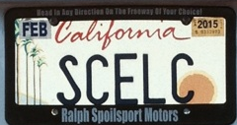
SCELC and Shared Print A New California Adventure
Print Archive Network Forum
ALA Midwinter
Philadelphia, PA
January 24, 2014
Rick Burke
Executive Director, SCELC

Slide 2
What Is SCELC
The Statewide California Electronic Library Consortium
We have 110 mostly small and medium-sized private academic and nonprofit research member libraries throughout the state, plus one in Nevada and six in Texas
Aggregate Member FTE is 278,714
Aggregate Member Materials Budget: $75.7 million
Members collectively licensed >$31 million in e-resources in FY13

Slide 3
Why Shared Print
SCELC was already a participant in the WEST program
Our strategic plan calls for the consortium to develop shared print programs to:
Preserve copies
Identify unique copies, prevalent copies
Develop processes to share books among member libraries

Slide 4
Feasibility Study
Feasibility study exploration authorized by SCELC Board in June 2013
Bob Kieft, John McDonald, Karen Schneider and others in the SCELC Resource Sharing Committee drafted proposal for the study
SCELC hired Lizanne Payne as its Shared Print Consultant to assist with the expansion of the study
This included the creation of shared print survey whose results were just gathered this past week

Slide 5
Goals of the SCELC Study
Understand SCELC members’ readiness to participate in a shared print agreement & study composition and use of SCELC member print collections
Look at potential partnerships with other systems
Develop proposals for addressing the long-term sustainability of the program, including business models, MOUs, or other legal agreements
Identify corollary studies that may be performed to support the potential SCELC Shared Print Program
Understand user behaviors with respect to print and electronic books
Analyze costs of performing condition surveys for circulating materials

Slide 6
The SCELC Shared Print Survey
The survey was designed to gather information about
Library identification and demographics
Library print collection size and plans
Consortium and shared print planning
Shared print goals
The survey was also shared with and circulated among the UC and Cal State (CSU) campuses

Slide 7
Survey Results
Summary of responses
56 SCELC members
15 CSU libraries
7 University of California libraries plus the California Digital Library and two Regional Library Facilities, for a total of ten UC responses
1 non-affiliated library, Stanford University

Slide 8
Some Major Survey Findings
Importance of SCELC shared print program:
68% of responses said that a shared print program in SCELC was either Very Important (13) or Somewhat Important (25).
It can probably be assumed that libraries that did not respond to the survey at all did not believe shared print was important to most of them.
Collaboration with UC:
37 SCELC libraries (66%) responded that a shared print program in collaboration with UC libraries would be Very Important (10) or Somewhat Important (27).
Collaboration with CSU:
36 SCELC libraries (64%) responded that a shared print program in collaboration with CSU libraries would be Very Important (7) or Somewhat Important (29).

Slide 9
More Major Survey Findings
Goal to Reclaim Space or Preserve the Scholarly Record:
33 SCELC libraries (59%) responded that Reclaim Space was their top priority (combined across “for newer materials” and “for other needs”)
Focus on Rarely-held or Widely-held Monographs:
36 SCELC libraries (64%) responded that a focus on “either or both” rarely-held or widely-held monographs would be most likely to attract participation by their institutions, i.e. no clear preference at this stage
Importance of prospective collection development:
44 SCELC libraries (79%) reported this would be Very Important (15) or Somewhat Important (29)

Slide 10
Yet More Major Survey Findings
Willingness to hold collections:
40 SCELC libraries (71%) said they potentially would be willing to retain monographs at their library as part of a shared print program
Factors playing the biggest role in willingness to participate:
39% of SCELC respondents ranked “contents of the shared collection” as #1 most important, followed by 23% of SCELC respondents who ranked “types and speed of access/delivery” as #1 most important.

Slide 11
Next Steps
Perform initial comparative collection analysis’
Identify optimal tools for collection analysis
Develop a framework for a shared print program, including policies, business models, services and governance
Explore with potential partners the establishment of corollary studies

Slide 12
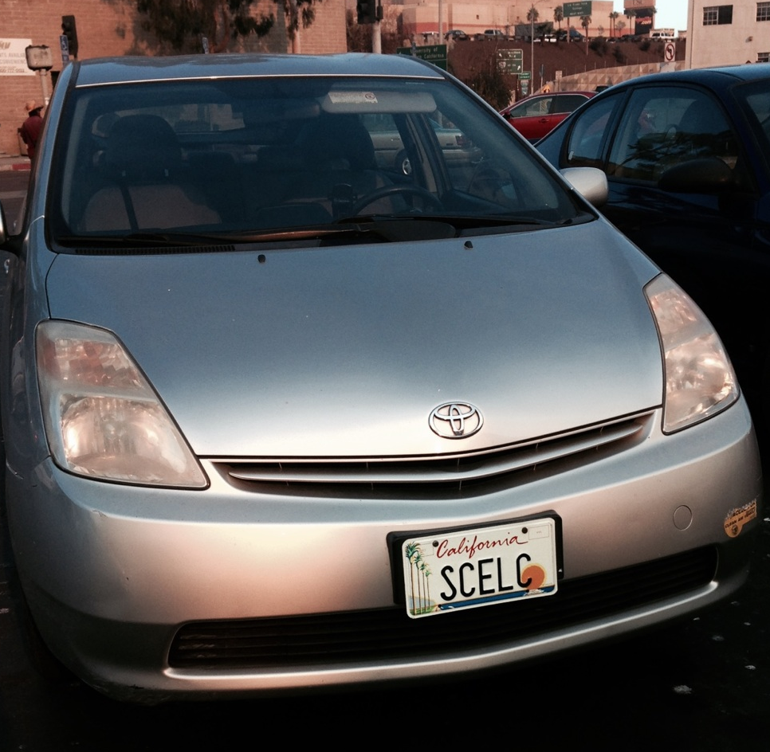
For Further Information
Rick Burke
rburke@scelc.org
Bob Kieft
kieft@oxy.edu

