Slide 1
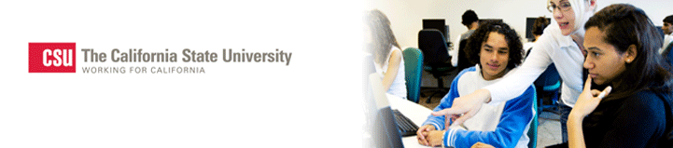

Makerspaces and Libraries:
Cal State University’s Strategies
Gerry Hanley, Assistant Vice Chancellor, Academic Technology
California State University, Office of the Chancellor
February 13, 2018
Linked Learning Convention 2018
Anaheim CA

Slide 2
WHY LIBRARIES?
Where is everyone welcome on a campus, including teachers, students, and others in the local community?
What is a safe, secure, and supervised location that is open for long hours on campuses?
Where do all students and faculty come to learn?
Who employs students regularly to support the university operations?
Where can computer science students provide “community service” to help people learn to code?
Where can student services and programs provide community engagement with families and community leaders that is open to all?
The LIBRARY!
The LIBRARY!
The LIBRARY!
The LIBRARY!
The LIBRARY!
The LIBRARY!

Slide 3
Sonoma State University Library and its Makerspace

Slide 4
System Facilitation of Campus Makerspaces
Repository of resources including: facility designs, curriculum, professional development materials, marketing materials, etc.
Support for professional development for campus leaders via Communities of Practice
Communications and outreach campaign
Partnership facilitation
Business operations support
Recommended policies and procedures
Grant acquisitions

Slide 5
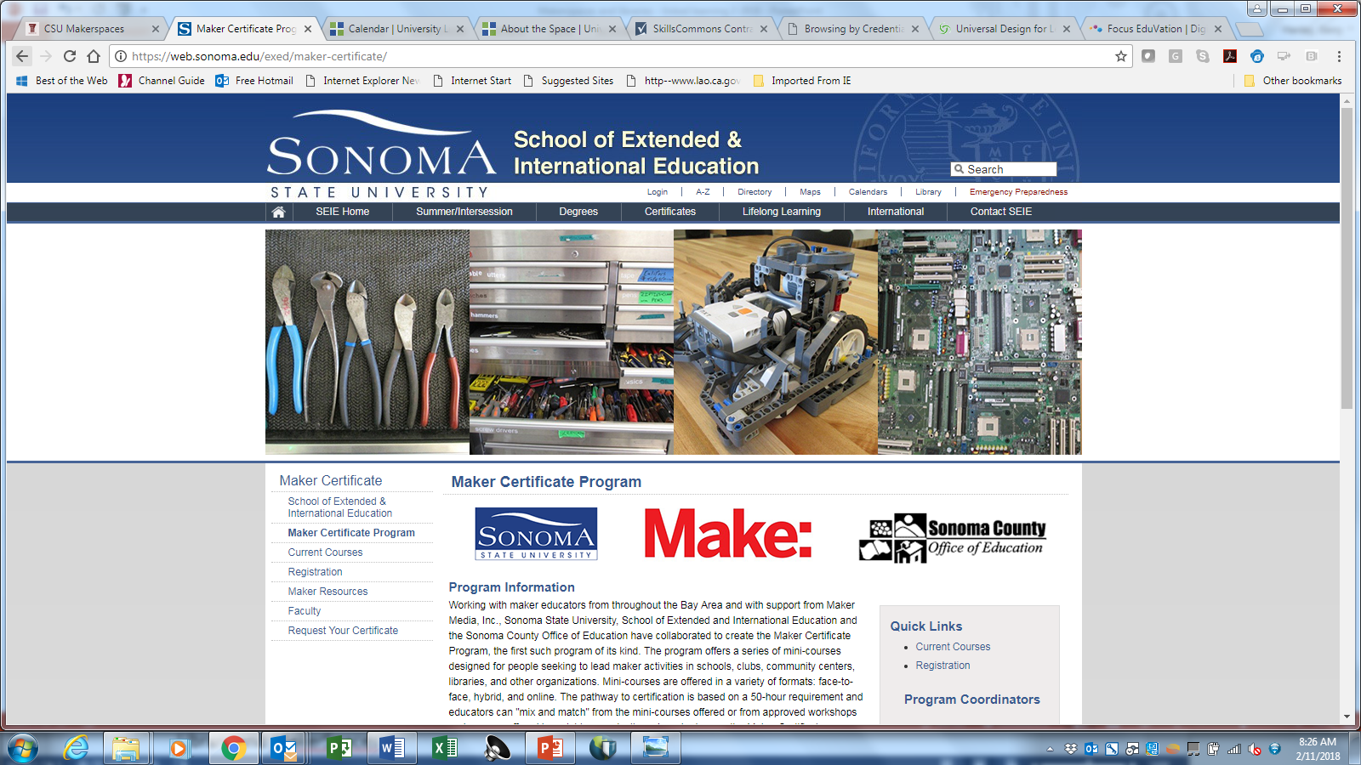
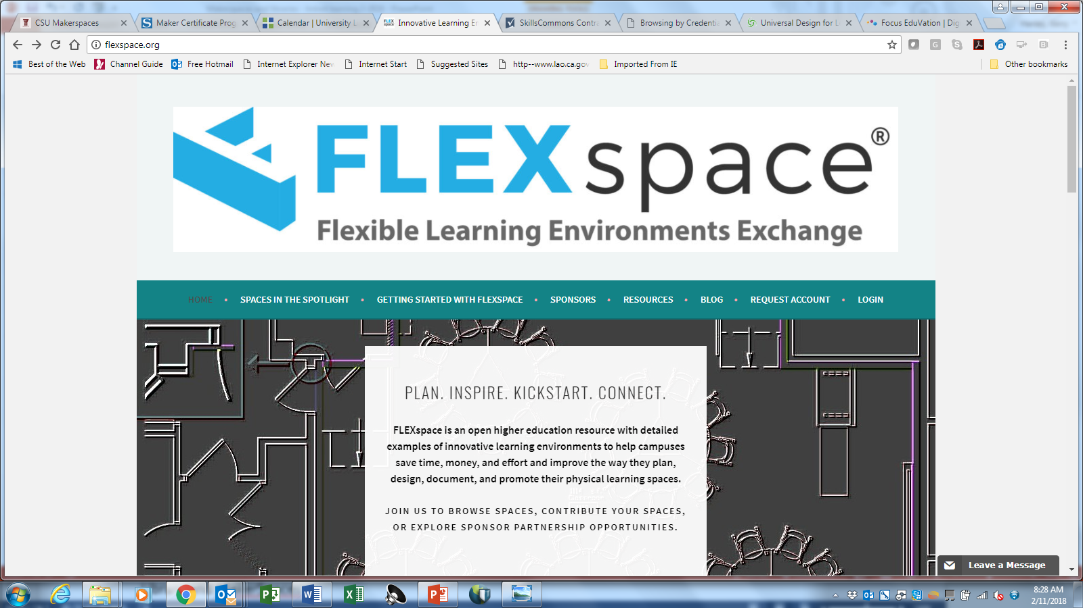
Building Capacity
Sonoma State Maker Certificate Program
FLEXSpace: A free and open library of learning spaces – including Makerspaces

Slide 6
QUESTIONS?

Slide 7
THANK YOU

