Slide 1

Advocacy and Matching the Media with the Message
Day Two
COLD Advocacy Workshop

Slide 2

Discovery
What are we already doing?

Slide 3

Discovery: What do we know?
How many use social media for their library?
Who from the CSUs do you follow?
On what platforms?
Who from the CSUs follows you?
What do you know about your advocacy targets from following them?
How have you used that knowledge to grab their attention?
What do you have that tells your collective story?
Where do you place it?
Do you have anything interactive?
Anything that requires repeat visits (a thermometer rising/# that increases from uses)

Slide 4
Pointers to a few more resources”

Slide 5
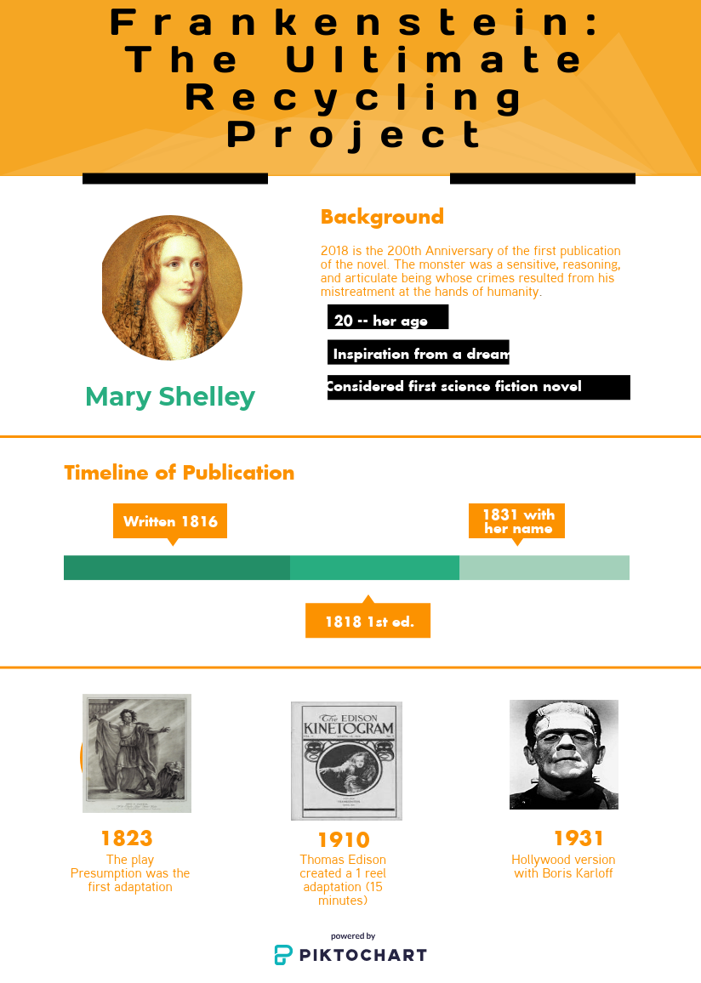
Marketing the Academic Library
Advocacy Toolkit
Libraries Transform Toolkit (ACRL LibGuide) and more http://www.ala.org/acrl/issues/marketing

Slide 6
Collaborative Messaging
Many hands make light work

Slide 7

Attention Grabbers/Not Passive
Who do you have telling the story?
  Need student voices
Need to include uses of resources with type of research which generated # of dollars (grant funds, new products, etc.) – could be collectively huge!
Recruitment stories of superstar faculty who can speak to importance of maintaining the access.
Just collecting use data without contextualizing it does not demonstrate value.

Slide 8
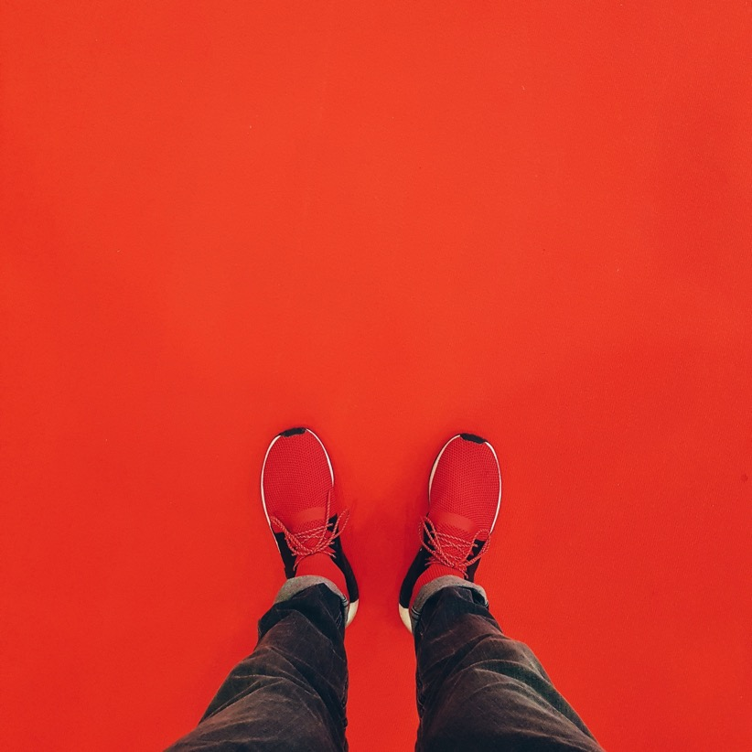
You already have conveyed the consortial cost savings. So how does that translate into what your top administrators care about?
**Tell THAT story.

Slide 9
Use social tools
Conversation, Twitter, FaceBook, etc.

Slide 10
A place for community to provide feedback, stories, new ideas
What is the CSU message?
How can the CSU Libraries connect their messages to it?
Which departments/institutions have messaged successfully?
What did they do?

Slide 11

Five Steps
Vision
Articulation of Needs
Design of Scripts
Format
Schedule

Slide 12

Six degrees of separation approach:
existing supporters;
potential supporters;
converting naysayers
Match your message to the targets.

Slide 13
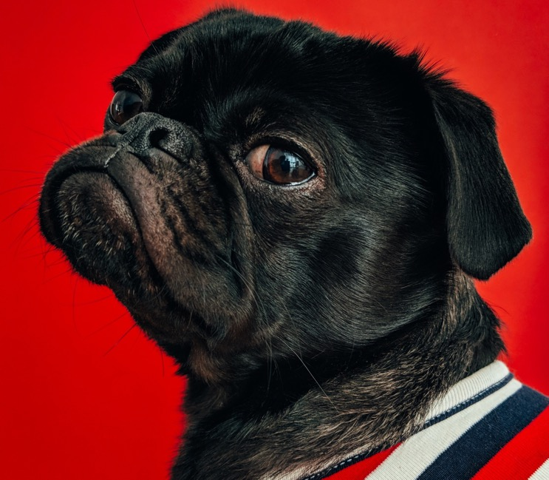
On to the work!”

