Slide 1
Resource Sharing Functional Committee
Update 2019

Slide 2
Tricor/Unity Reporting Tool
Available on the RSFC Wiki
Available since October
19 Submissions to date

Slide 3
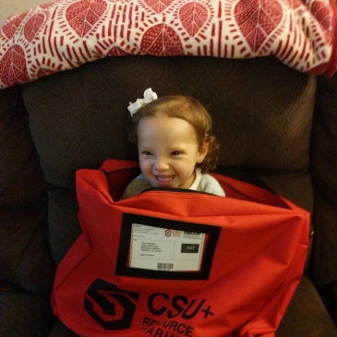
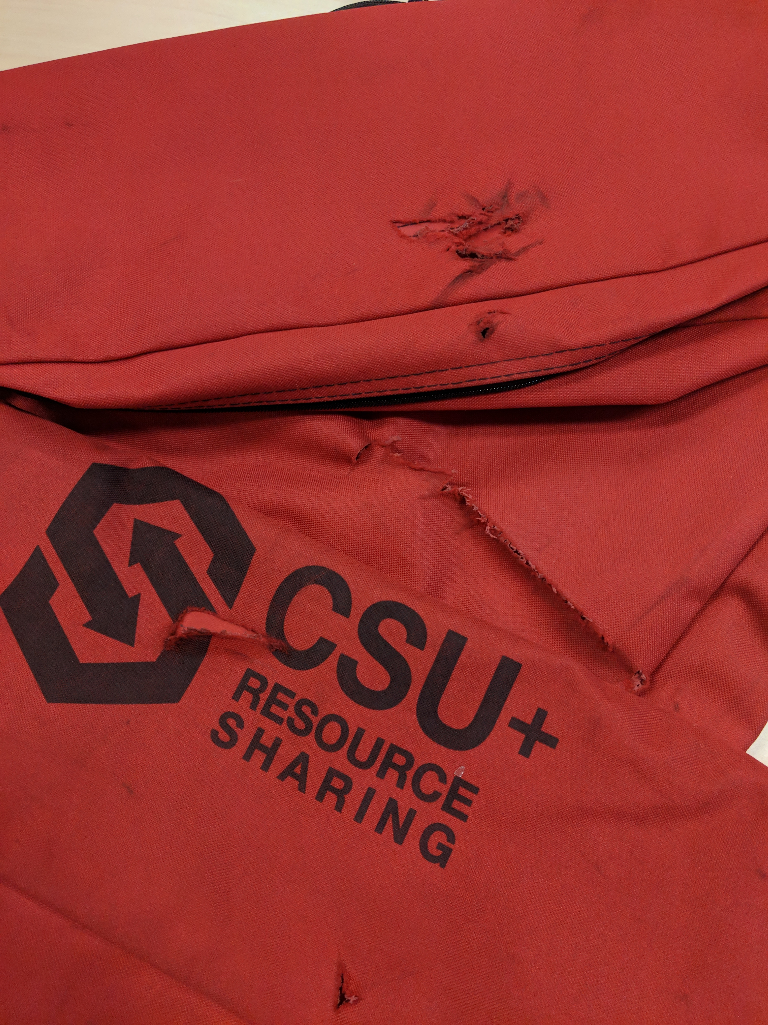
Tricor/Unity Bag Repair/Replacement
42 bags broken and needing repair/replacement through first year of CSU+
One Year Later

Slide 4
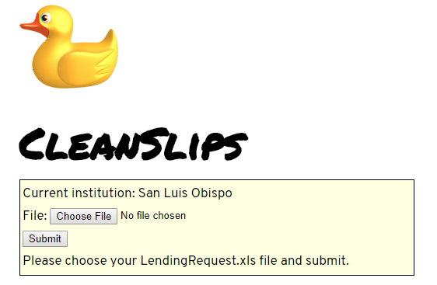
CleanSlips Online
https://slips.calstate.edu

Slide 5
Additional Projects
Create Holiday Closure guide
Turned off expiration dates over winter break. Turned back on after New Years Day.
Assessing Workflow Profiles
Looking at what additional profiles are needed and what can be removed. Ongoing.

Slide 6
Monthly Release Testing
Check for Duplicates When Creating Borrowing Requests
Determined it interfered with common CSU+ practices. Did not recommend as system wide policy
November Release caused items to be marked as lost
Scheduled to be fixed in the March update
Conditional messages
New feature currently not working as hoped. General Messages perform same function

Slide 7
Cooperation with other Functional Committees
Resource Sharing Request Task Force (with Discovery)
Joe Adkins
Walk in patron (with Fulfillment)
Joe Adkins
Lost/missing/damaged workflow (with Fulfillment)
Isabel Pina and Karla Salinas

Slide 8
CSU+ overview

Slide 9
About the data
Fall 2017 and Fall 2018 comparison
Numbers pulled from
Alma Network Zone Analytics
OCLC Analytics
CO data on student enrollment
Notes:
Spreadsheet of data I used is posted with the COLD agenda for today.
I want to start by walking through some data, providing a summary of what I see in comparing two semesters of CSU+ and ILLiad data.
We’ll be looking at borrowing and lending activity for for Fall 2017 and Fall 2018 since at this point we don’t have comparative data for CSU+ a full academic year. The data has been pulled from the Alma Network Zone and OCLC usage statistics. Student enrollment data was retrieved from the CO.

Slide 10
Notes:
First looking at Lending activity:
We’re seeing an increase in CSU+ lending activity from Fall 2017 to Fall 2018, a 15% increase to be precise while ILLiad traffic has decreased by 3% from year to year.
This overall increase is contrary to a consistent general downward trend in ILL volume that we’ve seen reflected in our ISPIE statistics since 2010

Slide 11
34%
37%
Notes:
We see similar trends in borrowing with an overall increase in borrowing despite a 4% decrease in ILLiad lending.
Another point to consider here is that the overall percentage of borrowing traffic that went through ILLiad went down by 3%.
This may speak to more accurate requesting configuration in discovery or increased accuracy of requestability configurations in Alma.

Slide 12
Notes:
Link+ libraries - to be clear, this doesn’t show Link+data, we are still limiting this comparison to ILLiad and CSU+ data, rather this is a look at ILL activity for the subset of the campuses who used Link+ at some point.
Lending showed a similar trend for this group - Combined ILLiad and CSU+ lending increased by 12% despite a 3% decrease in ILLiad lending. CSU+ lending did increase by a larger percentage (24% instead of 15% for the system as a whole).

Slide 13
Notes:
Borrowing activity for this group shows some points of divergence from system wide trends – combined CSU+ and ILLiad borrowing increased 7% (whereas the system increased by 13%) but what differs in this case is that both CSU+ and ILLiad borrowing requests increased from one semester to the next which we did not see in our system wide numbers.
More detailed campus by campus information is available in the spreadsheet I linked to on the COLD agenda for today.

Slide 14
Notes:
Something being brought up as a point of discussion is the impact of Primo’s default scope on borrowing activity. I want to take a different approach with this data. Rather than compare year over year, let’s take a look at a single semester and see how campuses with each type of scope distribute. Taking a look at borrowing requests per capita controls for campus size so that student population isn’t a driving factor putting bigger campuses automatically at the top.
Those with a local default scope are in red while those that default to all-CSU materials are shown in blue. we can see looking at this chart that more of the campuses on the left side with a higher per capita borrowing rate have the default scope set to all CSUs. Which makes for a compelling argument that defaulting to a CSU-wide scope has a positive effect on CSU+ borrowing activity.

Slide 15
Alma rota: The gift that keeps giving
It’s still random but we’re still seeing the effects from when it wasn’t.
 | Fall 17 CSU+ Lending | Fall 18 CSU+ Lending | % +/-
Bakersfield | 863 | 812 | -6%
Monterey Bay | 798 | 691 | -13%
Sacramento | 1957 | 1894 | -3%
San Francisco | 1725 | 2058 | +19%
San Luis Obispo | 674 | 704 | +4%
San Marcos | 949 | 784 | -17%
Stanislaus | 905 | 852 | -6%
Notes:
The rota has remained in its randomized state since April 2018. You may recall, it was supposed to be un-ordered since go-live in July 2017 but due to an oversight three campuses were using an ordered rota until April 2018. Of the campuses in the top 3 positions of those ordered rotas, all but 2 saw a decrease in lending from Fall 17 (when the ordered rota was in place) to Fall 18 (when it was fully randomized between all campuses). A change made at one or two campuses can have a notable impact elsewhere in the CSU.
I have yet to do any major explorations of what’s possible in Alma rota configuration primarily due to the lack of established resource sharing priorities and goals… but more on that in a couple slides.

Slide 16
what’s the takeaway?
CSU+ is working pretty well and getting better
Patrons are engaging more with CSU-wide collections
CSU+ staff can handle increased traffic
Notes:
The past year – 18 months has been about getting CSU+ up and running and building the capacity to effectively support our new resource sharing system. To that end the increase in system wide volume shows that CSU+ is working pretty well and based on the changes we’re seeing from year to year CSU+ performance is improving.
Patrons are engaging more with CSU-wide collections through increased access via Primo and streamlined processing in Alma.
CSU+ staff are growing more comfortable with Alma workflows and are able to handle a greater volume of activity than they were last year.
With this stronger knowledge base of how Alma works and what it means to have monthly releases and enhancement cycles the RSFC is now engaging with opportunities to fine-tune our system and workflows further, analyzing and testing configuration and processes set at go-live and making thoughtful changes. There’s still a lot of space to make improvements but establishing a mutually accepted philosophy is a key piece of creating meaningful change in CSU+.

Slide 17
The philosophy
Notes:
I’m hoping by now that you’ve all had the opportunity to look at the philosophy document Jen sent out last week. If you haven’t I’ll provide a quick summary of what I’m proposing to adopt and why. There are two main principles that I lay out in the document:
1) We should seamlessly provide access to as much as we can to all users at each campus equally – everyone in the CSU should be able to use CSU collections regardless of campus affiliation.
2) Get the right thing to the patron as fast as we can. Speed and accuracy tend to be the markers of patron satisfaction in resource sharing transactions so decreasing delivery time and ensuring accuracy equates to better service.
These principles may seem basic but they provide a necessary framework to measure performance, evaluate changes and guide the use of the tools we have at our disposal.
In the coming year I want to assess the system with an eye toward how well we are fulfilling the goals of resource sharing. If the CSU+ philosophy is adopted I can use the two key points laid out to measure the effectiveness of CSU+. We can then use the tools at our disposal, such as changing the rota and sharing best practices from campuses with efficient workflows, to better serve our goals and optimize the service.

