Slide 1
Strategic Plans: A Love Story or How the Office of Undergraduate Studies and the University Library Created an Intentional Partnership to Support Students’ Academic Success February 10, 2017
Dawn M. Formo, Dean, Undergraduate Studies
Bianca MothÉ, Associate Dean, Undergraduate Studies

Slide 2
Improving Retention for All Students
CSUSM has successfully closed the gap in one-year retention rates between underrepresented minority and non-underrepresented minority first-time, first-year students.
83.1%
Source: Retention File Maintained by Institutional Planning & Analysis

Slide 3
Governor’s $2.5 Million Award for Innovation in Higher Education
Dawn Formo with Vice-Provost Kamel Haddad and Christian Osmena from the Governor’s Finance Office

Slide 4
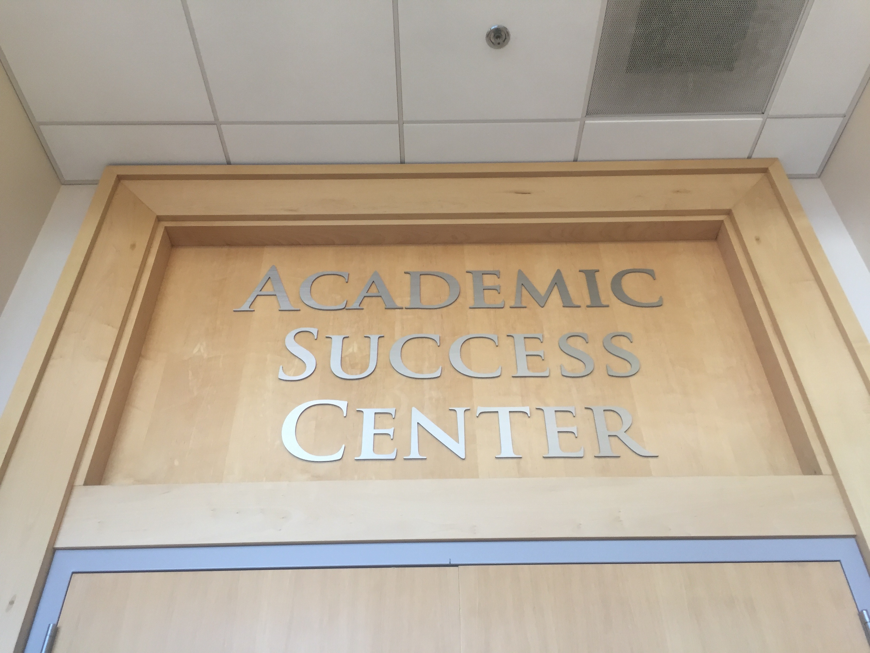
Launching our Academic Success Center (ASC)
I have known for many years that campus libraries are the ultimate student success centers....
- Jen Fabbi, ASC Showcase Remarks, Oct. 2016
A partnership between the Office of Undergraduate Studies and the University Library
Strategic Plans: A Love Story

Slide 5
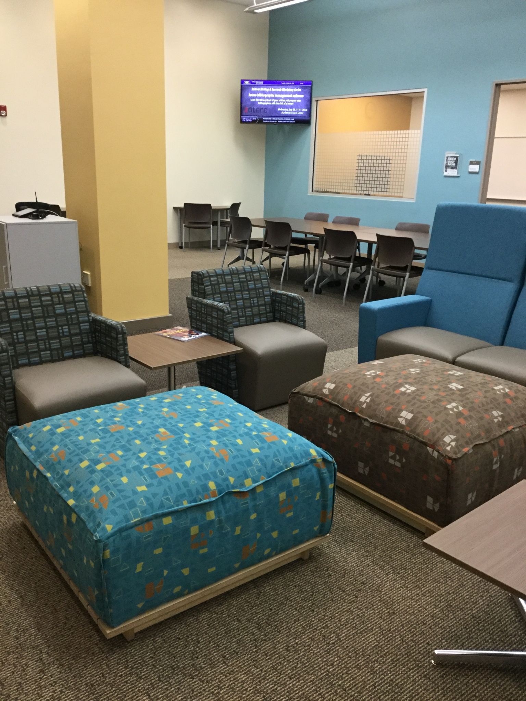
The Library/OUGS Love Story
Library
OUGS
The Library will …[c]ollaborate with campus partners to explore opportunities to develop first year and general education students’ engagement and ability to pursue inquiry both within and beyond the classroom in order to increase retention and positively impact time to graduation.
Establish OUGS…. as the central campus hub for fostering and enhancing the academic success of undergraduate students.
Identify and enhance partnerships… that support students’ academic success across campus.

Slide 6
Collaborative Development Process
Fall 2015: national research on Academic Success Centers
Spring 2016:
Travel team
Faculty/Staff/Student implementation team
Spring/Summer 2016: Renovation of space
Fall 2016/Spring 2017: Launch of services and programming

Slide 7
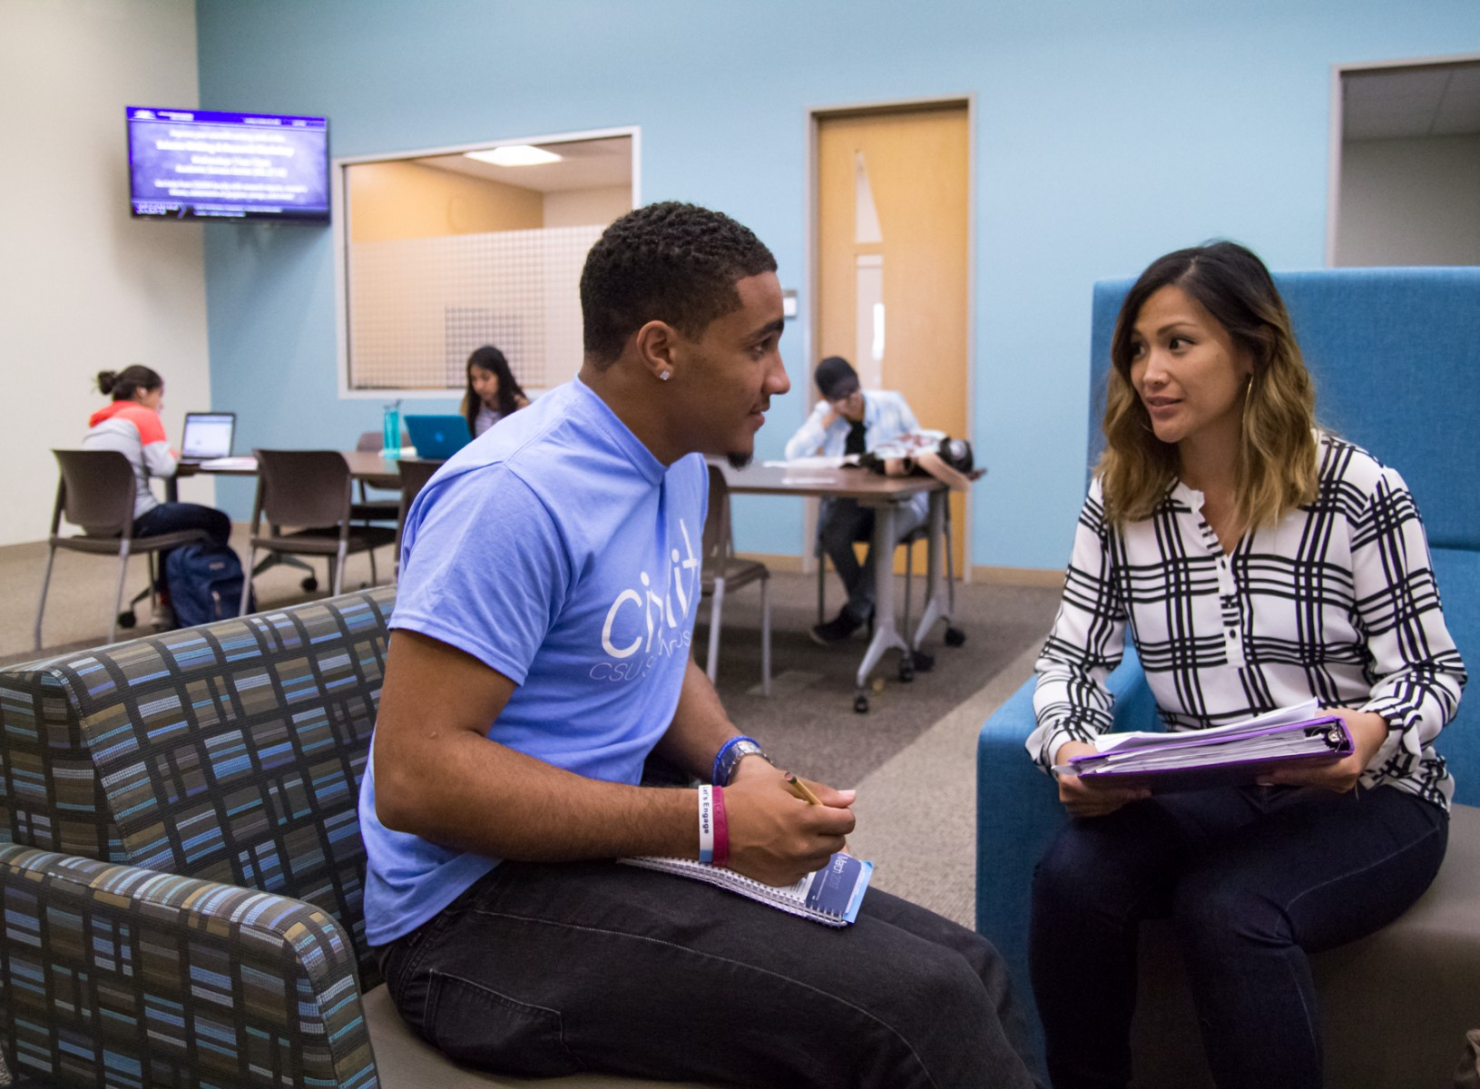
ASC Mission
Designed to help our students realize their full academic potential through
one-on-one academic coaching
discipline-specific academic programming

Slide 8
ASC Vision
Open to all students
Dual-use space
Use of analytics to identify student needs
Seamless referral
Content focus
1) Arts, Humanities, and Undeclared
2) Behavioral and Developmental Sciences
3) Social Sciences
4) Sciences and Mathematics
5) Transfer Success and Information Literacy
Team approach
Staff leads
Faculty liaisons
Student peer educators

Slide 9
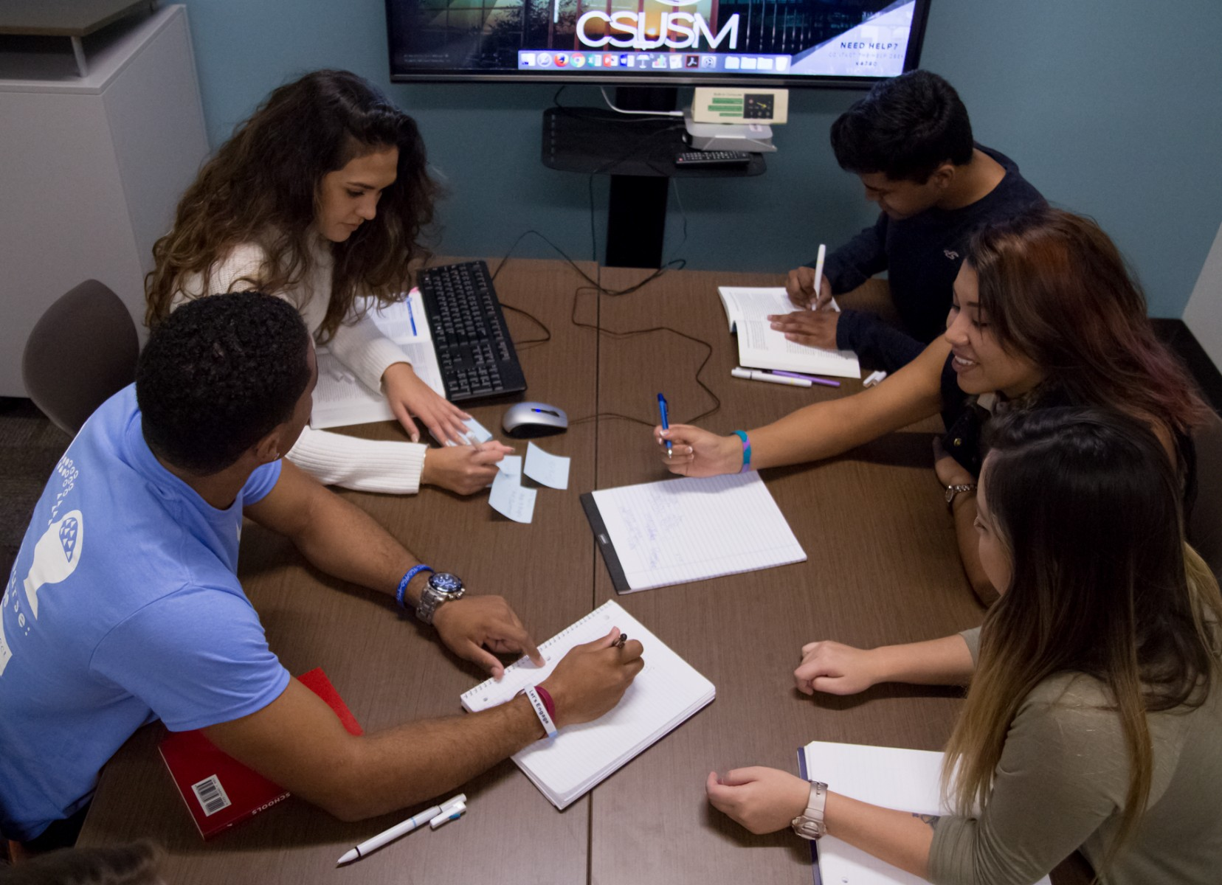
Data-Informed Academic Interventions
CSU 2025 Graduation Initiative
Problem: CSUSM research uncovers Sophomore Success Concern
Sophomore-Specific Interventions:
1. ASC as a bridge for First-Year to Sophomore Success
2. Academic Coaching for Sophomores
2.2 GPA
0.375 term GPA in one semester
Data-informed discipline-specific programming
Faculty Liaison Program

Slide 10
Library/OUGS Partnership
...I knew it would be a perfect fit in the Library, both physically and programmatically.
- Jen Fabbi, ASC Showcase Remarks, Oct.2016
Notes:
Closing—We invite you think about your own campus partnerships in relationship to the mission vision of your campuses and your libraries.

Slide 11
Contact Info
Dawn M. Formo, Dean
Undergraduate Studies
Craven 5211a
760-750-7326
dformo@csusm.edu
Bianca R. Mothé, Associate Dean,
Undergraduate Studies
Craven 5102h
760-750-7329
bmothe@csusm.edu

