Slide 1
Notes:
https://flic.kr/p/oqYSE1 Image from page 190 of "An illustrated dictionary of words used in art and archaeology. Explaining terms frequently used in works on architecture, arms, bronzes, Christian art, colour, costume, decoration, devices, emblems, heraldry, lace, personal orname

Slide 2
Here Be Dragons:
The ScholarWorks Update
Carmen Mitchell, Cal State San Marcos
Aaron Collier, CSU Office of the Chancellor

Slide 3
How did we get here?
AKA: historical background
2013 STIM Subcommittee Report:
Focused on a “total cost of ownership” analysis between DSpace and Digital Commons.
Recommendation to investigate “next generation” IR platforms.
Exploring additional services like Open Journal Systems.
Notes:
CSU Adopted DSpace as the system-wide IR back in 2007. At that time, there weren’t many other open source IR platforms that were “out of the box” ready. Both Islandora and Hydra were still in fairly early stages of development. But that’s changed now. DSpace development has depreciated, while Hydra gains new code committers and partners every year.

Slide 4
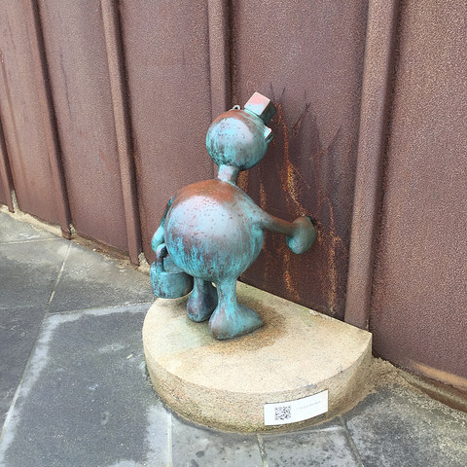
At the beginning of 2013:
•16 campuses
•Various versions of DSpace (from 1.5 – 3.x)
•A shared server with individual resources
Mid-2014: Multitenant Migration Complete
Today:
•18 Campuses
•3 Non-campus projects
Notes:
Tripled our storage usage since mid-2014
Growth of 60GB / month on average
A lot more data waiting in the wings…

Slide 5
2015 STIM Report & Survey
(We’re going to need a bigger boat!)
More campuses using DSpace.
Growth of 60GB / month on average.
Campuses want additional services: OJS, OCS, Faculty profiles.
2015 CSU ScholarWorks Conference: reinvigorated the ScholarWorks group!
We’ve outgrown what DSpace can do.
Planning for migration

Slide 6
Usage Explodes!
Multi-Tenant Outgrows Dspace 2014-2016
Hydra Comes of Age
2017
Infinity & Beyond
Notes:
Growth & Storage Narrative

Slide 7
Our
mug
Is
overflowing
Notes:
This growth estimate means no available storage the end of 2017.

Slide 8
Planning
Now
Customizing
Ongoing
Deploying
We need a sustainable solution
Review of possible systems
System selection
Targeted testing and planning
Migration planning and metadata review
Feature review and analysis
Notes:
Modulare Strategy and developments toward sustainability

Slide 9
would
you
ride
a
bike
in
the
FAST LANE?
Notes:
Performance & Scalability Narrative

Slide 10
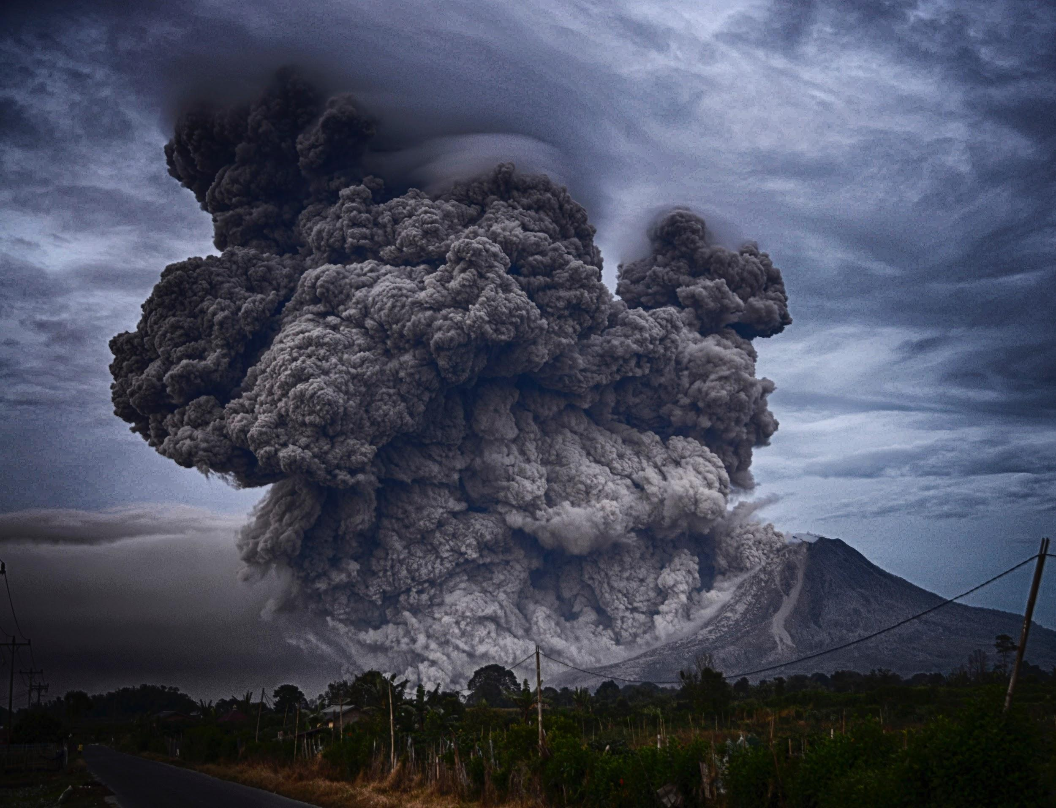
What, me worry?
Notes:
Backup/Recovery, Multi-zone deployment narrative

Slide 11
Progress and Evolution
Notes:
Progress in relation to proposed plan.

Slide 12
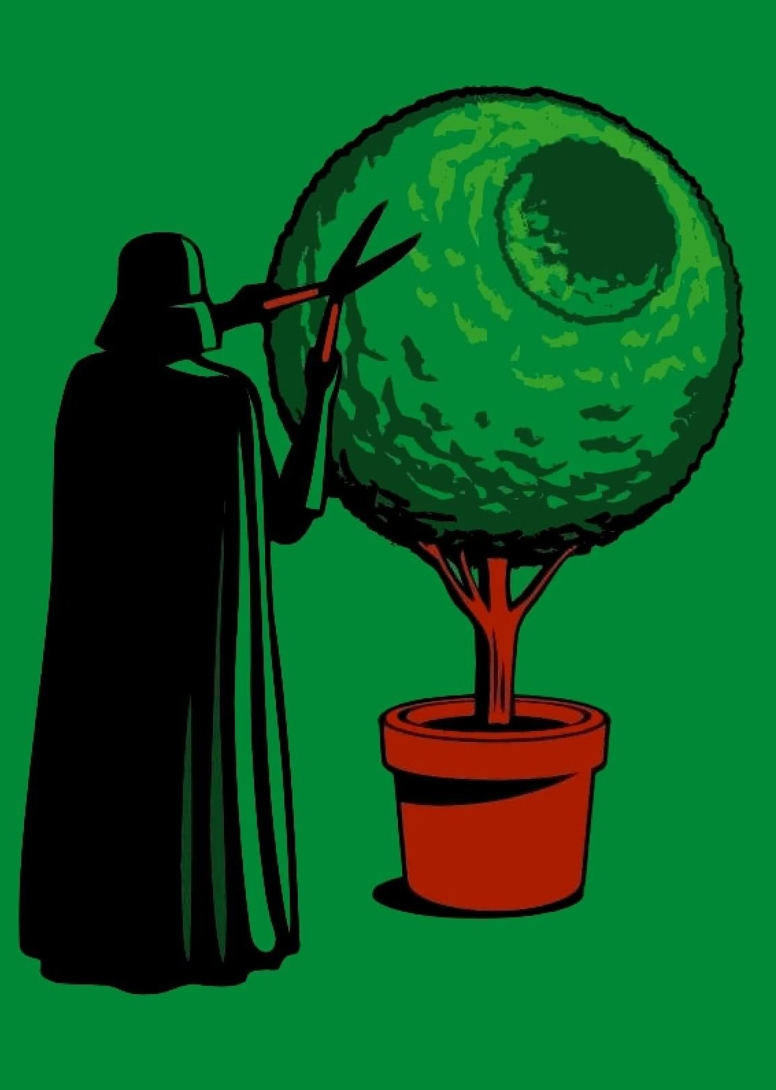
We need to
cultivate our
metadata
Notes:
Governance needs, especially around metadata best practices

Slide 13
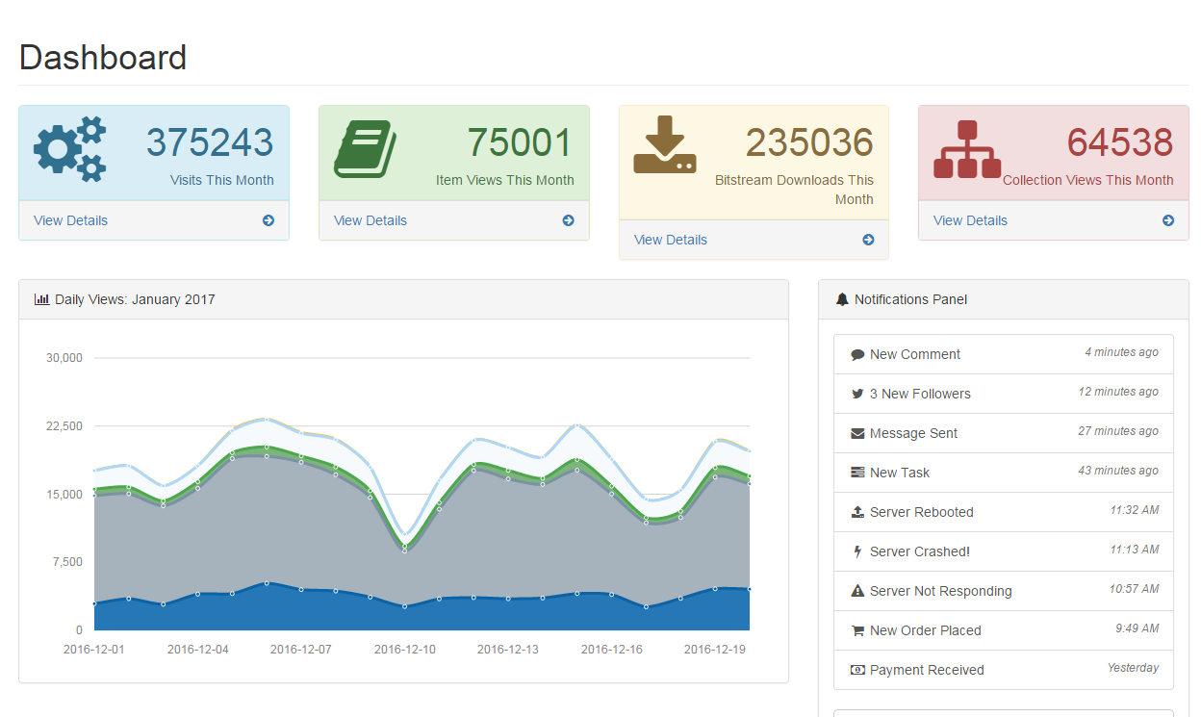
Better Statistics Dashboard

Slide 14
Let’s review the timeline
January
Data Migration Testing, Time & Space Estimates, Developing automated deployment strategy.
February
Iterative Deployment Testing, Metadata Review & Cleanup, Feature Planning.
March
Small & Midsize Collection Available in Production Environment, Large Collection Stress Testing.
April
Collection Cohort Review Meetings, Feature Stress Testing, Develop User Guides & Workshops
May
Feature Complete, Finalize Deployment Schedule
June+
LAUNCH
Notes:
Review and Establish timeline

Slide 15
DEMOS
Links to Development Repositories
Hyrax: :http://swdemo.jqfbicueh9.us-east-1.elasticbeanstalk.com/
GeoBlacklight: http://geoblacklight.desub2284d.us-east-1.elasticbeanstalk.com
Faculty Research: https://curate.nd.edu/
Image Repository: https://repository.duke.edu/
Other Examples
https://pages.dlib.indiana.edu/catalog
http://openvault.wgbh.org/
http://opaquenamespace.org

Slide 16
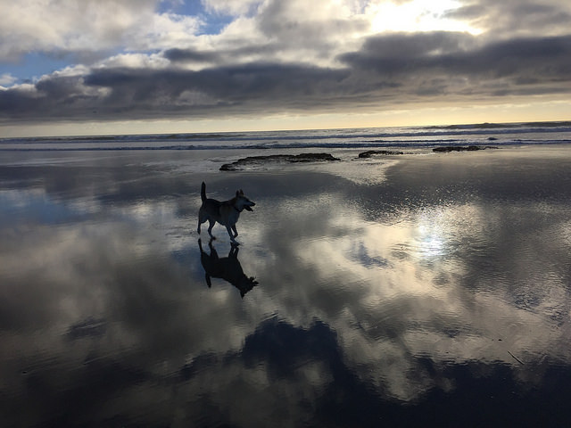
Questions?
Carmen Mitchell, Scholarly Communication Librarian, CSUSM
cmitchell@csusm.edu
Aaron Collier, CSU Office of the Chancellor
acollier@calstate.edu

Slide 17
IMAGE CREDITS
Internet Archive Book Images: https://flic.kr/p/oqYSE1
Carmen Mitchell: https://flic.kr/p/EC5tiT
https://unsplash.com/@foodess
https://unsplash.com/@white73widow
https://unsplash.com/@yoshginsu
Photographs by Unsplash

