Slide 1
COLD Student Success Study Status Report
Lili Luo & Tracy Elliott

Slide 2
Outline
Project progress
Impact of COVID-19 on data collection
Plans for next steps

Slide 3
Project Progress
Study Objectives
The COLD Student Success Study is to replicate the GWLA study in answering the following research questions:
1. What effect does library instruction have on the retention?
2. Which specific library instruction methods have the greatest impact on retention?
3. What effect does library instruction have on academic success?
4. What effect does specific library instruction interactions have on
academic success?
To answer the research questions, data is collected across participating CSU campuses on 1) 2019-2020 first year students’ basic demographics, GPA, credits, courses enrolled and retention; and 2) IL instruction provided by the library in 2019-2020

Slide 4
Project Progress
Pre-study Preparation
Conversations with Jade Winn from University of Southern California Library, who was responsible for coordinating the GWLA study.
Lessons from the GWLA experience:
No need to collect data on variables for which we do not anticipate any current or future use for analysis.
There are students who have taken more than one courses where they received information literacy (IL) instruction.
Ideas to optimize the data collection instrument - e.g. how to collect data on IL instruction methods to make data analysis easier; how IR data could be broken into enrollment and course data, etc.

Slide 5
Project Progress
Development of Data Collection Instrument
For institutional data and IL instruction data – documents are created to explain all the variables required, data collection timeline, and what the data collection instrument and data output should look like.
A series of meetings were held with participating librarians and representatives from the institutional research office to 1) explain the variables and the data collection process, and 2) to collect input to make the data collect collection instrument more effective.

Slide 6
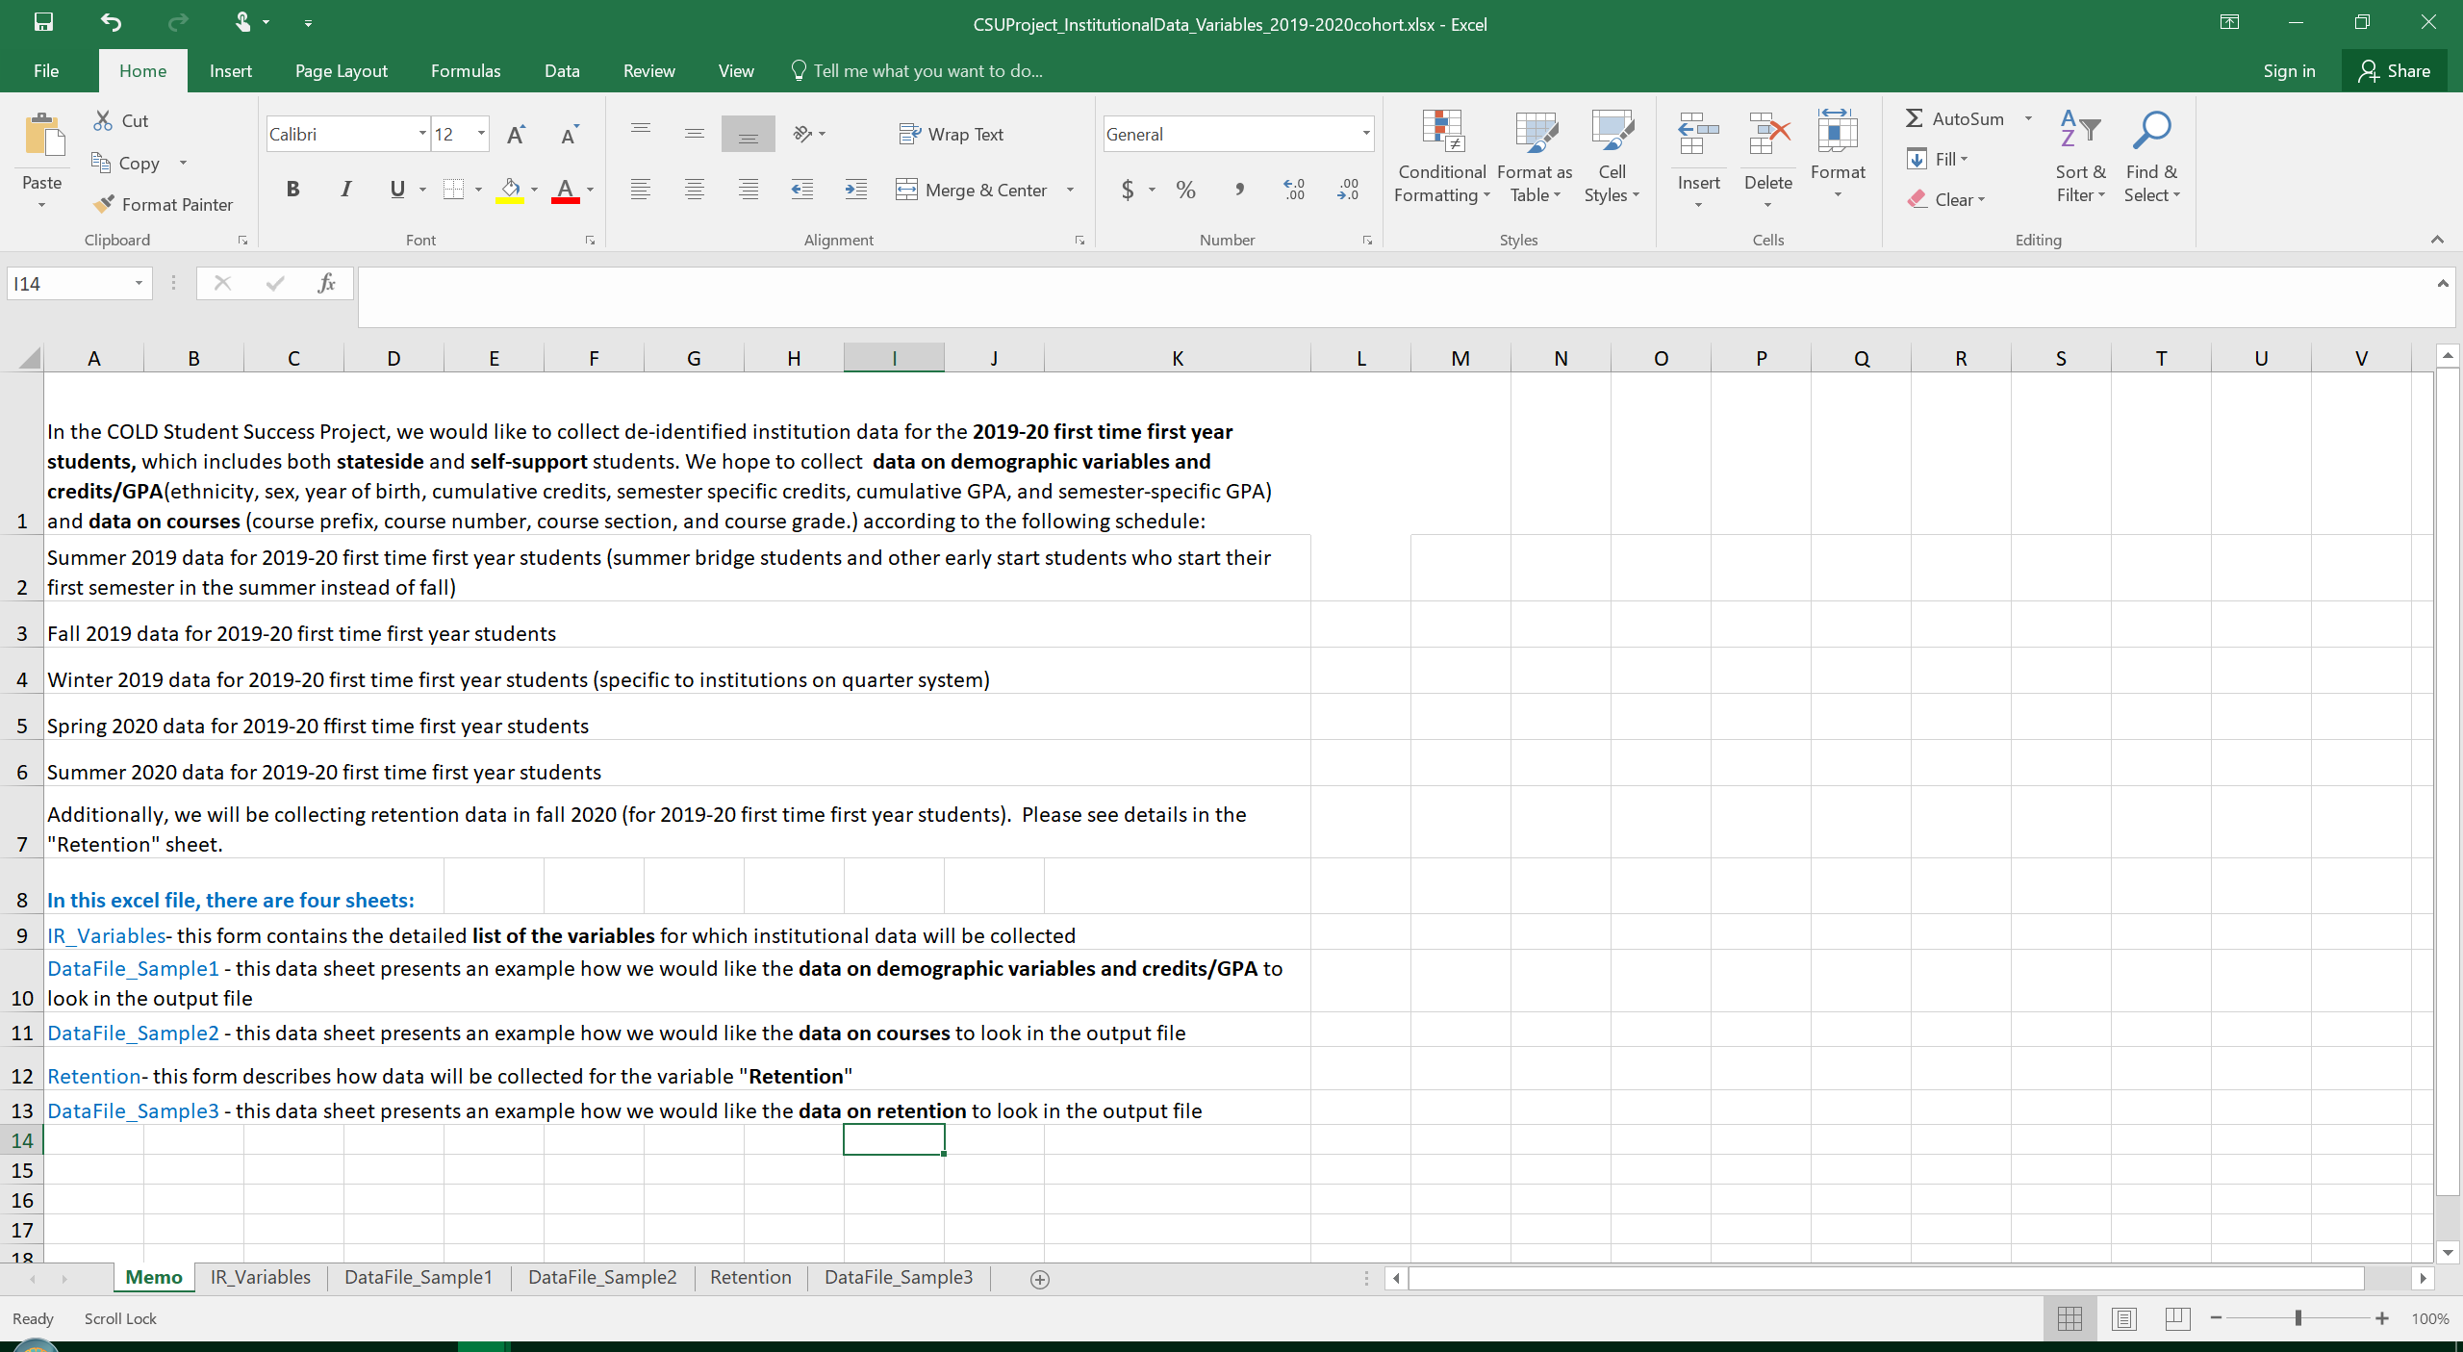
Document Explaining Institutional Data Collection

Slide 7
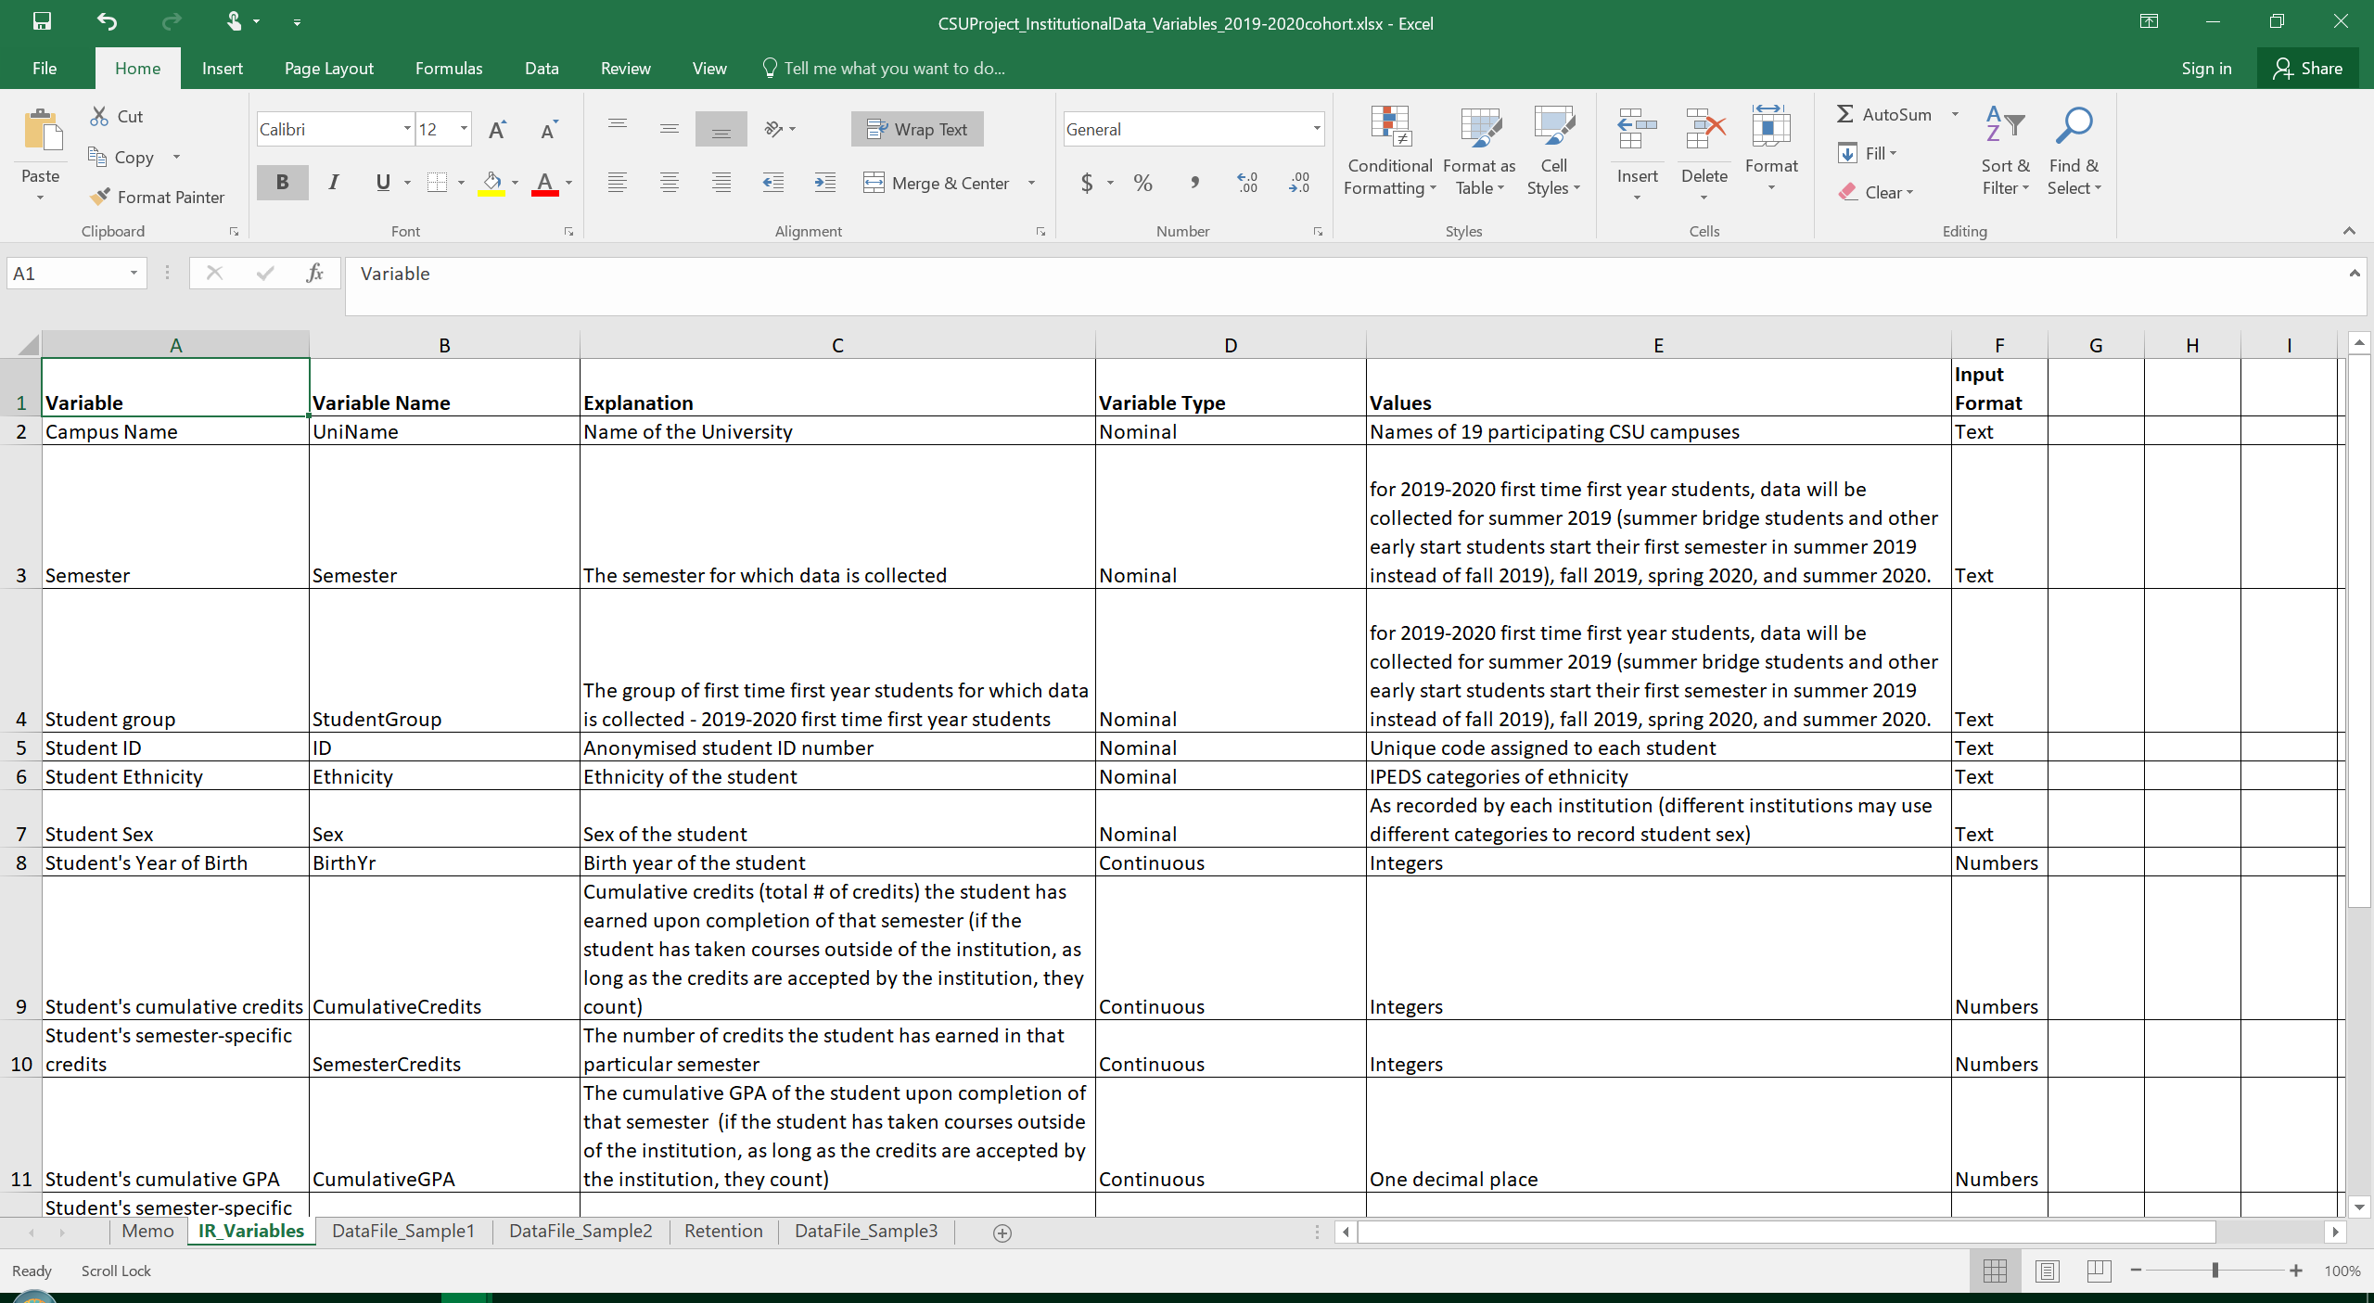
Document Explaining Institutional Data Collection

Slide 8
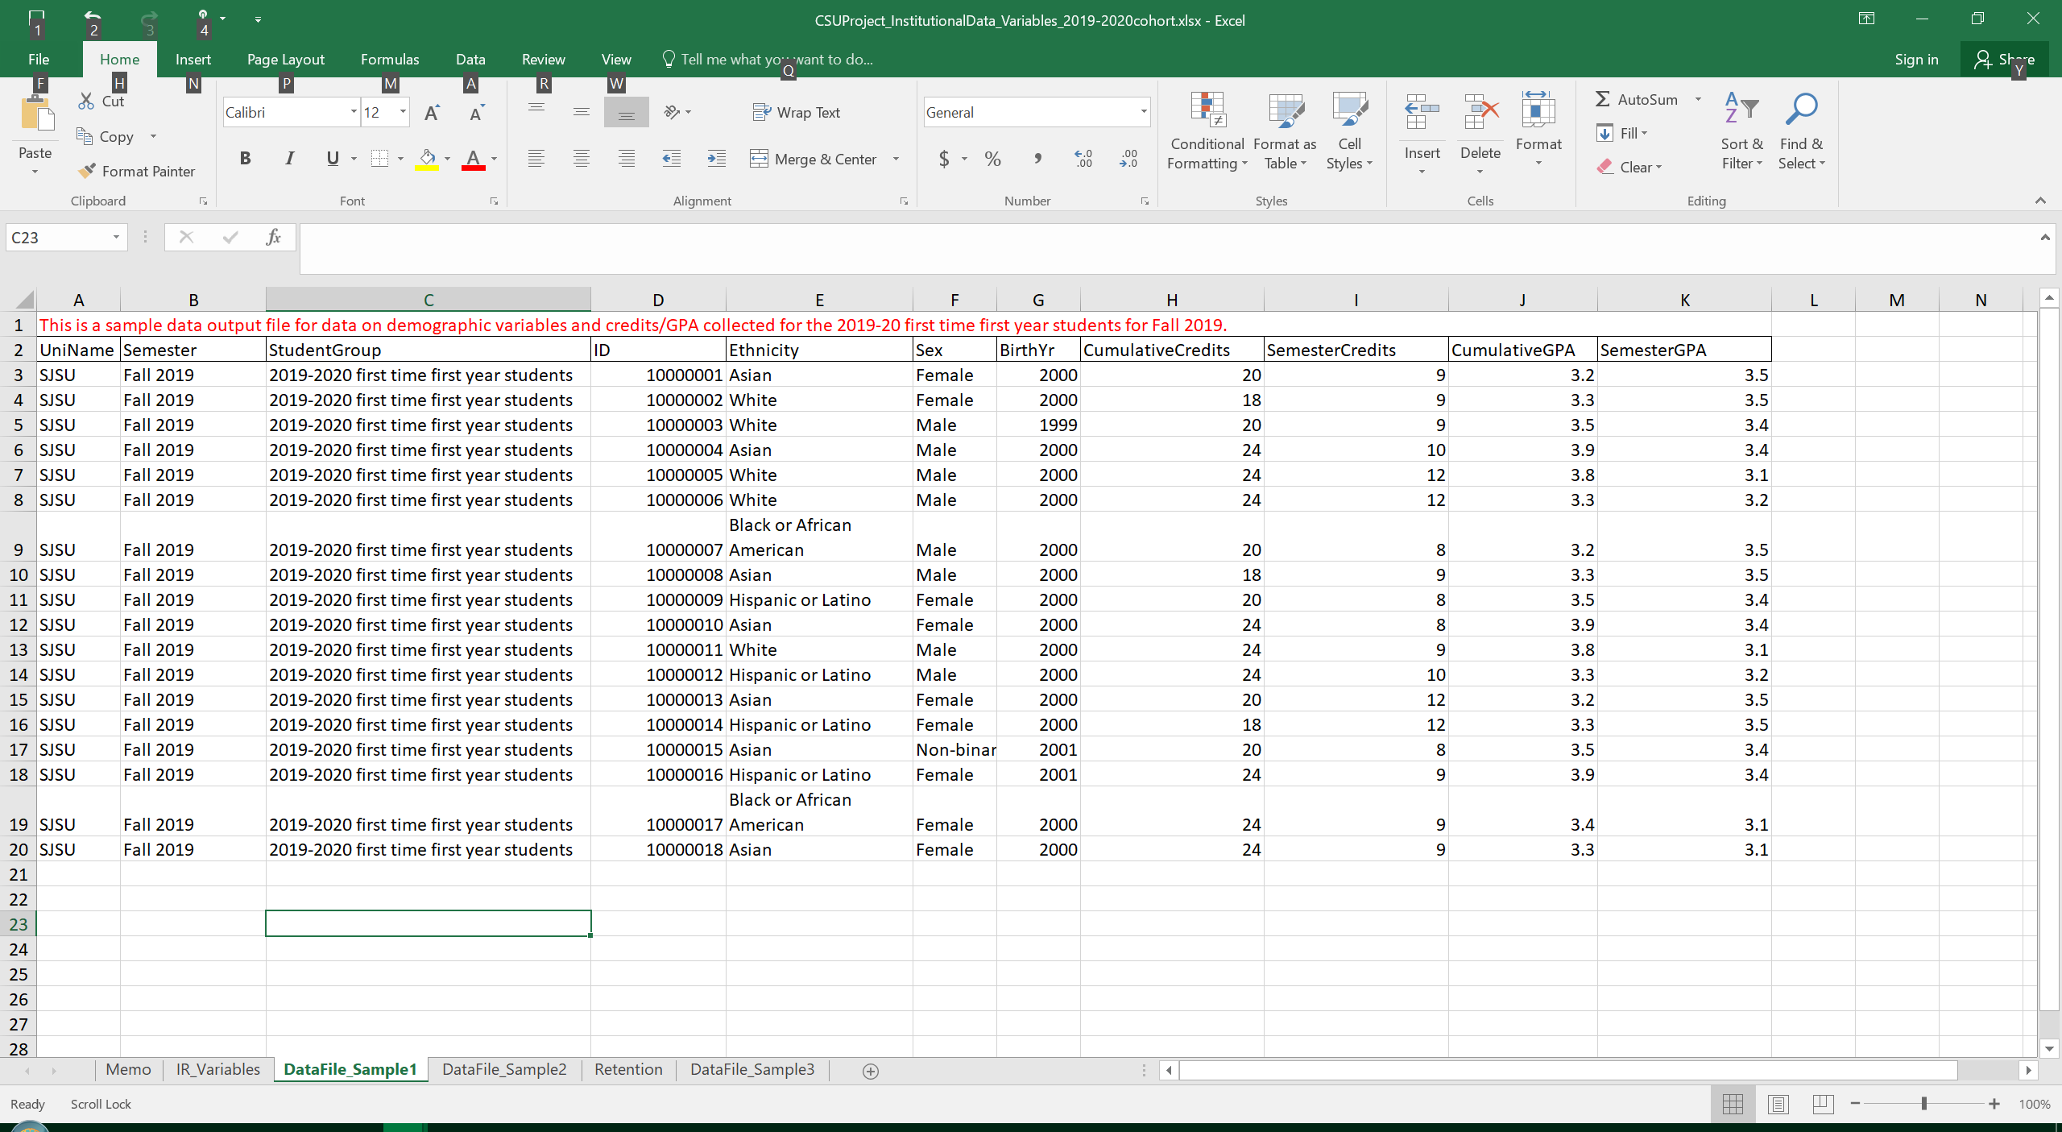
Document Explaining Institutional Data Collection

Slide 9
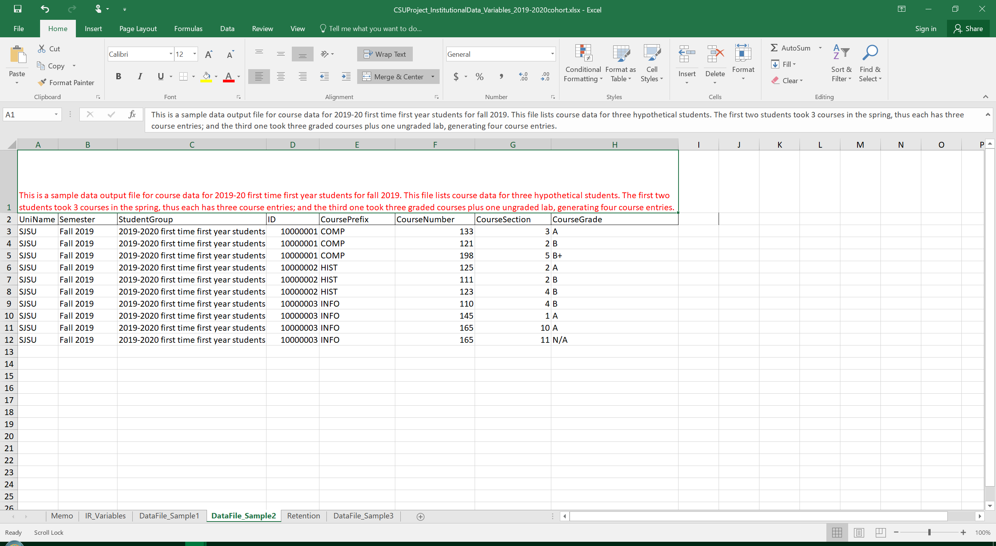
Document Explaining Institutional Data Collection

Slide 10
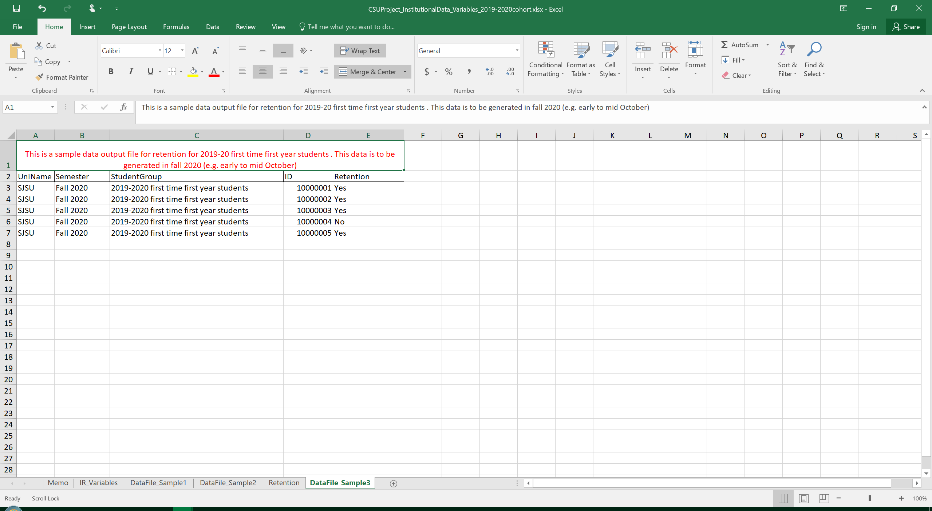
Document Explaining Institutional Data Collection

Slide 11
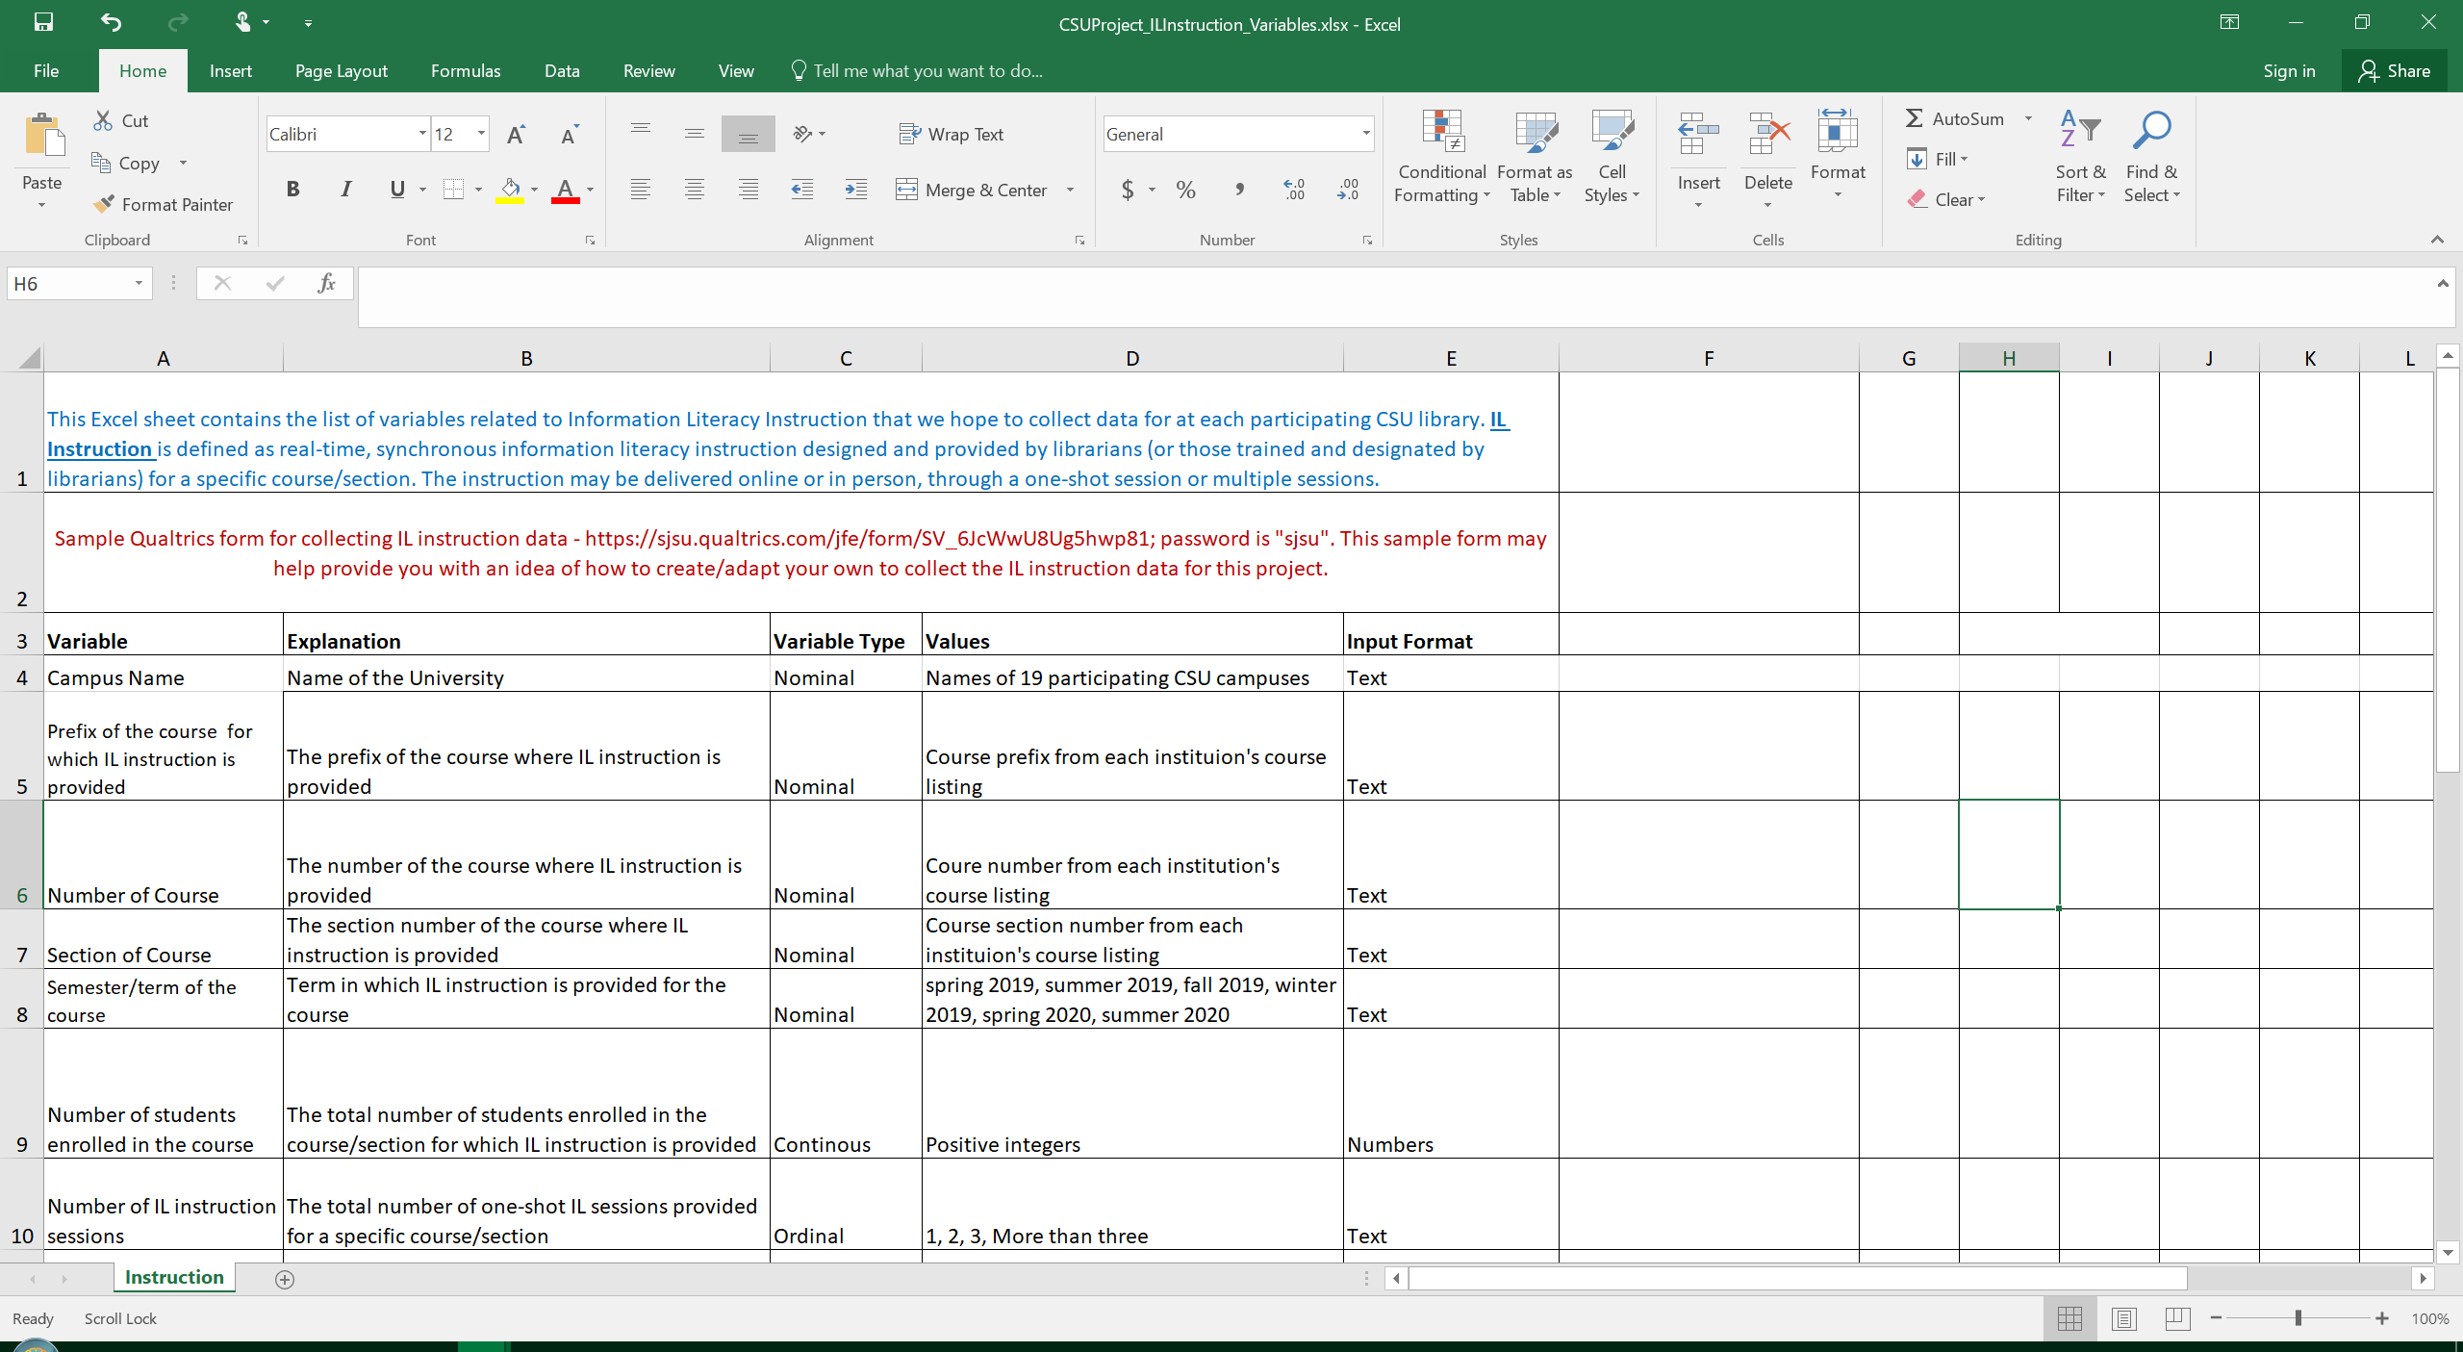
Document Explaining IL Instruction Data Collection

Slide 12
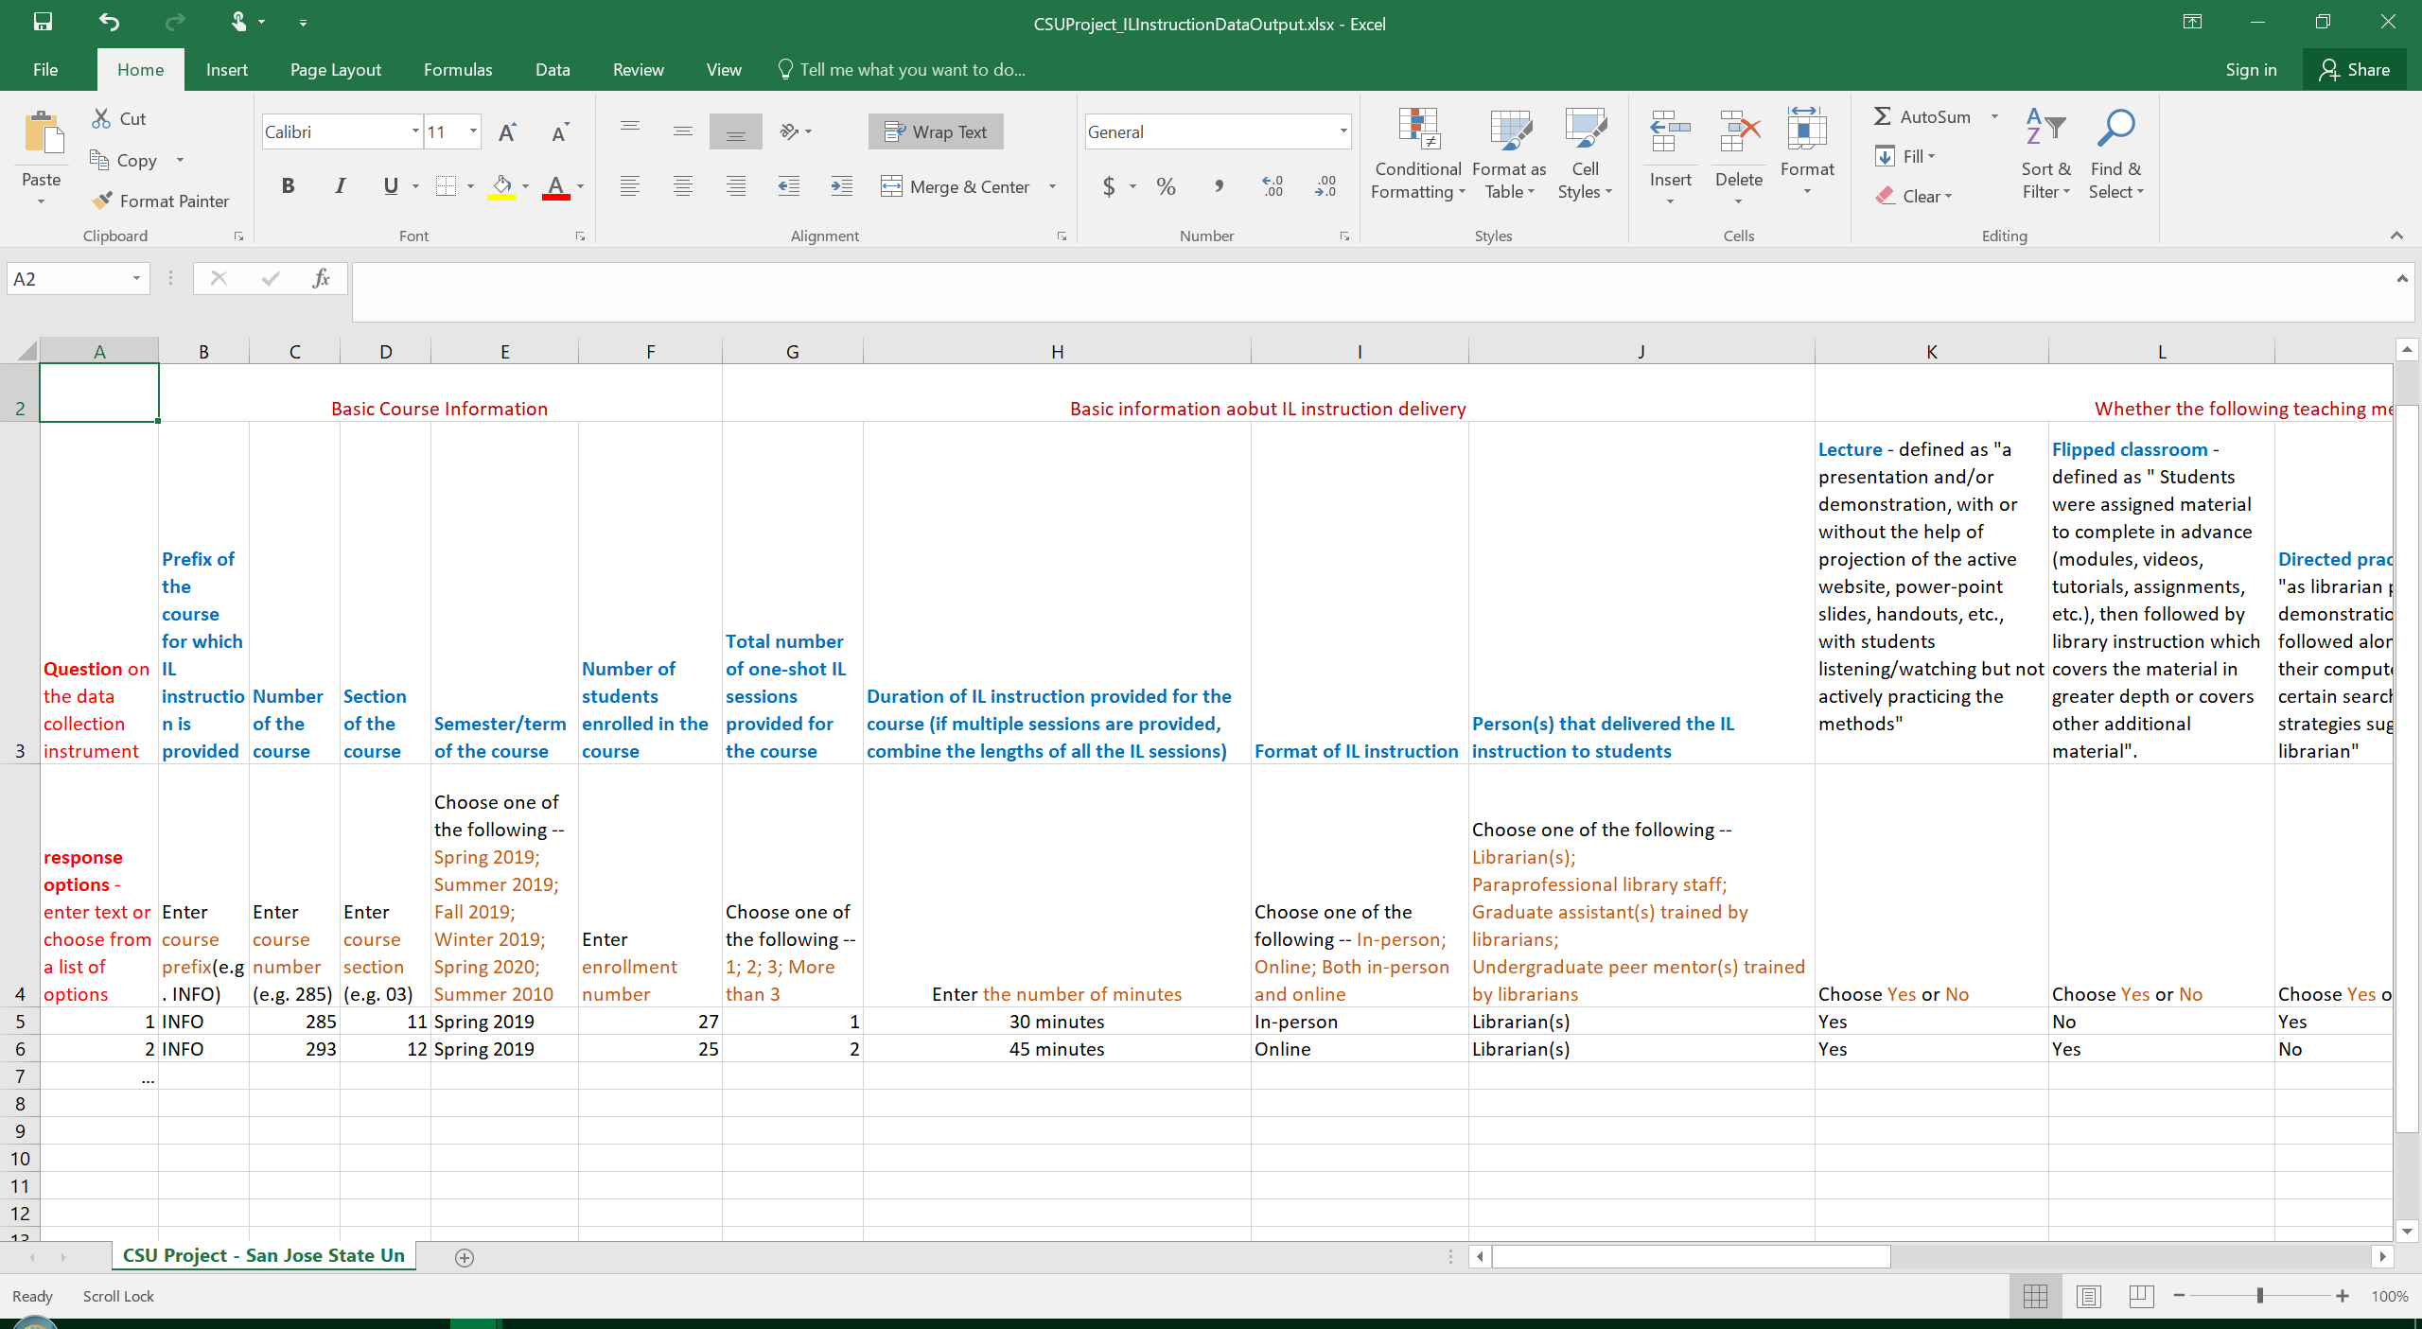
Document Explaining IL Instruction Data Collection

Slide 13
Document Explaining IL Instruction Data Collection

Slide 14
Project Progress
IRB Approval
SJSU IRB was approved in September 2019
Then we worked with participating campuses to gain IRB approval
Different campuses have different requirements, which ranged from exempt, submission of cooperative agreement from SJSU, to full resubmission involving co-PIs re-taking the required research ethics training.

Slide 15
Project Progress
Data Collection
Pilot testing phase:
Data is collected for the 2018-2019 first year student cohort to test the data collection instrument and procedures
Enrollment and course data was collected for spring 2019, and retention data was collected in fall 2019 for this cohort
IL instruction was collected for spring 2019
Many thanks for the following institution for submitting institutional and/or IL instruction data for spring 2019:
CalPolyPomona, Chico, CSUB, CSUCI, CSUMaritime, CSUMB, CSUSacramento, CSUSM, Humboldt State, SJSU

Slide 16
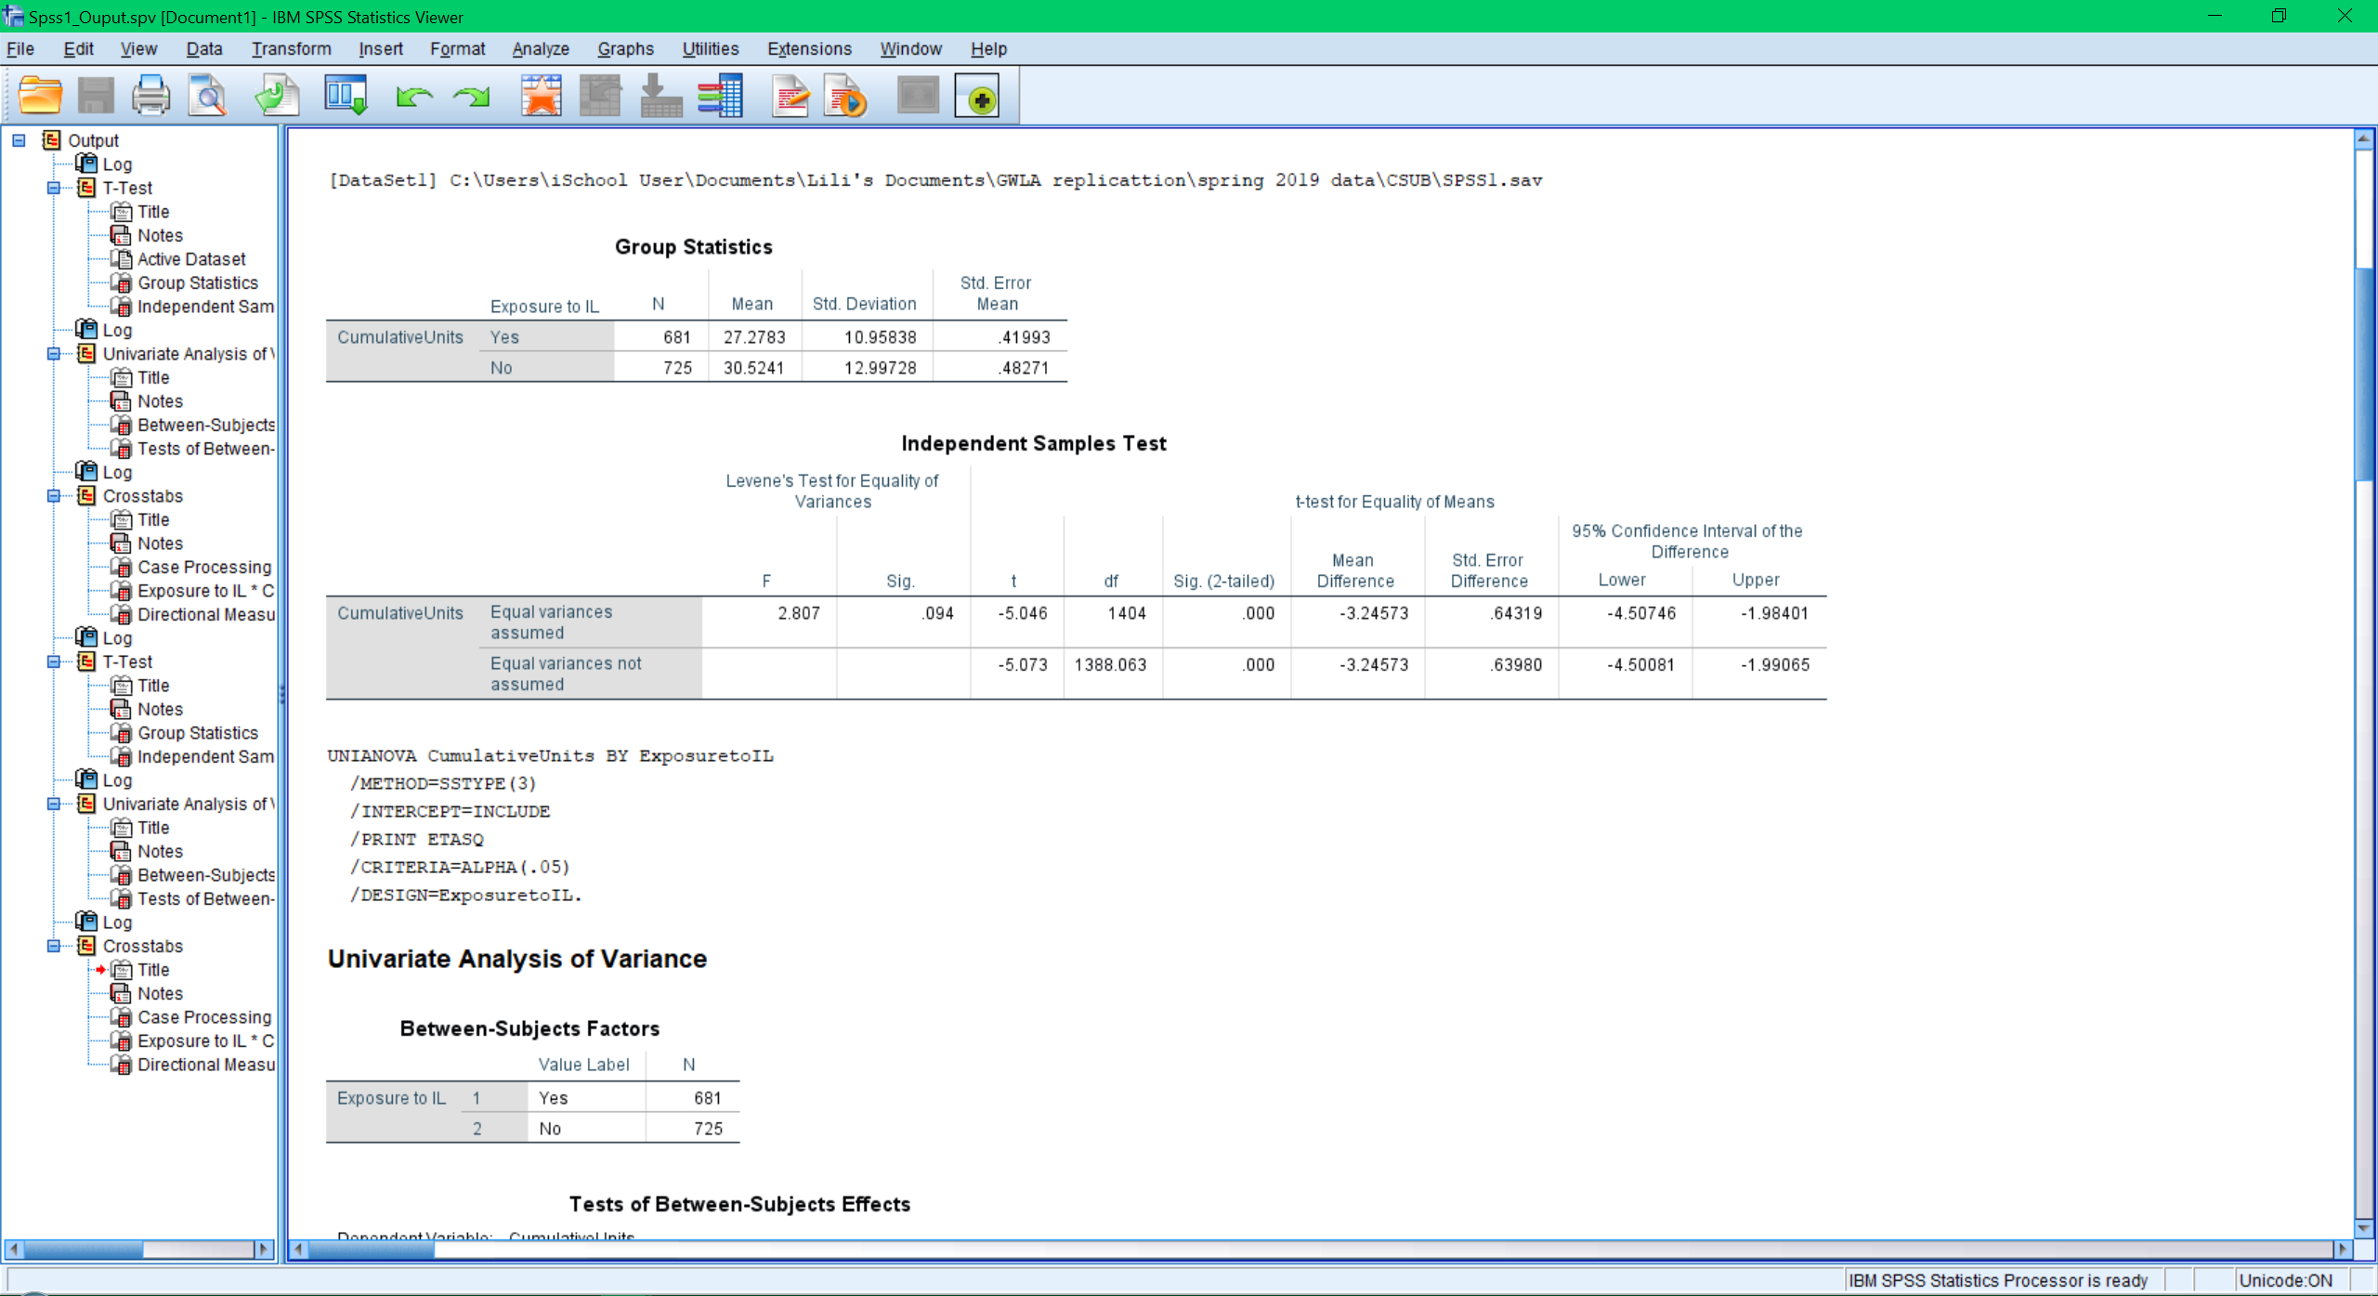
Sample Statistical Analysis from the Pilot Test

Slide 17
Project Progress
Data Collection
Actual data collection:
Data is collected for the 2019-2020 first year student cohort;
Enrollment and course data is collected for summer and fall 2019, and spring 2020
Retention data is collected in fall 2020 for this cohort
IL instruction is collected for summer and fall 2019, and spring 2020
Many thanks for the following institution for submitting institutional and/or IL instruction data for summer and/or fall 2019:
CSUB, CSUMB, CSUSacramento, CSUSB, CSUCI, Humbolt

Slide 18
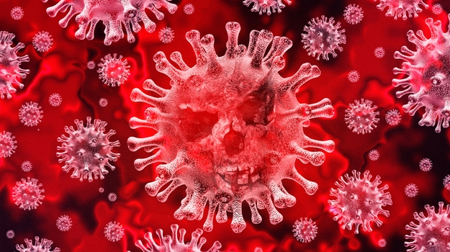
Impact of COVID-19

Slide 19
Impact of COVID-19
Impact on Data Collection
No impact on data collected for summer and fall 2019
Spring 2020 data will be impacted by confounding variables introduced due to COVID-19
Sudden change of learning modality
Additional struggles in life (job loss, health problems, stress, etc.)
Change of IL instruction format, quality and quantity
Internal validity of the study will be challenged
Ethical concerns – is it ethical to impose on people for data collection during a pandemic where everybody struggles

Slide 20
Plans for Next Steps
Alternatives to the Original Project Plan
Project report/publication
Answering the research questions based on analysis of data on the 2919-2020 first year cohort from summer and fall 2019
What effect does library instruction have on academic success?
What effect does specific library instruction interactions have on
academic success?
Providing a description of IL instruction by continuing to collect spring 2020 IL instruction data (also offering a comparative view of how IL instruction changed before and after the pandemic)
Methodology report/publication
Documents in detail the methods we used in this multi-site study, including coordinating multiple participating institutions, data collection, data analysis, etc.
Explains how to respond to sudden disruptive events by assessing the impact and revising the research strategies

Slide 21
Plans for Next Steps
Deadlines
July 31st, 2020
submission of summer and fall 2019 institutional data for the 2019-2020 first year cohort
IL instruction data for summer and fall 2019 and spring 2020
Dec 2020
project report and methodology report submitted to COLD

Slide 22
Questions?

