Slide 1
18-19 I-SPIE Data
Meghann Weldon, meghann@humboldt.edu
Natalya Serge Magazino

Slide 2
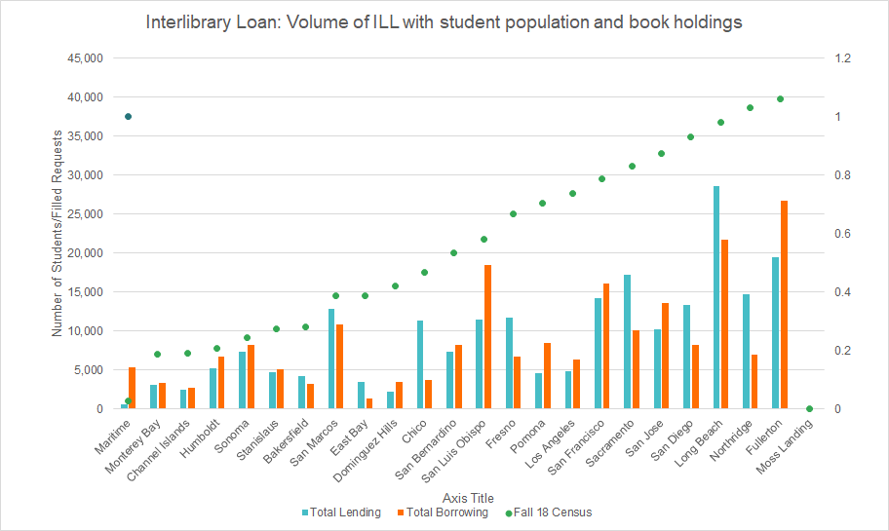
What Impacts ILL at your Library?
Size of your campus?
Collection size?
Collection content?
Discovery settings?
Marketing outreach?

Slide 3
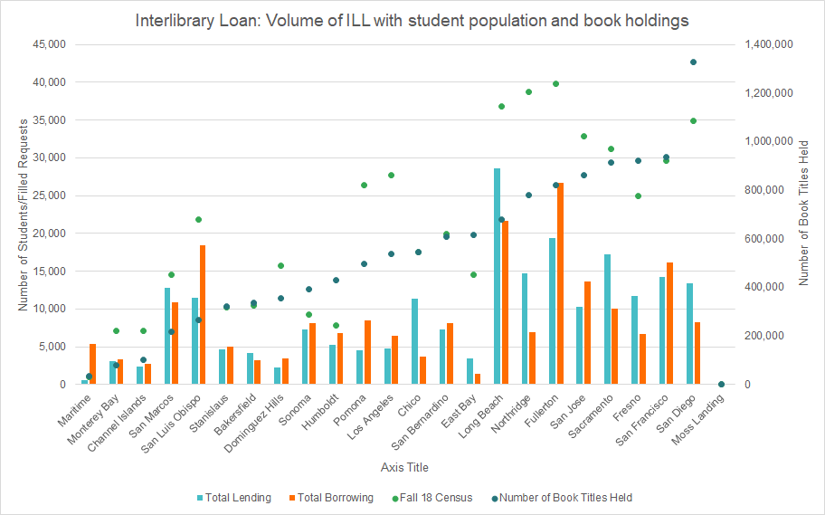
Fall 2018 census data taken from CSU webpages
book titles held taken from 17-18 ACRL report
“Total” here is summing ILL and CSU+ articles and loans
Notes:
Funny to note:
Bakersfield, Stanislaus, San Bernardino, San Francisco, and Chico have about same number of books as students
San Diego, Humboldt, Sonoma, East Bay have more books than students

Slide 4
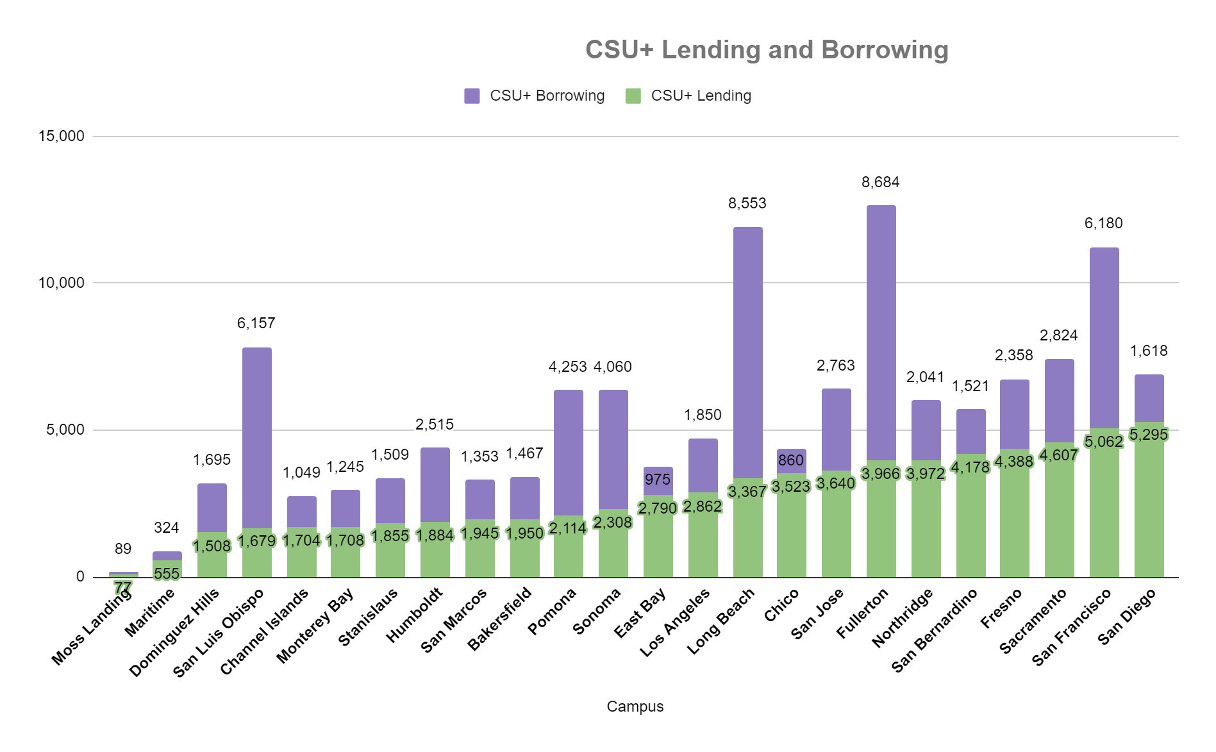
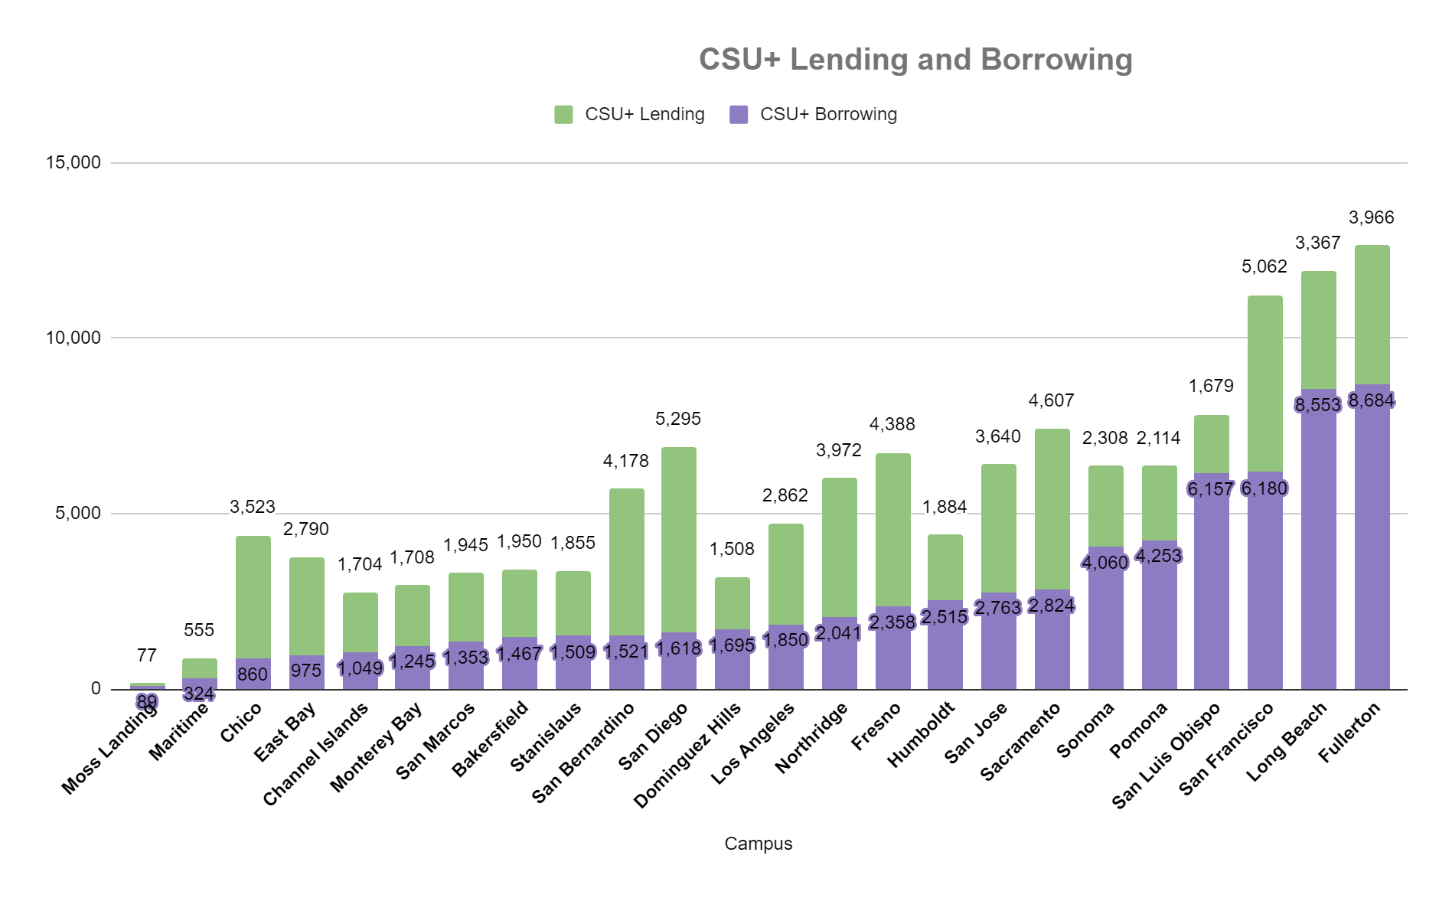
CSU+: Lending and Borrowing at Each Campus
Sorted by lending volume
Highlighting our biggest CSU+ lenders
Sorted by borrowing volume
Highlighting our biggest CSU+ borrowers

Slide 5
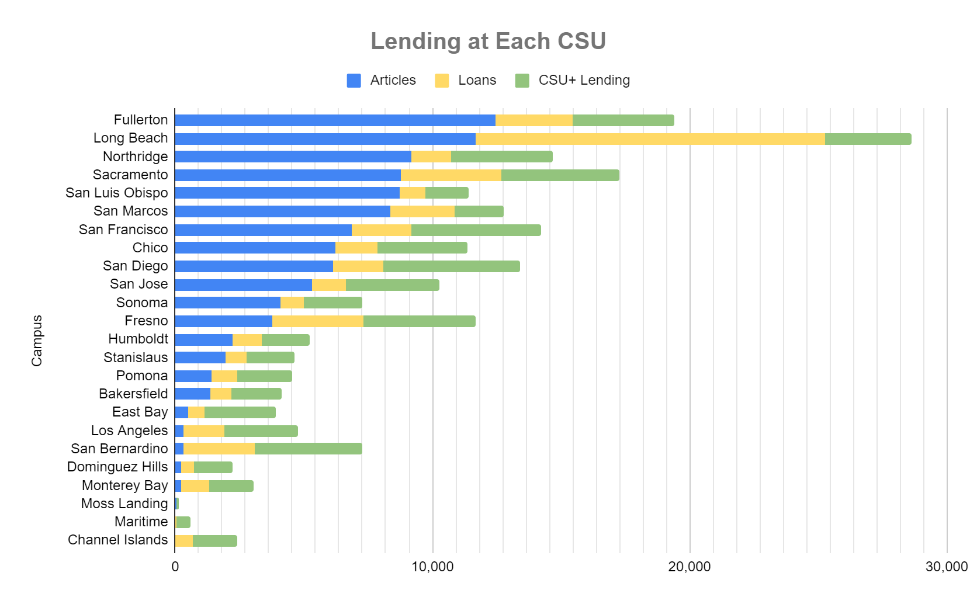
Articles and Loans values come from self reported data and CSU+ Lending values come from Alma NZ

Slide 6
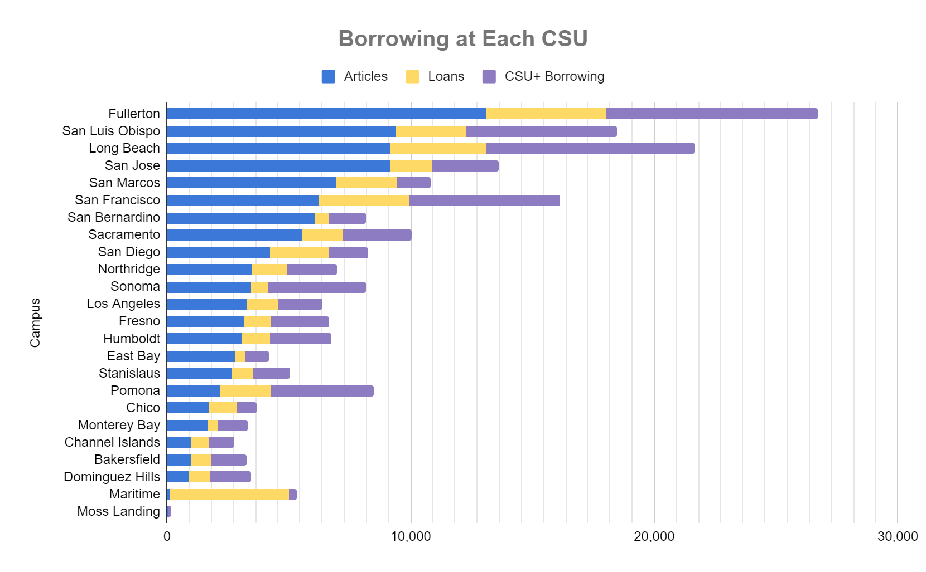
Articles and Loans values come from self reported data and CSU+ Lending values come from Alma NZ
Starred campuses are identified as having discovery setting default to local limiting discovery and volume of CSU+

Slide 7
What are our users requesting?
Borrowing Via ILL
100,293 articles borrowed
42,161 physical items borrowed
Borrowing Via CSU+
65,943 CSU+ borrowed
Total: 208,397
Lending Via ILL
100,171 articles loaned
48,302 physical items loaned
Lending Via CSU+
66,937 CSU+ loaned
Total: 215,410

Slide 8
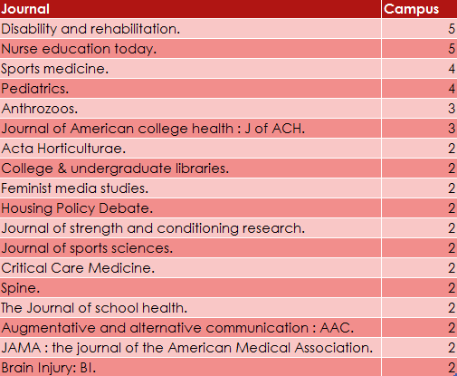
Most Requested Titles: Titles in the top 10 at multiple campuses
Journal a
Journal b
Journal c
Journal a
Journal b
Journal c
Stars represent the number of campuses with these titles in the top ten
Each campus pulled top 10 most requested titles from ILLiad Web Reports

Slide 9
Borrowed Journal Titles: Top 5 Borrowed via RapidILL
RapidILL shared the top 20 most requested titles for each campus for the 17 CSU libraries using this service
This table shows the most requested titles from the compiled list
Titles with Highest Number of Requests | Number of Requests | Number of Campuses | Campuses
Pediatrics | 187 | 6 | CS1, CSA, CSB, CSH, CSJ, CTU
Disability and Rehabilitation* | 120 | 8 | CFI, CSJ, CS1, CNO, CLO,CSF, CSA CCH
Child & Family Behavior Therapy | 85 | 1 | CSB
Brain Injury | 84 | 5 | CFI, CSJ, CFS, CLO, CS1
Intelligence and National Security | 70 | 1 | CSB
* Disability and Rehabilitation was the title requested by the most campuses (8 out of 17) through RapidILL

Slide 10
RapidILL for the 17 CSUs using RapidILL
Data from RapidILL (17 CSU libraries)
As borrowers getting material for CSU patron’s through RapidILL:
96-99% of items that go through RapidILL are filled via RapidILL
The CSU average turnaround times range from 10.3-15.9 hours
As lenders filling requests for other libraries through RapidILL:
The CSU fill rates range from 59-95%
The CSU average turnaround times range from 2.4 to 22.2 hours

Slide 11
Turnaround Time and Use of CSU+
What impacts turnaround time at your campus?
Staffing? Workflow?
What impacts the way your user’s interact with resource sharing?
Discovery? Time? Notifications?

Slide 12
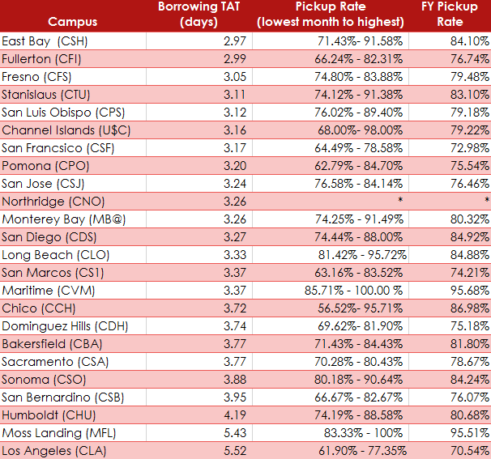
CSU+ Pickup Rates Across the System 2018-2019
61,951 CSU+ requests were picked up in 18-19*
16,122 CSU+ requests were not picked up in 18-19*
79.35% average pickup rate for the CSU system in 18-19*
Average borrowing TAT was 3.4 days
* Northridge numbers are not included in pick up rate. Due to their workflow these numbers can not be gathered in the NZ. Thus, the CSU+ picked up items do not include values for Northridge users.
What factors affect pickup rate and TAT at your campus?

Slide 13
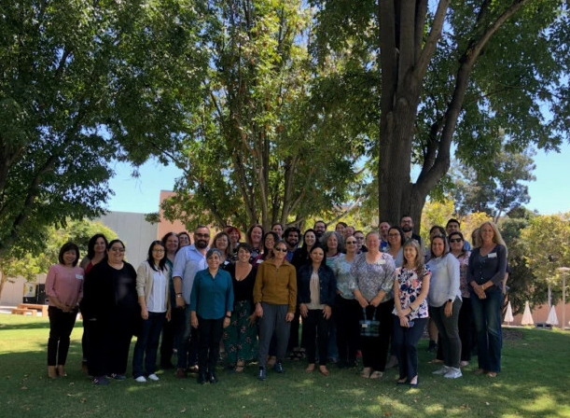
Who makes ILL happen at our CSUs?
Photo from: I-SPIE Conference 2019 at CSU Fullerton

Slide 14
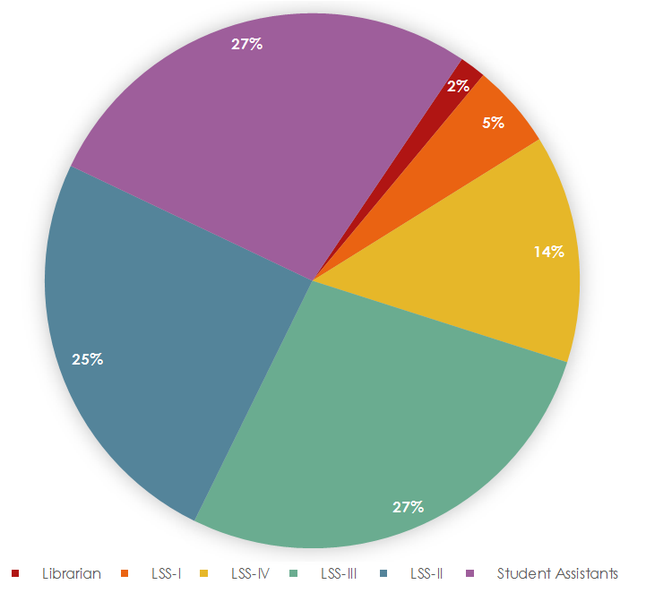
Staffing by Classification
Hours By Classification Each Week
ILL is supported by…
Librarians at 4 CSUs
LSSIVs at 11 CSUs
LSSIIIs at 16 CSUs
LSSIIs at 14 CSUs
LSSIs at 4 CSUs
Student Assistants at 21 CSUs
* San Diego’s student hours not represented

Slide 15
Data is from the following sources:
ILL Volume , Staffing, Most Requested Journal Title
was shared by colleagues at each campus who pulled it from ILLiad Web Reports:
Thank you to all of our ILL colleagues for reporting their numbers
RapidILL Data was shared from Mike Richins at RapidILL
Thanks to Mike Richins for a prompt response in pulling our requested information
CSU+ Data Pulled from NZ
Thank you to Natalya, Nikki, Mallory and others who have worked on creating reports in Alma Analytics
Fall 2018 Census from CSU: https://www2.calstate.edu/data-center/institutional-research-analyses
Books held from ACRL Reports: https://www2.calstate.edu/csu-system/administration/sdlc/Pages/library-statistics-reports.aspx
Please find dataset linked on I-SPIE website: https://ispiecsu.wordpress.com/statistics/

