Slide 1
Deans Briefing
ULMS Team
COLD Meeting, Sonoma April 2017

Slide 2
What Deans need to know between now and the Fall COLD meeting
Schedule
Communication with Project Manager
Go-live readiness checks
What to expect at/after Go-live
Communication from CO ULMS Team
Where to get more information

Slide 3
Project Milestones
April 2017: Conclude major testing and configuration; Prep migration forms
May 2017: Data files delivered to Ex Libris, Tech freezes begin. ExL tests data
June 2017: Campuses cutover to Alma/Primo, preceded by short circ freeze
July 2017: Alma health checks, troubleshooting of migration issues
Aug 2017: ExL support switches from Implementation to Support teams

Slide 4
Cutover schedule for your library

Slide 5
Communication with Project Manager
The PM is your partner in this project
Essential to talk regularly and support each other
Get updates, discuss concerns e.g.
Checking with vendors who may be affected by the change
Training progress of staff and librarians
Readiness for go-live

Slide 6
Go-live Readiness Checks
Alma Health Check
Alma Task Checklist
Pre Go-live Tasks

Slide 7
Alma Health Check

Slide 8
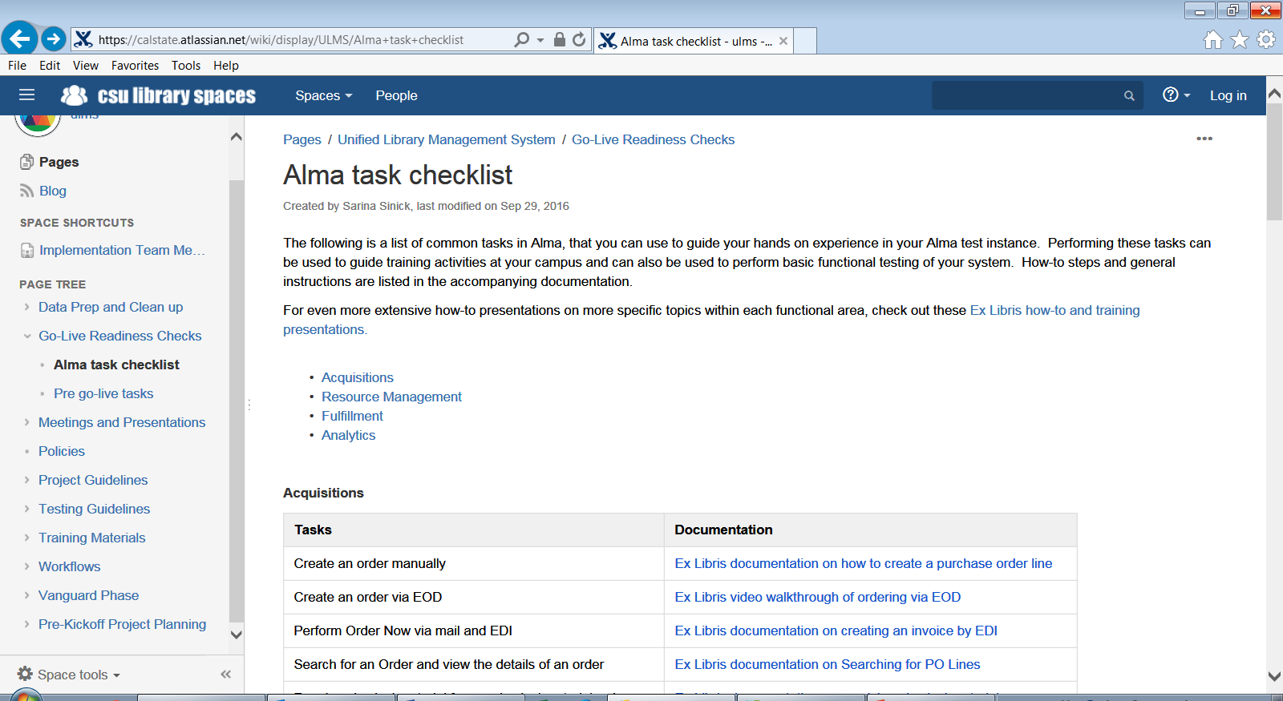

Slide 9
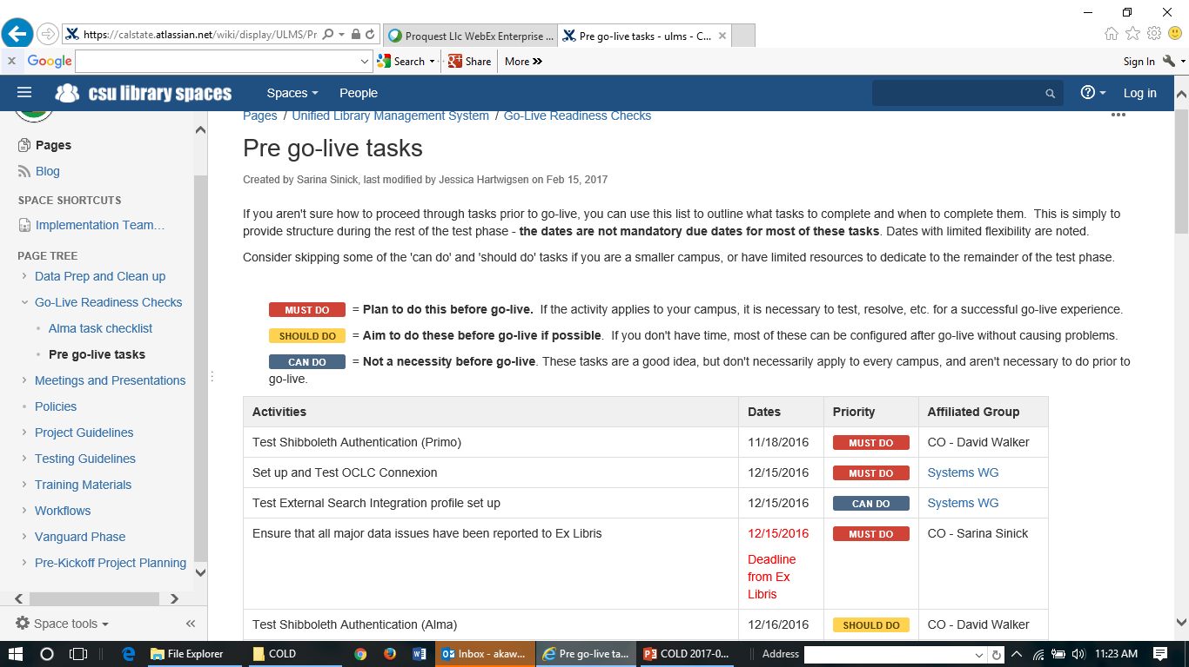

Slide 10
What to expect at/after Go-live
Most things will go well
Not everything will be working on Day 1
There will be issues
Help your staff stay the course, get into problem-solving

Slide 11
Post-implementation training support
CO will coordinate in conjunction with working groups and task forces
Topic-focused forums, webinars and video recordings will be posted to Confluence site
New employee orientation topic outlines
Local meetings

Slide 12
Communication from CO ULMS Team
Notices of issues affecting multiple campuses
Updates on status of campuses
Handoff to Ex Libris Support
Continued sharing of contents of Alma/Primo updates
Re-formation of working groups and task forces
Requests for input e.g. governance, WG & TF nominations

Slide 13
Where to get more Information: Confluence https://calstate.atlassian.net/wiki/spaces/ULMS

