Slide 1
The Future of ScholarWorks
Where we’re going and where we’ve been

Slide 2
WELCOME
Introductions
Agenda
Notes:
-- Welcome to the 2016 ScholarWorks symposium, the first official ScholarWorks gathering, and I’m very excited.
-- Last year we had about half this turn out for a great meeting in San Jose that really was the start of most of the work we’ll discuss today.
-- We have a full agenda with some really good info from Pomona and from CalPoly. We have our friends from UCSD here to show us what they’ve been doing in their DAMS which is really exciting.

Slide 3
A Brief History
10 years in the making
At the beginning of 2013:
  16 campuses
  Various versions of DSpace (from 1.5 – 3.x)
  A shared server with individual resources
Mid-2014: Multitenant Migration Complete
Today:
  18 Campuses
  3 Non-campus projects
Notes:
Earliest ScholarWorks installation(s) were in 2007.
From 2007 – 2013 there was minimal support and as a result limited usage. This also includes the furlough period, and budget/hiring limitations. So while not an ideal time to launch and try to support a systemwide service, we were still pretty early to the repository game and systems (especially turn key) were very limited.
When I joined the project in 2013 – this was the status.
-- The service was relatively unreliable through 2013 (required most tomcat instances to be restarted daily).
New campuses include: Cal Poly Pomona, Stanislaus
Projects include: COOL4Ed, QUARRY (Quality Assurance Resource Repository), and Visual Collective has bring brought into Multi-tenant

Slide 4
Amazing Growth
Tripled our storage usage since mid-2014
Growth of 60GB / month on average
A lot more data waiting in the wings…
Notes:
- We’ve seen an explosion in usage with the multitenant structure.

Slide 5
Growth Rate
Notes:
Shows that the current annual item count growth, since 2014, matches the system usage for all of the prior 7 years
Large spike in usage during 2015 with a stable and similar growth projection to close out 2016.

Slide 6
System Needs Have Taken Off
Notes:
The first 7 years of ScholarWorks only represents 25% of the current usage needs
Relatively similar average monthly growth since 2014
Data usage spiked in 2015 (similar item count, but larger items)
This also represents a burst of bulk loading after the april meeting last year where the deposit portal was shown.

Slide 7
All grown up!
We’ve outgrown DSpace
We’ve outgrown our Data center
A lot more data waiting in the wings…
Notes:
Increased use in the last couple of years has really highlighted where we are kind of bursting the seams of what dspace can reasonably provide, especially in multitenancy.
This growth taxed the AtMos cloud appliance that was initially designed for scholarworks
Presented with the opportunity to utilize the CO data center during the winter move when upgrading virtual machines that allowed us to decommission the AtMos appliance and reclaim the service fees of around 10K/year
However, we’re growing at a rate that they aren’t quite ready for.

Slide 8
Refocused Subcommittee
July, 2015 - Request for participation
August, 2015 - Formation of the “ScholarWorks Planning & Advisory Group”
August, 2015 – January, 2016:
  Draft Vision
  Focus on the goals of a “System wide Institutional Repository”
  Establish a plan for the future of ScholarWorks
Notes:
-- In late 2012 through early 2013 there was a formal STIM subcommittee that focused on the TCO of a System wide IR platform. Mostly focused on the comparison between Dspace and BePress (fedora based repositories were still far from turn key and there wasn’t support for such modular systems at the time).
-- Special thanks to the initial members: (San Marcos) Carmen & Ian, (Pomona) Suzanna [Ryan Rush in her place], (San Jose) Emily Chan, (Northridge) Andrew & Elizabeth, (Humboldt) Jeremy.
-- Additional Members: (Cal Poly San Jose) Dale Kohler, Zach Vowell, and Michele Wyngard, (LA) Jayati Chauduri, (Channel Islands) Matt Cook, Marco Ruiz, and Sabastian Hunt, (San Diego) Melissa Lamont

Slide 9
Report to COLD – February 2016
A proposed ScholarWorks roadmap through 2017
Expand ScholarWorks to offer publishing support
Establish an annual ScholarWorks Symposium (WELCOME!!)
Utilize confluence to promote the wiki and establish a project site
Adopt a campus facing support platform
Notes:
The proposed roadmap highlighted the follow up IR platform landscape review from the 2013 report.
At the time, Dspace was the only real option for a centrally supported service. However, since then, fedora based platforms have significantly matured with both Islandora and Hydra offering mostly turn key repositories. Additionally, the community support for these platforms is stronger than ever while Dspace is starting to falter a bit.
OJS and Scalar
The success of last years gathering really showed how important it was to regularly get everyone involved in their repositories (including any self hosted) together. We are really looking forward to the afternoon round table to see what folk are working on.
The calstate confluence wiki was started for the ULMS site and quickly highlighted it’s quality as an information platform.
JIRA

Slide 10
Roadmap
Q1 2016 – Review systems & describe requirements
Q2 2016 – Data migration development, testing, and planning
Q3 2016 – System selection, development & testing begins
Q4 2016 – Early adopter campus working groups & migration
Q1 2017 – Final ScholarWorks migration planning & deployment
Q2 2017 – Q4 2017 – Decommissioning of Dspace services
Notes:
I did quite a bit of investigative development closing out 2015 in order to pursue system reviews during the early part of 2016.
Discuss Requirements survey here. – We surveyed scholarworks users about their experience with Dspace and feature needs.
Q2 included exploratory data migration planning. Lots of research, community discussion, etc
In the middle of q3 now has been much more active development and establishing a data migration strategy that I will discuss in a bit.

Slide 11
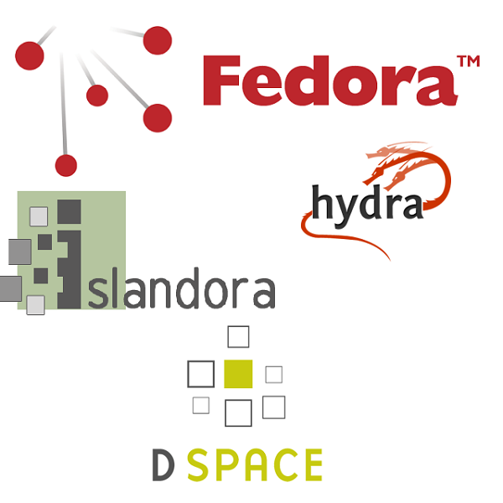
Initial
System
Review

Slide 12



Slide 13
Benefits of Hydra
Community
Modular system
Less dependence on 3rd party systems for deployment (i.e. Java, Drupal, etc.)
Robust collaboration
Extensible metadata structure (through PCDM & LDP)
Notes:
-- Rapid development vs. Locked into drupal structure with islandora and archaich java structure with dspace.

Slide 14
Data Migration Development & Planning
Dspace Export Strategy
Review of data exported from Dspace
Data Movement Strategy
Staging to Dropbox
Develop Import Tools
Download from Dropbox
Unpack
Expand AWS resources as necessary
Submit items/collections to IR
Analyze metadata available in export => metadata required for import
Notes:
-- Migration strategy informed system selection

Slide 15
Cloud Deployment - AWS
Glacier
System Scalability
Cost aggregation
Seamless (and low cost) disaster recovery structure
Security compliance

Slide 16
Migration Strategy
Dspace data export: system resource requirements
Data transfer timing
Import to Development Instance
Concurrently
  Look & Feel Customizations
  Testing
Repeat for Production

Slide 17
Early Adopter Campuses
Focusing on feature specific usage for efficient planning
  San Marcos: Collection/Type specific submissions, Embargoes
  Northridge: SWORD, Embargoes (via sword)
  Pomona: Submission workflow
Campus sprint planning in progress
Development repositories will be updated in parallel with DSpace

Slide 18
Modules & Features to integrate
CAS/Shib/LDAP Authentication
  In use at: Virginia Tech, George Washington, Cleveland Museum of Art
Nested Collections
DOI/Handles
Mediated Deposit (approval workflow)
SWORD

Slide 19
Exciting Developments
COLD strategic goal
STIM subcommittee appointment
Hydra-in-a-Box
Dspace/Hydra Migration Interest Group
Contributing to the community
The goal of CSU's shared digital collection is to contribute to research, scholarship, teaching and learning by collaboratively collecting, organizing, preserving, and sharing scholarly and creative works produced by students, faculty, and staff at California State University campuses.

Slide 20
Demos (more to come)
http://csusm-scholarworks.dev.calstate.edu/ (Sufia)
http://hydra-demo.dev.calstate.edu/ (Hydra)

Slide 21
QUESTIONS?

Slide 22
THANK YOU!

