Slide 1
Authentication and Workflow Management
Scholarworks Symposium 2016 CSU San Marcos
Ryan Rush
Institutional Repository Specialist
Cal Poly Pomona

Slide 2
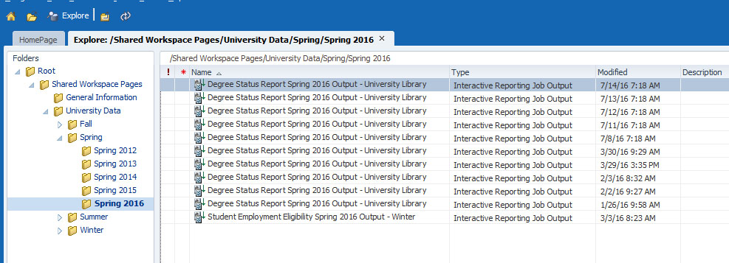
Who’s Graduating
Gather the names of those who have applied to graduate
Notes:
We access our data warehouse to get a list of graduate students who applied to graduate

Slide 3
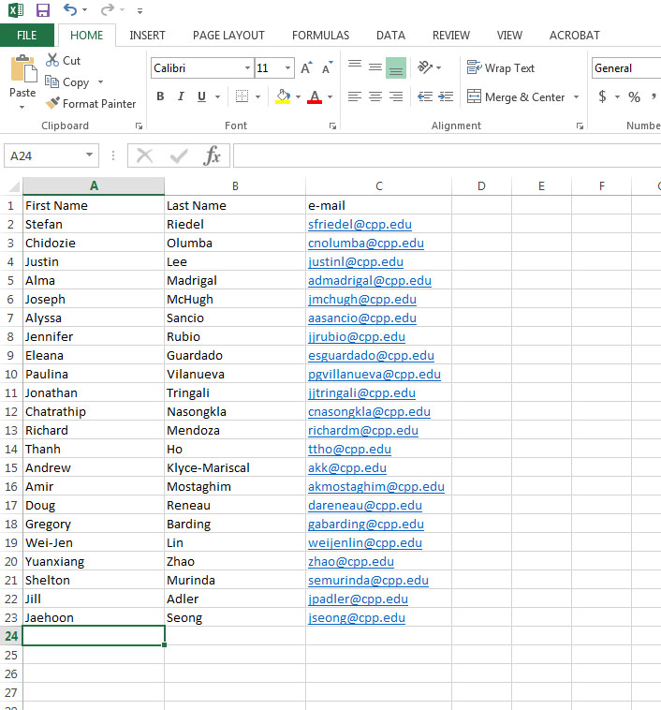
Strip down the info to just the First, Last and e-mail of the student.
Send this list to Aaron so he can add the names into Scholarworks.
Notes:
We filter the excel sheet to just the programs involved (soon to involve all) and strip it down to just the students first and last name and their student e-mail.
We then send the list to Aaron so he can add the names to the database.
This is to set up permission for the students self submittal
This is a bypass for the CAS authentication

Slide 4
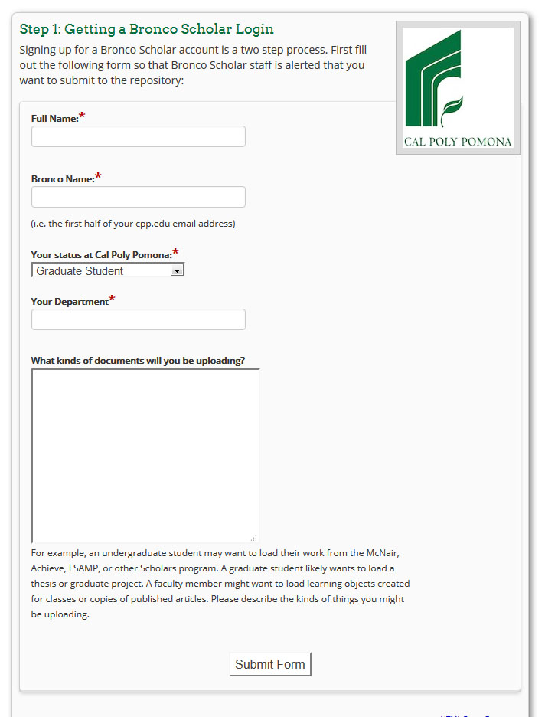
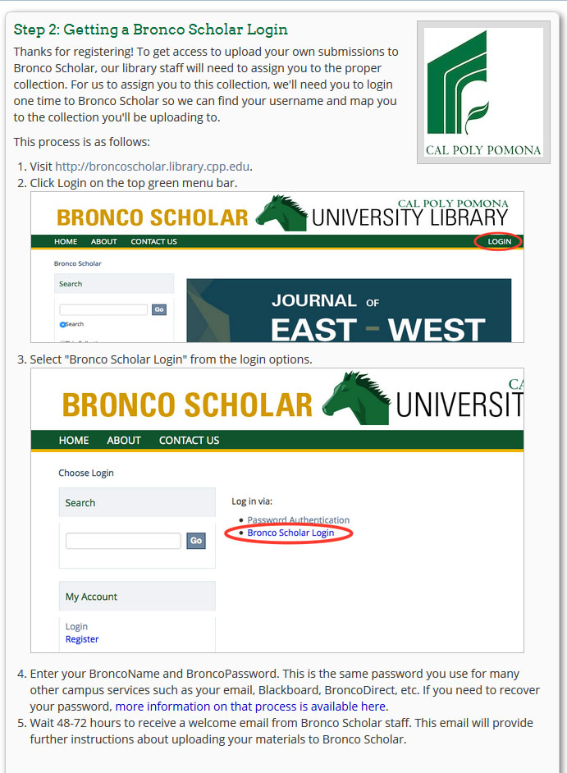
Students requesting a login
Students then go through the process to request a login
The let us know what degree program they are apart of
Notes:
Here we have the students go through the process of requesting a login.
The students technically already have a login however this process will allow us to gather information like which collection they’ll be submitting to and what they’re going to be submitting (Thesis, projects, research, etc.)
This will also help us identify anyone who might have been missed in the database update

Slide 5
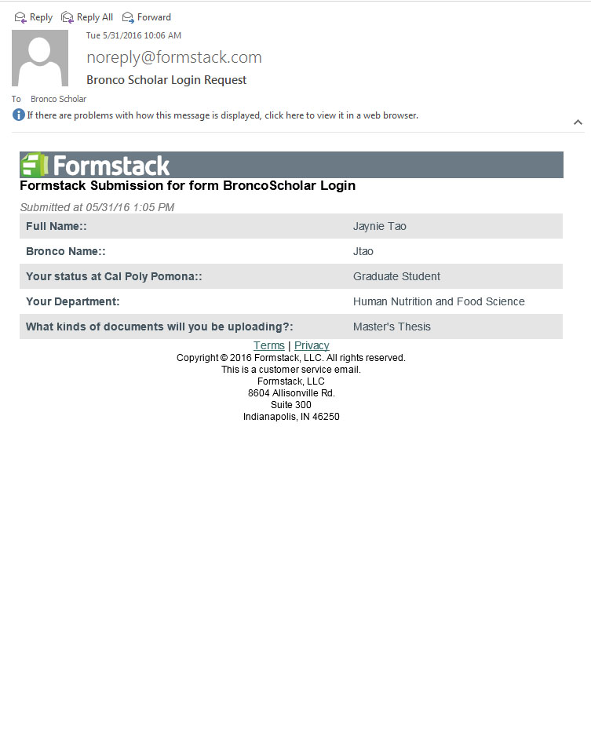
We receive an e-mail once the student has requested their login
Notes:
Once we receive an e-mail that the students have requested a login, we add their names to the submitters corresponding to their program
Within the formstack e-mail we’ll see what type of item they’re submitting, which department they’re submitting to and their bronco name

Slide 6
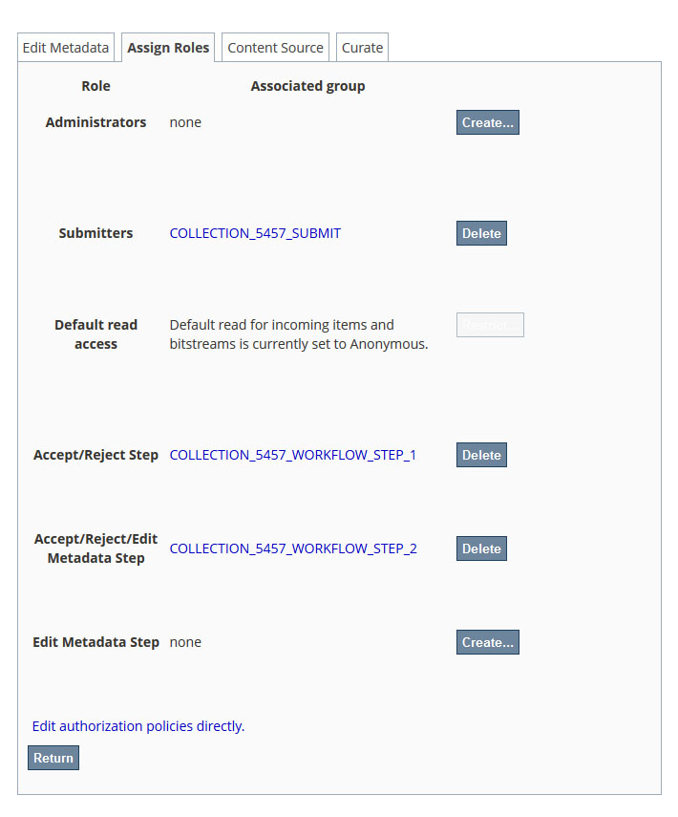
Adding a user
Find the collection they’ll be submitting to
Click Edit Collection
Go to the Assign Roles tab
Notes:
Go to the collection created for the user and click edit collection
Click on the assign roles tab
To add a user click on create or the link that says Collection_????_Submit

Slide 7
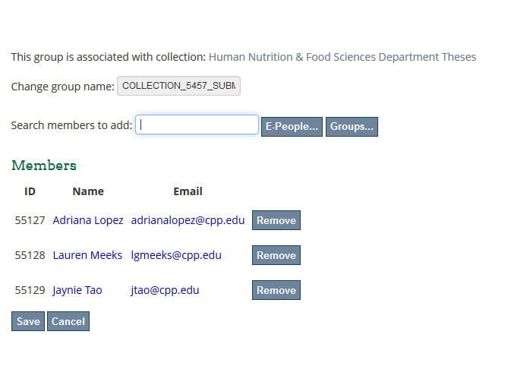
Click Submitters where it says Collection_????_submit
Be sure not to click delete
Add the user based off the e-mail you sent to Aaron
Notes:
Here you can type in the student’s e-mail address and click E-People
Click Add and then be sure to Click Save
It will say pending until you hit save
Then they will be fully added

Slide 8
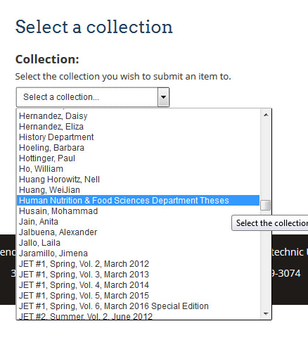
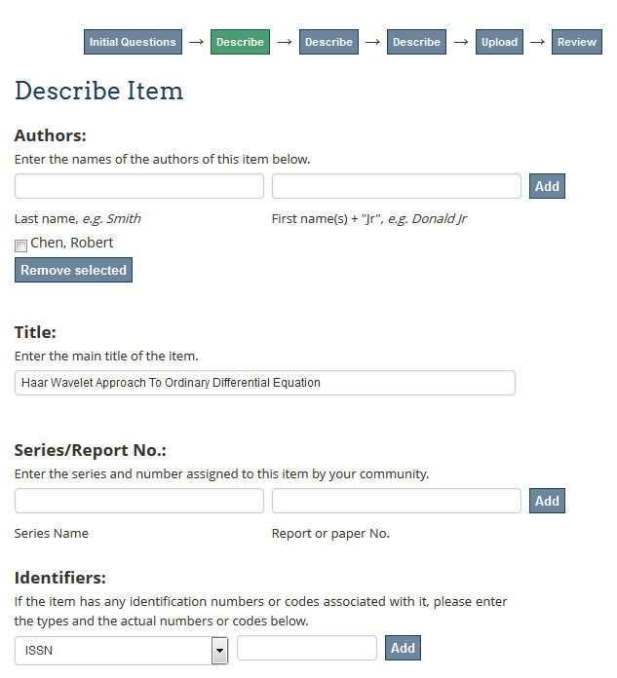
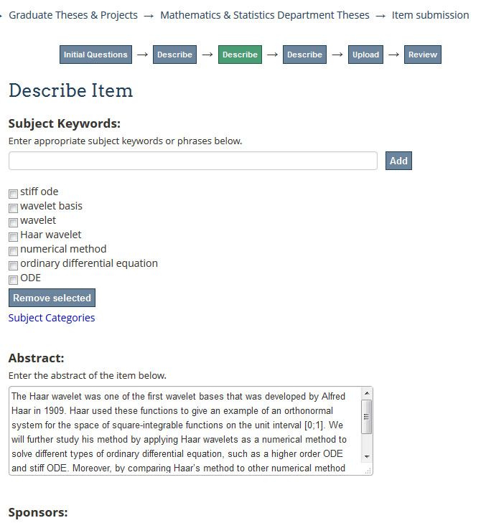
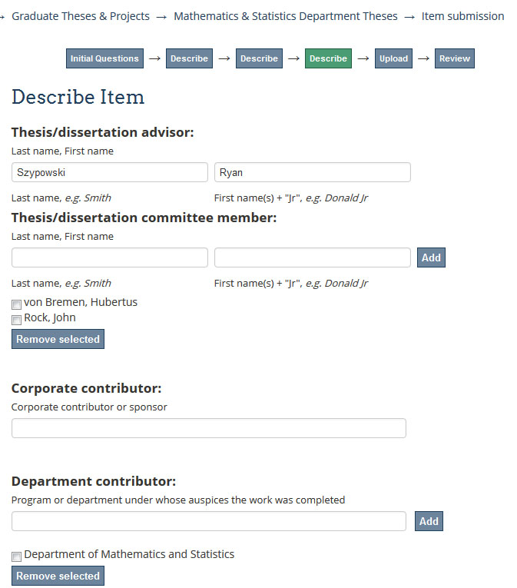
Student Submits
Student clicks on submissions
Then they click Start a new Submission
Student selects their collection
Submits like normal
Notes:
Now the student is ready to submit their item
They need to login to Bronco Scholar
They click on the submissions link
Then they click Start a new Submission at the top
They’ll be presented with a pull down menu, here they select their collection
In most cases it will just be the one collection
Here they submit like normal

Slide 9
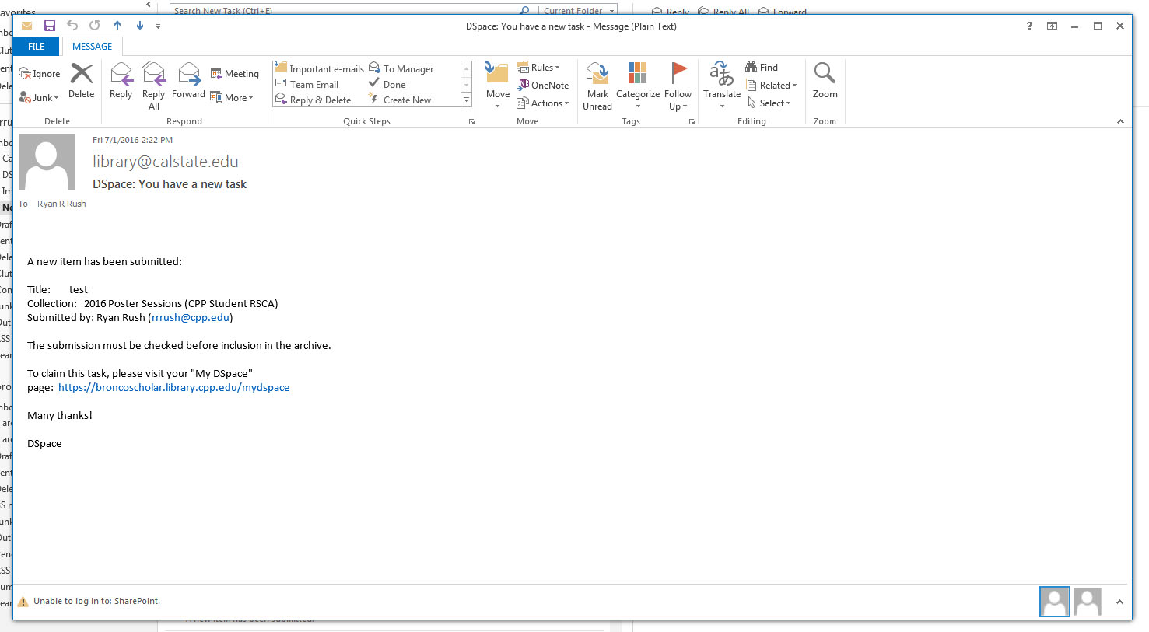
Notifications
We receive a notification stating we have a new task
Notes:
Once the student hits submit, we’ll receive an e-mail similar to the Dspace submission e-mail that states we have a new task
Notifications will be delivered to who ever has permission to each step
BroncoScholar will receive notifications from every step including the ones where the item is returned back to the task pool

Slide 10
Assigning Roles
There are 3 roles we assign users
Submitters
Accept/Reject (approver)
Accept/Reject/Edit Metadata (editor)
Notes:
There are 3 roles we assign users
Submitters - which are usually the students
Accept/Reject – This will be our Bronco Scholar login and our Digital Repository Assistant
Accept/Reject/Edit Metadata – Suzanna, myself and our Bronco Scholar login
We separate the different logins to prevent an accidental submission. This sometimes however does happen
Talk about 3rd step

Slide 11
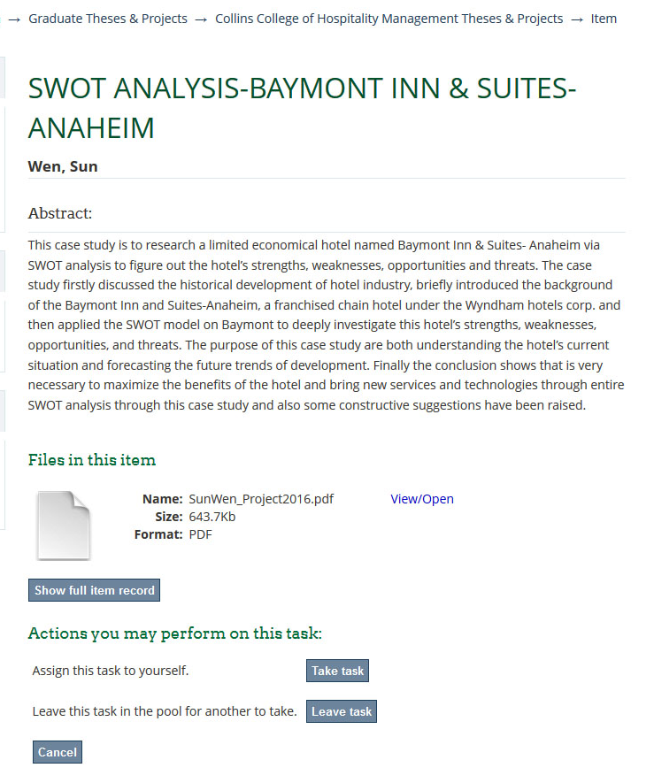
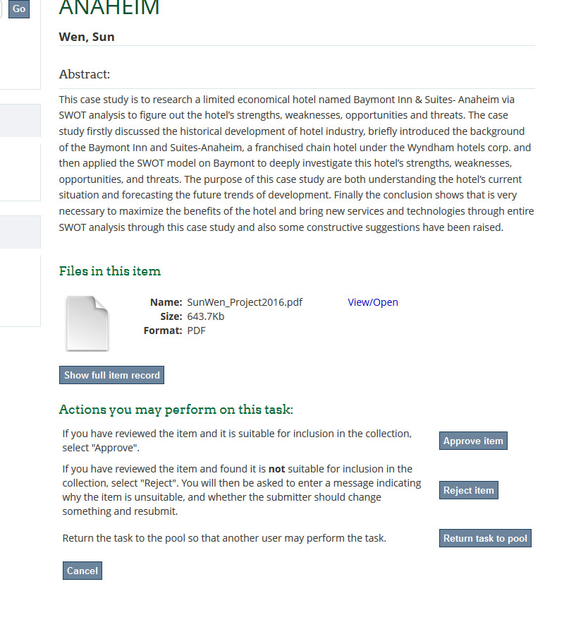
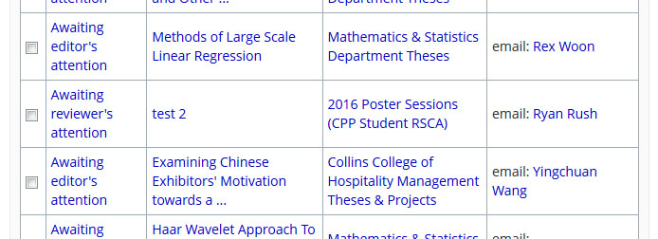
First approval step
Have the students done the basics?
Attempted ADA tagging
Proper naming convention
Properly fill in info
Take Task
Approve or reject
Notes:
This would be the Accept/Reject step
When the student finally submits we receive an e-mail
We start by taking the task
From here we check that they’ve done the basic ada compliance, added the basic metadata, etc.
Either approve or reject based on the work they’ve done thus far

Slide 12
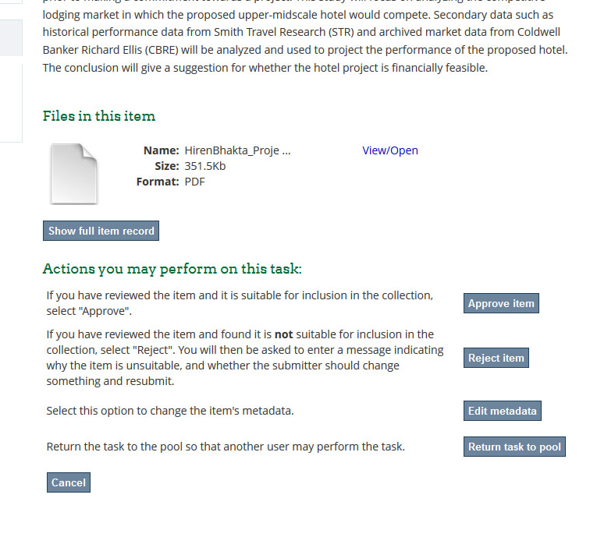
Second approval step
Once the basics are checked the item is pushed to the second step and any additional ADA compliance is completed.
Edit/Add/Delete the basic metadata
Notes:
This is the step where we can edit the basic metadata
Once the item has been approved from the first step and complex ada compliance is performed
The metadata is modified according to the standard language used
Once finished the item is returned to the task pool and we wait to see who has been awarded

Slide 13
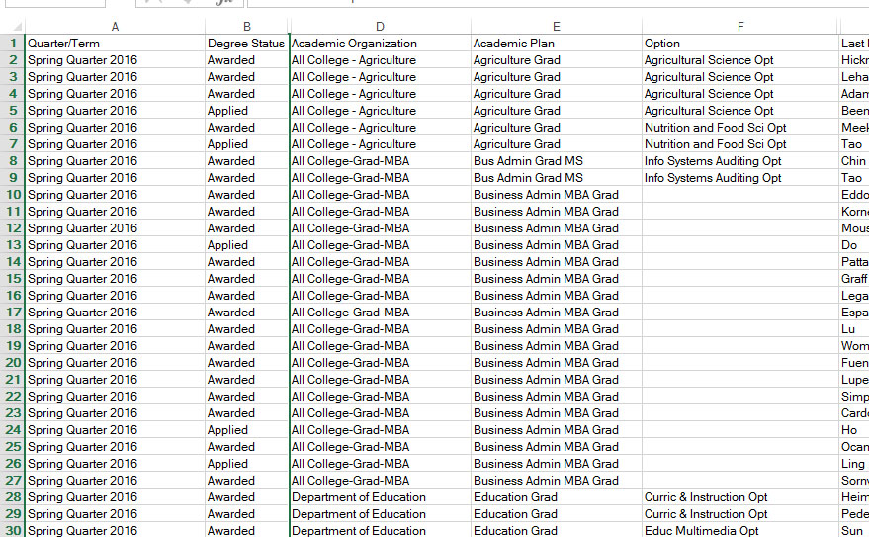
Final Approval
After the semester/quarter ends, check to see who has been awarded
Anyone who’s been awarded, hit approve
Once the item is live, edit any detailed metadata fields
E-mail the student their item is available
Notes:
After the quarter/semester has passed we pull another list from the data warehouse
The excel sheet will say awarded instead of applied next to the ones who successfully graduated
From here we take the task again and click approve item
After the item is live, we input any additional metadata we couldn’t before and e-mail the student that the item is now available

