Slide 1

The UC San Diego Library DAMS
SCU ScholarWorks Symposium
August 18th, 2016
Declan Fleming, Chief Technology Strategist and Director of ITS
University of California San Diego Library

Slide 2

A Brief History….
Origins of the DAMS at UCSD
~2001 - Dark archive
DAMS content focused on SC&A, preservation
Rich metadata - investment in RDF/linked data
Development of a public access system (PAS)
Growth and refinement of our digital object viewer
Events management and preservation

Slide 3
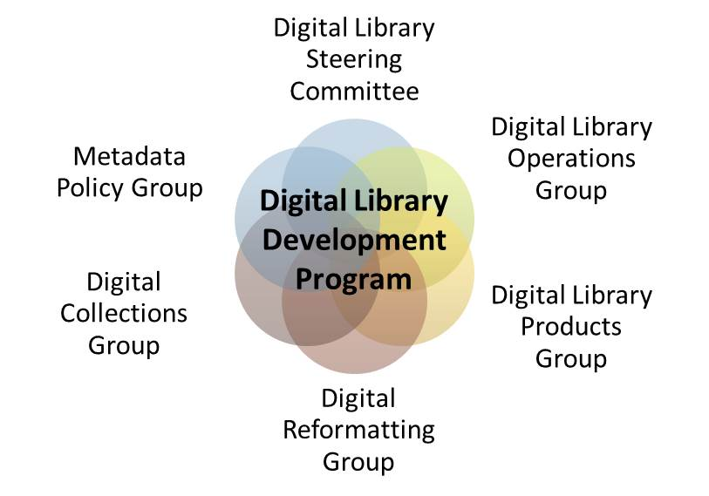
Governance

Slide 4
DAMS 4 Change Requests
Need to better manage and display complex objects, data curation data sets
  Implement revised data model
Desire to develop features collaboratively with a community
New front end
  Facilitate search engine discovery (SEO)
Provide enhanced curatorial tools
Implement collection level records
Provide functionality for user comments

Slide 5
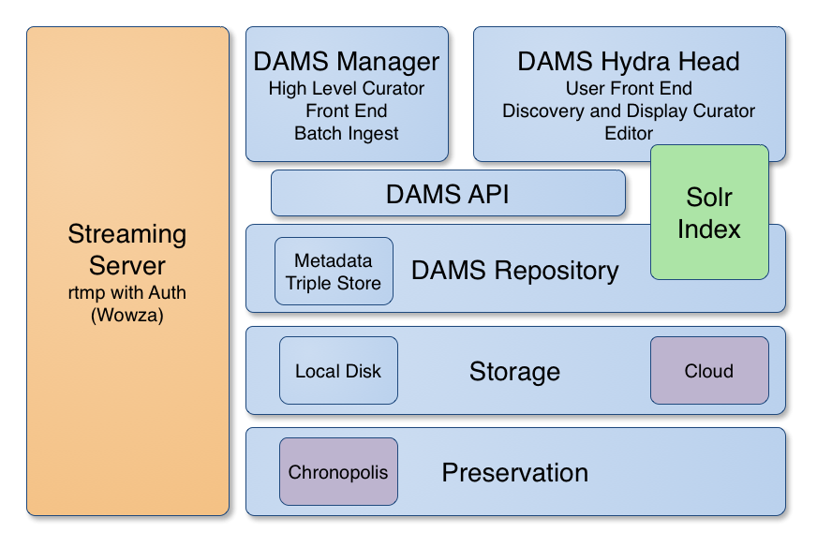
DAMS Architecture

Slide 6


Hydra
Homegrown -> Community Model
Open Source
Blacklight
Testable
Hydra Camps
Consultants: http://curationexperts.com/

Slide 7








































































Fedora Community

Slide 8
Hydra Partners
Stanford University
University of Virginia
University of Hull
Fedora Commons (now part of DuraSpace)
University of Notre Dame
Northwestern University
Columbia University
Penn State University
Indiana University
London School of Economics and Political Science
Rock and Roll Hall of Fame
The Royal Library of Denmark
WGBH
Boston Public Library
Duke University
Yale University
Virginia Tech
University of Cincinnati
Princeton University Library
Cornell University
University of Oregon (as Oregon Digital)
Oregon State University (as Oregon Digital)
Case Western Reserve University
Tufts University
Duoc UC
University of Alberta
Digital Public Library of America (DPLA)
University of Michigan
University of California, San Diego
University of York
Lafayette College
Washington University in St Louis

Slide 9
Hydra Never Stops
Sufia
CurationConcerns
Hydra::Works
Hydra::PCDM
AF

Slide 10
DAMS 5!
Migrate backend to Fedora 4
Implement new data model
  PCDM/DPLA/Local
Integrated curation tools
Starting at CurationConcerns Level
Exhibits
  Spotlight
  Omeka

