Slide 1
UCSD DAMS
Hydra, Linked Data, and Collaborative Data Modeling
Arwen Hutt
SCU ScholarWorks Symposium
August 18, 2016

Slide 2
Metadata in (our) Hydra
Collection records
Faceting of search results
Hierarchical, multi-part objects
Customizable metadata
Authorities
Notes:
I want to talk about this word a bit - what I’m going to show is what we’ve developed for our current repository, it’s not what Sufia or Hydra-in-a-Box will look like out of the box, though many of the functions will be there in different forms

Slide 3
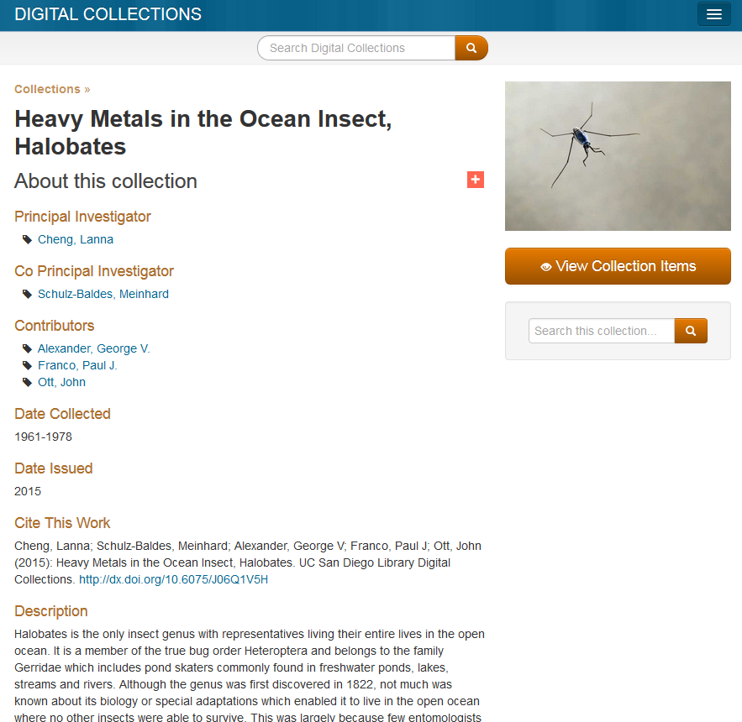
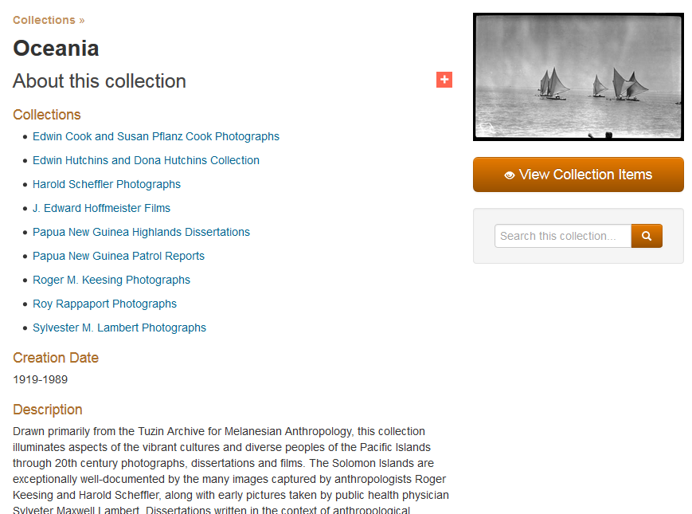
Collection Records
http://library.ucsd.edu/dc/collection/bb8056206n?counter=1
Notes:
Collection records can have lots of metadata and description
And you can nest collection records, so have a parent collection (in this example Oceania) and sub-collections

Slide 4
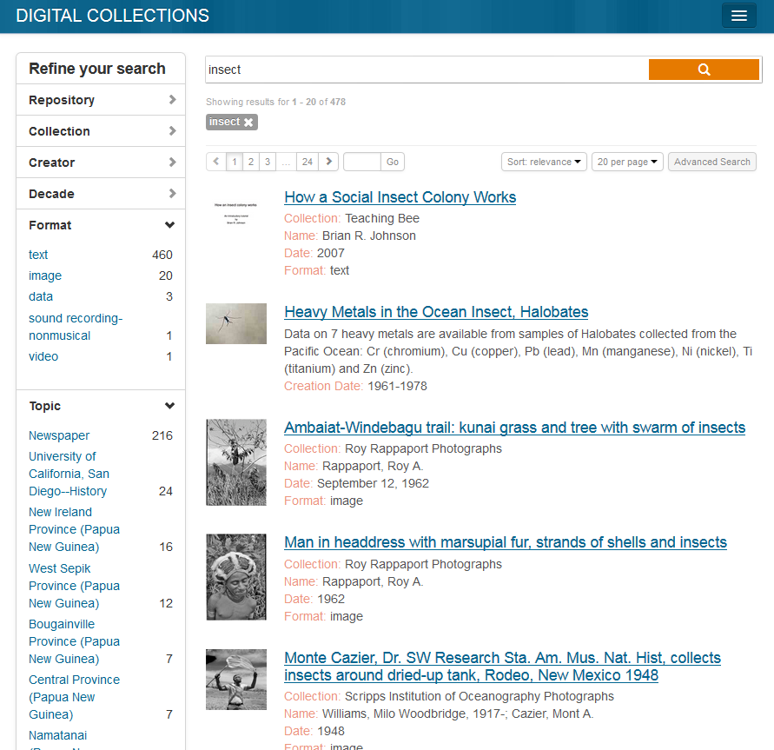
Faceting
http://library.ucsd.edu/dc/search?utf8=%E2%9C%93&q=insect#

Slide 5
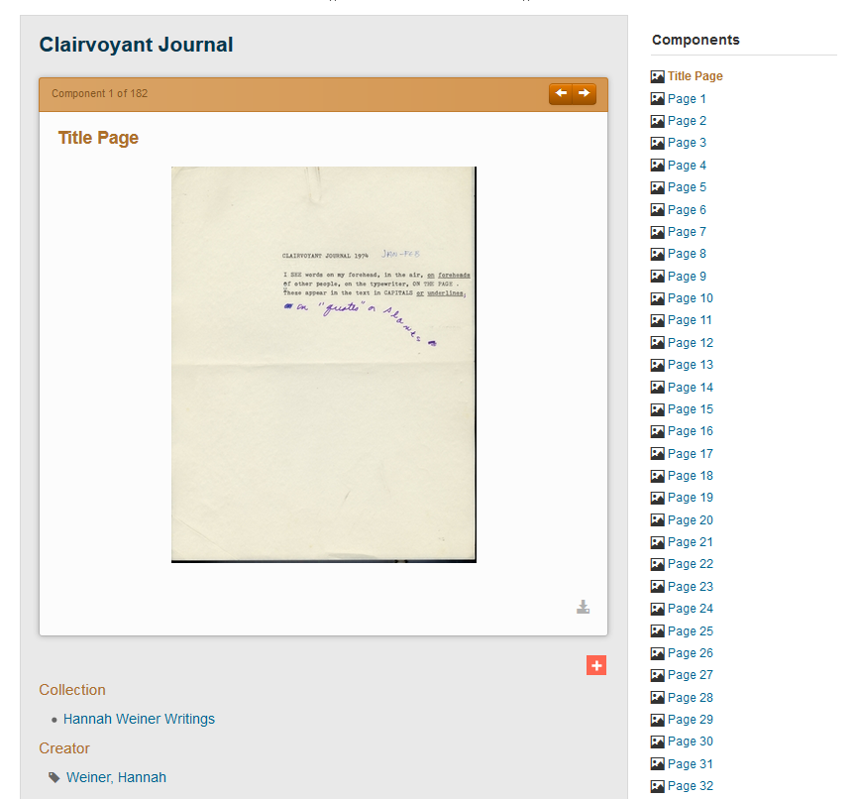
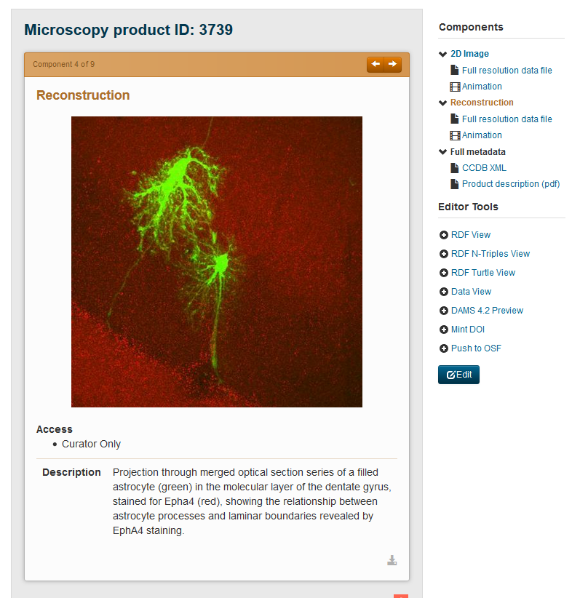
Hierarchy
http://library.ucsd.edu/dc/object/bb59054559

Slide 6
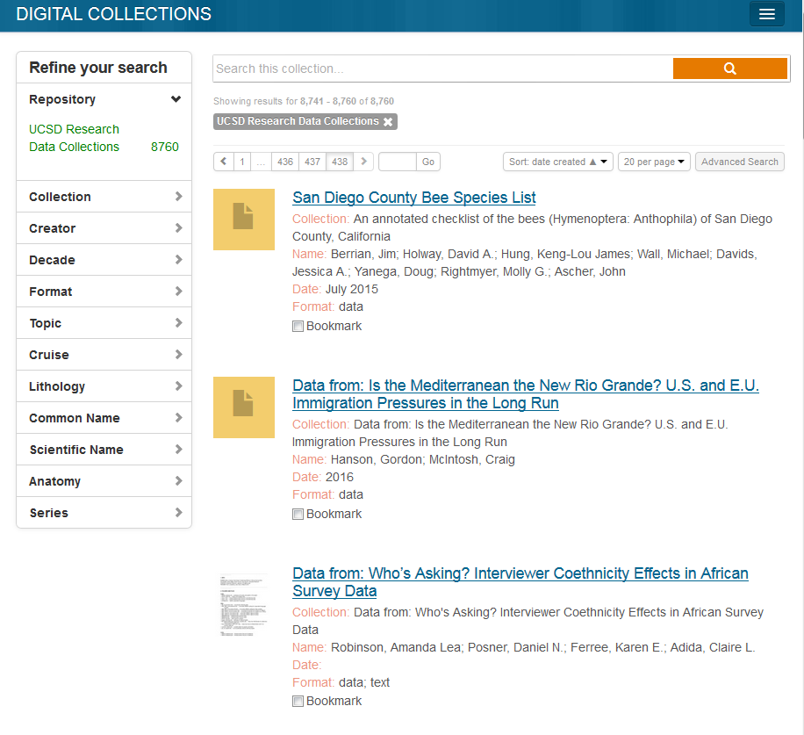
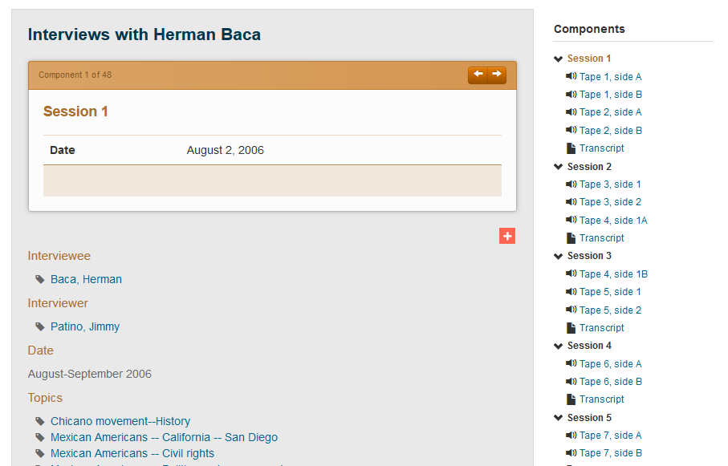
Custom Metadata
http://library.ucsd.edu/dc/object/bb16403200

Slide 7
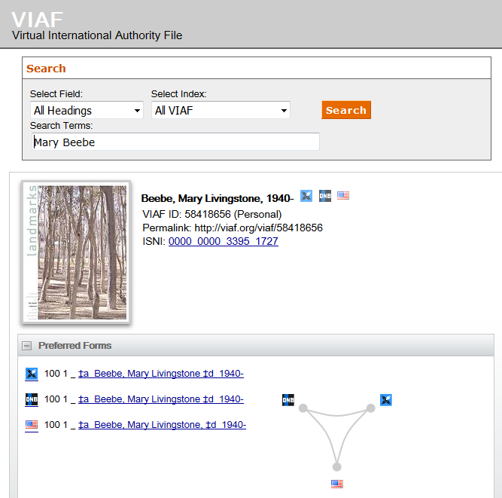
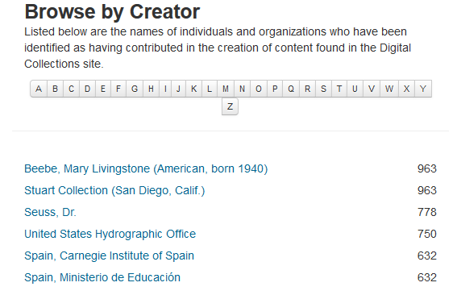
Authorities

Slide 8
Linked Data
Linking (and syncing) our authorities with external authorities (LC, VIAF, FAST, Getty vocabularies, GeoNames, etc.)
Updating automatically as the external vocabularies are updated
Enhancing our authorities
Non-preferred terms
Other languages
Birth and death dates
Link to Wikipedia
Related terms
Geographic coordinates
and probably more...

Slide 9
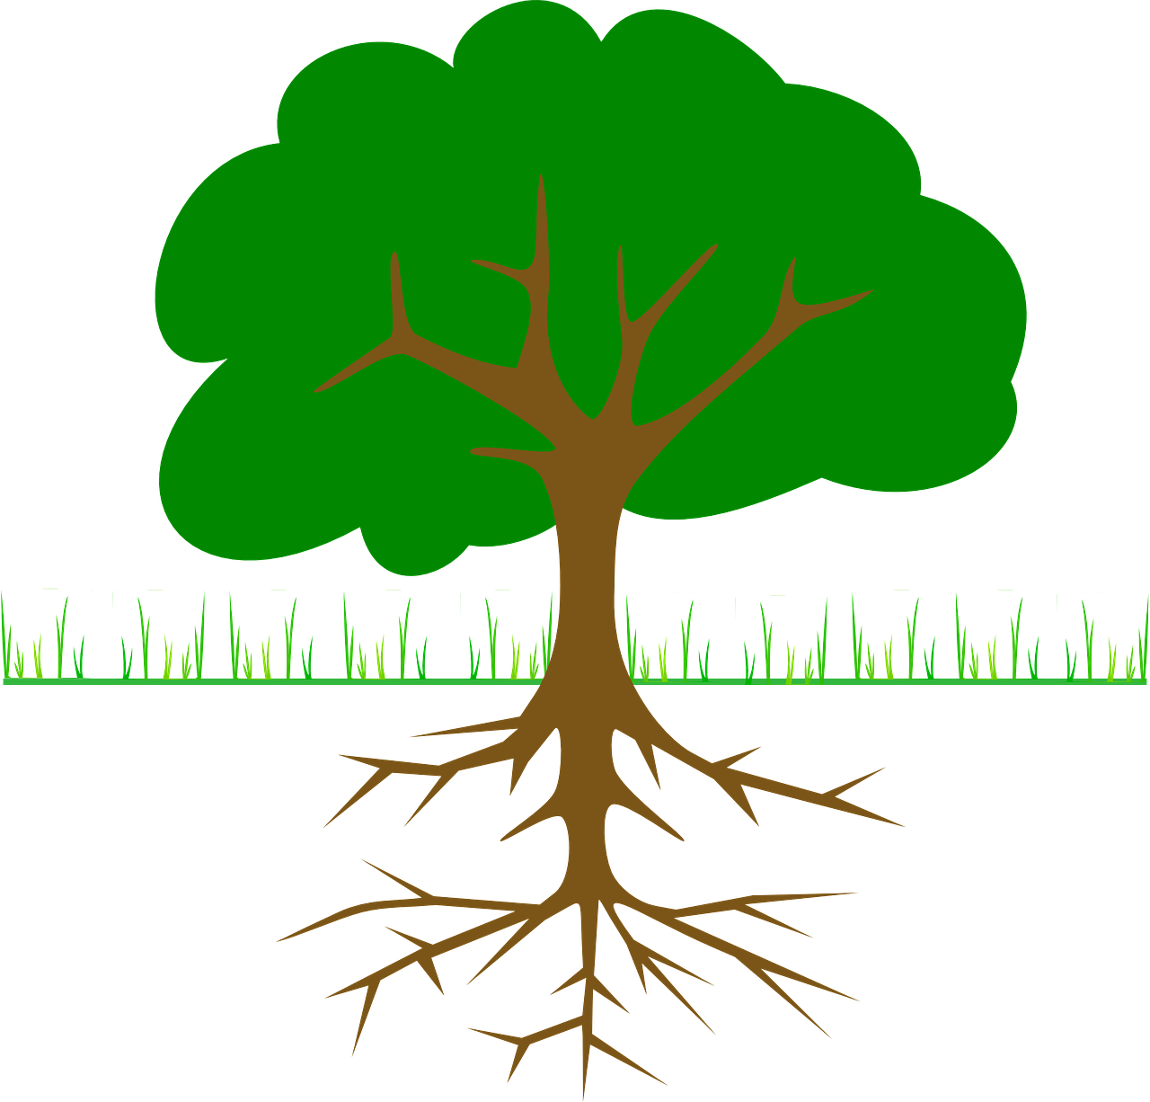
Hydra
Customizable, so we really needed a...
Notes:
As I’ve mentioned one of the big advantages of Hydra is that you can customize it, but that also means there needs to be some planning about how to implement.
So we created a data model. This is basically documentation about what metadata you want, any rules about how they relate, or what can be done with it. This includes both the stuff the user sees (descriptive metadata) and the hidden administrative and technical metadata that supports the system. For example it could tell you that leaves must be attached to a branch, and that a branch can have many leaves. Or that a branch must be attached to a larger branch, and you could only have two layers of branches before reaching the trunk, etc. But, of course, with stuff like titles and subjects and people.
I should mention that are a number of Hydra Heads/Implementations which are currently available that can be deployed without requiring much customization, but there were fewer options when we started this, and we had a lot of, um, expectations for our metadata and system. So we [click]

Slide 10
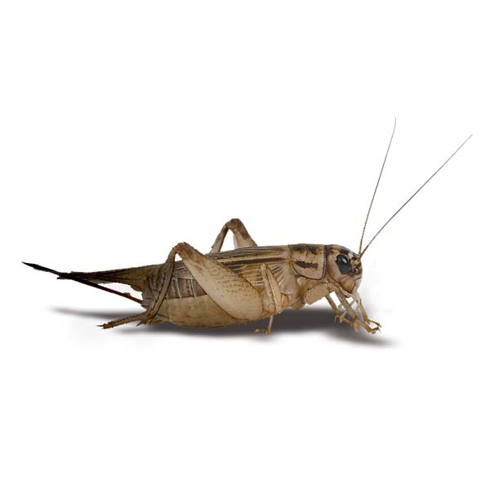
Data Modeling, take 1
Locked room approach
Developed a rich and robust local OWL ontology
Based on community standards (METS, MODS, PREMIS, and some others)
Shared it with the community
Waited for others to use it and build on it...
Notes:
Created our own data model. I’m not going to go into detail about this, but it was a very rich, complex, model. It melded some common community standards into RDF (which if I haven’t mentioned before) is a linked data thing. We hoped that others would adopt it and build on it, so we could share code, etc. But.
That didn’t happen.
There were lots of reasons, timing, a lot of places weren’t implementing RDF yet, the complexity, and the way we created it.
We implemented it, and learned a lot about the technologies we were dealing with, so we decided to do it again.

Slide 11
Data Modeling, take 2
Simplify how we represent things without losing descriptive richness
More RDFy, less XMLy
Reuse properties from existing standards whenever possible
Collaborative and organic
Notes:
This time we approached it much differently.

Slide 12
Success!
Portland Common Data Model
Model for structural relationships (supports both simple and complex use cases, including “rich hierarchies of inter-related collections and works” ¹)
Started as an in between conference session conversation between UCSD and Oregon Digital folks, grew into a much larger community conversation, and turned into PCDM
Is now being implemented by many of the major Hydra development efforts (CurationConcerns, Sufia, Hydra-in-a-Box, etc.)
Hydra Rights Metadata
Initial discussions at UCSD, again in collaboration with Oregon Digital, led to the Hydra Rights Metadata Working Group
Is now a community recommendation ²
1 https://github.com/duraspace/pcdm/wiki
2 https://wiki.duraspace.org/display/hydra/Rights+Metadata+Recommendation
Notes:
And it worked out much better.
There are two pieces that are kind of “done”

Slide 13
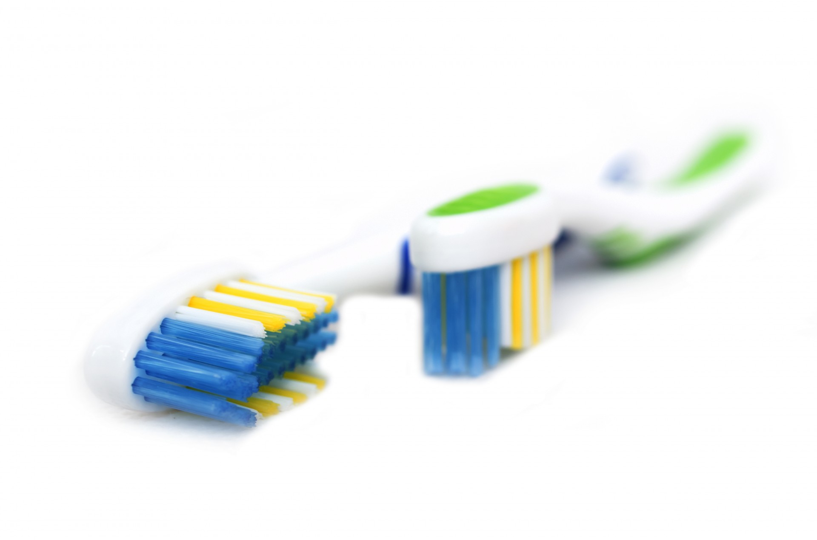
Descriptive Metadata
...is a little harder.
[why]
Bigger universe
Content varies a lot (from musical performances to visual resources to metabolomic data)
Granularity varies
Controlled vocabularies vary
Everything varies
and then there’s always the toothbrush problem...
Notes:
But we’re still working on descriptive metadata. We have a draft of what we want, but after the community work on the other components, we just wanted more.
But descriptive metadata has been harder.
“Everybody wants one but nobody wants to use anybody else’s.”

Slide 14
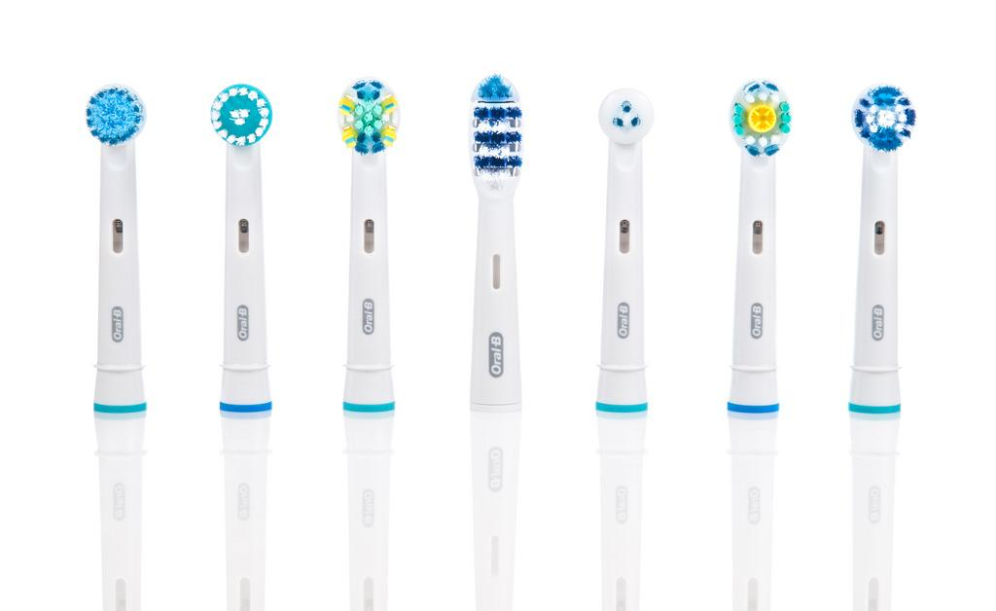
How we’re doing this
Sharing, freely and frequently, our work, even when it’s drafty (google sheet)
Participating in relevant communities (Hydra groups, UC Common Knowledge Groups)
Organizing events (UC Hydra, Blacklight, Fedora 4 Camp last year, West Coast Regional Hydra Group Meeting at the beginning of this year)
Ongoing conversations with interested partners (UC Santa Barbara)
Agile approach to development
Mostly we talk a lot...
Notes:
But we think there’s a lot of long term value here, so we are still working towards this goal. We aren’t freezing our work while we wait for something perfect, but we’re continuing to explore and build bridges and look for opportunities.
[slide content]
So we’ve talked to a lot of people, shared our idea that it’s not A whole toothbrush we’re sharing, but maybe just the charger, or the base. We all get our own brush.

Slide 15
The Metadata Gumball*
Dublin Core | Creator with free text
DPLA | Creator with link to authority record
Pacific Coast | Researcher with link to authority record
Local Properties | Principal Investigator with link to authority record
Notes:
Here’s what we are thinking right now. This is largely being worked on right now by UCSD and UCSB, but we’ve had, and will continue to have, conversations with others in the UC community and others in the Hydra community.
Like with PCDM and the rights discussion, we’re not looking for 100% consensus but rather how much can we agree on, and how can we do that in a way that lets us build together, while still being free to do our own thing when we need to.
So at the Core is, naturally Dublin Core. This is the minimum level encoding, and the lingua franca that would cross most institutional boundaries.
The next layer is the DPLA data model. This is a pretty big step up in richness, and is both an increasingly important standard in the United States, as well as being cross-pollinated with the Europeana Data Model. It is, however, still focused on large aggregations of primarily cultural heritage material.
The next layer is what we are working on right now. We nicknamed it Pacific Coast model, because the idea came about at the West Coast Hydra regional meeting. The idea is that this layer would be more detailed and richer than the DPLA data model, while still applying to a wide number of institutions or hydra implementers.
The outside layer would be the most granular.
A central part of this idea is that the layered models are created in such a way that the more granular and specific elements are modifications to the shared layers so a Principal Investigator - is a type of Researcher - is a type of Creator. It allows a richness of expression which easily maps to a lingua franqa as needed.
* Graphic inspired by the Hydra representation from John Stroop, and adapted for metadata by Chrissy Rissmeyer.

Slide 16
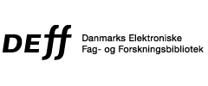
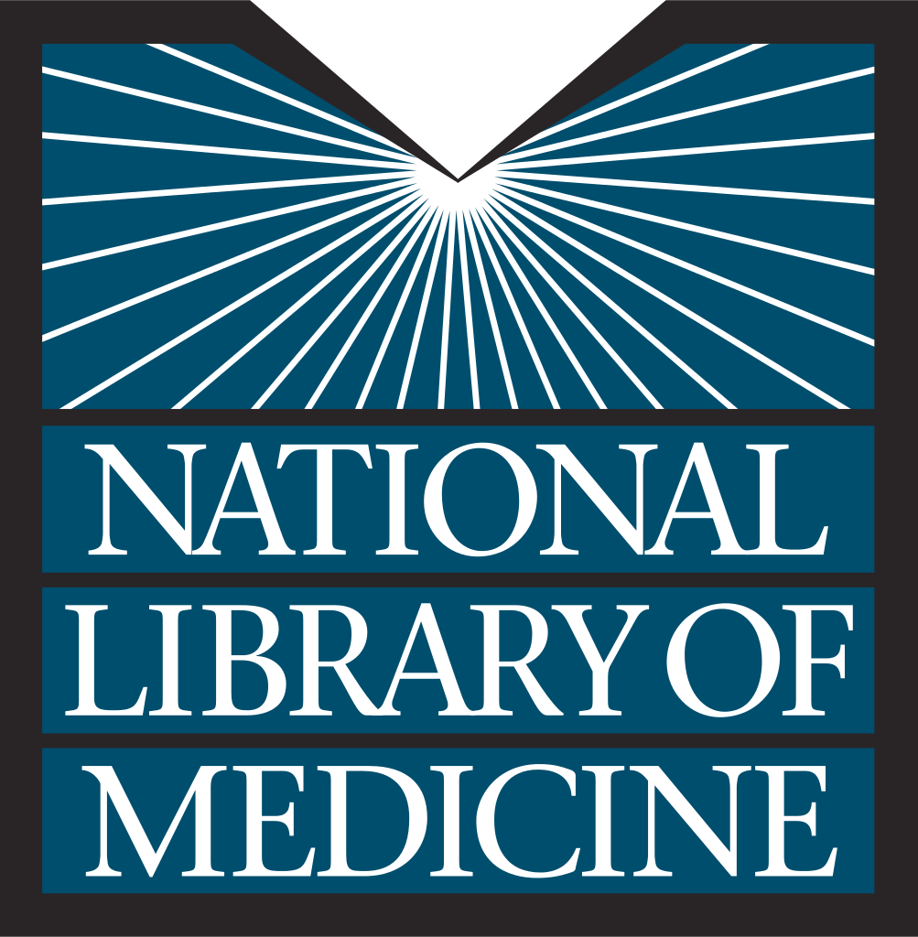
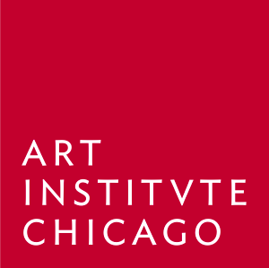
Community
Fedora Community
Notes:
Metadata things available or being worked on
Batch ingest (this is one we want to help build on)
User deposit workflows
Linked data support
Exhibit creation and display
API's for data
Customizable access control
And lots more…

Slide 17
What next?
Migrate to Fedora 4
Subject clean up and reconciliation
Keep working on ways to make collaboration easier
Keep talking (we’re planning an unconference session at Hydra Connect. If you’re going, please join us!)
Proof of concept of the benefits of a shared model

Slide 18
Questions?

