Slide 1
Declaration of Rights and Principles to Transform
Scholarly Communication
2018 ScholarWorks Symposium - July 24, 2018
CC-BY Allegra Swift, Scholarly Communication
Notes:
Allegra Swift
Scholarly Communications Librarian
UC San Diego Library
https://orcid.org/0000-0003-2160-6960
lib.ucsd.edu/schol-comm
CONDUIT the scholcom blog | @UCSDScholCom
At UCSD > position > report to the AUL for Collections though scholcom work has connections in just about every unit in the library > responsibilities include eScholarship, SCWG & UC OA policies
Previous position at CCL, digital library metadata > faculty works on CDM > moved to bepress > IR responsibilities > schol comm
Negotiated on behalf of authors and IR with publishers on behalf of posting in the IR, retaining or reverting author copyrights
Saw a lot of rapid transformation in publisher/author agreements, increasing shift to OA but with APC

Slide 2
Also…
Declaration of Rights and Principles to Transform Scholarly Communication
OA2020
Call to Action
Choosing Pathways to OA & #CP2OA18
[any documentation or publications I mention
will be linked at the end of the presentation]
Notes:
Asked to talk about the Declaration but will also relate OA2020 as background for the Declaration and the recent Call to Action for change in journal negotiations, from the UC Systemwide Library and Scholarly Information Advisory Committee (SLASIAC.
In April 2018, the UC libraries identified and analyzed the constellation of potential funding strategies as a menu of reinvestment options, which were published as the “Pathways to OA” toolkit.
Will talk about the upcoming forum CP2OA

Slide 3
The California Connection…
Notes:
I hope you’ll see how these efforts relate to your work and your IR,
In discussing what the UCs are up to, i hope you’ll see not only these connections but opportunities to nudge your own institutions down the pathways to OA.

Slide 4
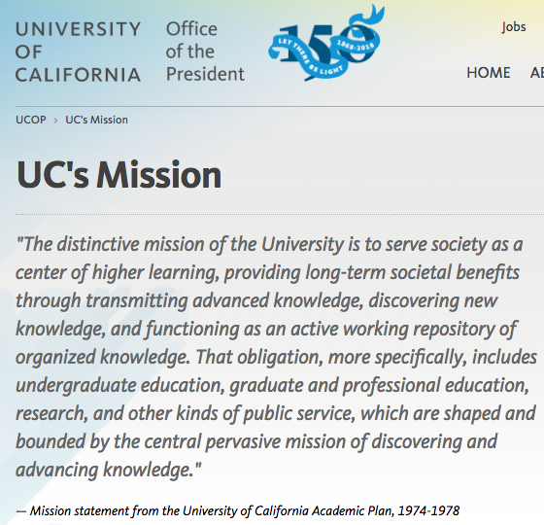
https://ucop.edu/uc-mission/index.html
Notes:
Where does this apply to your work
Where can you align your IR, your institution, and the CSU system and perhaps new national alliances
we are guided by a mission to serve society by discovering, transmitting, organizing, and preserving knowledge. The current subscription-based academic journal system — which charges institutions unsustainable costs to read and provide access to global scholarship, including works produced by our universities’ own authors — impairs our ability to serve this mission.
http://blogs.lse.ac.uk/impactofsocialsciences/2018/07/23/a-variety-of-strategies-and-funding-approaches-are-required-to-accelerate-the-transition-to-open-access-but-in-all-authors-are-key/
Mission guides us to serve society by discovering, transmitting, organising, and preserving knowledge. The current subscription-based academic journal system

Slide 5
Declaration
What?
2017-2018 developed and “strongly endorsed” by UCOLASC
UC will push for terms and conditions in publisher agreements that are transformative and closely aligned with short- and long-term goals for scholcomm
Why?
Advance the public mission of the UC
Accelerate OA for UC pubs
Leverage faculty backing to ensure the UC spends taxpayer money in an ethical, moral, and socially responsible way
Notes:
The UC system-wide faculty senate library committee (UCOLASC) recently released a Declaration of Rights and Principles to Transform Scholarly Communication to guide our libraries when negotiating with publishers.

Slide 6
The Declaration: Assert the R&P when negotiating with publishers during journal license renewals
No copyright transfers.
No restrictions on preprints.
No waivers of OA Policy.
No delays to sharing.
No limitations on author reuse.
No impediments to rights reversion.
No curtailment of copyright exceptions.
No barriers to data availability.
No constraints on content mining.
10. No closed metadata.
11. No free labor.
12. No long term subscriptions.
13. No permanent paywalls.
14. No double payments.
15. No hidden profits.
16. No deals without OA offsets.
17. No new paywalls for our work.
18. No non-disclosure agreements
Notes:
Systemwide Library and Scholarly Information Advisory Committee (SLASIAC)
system-wide faculty senate library committee (UCOLASC)
the 18 rights and principles are listed on P. 3 of the Declaration pdf
terms directly related to the population and navigation of IRs:
Terms such as OA policy, rights reversion, content mining, bibliographic records, data on hybrid OA payments, and of course “deposit into our institutional repository”
Also related to the evolution of scholarly communication, are mentions of access and control over research data, research information management systems and other forms of research intelligence and credit reporting (when i say, “credit,” I mean tenure and promotion not the card)
It would be a good idea to evaluate what lengths your campus and campus culture could go to in negotiating these rights and principles. If the publisher pushes back, where is your line in the sand?

Slide 7

OA2020
Journal subscriptions
Funds that support sustainable business models
More than 100 signatories in 35 countries
UC San Diego Academic Senate will review
U.S. signatory institution https://oa2020.us/
Notes:
The OA2020 movement intends to accomplish this “flipping” by encouraging institutions to convert resources currently spent on journal subscriptions into funds that support sustainable OA business models. Berkeley signed the OA2020 Expression of Interest in March 2017 along with UC Davis and UCSF.
Signatories to the EoI express agreement upon three aims:
Transforming a majority of today’s scholarly journals from subscription to OA publishing in accordance with community-specific publication preferences.
Pursuing this transformation process by converting resources currently spent on journal subscriptions into funds to support sustainable OA business models.
Inviting all parties involved in scholarly publishing, in particular universities, research institutions, funders, libraries, and publishers to collaborate on a swift and efficient transition for the benefit of scholarship and society at large.
When an institution commits to signing the EoI, it agrees to make a good faith effort to devise and implement practical strategies and actions for attaining these OA aims.

Slide 8
Call to Action - Strategic Guiding our Near Term Actions https://libraries.universityofcalifornia.edu/groups/files/slasiac/docs/NegotiatingJournalAgreementsAtUC_ACallToAction_final.pdf
We will evaluate all publishers on both cost-benefit and values-based grounds in our cancellation and retention decisions, including conformance to the UCOLASC Declaration of Rights and Principles to Transform Scholarly Communication, and sustainable, transparent, cost-based OA fees.
We will adjust our investments to follow and support transformative initiatives mounted by academic authors, editorial boards, and societies when they seek to establish a journal on fair open access principles, including transitioning support from prior legacy journals when necessary.
We will actively seek to partner with other national and global research institutions in transforming research output to OA.
Notes:
https://libraries.universityofcalifornia.edu/groups/files/slasiac/docs/NegotiatingJournalAgreementsAtUC_ACallToAction_final.pdf
As public investment in higher education continues to decline, many of our campus libraries as well as the California Digital Library (CDL) face persistent budget shortfalls that imperil their ability to continue these licenses.
This Call to Action outlines some of the priorities and actions that will guide UC in addressing the issues of sustainability and open access transformation in our negotiations with journal publishers from 2018 forward, and articulates the ways in which we will engage with our stakeholder communities to advance these efforts.
Strategic Priorities for Journal Negotiations - about negotiating licenses and agreements with publishers

Slide 9
Call to Action – Stakeholders & Partners https://osc.universityofcalifornia.edu/2018/06/championing-change-in-journal-negotiations/
Other libraries, research institutions, and consortia must be key strategic partners in transforming the scholarly literature. We will work proactively with peer institutions across the globe, through the OA2020 initiative and other means, to foster a sense of shared mission, cultivate and share best practices, and to enter into constructive collaborations that can advance our shared goals.
Notes:
building on the declaration and these other initiatives, the call is for change in journal negotiations, and was issued by the UC Systemwide Library And Scholarly Information Advisory Committee (SLASIAC)
Endorsed by the UC Council of University Librarians (CoUL)
Endorsed by the UC Academic Senate University Committee On Library And Scholarly Communication (UCOLASC)
We’re entering a new round of journal negotiations, the time is ripe for UC to harness its agreements with publishers as instruments of large scale transformation
This is as an effort to transition the system of journal subscriptions to one that meets dual needs:
controlling institutional costs in gaining access to scholarly literature created by others,
while ensuring free, immediate, and open access (OA) to the publications created by our own scholars.
While the first purpose speaks especially to library budgets, the second purpose relates to IRs and rights management

Slide 10
Next steps …
http://blogs.lse.ac.uk/impactofsocialsciences/2018/07/23/a-variety-of-strategies-and-funding-approaches-are-required-to-accelerate-the-transition-to-open-access-but-in-all-authors-are-key/
Notes:
Rachael G. Samberg, Richard A. Schneider, Ivy Anderson and Jeff MacKie-Mason share the University of California’s range of open access policy and advocacy materials, and highlight some potential next steps that may be of use to faculty and author communities.
I’ve run through a plethora of initiatives and documentation that are in the forefront of recent UC efforts on achieving OA. These documents are available to all to reveal our processes, in the hope that other institutions and communities may find these resources equally valuable.
In the previously mentioned post linked on this slide (previously only mentioned UCB’s Samberg as the author but giving credit where it is due, co-authors are Rich Schneider of UCSF, Ivy Anderson of the CDL, and Jeff MacKie-Mason, the UCB UL), they outline three next steps that could be implemented at your institutions with an eye towards keeping faculty interests and backing at the fore

Slide 11
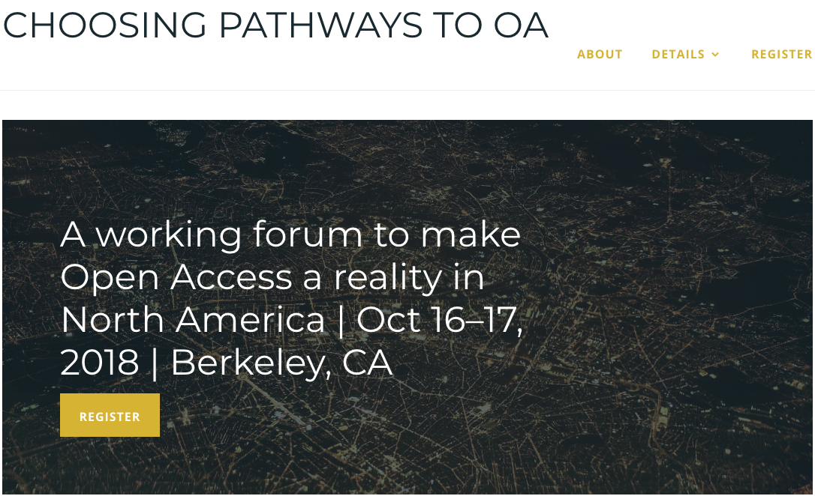
https://cp2oa18.com/
Notes:
https://cp2oa18.com/
This past March (2018) the UC libraries and the California Digital Library released the Pathways to Open Access toolkit. The Pathways toolkit analyzes the many approaches and strategies for advancing the large-scale transition to OA, and identifies possible next action steps for UC system-wide investment and experimentation.
the Pathways toolkit was designed to be a practical resource for other institutions wrestling with the same choices.
CP2OA is an opportunity to join with other institutions in a decision-making process to create localized plans suitable for your own institution or community.
THE CALL:
Participate in a two-day working forum centered on action-focused deliberations about redirecting subscription and other funds toward sustainable open access publishing.
I’m on the planning committee and will be attending along with my UL and AUL for collections. So any questions please feel free to ask

Slide 12

https://senate.universityofcalifornia.edu/_files/committees/ucolasc/scholcommprinciples-20180425.pdf
https://osc.universityofcalifornia.edu/2018/06/championing-change-in-journal-negotiations/
http://blogs.lse.ac.uk/impactofsocialsciences/2018/07/23/a-variety-of-strategies-and-funding-approaches-are-required-to-accelerate-the-transition-to-open-access-but-in-all-authors-are-key/
https://libraries.universityofcalifornia.edu/groups/files/slasiac/docs/NegotiatingJournalAgreementsAtUC_ACallToAction_final.pdf
Allegra Swift
akswift@ucsd.edu
lib.ucsd.edu/schol-comm
CONDUIT https://knit.ucsd.edu/scholcomm/
@UCSDScholComm

