Slide 1
ScholarWorks Symposium ‘18
Where we’ve been, where we are, and where we’re going

Slide 2
ScholarWorks is:
Application: DSpace -> Hyrax
Platform: Broad domain of shared services
Community: Cross campus information professionals

Slide 3
...an application
DSpace : Outlived scalability, functionality for modern services
Hyrax on Amazon Web Services : Shared architecture that addresses per campus requirements

Slide 4
...a platform
Began as several institutional repositories oriented around a single service (DSpace)
Now -- Target range of tools and services in collaboration with CSU organizational bodies, the Chancellor’s Office, and CSU campuses

Slide 5
...a community
Librarians, archivists, technologists throughout the CSU supporting IR
Now -- (more) practitioners with goals for knowledge and resource sharing across CSU
ex. ScholarWorks IGs -- emerged from previous ScholarWorks Symposium Digital Archives, Metadata/Linked Data, Publishing, Faculty Profiles, Best Practices

Slide 6
Challenges
New infrastructure takes time
Breadth of outcomes for platforms and applications

Slide 7
Solutions
Simplicity when possible
Orchestrate features as discrete works or sprints
Reduce external dependencies
Leverage community engagement

Slide 8
The Future
Open Access For CSU Faculty Publications
CSU Libraries Strategic Plan 2017
ContentDM and Islandora migrations to Hyrax
Open services toolkits through OJS, Scalar, etc

Slide 9
Questions?
Thanks!

Slide 10
If we can put a man on the moon and sequence the human genome, we should be able to devise something close to a universal digital public library.
–Peter Singer

Slide 11
Hello!
I am Carmen Mitchell
I am here because I love to give presentations.

Slide 12
Planning for the Future of ScholarWorks

Slide 13
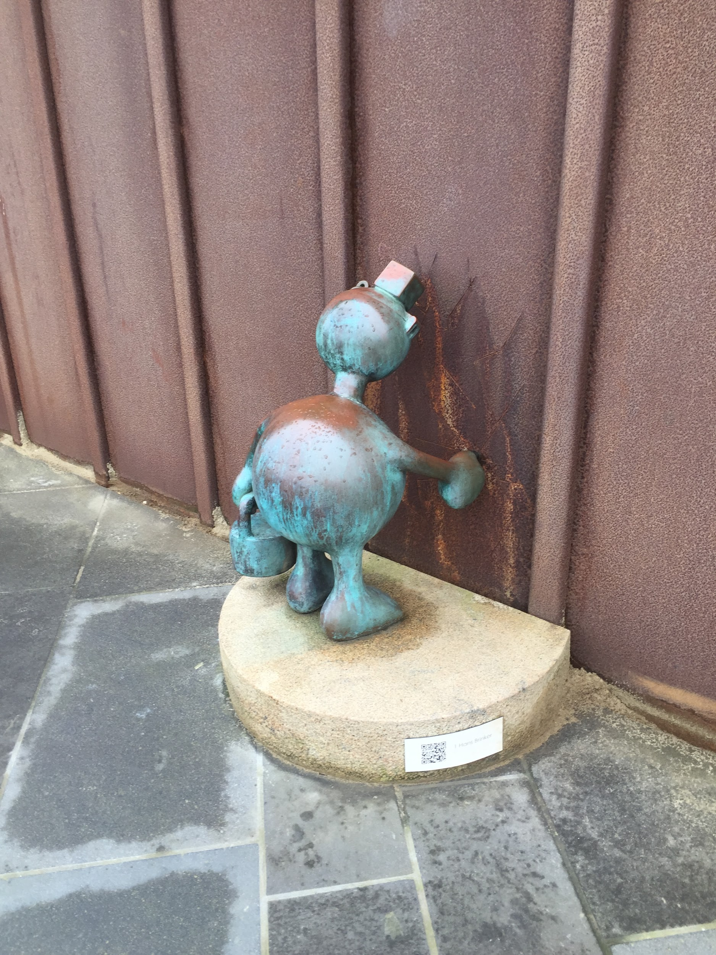
Why plan?
We is smarter than me.
The Samvera Way: investment is in a framework, not an application.
Share our strengths and expertise.
Notes:
When one campus does things on their own, it’s much more difficult to share the changes and innovations. The new system allows for code to be pushed to the shared instance...but that only works if you are already using the shared code to start with. CM - talk about the history here.

Slide 14
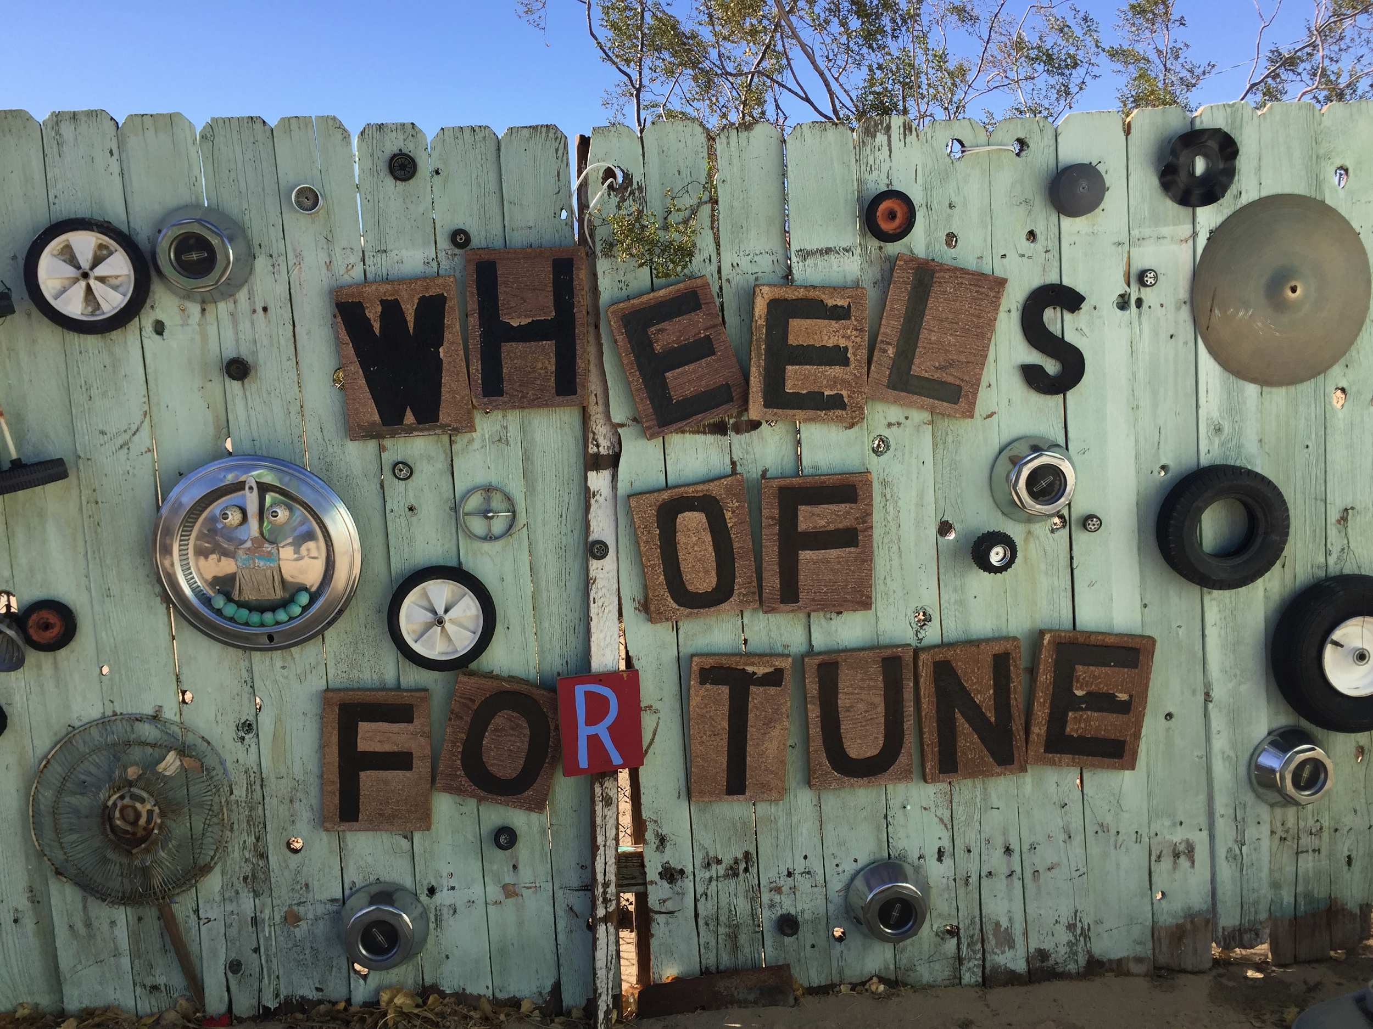
It's about utilizing the expertise of the people who [already] do the work
Notes:
Campus experts? Utilize the IGs! Share information via the CSU Confluence site!

Slide 15
We might need HELP
$52,500 budget request to COLD for enhancements!
We need your ideas: http://bit.ly/SWSY2018

Slide 16
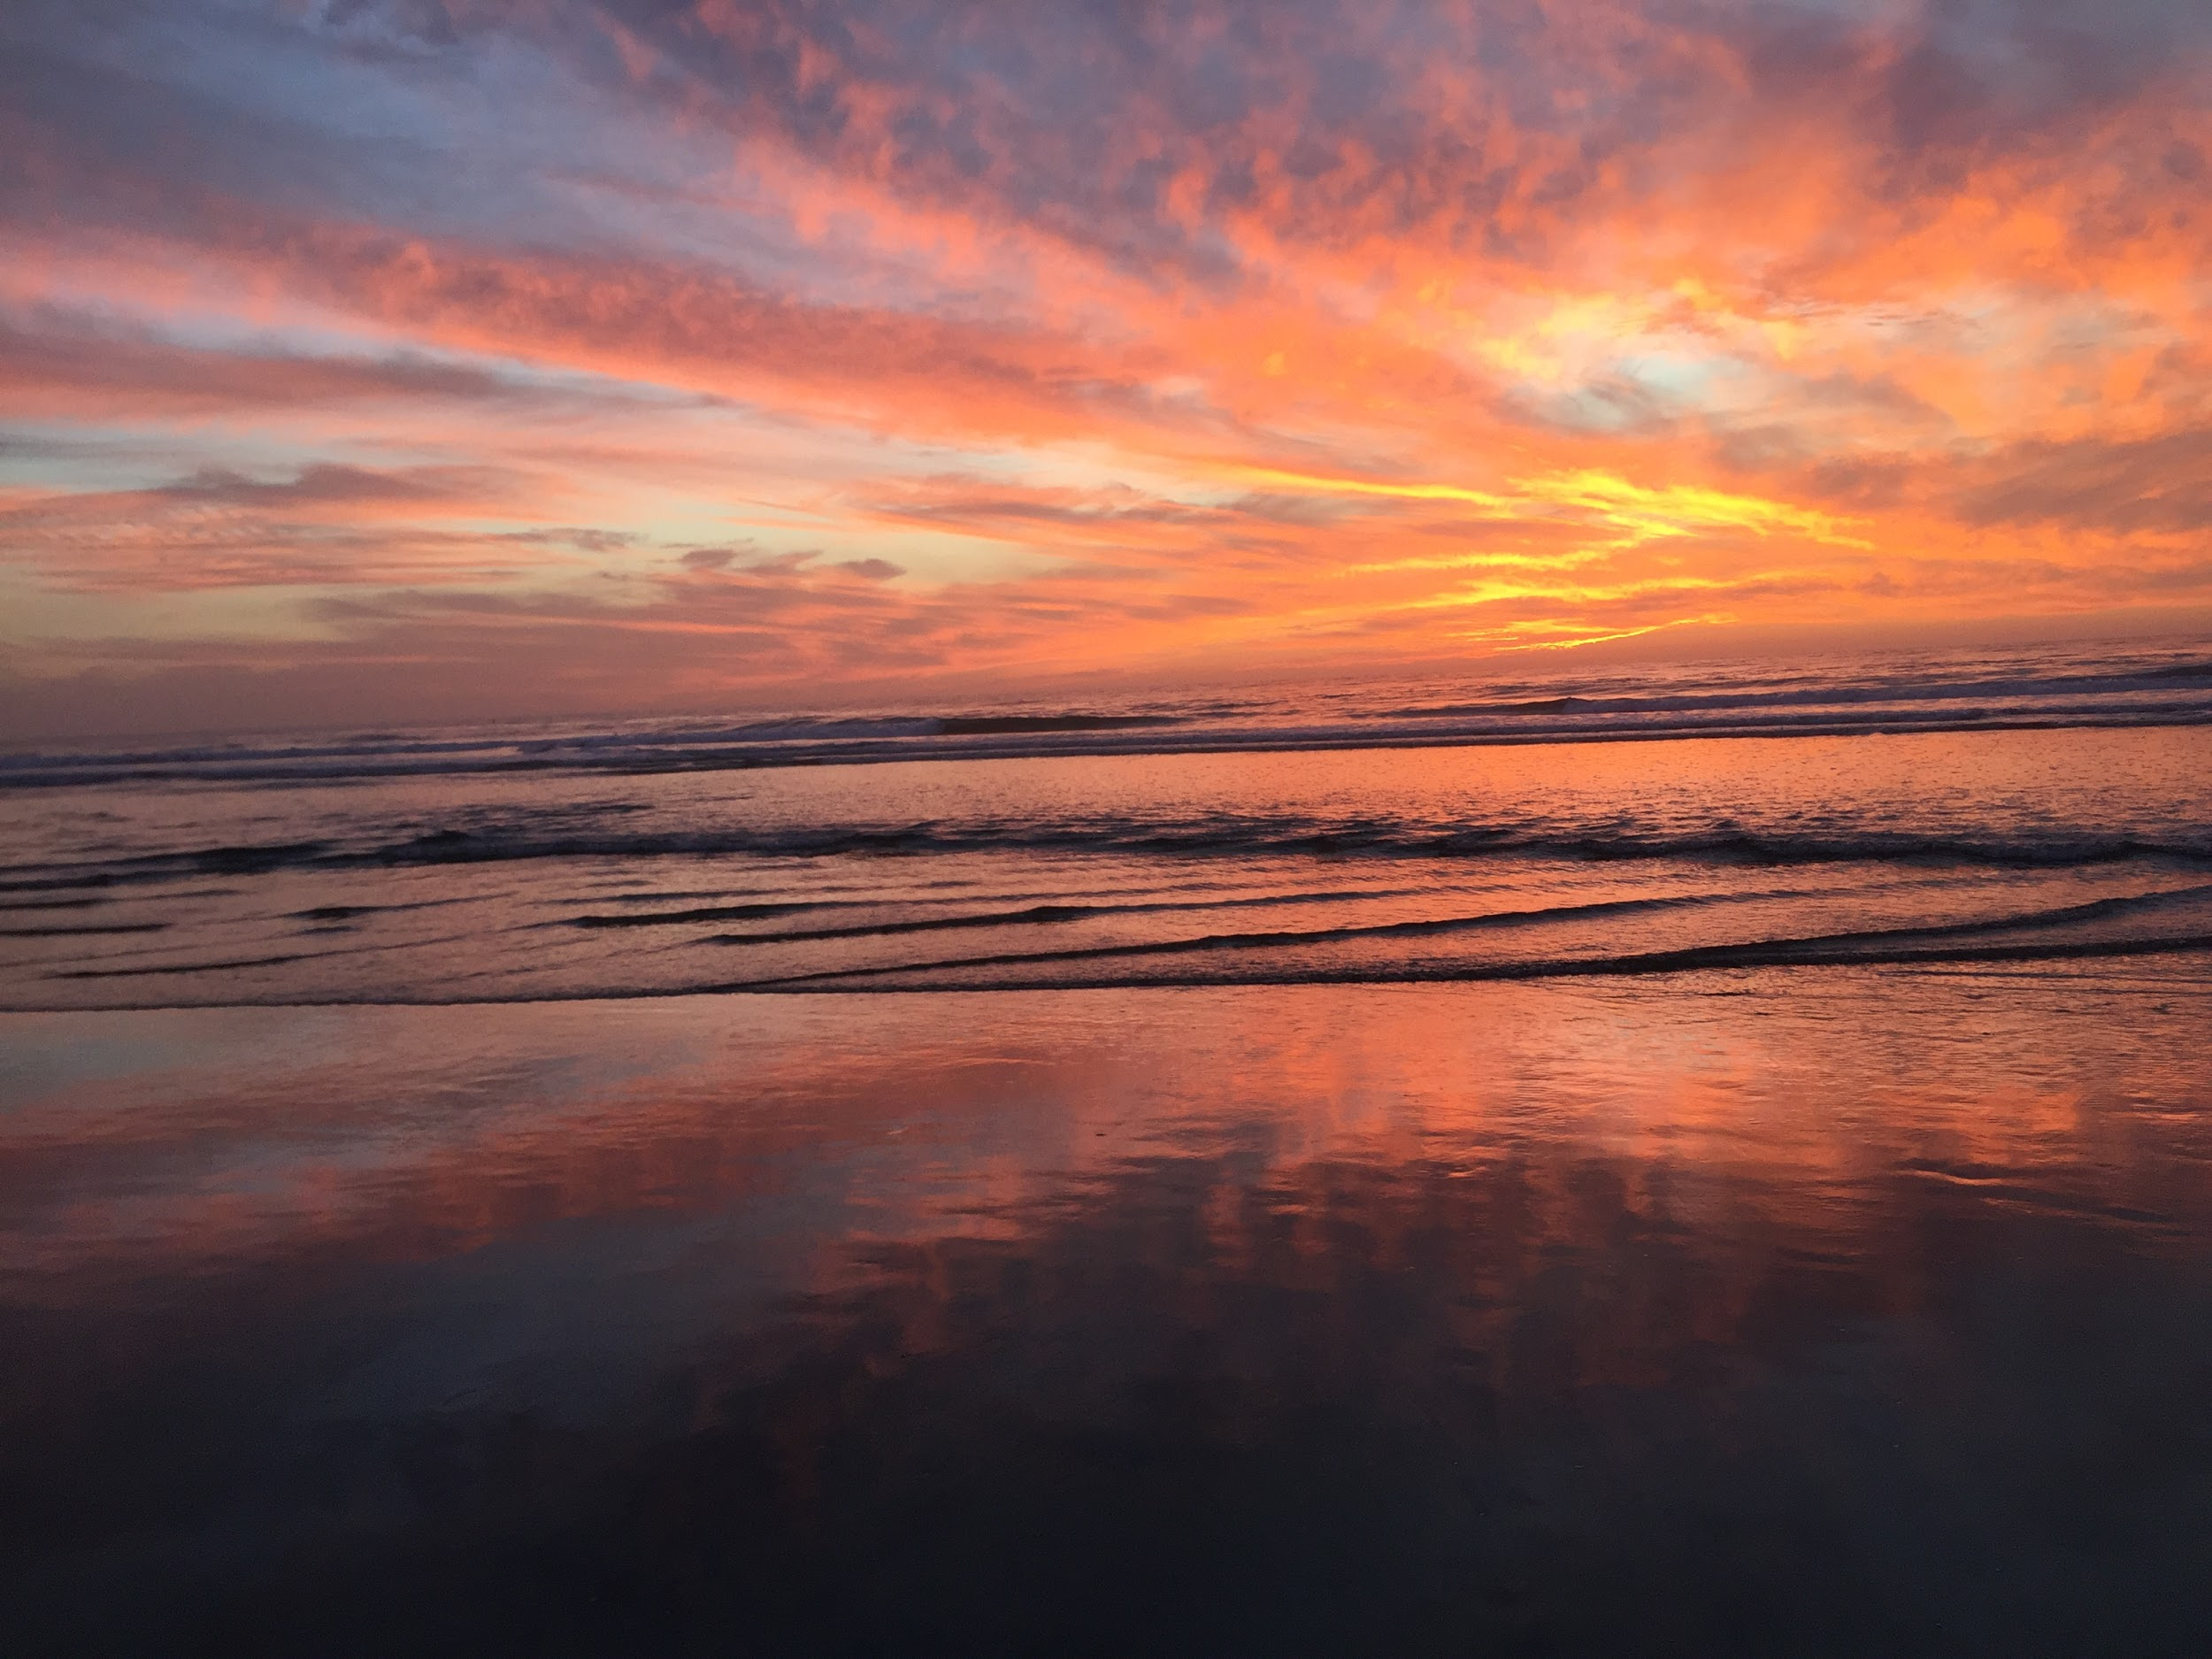
ScholarWorks Symposium 2019 Codesprint!

Slide 17
Video © Carmen Mitchell, all rights reserved.

Slide 18
THANKS!
Any questions?
You can find me at:
cmitchell@csusm.edu

Slide 19
bit.ly/SWsurvey2018

Slide 20
CREDITS
Special thanks to all the people who made and released these awesome resources for free:
Presentation template by SlidesCarnival
Photographs by Carmen Mitchell

