Slide 1

Alma Normalization Rules & Processes
Israel Yáñez
ULMS Summer Meeting
August 14, 2018
Notes:
This will be a basic introduction to how Alma norm rules & processes can be useful in our day-to-day work.

Slide 2
What We’ll Cover
What are Alma normalization rules & processes?
Rules language & syntax
How to create & test a normalization rule
How to configure a normalization process
Where & how normalization processes can be executed
Notes:
We’ll begin by looking at what Alma normalization rules and processes are.
We’ll take a close look at the rules language & syntax.
We’ll learn how to create and test a norm rule.
We’ll learn how to configure a normalization process.
We’ll look at where and how norm processes can be executed in Alma
This presentation includes slides for the last three sections, since we’ll be sharing them with everyone later. But in today’s session, we’ll move into the live Alma environment…

Slide 3
What We’ll Cover
What are Alma normalization rules & processes?
Rules language & syntax
How to create & test a normalization rule
How to configure a normalization process
Where & how normalization processes can be executed
Notes:
…to cover these.

Slide 4
What are Alma normalization rules?
Contain syntax for actions to modify MARC records
Alma role required: Cataloger, Catalog Manager, or Catalog Administrator
Closely tied to Alma normalization processes
Share constant elements
Notes:
An Alma norm rule is a file that contains syntax for actions to modify MARC records. This includes both MARC bibliographic and MARC holdings records.
To work with norm rules, you must have one of the following roles: Cataloger, Catalog Manager, or Catalog Administrator.
While norm rules are closely associated with norm processes, they’re not quite the same thing. In our everyday work, we sometimes say norm rule when we mean norm process, and that’s fine. But for the purpose of this session, there’s value in making a distinction to better understand the relationship between the two.
Finally, Alma norm rules all share the same required elements. We’ll examine that more closely when we begin to talk about rule syntax.

Slide 5
What are Alma normalization processes?
Used to correct or update MARC records
Alma role required: Catalog Administrator or General System Administrator
Applied typically in the metadata editor, by running a job on a set of records, or as part of an import profile
Call on defined norm rules to update MARC data.
A norm rule is a file containing actions; those actions are executed by a norm process.
Notes:
A normalization process is an Alma operation used to correct or update MARC records in Alma.
To configure a normalization process you’ll need one of these roles: catalog administrator, or general system administrator.
While normalization processes are applied in Alma in a number of ways, they’re most commonly applied in the metadata editor or by running a job on a set of MARC records.
When a norm process includes a MarcDroolNormalization task, it calls on norm rules, according to your configuration of the process, to update MARC records.
So, to distinguish rules from processes and to better understand the relationship between the two, we can think of them in this way: a norm rule is a file containing actions; those actions are executed by a norm process.

Slide 6
Normalization rules & processes in the ULMS environment
Place normalization rules locally, not on the network
Notes:
We are in a consortium and we work in a collaborative network environment. There are a few things we need to keep in mind when we talk about Alma norm rules and processes in our ULMS environment.
First, we need to be sure to place norm rules locally and not on the network. We, as individual campuses, can only configure IZ-level norm processes which can only call on IZ-level norm rules. So, it’s important to ensure that we set the placement of new rules to the IZ.

Slide 7
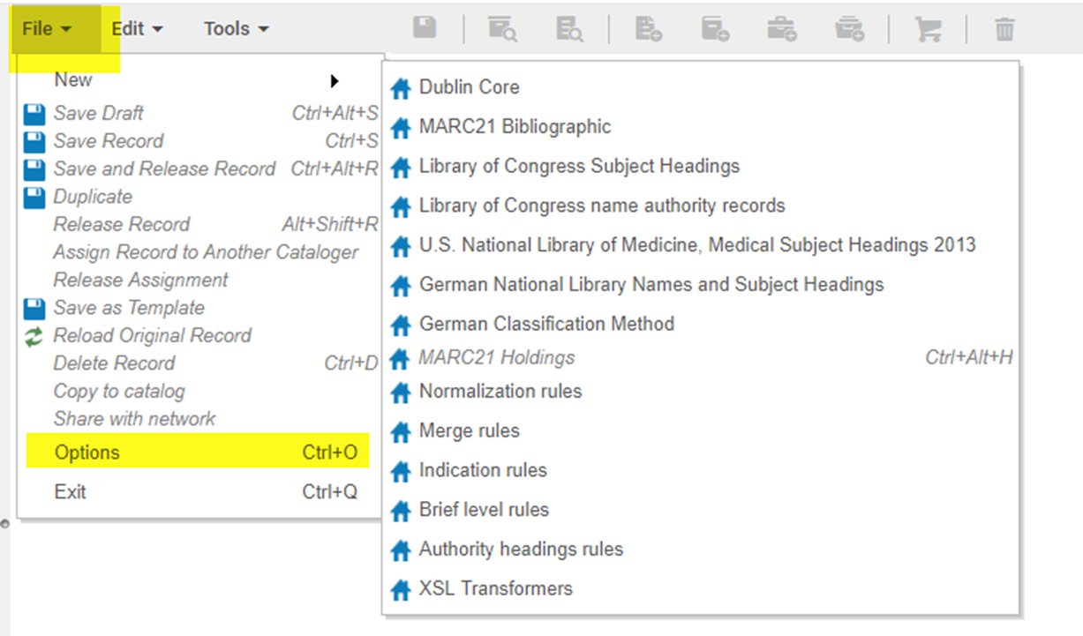
Normalization rules & processes in the ULMS environment
Notes:
We can do that by going to the metadata editor, selecting File, Options

Slide 8
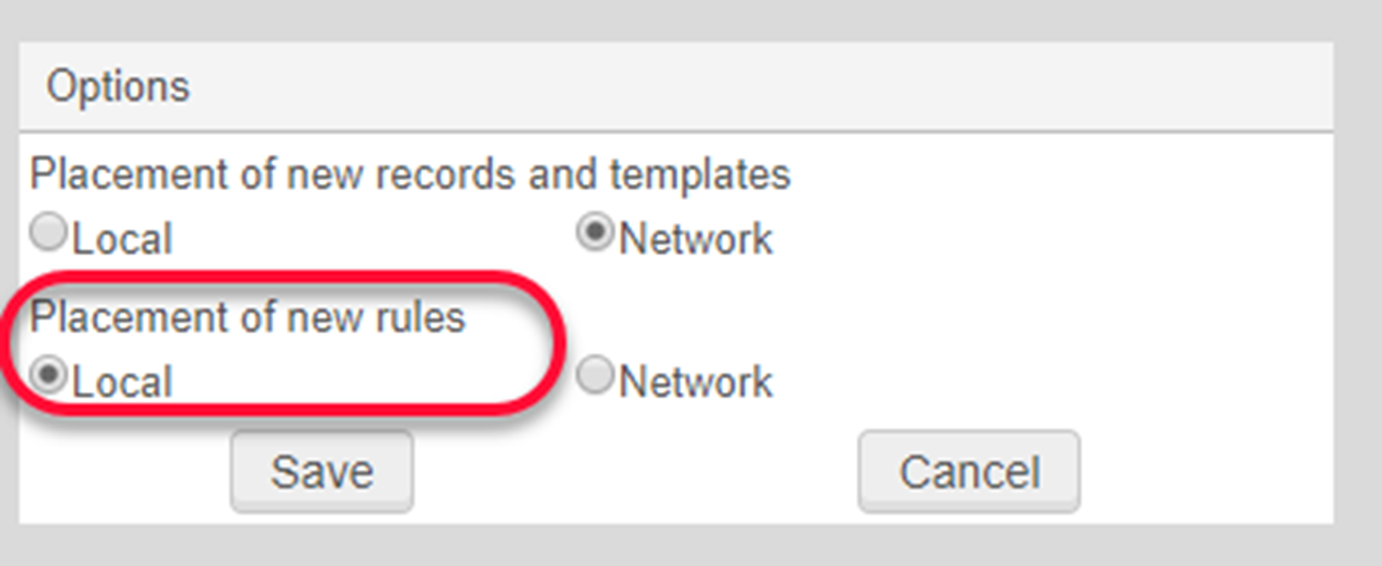
Normalization rules & processes in the ULMS environment
Notes:
…and ensuring that the placement of new rules is set to local.

Slide 9
Normalization rules & processes in the ULMS environment
Place normalization rules locally, not on the network
Normalization processes on NZ-linked bibliographic records should be limited to local fields
No ULMS implications for IZ-only bibliographic records or holdings records
Notes:
The other thing we need to keep in mind is that norm processes on NZ-linked bib records should be limited to local fields. We don’t want to make changes to other fields in an NZ record because we use the WorldCat master record as our NZ record and our ULMS operational policy is to make those changes at the WorldCat level.
Normalization processes on IZ-only bib records are not limited to local fields. You can make changes to any fields in IZ-only bib records.
Holding records are by nature local, there are no ULMS implications for holdings records when it comes to norm rules & processes.

Slide 10
Norm rule syntax
rule “rule name”
when
(condition on MARC record)
then
Action1
Action2 (condition on MARC field)
end
Notes:
We’ll now begin looking at the general structure and syntax of a norm rule. A norm rule has four general sections.

Slide 11
Norm rule syntax
rule “rule name”
when
(condition on MARC record)
then
Action1
Action2 (condition on MARC field)
end
Notes:
First we have the rule name.

Slide 12
Norm rule syntax
rule “rule name”
when
(condition on MARC record)
then
Action1
Action2 (condition on MARC field)
end
Notes:
In the second section, we have a condition that is tested at the record level. The rule looks at the entire record to determine whether the condition is met. If the condition is met, the rule continues and applies what we see in the third section,

Slide 13
Norm rule syntax
rule “rule name”
when
(condition on MARC record)
then
Action1
Action2 (condition on MARC field)
end
Notes:
An action or multiple actions. When you have more than one action, the actions are executed in order. Some of these actions may have conditions themselves. These are tested at the field level.

Slide 14
Norm rule syntax
rule “rule name”
when
(condition on MARC record)
then
Action1
Action2 (condition on MARC field)
end
Notes:
And finally we simply end the norm rule.

Slide 15
Every normalization rule contains these four constant elements:
rule
when
then
end
Notes:
Every norm rule contains four constant elements: the words rule, when, then, end. These four words are required in every norm rule and can help us remember the four main sections of a norm rule.

Slide 16
Every normalization rule contains these four constant elements:
A name or description follows rule
A condition follows when
An action(s) follows then
Last line in norm rule is simply end
rule "Add field 973 for TSAK"
when
(not exists "973.a.Tsakopoulos Hellenic Collection")
then
addField "973.a.Tsakopoulos Hellenic Collection"
addSubField "973.9.LOCAL" if (not exists "973.9.LOCAL")
end
Notes:
A name or description follows rule
A condition follows when.
A normalization action, or a number of actions, follow then
And the last line in a norm rule is simply end.
As I mentioned earlier, conditions can also follow actions as you can see in this example.

Slide 17
Every normalization rule contains these four constant elements:
Record-level condition
A name or description follows rule
A condition follows when
An action(s) follows then
Last line in norm rule is simply end
rule "Add field 973 for TSAK"
when
(not exists "973.a.Tsakopoulos Hellenic Collection")
then
addField "973.a.Tsakopoulos Hellenic Collection"
addSubField "973.9.LOCAL" if (not exists "973.9.LOCAL")
end
Notes:
The condition that follows when is tested at the record level. So, if a record meets this condition, the rule then proceeds to apply the following action or actions.

Slide 18
Every normalization rule contains these four constant elements:
A name or description follows rule
A condition follows when
An action(s) follows then
Last line in norm rule is simply end
rule "Add field 973 for TSAK"
when
(not exists "973.a.Tsakopoulos Hellenic Collection")
then
addField "973.a.Tsakopoulos Hellenic Collection"
addSubField "973.9.LOCAL" if (not exists "973.9.LOCAL")
end
Field-level condition
Notes:
If a condition follows an action, it is tested at the field level. When a condition follows an action…

Slide 19
Every normalization rule contains these four constant elements:
A name or description follows rule
A condition follows when
An action(s) follows then
Last line in norm rule is simply end
rule "Add field 973 for TSAK"
when
(not exists "973.a.Tsakopoulos Hellenic Collection")
then
addField "973.a.Tsakopoulos Hellenic Collection"
addSubField "973.9.LOCAL" if (not exists "973.9.LOCAL")
end
Notes:
the data field in the action element …

Slide 20
Every normalization rule contains these four constant elements:
A name or description follows rule
A condition follows when
An action(s) follows then
Last line in norm rule is simply end
rule "Add field 973 for TSAK"
when
(not exists "973.a.Tsakopoulos Hellenic Collection")
then
addField "973.a.Tsakopoulos Hellenic Collection"
addSubField "973.9.LOCAL" if (not exists "973.9.LOCAL")
end
Notes:
… and the data field in the condition must be the same.

Slide 21
Norm rule syntax
rule “rule name”
when
(condition on MARC record)
then
Action1
Action2 (condition on MARC field)
end
Notes:
When we create and work with norm rules, we really don’t have to think too much about the first and last sections of the norm rule. We don’t have to give much thought to the rule name, other than we need to enclose the rule name in double quotes. And of course, the last line of the norm rule will always be end.

Slide 22
Norm rule syntax
rule “rule name”
when
(condition on MARC record)
then
Action1
Action2 (condition on MARC field)
end
Notes:
Most of what we have to think about has to do with the second and third sections of the norm rule: the conditions, actions, and the record element strings that follow these. We’ll focus on those, and we’ll cover them in sections. As we move along, I’ll be showing examples of norm rules. In these examples, you may see syntax in sections of the rule we haven’t covered yet. If you’re new to norm rules, the syntax may not make sense to you, but let’s save questions until the end of this syntax section.

Slide 23
Conditions
(TRUE)
exists
existsControl
not exists
not existsControl
existsMoreThanOnce
Notes:
Let’s begin with conditions. We find conditions in the second part of the rule, after the word when. We also can find them in the third section of a rule, following an action. Here is a list of the conditions used in norm rules.
(TRUE), exists/existsControl, not exists/not existsControl, and existsMoreThanOnce.

Slide 24
(TRUE)
Used only at the record level
Applies the rule unconditionally
Notes:
(TRUE) – This condition is used only at the record level. This condition is a sort of non-condition. If you have a rule with the TRUE condition, the rule will automatically proceed to the action section.

Slide 25
(TRUE)
rule "remove all 956 fields"
when
(TRUE)
then
removeField "956"
end
Notes:
In this example, the TRUE condition doesn’t require any condition to be met at the record level. The rule automatically proceeds to the action. When this rule is run by a process, all 956 fields will be removed.

Slide 26
exists
exists applies to data fields
existsControl applies to control fields
At least one match is found
existsControl
Notes:
Exists applies to data fields and existsControl applies to control fields. Control fields in a MARC record include the leader and MARC 001 through 009 fields. In order to be met, this condition requires that at least one match be found.

Slide 27
exists
rule "remove 260 if 264 exists"
when
(exists "264")
then
removeField "260"
end
Notes:
Here’s an example of the exists condition at the record level. The record-level condition requires that a 264 field exist. If a 264 field exists, then the action, removing the 260, will be applied to the record. Before Sacramento went live with the ULMS, we were in a single-institution instance of Alma. At one point, we were having trouble with our merge rule for full records that were coming in and merging with brief order confirmation bibs. Those brief order bibs had 260 fields, and the incoming full records typically would have a 264 field. In the merge process, the 260 field would remain in the merged record, so we had to do some cleanup. This is not a norm rule we’d include in a process now in the ULMS environment on NZ-linked records since we should be limiting processes to local fields.

Slide 28
existsControl
rule "replace 008 cp 33"
when
(existsControl "008")
then
replaceControlContents "008.{33,1}" with "v"
end
Notes:
This is an example of a existsControl condition. In this rule, we require that the MARC record include a 008 field. If it does, then the condition is met and the rule will continue and apply the following action.

Slide 29

not exists
not exists applies to data fields
not existsControl applies to control fields
No match is found
Notes:
Much like the pair of conditions we just looked at, not exists applies to data fields, and not existsControl applies to control fields. These conditions are met when no match is found.

Slide 30
not exists
rule "Add field 973 for TSAK"
when
(not exists "973.a.Tsakopoulos Hellenic Collection")
then
addField "973.a.Tsakopoulos Hellenic Collection"
addSubField "973.9.LOCAL" if (not exists "973.9.LOCAL")
end
Notes:
In this rule, the not exists condition is looking for the absence of a 973 with the value Tsakopoulos Hellenic Collection. Only records that lack this MARC field with that value will meet the condition. If a record meets this condition, then the rule will proceed to apply the actions.

Slide 31
rule "add control 007"
when
(not existsControl "007")
then
addControlField "007.vd#uvaizu"
end
Notes:
This is an example of a not existsControl condition. In this rule, we require that the MARC record not contain a 007 field. If it doesn’t, then the condition is met and the rule will continue on to the action.

Slide 32
existsMoreThanOnce
Applies to data fields
Multiple matches are found
Probably more useful in indication rules
Notes:
existsMoreThanOnce applies to data fields. To meet this condition, the record element must be found multiple times. I couldn’t think of a use case example for this condition. I imagine this would be more useful in indication rules.

Slide 33
Actions
addField
removeField
addSubField
removeSubField
addControlField
removeControlField
Complete list of actions
Notes:
Now we’ll move on to the third part of a norm rule, the actions. On this slide, I’ve included a link to the complete list of actions used in normalization rules in Alma. In this session, we’ll only look at some of the more commonly used actions. Most of these actions are self-explanatory. We have add and remove actions for field, subfield, and control field.

Slide 34
addField, addSubField
rule "Add field 973 for TSAK"
when
(not exists "973.a.Tsakopoulos Hellenic Collection")
then
addField "973.a.Tsakopoulos Hellenic Collection"
addSubField "973.9.LOCAL" if (not exists "973.9.LOCAL")
end
Notes:
This is an example of addField and addSubField.

Slide 35
addControlField
rule "add control 007"
when
(not existsControl "007")
then
addControlField "007.vd#uvaizu"
end
Notes:
Here’s an example of the action addControlField. This is a rule that we use on our course reserve bib records for personal copies DVDs. The quick cataloging tool does not have an option for DVD material type, so the records are created with material type book. This rule adds the 007 for DVD.

Slide 36
removeField
rule "remove 590 restriction note"
when
(TRUE)
then
removeField "590" if (exists "590.a.Available only*enrolled in this course*")
end

Slide 37
removeSubField
rule "remove 852 subfield z if it has unavailable for overnight"
when
(TRUE)
then
removeSubField "852.z" if (exists "852.z.*unavailable for overnight*")
end

Slide 38
Actions
replaceContents
replaceControlContents
Notes:
Here we have replaceContents and replaceControlContents. We use replaceContents with variable data fields and replaceControlContents for control fields.

Slide 39
replace … with
rule "host bib records change title 245 $a"
when
(TRUE)
then
replaceContents "245.a.Host bibliographic record for boundwith item barcode" with "Multiple titles bound as a single volume with the barcode"
end
Notes:
The syntax is “replace” … “with” Here’s an example of a norm rule that uses this action. This is the norm rule Marcus created so that we could replace the titles for the boundwith host bibs.

Slide 40
replace … with
rule "replace 008 cp 33"
when
(existsControl "008")
then
replaceControlContents "008.{33,1}" with "v"
end
Notes:
This

Slide 41
Record Element Syntax
Follow conditions & actions
Include:
  MARC fields
  Indicators
  Subfields
  Field/subfield metadata
Separated by periods
Enclosed in double quotes
Notes:
So, we’ve looked at the language and syntax for conditions and actions. Now let’s move on to record element strings. Record elements follow conditions and actions. Record elements include MARC fields, indicators, subfields and metadata values. When there is more than one record element, elements are separated by periods. We enclose record element strings in double quotes.

Slide 42
Record element syntax- Data fields
rule "Add field 956 containing Winter gift plate url if it doesnt exist"
when
not exists "956.{4,2}.u.http://library.csus.edu/bookplates/winter"
then
addField "956.{4,2}.u.http://library.csus.edu/bookplates/winter"
addSubfield "956.{4,2}.z.Gift of Kevin Winter" if (exists "956.{4,2}.u.http://library.csus.edu/bookplates/winter")
addSubfield "956.{4,2}.9.LOCAL" if (exists "956.{4,2}.u.http://library.csus.edu/bookplates/winter")
end
Notes:
In this example we have record elements following the record-level condition…

Slide 43
Record element syntax- Data fields
rule "Add field 956 containing Winter gift plate url if it doesnt exist"
when
not exists "956.{4,2}.u.http://library.csus.edu/bookplates/winter"
then
addField "956.{4,2}.u.http://library.csus.edu/bookplates/winter"
addSubfield "956.{4,2}.z.Gift of Kevin Winter" if (exists "956.{4,2}.u.http://library.csus.edu/bookplates/winter")
addSubfield "956.{4,2}.9.LOCAL" if (exists "956.{4,2}.u.http://library.csus.edu/bookplates/winter")
end
Notes:
We also have record elements following the first action….

Slide 44
Record element syntax- Data fields
rule "Add field 956 containing Winter gift plate url if it doesnt exist"
when
not exists "956.{4,2}.u.http://library.csus.edu/bookplates/winter"
then
addField "956.{4,2}.u.http://library.csus.edu/bookplates/winter"
addSubfield "956.{4,2}.z.Gift of Kevin Winter" if (exists "956.{4,2}.u.http://library.csus.edu/bookplates/winter")
addSubfield "956.{4,2}.9.LOCAL" if (exists "956.{4,2}.u.http://library.csus.edu/bookplates/winter")
end
Notes:
… and here we see that record elements follow the second action, as well as the field-level condition on that line. Let’s take a closer look at one of these example record elements….

Slide 45
Record element syntax- Control fields
rule "replace 008 pos 33"
when
(existsControl "008")
then
replaceControlContents "008.{33,1}" with "v"
end
Notes:
Here we have an example of a record element following the existsControl condition.

Slide 46
Record element syntax- Control fields
rule "replace 008 pos 33"
when
(existsControl "008")
then
replaceControlContents "008.{33,1}" with "v"
end
Notes:
And here we see record element strings for a control field following the action replaceControlContents and the corresponding “with”.

Slide 47
Record element syntax- Data fields
MARC tag
Subfield
“956.{4,2}.u.http://library.csus.edu/bookplates/winter”
First indicator, second indicator
Subfield contents/metadata
Notes:
Let’s review the record element syntax for data fields.

Slide 48
Record element syntax- Control fields
Position length
MARC tag
“008.{33,1}.v”
Character position
Position length value
Notes:
And control fields.

Slide 49
Record element syntax- Control fields
Position length
“008.{33,1}.v”
Position length value
Notes:
The number of character positions should match the number of characters in the position value, if included.

Slide 50
Record element syntax- Control fields
Position length
“008.{35,3}.eng”
Character position
Position length value
Notes:
This is how a record element string for the language code in the 008 would look like.

Slide 51
Wildcards & Special Characters
Asterisk * - matches any string
rule "remove 590 restriction note"
when
(TRUE)
then
removeField "590" if (exists "590.a.Available only*enrolled in this course*")
end

Slide 52
Wildcards & Special Characters
Hash # at the begnining of a line- comments out a line
rule "Append subfield $A 01CALS_USL to local field if it doesn't exist"
# this rule is necessary for local fields in IZ-only records to display in Primo
when
(TRUE)
then
addSubField "590.A.01CALS_USL" if (not exists "590.A.01CALS_USL")
addSubField "690.A.01CALS_USL" if (not exists "690.A.01CALS_USL")
addSubField "694.A.01CALS_USL" if (not exists "694.A.01CALS_USL")
addSubField "961.A.01CALS_USL" if (not exists "961.A.01CALS_USL")
addSubField "956.A.01CALS_USL" if (not exists "956.A.01CALS_USL")
addSubField "973.A.01CALS_USL" if (not exists "973.A.01CALS_USL")
end

Slide 53
Wildcards & Special Characters
Empty indicators- blank space or hyphen
addField "100.{1, }.a.Doe, John
addField "100.{1,-}.a.Doe, John"

Slide 54
Wildcards & Special Characters
Ending period must be escaped with four backslashes
rule "Add data field 852 with subfield z = Anton"
when
( not exists "852.z.Gift of Prof. John P. Anton" )
then
addSubField "852.z.Gift of Prof. John P. Anton\\\\."
end

Slide 55
Wildcards & Special Characters
Pipe symbol | - can indicate an OR operator in a condition
rule "remove catalogers initials"
when
(TRUE)
then
removeField "974" if (exists "974.a.iy|kr")
end

Slide 56
Wildcards & Special Characters
Can't use $$ in a rule, even in the rule name
rule "replace 2nr with 4n in 852 $$c"
when
(TRUE)
then
replaceContents "852.c.2nr" with "4n"
end
Notes:
This is a relatively recent development. The $$ to represent a subfield delimiter is no longer allowed anywhere in the rule, even in the name.

Slide 57
Multiple rules
rule "Fix second indicator for The"
priority 3
when
( (exists "245.a.The *") AND (not exists "245.{*,4}") )
then
changeSecondIndicator "245" to "4"
end
rule "Fix second indicator for An"
priority 2
when
( (exists "245.a.An *") AND (not exists "245.{*,3}") )
then
changeSecondIndicator "245" to "3"
end
rule "Fix second indicator for A"
priority 1
when
( (exists "245.a.A *") AND (not exists "245.{*,2}") )
then
changeSecondIndicator "245" to "2"
end
Notes:
Two final things on norm rule syntax– when you have multiple rules in a norm rule file, and the rules involve the same field, you should use the priority factor. Rules with a higher priority are executed first. By higher priority, we mean a higher number. This may be counter-intuitive to some of us.

Slide 58
Boolean operators
rule "Fix second indicator for The"
priority 3
when
( (exists "245.a.The *") AND (not exists "245.{*,4}") )
then
changeSecondIndicator "245" to "4"
end
rule "Fix second indicator for An"
priority 2
when
( (exists "245.a.An *") AND (not exists "245.{*,3}") )
then
changeSecondIndicator "245" to "3"
end
rule "Fix second indicator for A"
priority 1
when
( (exists "245.a.A *") AND (not exists "245.{*,2}") )
then
changeSecondIndicator "245" to "2"
end
Notes:
Boolean operators are allowed in rule. You can even use multiple operators. However, you should keep in mind that a large number of Boolean operators may slow down performance. I’ve found that Boolean operators can only be used with record-level conditions, and not with the field level conditions that follow actions.

Slide 59
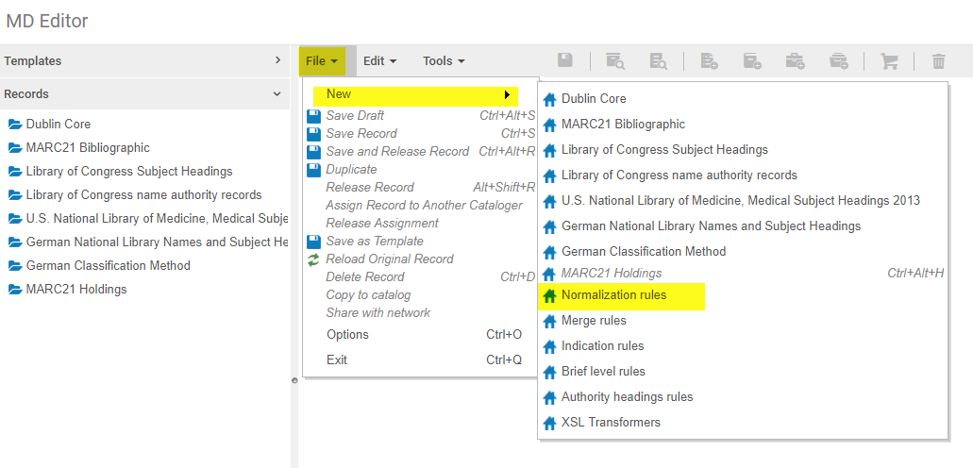
How to create a norm rule
Notes:
You can create a rule from scratch by going to the ME, File, New, Normalization rules.

Slide 60
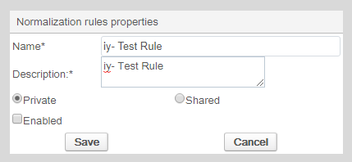
How to create a norm rule
Notes:
The name and description of the rule are required. The default setting for a new norm rule is private. If you leave this setting, no one will be able to see your rule and you won’t be able to include this rule as part of a norm process. As a general practice, I simply set my newly created norm rules to shared and enabled.

Slide 61
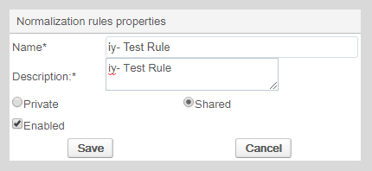
How to create a norm rule

Slide 62
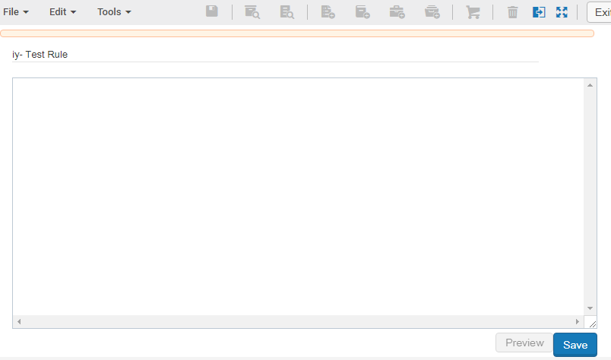
How to create a norm rule

Slide 63

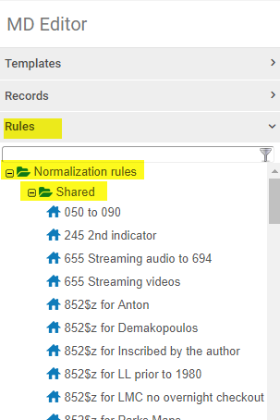
How to create a norm rule
Notes:
You can also duplicate an existing norm rule.

Slide 64
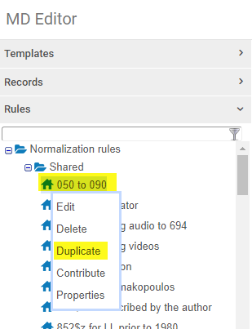
How to create a norm rule

Slide 65
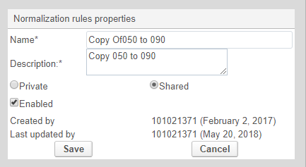
How to create a norm rule

Slide 66
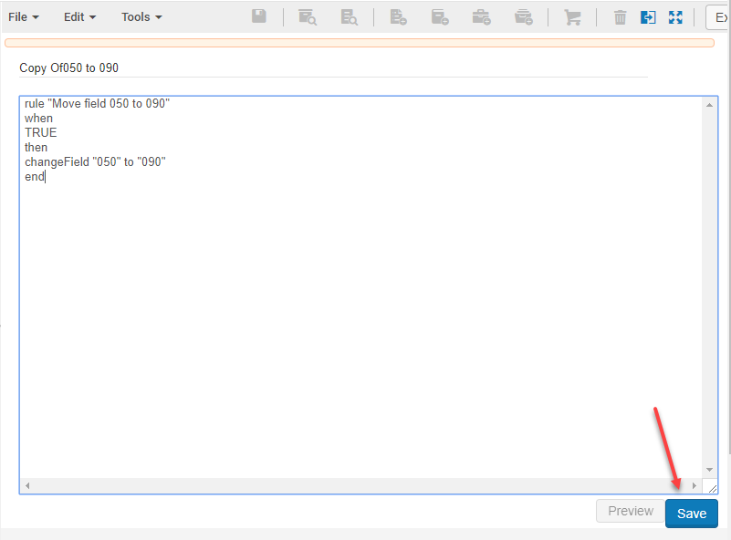
How to create a norm rule

Slide 67
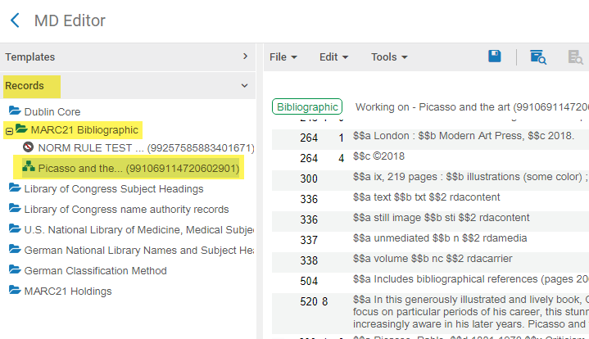
How to test a norm rule

Slide 68
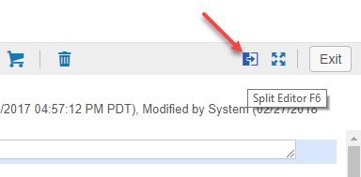
How to test a norm rule

Slide 69
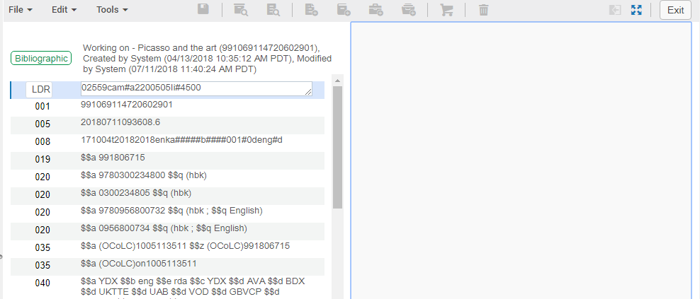
How to test a norm rule

Slide 70
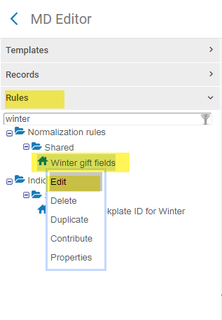
How to test a norm rule

Slide 71
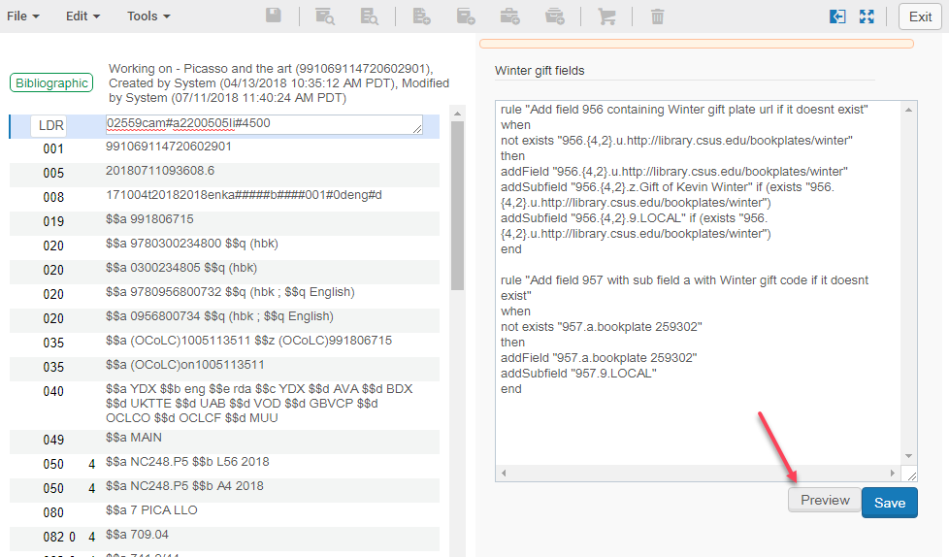
How to test a norm rule

Slide 72
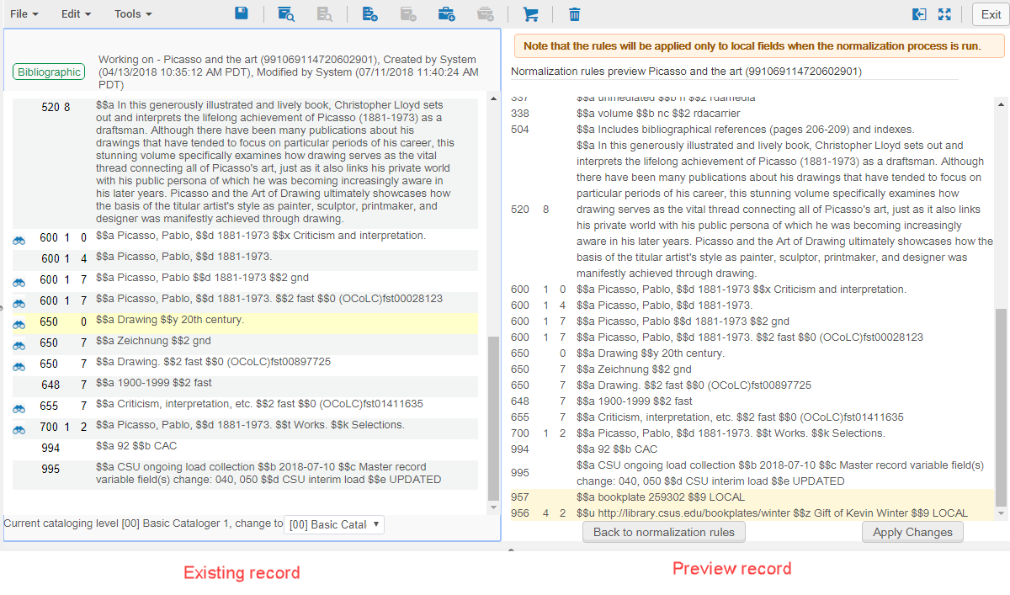

Slide 73
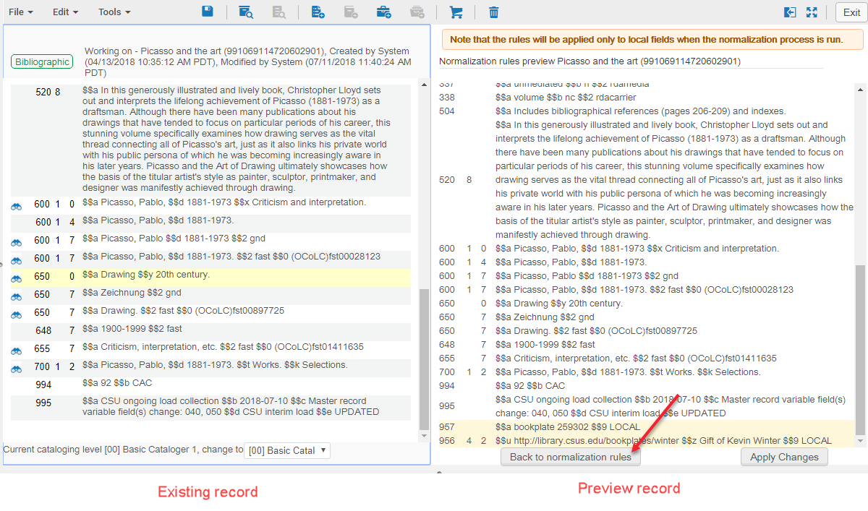

Slide 74
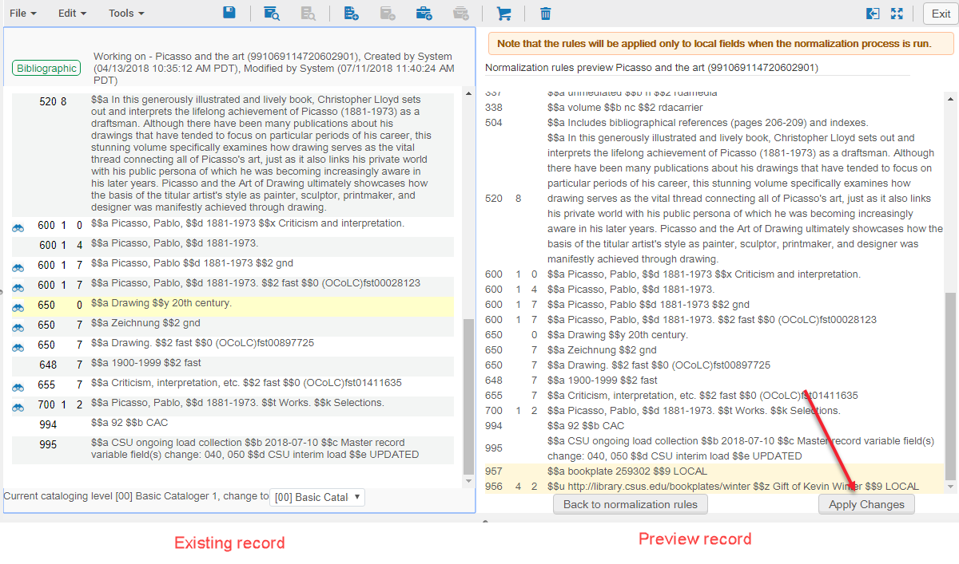

Slide 75
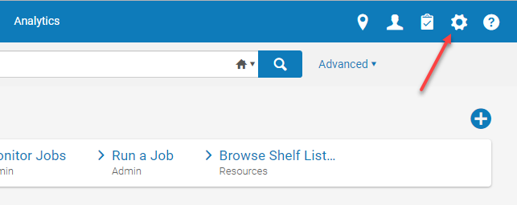
How to configure a norm process

Slide 76
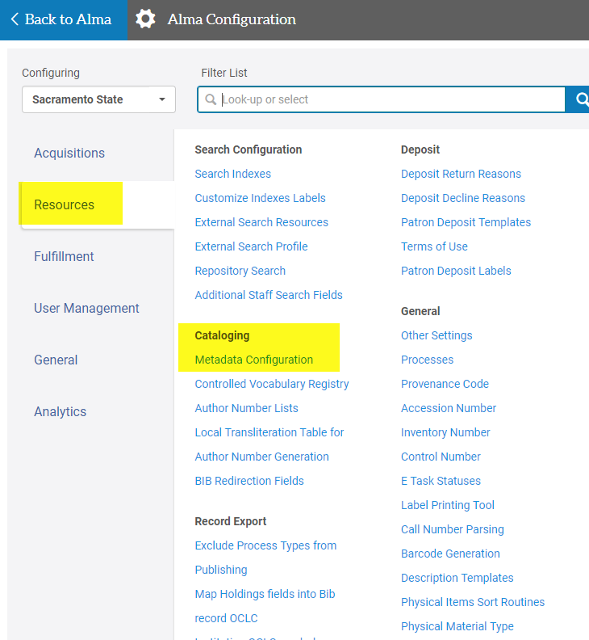
How to configure a norm process

Slide 77
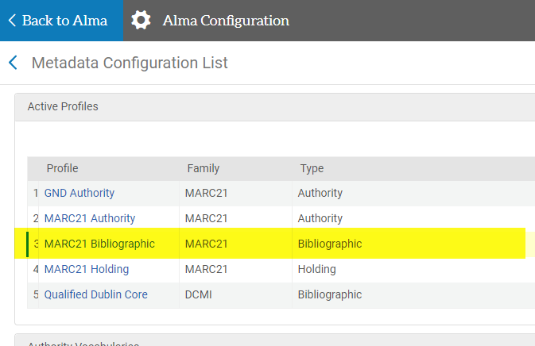
How to configure a norm process

Slide 78
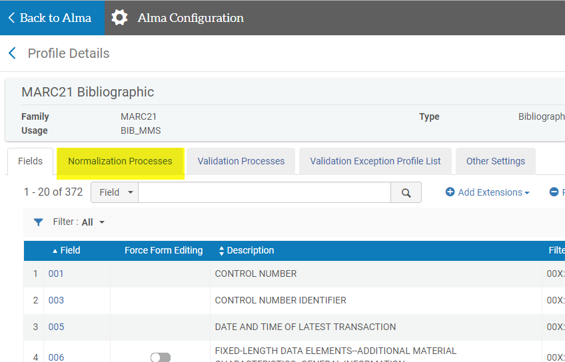
How to configure a norm process

Slide 79
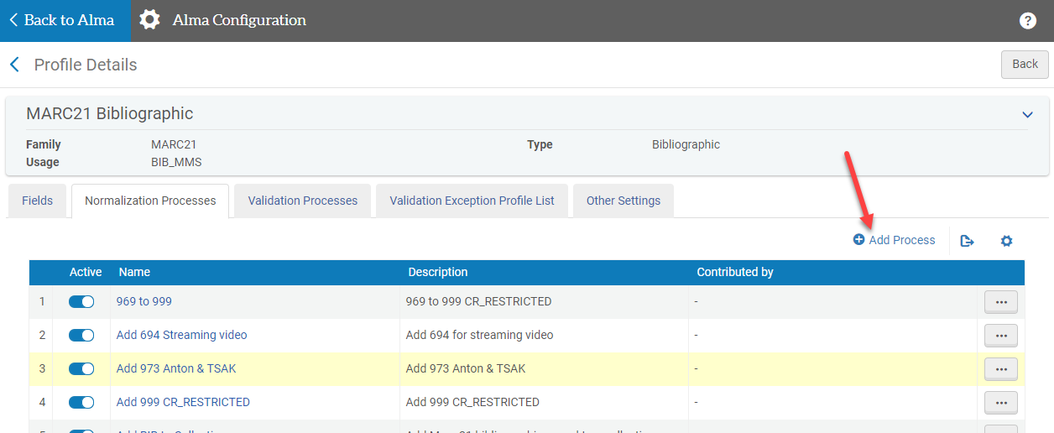
How to configure a norm process

Slide 80
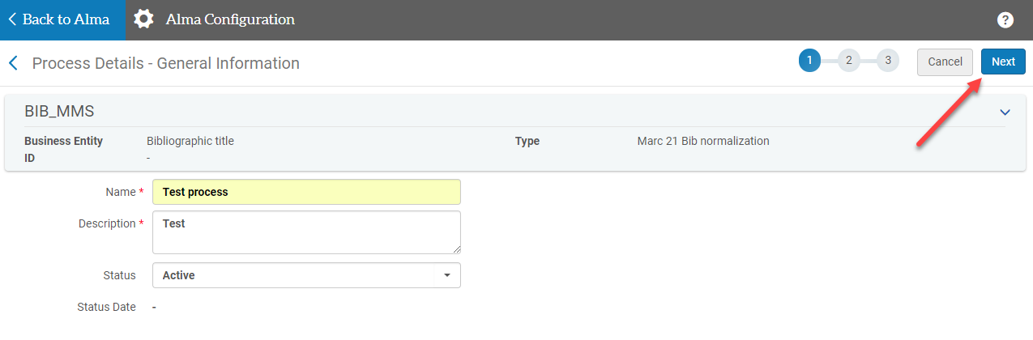
How to configure a norm process

Slide 81
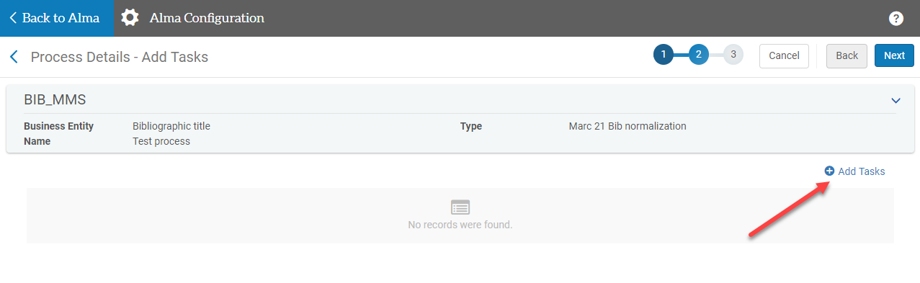
How to configure a norm process

Slide 82
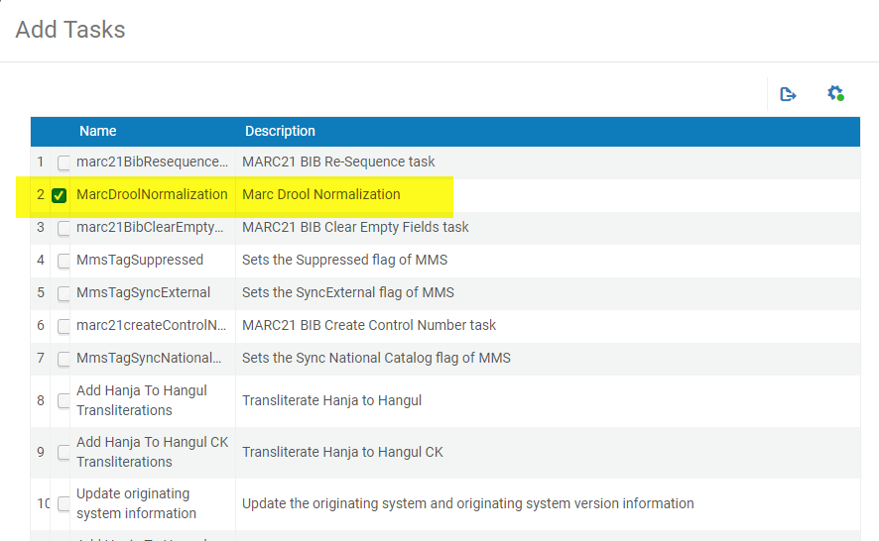
How to configure a norm process

Slide 83
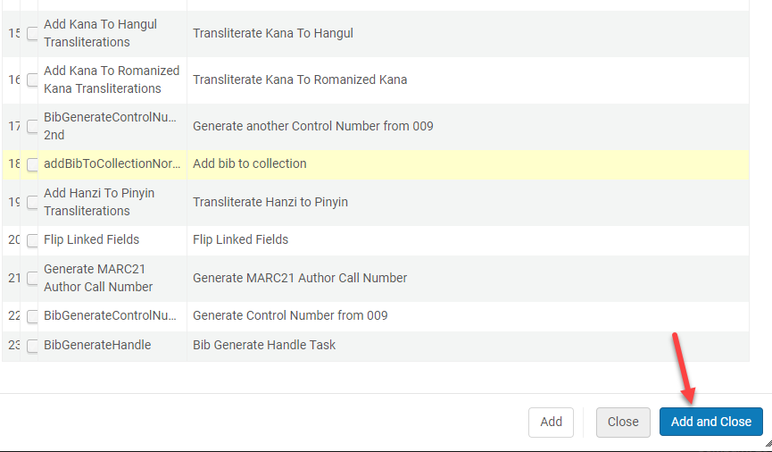
How to configure a norm process

Slide 84
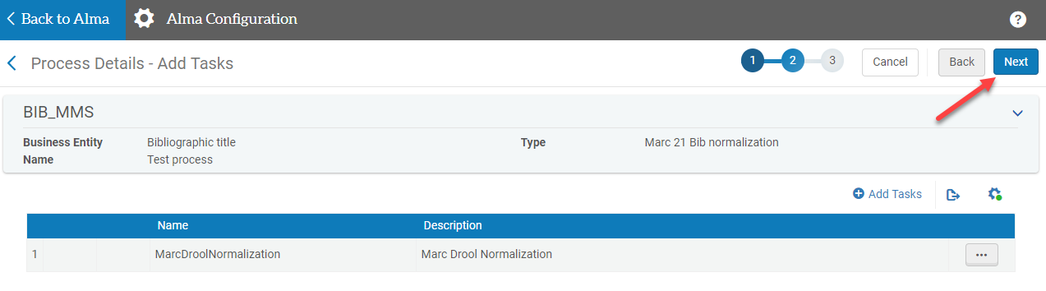
How to configure a norm process

Slide 85
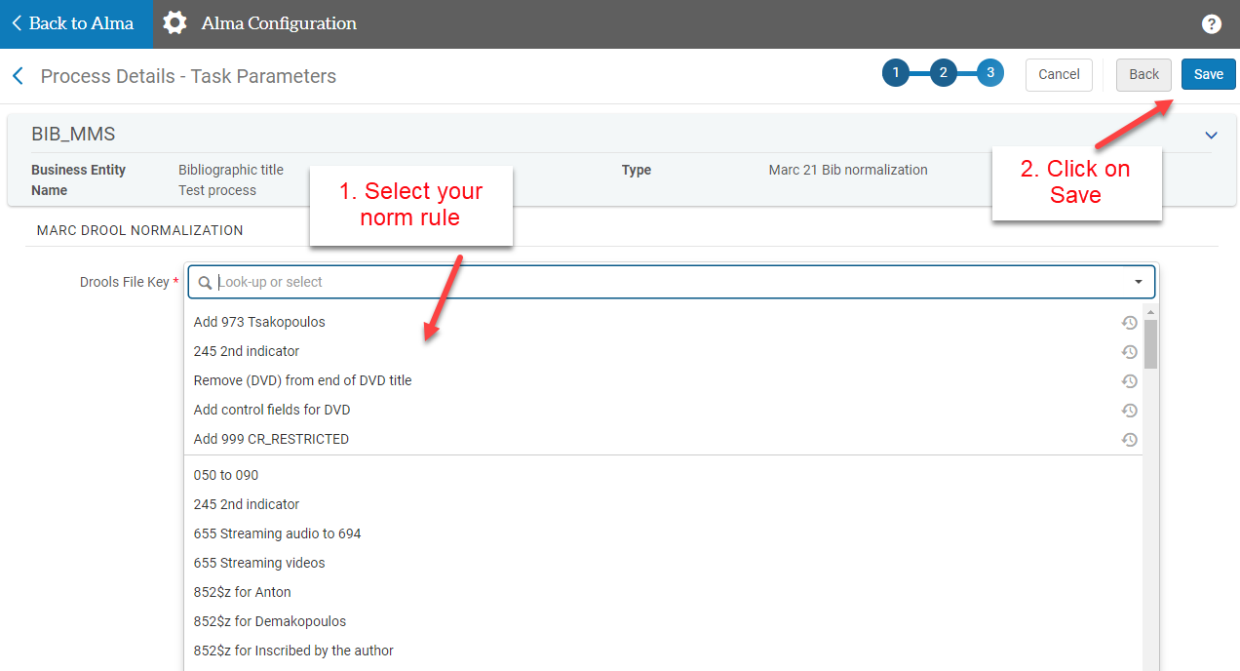
How to configure a norm process

Slide 86
Where are norm processes executed?
Metadata editor (enhance a record)
As a job on a set of MARC21 bib records
Change holding information job
Part of an import profile
Notes:
Also executed in:
Normalize records imported via Search External Resources
Normalize records imported via an integration profile
Publishing profile
Normalize on Save

Slide 87
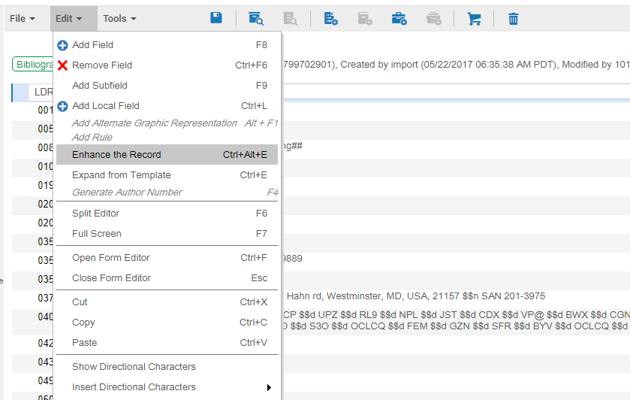
Enhance a bib record (ME)
Notes:
ULMS consideration: When you’re in an NZ bib record and select enhance a record (CTRL+ALT+E), you’ll be presented with NZ normalization options. When you’re in an IZ bib record, you’ll be presented with IZ normalization options. Most of the bibs we work with are NZ-linked bibs, and most of our norm processes are configured at the IZ level. So, this particular workflow may not seem ideal. While you can’t run an IZ normalization process on an NZ bib record within the metadata editor, you can run an IZ-based process on a set of NZ-linked bibs via a job.

Slide 88
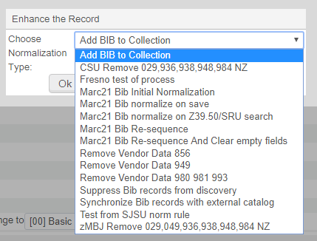
Enhance a bib record (ME)
Notes:
ULMS consideration: When you’re in an NZ bib record and select enhance a record (CTRL+ALT+E), you’ll be presented with NZ normalization options. When you’re in an IZ bib record, you’ll be presented with IZ normalization options. Most of the bibs we work with are NZ-linked bibs, and most of our norm processes are configured at the IZ level. So, this particular workflow may not seem ideal. While you can’t run an IZ normalization process on an NZ bib record within the metadata editor, you can run an IZ-based process on a set of NZ-linked bibs via a job.

Slide 89
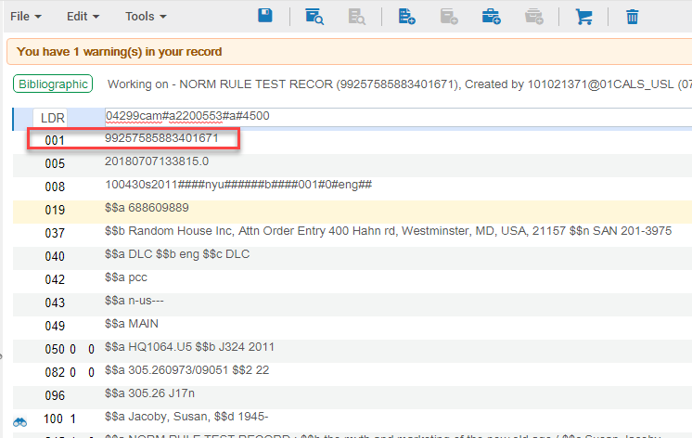
Enhance a bib record (ME)
Notes:
ULMS consideration: When you’re in an NZ bib record and select enhance a record (CTRL+ALT+E), you’ll be presented with NZ normalization options. When you’re in an IZ bib record, you’ll be presented with IZ normalization options. Most of the bibs we work with are NZ-linked bibs, and most of our norm processes are configured at the IZ level. So, this particular workflow may not seem ideal. While you can’t run an IZ normalization process on an NZ bib record within the metadata editor, you can run an IZ-based process on a set of NZ-linked bibs via a job.

Slide 90
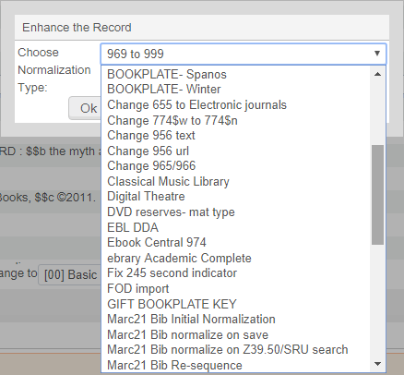
Enhance a bib record (ME)
Notes:
ULMS consideration: When you’re in an NZ bib record and select enhance a record (CTRL+ALT+E), you’ll be presented with NZ normalization options. When you’re in an IZ bib record, you’ll be presented with IZ normalization options. Most of the bibs we work with are NZ-linked bibs, and most of our norm processes are configured at the IZ level. So, this particular workflow may not seem ideal. While you can’t run an IZ normalization process on an NZ bib record within the metadata editor, you can run an IZ-based process on a set of NZ-linked bibs via a job.

Slide 91
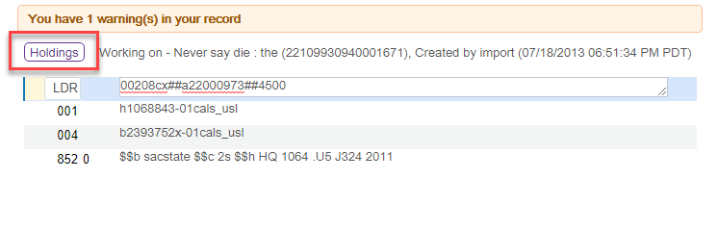
Enhance a holdings record (ME)
Notes:
ULMS consideration: When you’re in an NZ bib record and select enhance a record (CTRL+ALT+E), you’ll be presented with NZ normalization options. When you’re in an IZ bib record, you’ll be presented with IZ normalization options. Most of the bibs we work with are NZ-linked bibs, and most of our norm processes are configured at the IZ level. So, this particular workflow may not seem ideal. While you can’t run an IZ normalization process on an NZ bib record within the metadata editor, you can run an IZ-based process on a set of NZ-linked bibs via a job.

Slide 92
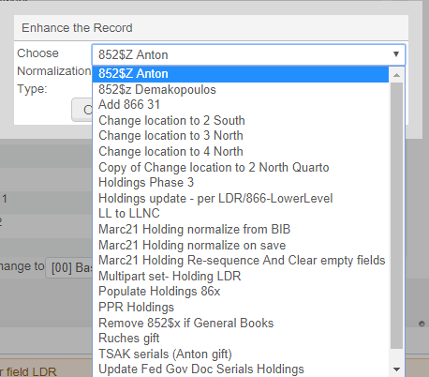
Enhance a holdings record (ME)
Notes:
ULMS consideration: When you’re in an NZ bib record and select enhance a record (CTRL+ALT+E), you’ll be presented with NZ normalization options. When you’re in an IZ bib record, you’ll be presented with IZ normalization options. Most of the bibs we work with are NZ-linked bibs, and most of our norm processes are configured at the IZ level. So, this particular workflow may not seem ideal. While you can’t run an IZ normalization process on an NZ bib record within the metadata editor, you can run an IZ-based process on a set of NZ-linked bibs via a job.

Slide 93
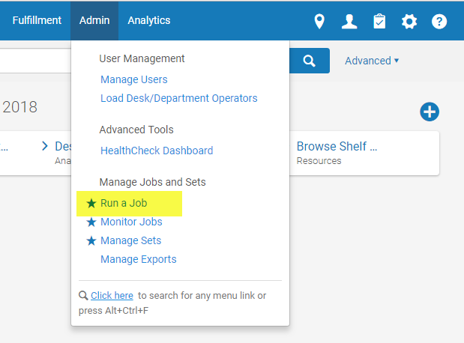
Run a job on a set of bib records

Slide 94
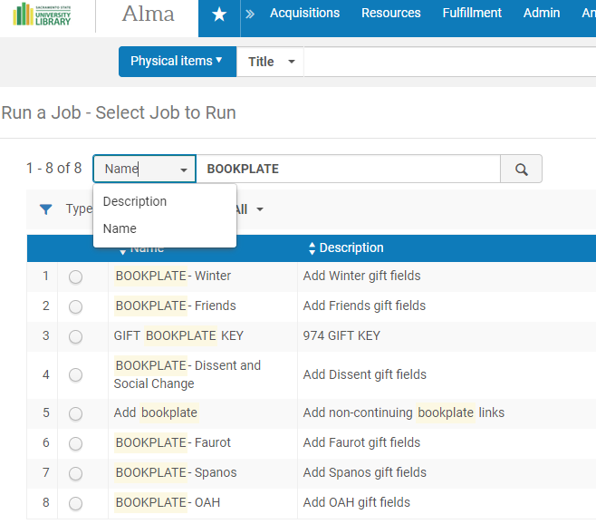
Run a job on a set of bib records

Slide 95
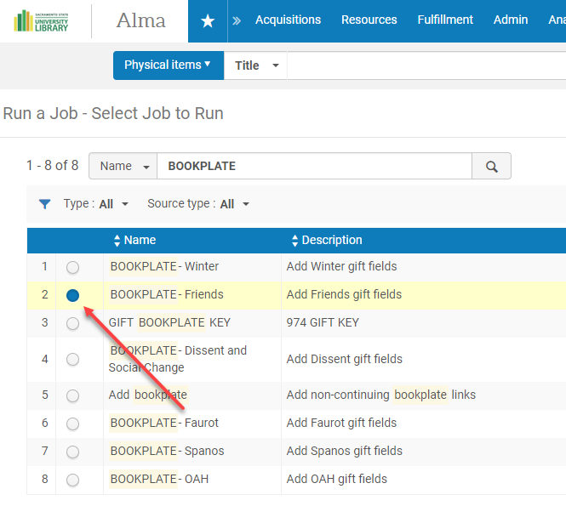
Run a job on a set of bib records

Slide 96
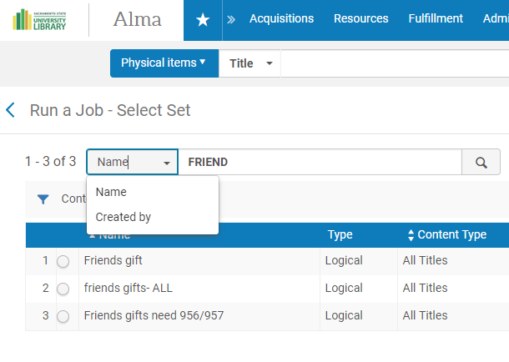
Run a job on a set of bib records

Slide 97
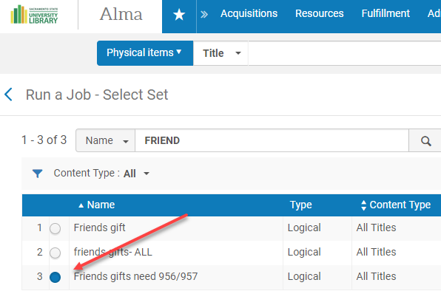
Run a job on a set of bib records

Slide 98
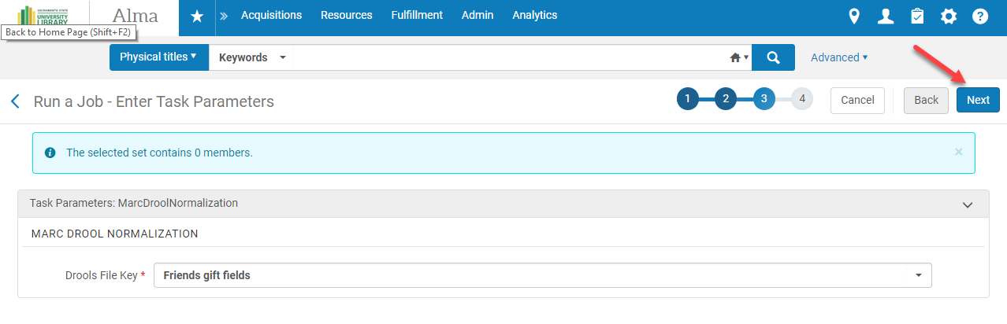
Run a job on a set of bib records

Slide 99
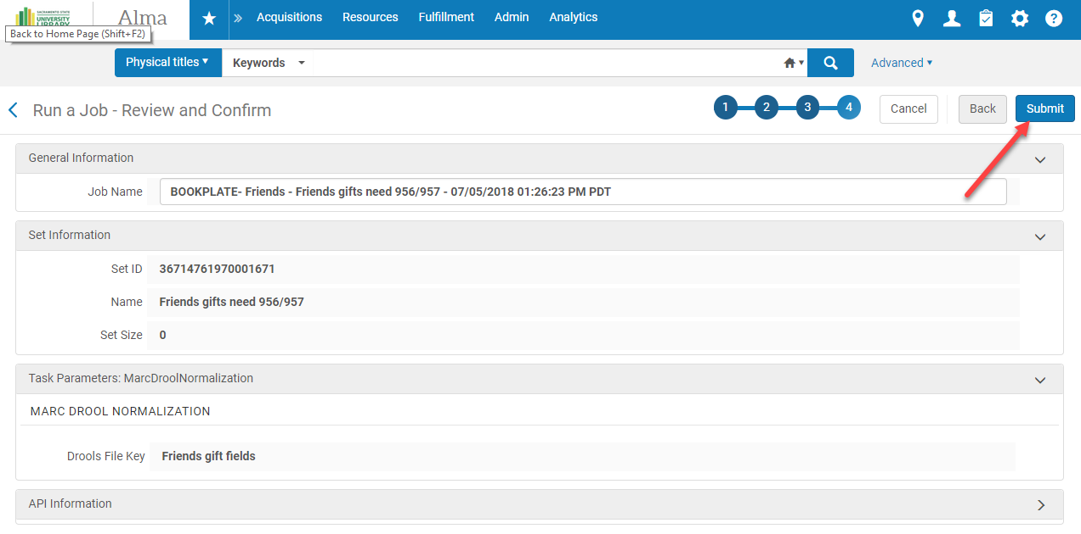
Run a job on a set of bib records

Slide 100
Run a Change Holding Information job

Slide 101
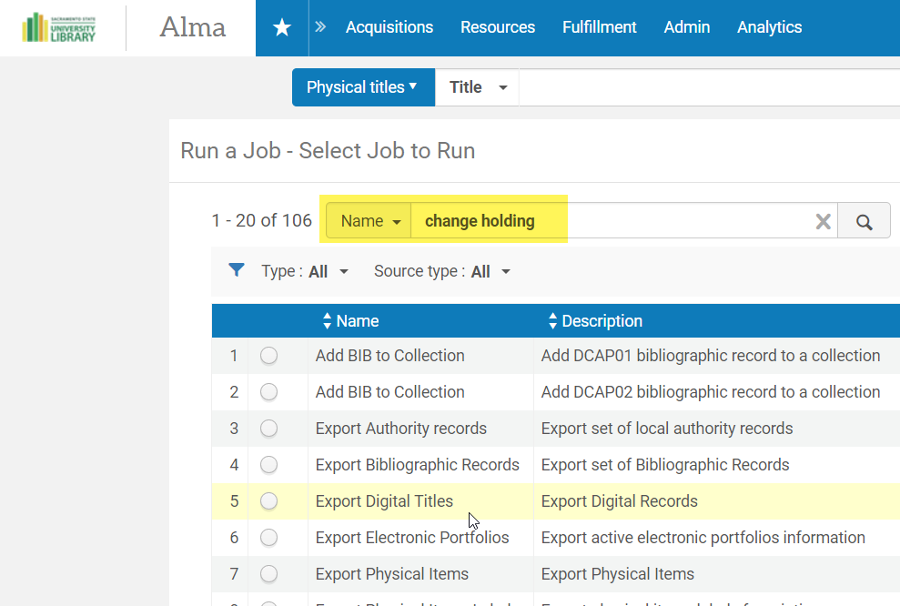
Run a Change Holding Information job

Slide 102
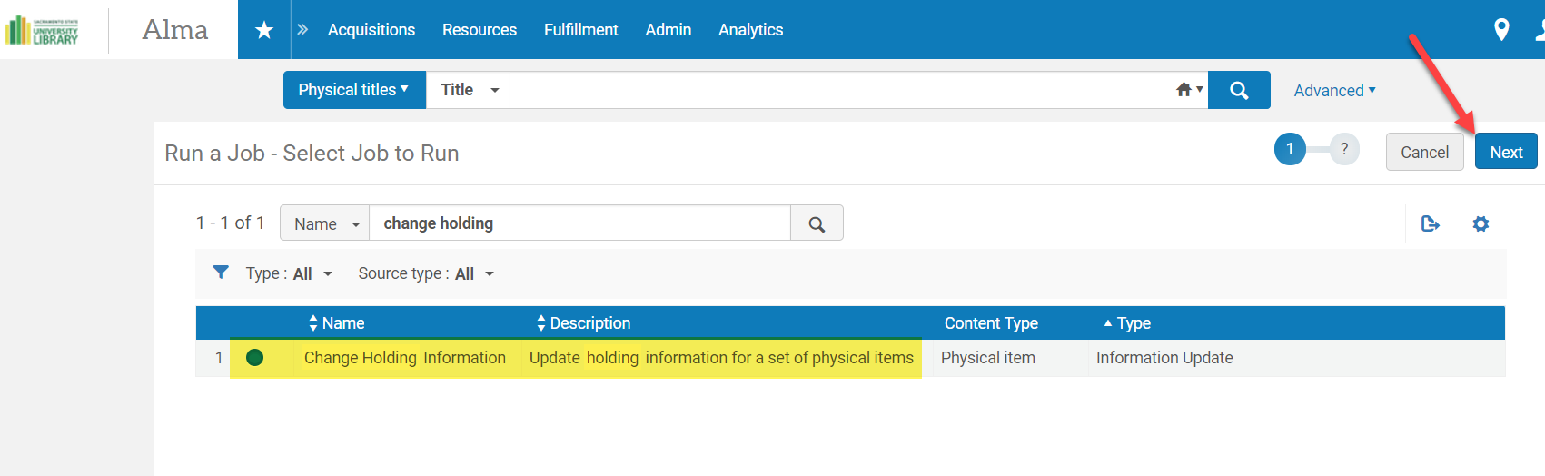
Run a Change Holding Information job

Slide 103
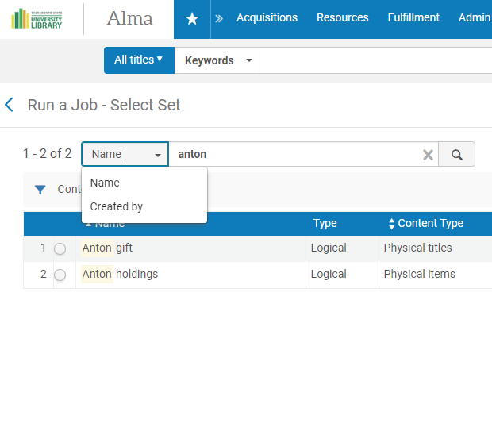
Run a Change Holding Information job

Slide 104
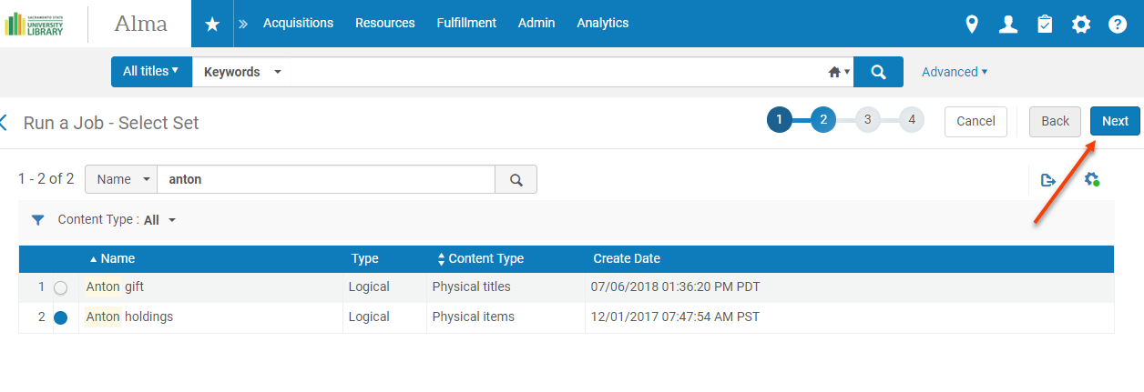
Run a Change Holding Information job

Slide 105
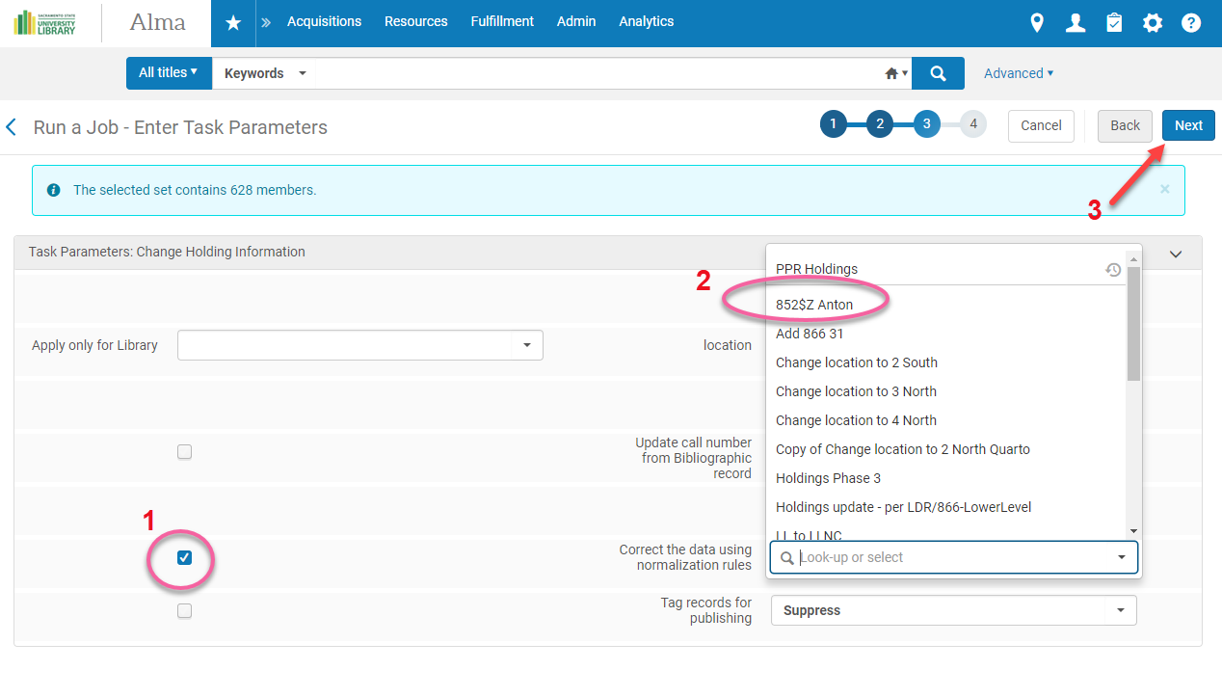
Run a Change Holding Information job

Slide 106
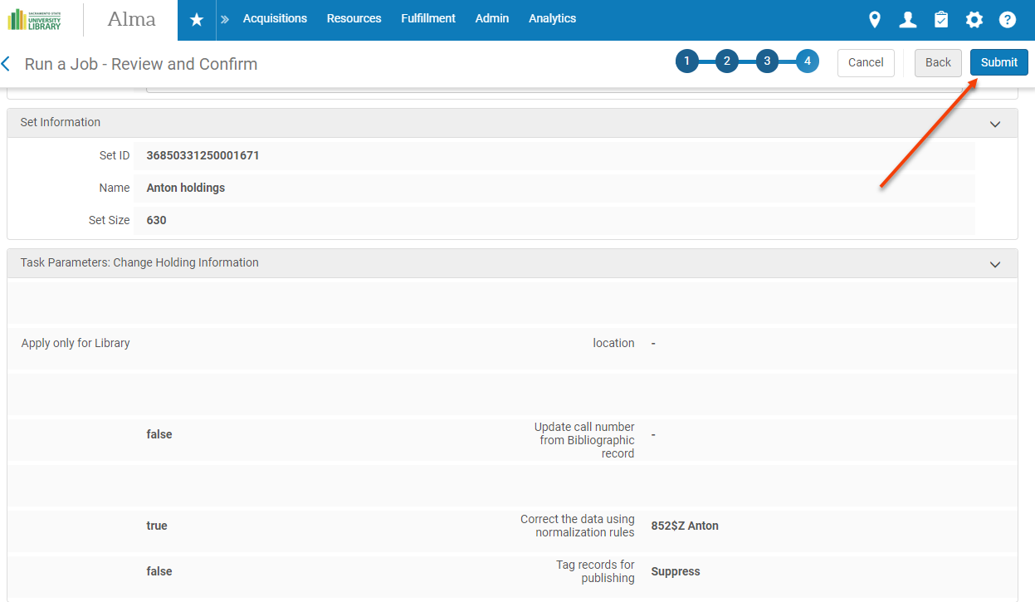
Run a Change Holding Information job

Slide 107
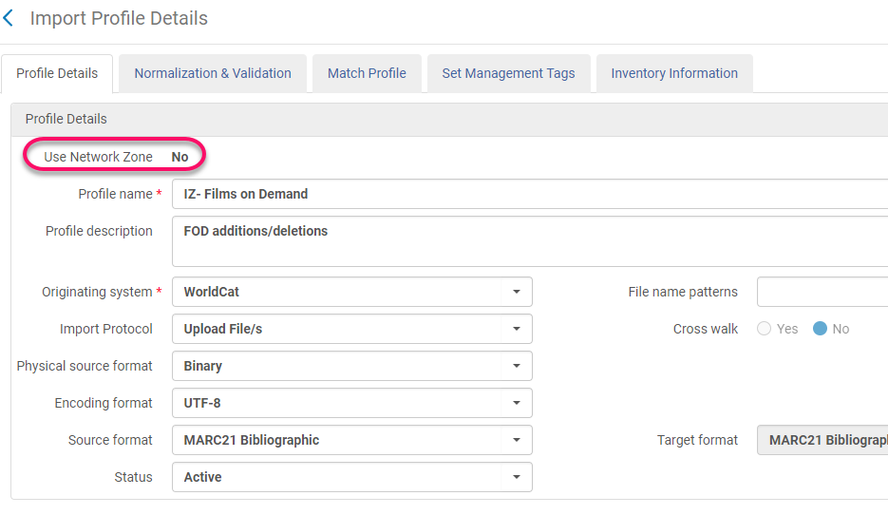
Import Profile Normalization

Slide 108
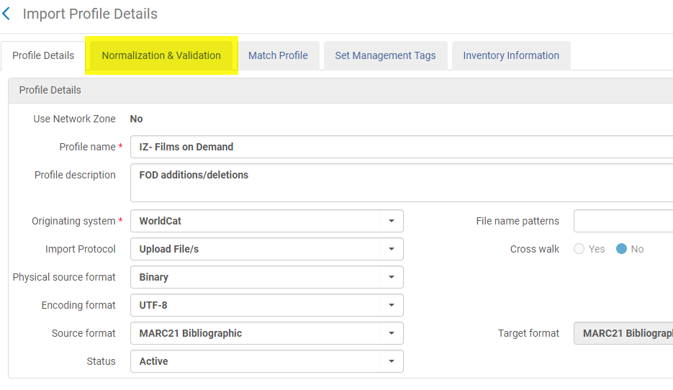
Import Profile Normalization

Slide 109

Import Profile Normalization

Slide 110

Import Profile Normalization

Slide 111

Import Profile Normalization

Slide 112

Import Profile Normalization

Slide 113
Import Profile Normalization

Slide 114
Import Profile Normalization

Slide 115
Resources
McDonald, Steve (2018) How to Write Alma Normalization Rules, presented at ELUNA, Spokane WA, 2018. (login required)
Working with Normalization Rules (Ex Libris Knowledge Center).
Normalization Rule Examples (Ex Libris Knowledge Center).
Additional Presentations & Documents- Normalization Rules (Ex Libris Knowledge Center).

Slide 116

Questions?
Israel Yáñez
yanezi@csus.edu
@israel on Slack

