Slide 1
Cal State Walk-in user CSU+ Configuration Points
User Identifiers
Account types
User Groups
User Roles
Password
Display logic and GES

Slide 2
User Identifiers
Primary Identifier
Used as Primo login User ID.
Cal State Walk-in user creation auto-generates a long number as Primary Identifier.
Change Primary Identifier to user email for an easy to remember Primo User ID.
Barcode
Add a Barcode Identifier for easy Alma patron identification.
Use a premade barcode sticker or create your own using a barcode font.

Slide 3
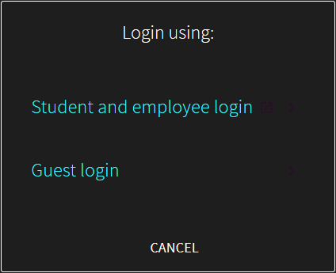
Account types
External
Account details stored and managed by an external system.
Primo External user login uses top button.
Internal
Account details stored and managed by Alma.
Primo Internal user login uses bottom button.

Slide 4
Account types
Cal State Walk-in accounts are created as External type
User details (limited) are transmitted from home campus Alma to host campus Alma.
–Verifies current CSU enrollment.
Cal State Walk-in External account cannot login to host campus Primo.
– Login credentials won’t pass campus authentication.

Slide 5
Account types
Toggle account type from External to Internal to allow login at host campus.
Imported user details get saved to host Alma and will not be updated by External system.
Cal State Walk-in Internal account can login to host Primo as Guest.
Toggle account type before creating user password – very important!
Internal user will need an internal expiration date – end of semester is recommended.

Slide 6
User Groups
User Groups are used to automatically add user roles and terms of service.
Cal State Walk-in account creation should automatically map to:
User Group = CalState Walkin Patrons
If this does not happen, manually select CalState Walkin Patrons and investigate later.
User Groups can be used in Display Logic Rules.

Slide 7
User Roles
User Roles determine what actions a user account can perform.
CalState Walkin Patrons User Group should automatically map to:
User Role = Patron
If this does not happen, manually add Patron role and investigate later.
Role name = Patron
Role area = Fulfilment
Scope = University

Slide 8
Password
Users need a password to login to host Primo.
Force password change on next login only applies to Alma – unclick checkbox.
If convenient for workstation setup – allow users to create their own password.
If inconvenient for workstation station setup – create a default password. -Give default to users with instructions to change Password after Primo login.
Toggling user account type will delete user password. – Create password at end of account creation to avoid user login failure.

Slide 9
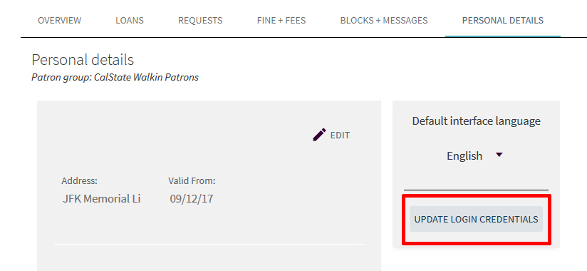
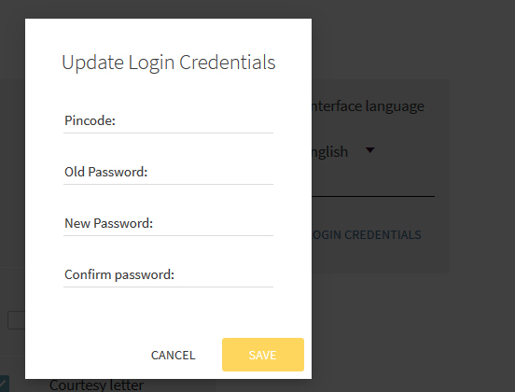
Password
Primo Password Change: My Account → Personal Details→ Update Login Credentials

Slide 10
Display Logic Rules and GES
Discovery Interface Display Logic determines what links appear for users.
Primo default is all links and services are visible – display logic works by hiding, not showing.
Display logic rules determine what links and services are hidden under specific conditions.
Verify that CalState Walkin Patrons User Group is not included in:
-Hide service Resource Sharing Request rule.
Display Logic Rules can also hide ILLiad link from CalState Walkin Patrons User Group.

Slide 11
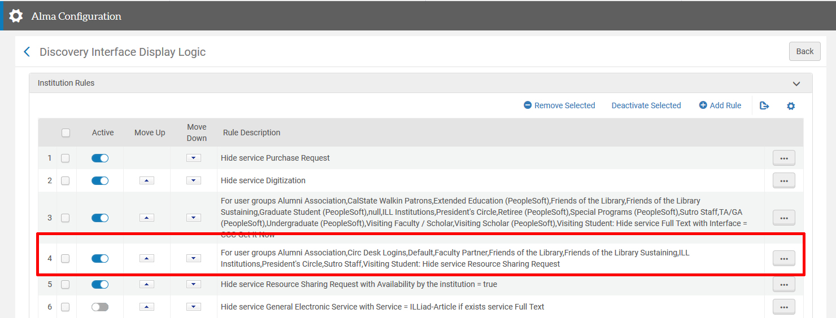
Display Logic Rules and GES

Slide 12
Display Logic Rules and GES
General Electronic Services- Primo links created by an institution for any purpose.
Doesn’t actually have to be a link. Can be used to hide a link as well.
Less common than Display Logic Rules, but a GES might be used to hide CSU+ from certain users.
If CSU+ link is still hidden after Display Logic verification, check General Electronic Services.

Slide 13
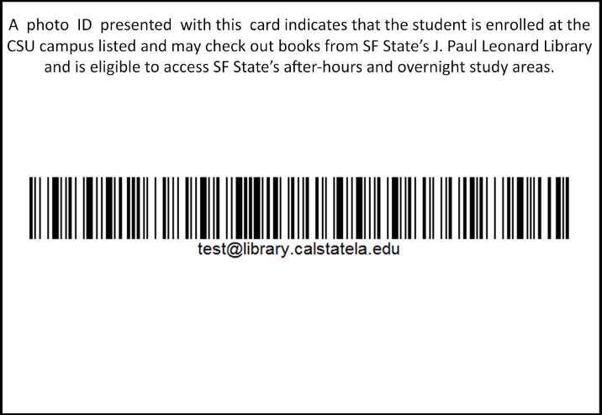
CSU Visiting User Library Card

Slide 14
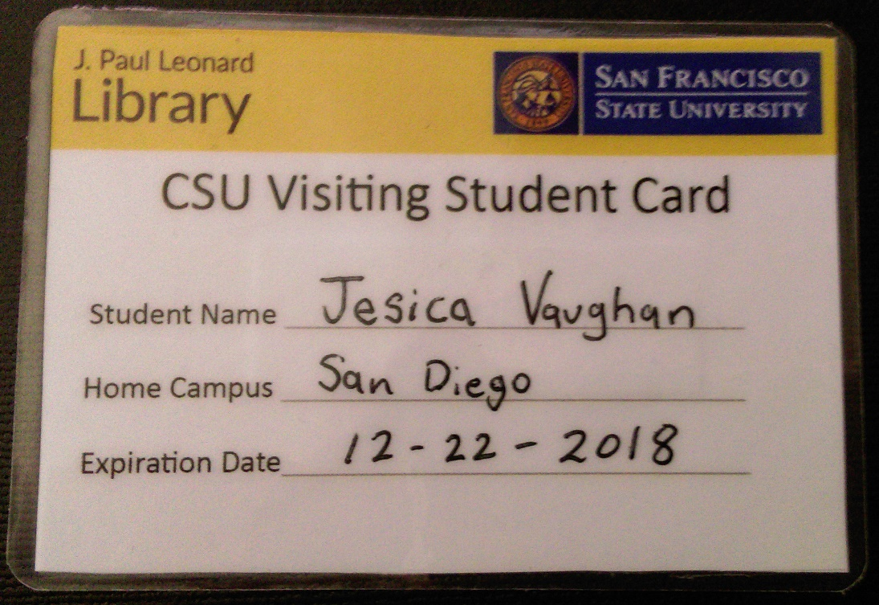
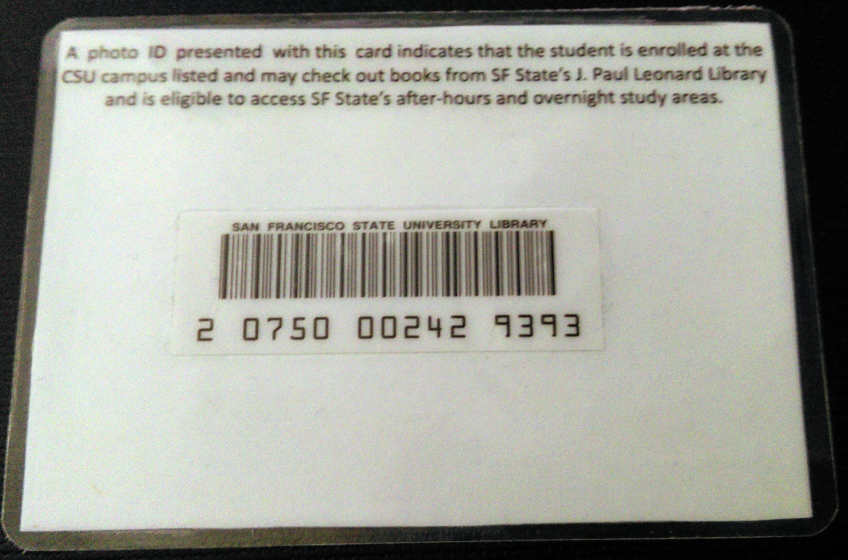
CSU Visiting User Library Card

Slide 15
Why go through the trouble of allowing Cal State Walk-in patrons access to CSU+?
Is CSU+ only a service to allow local users access to other CSU library collections?
Or
Is CSU+ an idea, one central to the concept of a unified CSU library?

Slide 16
The CSU Libraries Strategic Plan

Slide 17
Vision
The CSU Libraries are internationally-recognized for their essential contributions to enriching the learning environment, informing and educating communities, and transforming knowledge and scholarship by connecting people and ideas.

Slide 18
Mission
The CSU Libraries collaborate, innovate, and leverage opportunities to advance learning, discovery, knowledge creation, and the public good through the provision of equitable services, expertise, and information resources.

Slide 19
Statement on Diversity and Social Justice
The CSU Libraries collectively advocate for social justice and inclusive excellence. We are dedicated to promoting and celebrating the diversity within our libraries and campuses by collaborating to create open and accessible collections, services, physical spaces, and hiring practices in support of an engaged and educated community.

Slide 20
Guiding Principles
The purpose of this strategic plan is to provide a roadmap for shared initiatives and decision-making across the libraries of the twenty-three CSU campuses. It is powerful--both symbolically and fiscally--when this large number of libraries advocate for collective action. However, because it is not always possible for a shared solution to meet the needs of all CSU Libraries, it is acknowledged that finding balance between a library’s responsibility to its campus mission and the CSU Libraries collective is influenced by a variety of factors and will vary by initiative. As such, the following values guide the collective action of the CSU Libraries:

Slide 21
Guiding Principles
The centrality of libraries to information literacy, critical thinking, and student success;
The importance of open and equitable access to information;
The responsibility of community engagement, especially in the preservation of history;
A culture of communication, honesty, respect, and trust;
The desire to advance creative thinking and infrastructure necessary for innovation;
A practice of continuous improvement; and
Intellectual freedom and user data privacy as bedrock principles.

Slide 22
Strategic Priorities
Student Learning and Success
In support of student success and continuous improvement, CSU Libraries advance student learning by assessing student information literacy competencies, evaluating library services, aligning student needs with their experience in the library, and leveraging shared analytics to make evidence-based decisions for student benefit and improvement. To further accomplish this, the CSU Libraries will:

Slide 23
Strategic Priorities: Student Learning and Success
Share knowledge to build bridges between strategies and tactics employed by individual campuses in support of Graduation Initiative 2025;
Review current and cutting-edge research methodologies to identify the most promising approaches;
Demonstrate how information literacy instruction can positively impact student learning and success and campus accreditation goals in order to develop CSU best practices;
Collaborate across libraries and with campus institutional research offices to build models to triangulate library data with institutional, programmatic, and course data; and
Communicate the impact of the CSU Libraries’ services, spaces, collections, and information literacy activities on student success to CSU stakeholders.

Slide 24
Strategic Priorities
Shared Collections
In support of existing and emerging research and teaching activities, the CSU Libraries facilitate discovery, delivery, and preservation of information resources and strive to acquire, preserve, and provide equitable access to shared information resources for all students and faculty regardless of campus. To further accomplish this, the CSU Libraries will:

Slide 25
Strategic Priorities: Shared Collections
Negotiate shared content rights when possible in order to provide expanded access to our students and faculty, while maximizing buying power and reducing duplicative costs;
Network to share information resources in print and digital formats as seamlessly and porously as possible across campuses;
Select, acquire, catalog, and preserve materials collaboratively;
Capitalize on storage efficiencies;
Collaboratively develop a model for a CSU-wide, long-term, shared print collection; and
Advocate for central budgetary support in order to sustain and grow core collections.

Slide 26
Strategic Priorities
Infrastructure for Innovation
In support of innovation, the CSU Libraries leverage the ability of the collective to optimize efficiencies and build new capacities in support of the research and learning needs of CSU students, faculty, and staff. CSU Libraries collaboratively advance shared platforms for data analysis, preservation, digitization, discovery, and information sharing. To further accomplish this, the CSU Libraries will:

Slide 27
Strategic Priorities: Infrastructure for Innovation
Maintain and improve upon a unified library services platform and resource sharing network;
Purchase, develop, and implement relevant technologies at scale to serve all twenty-four libraries;
Share skills and expertise across libraries and emphasize technical training and continuing professional development for library faculty and staff;
Share digital learning objects, scripts, or applications that facilitate the discovery and delivery of library resources; and
Highlight CSU Library innovations and workflows via national and local conferences and publications.

Slide 28
Strategic Priorities
Scholarly Communications and Openness
In support of open access and the economic justice inherent in supporting faculty and students’ unfettered access to research and course materials, the CSU Libraries work collaboratively to redefine existing models of scholarly communication, create shared infrastructure for hosting open information, and educate our communities about these and related issues. To further accomplish this the CSU Libraries will:

Slide 29
Strategic Priorities: Scholarly Communications and Openness
Support publishing models that prioritize flexibility and open access in our collections decisions;
Promote open access publishing with CSU faculty and collaborate to highlight the scholarly, creative, and unique collections produced by the CSU community;
Develop ScholarWorks as a CSU-wide option for highlighting and publishing research, scholarship, and creative works produced by the CSU system;
Lead efforts to collaborate with faculty to transition course materials to open education resources;
Commit to open source applications, when feasible;
Support open data standards; and
Ensure a library workforce with the skills to engage in these emerging scholarly communications conversations.

Slide 30
Future Concerns
To provide access to the shared print collection for all students and faculty regardless of campus (or campus visited), users need to know about Cal State Walk-in users and CSU+.
How do we, as the CSU+ community, inform and educate the collective usership of CSU Libraries about CSU+ as an idea instead of just a local service?

Slide 31
Special Thanks to:
Fellow members of the Visiting patron task force:
Troy Compton, San Diego State University
Chris Lee, Cal Poly San Luis Obispo
Matthew Prutsman, Cal State LA
the amazing acting performance by:
Jesi Vaughan, San Diego State University

