Slide 1
Introduction to Alma Analytics
ULMS Summer Meeting 2018
Megan Drake
Senior Implementation Consultant

Slide 2
Agenda
1
Analytics Basics – Structure & Terms
2
Out-of-the-Box analyses
3
Creating new analyses
4
Honorable Mentions

Slide 3
Analytics Basics & Structure
Design Analytics takes you to an outside application / Oracle
Analytics retains deleted items, bibs, portfolios, and requests
Notes:
Subject Area >Dimensions >Field
Measure
Descriptive

Slide 4
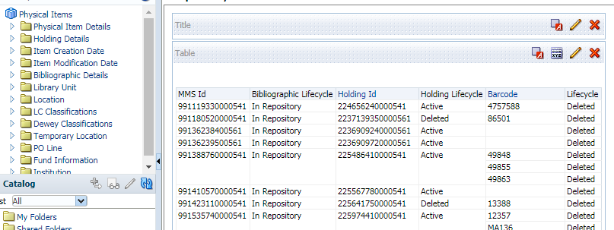
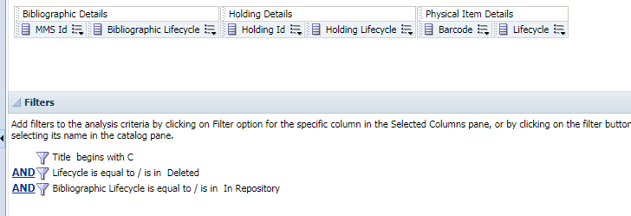
Analytics Basics & Structure
Notes:
Important to remember when building reports.
Sometimes people build a report and find bibs or barcodes that are not found in Alma – they have not added a filter to find only things not deleted.

Slide 5
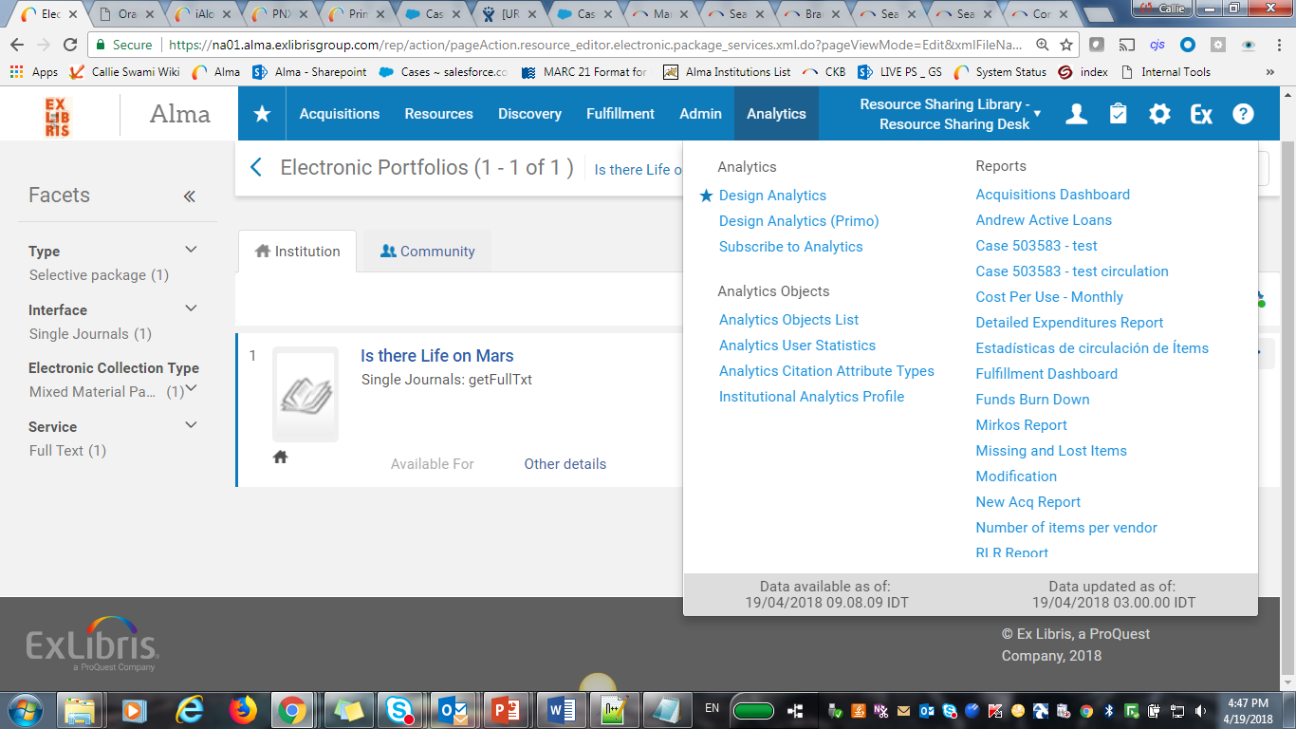
Analytics Basics & Structure
Analytics is updated daily

Slide 6
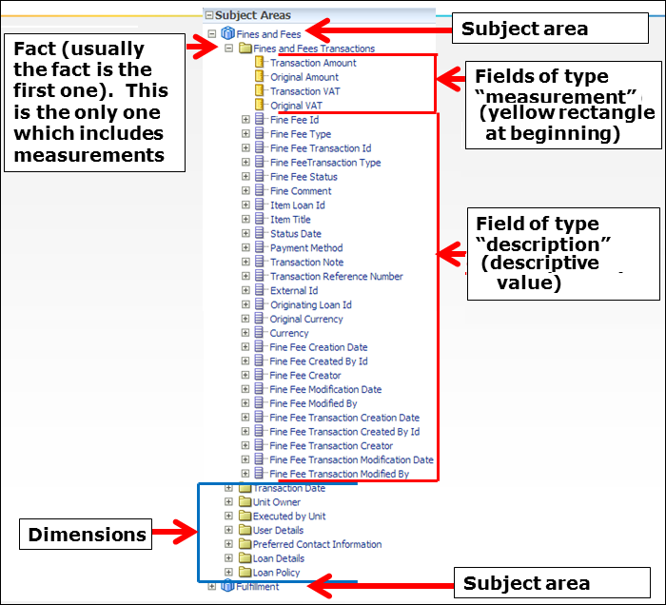
Terminology
Notes:
Analytics is made of Subject Areas containing various fields

Slide 7

Hands-on: Exploring Analytics
Notes:
In Alma – Analytics Tab – Shows when it was updated
Open Design analytics
Catalog – The following folders are available:
My folders – A read / write personal folder accessible only to the logged in user.
Alma – A read-only folder containing out-of-the-box reports produced by Ex Libris.
Your Institution – A read / write folder for the institution to save and edit reports. It is accessible and visible only to the institution. It has the name of the specific institution.
Community – A read / write folder visible and accessible to save and copy reports for all institutions. Includes reports and dashboards of all the institutions with Alma in the world. It contains only queries (no data of other institutions is visible).
If you save a report in any subdirectory of /shared/Community/, there is a chance that a member of another institution will edit or delete it.
If you save a report in any subdirectory of /shared/INST/, no member of any other institution can edit or delete it.
Community Folder
Cosortia - A folder for consortia to open sub-folders as desired and share reports, dashboards, etc. The consortia can agree that all separate institutions can create and access reports from this folder.
Ex Libris Development - A folder for Ex Libris
Institutions - A folder for institutions to open sub-folders as desired and share reports, dashboards, etc. One institution, for example, might tell another institution to look at the report it made in John Smith College under the Institutions folder of the community.
Regional User Groups - A folder for regional user groups to save reports. This may be useful, for example, when preparing for local conferences.
Shared Reports - Contains the Reports sub-folder and multiple sub-folders by subject and business area. Each institution can contribute their own reports, prefixing the report by the name of their institutions.
Support - A folder used by support. Each institution can place a report in the support folder and then notify Ex Libris support when sending the support case that the report is in the support folder.
SEARCH Box - Expenditure per Classifications
Double click opens to criteria page – go home and show that it is saved under open

Slide 8
Agenda
1
Analytics Basics – Structure & Terms
2
Out-of-the-Box analyses
3
Creating new analyses
4
Honorable Mentions

Slide 9
Out-of-the-Box Reports
Found under Shared Folders > Alma
These are read-only
Opening will run query with your data

Slide 10

Hands-on: Out-of-the-Box Reports
Fulfillment – Count of Items Loaned by Patron Group
Acquisitions – Expenditure per Classifications
Inventory – Physical Inventory Count
E-Inventory - Electronic Inventory Count
Notes:
Shared > Alma > Fulfillment > Reports > Count of Items Loaned by Patron Group
Displays the number of items loaned annually per library and patron group.
Edit to see the criteria – in house loans are being edited
Shared > Alma > Acquisitions > Reports > Expenditure per Classifications
Displays annual expenditure per classification.
Shared > Alma > Inventory > Reports > Physical Inventory Count
Displays a count of physical items grouped by material type
Shared > Alma > E-Inventory > Reports > Electronic Inventory Count
Displays a count of electronic items grouped by material type
https://knowledge.exlibrisgroup.com/Alma/Product_Documentation/010Alma_Online_Help_(English)/080Analytics/060Out-of-the-Box-Reports

Slide 11
Hands-On: Fulfillment – Count of Items Loaned by Patron Group
Shared > Alma > Fulfillment > Reports > Count of Items Loaned by Patron Group
Re-ordering Columns
  Hover over the Library Name column, place the cursor up to the “bubble” header where it becomes a and move the column to the left-most position
Saving
  Choose SAVE AS – and save the report elsewhere (My Folder, Inst Folder, etc.)
Notes:
From the Fulfillment folder, let’s open the Count of Items Loaned by Patron Group analysis by clicking on the Edit button
Look at the results of the analysis
Notice the order of the columns on the Results tab, maybe you want the data organized by library instead of patron group.
Hover over the Library Name column, place the cursor up to the “bubble” header where it becomes a four-way arrow and move the column to the left-most position; Save as <Initials> Items Loaned a Long Time Ago and Not Returned.

Slide 12
Hands-On: Fulfillment
Edit Filter – limit to more recent data
    In Criteria tab > Loan Year Filter
    Greater that 2015
Adding Fields –
    Results tab > Bibliographic Details folder > drag and drop the Title column to the right of the Patron Group column
    Results tab > Loan Details > Double click Call Number
    Search for Barcode
Notes:
Go to the Criteria tab to edit the Loan Year filter to limit the results to year greater than; Save and review via the Results tab.
While on the Results tab, open the Bibliographic Details folder, drag and drop the Title column to the right of the Patron Group column; add Call Number and Barcode from the Loan Details folder as well as Due Date from the Due Date folder.
Review the updated analysis.
Perform a final Save for the analysis.

Slide 13
Hands-On: Acquisitions – Expenditure per Classifications
Shared > Alma > Acquisitions > Reports > Expenditure per Classifications
Editing Expenditures column to include exact dollar values
  Criteria Tab > Column Properties for Expenditures
  Data Format > Override Default Data Format
Editing a Filter
  Criteria Tab > Transaction Item Type > Click Pencil to edit filter
Editing a Column Header
  Criteria Tab > Column Properties for Expenditures
  Column format > Column Heading
Notes:
From the Acquisitions folder, let’s open the Expenditure per Classifications analysis by clicking on the Edit button.
Look at the results of the analysis.
Modify how we are seeing the data displaying in the Expenditures column to include exact dollar values.
Identify the three types of data that we can view.
Show how to change it to Allocation (Transaction Item Type filter)
Edit Column Heading
Use the Save As option to save the edited analysis to the institution folder.

Slide 14
Hands-On: Inventory – Physical Inventory Count
Shared > Alma > Inventory > Reports > Physical Inventory Count
Modify to compare bib level material type with the item material type
  Criteria Tab > Column Properties for Material Type
  Column format > Column Heading > Change to Bib Material Type
  Add Physical Item Details > Material Type
  Edit this column heading to Item Material Type
Notes:
From the Inventory folder, let’s open the Physical Inventory Count analysis by clicking on the Edit button.
Look at the results of the analysis; do the numbers make sense?
The Material Type column represents data taken from the Bib fixed fields.
Let’s modify this analysis to help us identify where we have material type mismatches between Bib and Item records.
Perform a Save as, calling the analysis, <initials> Physical Inventory Count with Bib and Item Material Types.

Slide 15
Hands-On: E-Inventory - Electronic Inventory Count
Shared > Alma > E-Inventory > Reports > Electronic Inventory Count
What resources are represented by a specific material type?
  Criteria tab > Material Type filter > “is equal to / is in” and choose a Value representing the smallest number of electronic resources
  Add title
  Adjust table using VIEW PROPERTIES > Maximum Width
Notes:
Maximum Width = 1500 pixels

Slide 16
Agenda
1
Analytics Basics – Structure & Terms
2
Out-of-the-Box analyses
3
Creating new analyses
4
Honorable Mentions

Slide 17

Creating new analyses
Start a new analysis by clicking on the down arrow next to New in the toolbar above the Compound Layout pane, and selecting Analysis.
A list of Subject Areas will appear.

Slide 18
Hands-on: Creating a User Analysis
New Analysis
Select User from subject list
From the User Details folder, double-click on User Group to add it to the Selected Columns pane. Do the same for User ID.
4. Go to Results tab
5. Save as to save the report
Notes:
Users.
From the User Details folder, double-click on User Group to add it to the Selected Columns pane. Do the same for User ID. Save the analysis and view the results.
Return to the Criteria tab to open the menu for the User ID column and select Edit formula.
With "User Details"."User Id“ selected, click on the f(…) button to open the Insert Function menu. Open the Aggregate folder and select Count from the list of options.
Click on the OK button to see a change to Column Formula; click on the OK button to apply the change to the column of data.
Save the analysis again and view the results.
Return to the Criteria tab to open the menu for the column now named, COUNT(User Id), and choose Column Properties.
Go to the Column Format tab and customize the Column Heading, changing it to Count.
Save the analysis and view the results.

Slide 19
Hands-on: User Analysis
6. Return to the Criteria tab to open the menu for the User ID column and select Edit formula.
7. With "User Details"."User Id“ selected, click on the f(…) button to open the Insert Function menu. Open the Aggregate folder and select Count from the list of options.
8. Click on the OK button to see a change to Column Formula; click on the OK button to apply the change to the column of data.
9. Save the analysis again and view the results.
Notes:
6. Return to the Criteria tab to open the menu for the User ID column and select Edit formula.
7. With "User Details"."User Id“ selected, click on the f(…) button to open the Insert Function menu. Open the Aggregate folder and select Count from the list of options.
8. Click on the OK button to see a change to Column Formula; click on the OK button to apply the change to the column of data.
9. Save the analysis again and view the results.
Return to the Criteria tab to open the menu for the column now named, COUNT(User Id), and choose Column Properties.
Go to the Column Format tab and customize the Column Heading, changing it to Count.
Save the analysis and view the results.

Slide 20
Hands-on: User Analysis
Return to the Criteria tab to open the menu for the column now named COUNT(User Id), and choose Column Properties.
Go to the Column Format tab and customize the Column Heading, changing it to Count.
Save the analysis and view the results.
Notes:
Return to the Criteria tab to open the menu for the column now named, COUNT(User Id), and choose Column Properties.
Go to the Column Format tab and customize the Column Heading, changing it to Count.
Save the analysis and view the results.

Slide 21
Agenda
1
Analytics Basics – Structure & Terms
2
Out-of-the-Box analyses
3
Creating new analyses
4
Honorable Mentions

Slide 22
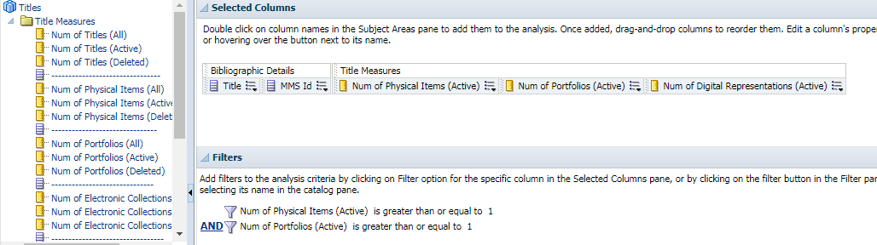
Newer Subject Areas – Honorary Mentions
Titles - create reports relating to ALL Titles
  Helpful for comparing physical/electronic inventory (weeding)
  Holdings

Slide 23
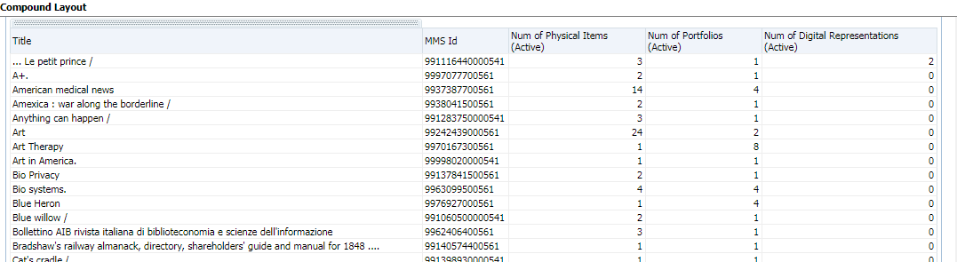
Honorary Mentions – Titles Subject Area

Slide 24
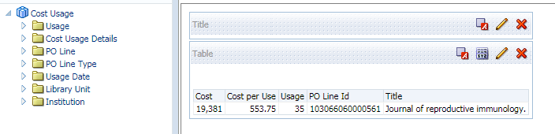
Newer Subject Areas – Honorary Mentions
Usage - Usage Data subject area originates from the COUNTER reports loaded by the Alma institution
  you must set the enable_usage_tracking parameter (Configuration > Analytics > Other Settings)
  Cost Usage - holds details about the purchase, including Cost, Cost Per Use, and PO Line ID
Notes:
The “Cost Usage” subject area uses a combination of data from
The “Usage Data” subject area of Alma Analytics
The acquisitions data from Alma
Cost per use = Cost / Estimated Usage
If all of the year’s data has been loaded than the Estimated Usage is the same as the Usage

Slide 25
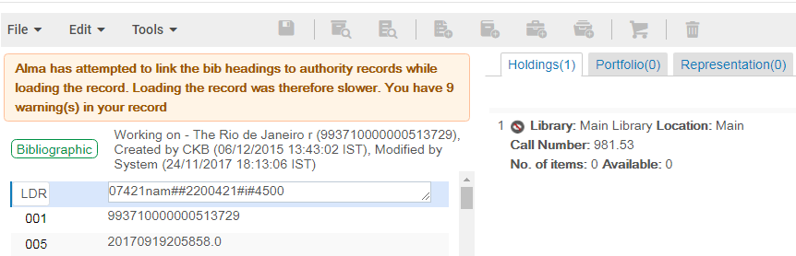
Newer Subject Areas – Honorary Mentions
Physical Inventory > Holding
Will now be able to find holdings that do not have physical items attached!

