Slide 1
Advanced Analytics
ULMS Summer Meeting 2018
Megan Drake
Senior Implementation Consultant

Slide 2
Agenda
1
Using Regular Expressions to Separate Multiple Appearances of Repeated Data
2
Adding Action Links to an Analysis
3
Views, Layouts and Formatting

Slide 3
Introduction
In Analytics, a “one to many” relationship sometimes displays for one entity when the “many” values appear are found in a field that is delimited with a semicolon
Some examples:
  One Bibliographic record may have multiple ISBN entries
  One Bibliographic record may have multiple 035 entries
  One Course Reserves container may have multiple instructors

Slide 4
Introduction
If desired, it is possible to have “semicolon-separated” values appear as separate columns in the results of an analysis
Doing so can be useful for display and filtering purposes
There are multiple ways in which this can be accomplished
We will use the “regular expression,” perhaps the simplest method, to identify Bibliographic records with multiple ISBNs

Slide 5
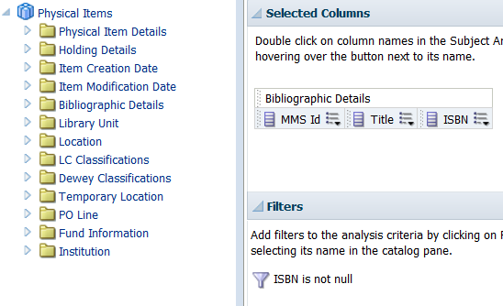
We Begin With This Analysis and…

Slide 6
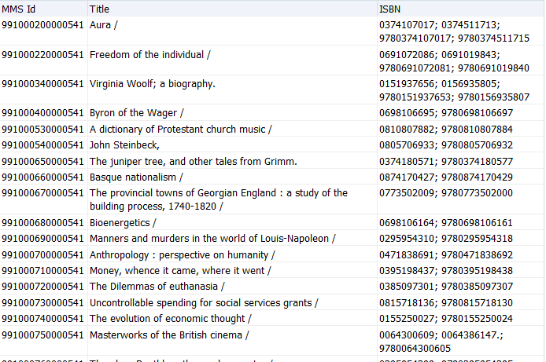
…These Results

Slide 7
Regular Expression Syntax
Evaluate('regexp_substr(%1,''[^\;]+'', 1,n)',REPLACE “Column”. “Name”,';','\;'))
Occurrence of value
Name of column as it appears in “edit formula”
The “n” is the column number (occurrence of the value between the semicolons)
The “Column”. “Name” is how the column appears by default when editing the formula

Slide 8
Regular Expression – ISBN
To establish the display of the first ISBN, the regular expression will be:
Evaluate('regexp_substr(%1,''[^\;]+'', 1,1)',REPLACE("Bibliographic Details"."ISBN",';','\;'))
Notes:
Regular expressions are a very powerful feature that can be used to find a patron through a filter on a string. OBIEE doesn’t have this function available “out of the box” but permits you to use regular expressions with the EVALUATE function.

Slide 9
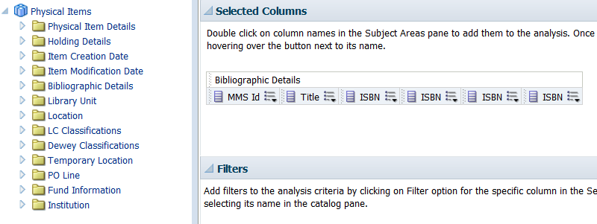
Building the Analysis
On the criteria tab, add the ISBN column for as many times as you want to display a separate column
Notes:
In our example, we add the ISBN column four times. Save as something like MMS, Title and ISBNs.

Slide 10
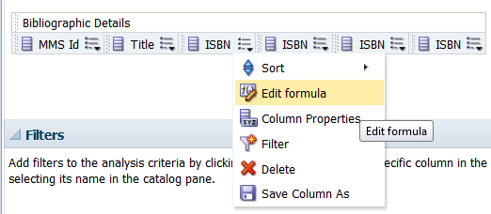
Building the Analysis
For each column, go to “edit formula”
Notes:
Go to Edit Formula.

Slide 11
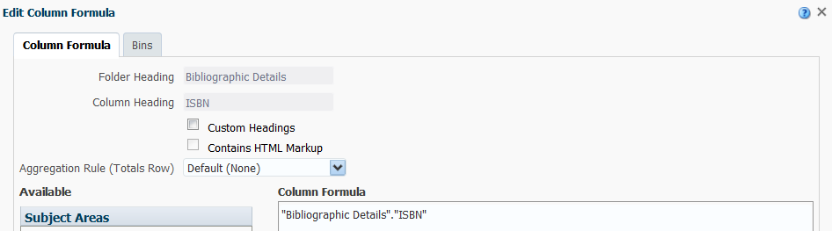
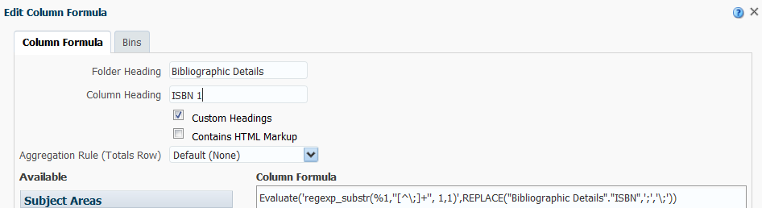
Building the Analysis
Notes:
Customize the Column Heading with a change to ISBN 1.

Slide 12
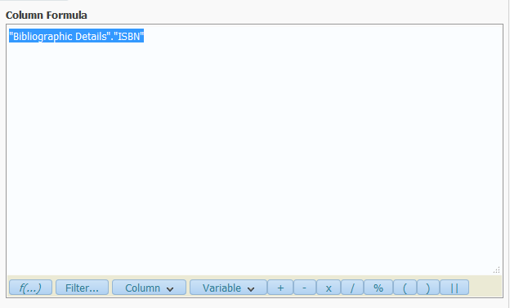
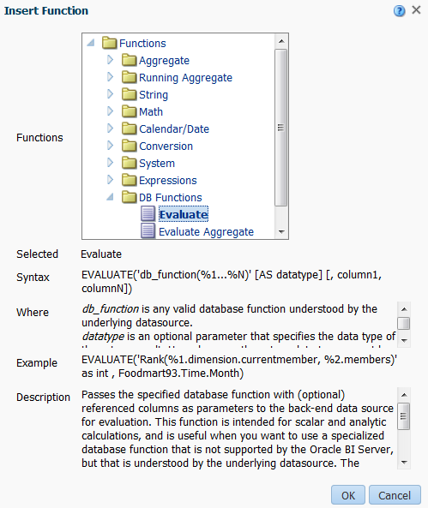


Edit Formula Step 1
Notes:
Add the EVALUATE function and modify the db_function statement as shown before removing everything from [AS datatype…to the end].

Slide 13

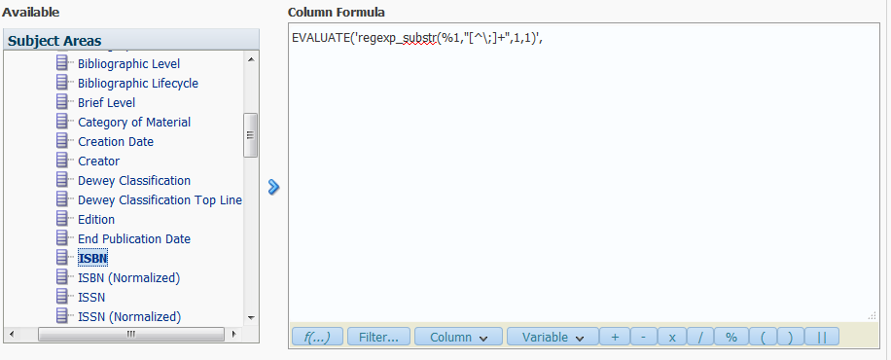
Edit Formula Step 1
Notes:
From the Available subject areas, open the Bibliographic Details folder, select ISBN and click on the > to push the column of data into the formula. It will fill in the blank space that I have identified.

Slide 14
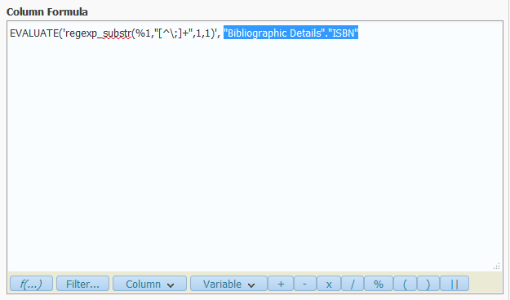
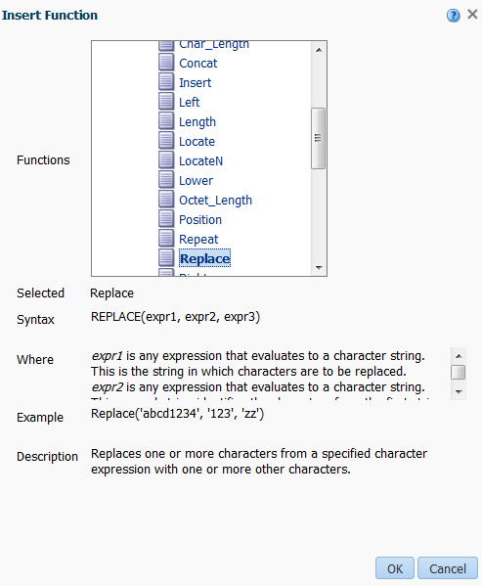
Edit Formula Steps III
Notes:
With the Bibliographic Details.ISBN column selected, add the REPLACE function.

Slide 15


Edit Formula Steps IV
Evaluate('regexp_substr(%1,''[^\;]+'', 1,1)',REPLACE("Bibliographic Details"."ISBN",';','\;'))
Notes:
Modify expr2 and expr3 in the REPLACE statement changing to ‘;’, ‘\;’. Finally, make sure that there are three pairs of parentheses.

Slide 16
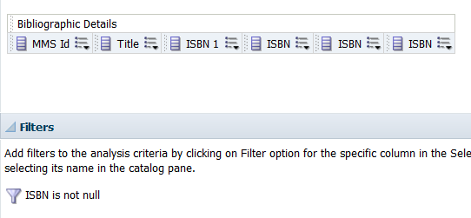
What the Analysis Looks Like at This Point

Slide 17
Adding the Formula to All ISBN Columns
Edit the formula for the ISBN 1 column and copy the entire EVALUATE statement
EVALUATE('regexp_substr(%1,''[^\;]+'', 1,1)',REPLACE("Bibliographic Details"."ISBN",';','\;'))
Close the ISBN 1 column and go to Edit Formula for the second ISBN column

Slide 18
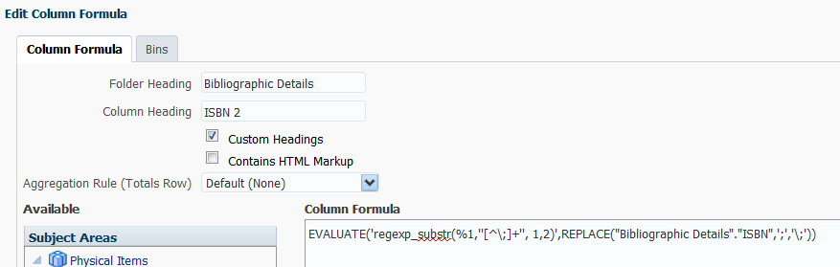
Adding the Formula to All ISBN Columns
Customize the Column Heading, changing to ISBN 2
Paste in the EVALUATE statement and edit as follows, changing the second appearance of 1 to a 2
Notes:
Customize the Column Heading, changing it to ISBN 2. Paste in the EVALUATE statement and edit as follows, changing the second appearance of 1 to a 2.

Slide 19
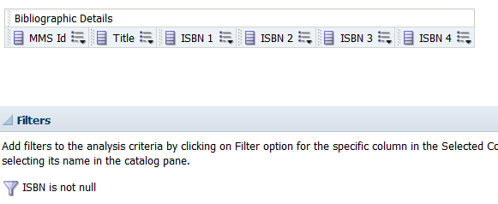
Adding the Formula to All ISBN Columns
Perform the same copy and paste function for the remaining ISBN columns, updating as appropriate for ISBN 3 and ISBN 4
Notes:
Start by customizing the Column Heading for ISBN columns 3 and 4. Paste in the EVALUATE statement and edit as follows, changing the second appearance of 1 to a 3 and a 4 for the appropriate columns.

Slide 20
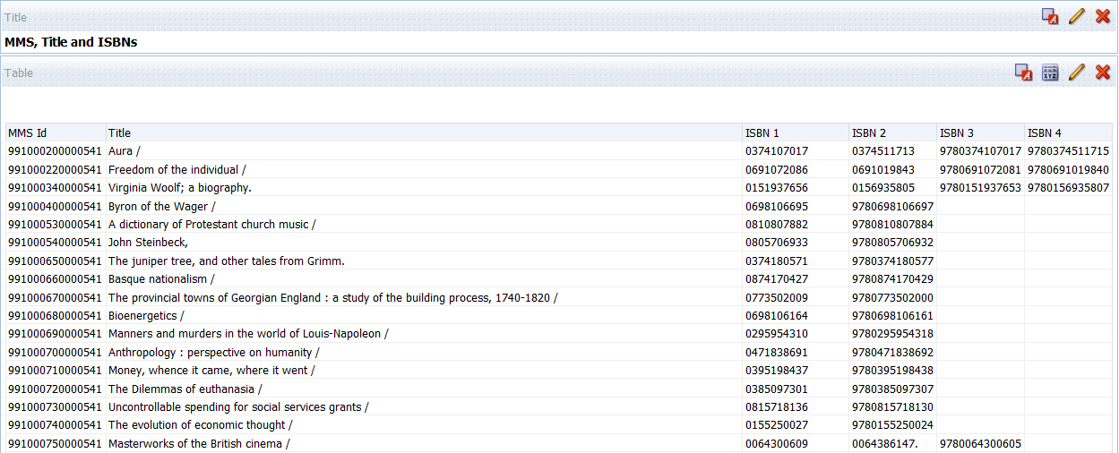
When Complete, We Have…
Notes:
Here is the final result of our efforts.

Slide 21
Agenda
1
Using Regular Expressions to Separate Multiple Appearances of Repeated Data
2
Adding Action Links to an Analysis
3
Views, Layouts and Formatting

Slide 22

Introduction
Action links may be used to allow more interactivity in reports and dashboards
Using drill-throughs, one report can feed into another
One way to make large reports into more manageable chunks
Involves two or more analyses that are linked together

Slide 23
Introduction
Using the E-Inventory subject area, we’ll create several analyses that are linked together
Goal is to obtain a list of Electronic Collections and create a link to the Electronic Portfolios part of those collections
As described on the previous slide, creating a report like this makes a potentially very large report much more manageable

Slide 24
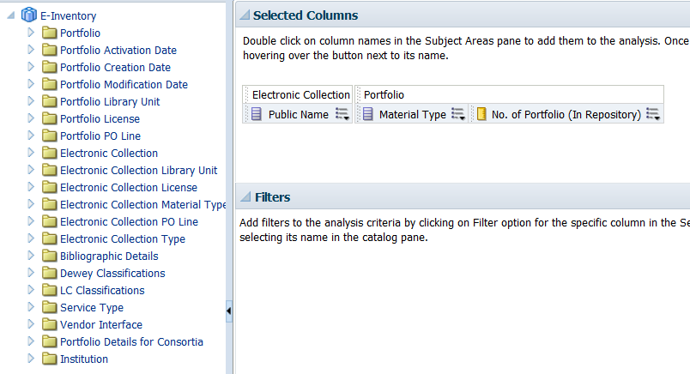
The Master Query
Save this analysis as Electronic Collections by Material Type and Number of Portfolios
Notes:
First, we create the Master query. In this example, we are using the E-Inventory subject area.

Slide 25
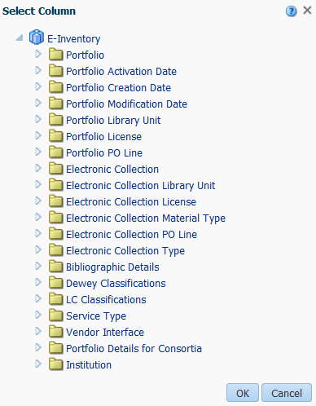
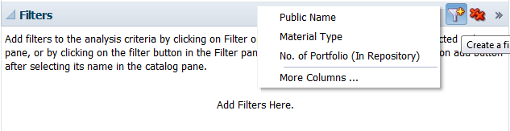
The Master Query
Notes:
Adding some filters via the More Columns option…

Slide 26
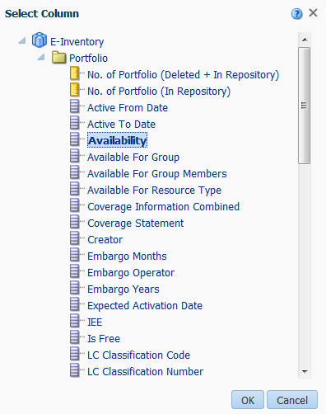
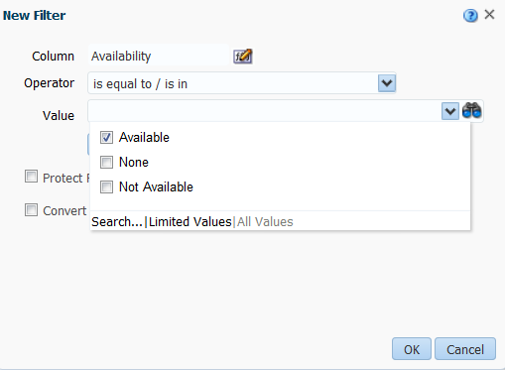
The Master Query
Notes:
…starting with Portfolio > Availability = Available.

Slide 27
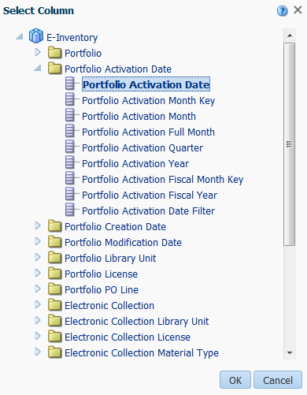
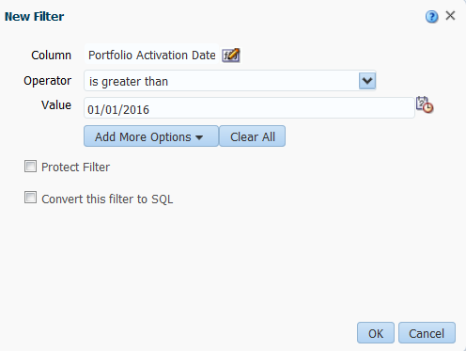
The Master Query
Notes:
Then, adding Portfolio Activation Date > Portfolio Activation Date. Pick a date sometime in the past 12 months.

Slide 28
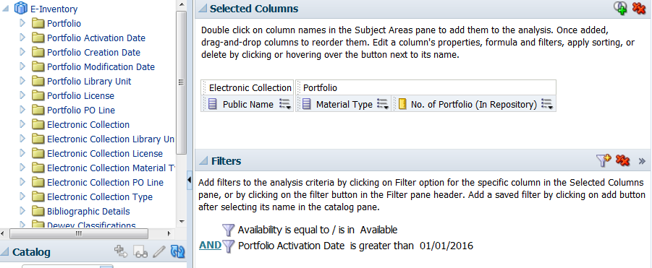
The Master Query
Save Electronic Collections by Material Type and Number of Portfolios
Notes:
Save as Electronic Collections by Material Type and Number of Portfolios.

Slide 29
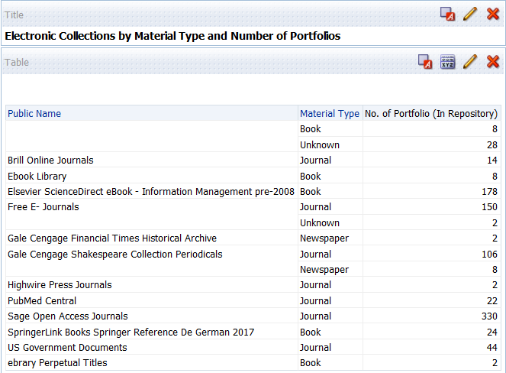
The Master Query
Notes:
Run the analysis to view the results as they currently stand. Then, let’s move on to the Details query.

Slide 30
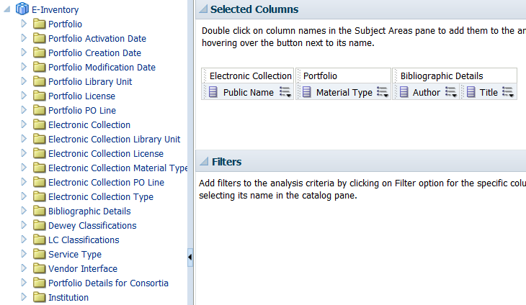
The Details Query
Save this analysis as Electronic Collections by Material Type and Number of Portfolios with Action Link to Portfolios
Notes:
You’ll notice that there are similarities between the Master and Details analyses. It’s what we do next that makes the difference.

Slide 31
The Details Query
Notes:
Adding some filters via the More Columns option…

Slide 32
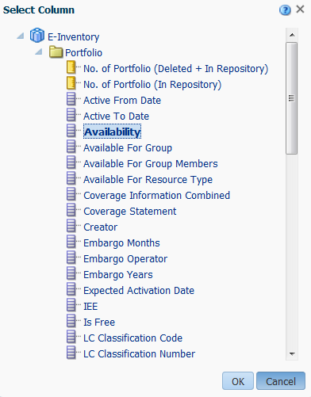
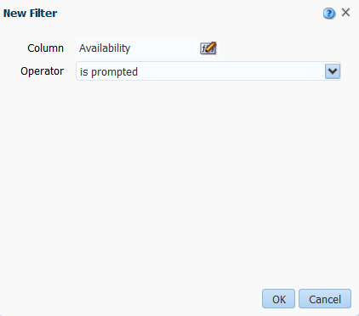
The Details Query
Notes:
…beginning with Portfolio > Availability and setting the Operator to is prompted. We use is prompted because Availability is defined in the Master Query.

Slide 33
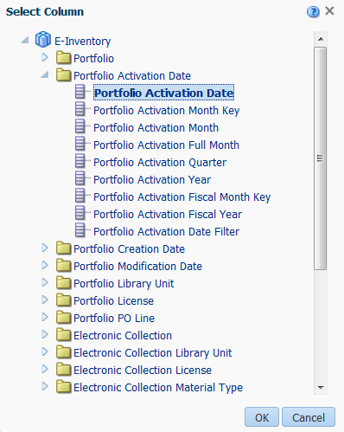
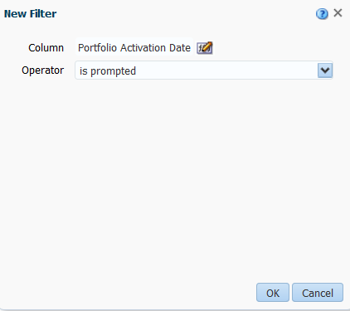
The Details Query
Notes:
Then, adding Portfolio Activation Date > and setting the Operator to is prompted. We use is prompted because Portfolio Activation Date is defined in the Master Query.

Slide 34
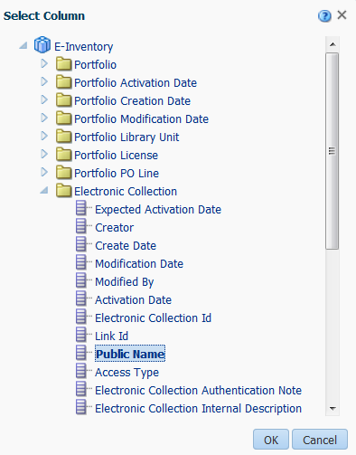
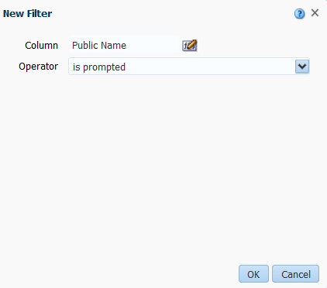
The Details Query
Notes:
Add a filter for Public Name and set the Operator to is prompted. Again, we use is prompted because Public Name is defined in the Master Query.

Slide 35
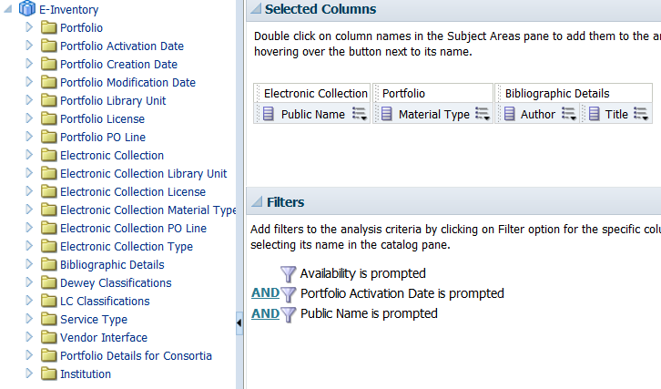
The Details Query
Save Electronic Collections by Material Type and Number of Portfolios with Action Link to Portfolios

Slide 36
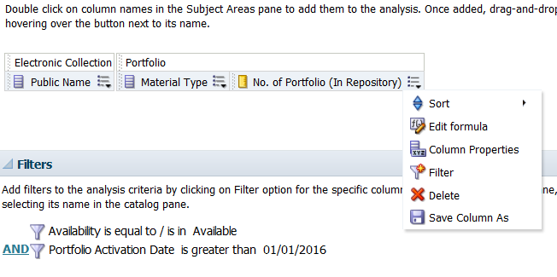
Return to the Master Query
Open Electronic Collections by Material Type and Number of Portfolios.
Notes:
Return to the Master query to edit it further.

Slide 37
More on the Master Query
Notes:
From the menu for No. of Portfolio (In Repository) column, choose Column Properties.

Slide 38
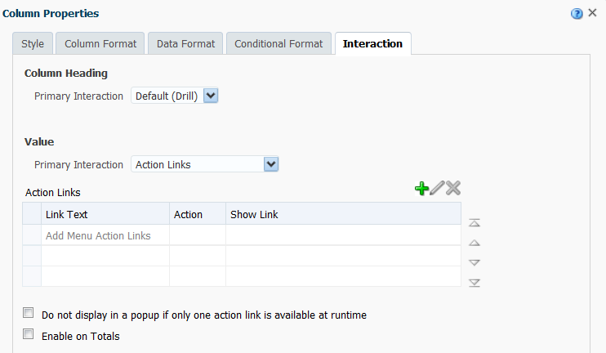
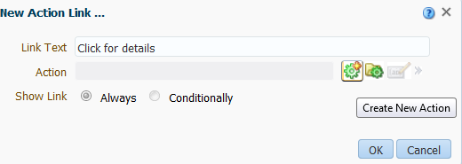
More on the Master Query
Notes:
Go to the Interaction tab…and change the Primary Interaction for Value from Default (Drill) to Action Links. Click on the green + to enter Link Text, Click for details before clicking on green Gear icon to Create New Action.

Slide 39
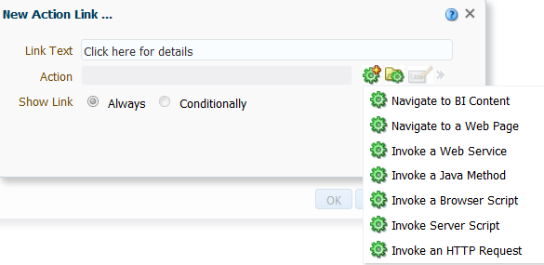
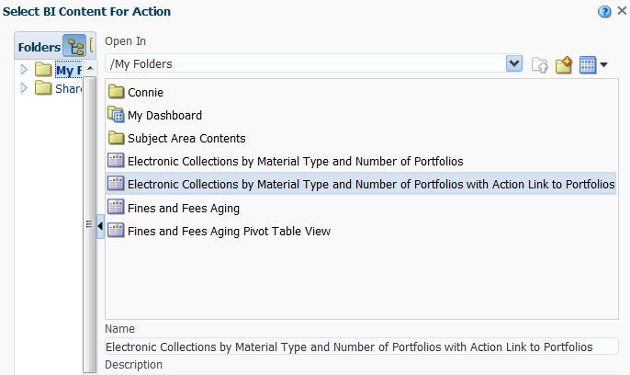
More on the Master Query
Notes:
Choose, Navigate to BI Content and identify the Details Query to establish the connection between the two fields.

Slide 40
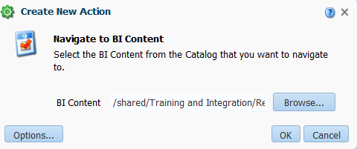
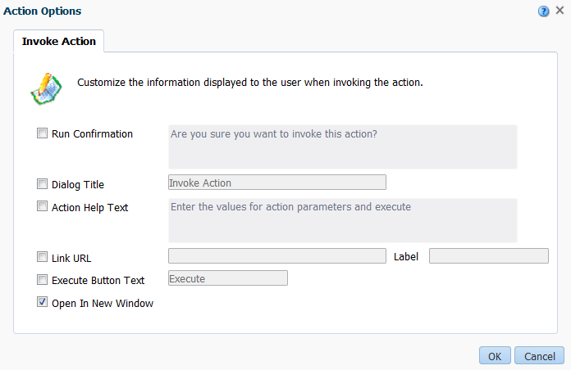
More on the Master Query
Notes:
Once the Details Query is selected, there are Action Options from which to choose. The option we particularly want to invoke is Open in New Window.

Slide 41
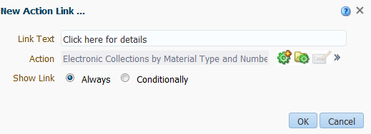
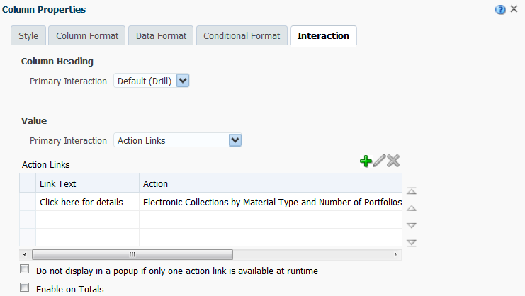
More on the Master Query
Notes:
Here is how things look after adding the Action Link to the Column Properties via the Interaction tab.

Slide 42
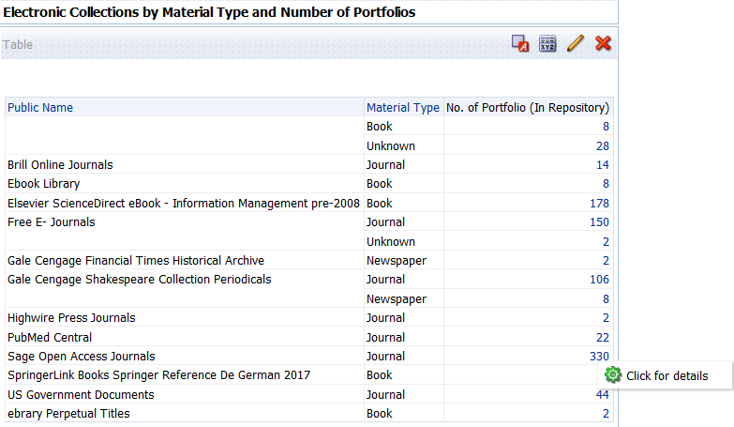
More on the Master Query
Notes:
Save the Master Query and run it. Note the hyperlinked items in the No. of Portfolios column. Click on the link to see the pop-up note, Click for details. Click on this message.

Slide 43
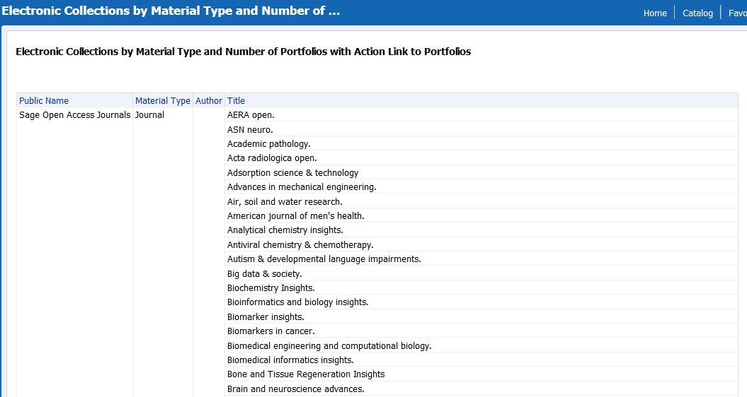
Results from Details Query
Notes:
View the results from the Details Query that open in another tab.

Slide 44
Agenda
1
Using Regular Expressions to Separate Multiple Appearances of Repeated Data
2
Adding Action Links to an Analysis
3
Views, Layouts and Formatting

Slide 45
About Views and Layouts
There are times when a different view and layout of an analysis is helpful in examining the results and interpreting them
We’ll use an example from the “out-of-the-box” set of analyses
Open Shared Folders > Alma > Inventory > Reports > Physical Inventory Count
Notes:
Working with Physical Inventory Count. You’ve already seen how to add a Pivot Table.

Slide 46
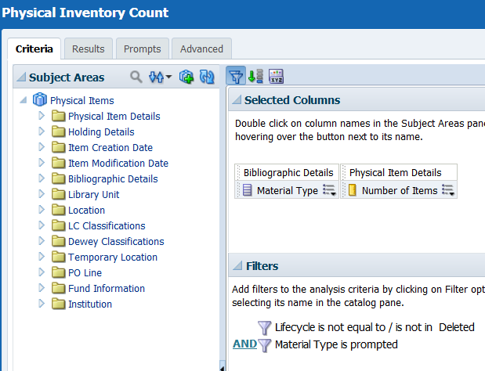
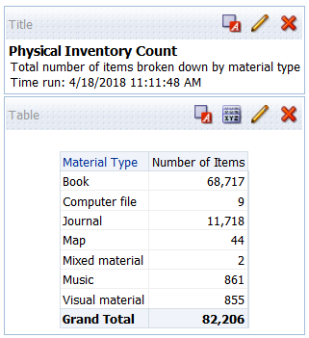
Physical Inventory Count
Notes:
Physical Inventory Count Criteria and Results tabs. Save As Physical Inventory Count with Pie Chart.

Slide 47
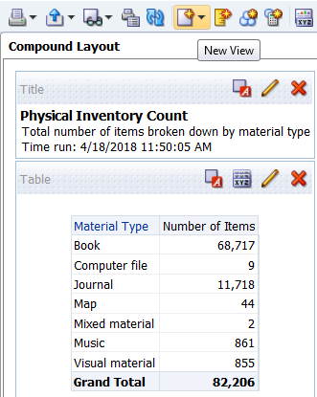
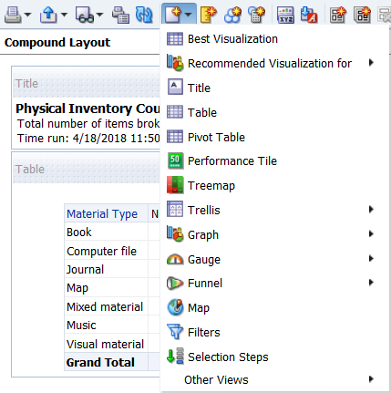
Physical Inventory Count
Notes:
Go to the New View button in the persistent bar and click on it to open the menu.

Slide 48
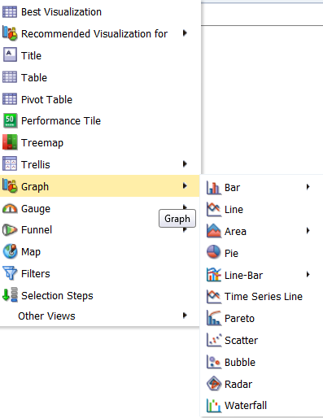
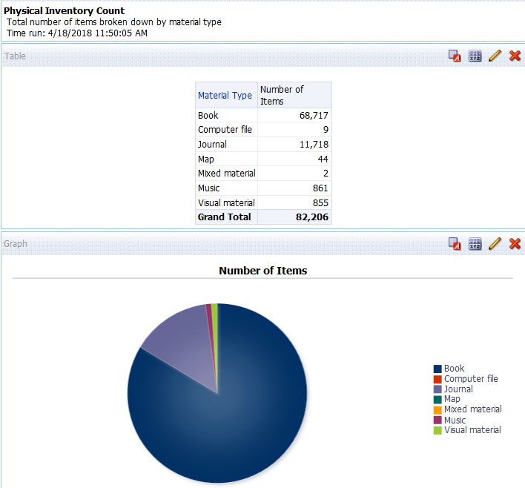
Physical Inventory Count
Notes:
Hovering over the Graph entry opens a sub-menu containing different types of graphs. Click on Pie to add a pie graph to the display. Try some of the other options such as Gauge or Funnel.

Slide 49
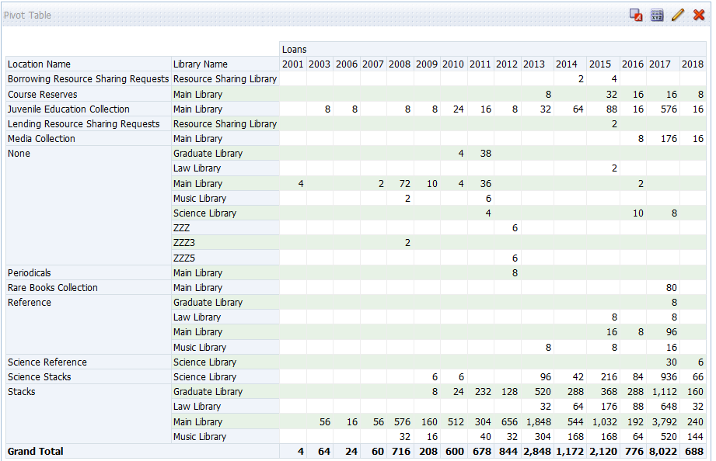
Count of Items Loaned
Notes:
Open the Fulfillment > Count of Items Loaned analysis. Save As Count of Items Loaned with Bar Graph.

Slide 50

Count of Items Loaned with Bar Graph - Vertical
Notes:
Add a Bar Graph – Vertical to this analysis.

Slide 51

Count of Items Loaned with Bar Graph - Vertical
Notes:
View the results. Try some of the other options for Bar Graphs. Click on the Pencil icon in the upper right corner to Edit the Layout.

Slide 52

Count of Items Loaned with Bar Graph - Vertical
Notes:
With the Layout View open, you can see the options for changing the appearance of the bar graph, including the fill for the data, 2D vs. 3D, and more. Choose Triangle from the drop-down to see the change in appearance. When you have finished making adjustments, click on Done located at the upper right.

Slide 53

About Formatting
From time to time, you or another individual are planning to regularly export the results of an analysis and you want to minimize how much additional formatting needs to be done after the export is complete

Slide 54

Print and Export Options
Open the analysis, Fulfillment > Reports > General Circulation Statistics
Remove the columns, Reading Room At Shelf and Reading Room At User
Save a local copy of the analysis
Notes:
Open the analysis, Fulfillment > Reports > General Circulation Statistics. Remove the columns, Reading Room At Shelf and Reading Room At User before saving a local copy of the analysis. Take a look at the results.

Slide 55



Print and Export Options
Notes:
The first thing I want to do with this analysis is to change the position of the Library Name column so that it is situated at the far left. I’ll do that by hovering on the column and moving the cursor to the header that appears. Once the four-headed arrow is visible, pick up the column and move it to the preferred position.

Slide 56



Print and Export Options
Notes:
Open the Print and Export Options. Change the Paper Size to something different than the User Default. Change the Orientation to Custom so that you may select Landscape for the PDF export.

Slide 57


Print and Export Options
Notes:
Export the analysis to PDF and see the landscape view.

Slide 58

Formatting Rows
Open the analysis, Funds Expenditure > Reports > Detailed Expenditures

Slide 59



Formatting Rows
Notes:
Here we are formatting the container and alternate rows for the analysis.

Slide 60

Formatting Rows
Notes:
View the results of those formatting changes. Save the changes.

Slide 61

Formatting Columns
Open any analysis and locate the column to modify
Click on the Options menu and select Column Properties

Slide 62

Formatting Columns

Slide 63

Other Formatting Options - Columns
Notes:
View the results of those modifications.

Slide 64


Formatting Columns – Another Way
Go to the Layout View for the Detailed Expenditures analysis
Notes:
Go to the Layout View for the Detailed Expenditures analysis and click on the More Options… button for the Allocated Fund column to select Format Values. Among other things, I’m changing the font colour and size for this column as well as adding a background colour.

Slide 65



Importing Formatting
Notes:
Begins by creating a very simple analysis. In this example, the analysis is created using the Physical Items subject area and has one column of data in it: Location > Library Name.

Slide 66



Importing Formatting
Notes:
Still working on the details.

Slide 67


Importing Formatting
Save the analysis as Formatting.
Notes:
Save the analysis as Formatting.

Slide 68

Importing Formatting

Slide 69

Importing Formatting

Slide 70

Importing Formatting

Slide 71
Conditional Formatting
Comprises a way to apply formatting only when a specific condition is met
Applied by
  Selecting one or more columns
  Specifying the condition to meet
  Modifying the formatting that should display

Slide 72

Conditional Formatting

Slide 73


Conditional Formatting

Slide 74


Conditional Formatting

Slide 75

Conditional Formatting

