Slide 1
Get It / View It Delivery
Delivery
Delivery Categories
Availability Statuses
Links to Data and Services
Uresolver

Slide 2
Delivery Categories

Slide 3
Basic Inventory Model
Intellectual Entity (IE):
Groups resources by their types:
P
E
D
MMS
MMS Record
IE
Hol record /
Pack. service
Inventory

Slide 4
Print: Book with four copies
BIB
Origin of the Species
IE – type ‘P’
Holdings
Main Library
Holdings
Law Library
Item
Copy 1
Item
Copy 2
Item
Copy 3
Item
Copy 4

Slide 5
Electronic inventory
MMS
Descriptive MD
IE – type ‘E’
Package Service
Service
Package
Portfolio
(coverage)

Slide 6
Print and Electronic inventory
MMS
Descriptive MD
IE – type ‘E’
IE – type ‘P’
Package Service
Service
Holdings
Law Library
Package
Portfolio
(coverage)
Item
Copy 3
Item
Copy 4

Slide 7
Publishing
Publishing works at the level of IE
Each IE is published as an individual record

Slide 8
Alma Delivery – Delivery Categories
Alma-specific delivery categories
Local data:
Alma-P
Alma-E
Alma-D
Remote resources (PCI, Metalib, Ebsco, etc.):
Remote Search Resource:Alma
Delivery Category is created by Primo normalization rules.
Notes:
For Consortia: Each Primo institution communicates with its Alma institution for delivery purposes.

Slide 9
Alma Delivery – Delivery Categories
Each delivery category can be associated with two delivery services:
GetIt Link 1
GetIt Link 2

Slide 10
Alma Delivery – Delivery Categories
Delivery Category | Action – GetIt Link 1 | Action – GetIt Link 2
Alma-P | Create ‘GetIt’ tab Calculate ‘GetIt’ query
Alma-E Alma-D Remote Search Resource:Alma | Create ‘ViewIt’ tab Calculate ‘ViewIt’ query | Create ‘ViewIt’ tab Calculate ‘ViewIt’ query

Slide 11
Availability Statuses

Slide 12
Alma Delivery – Availability Statuses
Examples of availability statuses for physical resources:
available_in_institution
available_in_library
unavailable_in_institution
check_holdings_in_library
Examples of availability statuses for electronic resources:
not_restricted
restricted
may_be_restricted
Availability statuses are calculated by Primo on-the-fly.

Slide 13
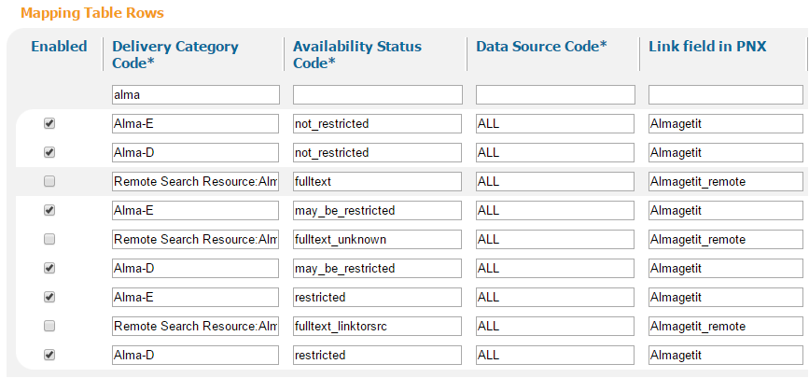
Alma Delivery – Availability Statuses
GetIt! Link 2 Configuration

Slide 14
Links to Data and Services

Slide 15
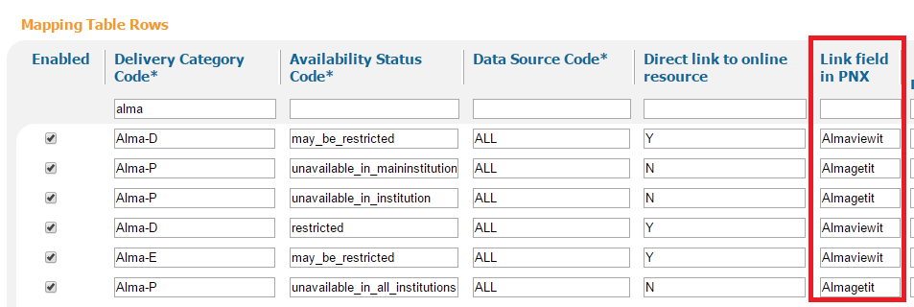
Alma Delivery – Links to Data and Services
GetIt Link 1 / Link 2 Configuration

Slide 16
Alma Delivery – Links to Data and Services
Delivery Templates

Slide 17
Alma Delivery – Links to Data and Services
ViewIt:
https://na01.alma.exlibrisgroup.com/view/uresolver/TR_INTEGRATION_INST/openurl?ctx_enc=info:ofi/enc:UTF-8&ctx_id=10_1&ctx_tim=2013-10-23T19%3A07%3A43IST&ctx_ver=Z39.88-2004&url_ctx_fmt=info:ofi/fmt:kev:mtx:ctx&url_ver=Z39.88-2004&rfr_id=info:sid/primo.exlibrisgroup.com-TRAINALMA&req_id=&rft_dat=ie=TR_INTEGRATION_INST:517506190000521,language=en_US,view=TRAINALMA&svc_dat=viewit&u.ignore_date_coverage=true
Uresolver base URL – in red
Alma_institution:IE ID – in blue

Slide 18
Alma Delivery – Links to Data and Services
GetIt:
https://na01.alma.exlibrisgroup.com/view/uresolver/TR_INTEGRATION_INST/openurl?ctx_enc=info:ofi/enc:UTF-8&ctx_id=10_1&ctx_tim=2013-10-23T19%3A07%3A43IST&ctx_ver=Z39.88-2004&url_ctx_fmt=info:ofi/fmt:kev:mtx:ctx&url_ver=Z39.88-2004&rfr_id=info:sid/primo.exlibrisgroup.com-TRAINALMA&req_id=&rft_dat=ie=TR_INTEGRATION_INST:517506190000521,language=en_US,view=TRAINALMA&svc_dat=getit&user_ip=
Uresolver base URL – in red
Alma_institution:IE ID – in blue

Slide 19
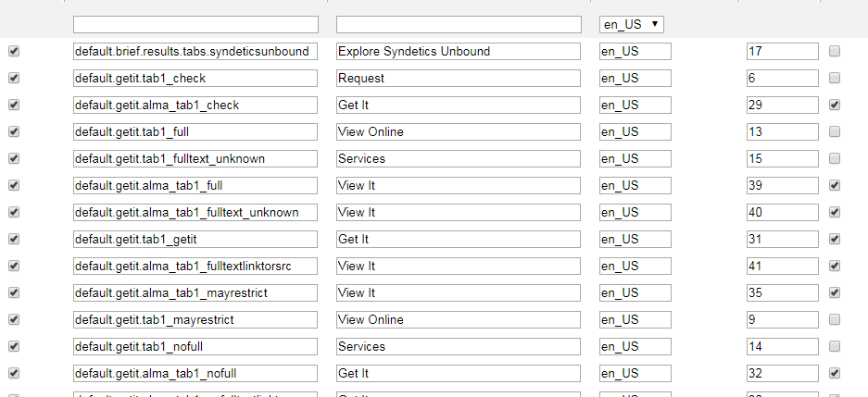
Alma Delivery – Links to Data and Services
Getit Link 1 / Link 2 Labels

