Slide 1
Ebook Central Integration Profile at CSUSB
ULMS Summer meeting 2019

Slide 2
Our situation
Pre-Alma, we had ebrary MARC records that we migrated, then relinked to the CZ ecollection.
Post-Alma, we use CZ records when acquiring new titles.
We did NOT migrate any of our pre-Alma acquisitions information.
However, we had consistently placed public notes on purchased titles indicating the number of user licenses available.
We have had a DDA pool in Ebook Central for many years, but it was troublesome to keep up with records added to the pool.
Our DDA funds are deposited on account, so purchases draw down that account—i.e. we are not billed monthly for triggered titles.

Slide 3
Help Documentation
ExLibris: Upload Electronic Holdings from ProQuest Ebook Central
ULMS wiki: ProQuest Ebook Central Integration Profile
Includes link to Jessica Hartwigsen’s ProQuest Ebook Integration profile presentation at the Nov. 8, 2018 Tech Services Open Forum
ExLibris: Webinar on ProQuest Ebook Central Integration, April 2019
Tip: Make sure you know what your password for the integration profile is, don’t try to guess! ProQuest must tell you what it is.
Tip: Clean out any Ebook Central titles waiting in your Task Lists before you turn on the profile the first time; they will get wiped out.

Slide 4
Things to know
Any EBC title that you have actually purchased will get a technical POL created, with a zero amount.
But, if you have existing POLs attached to your EBC portfolios, they will NOT get overwritten and no additional POL will be added.
People on the Alma listserv have complained about getting duplicate POLs. We wonder if this might happen if your POL is attached to the bib, not the portfolio, which is the case with the GOBI API or GOBI Export records.
Titles that are part of your DDA pool only, not yet triggered for purchase, will NOT get technical POLs. (This is in fact how you can distinguish them in the e-collection.)
Any notes in your portfolios will NOT get overwritten.

Slide 5
Things to know, continued…
The Ebook Central (EBC)titles perpetually purchased by the CSU will be included. Yes, this duplicates the perpetual EBC record set in the NZ. From the Primo side, it seems to make no difference. If you want to sort these titles out from your IZ ecollection, you should be able to do so after the job initially runs.
The ProQuest Books division updates run weekly on Wednesday. The Alma weekly integration job updates used to occur only on Monday. As of the Alma August Release, you can choose what day you want the Alma job to run.
Because of the weekly schedule, there will always be some delay in getting new records.

Slide 6
What about those records?
Bib records used are those from the CZ. We find that most of the EBC records are full enough for our purposes.
Because it’s a CZ record, if it starts off a little thin but is updated later, you’ll automatically get the improvements.
If you find a brief record, you still have the option to pull in a fuller OCLC record if you want.

Slide 7
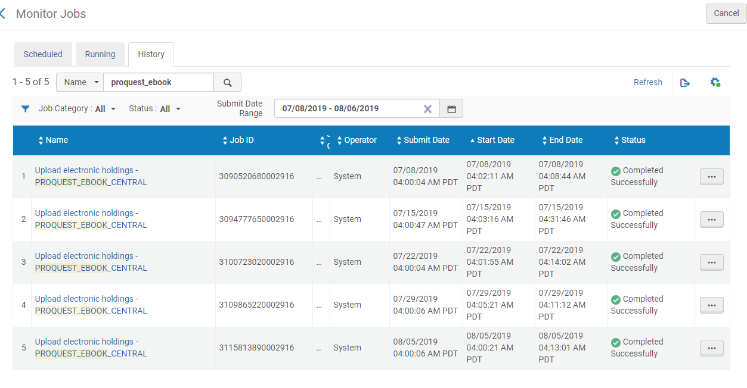

Slide 8
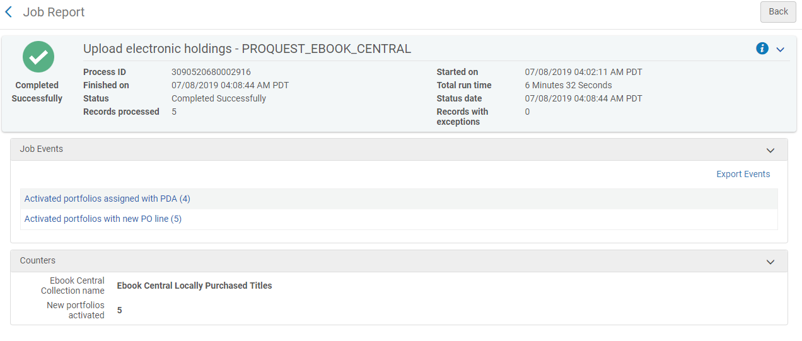
Example of a job report. This one has 5 new titles
we ordered, plus 4 titles that became active in our DDA pool.

Slide 9
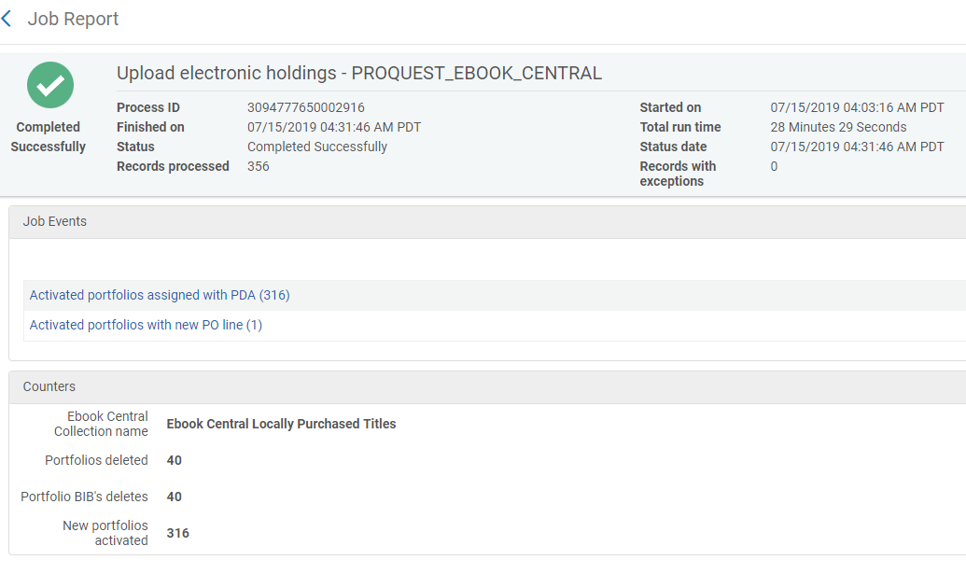
BTW, yes, sometimes DDA titles get deleted from the pool too.

Slide 10
What the details look like.…These 4 titles are additions to our DDA pool. We get the records for discovery purposes.
No POL’s over here!

Slide 11
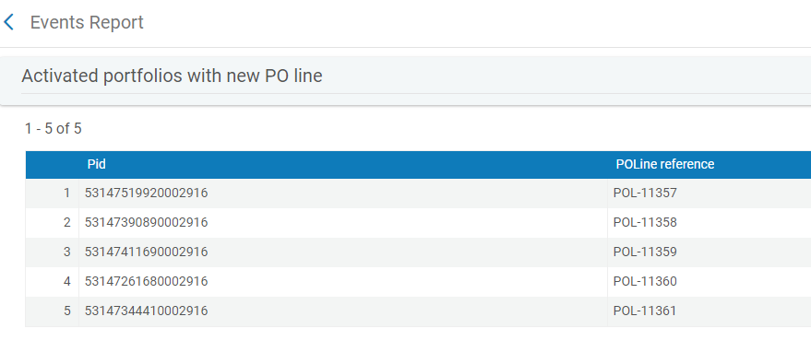
What the details look like… This set of 5 includes orders or triggered DDA purchases, because they have POL’s.
Not clickable, but you can search by either PID or POL number.

Slide 12
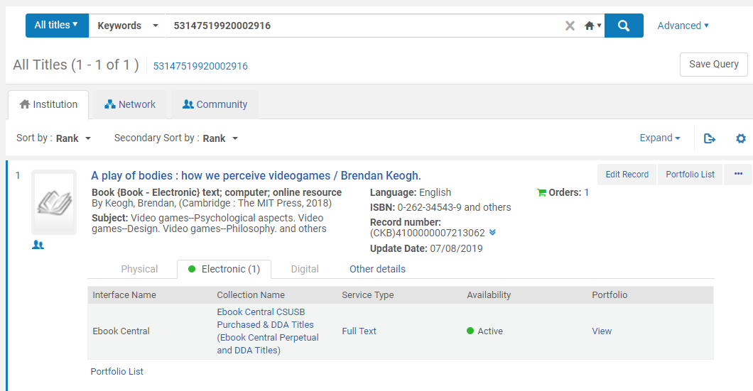

Slide 13
On the order record, the price is zero.
If you want to track the price, assign a fund, etc., you must change it.

Slide 14
When we order ebooks
Normally, we order ebooks directly from Gobi.
POLs are created in ALMA manually when we receive an invoice and links for the titles ordered.
Almost all ProQuest ebook orders can be found in the CZ, so all of our POLs are attached to CZ records.
Rarely do we have to attach a POL to an IZ or an NZ record.
Since we know when this job will run in ALMA, we are able to time our orders so that we can have POLs created in ALMA before this job runs.
However, if we need to change a technical POL to a normal ebook POL there are ways to do so.

Slide 15
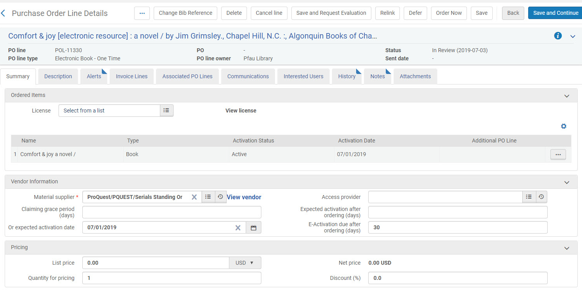
Technical POL example

Slide 16
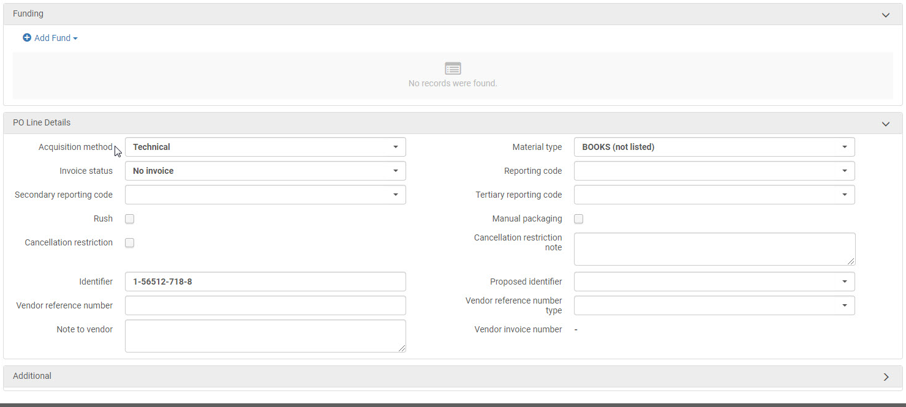
Technical POL example pt.2

Slide 17
Updating Technical POL
Updating a technical POL in ALMA is about the same number of steps as creating a POL from a template.
We simply need to edit the following:
Material Supplier
List Price
Add Fund
Acquisition Method
Add Note to Vendor
And click Order Now to confirm order and save the updated POL.
We also add these titles to the E-Activation Task list, so that they are listed for our cataloging department like any other ebook title.

Slide 18
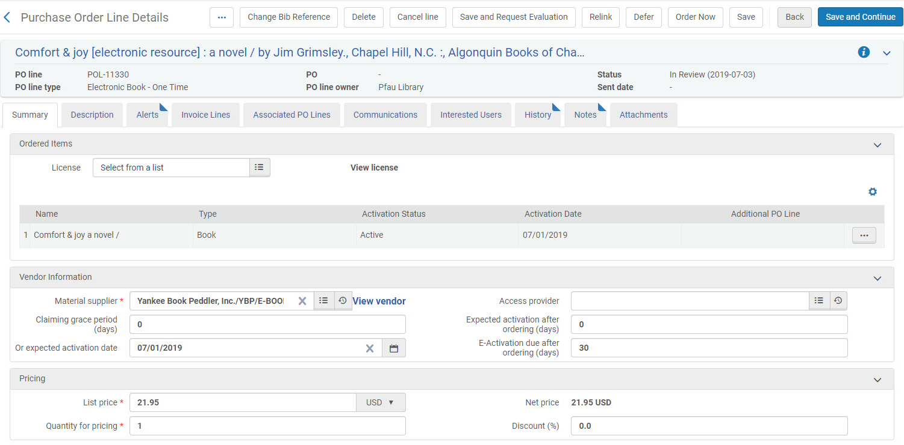
Updated POL

Slide 19
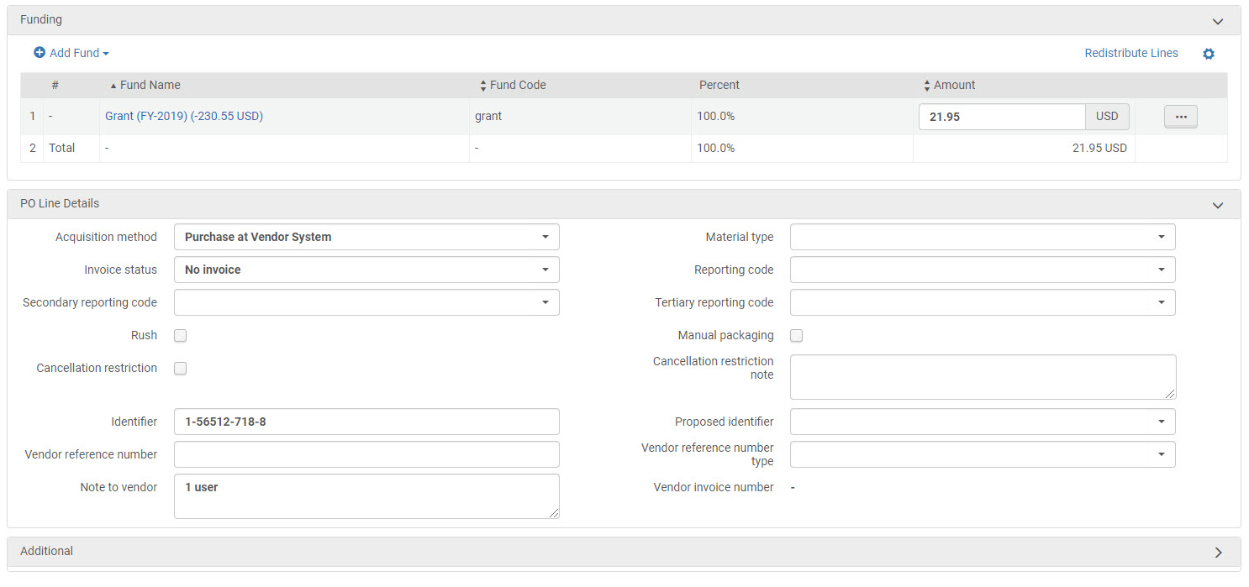
Updated POL pt.2

Slide 20
So what does the cataloger do?
The catalogers workflow is essentially the same for the ProQuest EBC titles as it is for any other ebooks.
We work from the ER Task List to quickly:
Click on link and verify our access
Make the portfolio available if the job hasn’t run yet
Add Public Note with number of users
Verify bib record matches and isn’t brief
As stated before, we find most of the CZ records for ebooks to be of acceptable quality. When we find a very brief bib, we will find a record in the NZ or bring in one from OCLC and relink the portfolio to the better bib record.

Slide 21
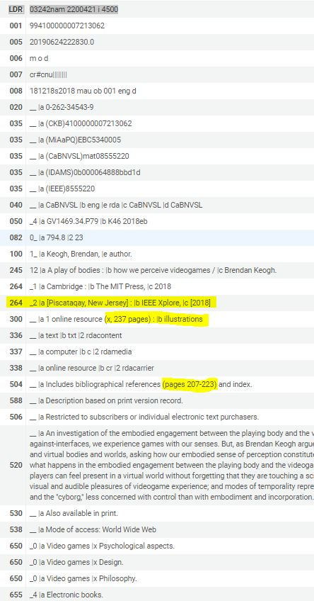
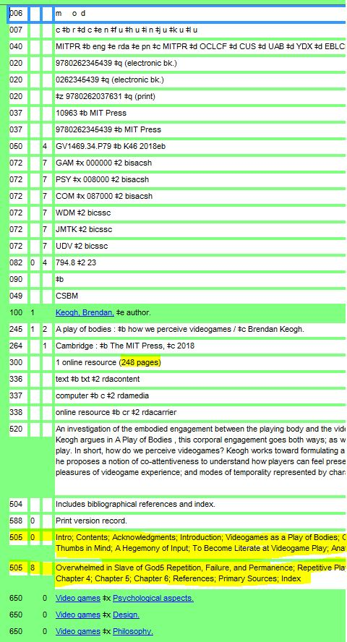
Comparison of Alma CKB & corresponding OCLC record—Example 1
The only significant difference between these is the lack of the 505 contents note in the CKB record. Other than that, the CKB record actually provides some additional small details.

Slide 22
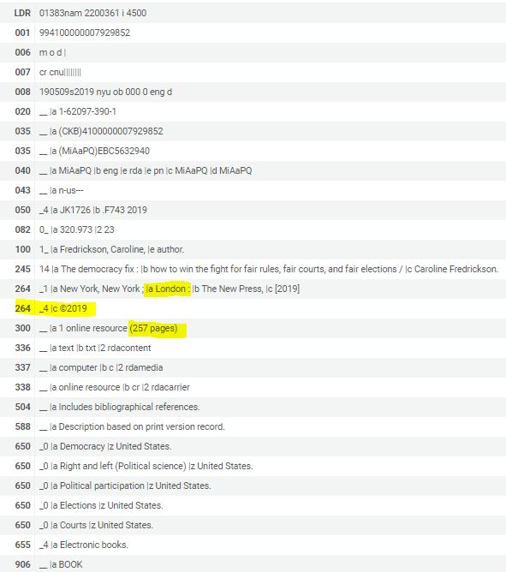
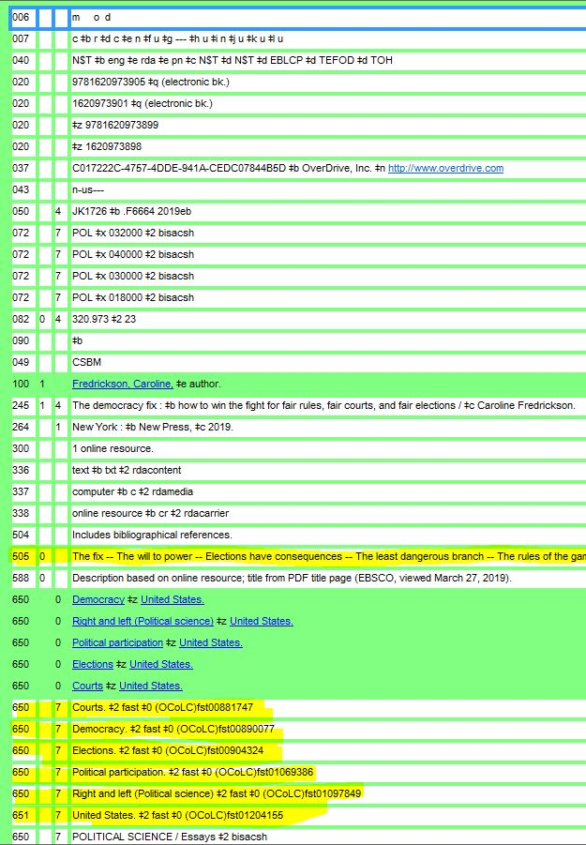
Comparison of Alma CKB & corresponding OCLC record—Example 2
Again just minor differences, like the 505. The authorized heading for the author and subject headings are identical.

Slide 23
Thank you!
If you have questions, feel free to reach out to
Stacy Magedanz (Electronic Resources) at magedanz@csusb.edu
Catrina Mancha (Acquisitions) at cmancha@csusb.edu
Eva Sorrell (Cataloging) at esorrell@csusb.edu

