Slide 1
CRSP Report-Out
Karen G. Schneider
2.4.16

Slide 2
Current CSU Print Monograph Fulfillment Models
Buy/borrow the book locally
Borrow the book from a vendor-based service (ILLIAD)
Borrow the book from a vendor-based premier service (Link+, Circuit), and if that route fails, go to ILLIAD
** All three models use longstanding, well-developed expert systems

Slide 3
Possible Alma Link+ Scenarios
Link+ libraries drop Link+. All or most CSU libraries rely on the ULMS as the 1st tier, with ILLIAD as the 2nd tier
Some or all Link+ libraries keep Link+ as a 2nd tier after the ULMS, with ILLIAD as 3rd tier
The CSU libraries choose to keep the existing model (combo of Link+, Circuit, & ILLIAD) and do not develop a system-wide ULMS resource sharing model
Wildcard: RapidR or alternative procurement/curation models could fit into this model somewhere

Slide 4
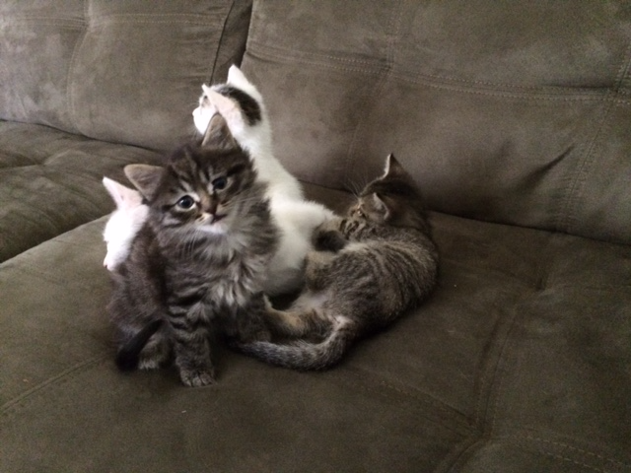
Any change will introduce unknown resource requirements…
But change is the direction CRSP recommends

Slide 5
Progress areas
Identifying key questions and scenarios
Identifying who’s at the table and pulling them into a fact-finding coalition (CO, COLD, ISPIE, Access, CRSP)
Contacting key players with key questions
Preliminary data-gathering for the most important questions

Slide 6
Threats and roadblocks
Lack of strategic direction from COLD
Anecdata, WOMs, and “feelings”
Border skirmishes among the nation-states that supply the coalition forces (CRSP, Access, ISPIE, COLD)
The usual challenge of getting people who aren’t invested in your problem to answer email and phone calls

Slide 7
Strengths and opportunities
Lack of strategic direction from COLD
Deep, heterogeneous knowledge of resource-sharing across the coalition forces (Link+, Circuit, ILL, Camino)
Growing sense of community among the coalition forces
Growing sense of pragmatism – “what’s best for our library and our users, what’s best for CSU, let’s follow the evidence”

Slide 8
And the key questions are…
Can the ULMS, alone or in combination with non-INNReach products, replace existing premier (aka lower-case-rapid) monographic fulfillment models?
What do we mean by “replace?” The evolving definition:
A well-supported premier monographic fulfillment service as good or better than existing models
Goodness means: high fulfillment, fast fulfillment, low-error fulfillment
Are the 23 libraries truly “together as one”? (And do we care?

Slide 9
Useful findings to date
There are very few Alma-INNReach implementations
III seems motivated to keep its CSU Link+ libraries
Link+ cannot punt requests to ILLIAD
Alma can (if enabled) punt requests to ILLIAD (how well this works is part of the OC inquiry)
The Link+ two-tier pricing model is disengenuous (because nobody would do the non-NCIP model)

Slide 10
Cost of moving to Link+ on Alma
Setup of each INN-Reach Member Library on DCB with NCIP (PS-231F and PS-231G):
140 hours x $125 = $17,500 per library
30% reduction applied from standard 200 hours
12 libraries x $17,500 = $210,000 23 libraries x $17,500 = $402,500
Standard DCB Training Online (train the trainer approach, up to 10 staff per session): 1 time x 12 hours x $125 = $1500 2 times x 12 hours x $125 = $3000 3 times x 12 hours x $125 = $4500

Slide 12
Key questions for the next 45 - 60 days
How well can holdings from the 23-library ULMS fulfill Link+ requests? (CO + ISPIE)
How well does the Orbis Cascade RS network function (and what else can they tell us about the level of effort resource-sharing)? (ISPIE + OC)
How well does INNReach work with Alma? (TBD. MI?)
What features do we gain/lose with Alma RS? (ISPIE + OC)
What are the system-wide, ten-year Link+ trends?
Is there a role for RapidR in the ULMS monographic fulfillment model? (TBD, RapidR contacted)

Slide 13
Link+ level of effort
Troubleshooting, ticket management, member relations
Statistical reports, training, training materials, documentation
Load balancing (and creating the load model in the first place)
Courier management
Manage development pipeline
Implement special features
Guidance for policy and procedures
Coordinate closures

Slide 14
RapidR and discovery
Model currently requires holding loads
Working with group of East Coast libraries on a model to discover their holdings
Group’s holdings will be searchable through each library’s local discovery service
Returnable requests will then be processed through Rapid via ILLIAD

Slide 15
Of note
Link+ activity at SSU down 40 percent in last five years (parallel with print activity) – not sure about system-wide trends
But: discovery on a consortial network is new to the CSUs – need to look to systems such as Orbis Cascade to forecast what usage looks like in a consortial environment, and factor in scenarios such as “fewer copies, more in motion”

Slide 16
Other possibilities
Investigate e-book fulfillment options
Investigate floating collections
Explore “circ to ARS” collection-planning models
Drones, flying cars, etc.

Slide 17
Process and big-picture questions
Who gets to decide? (COLD, with input from CRSP, Access, & ISPIE)
What goals will system-wide resource-sharing fulfill? (COLD)
What are we willing to lose to move forward?
What opportunities do we want to enable from the ULMS?

