Slide 1




Contactless Library Locker Pickup Survey Summary Results
Prepared by Teresa Roudenbush
For the Fulfillment Functional Committee, Locker Task Force
Presented on Friday, November 6, 2020

Slide 2



Created to get input from other libraries using lockers
  Types being used
  Length of time in use
  Best practices
About the Survey...
Survey sent to LibCircPlus listserv on September 17, 2020
https://forms.gle/JX9yrGiQQfmNBQXQ7
  Sent also to ALA Connect Group

Slide 3

Who Responded?
Thank you to the following Libraries...
  Brandeis University Library
  CSU Dominguez Hills
  CSU Fullerton Pollak Library
  Hoboken Public Library
  MidPointe Library System - Liberty Branch
  North Liberty Library (IA)
  Northern Illinois University
  Undergraduate Library - University of Illinois
  University of Alberta Library
  University of Nevada Reno Knowledge Center
  UT Chattanooga / UTC
PITCH DECK V 1.0

Slide 4

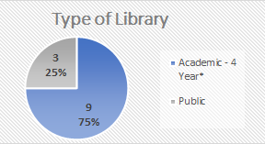
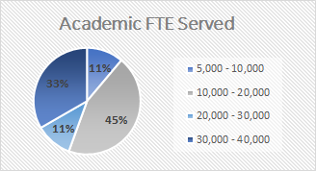
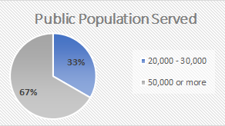
Survey Demographics...
Highlights:
  Received 12 responses from 11 different institutions
  Majority of responses from Academic 4 year
*Includes responses from 2 CSU’s

Slide 5

Locker Type & Functionality...
In this section of the survey we investigated:
  Locker Brand/Type
  Integration with ILS system
  Number of Lockers
  Location(s) of Lockers
    In relation to Library/Campus
    Shelter from Environmental Elements
  Method Used for Transporting Items To/From

Slide 6
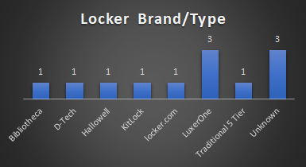


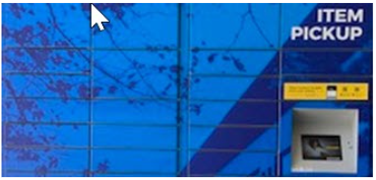


What Brand/Type of Locker is in Use?
And more...

Slide 7

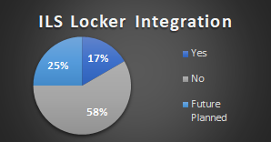

Locker Integration How it Works?
How Integration Works…
  The Bibliotheca lockers function like a "branch" in Sierra as far as selecting a location for holds pickup, and then the lockers check out the items when the patron enters their card number to open the lockers
  When the first part of the integration is live, an Alma request will result with the patron's information being entered into the Luxer Locker Recipients list
  Less than half reported Locker/ILS integration
  Lockers with known or future planned IILS integration:
    Bibliotheca
    D-Tech
    LuxerOne

Slide 8
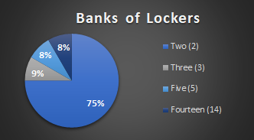
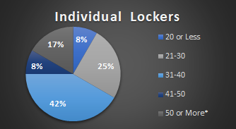
How Many Lockers Do You Have?
Highlights:
  Majority of the respondents have 2 banks of lockers
  67% having between 21-50 individual lockers

Slide 9
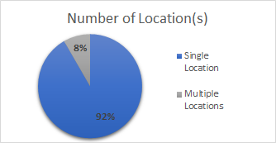
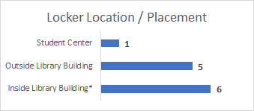
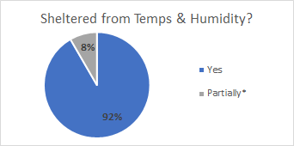
Locker Locations & Placement
Highlights:
  Nearly all lockers are located in a single location
  Majority are located inside the library or just outside with shelter

Slide 10
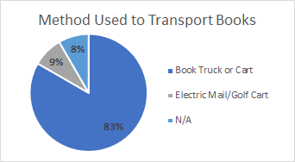
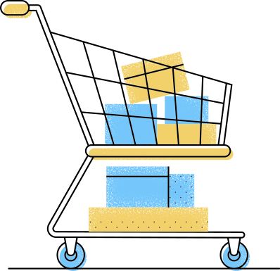
How Are Books Transported to the Lockers?
Highlights:
  A majority (83%) of libraries use a book truck or cart to deliver books to the lockers

Slide 11

Use of Lockers...
In this section of the survey we investigated:
  Length of Time Lockers Have Been In Use
  Who Manages the Lockers
  What Material is Placed in Lockers
    Impact of Temperature

Slide 12
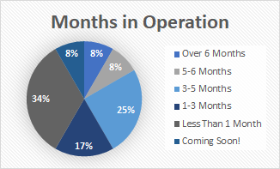
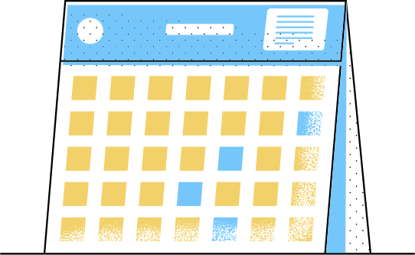
How Long Have Lockers Been in Use?
Based on results, this appears to be a fairly new service, trending after the onset of COVID-19
  Only one respondent had been using prior to the pandemic
  42% are either in planning stages or have been using less than 1 month

Slide 13
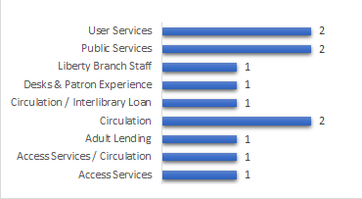
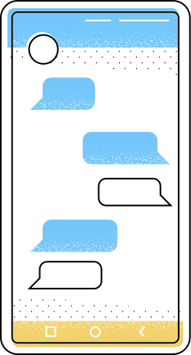
What Department Manages the Lockers?
Results strongly indicate that this is a responsibility of the Access, User, or Public Services Department--primarily the Circulation, Interlibrary Loan or Patron Experience Desks

Slide 14
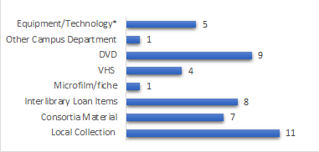
What Material is Placed in Lockers?
Highlights:
  A majority of the libraries place local collection books, DVD's, Interlibrary Loan and Consortia Material in the lockers
  A few libraries loaned Equipmetn/Technology, VHS, Microforms, or material owned by another department

Slide 15

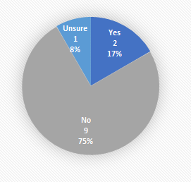

Does Temperature Determine What Goes into Lockers?
Results show that temperature does not play a role in what material is placed in lockers

Slide 16

Other Comments on Locker Use...
Respondent feedback:
  Unsure if media outside of DVD's will be placed in lockers
  90% respondents don't allow material from other departments in the lockers
  If campus partners are allowed to place items in the lockers, responses were mixed 50/50 between whether the other department or Library employees would manage the locker activity
  Materials from other departments are not added to or tracked in the ILS
  None of the respondents allow users to drop off material to a locker currently, however one indicated that faculty will be allowed to drop off their personal copies for Reserves next semester

Slide 17

Requesting & Locker Processing
In this section of the survey we investigated:
  How Items are Requested
  Number of Requests Received
  How Frequently Requests are Processed
  Amount of Time it Takes to Process
  Point at Which Items are Checked Out
  How Users are Notified
    Number of Notices Received
  Days Items Remain in Lockers
  Quarantine of Non-Pickups

Slide 18
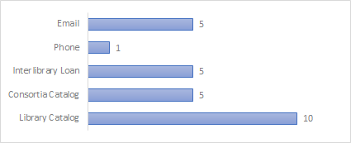
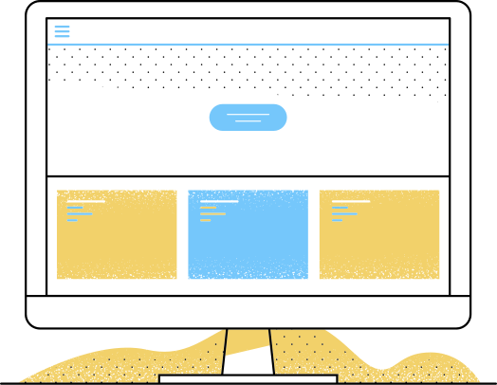
How Are Items Requested?
Based on results, requests for locker pickup typically come in through the library catalog, however some also come through interlibrary loan, a consortia catalog, or email

Slide 19
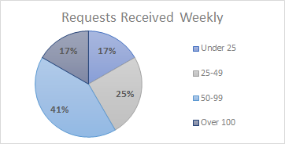
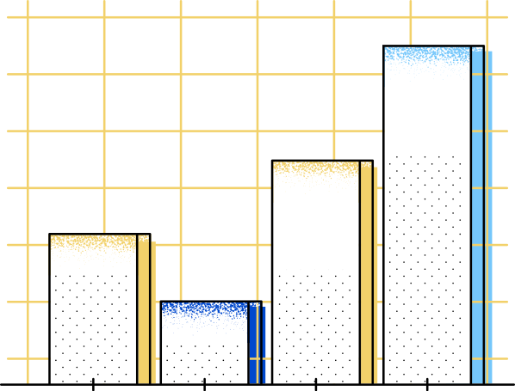
How Many Requests Do You Receive ?
Results show that a majority of the respondents (67%) received between 25-99 request per week, the highest number receiving between 50-99 requests

Slide 20

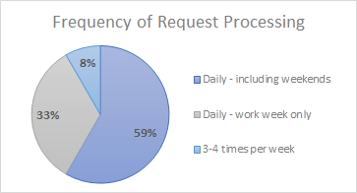
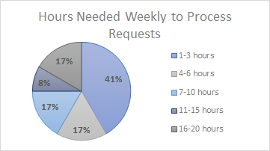
Frequency of & Time Needed
For Request Processing
Results show that most Libraries process requests daily, including weekends
75% of Libraries can process weekly requests within 10 hours per week

Slide 21
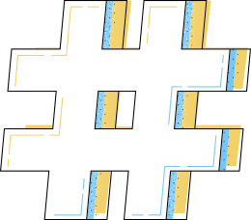
Other Responses on Request Processing...
Based on Survey Responses:
  All respondents indicated that they batch items for the same user into a single locker
  75% of the respondents have never reached capacity in their lockers
  3 respondents or 25% have indicated they have had times when all lockers were at capacity
We will likely have a one-week holds pickup requirement
Pick up at the Check Out Desk
We use LibCal's seats, user has to book a locker, lockers will run out and they will have to book a different day for pickup
Email patron
Audit for expired requests, contact patrons for a choice for grab and go pickup
Items remain "in-transit" and aren't checked in to trigger the hold until there is space for the lockers. We put those in transit items together by name so that when a locker comes available, we can check in all items for that patron and activate the holds.
We will keep them on the library hold shelf and email the patron asking if they want to do a pickup where the staff brings the items outside to them, or if they would rather us mail the items to them.
Batch Items
Capacity Reached

Slide 22
Comments on When All Lockers are Full...
Respondent feedback:
  We will likely have a one-week holds pickup requirement P
  Pick up at the Check Out Desk
  We use LibCal's seats, user has to book a locker, lockers will run out and they will have to book a different day for pickup
  Email patron
  Audit for expired requests, contact patrons for a choice for grab and go pickup
  Items remain "in-transit" and aren't checked in to trigger the hold until there is space for the lockers. We put those in transit items together by name so that when a locker comes available, we can check in all items for that patron and activate the holds.
  We will keep them on the library hold shelf and email the patron asking if they want to do a pickup where the staff brings the items outside to them, or if they would rather us mail the items to them.

Slide 23
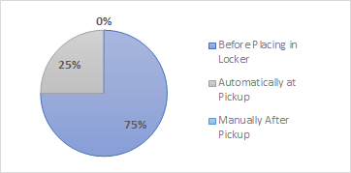


At What Point Are Items Checked Out?
  75% of the respondents indicated that items are checked out before they are placed in the lockers
  The other 25% are checked out automatically at the time of pickup as a result of system integration

Slide 24

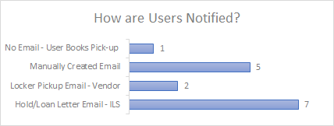
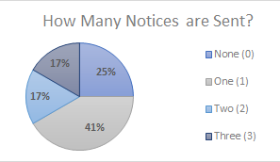
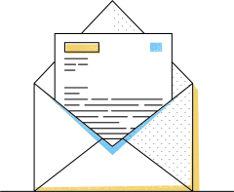
Notification & Notices
Highlights:
  A majority of respondents report that users are sent notices automatically generated through the local ILS
  A fair number of others report sending manually created emails
  There were also a couple of responses indicating that notices are sent from the vendor
  41% of the responding libraries reported sending only ONE notice

Slide 25
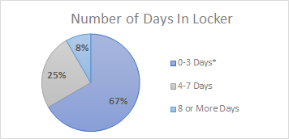
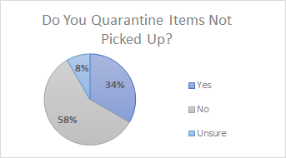
Days Held for Pickup & Quarantine
Highlights:
  Most items are kept in the lockers for 1-3 days
  58% of libraries do not quarantine material not picked-up from lockers, however some report that the are held for an additional week

Slide 26

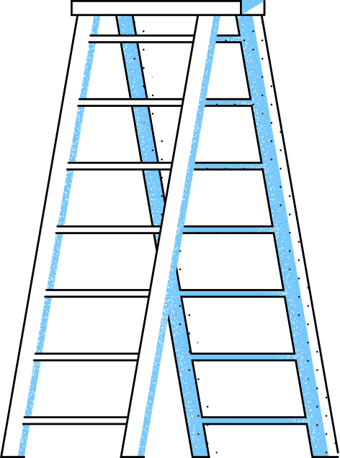



Maintenance, Cleaning & Security
In this section of the survey we investigated:
  Locker Audits & Technical Support
  Cleaning
  Safety & Security Measures

Slide 27
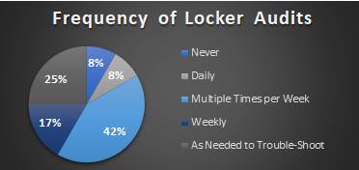
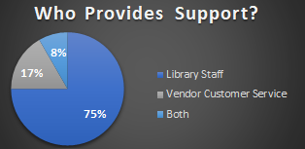
Locker Audits
Technical Support
Highlights:
  67% of respondents report that locker audits are conducted at least weekly
Highlights:
  75% of respondents report that technical support is done by library staff, with an additional 8% indicated that support is shared with vendors customer service

Slide 28
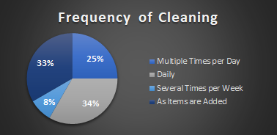
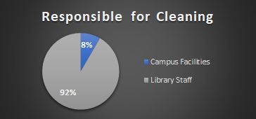



Locker Cleaning
Highlights:
  Based on results, lockers are primarily cleaned by Library Staff as items are added to the lockers, multiple times a day or daily.

Slide 29

Comments on Supplies & Cleaning...
Recommened Supplies
Recommended Cleaning
  Cloths for wiping/drying
  Disinfectant wipes
  Mild Soap
  Alcohol, Lysol, Sani-Quat or Other Disinfecting Spray
  Sanitizing Spray Mace or Digger
  Inside surface (when empty)
  Outside lock, keypad, and door whenever touched
  Nightly spraying of exterior by campus facilities
"Disinfectant sprayed on cloth wiped on surface of locker and keypad, let sit and clean off with clean cloth"
"Clorox wipes on interior; exterior is sprayed with a digger in the evening hours"

Slide 30

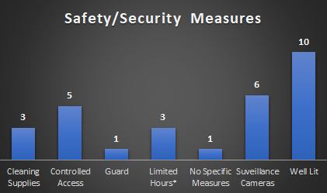

Safety & Security
Highlights:
  Most lockers are in well lit areas
  Half of the respondents have surveillance cameras, and others rely on controlled access
  Controlled access is by card swipe, or limited to access when the building is open and staffed
  Surveillance cameras are primarily monitored by staff or security in the Library, but in one instance campus security

Slide 31

Questions?
Contact:
Teri Roudenbush
troudenb@csusm.edu
(760) 750-4376

