Slide 1
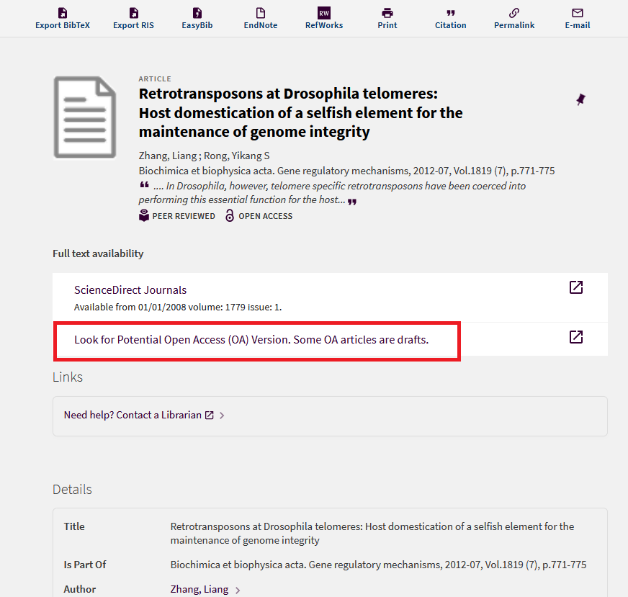
Having full text from other DBs
e.g. Retrotransposons at Drosophila telomeres: Host domestication of a selfish element for the maintenance of genome integrity
https://csu-sfsu.primo.exlibrisgroup.com/discovery/search?query=any,contains,%22Retrotransposons%20at%20Drosophila%20telomeres:%20Host%20domestication%20of%20a%20selfish%20element%20for%20the%20maintenance%20of%20genome%20integrity%22&tab=Everything&search_scope=Everything_Test&vid=01CALS_SFR:01CALS_SFR&lang=en&offset=0

Slide 2
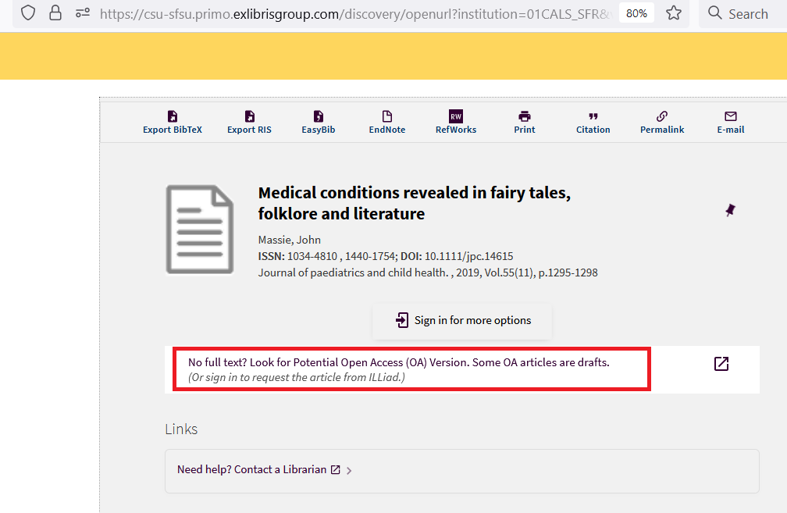
No full text from other DBs
e.g. Sidney Holt’s legacy lives on in fisheries science
https://csu-sfsu.primo.exlibrisgroup.com/discovery/openurl?institution=01CALS_SFR&vid=01CALS_SFR:01CALS_SFR&volume=78&date=20210901&issn=10543139&issue=6&au=Anderson,%20Emory%20D&rft_id=info:doi%2F10.1093%2Ficesjms%2Ffsab091&isbn=&genre=article&spage=2150&title=ICES%20Journal%20of%20Marine%20Science%20%2F%20Journal%20du%20Conseil&atitle=Sidney%20Holt%27s%20legacy%20lives%20on%20in%20fisheries%20science.&sid=EBSCO:Academic%20Search%20Complete:152769017

Slide 3
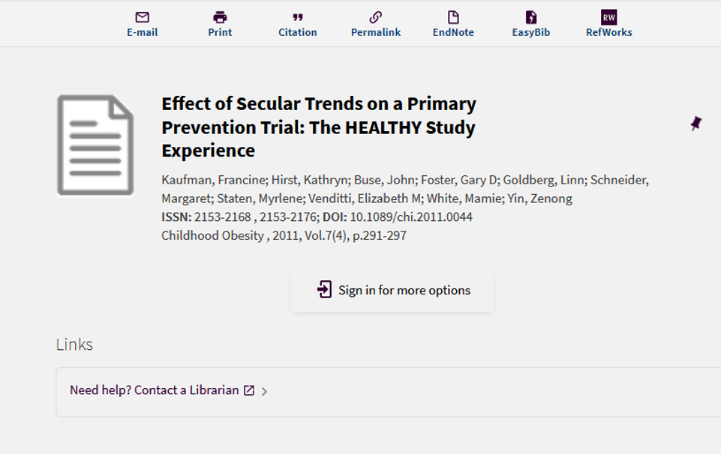
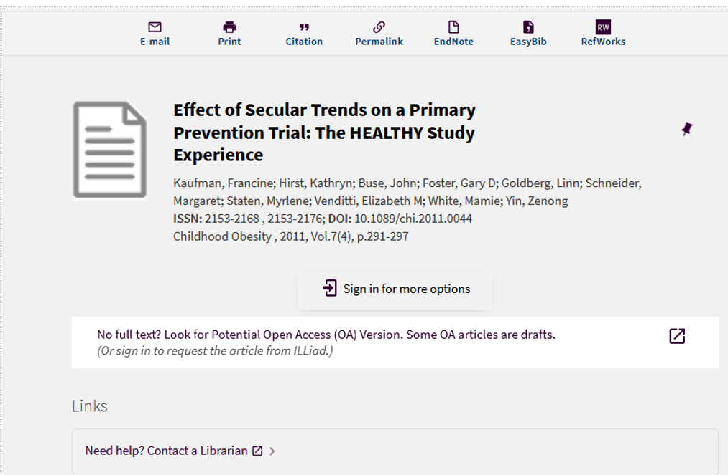

Slide 4
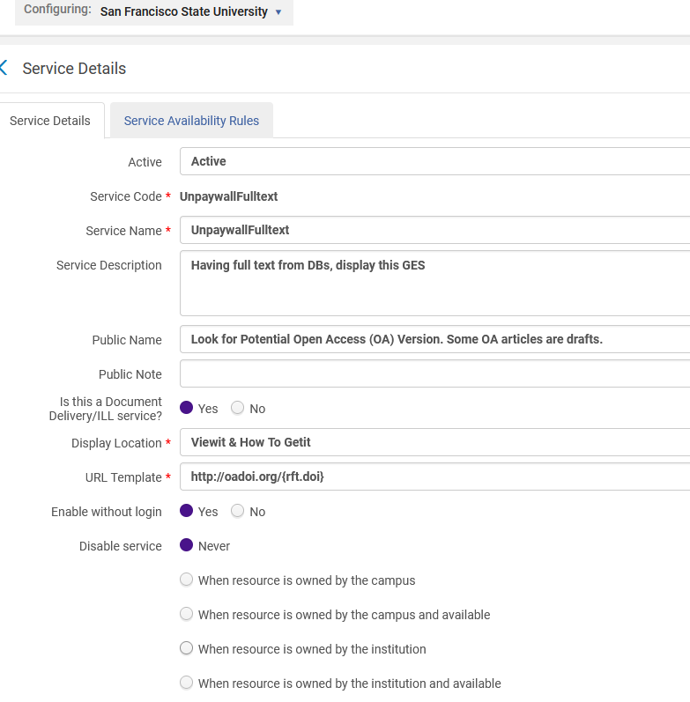
Having full text from other DBs
http://oadoi.org/{rft.doi}

Slide 5
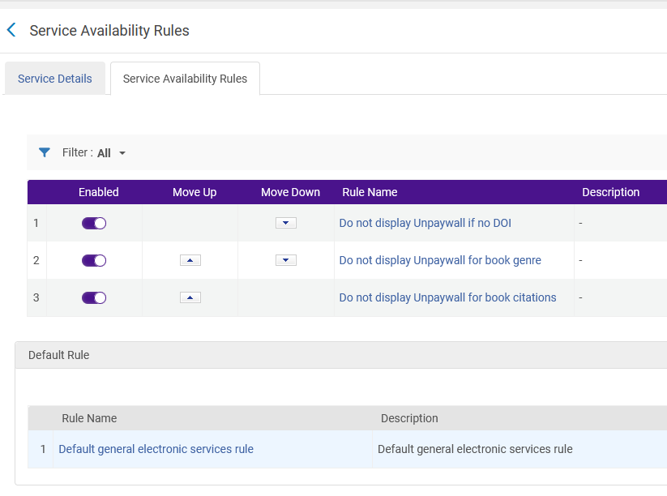
Having full text from other DBs

Slide 6
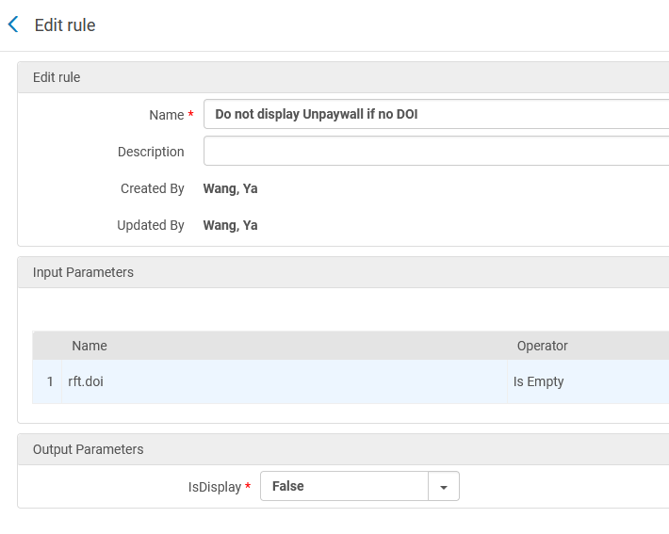

Slide 7
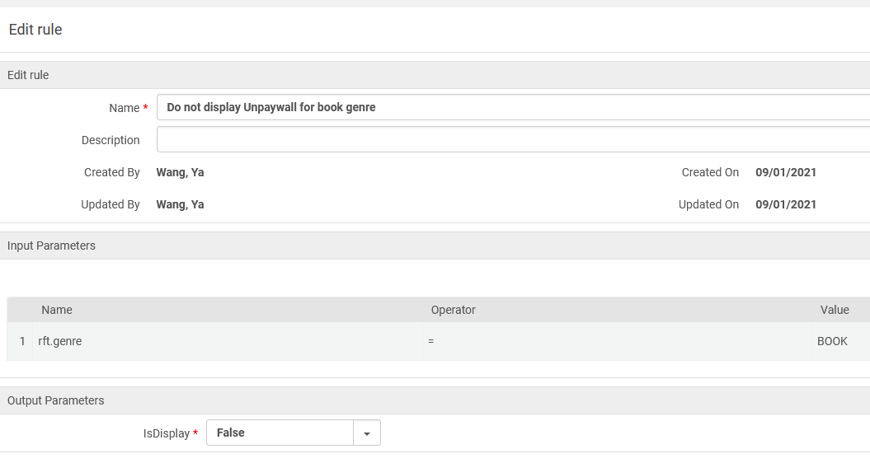

Slide 8
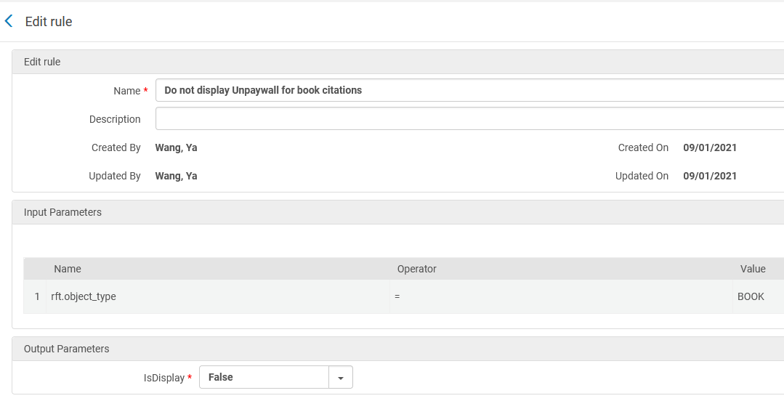

Slide 9
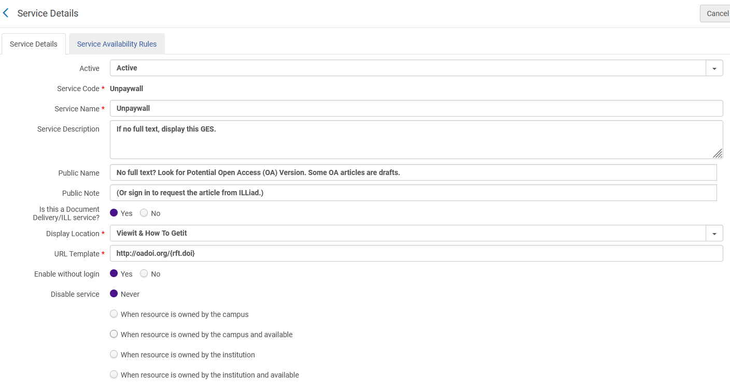
No full text from other DBs

Slide 10
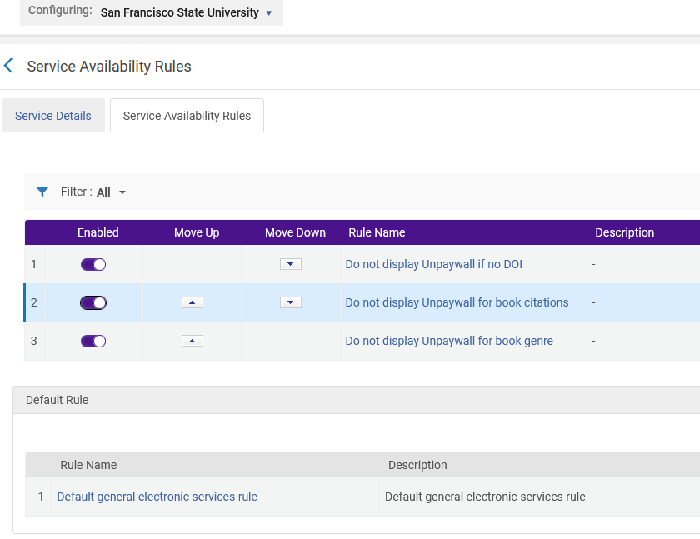
No full text from other DBs

Slide 11
Display Logic Rules

Slide 12
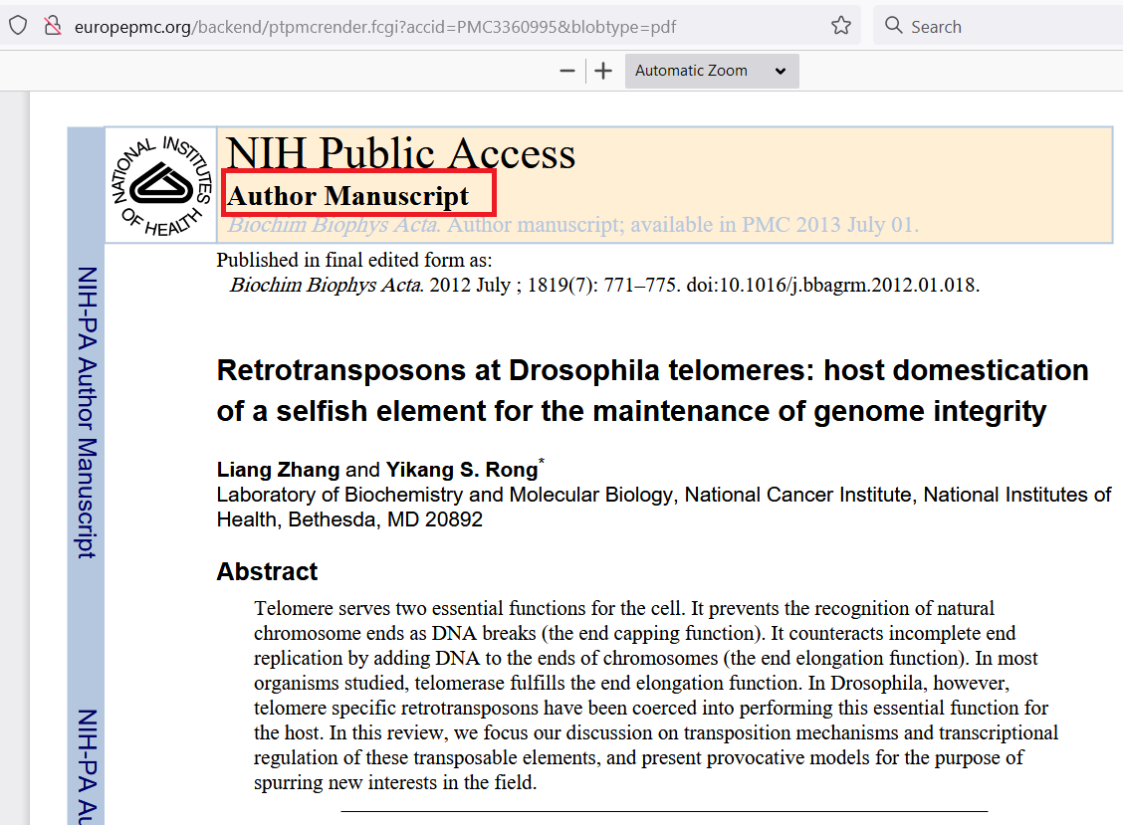
https://csu-un.primo.exlibrisgroup.com/discovery/search?query=any,contains,Retrotransposons%20at%20Drosophila%20telomeres:%20Host%20domestication%20of%20a%20selfish%20element%20for%20the%20maintenance%20of%20genome%20integrity&tab=LibraryCatalog&search_scope=MyInst_and_CI&vid=01CALS_UNO:01CALS_UNO&lang=en&offset=0

