Slide 1

Form Matters
Looking at the Impact of Layout and Wording on Discoverability

Slide 2

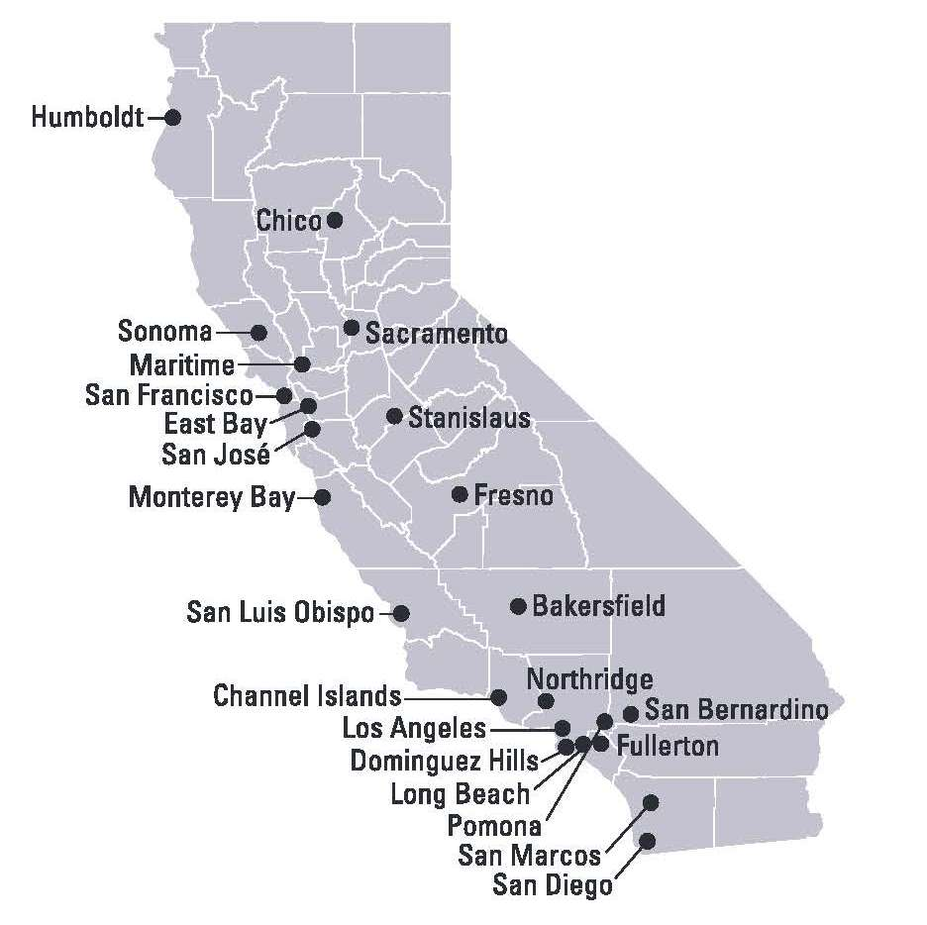
Background –Who We Are
23 campuses
480.000 students
Largest 4 year university in the US
800,000 visitors per week
Over 17 million Volumes

Slide 3


Background
2015
CSU System Adopts Alma
CSU Chooses Primo
Working Groups Formed

Slide 4

Discovery Working Group
Outreach Task Force
Results Boosting
FRBR
Third Party Integration
UX Best Practices

Slide 5

UX Best Practices Task Force
Focus on the New Primo UI
Focus on Navigation and Customization Options
Establish Best Practices
Develop a standard look and feel with consistent branding

Slide 6
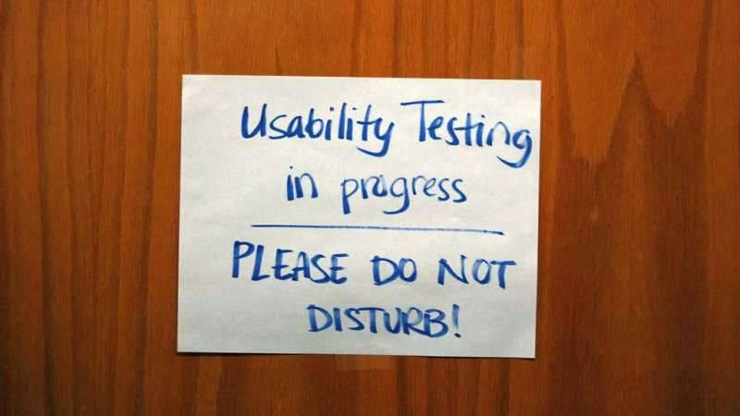
Usability Testing: Round 1
Four campuses participated –Los Angeles, Fullerton, Fresno, Northridge
Task based
5 standard tasks
Supplemental tasks

Slide 7
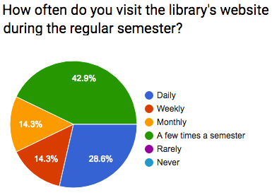
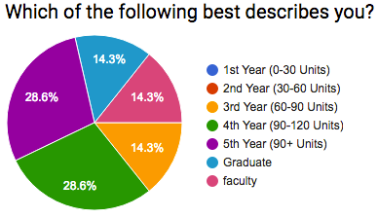
Who We Tested: Round 1
24 total participants
Variety of grade levels and experience

Slide 8

Recommendations
Make Icons more clearly defined
Make scopes more understandable
Limit facet options
Make sign in more visible
Show all CSU collections by default

Slide 9

Enter Central Package
Responsive Logo
Sidebar/Facet changes
  Width
  Padding
Change the Sign In Area
Move browse pager to the right
Google Analytics

Slide 10
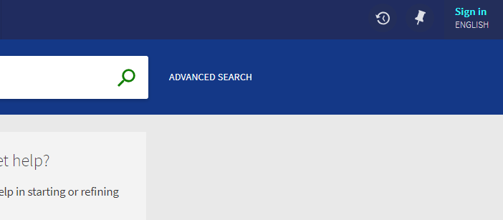
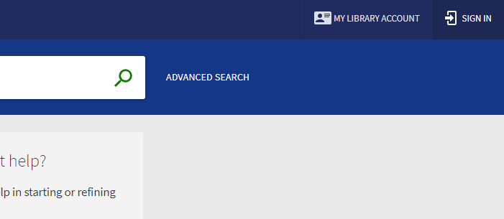
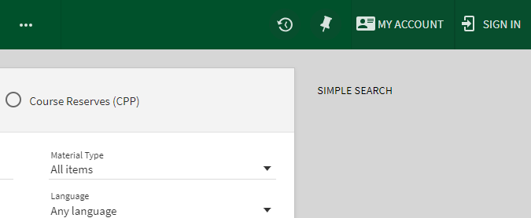
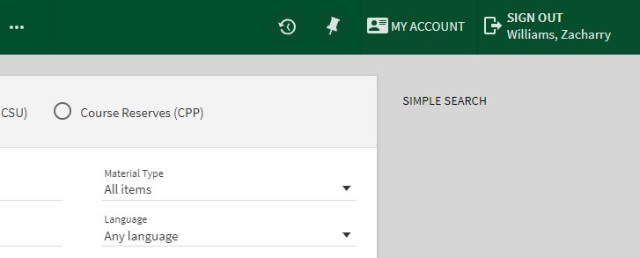
CP Mods: Sign-In Area

Slide 11
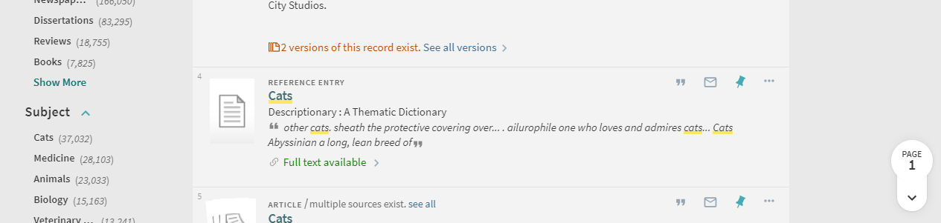
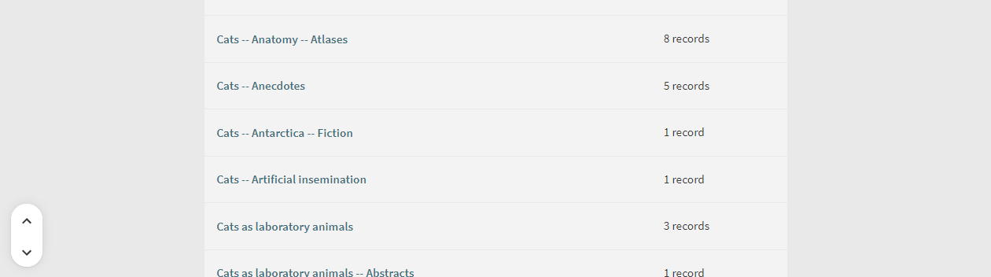
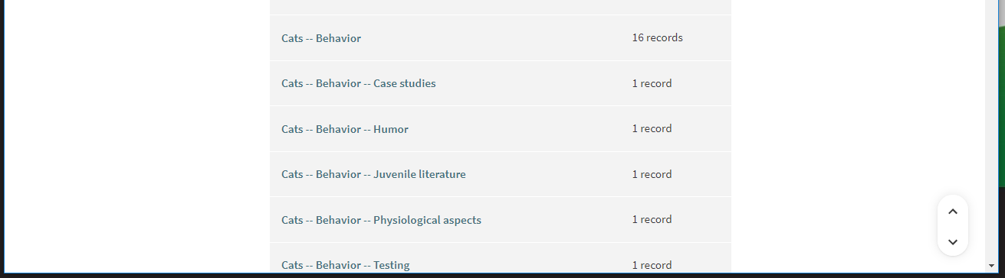
CP Mods: Page Indicator

Slide 12
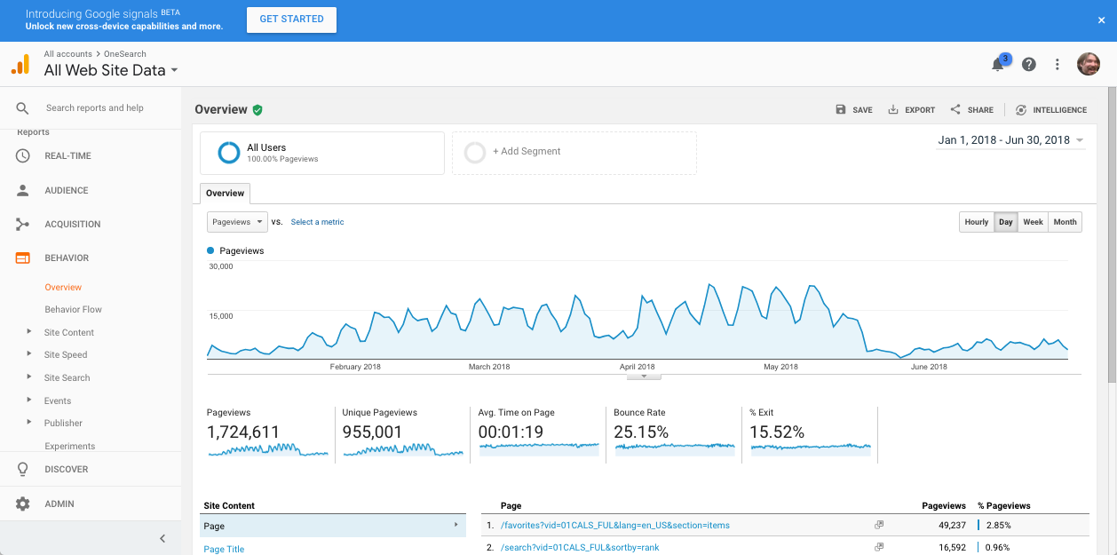
CP Mods: Google Analytics

Slide 13

User Testing: Round 2
Done after recommendations were applied
This round at Fullerton only
Same tasks assigned
Changes worked!

Slide 14
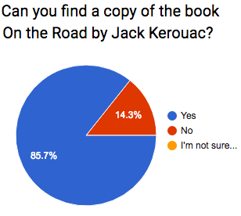
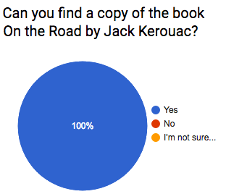
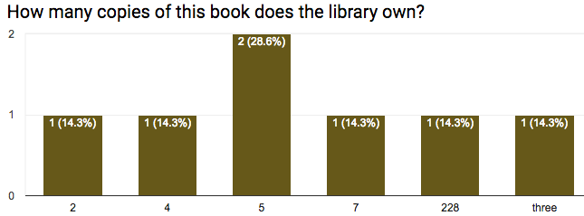
Round 2: Find a Book

Slide 15
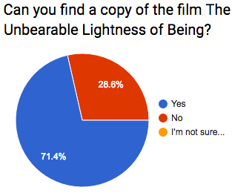
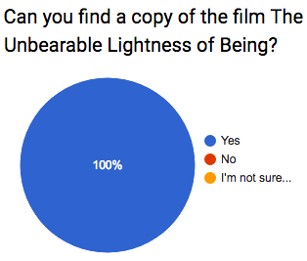
Round 2: Find a Film

Slide 16
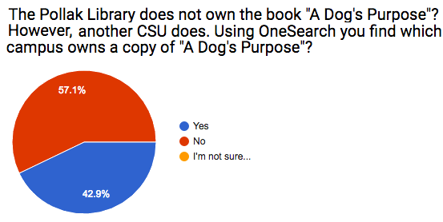
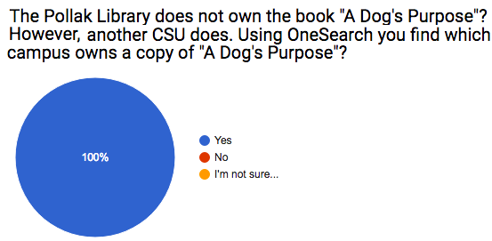
Round 2: Find Network Zone Item

Slide 17
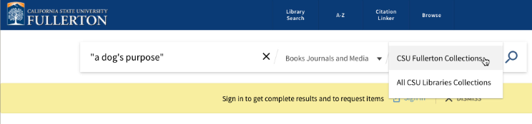
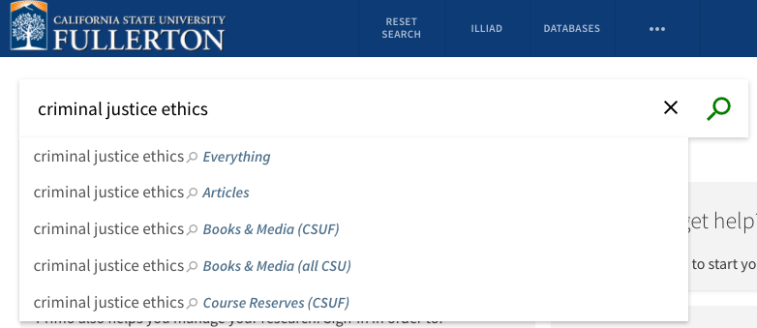
Round 2: Find Network Zone Item

Slide 18
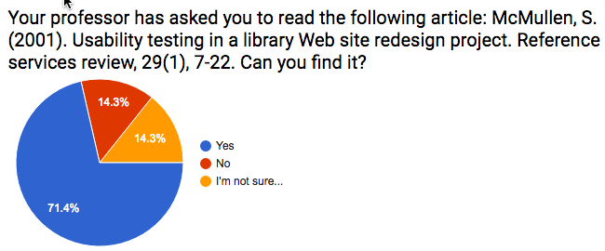
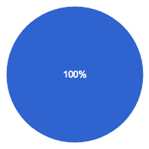

Results: Other Tasks

Slide 19
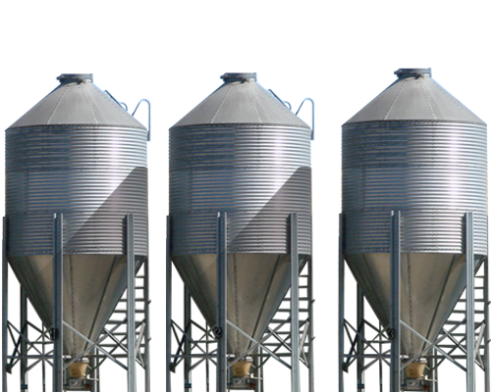
Did Everyone Go Along?
No

Slide 20
Environmental Scan
Who Participated?
Everyone

Slide 21
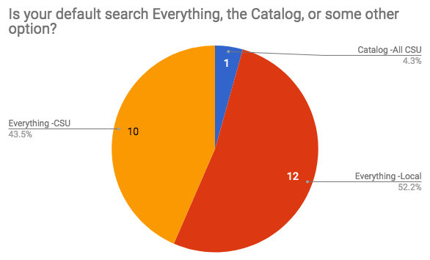
Differences

Slide 22
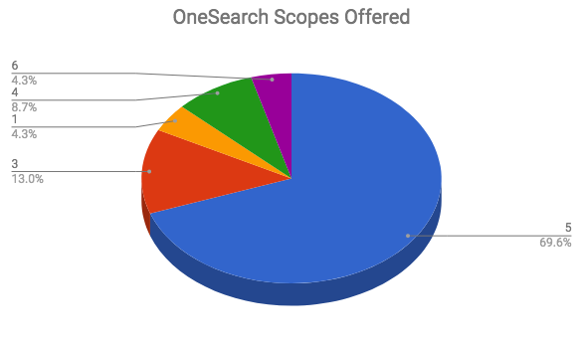
Differences

Slide 23
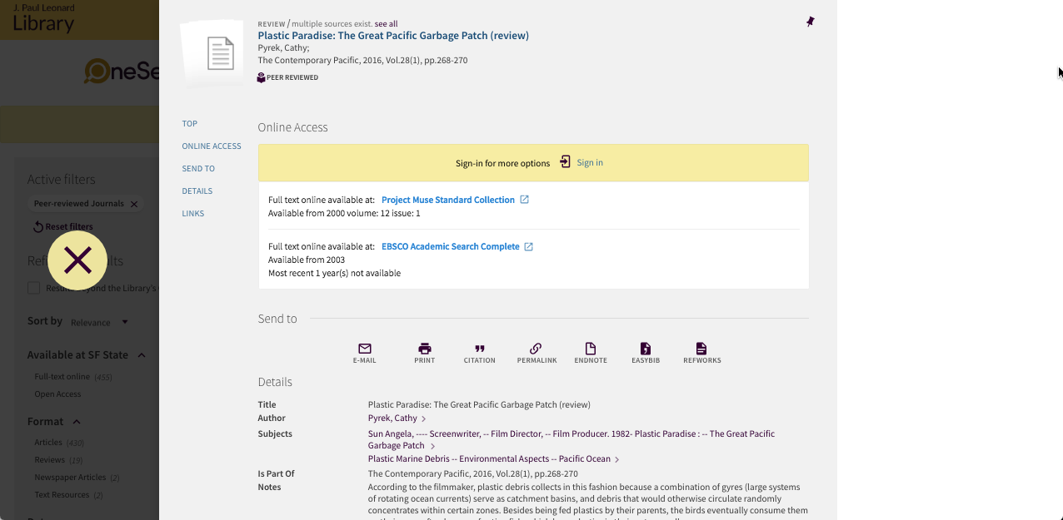
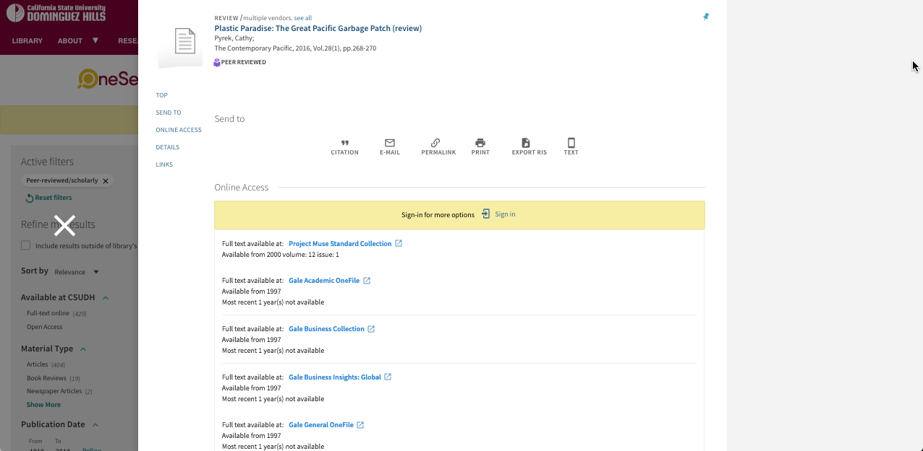
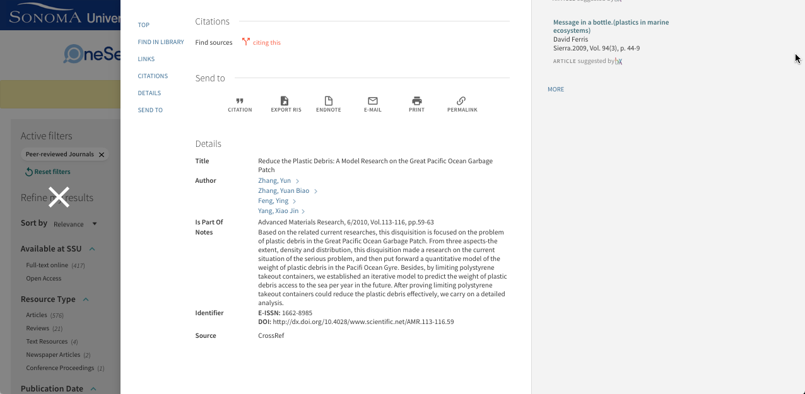
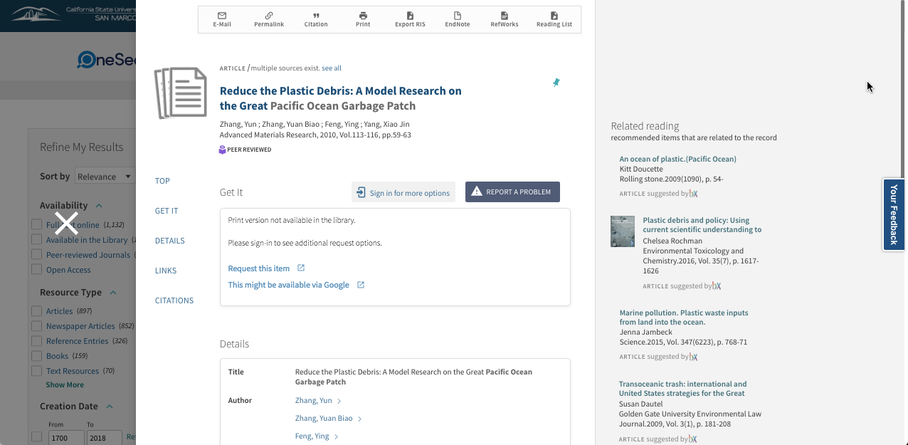
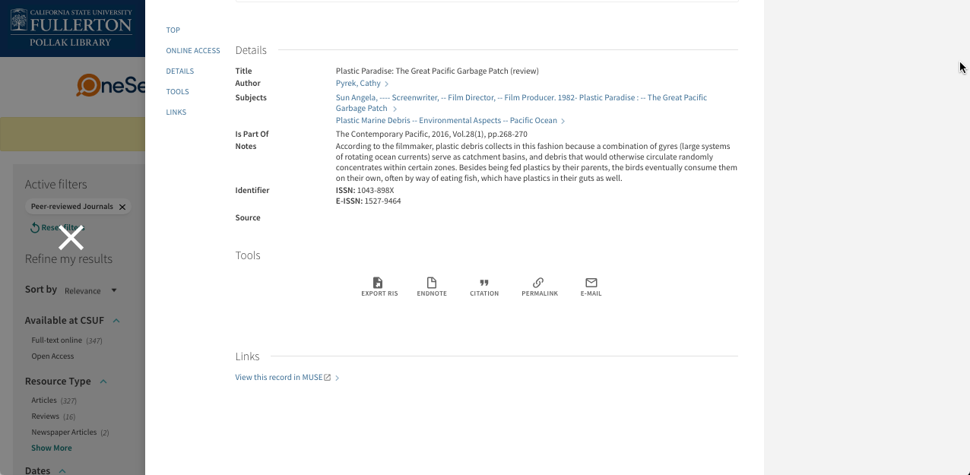
Differences: OneSearch Scopes

Slide 24
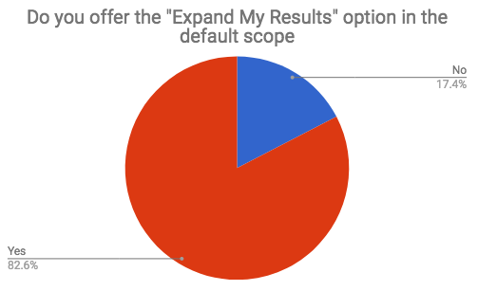
Differences

Slide 25
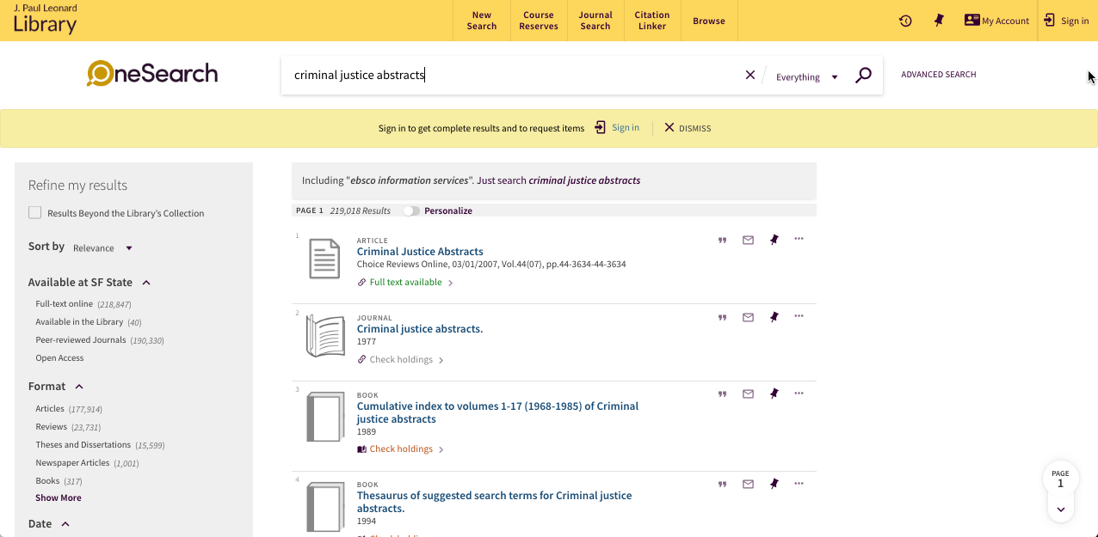
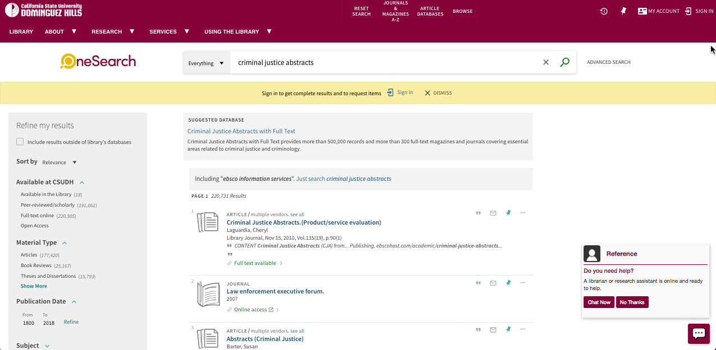
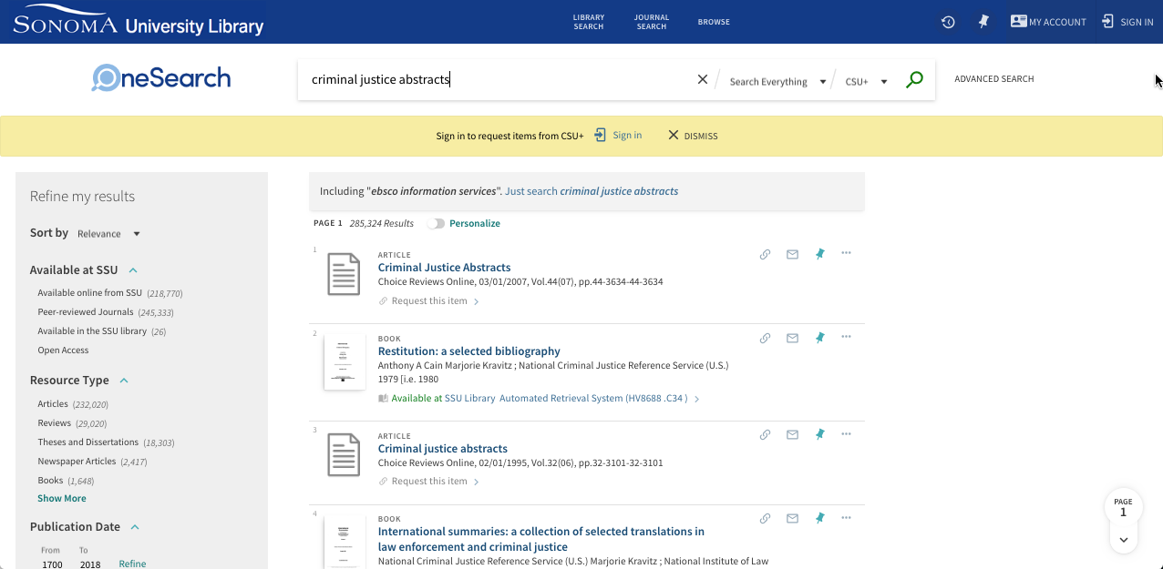
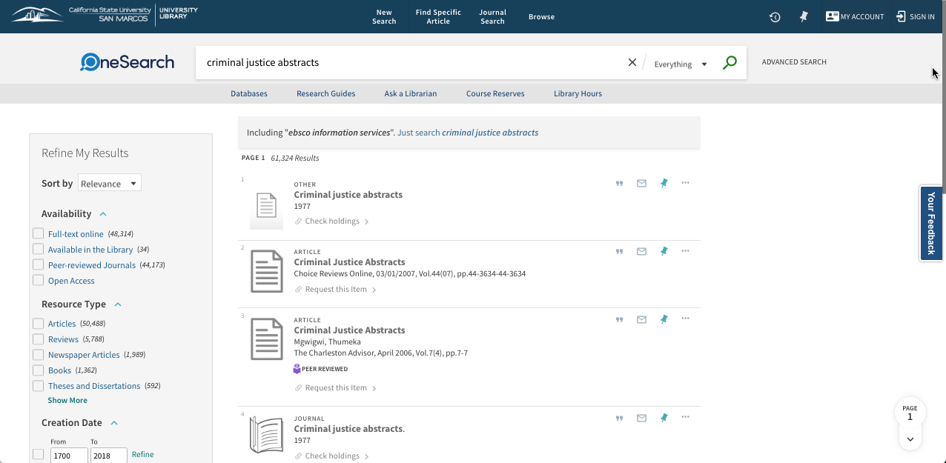
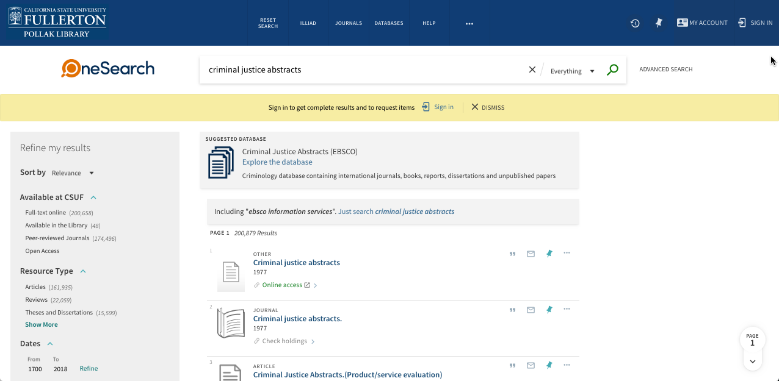
Differences: Expand My Results

Slide 26

User Testing: Round 3
Who Participated
San Francisco
Dominguez Hills
Sonoma
San Marcos
Fullerton

Slide 27
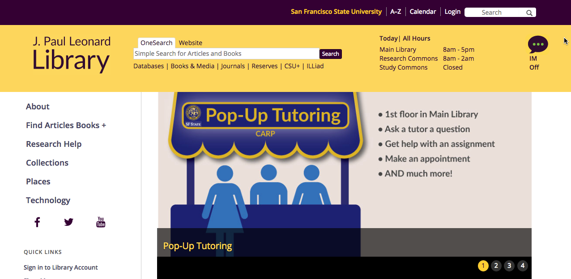
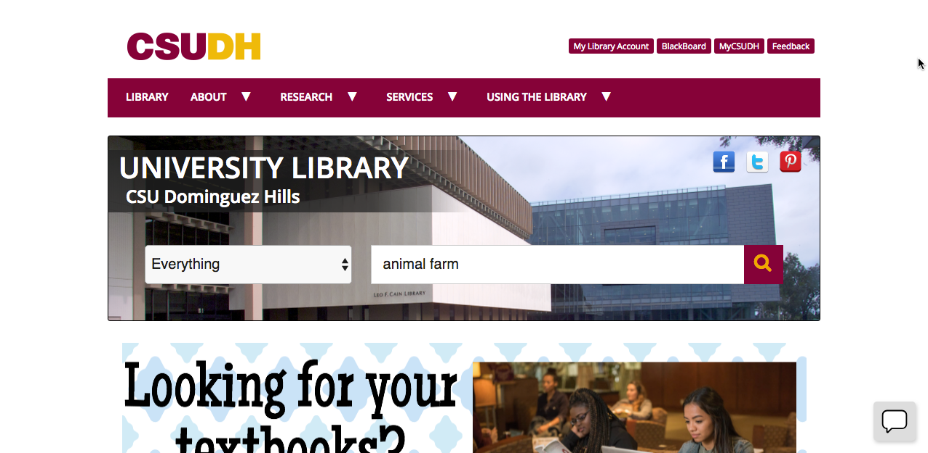
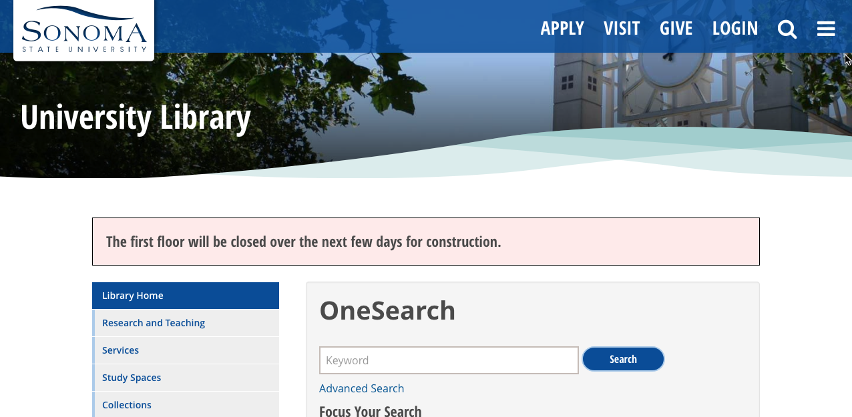
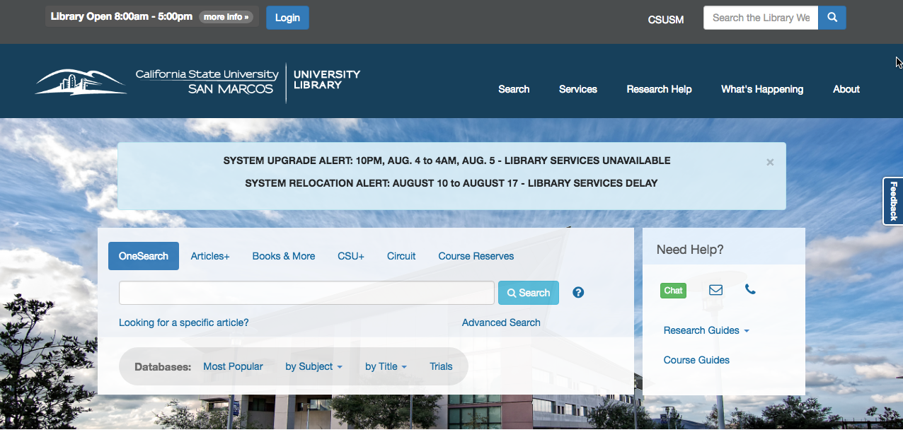
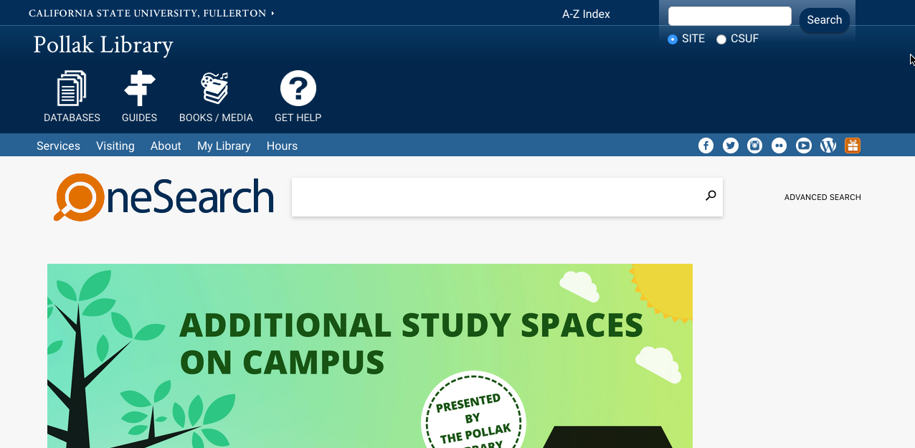
How do users get to OneSearch?

Slide 28
Can you find a copy of the book Animal Farm?

Slide 29
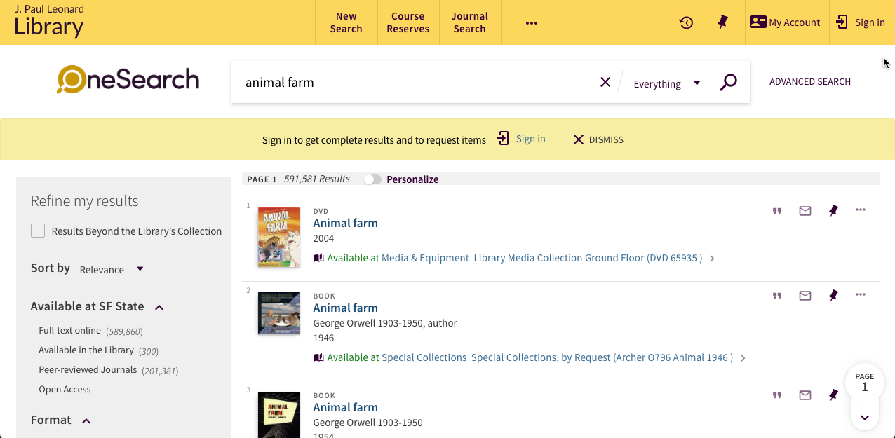
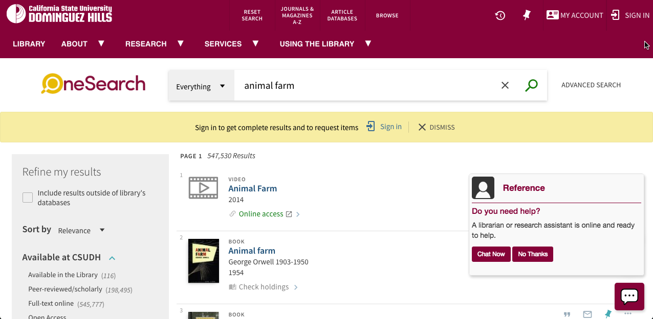
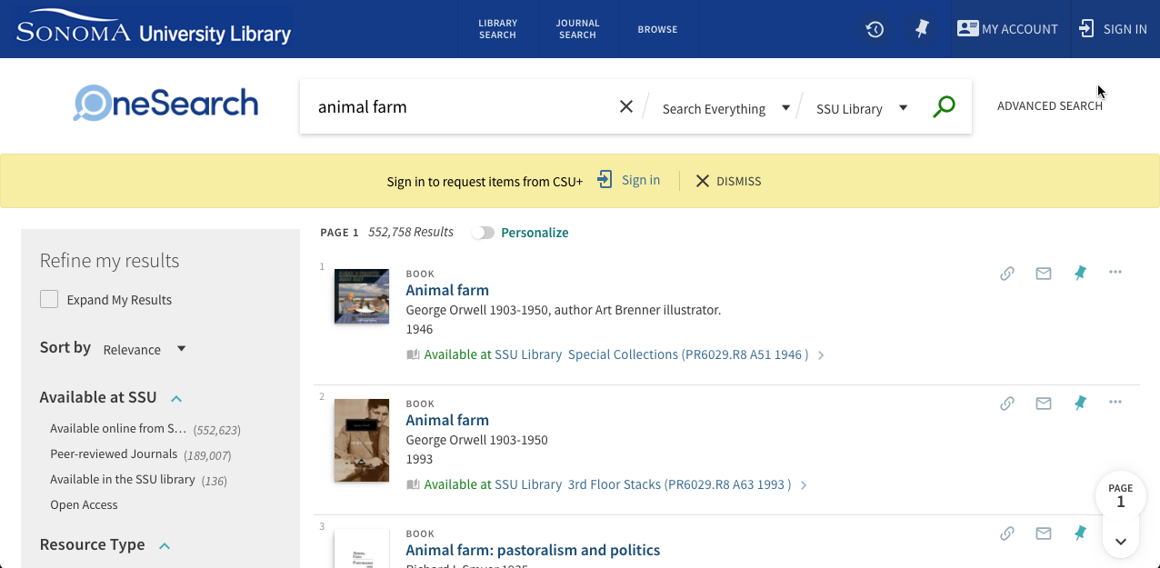
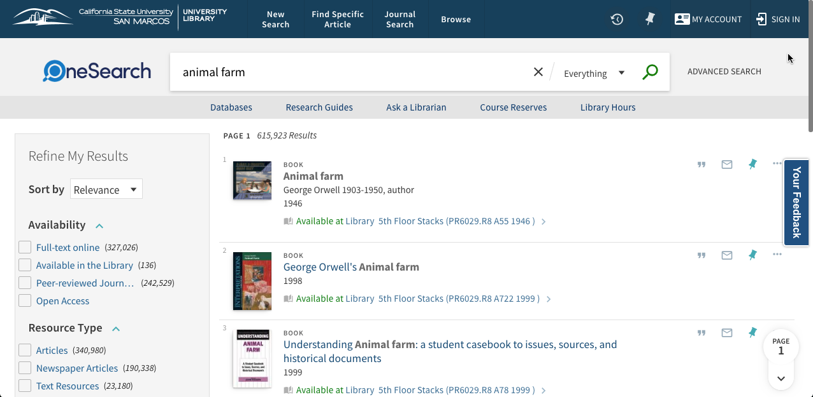
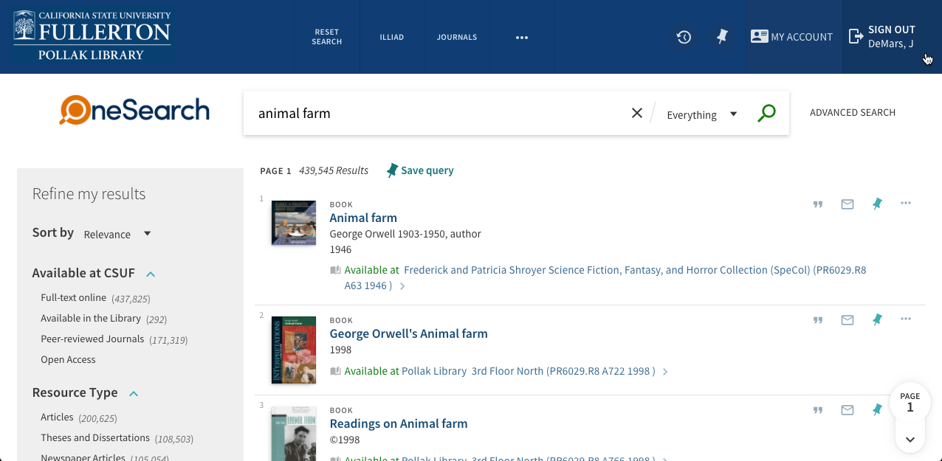
What did users see?

Slide 30
The library does not own the book “The Hat Party,” however another CSU does. Can you find which campus owns a copy of “The Hat Party”?

Slide 31
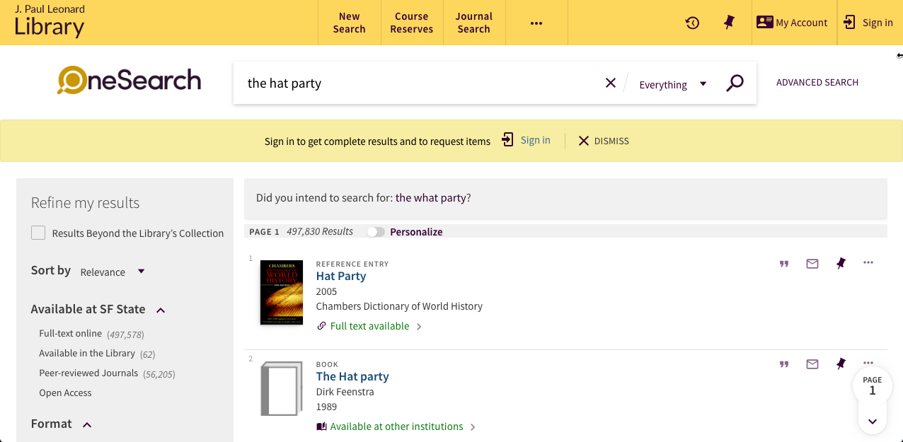
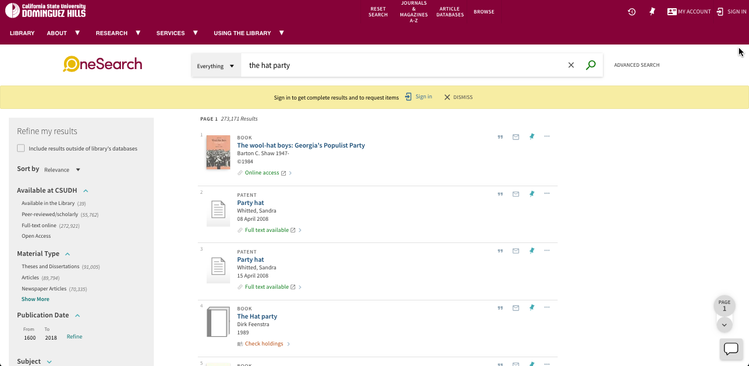
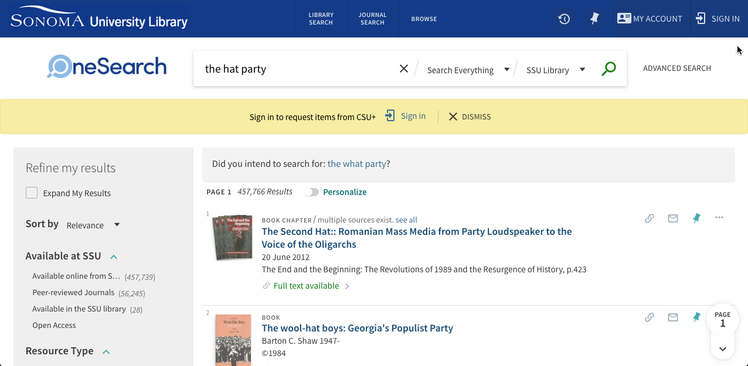


What did users see?

Slide 32
Were you able to tell which CSU owns a copy of “The Hat Party”?

Slide 33

How do users find that?

Slide 34
If you found “The Hat Party” are you able to request it from another library?

Slide 35





How do we help people figure this out?

Slide 36
Can you find a peer reviewed journal article on the Pacific Ocean garbage patch?

Slide 37





What did users see?

Slide 38
If you found the article, can you email it to yourself using OneSearch?

Slide 39
This was a question about options

Slide 40
Can you find the journal titled Criminal Justice Abstracts?

Slide 41
What did they see?

Slide 42
Can you find a copy of the article “Stress During Residency Training”?

Slide 43





How can they find this when we don’t have it?

Slide 44
If you found a copy of the article, can you request it from another library?

Slide 45





How do they order something?

Slide 46
OneSearch provides you a way to check your library account. Can you find and check your account?

Slide 47





How do they log in?

Slide 48

Alright, so what do we do now?
Enable all books in CSU+ to appear by default
Enable full PCI by default
Modify existing default wording so that it makes more sense to users
Think about Newspapers

Slide 49

Questions?
Mike DeMars
CSU Fullerton
mdemars@fullerton.edu
Zach Williams
Cal Poly Pomona

