Slide 1
OneSearch UX
Chico State
Ryan Schwab & Irene Korber

Slide 2
Our Study
Moderated, in-person.
10 Questions, 24 first-year or transfer students.
A follow-up on a UX study completed in 2016
Purpose: To determine how best to implement a website redesign.
Bonus: UX insights on OneSearch!

Slide 3
1. Using the library website, find one book on capital punishment.
Follow-up: Tell me the title and where you would find it in the library.

Slide 4
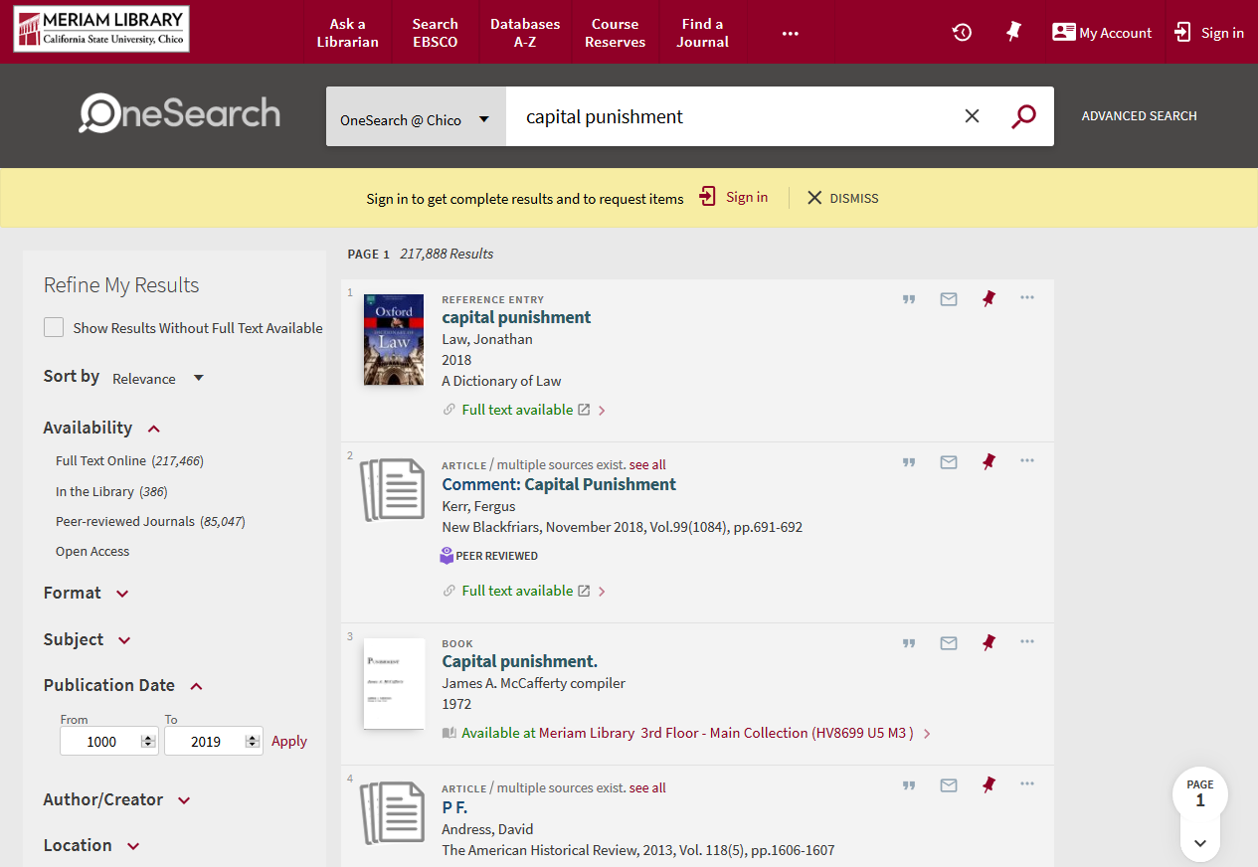

Slide 5
1. Using the library website, find one book on capital punishment.
Follow-up: Tell me the title and where you would find it in the library.
Insights:
Most incorrect answers chose the wrong format.
Reference Entries look like books (remove cover?)
Style format text to be more noticeable.

Slide 6
2. Using the library website, find one journal article on swine flu.
Follow-up: (1) Tell me the article title and journal title. (2) Show me how
to get the full text

Slide 7
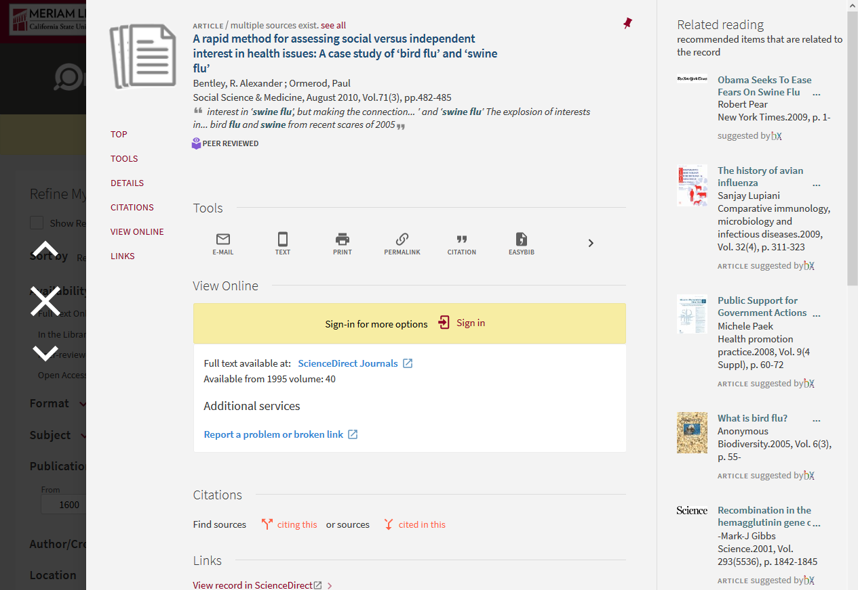

Slide 8
2. Using the library website, find one journal article on swine flu.
Follow-up: (1) Tell me the article title and journal title. (2) Show me how
to get the full text
Insights:
Many students could not find the journal title.
“Is Part of” text is vague, could be improved?
No labels at the top of the full display.

Slide 9
3. Using the library website, show me if the library has the journal Early Education and Development.

Slide 10
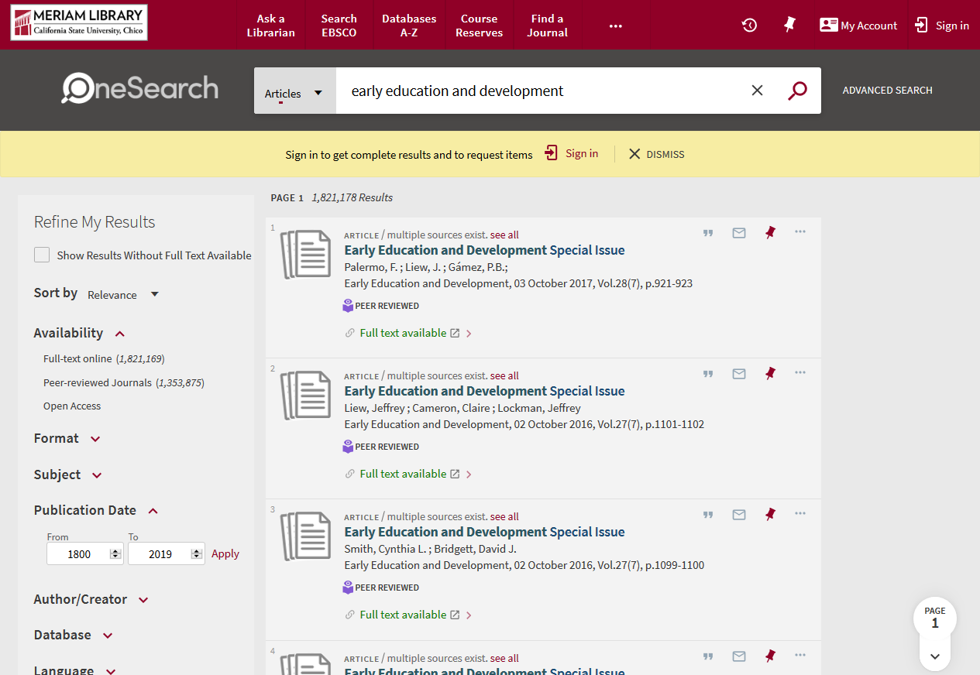

Slide 11
3. Using the library website, show me if the library has the journal Early Education and Development.
Insights:
Every incorrect answer used the Articles scope.
Include journals in Articles scope?

Slide 12
4. Using the library website, show me how to find one newspaper article on gun control.
Follow-up: Tell me the article and newspaper name.

Slide 13
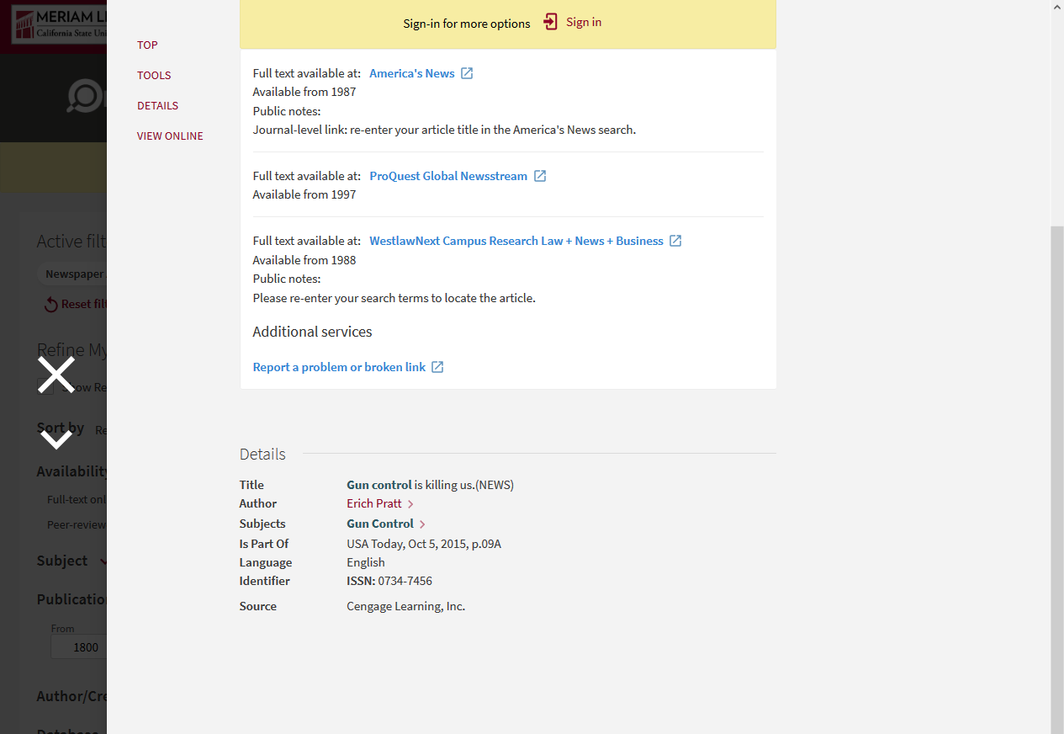

Slide 14
4. Using the library website, show me how to find one newspaper article on gun control.
Follow-up: Tell me the article and newspaper name.
Insights:
Some had trouble identifying newspaper name.
Some identified resources other than newspapers.
Could upcoming newspaper search improve this outcome?

Slide 15
5. Using the library website, show me whether or not the library has the book A Short History of Virginia City.
Follow-up: Show me how you can borrow it from another library using
this library’s website.

Slide 16
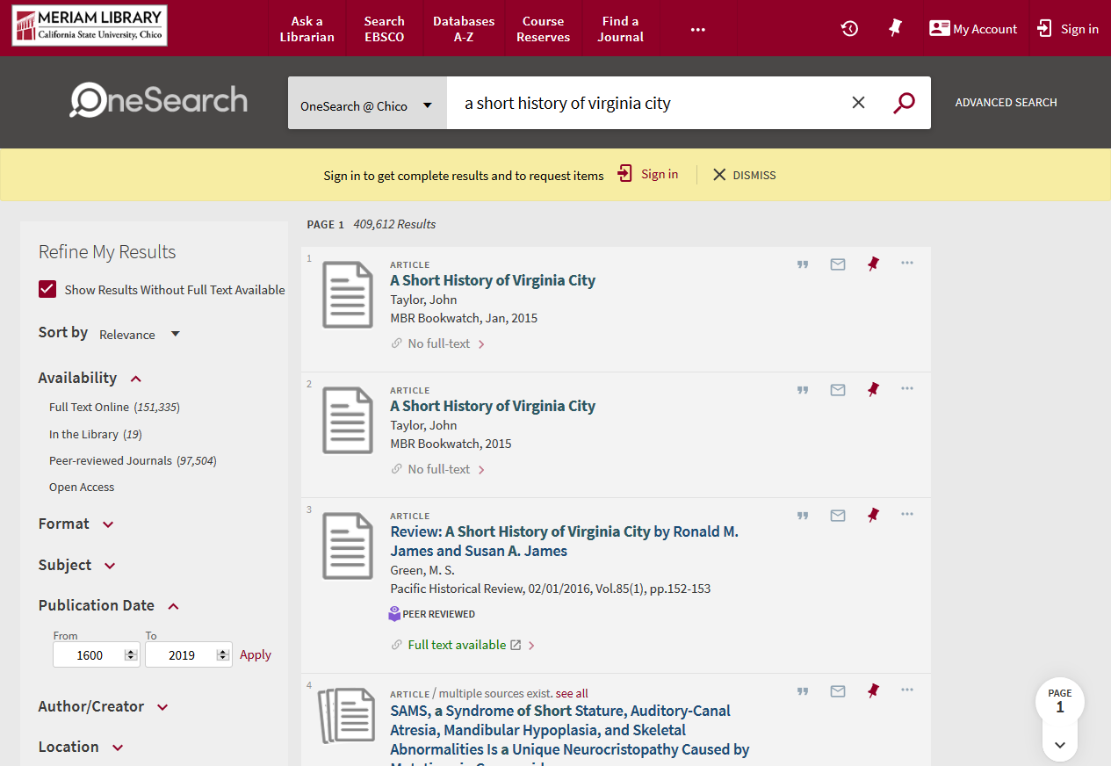

Slide 17
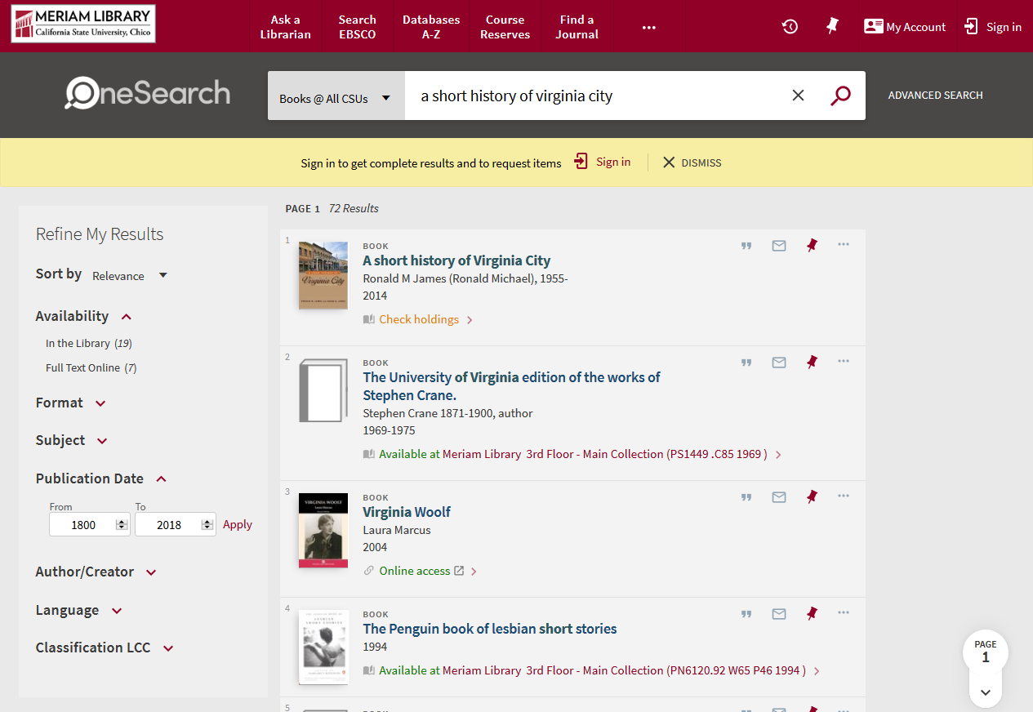

Slide 18
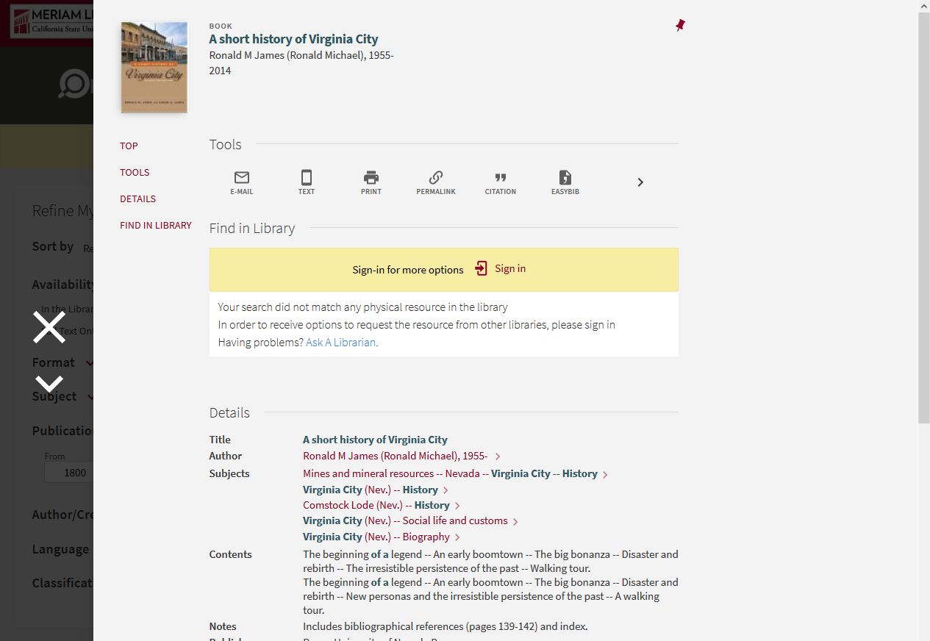

Slide 19
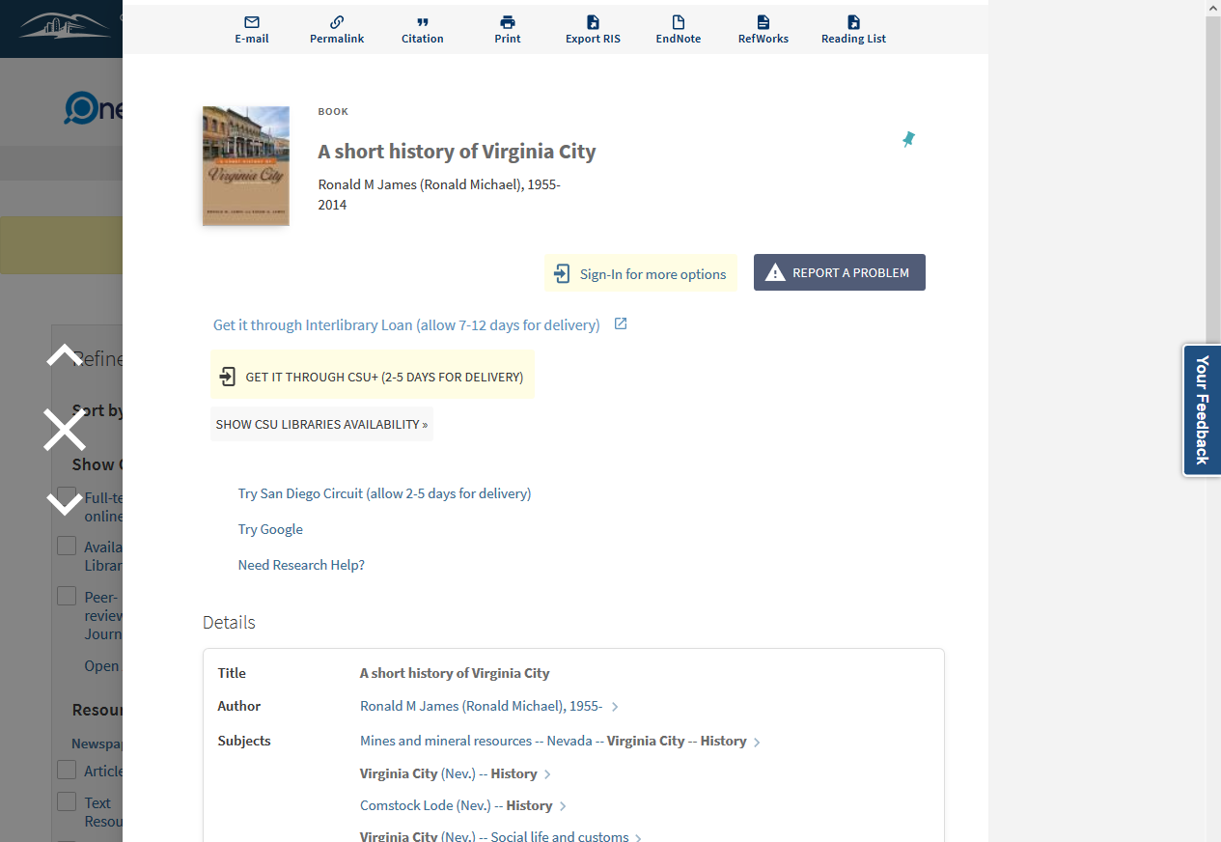

Slide 20
5. Using the library website, show me whether or not the library has the book A Short History of Virginia City.
Follow-up: Show me how you can borrow it from another library using
this library’s website.
Insights:
Most failed at ILL task.
Those who were successful went back to the homepage.
Default Primo behavior is insufficient.
GES for ILL should be prominent, and showed before logging in.

Slide 21
6. Using the library website, show me if Professor Wasinger has any books on reserve.

Slide 22
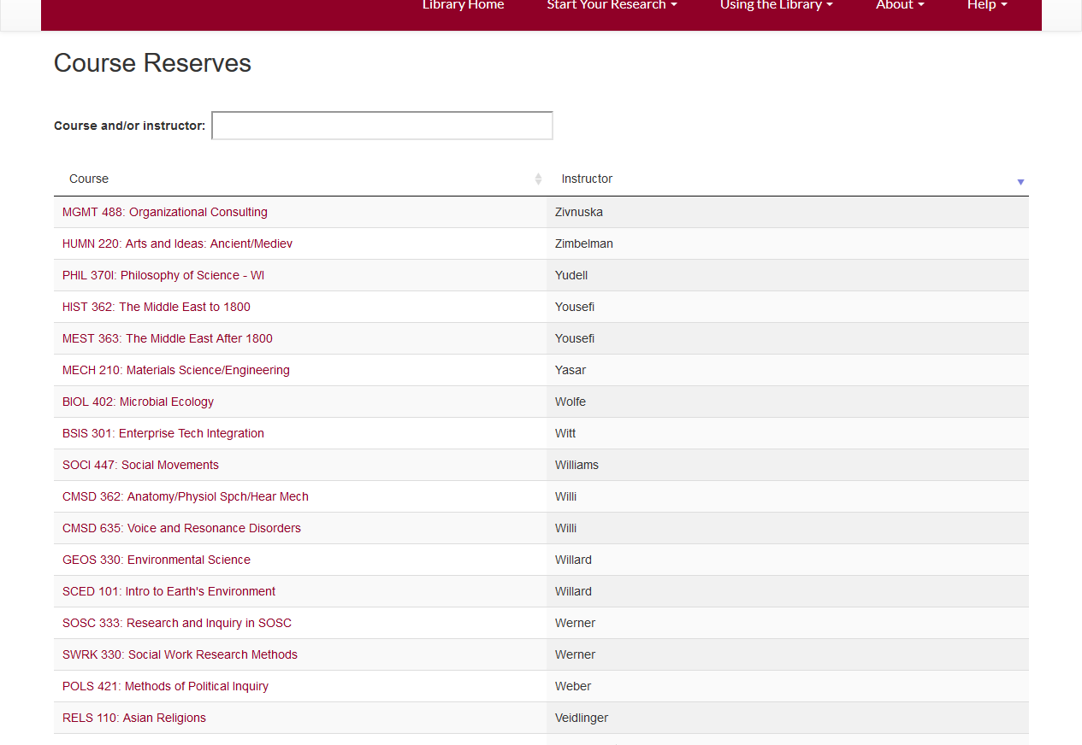

Slide 23
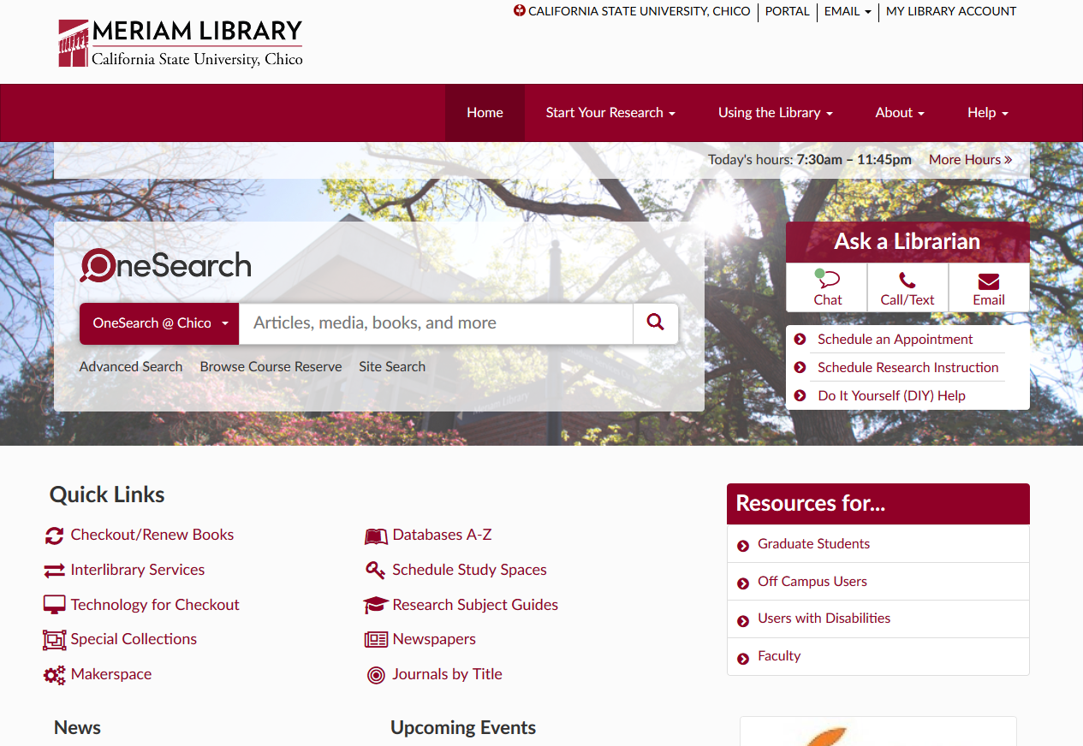

Slide 24
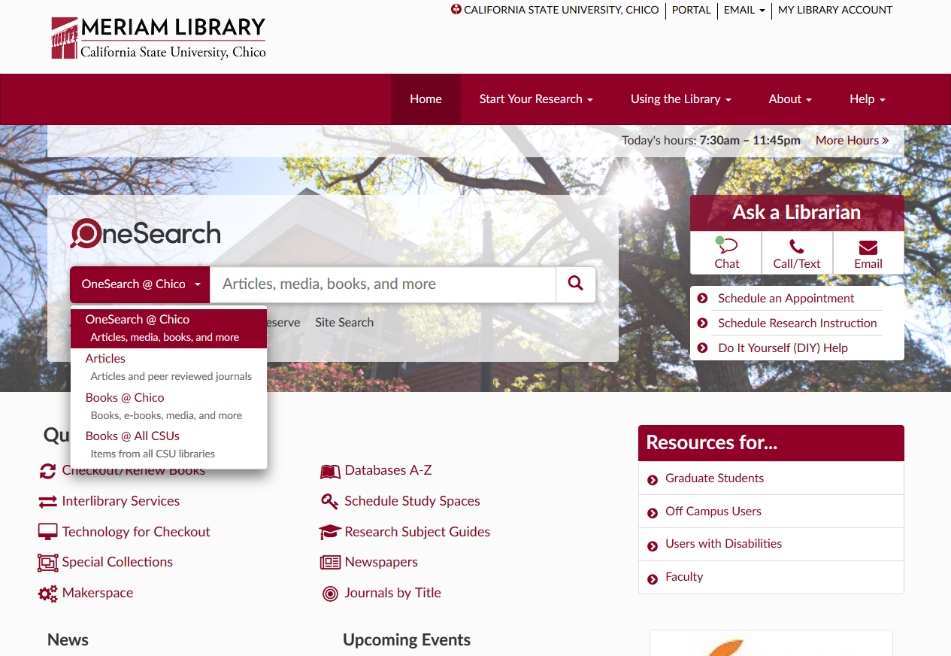

Slide 25
6. Using the library website, show me if Professor Wasinger has any books on reserve.
Insights:
Name sorting can obscure results.
Search bar blends in with background.
Carefully consider scope presentation on your homepage.

Slide 26
Thank you.

