Slide 1
Network Zone Analytics
Nikki Demoville, cal poly san luis obispo
Southern California technical services meeting - October 2018

Slide 2
Alma and Alma Analytics
Basic Structure
Institution Zone
Institution A
Institution Zone
Institution B
Users, vendors, orders, local metadata, holdings & inventory, fulfillment & usage data
Network Zone
Users, vendors, orders, local metadata, holdings & inventory, fulfillment & usage data
Shared catalog
NZ-managed e-resources
Resource Sharing Network
IZ Analytics
All data for Institution A
Network Zone Analytics
All Network Zone data
+
All Institution Zone data for All Institutions in the Network
IZ Analytics
All data for
Institution B

Slide 3
When to use nz analytics
Always use IZ Analytics if possible because it’s much faster and you don’t have to filter out other institutions | Institution Zone Analytics | Network Zone Analytics
E-Resources inventory (including NZ-managed resources) with basic bib data (title, ID) |  | 
E-Resources inventory (including NZ-managed resources) with any other bib data |  | 
E-Resources usage for IZ- and NZ-managed resources |  | 
Resources my institution has loaned to other partners in my network |  | 
Resources my institution has borrowed from other partners in my network w/basic bib data |  | 
Resources my institution has borrowed from other partners in network with any other bib data (must run lending report filtered for my institution as partner) |  | 
Print resources my institution owns compared to other institutions in the Network Zone |  | 

Slide 4
NZ Analytics requirements
Alma Network Zone login
Designs Analytics role: create reports in Alma Analytics (required)
Analytics Administrator role: configure and expose Analytics to others, e.g. in dashboards (optional)
Analytics roles have no power to change anything in the Network Zone so they are generally safe*
Contact Mallory DeBartolo or Marcus Jun for Network Zone accounts
*Even highly-limited Alma roles have the additional capability of Creating a Purchase Request. Just Don’t Do It.

Slide 5
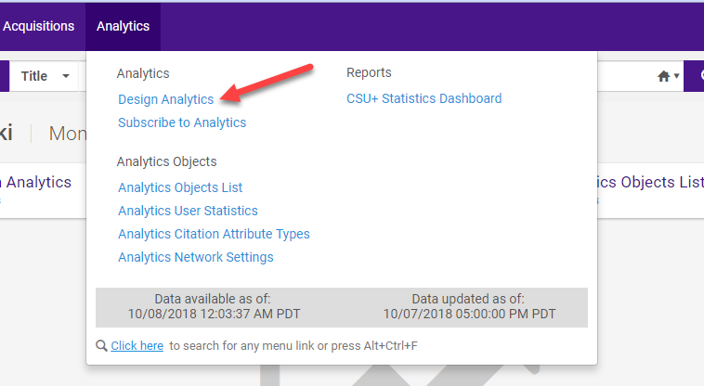
Getting to analytics
Log into the Network Zone
Click on Analytics in the top menu
Choose Design Analytics

Slide 6
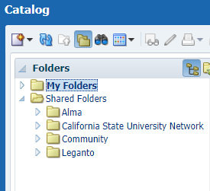
Where to start
To create a new report from scratch, choose New, then Analysis, then Select a Subject Area
To use a saved report of your own, choose Catalog, then My Folders
To use an out-of-the-box report, or a community-contributed report, choose Catalog, then Shared Folders
  The Alma folder contains reports designed by Ex Libris
  The California State University Network folder contains reports created by CSU users
  The Community folder contains reports created by Ex Libris users all over the world

Slide 7
Example reports
You can find all the example reports in the following folder in the NZ Analytics Catalog:
  /Shared Folders/California State University Network/Reports/SoCal TS Mtg 2018
The slides have complete directions, so you can follow along now or later
There are quick reference slides at the end with institution codes, filter values, etc.
The following reports are included here:
  A report of all the nursing e-journals available to a specific campus through both IZ and NZ e-collections
  JR1 - Journal Usage Counter (total) by Platform and Institution
  A comparison of a campus weeding target list with print holdings of all campuses

Slide 8
  Example report 1
A report of all the nursing e-journals available to a specific campus through both IZ and NZ e-collections
STEP 1: Choose NEW Analysis, then E-INVENTORY. Add the following fields and SAVE:
  Institution: Institution Code
  Portfolio: Available For Group Members
  Portfolio: Availability
  Portfolio: Lifecycle
  Electronic Collection: Electronic Collection Public Name
  Bibliographic Details: Material Type
  Bibliographic Details: Title
  Bibliographic Details: Subjects
  LC Classifications: Group1
    Group1 allows filtering to the first LC Subclass level, e.g. RT Nursing
    Per Ex Libris, “Alma takes LC classification information from the holdings record for the Physical Items subject area and from the bibliographic record for the LC Classifications field in other subject areas. Alma stores four levels in the LC classification dimension.”

Slide 9
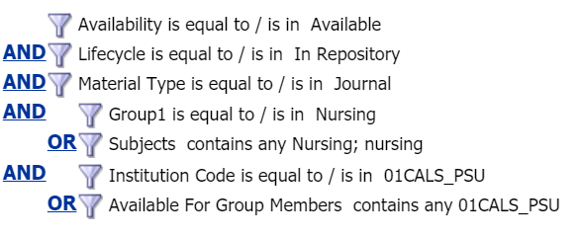
Example report 1, continued
STEP 2: Create the filters and SAVE
  Portfolio Lifecycle is equal to / is in In Repository ← timesaver: don’t use the drop down—type or paste it in
  Portfolio Availability is equal to / is in Available ← timesaver: don’t use the drop down—type or paste it in
  Bibliographic Details: Material Type is equal to / is in Journals
  LC Classifications: Group1 is equal to / is in Nursing
  Bibliographic Details: Subjects contains any Nursing;nursing
  Institution: Institution Code is equal to / is in [MY INSTITUTION CODE]
  Portfolio: Available For Group Members contains any [MY INSTITUTION CODE]*
STEP 3: Add and/or logic
  Click the AND next to Subjects to turn it into OR
  Click the AND next to Available for Group Members to turn it into OR

Slide 10
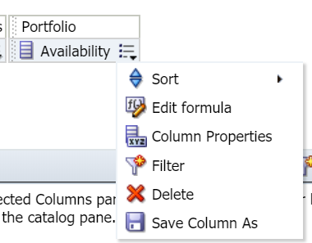
Example report 1, continued
STEP 4: Once your filters are in place, you can remove some fields from your report to simplify the display
  To remove a field, mouse over the menu icon and choose delete from the dropdown
  Remove the following fields and SAVE:
    Availability
    Lifecycle
    Material Type
    Institution Code
    Available for Group Members
  You should be left with this:
    Electronic Collection Public Name, Title, Subjects, Group1

Slide 11
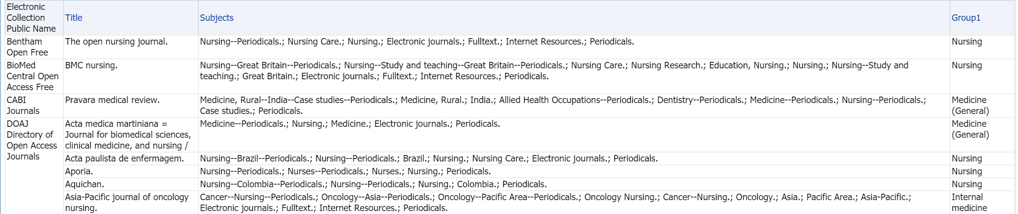
Example report 1, continued
Click the Results tab. The report will probably run for a long time.
Your results should look something like this:
This is all of the IZ+NZ journals with either LC subclass Nursing (RT) or a Subject containing Nursing.
It will not include any journals with records too brief to include either call numbers or subjects.

Slide 12
Example report 2
JR1 (COUNTER JOURNAL REPORT FOR ARTICLE DOWNLOADS) BY PLATFORM AND INSTITUTION
NOTE: This report uses the usage data loaded by each campus, either manually or via SUSHI. For various reasons, not every campus will have loaded recent data for every resource.
STEP 1: Choose NEW Analysis, then USAGE DATA. Add the following fields and SAVE:
  Usage Data Details: JR1 – Journal Usage Counter (total)
  Usage Data Details: Material Type Indicator
  Usage Date: Usage Date
  Usage Date: Usage Date Year
  Usage Date: Usage Date Month Key
  Usage Date: Usage Date Full Month
  Platform: Platform
  Institution: Institution Name

Slide 13
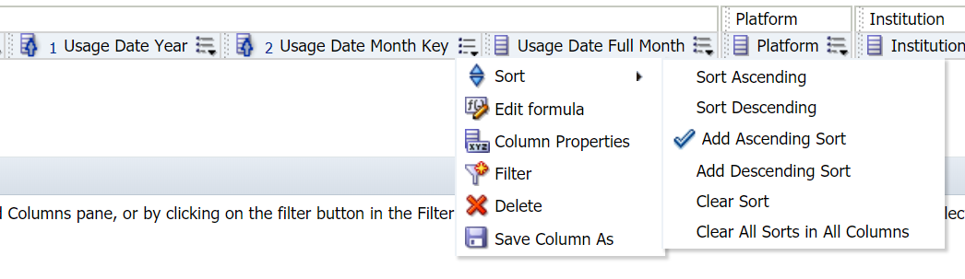
Example report 2, continued
STEP 2: Create the filters and SAVE
  Material Type Indicator is equal to / is in Journal
  Usage Date is between 07/01/2017 and 06/30/2018
STEP 3: Add a sort and SAVE
  Mouse over the menu for Usage Date Year and choose Sort > Sort Ascending
  Mouse over the menu for Usage Date Month Key and choose Sort > Add Ascending Sort

Slide 14
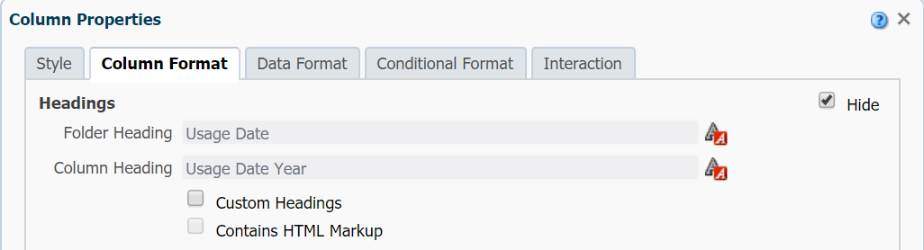
Example report 2, continued
STEP 4: Once your filters are in place, you can remove some fields from your report to simplify the display
  Remove the following fields and SAVE:
    Material Type Indicator
    Usage Date
STEP 5: Hide the sort fields to further simplify the display and SAVE
  Mouse over the menu for Usage Date Year, choose Column Properties, and the Column Format tab
    Click the box next to Hide
  Repeat for Usage Date Month Key

Slide 15
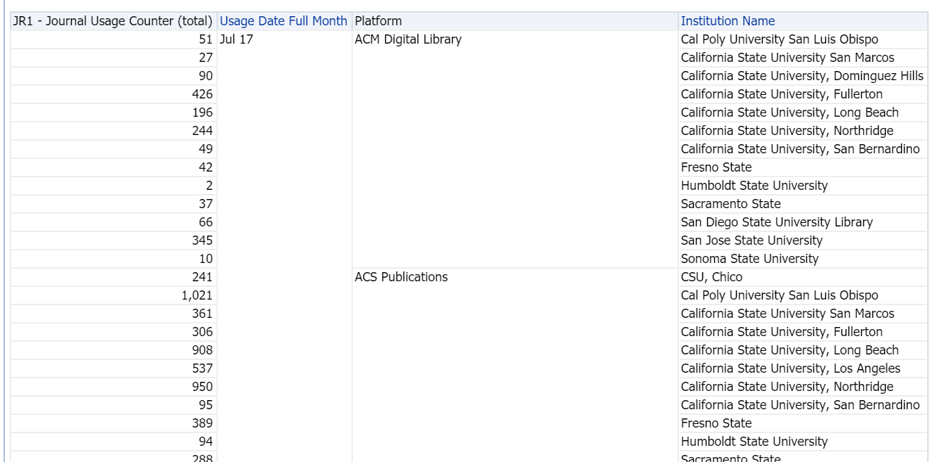
Example report 2, continued
STEP 6: Click the results tab to run the report. This will take a long time.
  The results should look like this:

Slide 16
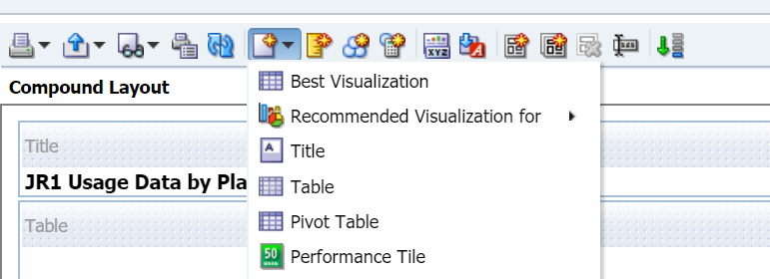
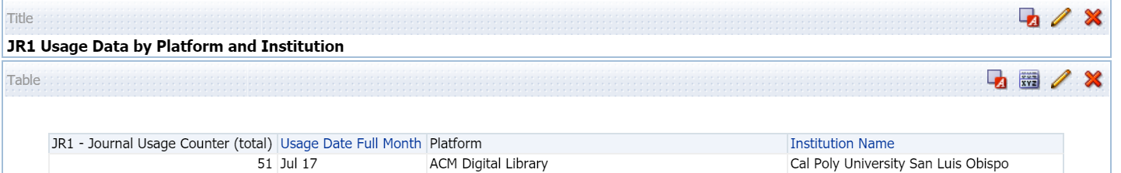
Example report 2, continued
STEP 7: Create a Pivot Table to make an easier-to-read report
  Go to New View (white rectangle with star) and choose Pivot Table
  Let the new table load, then SAVE
  Delete the first Table by clicking the red X in the upper right corner
    You should now see only the pivot table in your display. SAVE again.

Slide 17
Example report 2, continued
STEP 8: Click the pencil icon to edit the Pivot Table
  Using the layout pane, drag and drop the following fields to new locations:
    Drag Usage Date Year to the Columns box
    Drag Usage Date Month Key to the Columns box
    Adjust the order in the Columns box so that Measure Labels is on top, followed by Usage Date Year, Usage Date Month Key, and Usage Date Full Month
    Drag Institution Name to the right of Platform in the Rows box
    Click the Sum button (∑) next to Columns
    Click the Sum button next to Platform
    Click Done and SAVE

Slide 18
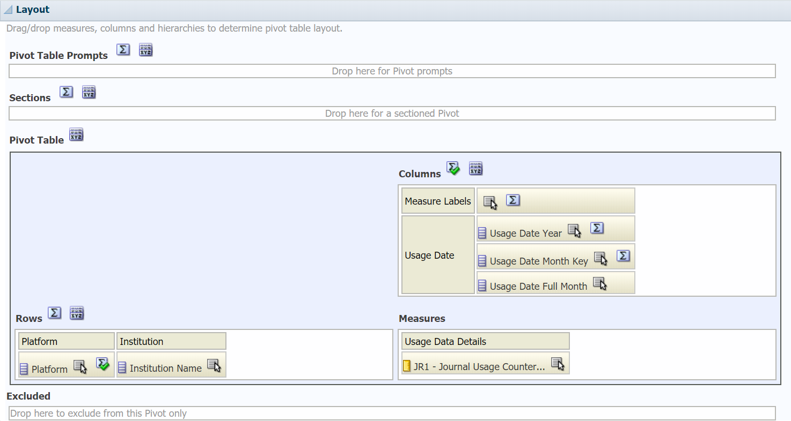
Example report 2, continued
Your Layout Pane should look like this now:

Slide 19
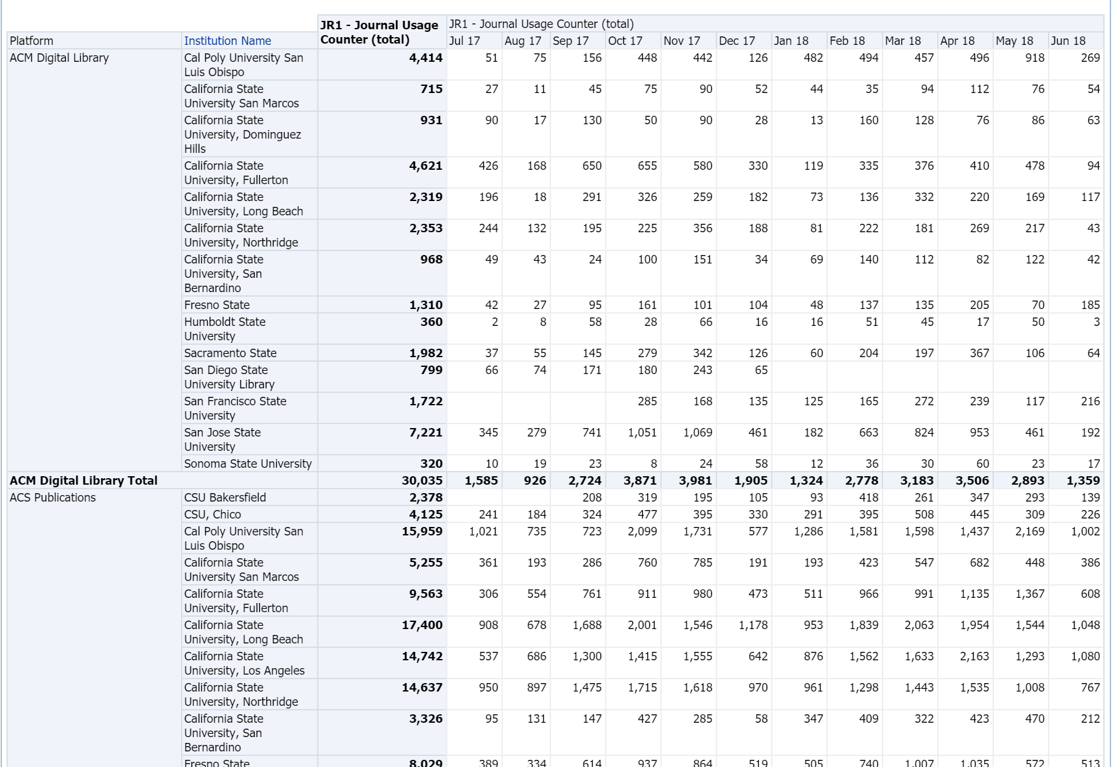
Example report 2, continued
Your report should look like this:

Slide 20
Example report 3
A COMPARISON OF A CAMPUS WEEDING TARGET LIST WITH PRINT HOLDINGS OF ALL CAMPUSES
This will require making TWO reports. The second report will use the first report as a filter.
The first report will be items with fewer than 3 loans and last loan date > 5 years
The second report will show how many other campuses, and which campuses, own the items identified in the first report
There’s no simple way to get all the information into one report in Analytics, but you can export both reports and combine them in Excel
 Alternative method on the horizon: Lauren Magnuson (CSUSM) and Jeremy Hobbs (CPSLO) are working on a web app that will provide the same report without using Analytics

Slide 21
Example report 3, continued
STEP 1: Choose NEW Analysis, then PHYSICAL ITEMS. Add the following fields and SAVE:
  Physical Item Details: Num of Loans (Not In House)
  Physical Item Details: Last Loan Date
  Physical Item Details: Lifecycle
  Bibliographic Details:
  Bibliographic Details:
  Bibliographic Details:
  Bibliographic Details:
  LC Classifications: Group1
  Institution: Institution Code

Slide 22
Example report 3, continued
STEP 2: Create the filters and SAVE
  Institution Code is equal to / is in [MY INSTITUTION CODE]
  AND Material Type is equal to / is in Book
  AND Lifecycle is equal to / is in Active
  AND Num of Loans (Not In House) is less than 3
  AND Group1 is equal to / is in Archaeology

Slide 23
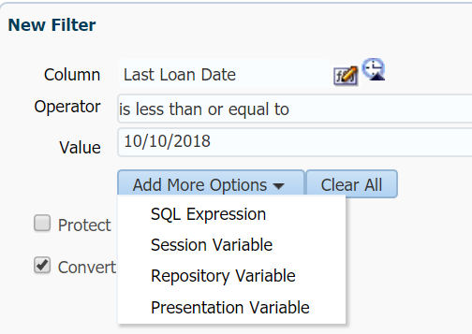
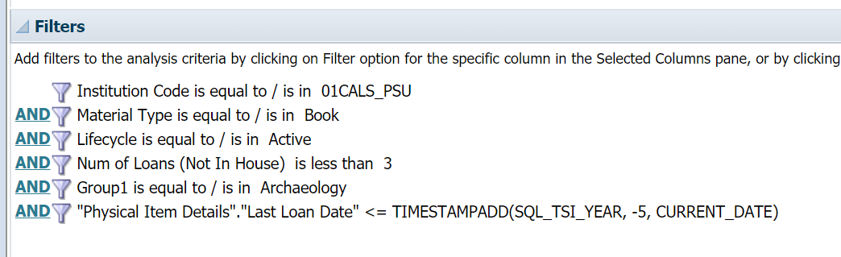
Example report 3, continued
STEP 3: Add a relative date filter for Last Loan Date:
  Open the filter menu for Last Loan Date
  Choose Operator: is less than or equal to
  Value: type any date
  Click the box to Convert this filter to SQL and click OK
  In the box, change <= timestamp '2018-10-10 00:00:00‘ to say <= TIMESTAMPADD(SQL_TSI_YEAR, -5, CURRENT_DATE) and click OK
  SAVE

Slide 24
Example report 3, continued
STEP 4: Once your filters are in place, you can remove some fields from your report to simplify the display
  Remove the following fields and SAVE:
    Lifecycle
    Material Type
    Institution Code
    Group1 (optional)
  You should still have the following fields:
    Num of Loans (Not In House), Last Loan Date, Network ID, ISBN, Title, Group1 (optional)

Slide 25
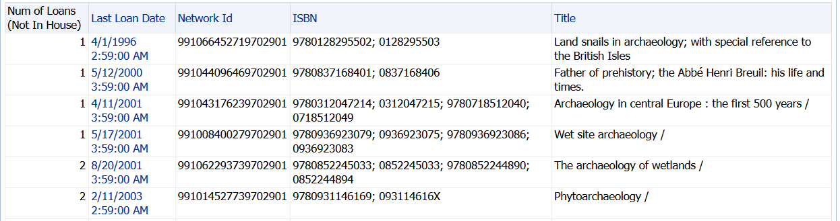
Example report 3, continued
STEP 5: Click the results tab to run your report
Your report should look like this:

Slide 26

Example report 3, continued
STEP 6: Choose NEW Analysis, then PHYSICAL ITEMS. Add the following fields and SAVE:
  Bibliographic Details: Network Id
  Bibliographic Details: Title
  Bibliographic Details: ISBN
  Institution: Institution Name
  Institution: Institution Name (a second time)
STEP 7: Create the filter and SAVE
  Open the filter menu for Network Id
  In the Operator dropdown, scroll to the bottom and select “is based on the results of another analysis”
  Browse for the Weeding Targets report you just created
  Keep Relationship set for “is equal to any”
  Set Use values in Column to Network Id and click OK
  Your filter should look like this:

Slide 27
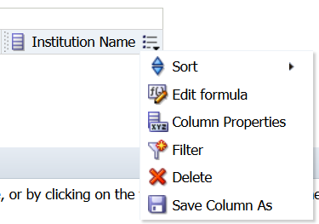

Example report 3, continued
STEP 8: Create a formula for Number of Other Institutions
  Mouse over the second Institution Name field and choose Edit Formula
  In the Column Formula window, click the “f(…)” button
    Make sure that "Institution"."Institution Name“ is highlighted before you click the button
  The Insert Function window will open up. Choose the first folder: Aggregate and double-click it
  Click on CountDistinct and then click OK
  Your formula should now look like this: COUNT(DISTINCT "Institution"."Institution Name")

Slide 28
Example report 3, continued
  STEP 8, Continued
    Click just inside the last parenthesis, then type (without quotes, but include spaces) “ by “
    In the Subject Areas window, click on Bibliographic Details, then Network Id. Click the > icon between the windows
    Your formula should now look like this: COUNT(DISTINCT "Institution"."Institution Name" by "Bibliographic Details"."Network Id")
    Click outside the last parenthesis and type (without quotes) “-1” (so you don’t include your own institution in the count)
    It should look like this: COUNT(DISTINCT "Institution"."Institution Name" by "Bibliographic Details"."Network Id")-1
    Click the Custom Headings box under Column Heading and rename the column to “Number of Institutions”
    Click OK and SAVE

Slide 29
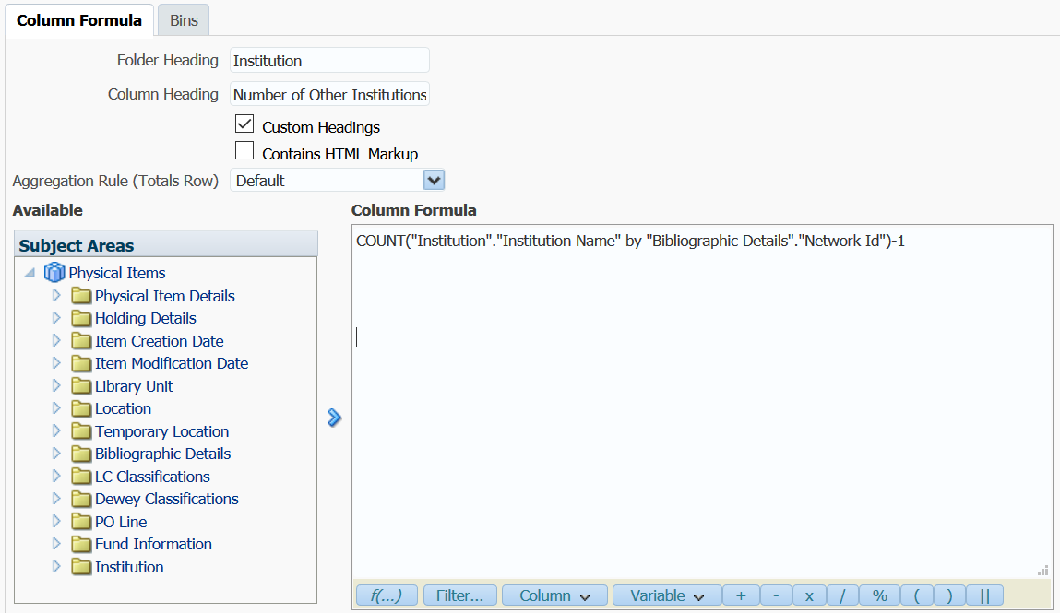
Example report 3, continued
  STEP 8, Illustrated

Slide 30
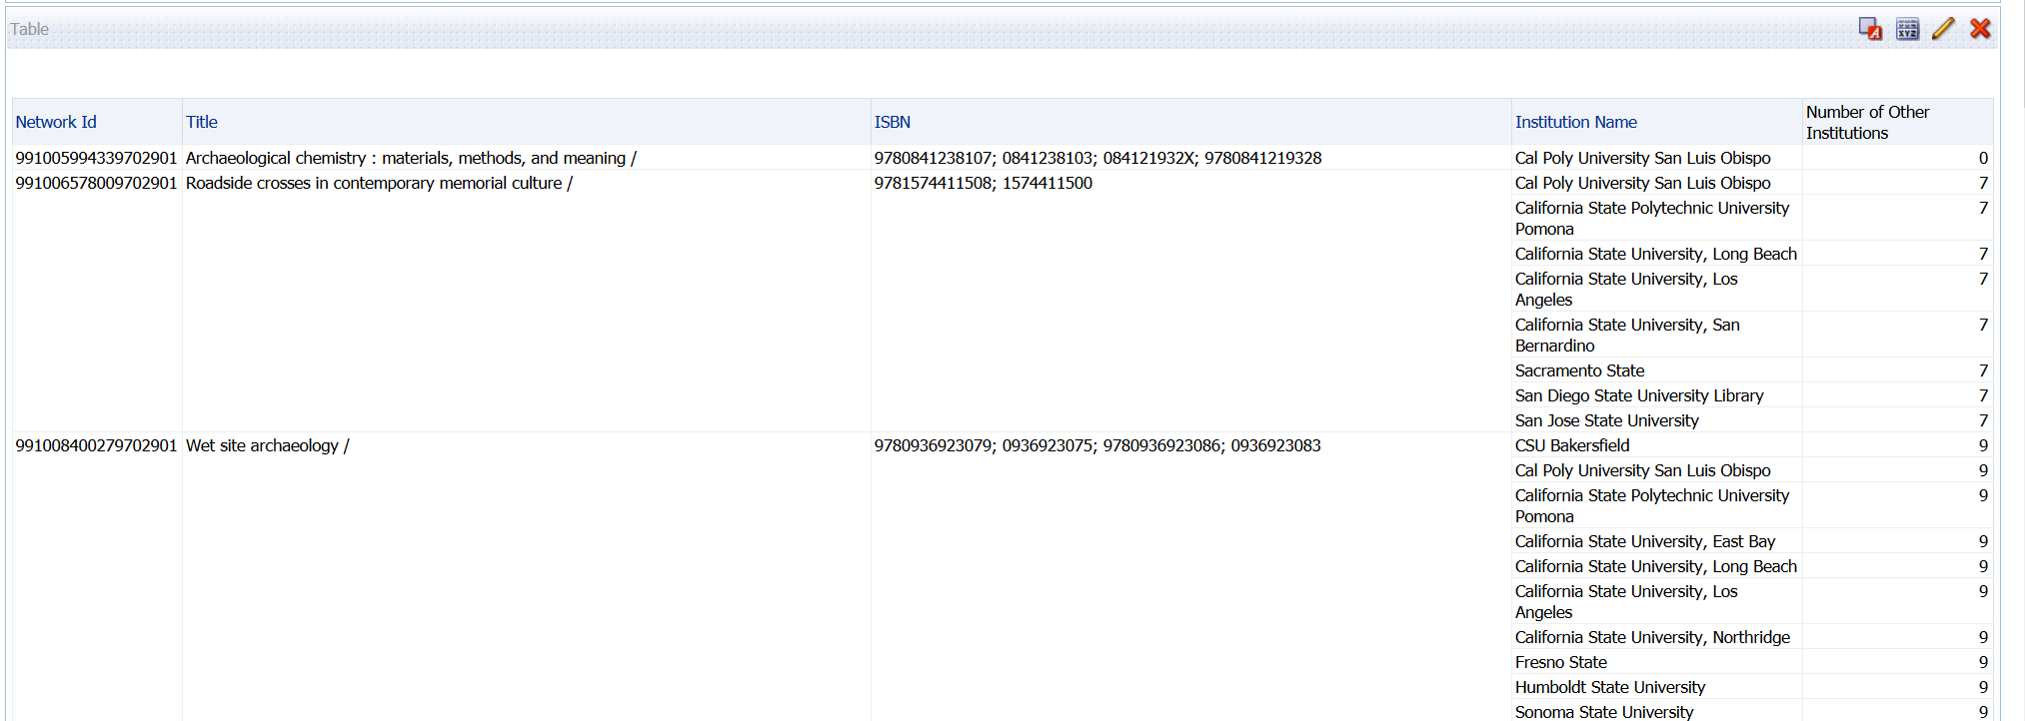
Example report 3, continued
Click on results to run the reports. It will take a long time.
Your report should look like this:

Slide 31
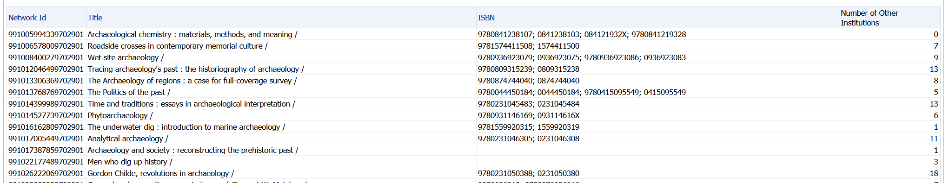
Example report 3
You can remove the institution listing if you just want the number of other owning institutions
You can also filter to show only titles with more than a certain number of other owning institutions

Slide 32
Quick reference – campus names and codes
CSU+ Partner Name | Institution Code or Available for Group Members | Available for Group | Institution Name
Bakersfield | 01CALS_UBA | CSUB | CSU Bakersfield
Channel Islands | 01CALS_UCI | CSUCI | California State University, Channel Islands
Chico | 01CALS_CHI | CSUC | CSU, Chico
Dominguez Hills | 01CALS_UDH | CSUDH | California State University, Dominguez Hills
East Bay | 01CALS_UHL | CSUEB | California State University, East Bay
Fresno | 01CALS_UFR | FRESNO | Fresno State
Fullerton | 01CALS_FUL | CSUF | California State University, Fullerton
Humboldt | 01CALS_HUL | HSU | Humboldt State University
Long Beach | 01CALS_ULB | CSULB | California State University, Long Beach
Los Angeles | 01CALS_ULA | CSULA | California State University, Los Angeles
Maritime | 01CALS_MAL | CSUM | Cal Maritime
Monterey Bay | 01CALS_UMB | CSUMB | California State University, Monterey Bay
Moss Landing | 01CALS_MLM | MLML | California State University Moss Landing Marine Laboratories
Northridge | 01CALS_UNO | CSUN | California State University, Northridge
Pomona | 01CALS_PUP | CPP | California State Polytechnic University Pomona
Sacramento | 01CALS_USL | CSUS | Sacramento State
San Bernardino | 01CALS_USB | CSUSB | California State University, San Bernardino
San Diego | 01CALS_SDL | SDSU | San Diego State University Library
San Francisco | 01CALS_SFR | SFSU | San Francisco State University
San Jose | 01CALS_SJO | SJSU | San Jose State University
San Luis Obispo | 01CALS_PSU | SLO | Cal Poly University San Luis Obispo
San Marcos | 01CALS_USM | CSUSM | California State University San Marcos
Sonoma | 01CALS_SOL | SSU | Sonoma State University
Stanislaus | 01CALS_UST | STAN | California State University, Stanislaus

Slide 33
Quick reference – statuses & fields
Field | Available Choices
Lifecycle (Bibliographic, E-Collection, Portfolio) | In Repository, Deleted
Lifecycle (Holdings, Item) | Active, Deleted
Portfolio Availability | Available, Not Available
Item Base Status (Physical Items, Fulfillment) | Item in place, Item not in place, None
Item Base Status (Lending Requests) | 1 (in place), 0 (not in place), -1 (none)
Suppressed From Discovery (Bibliographic) | Yes, No
Temporary Physical Location In Use | Yes, No
Network ID | NZ MMSID
Network Number | OCLC number (“other system number;” includes 035, 019)
Holding Details Permanent Call Number | The actual call number on the piece
Holding Details Normalized Call Number | Use if you want to sort by call number
Physical Items Physical Item Details Num of Loans | Use this field to include pre-migration circ data

Slide 34
Quick reference – essential filters
Capture E-Inventory managed at my institution plus E-Inventory managed for my institution in the NZ
  Use Portfolio Information for Consortia --Portfolio and --Institution
    Institution Code is equal to / is in [MY INSTITUTION CODE]
    OR Available For Group Members contains any [MY INSTITUTION CODE] ← timesaver: don’t use the drop down—type or paste it in
  Tip: Apply filters with “OR” logic last to avoid grouping problems
Keep deleted or inactive items or portfolios out of your results
  Use Portfolio or Physical Item Details
    Lifecycle is equal to / is in In Repository ← timesaver: don’t use the drop down—type or paste it in
    Availability is equal to / is in Available ← timesaver: don’t use the drop down—type or paste it in
  You can also use the following measures that are pre-filtered:
    No. of Portfolio (In Repository) or Num of Items (In Repository)
Filter on Material Type
  Use Bibliographic Details Material Type for e-resources
  Portfolio material type is currently undergoing significant changes, during which most of the current data will be deleted from the system
  https://knowledge.exlibrisgroup.com/Alma/Product_Documentation/010Alma_Online_Help_(English)/040Resource_Management/050Inventory/020Managing_Electronic_Resources#Editing_a_Portfolio_Using_the_Electronic_Portfolio_Editor

Slide 35
Further resources
Assessment & Analytics wiki space: https://calstate.atlassian.net/wiki/spaces/ULMSR/overview
  Includes contact information to email questions to the group
Slack channel #Analytics
Tips, tricks and frequently asked questions: https://calstate.atlassian.net/wiki/spaces/ULMSR/pages/181338128/Tips+Tricks+and+Frequently+Asked+Questions
Ex Libris Common Analytics Procedures: https://knowledge.exlibrisgroup.com/Alma/Product_Documentation/010Alma_Online_Help_(English)/080Analytics/050Common__Analytics_Procedures
Ex Libris Analytics Documentation: https://knowledge.exlibrisgroup.com/Alma/Product_Documentation/010Alma_Online_Help_(English)/080Analytics
These slides: https://calstate.atlassian.net/wiki/spaces/ULMSR/pages/208338952/Training+Resources

