Slide 1
ULMS Assessment and Analytics March Open Forum
Managing Usage Statistics in Alma: COUNTER & SUSHI

Slide 2
Resources
COUNTER (Counting Online Usage of Networked Electronic Resources) Release 5 | Project Counter
Format of the report, also the organization name
SUSHI (Standardized Usage Statistics Harvesting Initiative) Protocol | NISO website
API for fetching/harvesting usage reports
Managing COUNTER-Compliant Usage Data
Managing SUSHI Accounts section
SUSHI Vendor Lists (Ex Libris)
Troubleshooting Tips for COUNTER 5 SUSHI Harvesting - Ex Libris Knowledge Center
SUSHI Resources - ULMS Assessment & Analytics - Confluence

Slide 3
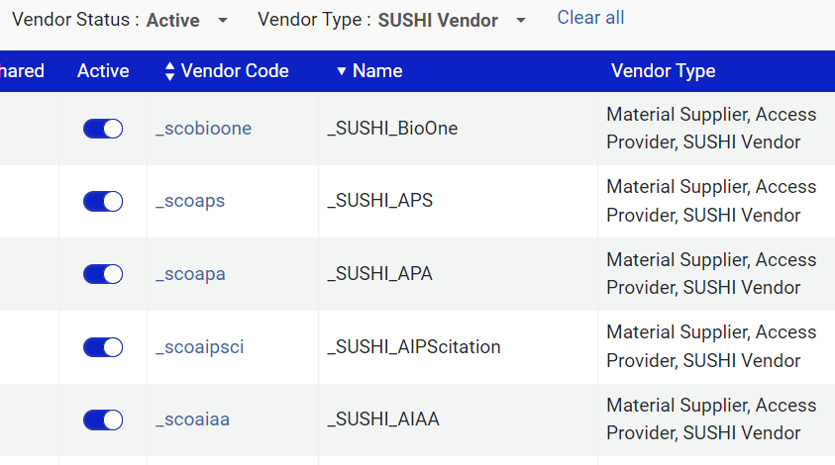
SUSHI Accounts in Alma
Vendor Details (Acquisitions) => Usage Data tab => SUSHI Account section

Slide 4
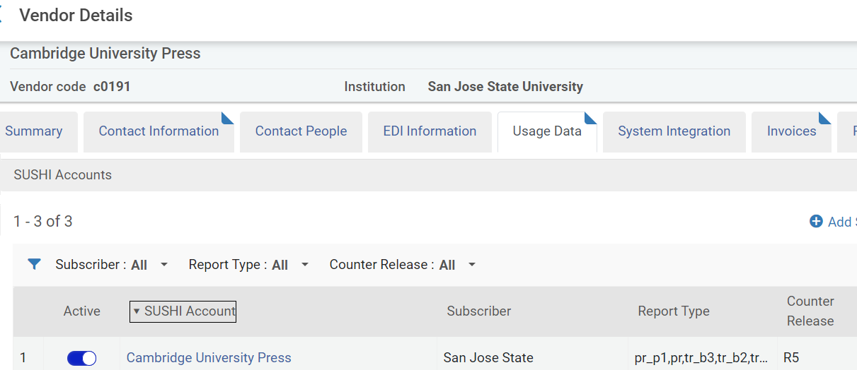
SUSHI Accounts in Alma

Slide 5
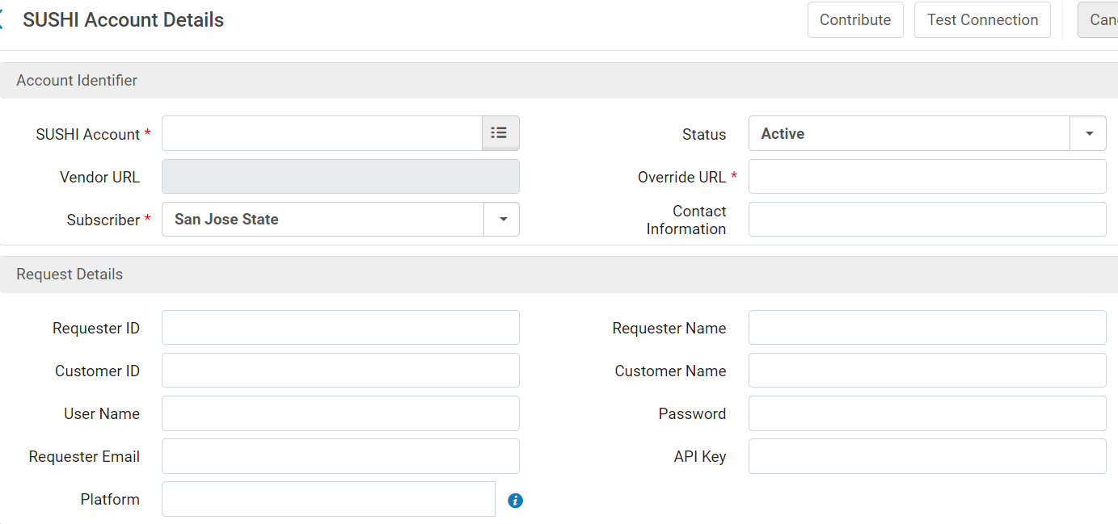
SUSHI Accounts in Alma

Slide 6
Where to find SUSHI information
Example COUNTER 5 SUSHI URLs for the ProQuest academic platform

Slide 7
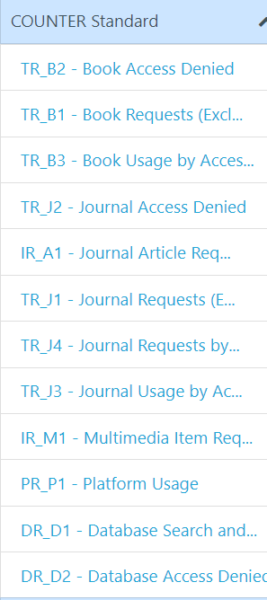
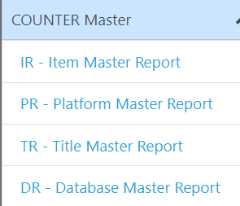
Which reports are available for SUSHI?
Most reports that are available on the vendor’s portal are also available for SUSHI.
Some reports may contain no data

Slide 8
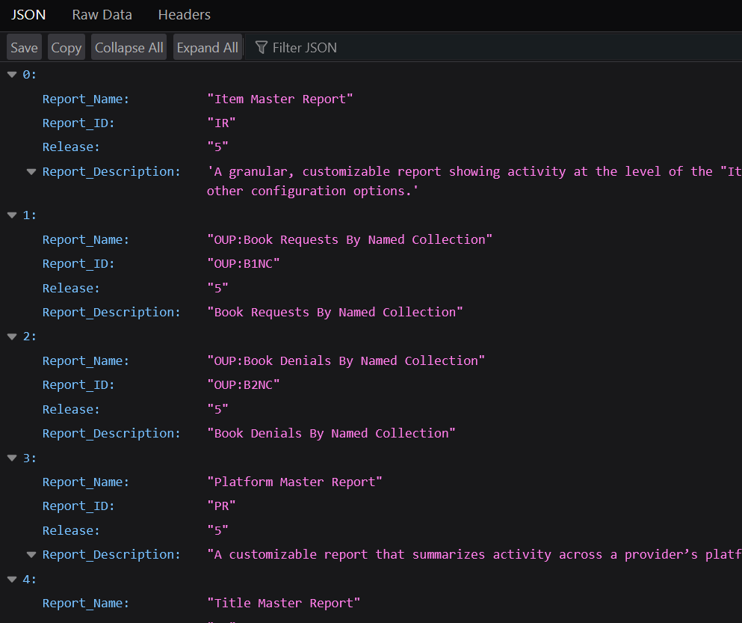
Which reports are available for SUSHI?
The base URL for the SUSHI account + “reports?” + SUSHI credentials can be used to view the list of reports available via SUSHI.
Example:
https://sushi5.scholarlyiq.com/counter/r5/reports?requestor_id=**********&customer_id=********

Slide 9
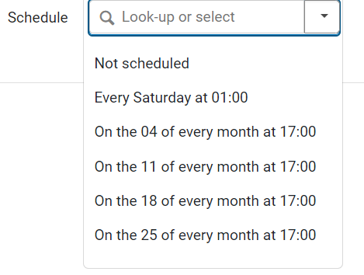
Scheduling SUSHI harvesting job
Alma Configuration => Acquisitions Configuration => General => Acquisition Jobs Configuration => SUSHI harvesting job

Slide 10
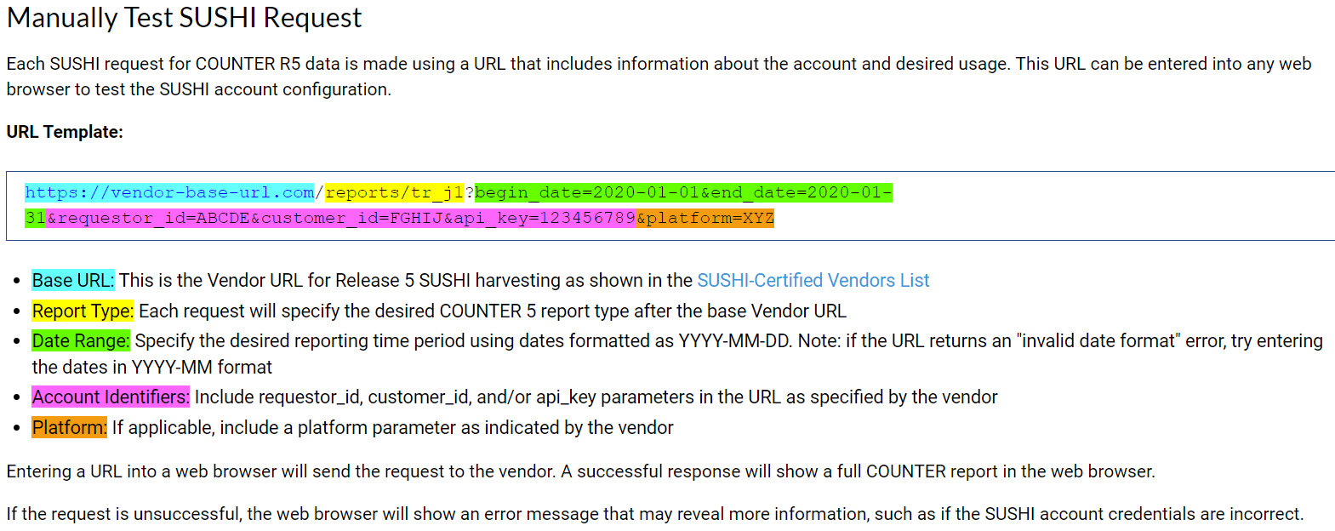
Troubleshooting
Troubleshooting Tips for COUNTER 5 SUSHI Harvesting

Slide 11
Common Errors
Artstor/JSTOR - Failed - No valid report items found in the file
Just rerunning the job usually resolve the issue.
Select Custom Harvest for the SUSHI account to harvest all reports for a specific month.
May have to rerun the custom harvest for the second time

Slide 12
Useful Dashboards
Monthly Usage Data (Ex Libris)
/shared/Alma/Usage via COUNTER reports - Release 5/Dashboards/Monthly Usage Data
Shows # of files per platform, report and month
The ones that have 0 files are marked red (even for future months)
Similar to Alma => Acquisitions => Load Usage Data => Monthly Usage tab
Does not include the name of the vendor accounts that SUSHI accounts are defined under
Displays all reports and all material type indicators from each report
SUSHI Monitoring Dashboard (Oregon Health & Science University)
/shared/Community/Reports/Institutions/OHSU/SUNYLA-SUSHI Monitoring Dashboard
Was demoed at SUNYLA 2024 - https://sunyla.org/sunyla-midwinter-2024/
Displays vendors, not platforms
Seems to display only one of the material types indicators from each report

Slide 13
Related Dashboards
eResource COUNTER Usage Dashboard (SJSU)
Not really for monitoring SUSHI harvesting
This dashboard allows you to look up usage statistics in the usage reports already harvested in Alma
https://drive.google.com/file/d/1OHz5qYzonPSkIlcyZP6ZxJrOyUjz6Smq/view?usp=sharing
Please share any other dashboards, reports or tools that you’ve found to be helpful.

