Slide 1
Printing in Alma
Spine Labels &
General Printing

Slide 2
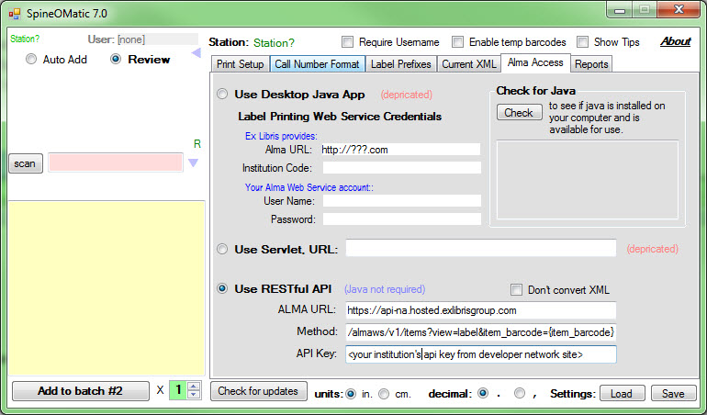
Spine Label Printing with SpinOMatic v7.0
3rd party software from Boston College.
One of the first things you want to do after installation is make sure you can connect to Alma to retrieve your records—Setting up Alma Access tab.
This requires the generation of an API key since the preferred method for retrieving the needed information is through Restful API.

Slide 3
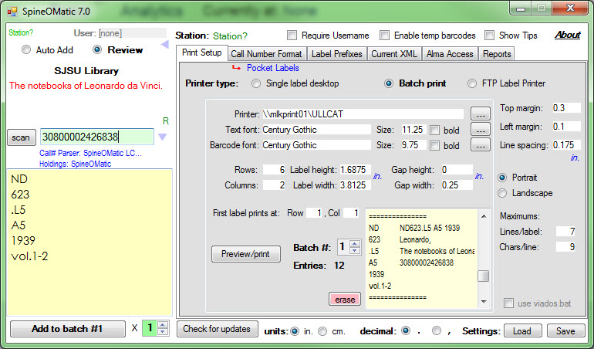
Out of the box the software worked well with just a few changes to the label height and width. For the typeface we chose Century Gothic since it resembled the type used on labels received by our vendors.

Slide 4
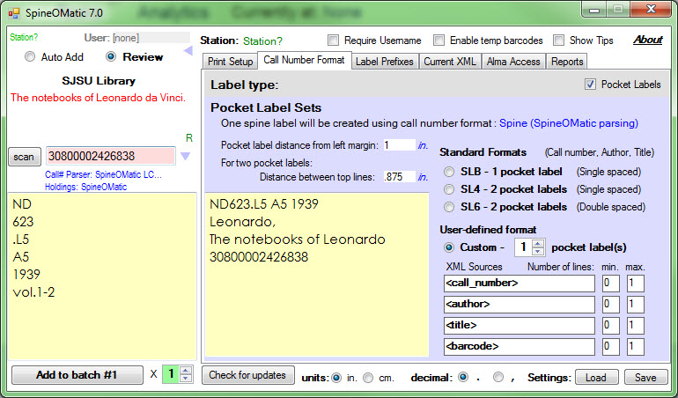
Printing can be accomplished in batch for each cataloger or one label at a time.
We tested batch printing with pocket labels and a custom setting to limit the number of printed lines on the pocket label.

Slide 5
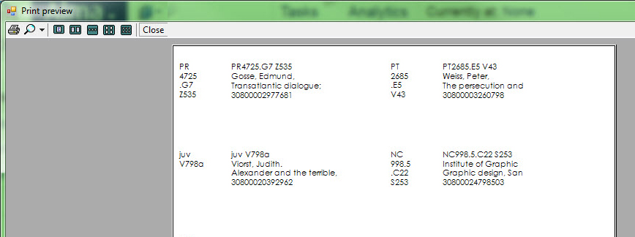
Note:Using dot-matrix printers was problematic.(Labels kept advancing 3 at a time after one successful print). So, we switched to laser labels, by the sheet. Much easier to deal with.

Slide 6
General printing in Alma
Since Alma out doesn’t print directly to a local or network printer the output needs to be directed in an email format.
SJSU requested the creation of service mail accounts from campus communications for the following departments:
Access Services & Resource Sharing – Fullfillment
Acquisitions – Acquisitions
Cataloging – Resource Management
Systems – Administration

Slide 7
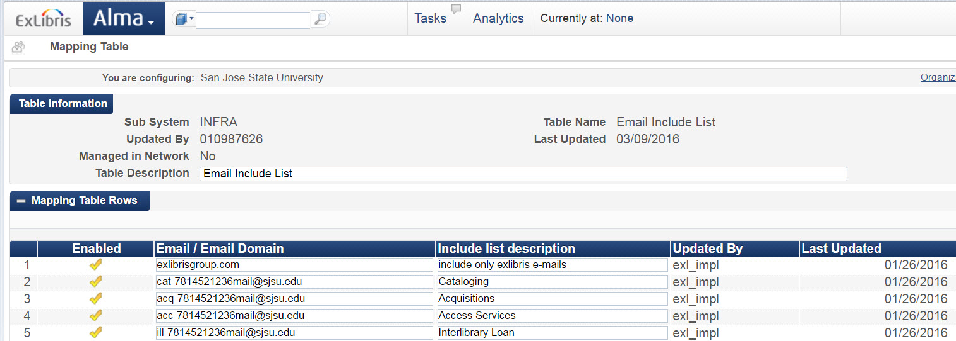
These email addresses were added to the Alma Configuration form to later populate the “Allowed Emails” Mapping table

Slide 8
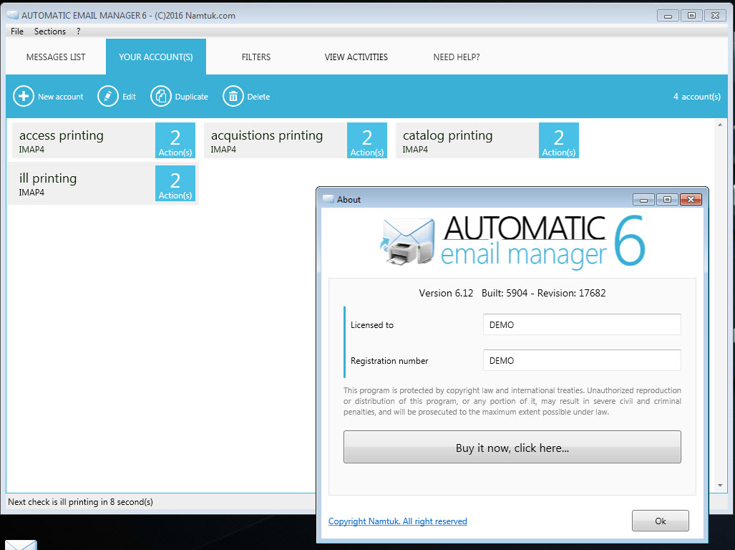
We used the Namtuk solution found in the Ex Libris Documentation, Automatic Email Manager v6

Slide 9
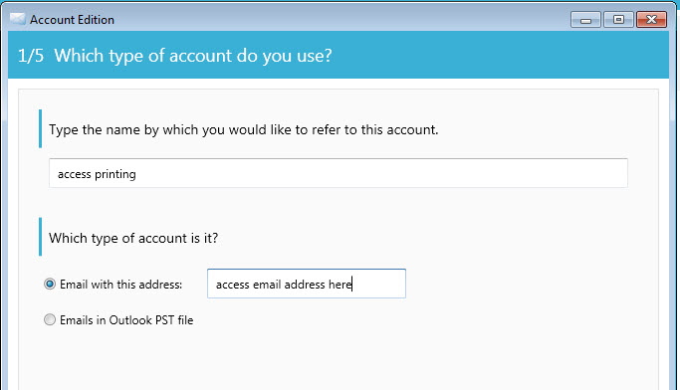
The software takes you through the typical setup wizard– 5steps. Steps 1 through 3 for identification and authentication settings.

Slide 10
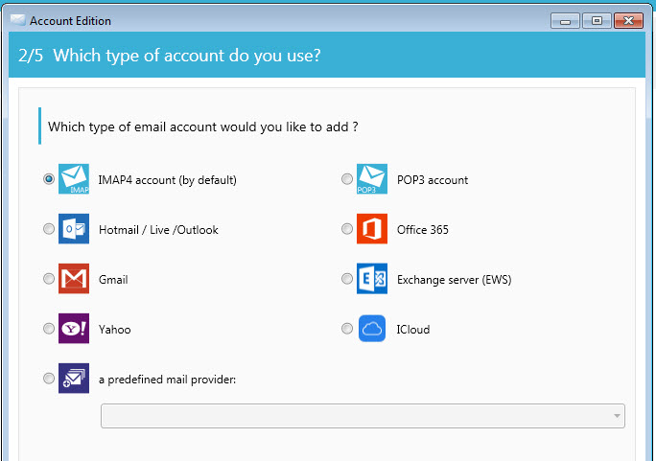
Select the IMAP4 protocol.

Slide 11
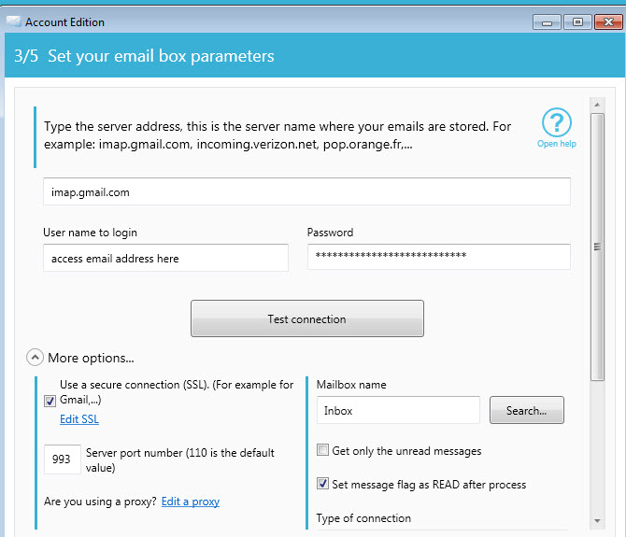
Secure connection needed to be checked. Also, campus had to enable the account to be accessed by a third-party application.

Slide 12
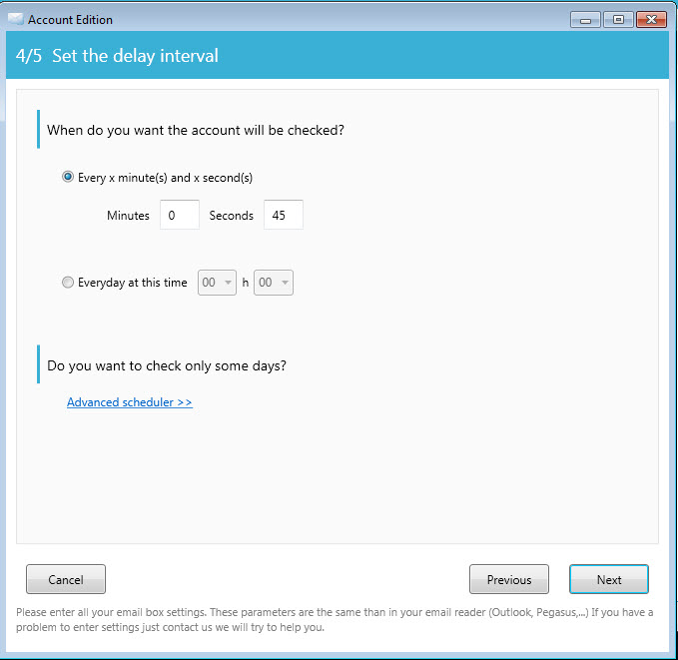
For the four printers tested we set up a staggered delay interval of 10 seconds between each email account check( 25, 35, 45, 55 sec) .

Slide 13
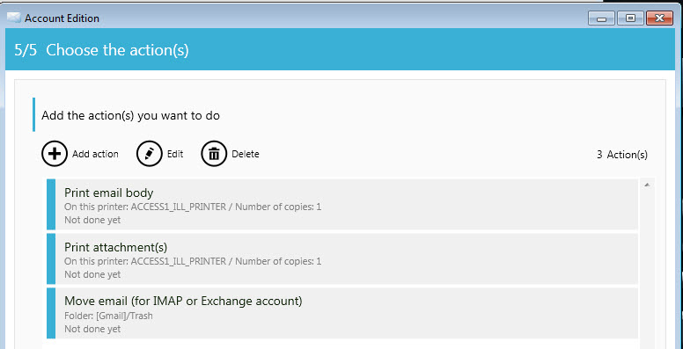
The last step allows you to specify what pat of the message to print. We set up two “Actions” for printing the body of the email and its associated attachments. A third action was added to move the mail message to the trash folder.

Slide 14
One drawback that has been brought up by our Access Services System Coordinator is that Namtuk will delay print jobs--up to 5-10 minutes in some cases even when the delay interval for checking is set below 1 minute.
So, testing with shorter intervals is being considered now.

