Slide 1
ULMS Technical Services
Chris Ashley, San Marcos
Carole Correa-Morris, San Jose
Jessica Hartwigsen, Chancellor's Office
Annie Hor, Stanislaus
Stacy Magedanz, San Bernardino
Luiz Mendes, Northridge (Chair)
Steve Savage, San Diego
Report
Alma Kick-Off Meeting
March 22, 2016—Fresno, CA

Slide 2
Contents
TS Task Forces
Activities
  Top 5 Priorities
  Data Clean-Up Recommendations Priorities Checklist
  CSU Migration of Local Bibliographic Data
  Populating the Network Zone & Defining the Master Record
  Shared E-Resources: SFX Extracts for Alma
Resources & Training
  Documentation & Training

Slide 3
ULMS TS Task Forces
Acquisitions
Carole Correa-Morris, SJSU (Chair)
Moon Kim, Fullerton
Tyler Rogers, San Diego
Kim Valenzuela, Stanislaus
Wendy Vermeer, Pomona
Delphia Williams, Northridge
ERM
Jessica Hartwigsen, CSUCO (Co-Chair)
Stacy Magedanz, CSUSB (Co-Chair)
Chris Bulock, Northridge
Christine Holmes, San Jose
Lisa Roberts, Sacramento
Michelle Swadish, Fullerton
Ying Liu, Chancellor’s Office SDLC

Slide 4
Top 5 Priorities
1. Populating & Developing the Network Zone
❏ Define the “master record’ and make recommendations for populating the Network Zone
❏ Work in collaboration with the Discovery Leads Group to assess the interplay between management of records in Alma and Primo: indexing, standardization, and display of fields
2. Cataloging (Resource Management)
❏ Community Zone: record management; and role of authorities in support of authority work in a shared environment
❏ Network Zone (shared cataloging): Identify workflows, best practices, policies and system-wide communication needed for ongoing cataloging
❏ Institution Zone: recommendations for bibliographic record extensions (fields for encoding local bibliographic data)
3. E-Resources (ECC & Opt-In) Management
❏ Workflow for shared e-resources acquisitions and management
❏ Define the method(s) for e-resources acquisitions & management in the Network Zone
❏ Define the role of effective use of the knowledgebase (Community Zone)
❏ Work in collaboration with Systems Leads Group to facilitate SDLC-to-Campus PeopleSoft integration in Alma
4. Collaborative Acquisitions (for print and non-ECC/SDLC resources)
❏ Initiate cross-system discussion, design workflows, and examine options
❏ Work in collaboration with Systems Leads Group on issues that facilitate Alma Acquisitions-PeopleSoft integration between the CSU and campuses
5. Technical Services Workflows Redesign
❏ Identify priority workflows for redesign (e.g., acquisitions; cataloging; authority work; ERM; YBP; electronic books; streaming media)

Slide 5
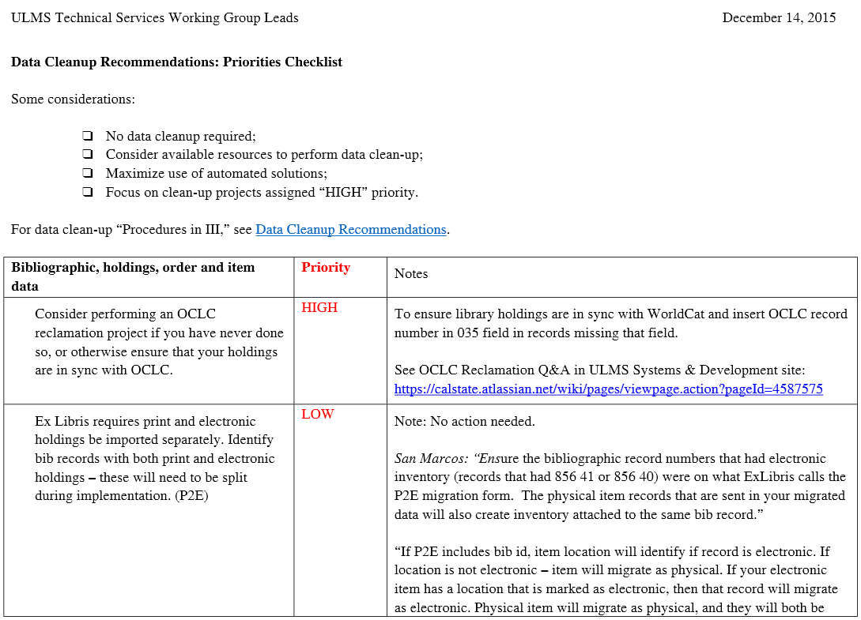
Data Clean-Up: Priorities Checklist

Slide 6
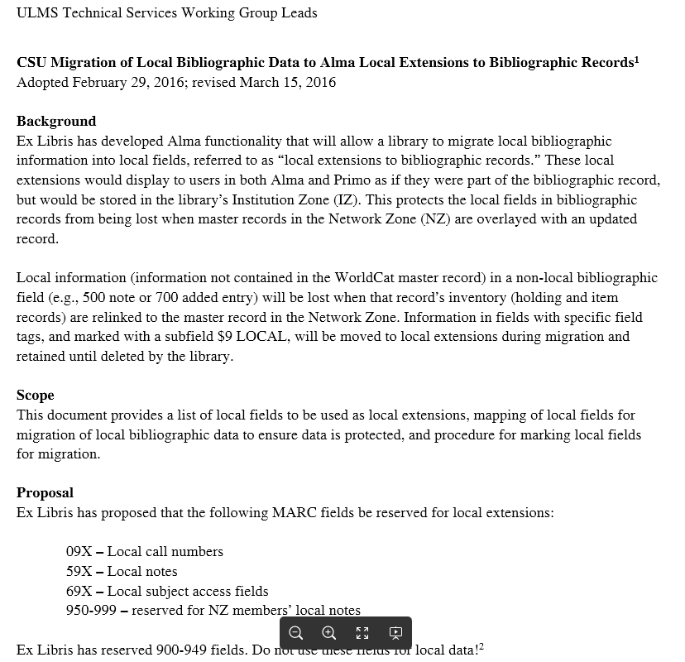
CSU Migration of Local Data

Slide 7
Local Extensions
Functionality that allows a library to migrate and maintain local bibliographic information
Stored in the (local) Institution Zone (IZ)
  Protected from overlay with an updated record
Display in Alma and Primo as if data were part of the bibliographic record
  In Alma: Local institution’s extensions display in the Metadata Editor to staff in local institution only
  In Primo: Follow work by ULMS Discovery WG Leads
Notes:
All CSU libraries were surveyed to determine how local fields were being used. Based on the results, and following the local bib extensions developed by Orbis, CSU adopted best practices for the migration of LOCAL DATA. When the NZ record is overlayed with an updated record, your local extensions are protected because they are stored in your IZ.

Slide 8
Categories of Local Extensions
09X Local call numbers
59X Local-institution defined public notes
69X Local subjects
900-949 Reserved for Ex Libris’ use
952-961, 971, 973 Local added entries (names and titles)
962-969 Local institution-defined internal notes
976-999 Network-defined internal notes

Slide 9
Migration of Local Data
Fields must be
  in the appropriate 09X, 59X, 69X, or 9XX field;
  AND marked with a $9LOCAL in order to create a local field in Alma.
Formatting: $9LOCAL
  No space, no final period
590 _ _ $a Library’s copy is imperfect: upper left corner missing. $9LOCAL

Slide 10
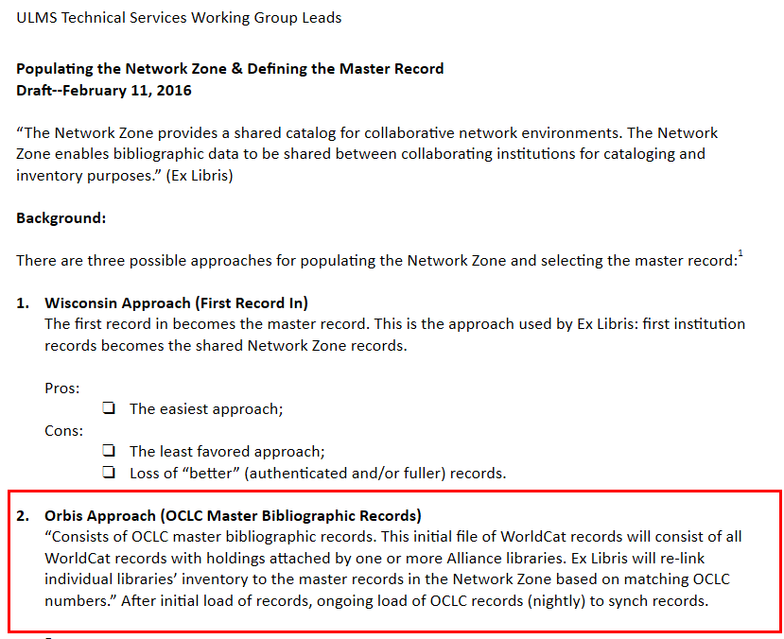
Populating NZ & Master Record
Notes:
Discussion paper distributed. Open Forum with TS Working Group held and support for approach two, which involves initial load of records from OCLC (using the Worldshare Metadata Collection Manager.

Slide 11
In the Network Zone (NZ)
To be populated using master WorldCat bibliographic records
  All CSU libraries’ WorldCat holdings;
  OCLC daily load of new records;
  Updated records: when the WorldCat master record is updated.
Rationale:
  Records loaded directly from OCLC;
  Benefits from latest enhancements and corrections to the OCLC record;
  Eliminates need to determine whose institution record is “the best”;
  Capitalizes on work efficiencies (catalogers often perform record updates in OCLC anyway);
  High percentage of “fuller” records in OCLC (based on random sample of CSU-held records);
  Proven successful approach.
Notes:
Future: Any time a CSU library puts their holdings on a record in Connexion, that record is delivered to the NZ in the daily new file. If you correct an error in an OCLC record and replace the record, it will automatically be loaded to the NZ in the OCLC daily loads.

Slide 12
OCLC
Bib Record
OCLC
Bib Record
Bib Record
Bib Record
Bib Record
Bib Record
Bib Record
Bib Record
Network Zone
Bib Record
Re-Linked based on matching OCLC number (035 field)
Institution Zone
Institution Zone
Institution Zone
Inventory
Inventory
Inventory
POL
POL
POL
Notes:
To illustrate the process for populating the NZ.

Slide 13
Shared E-Resources: SFX Extracts
Reminder: Procedure & Timeline
Jessica Hartwigsen will perform SFX extracts for Alma for every instance;
Procedure takes about 2 hours per instance.
March 2016 Extracts will begin the last weekend in March and continue on the weekends until complete
April 15, 2016 Files will be uploaded to Ex Libris before the April 15th deadline.

Slide 14
Future Directions
Task Forces
Tasks and Timeline
Open Forums (Consultation & Collaboration)
Training webinars
…and for more, join us for the Technical Services breakout session in Auditorium 2206!

Slide 15
Resources & Training
Alma (Ex Libris Knowledge Center) https://knowledge.exlibrisgroup.com/Alma
Unified Library Management System (ULMS)
https://calstate.atlassian.net/wiki/display/ULMS
ULMS Technical Services
https://calstate.atlassian.net/wiki/display/ULMST/ULMS+Technical+Services

