Slide 1
ULMS @ the Oviatt
CSUN ULMS Implementation Team:
Chris Bulock
Del Williams
Elizabeth Altman
Lauren Magnuson, Project Manager
Laurie Borchard
Luiz Mendes
Mike Villalobos
8-4-2015
Notes:
Thank you all for coming to this Town Hall meeting focused on the Unified Library Management System. I want to first recognize the newly formed CSUN ULMS Implementation Team:
Chris Bulock
Del Williams
Elizabeth Altman
Laurie Borchard
Luiz Mendes
Mike Villalobos
and myself, Lauren Magnuson, CSUN’s ULMS Project Manager.
In this presentation we hope to answer many of the questions you may have about the Unified Library Management System project, and there will be plenty of time for other questions at the end as well.
Fair warning that the slides have a lot of information on them, and we'll be distributing the slides after today's meeting.

Slide 2
What is the ULMS?
ULMS stands for Unified Library Management System.
"It’s a next generation digital platform for providing library services across the California State University.”
ULMS Timeline, 2013-2015
Request for Proposals (RFP) Draft Written
Vendors submitted written responses
Written Responses Evaluated
In-Person Demos
Vendor Selected
2013
2014
2015

Slide 3
Why the ULMS?
Strategically/ Fiscally:
Individual contracts with multiple disparate vendors cost more
Some campuses face cost/staffing barriers to implement new systems
Productivity costs are higher in separate systems from duplication of effort
Our current systems are now “legacy systems”
Benefits for end users (students and CSUN faculty):
One search tool across resources, including digital archives and other assets
Ready access to CSU-wide holdings
Potential for additional indexed content in discovery
Potential for new services
Notes:
fragmented systems = reliance on multiple third parties for work, e.g., Serials Solutions Coverage Loads

Slide 4
Why the ULMS?
Benefits for library staff & librarians:
More efficiencies and collaboration among CSUs
Consortium-wide functionality
Improved analytics and data access
Data-driven decision making
Improved integration with third-party systems (e.g., PeopleSoft)
Less fragmented systems and approaches
No downtime for software updates; more frequent updates with new features

Slide 5
Who is the ULMS Vendor?
Ex Libris is an Israeli software company founded in 1980. They have offices in Europe and North America (Boston and Chicago). Some of their legacy products include SFX, MetaLib, and the Aleph library system, and their newer systems include Alma and Primo.

Slide 6
What does the ULMS include?
Alma Library Services Platform and Application Programming Interfaces (APIs) (Back-End Staff View) | Cloud-hosted, browser-based: Circulation & Course Reserves Acquisitions Cataloging Electronic Resource Management (ERM) OpenURL Link Resolver ASRS Interoperability
Primo Discovery Service and Application Programming Interface (API) (Front-End User Interface) | Search Engine (Books, Articles, Journals, Holdings, Course Reserves etc.) My Library Account

Slide 7
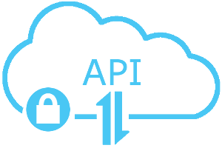
What’s an API?
API stands for Application Programming Interface.
An API is like a (secure) doorway to a software programs’ data or functionality. You can use APIs to write custom programs or functions.
Notes:
Because Ex Libris APIs are included in our contract, we may be able to leverage certain APIs to create new services or features.

Slide 8
What is Going Away?
Going Away | Replaced By
Millennium (Cataloging, Acquisitions, Electronic Resource Management, Circulation, Statistics, Course Reserves processing) | Alma
Online Catalog (suncat.csun.edu) | Primo
OneSearch (Xerxes / Summon API) | Primo
SFX (‘Find Text’ Link Resolver) | Alma Link Resolver

Slide 9
What ISN’T going away?
ILLiad (Inter-Library Loan Software)
ASRS system
EZProxy (Off-campus authentication system)
ContentDM (Digital Library / Archives)
DSpace (ScholarWorks)
VideoFurnace (Streaming Video)
Drupal (Library website)
Archon (FindingAids)
Databases A-Z and Databases by Subject (potentially)

Slide 10
Who will be affected?
Everyone.
Library staff + faculty, student workers, and end users (CSUN students, faculty, and staff who use the library).
You will be affected even if you never worked with Millennium.

Slide 11
What is the timeline?
Vanguard Test Load - 3 Campuses
(Dec. 2015)
Testing Continues
Additional Data Loads - All Campuses
May-June: Go Live (July for Acquisitions)
Planning and Setup
In-Person Training: Configuration
Training - All Staff
Fall 2015
Spring 2016
Summer 2016
Fall 2016
Spring 2017
Summer 2017
The “Single Cohort Model”:
all 23 campuses migrate together.
Notes:
Note: a more detailed timeline, created by Brandon Dudley at the Chancellor’s Office is available on the CSUN ULMS blog.

Slide 12
Why the “Single Cohort”?
All CSU’s benefit from time and experience with the system
Almost a year to experiment with the system before go-live date
This is ExLibris’ preferred method for migrating large consortia

Slide 13
CSU-Wide ULMS Governance Structure
CSU Implementation Team
David Walker, Chancellor’s Office
Brandon Dudley, Chancellor’s Office
Alice Kawakami, Chancellor’s Office
Rae Ann Stahl, San Jose
Patrick Newell, Fresno
Working Groups: 7 members
**Representative from CSUN on Working Group
**Technical Services Advisory Working Group
Access Services Advisory Working Group
**Discovery & Public Services Advisory Working Group
**Systems/Dev Advisory
Working Group
Analytics & Reporting Advisory
Working Group
Comm. & Training Advisory
Working Group
23 CSU Campuses
Notes:
Emphasize 2-way communication between campuses and working groups – we will be consulted. Luiz is on Technical Services Advisory Group, Elizabeth is on Discovery and Public Services, and Lauren is on Systems/Development.

Slide 14
CSUN LOCal ULMS Project Structure (Proposed)
Oviatt Library Staff and Faculty
Technical Services Advisory Working Group
Access Services Advisory Working Group
Discovery & Public Services Advisory Working Group
Systems/Dev Advisory
Working Group
Analytics & Reporting Advisory
Working Group
Comm. & Training Advisory
Working Group
CSUN ULMS Implementation Team Lauren Magnuson| Mike Villalobos | Laurie Borchard | Elizabeth Altman | Del Williams | Chris Bulock | Luiz Mendes
CSU Working Groups & Implementation Team
Notes:
Emphasize that at CSUN, this process will be driven by Oviatt Library staff and faculty. Implementation Team and Working Groups will invite participation from all library staff and faculty. We’ll be looking for volunteers to serve on Working groups – expect sign-up forms to be distributed soon.

Slide 15
How is the Chancellor’s Office involved?
Funding for initial implementation costs
CO staff involvement with CSU-wide “Governance Committee”
Project manager for ULMS (Brandon Dudley, formerly @ Sonoma)

Slide 16
How is the Chancellor’s Office involved? Contd.
Staff to assist with data migration and project management (new, 2-year positions):
Manager for Library Workflow Processes
Manager for Library Data Migration
Communication with peers (e.g., Orbis Cascade)

Slide 17
Who is going to make decisions?
CSU-Wide:
CSUN Locally:
CSU Implementation Team and working groups
Governance structure for some CSU-wide decisions involving shared functionality
CSUN ULMS Implementation Team and working groups
Will consult with and communicate with all Oviatt staff and faculty, as well as consult with the CSU-wide Implementation Team.
All Oviatt staff and faculty will be included in decision-making for their functional areas.

Slide 18
What are the migration challenges?
Learning curve
Integration with ASRS
Data issues during migration
Rethinking current workflows and workarounds
No real-time updates for data in Primo (12-hour delay)

Slide 19
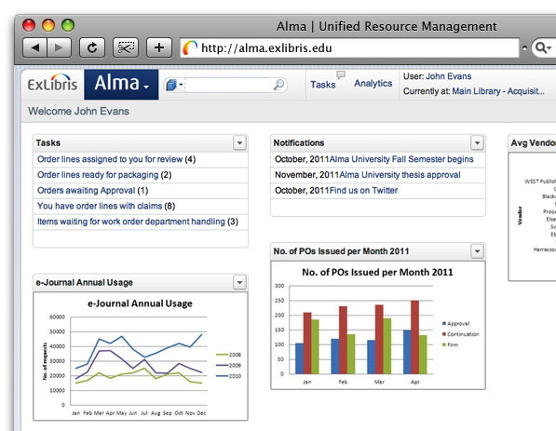
What does alma look like?
Browser-Based (works on iPads/tablets)
Task / Workflow Assignment
Auto-Populating Statistics

Slide 20
How is alma’s Software Updated?
Monthly
No downtime
Release notes sent over listservs and posted on Ex Libris documentation center
ELUNA (ExLibris Users of North America) enhancement voting structure

Slide 21
What does Primo Look Like?
Primo will be getting an entirely new interface design, which includes responsive design for mobile devices, in early 2016.
We may get some “sneak peeks” for this new interface design in late 2015.

Slide 22
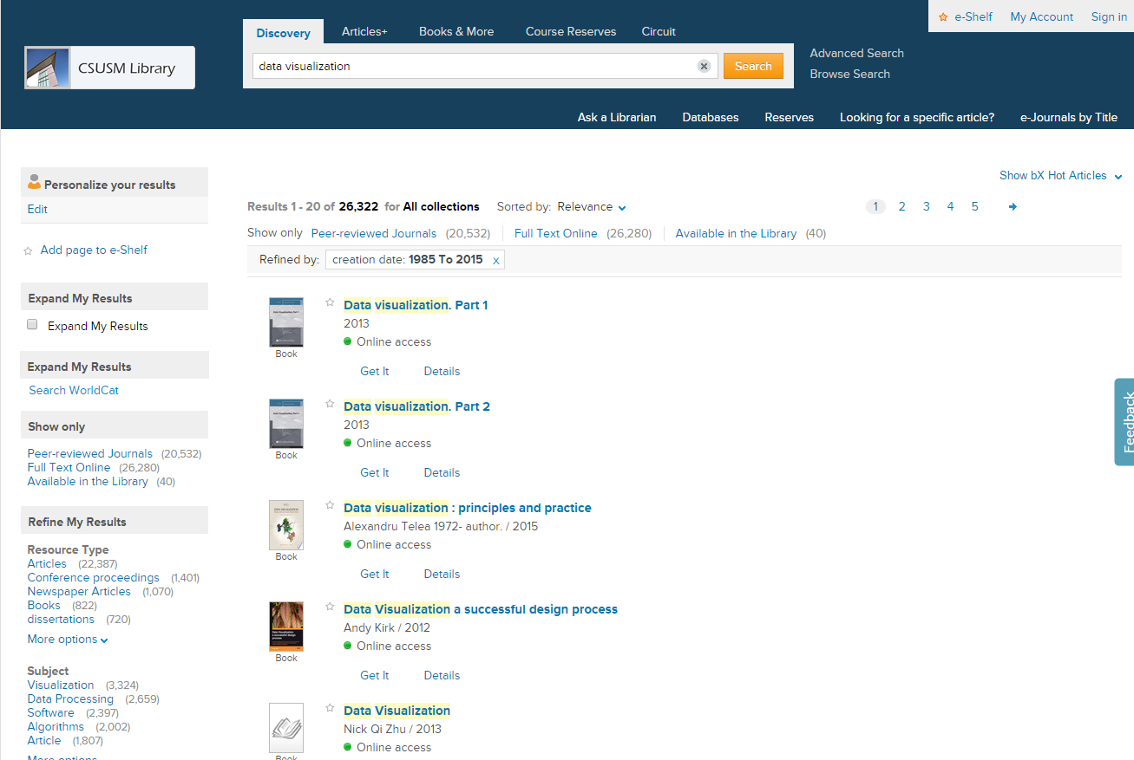
What does primo look like?
CSU San Marcos
Notes:
One example of a recent implementation. You can go to CSU San Marcos Library’s website to try out their implementation of Primo.

Slide 23
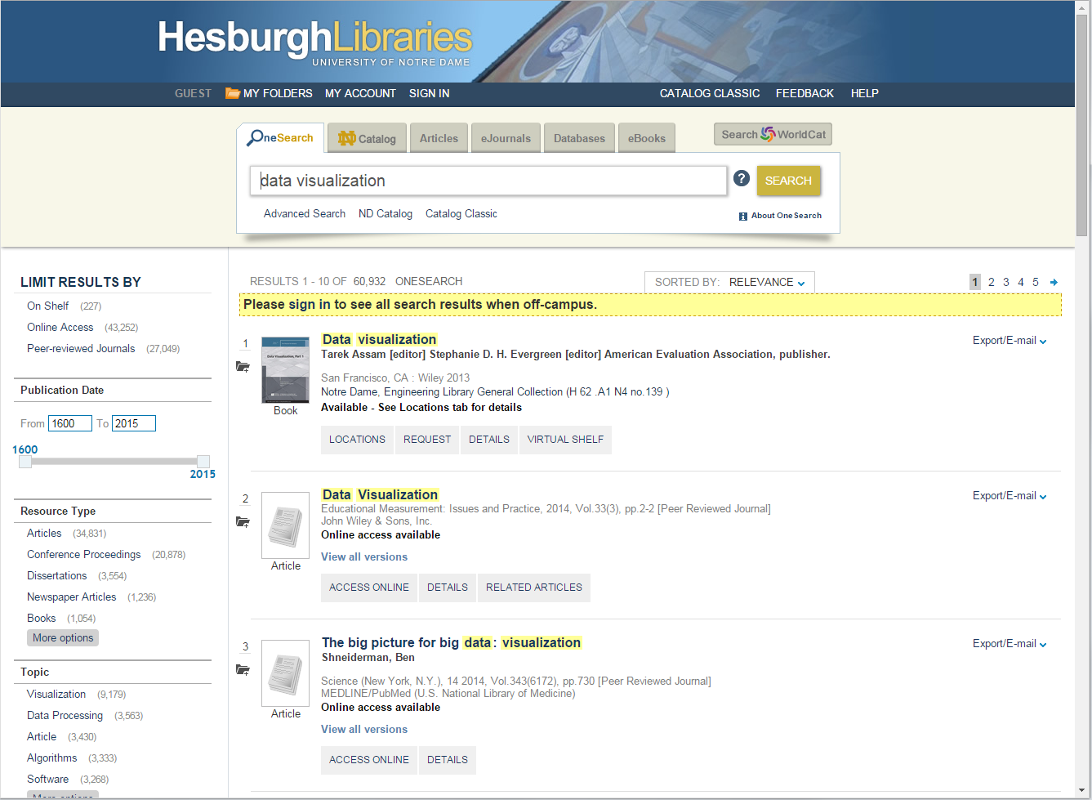
What does primo look like?
University of
Notre Dame
Notes:
Notre Dame was one of Primo’s earliest adopters. You can see they have customized and branded it so that it looks slightly different from San Marcos’ implementation.

Slide 24
How do we prepare for implementation?
Deciding what to migrate
i.e., there may be old, outdated data or records in Millennium that do not need to be migrated
Data Cleanup
e.g., checking for OCLC Numbers in records
Documenting workflows
It will be helpful to document the goals of regular workflows
Notes:
The workflows may change in the new system, but the end goals should be the same.

Slide 25
How will Millennium data be preserved?
Data will be exported and preserved (as spreadsheets in many cases) during migration for future reference.
The CSUN Project Manager and Working Groups will work with faculty and staff to identify data for preservation.

Slide 26
How will I be trained?
Online and in-person training by Ex Libris
Online training via ExLibris-created Moodle courses (starting in October 2015 and available on-demand)
Weekly Q&A sessions with project managers across CSU
In-person regional training summer 2016, likely for those doing system configuration, such as coordinators and supervisors
Additional training in 2017 TBD

Slide 27
Where can I find documentation?
Ex Libris Documentation
http://www.customercenter.exlibrisgroup.com/
Username: 01CALS
Password: 2253
Notes:
community resources may be out of date or represent problems that will be resolved by our go-live

Slide 28
What other resources are available?
Ex Libris / CSUN Community resources
CSUN ULMS Blog
CSU Project Management Site (Confluence system under construction)
Primo Listserv
Alma Listserv
ELUNA (Ex Libris Users of North America)
Notes:
Links to all resources will be provided at the end of the slides.

Slide 29
How will my job change?
More opportunity for collaboration with other CSU staff
More opportunities for cross-training
More time devoted to training and implementation of the new system
Opportunity to fix workarounds and solve old problems

Slide 30
How will I have time?
Each staff supervisor will work with each employee affected by the migration to help prioritize and organize his or her time as we transition from Innovative to Ex Libris.
While local processes will vary from campus to campus, it is possible that the CSU systemwide working groups may make recommendations to the campuses in regard to some suggested ways to handle what we might call “parallel work flows” during migration.

Slide 31
What are the future possibilities?
Future consortial resource sharing (print and electronic)
Improved services for distance students
Greater flexibility and extensibility enabling us to prepare for future data structures and systems

Slide 32
Advice from orbis cascade
Go into the process with eyes wide open
Data clean-up pre-migration is important
Alma is not Millennium. Holding onto current workflows leads to an unhappy experience in Alma.
ExLibris provides responsive support during the entire process
Alma is still evolving and maturing
Most believe in ExLibris’ vision for the future
Notes:
The Orbis Cascade Alliance is a nonprofit consortium of 37 colleges and universities in Oregon, Washington, and Idaho. They migrated to Alma between 2012-2015

Slide 33
Next steps
Ongoing Millennium data cleanup through December
CSUN Working Groups to be formed
Anyone can volunteer to be on a working group, but there will be only 5 spots on each working group available.
Working Groups will work with faculty and staff to:
Document Millennium data preservation needs
Help document functional needs for the new system
October 2015:
Web-based training available for all staff on demand
Primo Central provisioned

Slide 34
Resource Links
CSUN ULMS Blog http://libnet.csun.edu/blogs/ulms
Ex Libris Documentation
http://www.customercenter.exlibrisgroup.com/
Username: 01CALS
Password: 2253
Listservs
Alma: https://listserv.nd.edu/cgi-bin/wa?SUBED1=alma-l&A=1
Primo: http://listserv.nd.edu/cgi-bin/wa?A0=PRIMO-DISCUSS-L
MyCSUN Box ULMS Documentation https://mycsun.box.com/s/b7koacmd3oab20bazaa7muyqzp0iwyo3
ELUNA http://el-una.org/
Notes:
Warning: Materials generated by other libraries and communities may be out of date.

Slide 35
Questions?

