Slide 1
Voyager to Alma Data Migration
Chen Marckfeld
January 14, 2016

Slide 2
Copyright Statement
All of the information and material inclusive of text, images, logos, product names is either the property of, or used with permission by Ex Libris Ltd. The information may not be distributed, modified, displayed, reproduced – in whole or in part – without the prior written permission of Ex Libris Ltd.
TRADEMARKS
Ex Libris, the Ex Libris logo, Aleph, Alma, SFX, SFXIT, MetaLib, DigiTool, Verde, Primo, Voyager, MetaSearch, MetaIndex and other Ex Libris products and services referenced herein are trademarks of Ex Libris, and may be registered in certain jurisdictions. All other product names, company names, marks and logos referenced may be trademarks of their respective owners.
DISCLAIMER
The information contained in this document is compiled from various sources and provided on an "AS IS" basis for general information purposes only without any representations, conditions or warranties whether express or implied, including any implied warranties of satisfactory quality, completeness, accuracy or fitness for a particular purpose.
Ex Libris, its subsidiaries and related corporations ("Ex Libris Group") disclaim any and all liability for all use of this information, including losses, damages, claims or expenses any person may incur as a result of the use of this information, even if advised of the possibility of such loss or damage.
© Ex Libris Ltd., 2013

Slide 3
Agenda
Migration Documents.
Voyager Auto Extract
Migration Form.
P2E.
SFX Auto extract.
Data cleanup and preparation
Notes:
Let’s begin looking at the building blocks for Fulfillment.

Slide 4
Migration Scope
Voyager
Link-resolver (SFX, Serial Solution, other)
ERM (if exists)
Notes:
Note that it is mandatory to download and install the AutoExtract kit from scratch twice during the migration period: the first time before the test load and the second time before the cutover.

Slide 5
Migration Documents
Voyager to Alma Migration Form.
P2E
Non-Exlibris link resolver form
Notes:
Note that it is mandatory to download and install the AutoExtract kit from scratch twice during the migration period: the first time before the test load and the second time before the cutover.

Slide 6
Migration Documentation
Supporting documentation:
Getting Ready for Alma Implementation.
Voyager to Alma Migration Guide.
Voyager to Alma Auto-Extract Migration Guide.
SFX to Alma Migration Guide.
SFX to Alma Auto-Extract Migration Guide.
http://knowledge.exlibrisgroup.com/@api/deki/files/38994/Getting_Ready_for_Alma_and_Primo_Implementation.pdf
http://knowledge.exlibrisgroup.com/Alma/Implementation_and_Migration/Migration_Guides/Guides/ILS
http://knowledge.exlibrisgroup.com/@api/deki/files/39005/Electronic_Resource_Handling_in_Alma_Migration.pdf
http://knowledge.exlibrisgroup.com/Alma/Implementation_and_Migration/Migration_Guides/Guides/Electronic
Notes:
Note that it is mandatory to download and install the AutoExtract kit from scratch twice during the migration period: the first time before the test load and the second time before the cutover.

Slide 7

Learning Center Videos
Alma Migration Form Instructions – Voyager.
http://knowledge.exlibrisgroup.com/Alma/Training/Implementation_Tutorials/01_Migration/Alma_Migration_Form_Instructions_-_Voyager
The Physical to Electronic (P2E) Conversion Process
http://knowledge.exlibrisgroup.com/Alma/Training/Implementation_Tutorials/01_Migration/The_Physical_to_Electronic_(P2E)_Conversion_Process
From SFX to Alma
http://knowledge.exlibrisgroup.com/Alma/Training/Implementation_Tutorials/01_Migration/From_SFX_To_Alma
Notes:
Review training sessions.

Slide 8
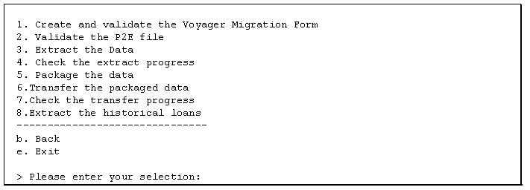
Voyager Auto Extract
http://knowledge.exlibrisgroup.com/@api/deki/files/39073/Voyager_to_Alma_AutoExtract_Migration.pdf
http://knowledge.exlibrisgroup.com/@api/deki/files/39074/Voyager_to_Alma_Migration_Guide.pdf

Slide 9
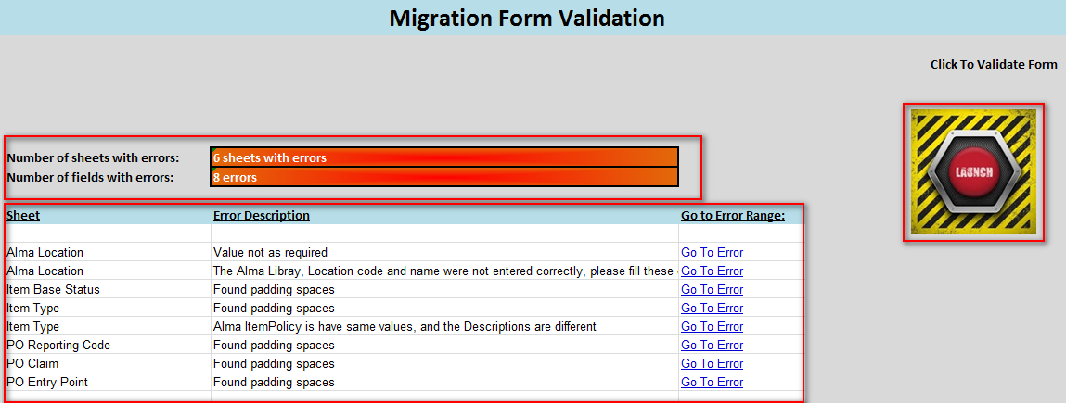
Migration Form Validation
The goal of the validation is to verify that all mandatory fields are filled out and are written in the correct format
Error Summary
Validation Button
Error Log with hyperlinks

Slide 10
Voyager Institutions
Institution Code /Institution ID | Institution Name | Customer code
01CALS_UBA/2902 | Bakersfield University | 01CALS
01CALS_UCI/2903 | Channel Islands University | 01CALS
01CALS_HUL/2909 | Humboldt University | 01CALS
01CALS_UMB/2923 | Monterey Bay University | 01CALS

Slide 11
Migration scope
Institution Zone
Bibliographic records
Inventory – physical (items, holdings records), electronic inventory (portfolios, electronic collections)
Patrons
Fulfillment – Loans (active), hold requests (on hold shelf), fine & fees (active)
Acquisition – vendors (migrate once in test load), purchase orders, invoices, funds
Course Reserves – Course information, Reading lists, Citations
P2E – Process to convert physical holdings to electronic
Network Zone
The “Master” NZ record with linking between IZ (Institution Zone) and NZ (Network Zone) records.

Slide 12
Migration Form
Migration Form - > specify which database to migrate
Fill separate Migration Form for each database
Specify Time Zone
Limit data exported by location: Unless instructed otherwise by your Ex Libris project manager, leave this as No.

Slide 13
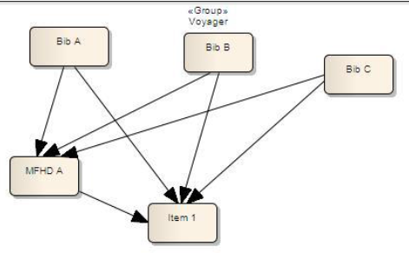
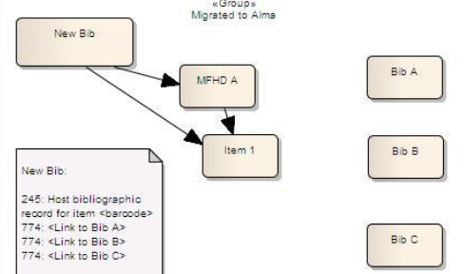
Bound Withs

Slide 14
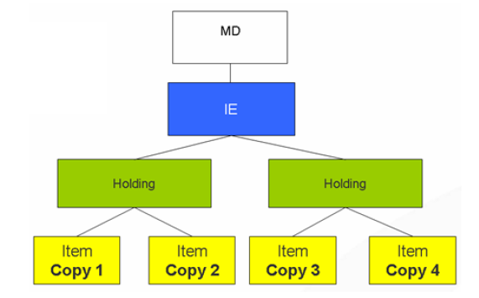
Physical Inventory

Slide 15
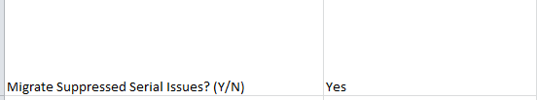
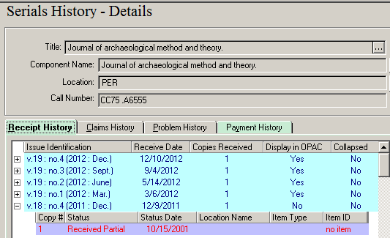
Questionnaire tab
Migrate Suppressed Serial Issues
Example of a serial issue in Voyager that is marked as suppressed in OPAC
If you want an item record created for such issues in Alma, select Y in the Form. If not, select N.

Slide 16
Questionnaire tab: E-Items
Migrate E-Items?
This is for e-items attached to course reserves in Voyager (live in EITEM table).
E-items in Voyager are migrated as physical items in Alma with a material type of LINK.

Slide 17
Libraries and Locations
Voyager has one level of location.
Alma has two levels - > library and physical/shelving location.
Libraries are higher level units that contain groups of locations.
Migration Form – > Alma Libraries & Location Mapping
Voyager -one level
Alma – two level
Alma library => Voyager policy location + Voyager happening location + physical locational

Slide 18
Holding record
MARC holdings file:
The Alma library is placed in the 852 $$b
The Alma location is placed in the 852 $$c
Voyager - 852 $$ c - must be moved to a different subfield.
Alma 852 $$c (location) migrate –
  From Voyager item, if different from holding. New Alma holding created.
  From Voyager holding record, if the same as item location.

Slide 19
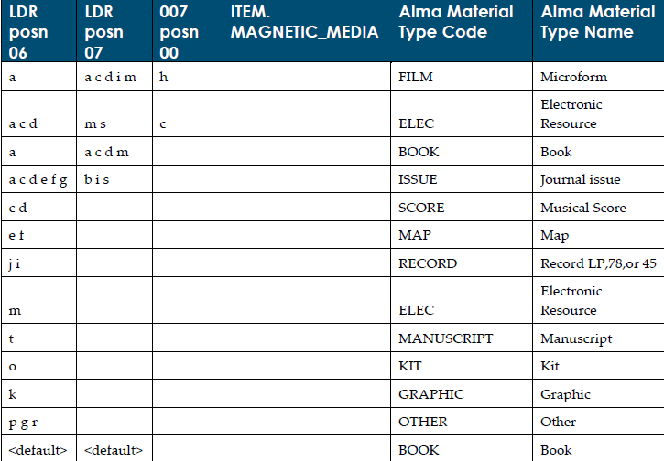
Item - Material type
Notes:
note

Slide 20
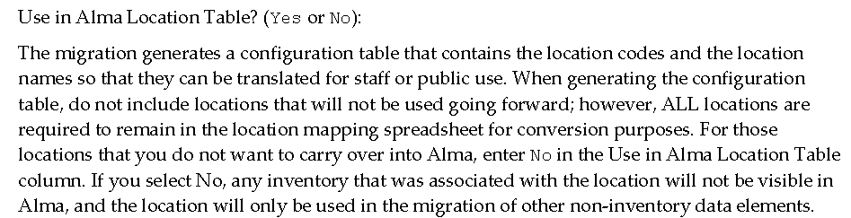
Locations tab – key points:

Slide 21

Questionnaire tab: List the prefix for SFX or Other Link Resolver System
1) BIBs w/Link Resolver prefix do not migrate if:
    Migrated Bib has items only in electronic location
2) BIBs w/Link Resolver migrate & set to suppressed if:
    Migrated Bib has an order
3) BIBs w/Link Resolver migrate & set to suppressed if:
    Migrated Bib has holding/s in physical locations

Slide 22
Physical to Electronic
Provide a list of bib keys that identify records that are electronic, in the following format:
123475-yyydb,portfolio
12345-yyydb,package
12346-yyydb,DB
Note: The P2E file must be submitted as a csv file.
For more information on the electronic migration approach to Alma, refer to the Electronic Resource Handling in Alma Migration document as well as the Voyager to Alma Migration document.

Slide 23
Physical to Electronic
A process (called P2E) converts records identified as electronic to the electronic format indicated in the e-resources extract.
First, the records are migrated as physical; then the P2E process is run to convert them to electronic.
BIB
BIB
ELECTRONIC LOCATION
PHYSICAL LOCATION
CONVERT THE ITEM
ADD PORTFOLIO

Slide 24
Electronic Types
Portfolio - stand-alone title electronic inventory. Example, journal title
Package - subscription/ aggregator package. E-inventory (portfolios) stored in Alma. Access provided to the whole package or specific portfolios. Example, “ProQuest 5000”
Database - Descriptive record link to 3rd party provider of metadata. E-inventory is not stored in Alma. Search is done on 3rd party provider site/database. Example, “Gale Virtual reference Library”

Slide 25
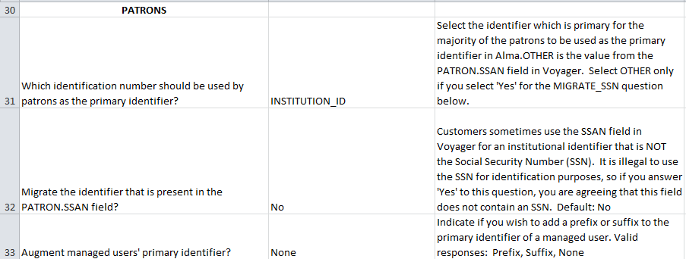
Questionnaire tab: Patrons

Slide 26

Questionnaire tab: Internal Patrons
List your Voyager Patron Group codes which should migrate as Internal in Alma
Alma categorizes users as either External or Internal
  External patrons are managed by an external system, such as a load from the bursar’s office
  Internal patrons are created and managed internally; they won’t be overlaid via patron loader

Slide 27
Voyager Migration Form: Reporting Funds
Question on Migration Form –
Convert Reporting Funds to Allocated Funds?
In Voyager, the reporting fund takes money from its parent allocated fund.
In Alma, there are no reporting funds. There are reporting codes.
Reporting Codes Tab
To be filled in only if “How do you want to migrate reporting funds?” question (REPORTING_CODE) was answered “MAP”. You can collapse values when mapping.

Slide 28
How do you want to migrate your Reporting Funds?
MAP - use the map in the "Reporting Codes" tab. Reporting funds' transactions will be assigned to the parent allocated fund. Reporting fund in Voyager will be sent through reporting code tab's map and then placed into the reporting code field in Alma.
DONOTTRANSFER - do not use reporting codes in Alma at all. Reporting funds' transactions will be assigned to the parent allocated fund. The reporting code field in Alma will be left blank, and all other information about reporting codes in funds from Voyager will not migrate be lost.
ALLOC - change the reporting funds to allocated funds. The reporting fund in Voyager will be changed into an Allocated fund in Alma, and all transactions are assigned to that allocated fund and no reporting codes are created in Alma.

Slide 29
PO Line Types in Alma
 | One time | Ongoing | Standing
Physical | Closed when received & invoiced One holding created per location One item created per copy Use for print books, serials, microfilm… | Open until canceled One holding created per serial run One item created per issue Use for serial subscriptions | Open until canceled Inventory created manually Not received through receiving workbench Use for approval plans, memberships, serial monographs, PDA…
Electronic | Closed when invoiced/activated Standard activation; activated indefinitely Use for single-payment e-resources | Open until canceled Standard activation; can be activated for range of subscription Use for e-resources available with beginning and end date | Open until canceled No direct inventory Rare; use for non-subscription ebooks or other inconsistent inventory

Slide 30
Acquisition
Ordering Library
Central Ordering vs. Ordering Location
Central Ordering Library – define here library if you use centralized ordering unit for all libraries in the institution.
(if Central Library used Default Order library is not required)
Default Order library – when Voyager ORDER_LOCATION is blank migration will assign default order library to an order.
(set Default library when Central Library is not used)

Slide 31
Acquisition
Vendors
Migrate only once.
Updates should be done in both systems during implementation.
New vendors should be added to Alma manually.

Slide 32
Acquisition
Renewal date
Renewal Date field is a mandatory fields in continuous order
It is required and used by system to identify resources that expected to be renewed as their subscription period ends
The migration programs first attempt to find a subscription renewal date from the Voyager SUBSCRIPTION.RENEWAL_DATE or based on the last invoice date if present and in the future.
If the renewal date is earlier than the migration date, or if the last invoice date is more than a year earlier than the migration date, the migration program uses a set renewal date, which is specified in migration form.

Slide 33
Data Clean-up
Preparing for Alma: Opportunities for Data Clean-Up, Techniques and Tools for Voyager Libraries

Slide 34
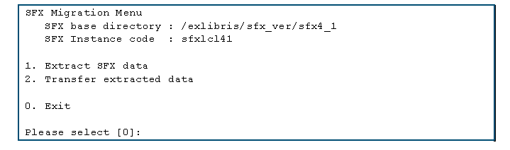
SFX Auto Extract

Slide 35

Questions

Slide 36
Thank You!

