Slide 1

Preparing for Alma: Opportunities for Data Clean-Up, Techniques and Tools for Voyager Libraries

Slide 2
Copyright Statement
All of the information and material inclusive of text, images, logos, product names is either the property of, or used with permission by Ex Libris Ltd. The information may not be distributed, modified, displayed, reproduced – in whole or in part – without the prior written permission of Ex Libris Ltd.
TRADEMARKS
Ex Libris, the Ex Libris logo, Aleph, Alma, SFX, SFXIT, MetaLib, DigiTool, Verde, Primo, Voyager, MetaSearch, MetaIndex and other Ex Libris products and services referenced herein are trademarks of Ex Libris, and may be registered in certain jurisdictions. All other product names, company names, marks and logos referenced may be trademarks of their respective owners.
DISCLAIMER
The information contained in this document is compiled from various sources and provided on an "AS IS" basis for general information purposes only without any representations, conditions or warranties whether express or implied, including any implied warranties of satisfactory quality, completeness, accuracy or fitness for a particular purpose.
Ex Libris, its subsidiaries and related corporations ("Ex Libris Group") disclaim any and all liability for all use of this information, including losses, damages, claims or expenses any person may incur as a result of the use of this information, even if advised of the possibility of such loss or damage.
© Ex Libris Ltd., 2015

Slide 3
Introduction
Acquisitions
Summary and resources
Circulation
MARC records
Matrices and policies
Preparing for Alma
Notes:
Introduction

Slide 4
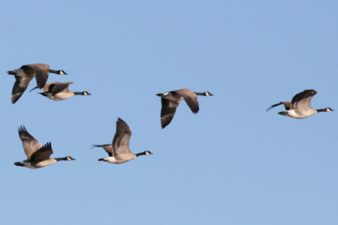
Introduction
Your migration to Alma is getting underway!
Excellent opportunity for embarking upon a Voyager data clean up project!

Slide 5

Introduction
Identify potential areas with problem data
Supply building blocks for locating data that needs analysis
Discuss evaluation of said data and possible options
Give ideas about how to remove or update data where appropriate

Slide 6
Introduction
Acquisitions
Summary and resources
Circulation
MARC records
Matrices and policies
Preparing for Alma
Notes:
Acquisitions Data

Slide 7
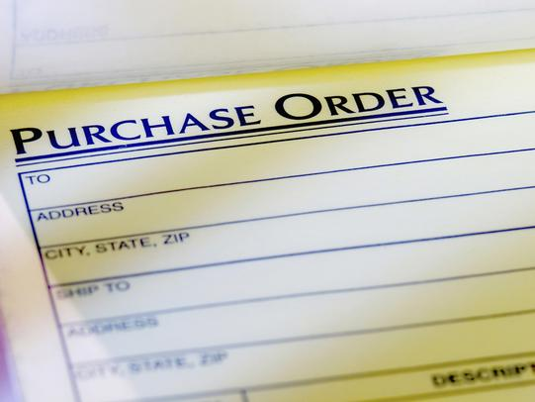
Vendors with Few Invoices or POs
Identify vendors with very few invoices or Pos.
There are many dependencies, so, before deleting vendors, all associated POs and invoices must be completed and deleted.
To delete POs, active marks/claims for associated line items must be deleted.
  In the client you can search by Vendor on Marked Line Items tab of Order Maintenance.
Notes:
SELECT VENDOR.VENDOR_NAME, Count(PURCHASE_ORDER.PO_ID) AS CountOfPO_ID
FROM VENDOR INNER JOIN PURCHASE_ORDER ON VENDOR.VENDOR_ID = PURCHASE_ORDER.VENDOR_ID
GROUP BY VENDOR.VENDOR_NAME
HAVING (((Count(PURCHASE_ORDER.PO_ID))<10));
SELECT VENDOR.VENDOR_NAME, Count(INVOICE.INVOICE_ID) AS CountOfINVOICE_ID
FROM VENDOR INNER JOIN INVOICE ON VENDOR.VENDOR_ID = INVOICE.VENDOR_ID
GROUP BY VENDOR.VENDOR_NAME
HAVING (((Count(INVOICE.INVOICE_ID))<10));

Slide 8
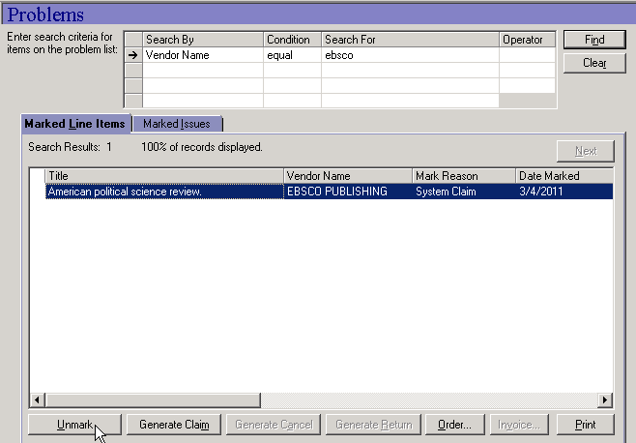
Completing and Deleting
Before completing and deleting POs, active marks or claims for associated line items must be removed
In Acquisitions, search by Vendor on Marked Line Items tab of Order Maintenance

Slide 9
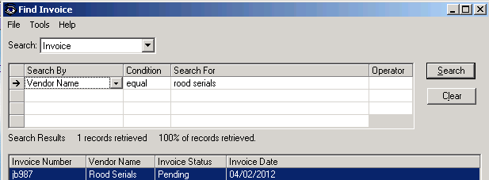
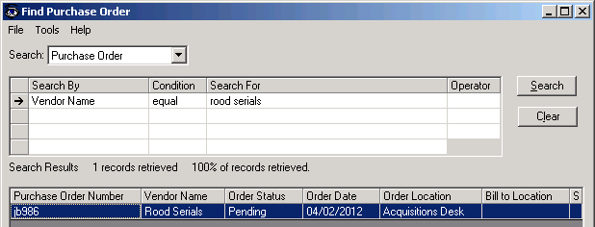
Completing and Deleting
Completing and deleting invoices and POs

Slide 10
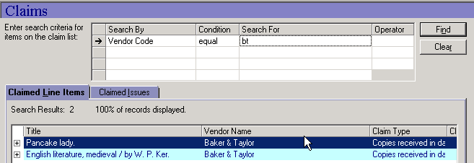
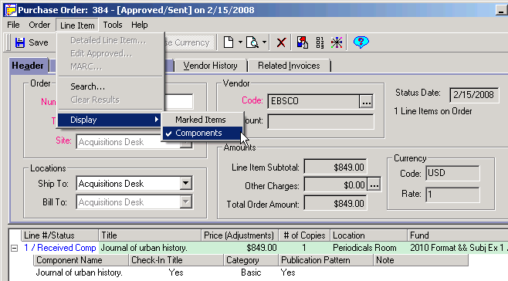
Claimed Line Items
In Acquisitions, search by Vendor on Claimed Line Items tab of Order Maintenance
If components are attached, they must first be deleted
If a component has marks/claims, they must first be deleted.
Notes:
SELECT VENDOR.VENDOR_NAME, COMPONENT.COMPONENT_NAME, PURCHASE_ORDER.PO_NUMBER, MARK_REASON.MARK_REASON_NAME, MARKED_ISSUE.MARK_DATE
FROM ((((PURCHASE_ORDER INNER JOIN LINE_ITEM ON PURCHASE_ORDER.PO_ID = LINE_ITEM.PO_ID) INNER JOIN (COMPONENT INNER JOIN SUBSCRIPTION ON COMPONENT.SUBSCRIPTION_ID = SUBSCRIPTION.SUBSCRIPTION_ID) ON LINE_ITEM.LINE_ITEM_ID = SUBSCRIPTION.LINE_ITEM_ID) INNER JOIN MARKED_ISSUE ON COMPONENT.COMPONENT_ID = MARKED_ISSUE.COMPONENT_ID) INNER JOIN MARK_REASON ON MARKED_ISSUE.MARK_REASON = MARK_REASON.MARK_REASON_ID) INNER JOIN VENDOR ON PURCHASE_ORDER.VENDOR_ID = VENDOR.VENDOR_ID
WHERE (((VENDOR.VENDOR_NAME)=[Enter Vendor Name]))
ORDER BY VENDOR.VENDOR_NAME;

Slide 11
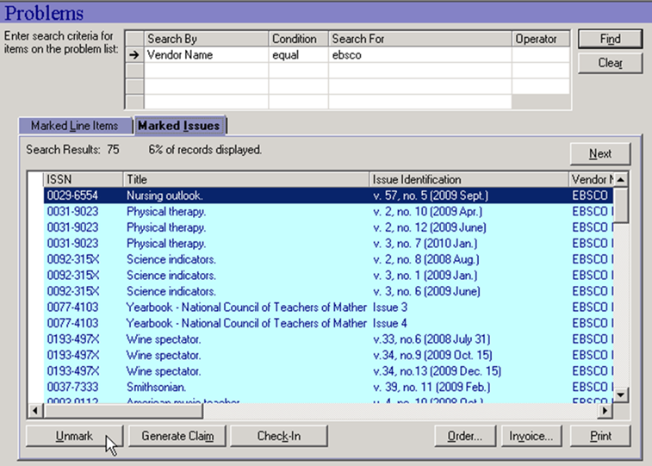
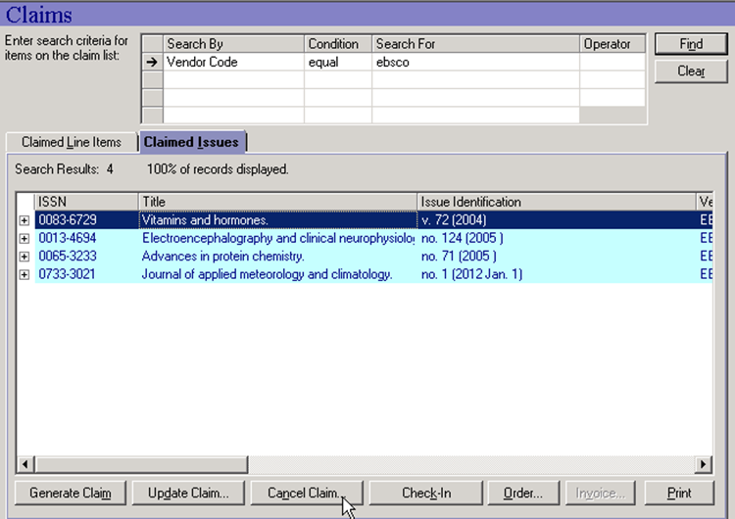
Claimed Line Items
In the client you can search for serial marks/claims by Vendor on Marked Issues and Claimed Issues tab in Order Maintenance.

Slide 12

Vendor Records
Vendor records have the potential to be duplicates
  Vendor name/code not required to be unique in Voyager, however, it is required to be unique in Alma
  May want to analyze whether separate vendor records can be consolidate to one vendor with multiple accounts
Notes:
SELECT VENDOR.VENDOR_ID, Count(VENDOR.VENDOR_CODE) AS
CountOfVENDOR_CODE, VENDOR.VENDOR_NAME
FROM VENDOR
GROUP BY VENDOR.VENDOR_ID, VENDOR.VENDOR_NAME
HAVING (((Count(VENDOR.VENDOR_CODE))>1));

Slide 13
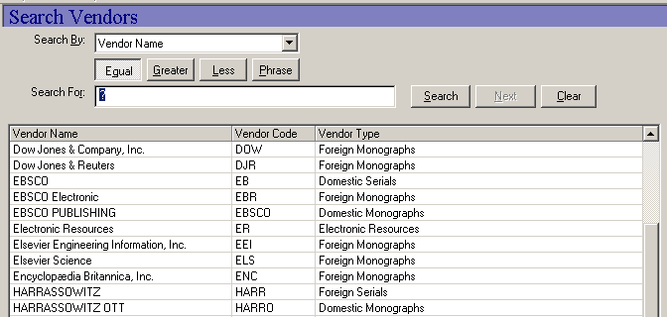
Vendor Records
Vendor code or name might be similar, not exactly the same, so it’s a good idea to eyeball all names either in query or in client

Slide 14

Funds and Ledgers
What funds don’t have unique names/codes?
  Voyager does not require unique fund names or codes even across unrelated ledgers
  Unique fund names are required in Alma
  There are places in Voyager where only fund name or code shows, which can cause operator error when selecting funds
  This can potentially cause confusion in migration
Notes:
SELECT FUND.FUND_ID, FUND.LEDGER_ID, FUND.FUND_CODE, FUND.FUND_NAME,
FUND.PARENT_FUND
FROM LEDGER INNER JOIN FUND ON LEDGER.LEDGER_ID = FUND.LEDGER_ID
GROUP BY FUND.FUND_ID, FUND.LEDGER_ID, FUND.FUND_CODE, FUND.FUND_NAME,
FUND.PARENT_FUND, LEDGER.LEDGER_NAME
HAVING (((LEDGER.LEDGER_NAME)="2015-2016"))
ORDER BY FUND.FUND_CODE;

Slide 15

Funds and Ledgers
What funds are not actively in use on line items?
  If a fund isn’t in use on any line items, it can be deleted
  Even if a fund was used on previous ledgers and no commitments rolled into the current ledger, it can be deleted
  If you delete a fund in this fiscal period and then roll, the new ledger will not have the deleted fund
Notes:
SELECT FUND.FUND_ID, FUND.FUND_NAME, FUND.COMMIT_PENDING, FUND.COMMITMENTS, FUND.EXPEND_PENDING, FUND.EXPENDITURES, FUND_TYPE.FUND_TYPE_NAME, FUND.CATEGORY
FROM (LEDGER INNER JOIN FUND ON LEDGER.LEDGER_ID = FUND.LEDGER_ID) INNER JOIN FUND_TYPE ON FUND.FUND_TYPE = FUND_TYPE.FUND_TYPE_ID
GROUP BY FUND.FUND_ID, FUND.FUND_NAME, LEDGER.LEDGER_NAME, FUND.COMMIT_PENDING, FUND.COMMITMENTS, FUND.EXPEND_PENDING, FUND.EXPENDITURES, FUND_TYPE.FUND_TYPE_NAME, FUND.CATEGORY
HAVING (((LEDGER.LEDGER_NAME)="2015-2016") AND ((FUND.COMMIT_PENDING)="0") AND ((FUND.COMMITMENTS)="0") AND ((FUND.EXPEND_PENDING)="0") AND ((FUND.EXPENDITURES)="0") AND ((FUND.CATEGORY)="1" Or (FUND.CATEGORY)="2"))
ORDER BY FUND.FUND_NAME;

Slide 16

Cleaning Up ‘Mistakes’
Remove POs and invoices created inadvertently or for testing purposes
No hard and fast way to identify these, but there are some clues:
  No associated line items
  For POs, old update date, no attached component (not a serial)
  For invoice, old create date, never approved
  PO or invoice number contains text ‘test’

Slide 17
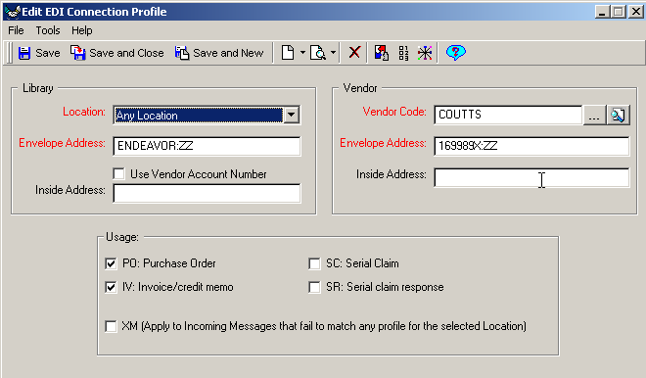
EDI Vendor Connection Profiles
Identify duplicate EDI Connection Profiles
Voyager allows duplicate EDI Connection Profiles where Alma does not
Duplicates are easy to create if the connection information doesn’t match when loading invoice and creating a profile on the fly
Notes:
SELECT EDI_CONNECTION_PROFILE.PROFILE_ID, Count(EDI_CONNECTION_PROFILE.VENDOR_ID) AS CountOfVENDOR_ID, VENDOR.VENDOR_NAME
FROM EDI_CONNECTION_PROFILE INNER JOIN VENDOR ON EDI_CONNECTION_PROFILE.VENDOR_ID = VENDOR.VENDOR_ID
GROUP BY EDI_CONNECTION_PROFILE.PROFILE_ID, VENDOR.VENDOR_NAME;

Slide 18
Introduction
Acquisitions
Summary and resources
Circulation
MARC records
Matrices and policies
Preparing for Alma
Notes:
Auths/Bibs/MFHDs/Items

Slide 19
Alma Inventory Model
Bib Records
Physical Inventory (Holdings)
Items
Electronic Inventory (Collections)
Portfolios

Slide 20
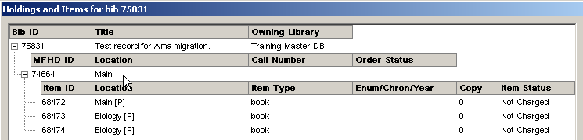
MFHD/Item Location Mismatch
A MFHD/item location conflict in Voyager may result in multiple holdings records in Alma
Voyager
MFHD 1, Location = Main
MFHD 2, Location = Biology
Item 1, Location = Main
Item 2, Location = Biology
Item 3, Location = Biology
Alma

Slide 21
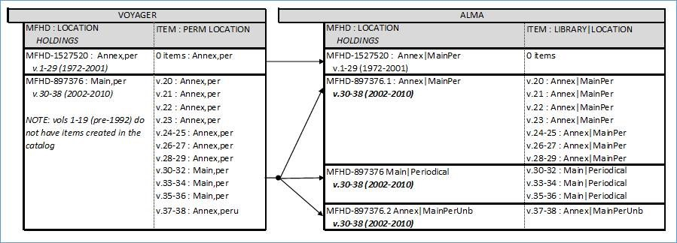
MFHD/Item Location Mismatch
After evaluating, you may want to perform some automated updates:
  Add item_barcode into the query
  Note that this leaves out items without barcodes – Pick and Scan requires item barcodes for processing
Notes:
SELECT BIB_MASTER.BIB_ID, BIB_TEXT.TITLE_BRIEF, MFHD_MASTER.MFHD_ID, LOCATION.LOCATION_CODE AS MLOC, MFHD_MASTER.DISPLAY_CALL_NO, LOCATION_1.LOCATION_CODE AS IPLOC, MFHD_ITEM.ITEM_ID, MFHD_ITEM.ITEM_ENUM, ITEM_BARCODE.ITEM_BARCODE
FROM (((((BIB_MASTER INNER JOIN BIB_TEXT ON BIB_MASTER.BIB_ID = BIB_TEXT.BIB_ID) INNER JOIN BIB_MFHD ON BIB_TEXT.BIB_ID = BIB_MFHD.BIB_ID) INNER JOIN (MFHD_MASTER INNER JOIN LOCATION ON MFHD_MASTER.LOCATION_ID = LOCATION.LOCATION_ID) ON BIB_MFHD.MFHD_ID = MFHD_MASTER.MFHD_ID) INNER JOIN (MFHD_ITEM INNER JOIN ITEM ON MFHD_ITEM.ITEM_ID = ITEM.ITEM_ID) ON MFHD_MASTER.MFHD_ID = MFHD_ITEM.MFHD_ID) INNER JOIN LOCATION AS LOCATION_1 ON ITEM.PERM_LOCATION = LOCATION_1.LOCATION_ID) LEFT JOIN ITEM_BARCODE ON ITEM.ITEM_ID = ITEM_BARCODE.ITEM_ID
WHERE (((LOCATION_1.LOCATION_CODE)<>[LOCATION].[LOCATION_CODE]));

Slide 22
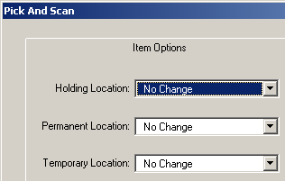
MFHD/Item Location Mismatch
Pick and Scan can update either the MFHD or item location
  This task requires close analysis
  If items have multiple locations, should some items have their location edited, or should a new MFHD be added?
  If items have a single location different than the MFHD, which location is the appropriate one?
  Be sure you know your data before performing any mass changes!

Slide 23
Bibs Without MFHDs
Good idea to identify any Bib records that do not have associated MFHDs
  Alma will display these records as “loners,” not having any inventory
  Use to…
    Complete processing
    Delete unneeded records
    Suppress when appropriate
Notes:
SELECT BIB_TEXT.BIB_ID, BIB_TEXT.TITLE, Count(BIB_MFHD.MFHD_ID) AS CountOfMFHD_ID
FROM BIB_MFHD RIGHT JOIN BIB_TEXT ON BIB_MFHD.BIB_ID = BIB_TEXT.BIB_ID
GROUP BY BIB_TEXT.BIB_ID, BIB_TEXT.TITLE
HAVING (((Count(BIB_MFHD.MFHD_ID))=0));

Slide 24
MFHDs Without Items
Good idea to display any MFHD records that do not have associated Items
  Alma will identify these records as not having items
    Use to…
        Complete processing
        Delete unneeded records
        Suppress when appropriate
Notes:
SELECT MFHD_MASTER.MFHD_ID, Count(MFHD_ITEM.ITEM_ID) AS CountOfITEM_ID
FROM MFHD_MASTER LEFT JOIN MFHD_ITEM ON MFHD_MASTER.MFHD_ID = MFHD_ITEM.MFHD_ID
GROUP BY MFHD_MASTER.MFHD_ID
HAVING (((Count(MFHD_ITEM.ITEM_ID))=0));

Slide 25
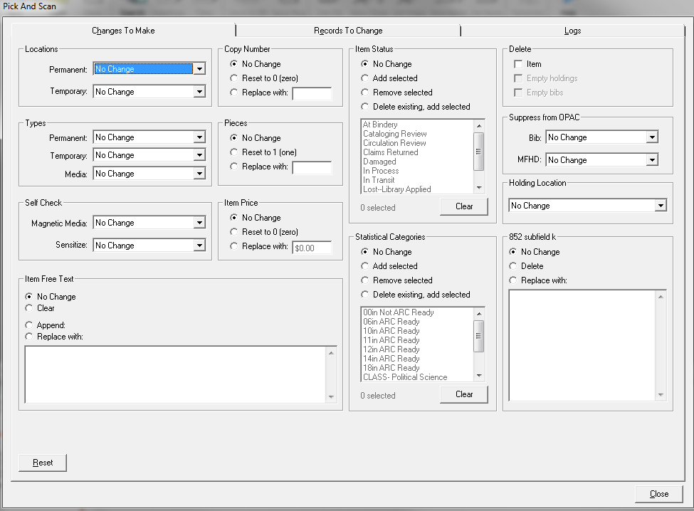
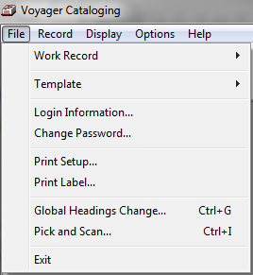
Item Types
Evaluate item types with low usage
  Good idea to change the permanent or temporary item types
  For large numbers of items, speed up the process by using Pick and Scan; requires barcode
Notes:
SELECT ITEM_TYPE.ITEM_TYPE_NAME, ITEM_BARCODE.ITEM_BARCODE
FROM (ITEM INNER JOIN ITEM_TYPE ON ITEM.ITEM_TYPE_ID = ITEM_TYPE.ITEM_TYPE_ID) INNER JOIN ITEM_BARCODE ON ITEM.ITEM_ID = ITEM_BARCODE.ITEM_ID
GROUP BY ITEM_TYPE.ITEM_TYPE_NAME, ITEM_BARCODE.ITEM_BARCODE
HAVING (((ITEM_TYPE.ITEM_TYPE_NAME)="REFCDMUSIC")) OR (((ITEM_TYPE.ITEM_TYPE_NAME)="NETCD-DATA")) OR (((ITEM_TYPE.ITEM_TYPE_NAME)="GAME")) OR (((ITEM_TYPE.ITEM_TYPE_NAME)="FILMSTRIP")) OR (((ITEM_TYPE.ITEM_TYPE_NAME)="TAPE"));

Slide 26

Authorities
Identify any duplicate authority records
  Catjob 5 does this for you!
  Alphabetized list of headings authorized by multiple authority records
  Generated by matching contents of 008 and 1XX fields
  Run from /sbin, data writes to /rpt and can be printed using Reporter

Slide 27

Authorities
Identify local authorities to migrate to Alma
  Alma already has the LC authorities file, so if you use these, there is no need to migrate authorities
  If you create local authorities that you want to maintain, identify them based on the create operator
Notes:
SELECT AUTHHISTORY_VW.CREATE_OPERATOR_ID, AUTHHISTORY_VW.AUTH_ID
FROM AUTHHISTORY_VW
WHERE (((AUTHHISTORY_VW.CREATE_OPERATOR_ID) Is Not Null));

Slide 28

Electronic Resources
Records that should migrate as electronic resource
  These records are migrated slightly differently than those for print resources
  Typically, these records are identified during migration by a holding location that is easily identifiable (i.e., named ‘Electronic’, ‘Online’, etc.)
  If you’re using locations in this way, make sure that they’re only used for this type of resource, so no other records migrate as electronic resources
Notes:
SELECT BIB_TEXT.BIB_ID, BIB_MFHD.MFHD_ID, LOCATION.LOCATION_CODE, BIB_TEXT.TITLE
FROM (((MFHD_MASTER INNER JOIN BIB_MFHD ON MFHD_MASTER.MFHD_ID = BIB_MFHD.MFHD_ID) INNER JOIN ELINK_INDEX ON BIB_MFHD.BIB_ID = ELINK_INDEX.RECORD_ID) INNER JOIN BIB_TEXT ON BIB_MFHD.BIB_ID = BIB_TEXT.BIB_ID) INNER JOIN LOCATION ON MFHD_MASTER.LOCATION_ID = LOCATION.LOCATION_ID
WHERE (((ELINK_INDEX.RECORD_TYPE)="M"));

Slide 29
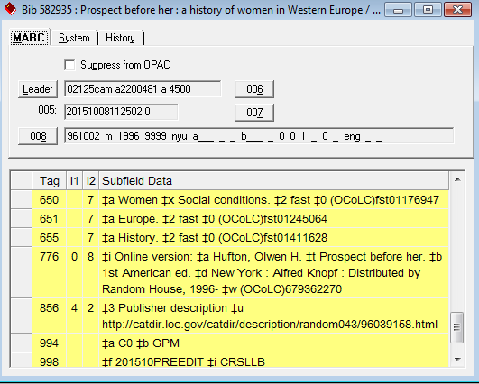
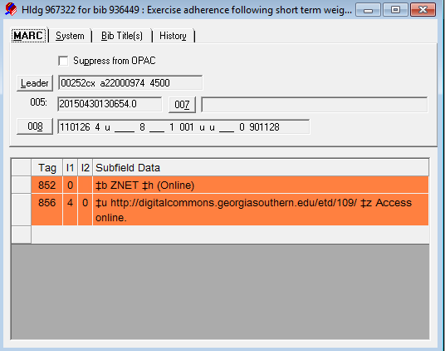
Electronic Resources
Another option to help with identifying records that represent Electronic Resources is to look for Bibs and MFHDs that store 856 fields
Notes:
SELECT DISTINCT BIB_TEXT.BIB_ID, LOCATION.LOCATION_CODE, BIB_TEXT.TITLE
FROM (((MFHD_MASTER INNER JOIN BIB_MFHD ON MFHD_MASTER.MFHD_ID = BIB_MFHD.MFHD_ID) INNER JOIN ELINK_INDEX ON BIB_MFHD.BIB_ID = ELINK_INDEX.RECORD_ID) INNER JOIN BIB_TEXT ON BIB_MFHD.BIB_ID = BIB_TEXT.BIB_ID) INNER JOIN LOCATION ON MFHD_MASTER.LOCATION_ID = LOCATION.LOCATION_ID
WHERE (((ELINK_INDEX.RECORD_TYPE)="B"))
ORDER BY LOCATION.LOCATION_CODE;
SELECT BIB_TEXT.BIB_ID, BIB_MFHD.MFHD_ID, LOCATION.LOCATION_CODE, BIB_TEXT.TITLE
FROM (((MFHD_MASTER INNER JOIN BIB_MFHD ON MFHD_MASTER.MFHD_ID = BIB_MFHD.MFHD_ID) INNER JOIN ELINK_INDEX ON BIB_MFHD.BIB_ID = ELINK_INDEX.RECORD_ID) INNER JOIN BIB_TEXT ON BIB_MFHD.BIB_ID = BIB_TEXT.BIB_ID) INNER JOIN LOCATION ON MFHD_MASTER.LOCATION_ID = LOCATION.LOCATION_ID
WHERE (((ELINK_INDEX.RECORD_TYPE)="M"));

Slide 30

9xx Fields
What data lives in your 9xx fields?
For enrichment data like availability, course reserves, cross-reference info, etc., the Voyager to Primo extract uses 9xx fields
Sites select which 9xx fields they want to use for this enrichment data
Using previously populated 9xx fields for enrichment can cause odd data to be loaded into Primo
It can be difficult to know which 9xx fields have never been used in any bibs in your database

Slide 31
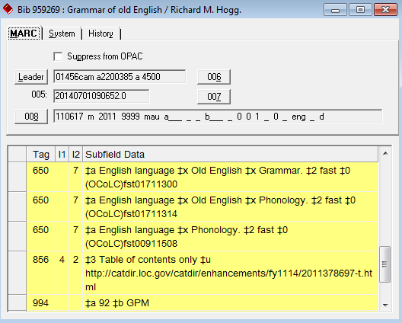
9xx Fields
We have found that many sites do not use 9xx fields consistently
Identify the 9xx fields currently in use as well as which ones are available for Enrichment for Primo

Slide 32
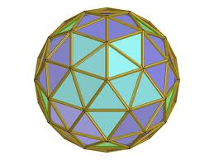
9xx Fields
We now have a scripted tool available to identify which 9xx fields are in use; available in the CodeShare area on EL Commons
http://www.exlibrisgroup.org/display/VoyagerCC/Voyager+9xx+tag+checker
  After you’ve run the script, determine which unused 9xx fields will be where you store extracted enrichment data
  Update your extract .ini config files to have the new 9xx information

Slide 33
9xx Fields
[Enrichment Tags]
# Tags added to marc record with additional data
#
# WARNING: You must change the orderInfoHolTag=960 in vxws.properties if you use the 960 tag in here.
#
# AVA tag contains the availability information
# AUT tag contains name cross-reference information
# SUB tag contains subject cross-reference information
# CR tag contains course reserve information
# DPS tag contains Digital Preservation System (Product Rosetta) information
# EITM tag contains E-Item availability data (New for 8.0.0)
InsertAVATag=949
InsertAUTTag=950
InsertSUBTag=951
InsertCRTag=952
InsertDPSTag=953
InsertEITMTag=954

Slide 34
9xx Fields
If you want to standardize your data, turn to GDC
  To be tidy, you can do more than just pick identified unused fields
  GDC can do mass updates that relocate data from one field in the bib to another
  Just make sure to be careful and preview all changes first to be sure that the changes you want to make are the changes you’re actually making!

Slide 35

Clean Up Links for Primo
In Primo, linked title, image and link listed first on the View Online tab pull from the first 856 in the extracted bib record, not the holding’s extracted 856
If the first bib 856 is not a preferred link for all holdings, this might be a display problem in Primo (say for consortia where individually appropriate links are listed after a generic bib 856, though appropriate individual 856s are in the MFHDs).
  Cleanest solution is to have no link in Bibs and correct links in individual MFHDs

Slide 36
Clean Up Links for Primo
GDC can help in this scenario as well!
Create a data set of the bib_ids of affected records (this specific query assumes the MFHD 856s are preferred; if that’s not the case for your data, the criteria may have to be refined)
Can likely use same queries for identifying records that represent Electronic Resources
Notes:
SELECT DISTINCT BIB_TEXT.BIB_ID, LOCATION.LOCATION_CODE, BIB_TEXT.TITLE
FROM (((MFHD_MASTER INNER JOIN BIB_MFHD ON MFHD_MASTER.MFHD_ID = BIB_MFHD.MFHD_ID) INNER JOIN ELINK_INDEX ON BIB_MFHD.BIB_ID = ELINK_INDEX.RECORD_ID) INNER JOIN BIB_TEXT ON BIB_MFHD.BIB_ID = BIB_TEXT.BIB_ID) INNER JOIN LOCATION ON MFHD_MASTER.LOCATION_ID = LOCATION.LOCATION_ID
WHERE (((ELINK_INDEX.RECORD_TYPE)="B"))
ORDER BY LOCATION.LOCATION_CODE;
SELECT BIB_TEXT.BIB_ID, BIB_MFHD.MFHD_ID, LOCATION.LOCATION_CODE, BIB_TEXT.TITLE
FROM (((MFHD_MASTER INNER JOIN BIB_MFHD ON MFHD_MASTER.MFHD_ID = BIB_MFHD.MFHD_ID) INNER JOIN ELINK_INDEX ON BIB_MFHD.BIB_ID = ELINK_INDEX.RECORD_ID) INNER JOIN BIB_TEXT ON BIB_MFHD.BIB_ID = BIB_TEXT.BIB_ID) INNER JOIN LOCATION ON MFHD_MASTER.LOCATION_ID = LOCATION.LOCATION_ID
WHERE (((ELINK_INDEX.RECORD_TYPE)="M"));

Slide 37
Introduction
Acquisitions
Summary and resources
Circulation
MARC records
Matrices and policies
Preparing for Alma
Notes:
Patrons, Patron Groups, Item Types

Slide 38
Duplicate Item Barcodes
Overall, a good thing to avoid, in any ILS, is duplicate item barcodes
  Duplicate barcodes are not permitted in Alma
  If duplicate barcodes are encountered during migration, they will be disambiguated
  30104278340561

Slide 39

Items Without Barcodes
In Voyager, item records may be saved without barcodes
  This is not the case in Alma where, item records with no barcode will be assigned a barcode of B+item_id (i.e., if item_id is 4567, item barcode will be B4567)
  This gives clear indication, post-migration, which Item barcodes were altered
Notes:
SELECT ITEM.ITEM_ID, ITEM_BARCODE.ITEM_BARCODE, BIB_TEXT.BIB_ID
FROM (ITEM_BARCODE INNER JOIN (BIB_ITEM INNER JOIN BIB_TEXT ON BIB_ITEM.BIB_ID = BIB_TEXT.BIB_ID) ON ITEM_BARCODE.ITEM_ID = BIB_ITEM.ITEM_ID) INNER JOIN ITEM ON ITEM_BARCODE.ITEM_ID = ITEM.ITEM_ID
WHERE (((ITEM_BARCODE.ITEM_BARCODE)<"0"));

Slide 40
Duplicate Patron Barcodes
Overall, a good thing to avoid, in any ILS, is duplicate patron barcodes
  Duplicate patron barcodes are not permitted in Alma
  If duplicate barcodes are encountered during migration, they will be disambiguated
50136129870561
Notes:
SELECT PATRON_BARCODE.PATRON_BARCODE, Count(PATRON_BARCODE.PATRON_BARCODE_ID) AS CountOfPATRON_BARCODE_ID
FROM PATRON_BARCODE
WHERE (((PATRON_BARCODE.BARCODE_STATUS)="1"))
GROUP BY PATRON_BARCODE.PATRON_BARCODE
HAVING (((Count(PATRON_BARCODE.PATRON_BARCODE_ID))>1))
ORDER BY PATRON_BARCODE.PATRON_BARCODE;

Slide 41


Patrons Without Barcodes
Identify patrons with blank barcodes
  Voyager allows patron records to have blank barcodes
  Patrons must have at least one barcode
Notes:
SELECT PATRON.PATRON_ID, PATRON.LAST_NAME, PATRON.FIRST_NAME, PATRON_GROUP.PATRON_GROUP_NAME, PATRON_BARCODE.PATRON_BARCODE
FROM (PATRON INNER JOIN PATRON_BARCODE ON PATRON.PATRON_ID = PATRON_BARCODE.PATRON_ID) INNER JOIN PATRON_GROUP ON PATRON_BARCODE.PATRON_GROUP_ID = PATRON_GROUP.PATRON_GROUP_ID
WHERE (((PATRON_BARCODE.PATRON_BARCODE) Is Null));

Slide 42

Patron Purge
Identify patrons to purge based on:
  Expire or purge date
  Barcode status
  Patron group
  Statistical category
Note: Patrons with current transactions or fines / fees will not be eligible for purge (same goes for historical fines / fees, if option is not checked in SysAdmin)

Slide 43

Patron Purge
Expires or Purge Date
  Easiest, as this is the criteria Patron Purge already uses
  At least one of the two fields is typically already populated
Notes:
SELECT PATRON.PATRON_ID, PATRON.LAST_NAME, PATRON.FIRST_NAME,
PATRON.PURGE_DATE, PATRON.EXPIRE_DATE
FROM PATRON
WHERE (((PATRON.PURGE_DATE)<#1/1/2013#));

Slide 44

Patron Purge
Once patrons for purge are identified
If criteria is expire/purge date, move ahead to circjob 39; if criteria is other, use patron update to set an expire/purge date for identified patrons
Can set expire/purge date to far in the past so no other patrons are affected
Run circjob 39 with the –a parameter, supplying the date set above
Note: Patron Purge runs in test mode by default; review logs to confirm and then run with –z parameter.
Notes:
pp. 5-11ff

Slide 45

Course Reserves
Verify that all necessary information is present and/or current
  Check for a course associated with reserve lists – if not there, can you update, or should this list be deleted?
  Are there any reserve lists with expiration dates far in the past?
Notes:
SELECT RESERVE_LIST.RESERVE_LIST_ID, RESERVE_LIST_COURSES.COURSE_ID, RESERVE_LIST.LIST_TITLE
FROM RESERVE_LIST INNER JOIN RESERVE_LIST_COURSES ON RESERVE_LIST.RESERVE_LIST_ID = RESERVE_LIST_COURSES.RESERVE_LIST_ID
WHERE (((RESERVE_LIST_COURSES.COURSE_ID)="0"));
SELECT RESERVE_LIST.RESERVE_LIST_ID, RESERVE_LIST_COURSES.COURSE_ID, RESERVE_LIST.LIST_TITLE, RESERVE_LIST.EXPIRE_DATE
FROM RESERVE_LIST INNER JOIN RESERVE_LIST_COURSES ON RESERVE_LIST.RESERVE_LIST_ID = RESERVE_LIST_COURSES.RESERVE_LIST_ID
WHERE (((RESERVE_LIST.EXPIRE_DATE)<#1/1/2014#));

Slide 46

Course Reserves
Look for duplicates
  Check to see if any list titles, courses, or departments are duplicates
  Analyze to see if duplicates are necessary, or if you can either delete or make unique
Notes:
SELECT RESERVE_LIST.RESERVE_LIST_ID, RESERVE_LIST_COURSES.COURSE_ID, Count(RESERVE_LIST.LIST_TITLE) AS CountOfLIST_TITLE, RESERVE_LIST.LIST_TITLE
FROM RESERVE_LIST INNER JOIN RESERVE_LIST_COURSES ON RESERVE_LIST.RESERVE_LIST_ID = RESERVE_LIST_COURSES.RESERVE_LIST_ID
GROUP BY RESERVE_LIST.RESERVE_LIST_ID, RESERVE_LIST_COURSES.COURSE_ID, RESERVE_LIST.LIST_TITLE
HAVING (((Count(RESERVE_LIST.LIST_TITLE))>1));
SELECT DEPARTMENT.DEPARTMENT_ID, DEPARTMENT.DEPARTMENT_NAME, Count(DEPARTMENT.DEPARTMENT_NAME) AS CountOfDEPARTMENT_NAME
FROM (RESERVE_LIST INNER JOIN RESERVE_LIST_COURSES ON RESERVE_LIST.RESERVE_LIST_ID = RESERVE_LIST_COURSES.RESERVE_LIST_ID) INNER JOIN DEPARTMENT ON RESERVE_LIST_COURSES.DEPARTMENT_ID = DEPARTMENT.DEPARTMENT_ID
GROUP BY DEPARTMENT.DEPARTMENT_ID, DEPARTMENT.DEPARTMENT_NAME
HAVING (((Count(DEPARTMENT.DEPARTMENT_NAME))>1));

Slide 47

Patron Groups
Identify and evaluate patron groups with low numbers
  Consider moving individuals to other patron groups for overall consolidation
Notes:
SELECT PATRON_GROUP.PATRON_GROUP_NAME, PATRON_BARCODE.PATRON_GROUP_ID, Count(PATRON_GROUP.PATRON_GROUP_ID) AS CountOfPATRON_GROUP_ID
FROM PATRON_BARCODE INNER JOIN PATRON_GROUP ON PATRON_BARCODE.PATRON_GROUP_ID = PATRON_GROUP.PATRON_GROUP_ID
GROUP BY PATRON_GROUP.PATRON_GROUP_NAME, PATRON_BARCODE.PATRON_GROUP_ID;

Slide 48

Patron Groups
Update patron groups manually in Circ or with Patron Update
  Create SIF with patrons that have barcodes with the unwanted group
  Set status of existing barcode to 4 or 5 (Expired or Other)
  Add new barcode using old barcode text, but new patron group
  Set status of new barcode to 1 (Active)
  Sample SIF for one patron:

Slide 49
Introduction
Acquisitions
Summary and resources
Circulation
MARC records
Matrices and policies
Preparing for Alma
Notes:
Circulation Policies

Slide 50

Matrices and Policy Definitions
Analyze current policy definitions and matrices
  Do you have many matrices in use on few or no transactions?
  Do you have similar matrix settings widely used across different patron groups/item types/Circ Policies?

Slide 51

Matrices and Policy Definitions
A look at current circulation data
  How many active transactions currently reside in the database?
  Get a current count for context when evaluating the number of transactions using specific matrices
  Keep in mind that historical context is available via circ_trans_archive

Slide 52

Matrices and Policy Definitions
Never/seldom used matrices
  Only matrices that are used will have entry in circ_transactions
    For this reason, must query separately for never used vs seldom used matrices
Notes:
SELECT DISTINCT CIRC_TRANSACTIONS.CIRC_POLICY_MATRIX_ID, CIRC_POLICY_MATRIX.CIRC_POLICY_MATRIX_ID
FROM CIRC_POLICY_MATRIX LEFT JOIN CIRC_TRANSACTIONS ON CIRC_POLICY_MATRIX.CIRC_POLICY_MATRIX_ID = CIRC_TRANSACTIONS.CIRC_POLICY_MATRIX_ID;
SELECT CIRC_TRANSACTIONS.CIRC_POLICY_MATRIX_ID, Count(CIRC_POLICY_MATRIX.CIRC_POLICY_MATRIX_ID) AS CountOfCIRC_POLICY_MATRIX_ID, CIRC_POLICY_GROUP.CIRC_GROUP_NAME
FROM (CIRC_POLICY_MATRIX INNER JOIN CIRC_TRANSACTIONS ON CIRC_POLICY_MATRIX.CIRC_POLICY_MATRIX_ID = CIRC_TRANSACTIONS.CIRC_POLICY_MATRIX_ID) INNER JOIN CIRC_POLICY_GROUP ON CIRC_POLICY_MATRIX.CIRC_GROUP_ID = CIRC_POLICY_GROUP.CIRC_GROUP_ID
GROUP BY CIRC_TRANSACTIONS.CIRC_POLICY_MATRIX_ID, CIRC_POLICY_GROUP.CIRC_GROUP_NAME;

Slide 53

Matrices and Policy Definitions
Now that you have this data, what to do about it?
  Are we better served by removing some of the matrices?
  Could we tweak our All/All settings to cover more scenarios instead of having individual matrices for all patron groups/item types?
  Can we identify trends as to which matrices, though for different patron groups or item types, actually have very similar settings?

Slide 54
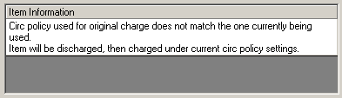
Matrices and Policy Definitions
If eliminating seldom/never used matrices
  Matrix may not be deleted if any active transactions
  Revoke privileges for a matrix until all the items charged under that matrix are returned (renewals will not be allowed)
  Change item type/patron group for item or patron involved in active transactions with that matrix
  Renewals are blocked but over-rideable in Circulation (with the block message that the policy has changed) for that matrix

Slide 55

Matrices and Policy Definitions
Looking for trends?
  Which matrices have similar loan and renewal periods?
  Which matrices have similar fine rates / intervals?
  Which matrices allow the same types of action (i.e., charge/renew, hold, recall, call slip)?
  Regardless of policy or type of item/patron, could these settings actually apply across several different matrices?

Slide 56
Introduction
Acquisitions
Summary and resources
Circulation
MARC records
Matrices and policies
Preparing for Alma
Notes:
Summary and resources

Slide 57

Summary
During this session, we have…
  Looked at different areas that may have problematic data
  Identified some ways to isolate data that needs evaluation
  Provided some possible methods for removing or updating that data

Slide 58
Pointers
Know your data! Everyone’s workflows and practices are different, so you have the best idea of what problems may exist in your database. If you think of some other areas to examine and need help figuring out where in the db that data lives, let Support know.
Test before making large changes! Tools like GDC, Pick and Scan and Patron Update are powerful, and while they can be very useful, they can also be very dangerous if you haven’t thoroughly analyzed your plan and tested with small batches of records first.

Slide 59

Resources
User Guides:
  Voyager 9 Circulation User’s Guide
  Voyager 9 Cataloging User’s Guide
  Voyager 9 Technical User’s Guide
  Voyager 9 Data Dictionary

Slide 60
Resources
CodeShare area on EL Commons:
  http://www.exlibrisgroup.org/display/VoyagerCC/Voyager+9xx+tag+checker
Ex Libris Customer Support:
  http://support.exlibrisgroup.com/

Slide 61
Thank you!

