Slide 1
Alma Configuration Form Meeting
California State University
Wednesday, April 27, 2016

Slide 2
Copyright Statement
All of the information and material inclusive of text, images, logos, product names is either the property of, or used with permission by Ex Libris Ltd. The information may not be distributed, modified, displayed, reproduced – in whole or in part – without the prior written permission of Ex Libris Ltd.
TRADEMARKS Ex Libris, the Ex Libris logo, Aleph, Alma, SFX, SFXIT, MetaLib, DigiTool, Verde, Primo, Voyager, MetaSearch, MetaIndex and other Ex Libris products and services referenced herein are trademarks of Ex Libris, and may be registered in certain jurisdictions. All other product names, company names, marks and logos referenced may be trademarks of their respective owners.
DISCLAIMER The information contained in this document is compiled from various sources and provided on an "AS IS" basis for general information purposes only without any representations, conditions or warranties whether express or implied, including any implied warranties of satisfactory quality, completeness, accuracy or fitness for a particular purpose.
Ex Libris, its subsidiaries and related corporations ("Ex Libris Group") disclaim any and all liability for all use of this information, including losses, damages, claims or expenses any person may incur as a result of the use of this information, even if advised of the possibility of such loss or damage.
© Ex Libris Ltd., 2015

Slide 3
Agenda
Introduction to Configuration Form & Process
Configuration Form
Other Topics, Documentation & Next Steps

Slide 4
Configuration Form
Purpose of form:
Gather information used to establish rules and behavior
Tool used to evaluate current configurations & possibly streamline
Starting point for configuration – not the be all/end all
Completing the Config Form is a one time process
Tool used to load configuration
You can make changes both
between configuration load and cutover
After go live

Slide 5
Configuration Process
Prepopulated with data from the Migration Form (ExLibris)
Fill in - focusing on required tabs/fields first (CalS)
Validate form (CalS)
Return draft by 5/11/16 end of day (CalS)
Proof & revise (both)
Return final by 5/25/16 (CalS)
Load when test load is delivered (ExLibris)
Test, submit changes & adjust during implementation within Alma (both)
After Certification, you add and adjust as needed within Alma

Slide 6
Configuration Retained at Cutover
Unlike data, configurations are retained at cutover:
Internal Users with type “STAFF” & their roles
External users - only roles are retained
Libraries & Locations
Vendor records manually added to Alma
All configuration done during implementation – including configurations for 3rd party integrations

Slide 7
Required Tabs (in order of completion)
Fulfillment: location types & patron types
(may need to complete the Libraries Tab before entering the Auto Renew Rules and Overdue & Lost Loan Rules)
Libraries: libraries & open hours
Printers
Circ Desks
Locations
Users
TOU
General: time zone & system date format

Slide 8
Tips
Fill out in order listed in last slide
Drop-down present – Use it! Don’t type!
Proof all pre-populated information
Fill out Item Policies Tab (if using) before TOU tab
Fill out Booking Tab (if using) after TOU tab
Fill out as much as possible
Ok to leave until you understand more about the functionality they support:
Resource Sharing Work Orders
Controlled Vocabularies Licensing

Slide 9
Agenda
Introduction to Configuration Form & Process
Configuration Form
Other Topics, Documentation & Next Steps

Slide 10
Fulfillment Tab
Fulfillment includes circulation
Alma uses location-based approach
Assumption: items shelved in same location circulate more or less the same for given user groups
Alma uses the item status (item policy &/or material type) to define exceptions
Migration is good time to evaluate lending policies and simplify to make easier on staff and users

Slide 11
Fulfillment Tab – Location Types
Max of 5 (just for Config Form)
Groups together locations whose materials circ in the same way
Choose name from drop-down – or enter something of your choosing
Examples: General, Limited, Short Loan, Closed Stack, Media…
Populates dropdowns in the Locations Tab as well as the Policies, TOU & Rules Tab
Map location to location type in the Locations Tab
Become Fulfillment Units in Alma

Slide 12
Location Type - On Shelf Request Policy
Sets default requesting & pickup point behavior for on shelf materials by location type
Example: all Limited location items are not allowed to have on shelf requests (holds)
May be overridden for specific users via the On Shelf Request Policy column of the Policies, TOU & Rules Tab
Example: Staff are able to place holds for on shelf items in the Limited locations

Slide 13
Fulfillment Tab – Patron Types
Groups together User Groups and works with Location Type to determine lending policies
Max of 4 (just for Config Form)
Populates the Patron Type field in the Users Tab & the Policies, TOU and Rules tab
Users Tab maps Patron Groups to Patron Type
Choose name from drop-down – or enter something of your choosing
Examples: Faculty, Staff, Students, Visitors

Slide 14
Fulfillment Tab – Item Exception Types
Max of 5 (just for Config Form)
Used to create exceptions to normal fulfillment (lending and requesting) rules
Populates drop-downs in Item Policies Tab and Policies TOU & Rules Tab
Item Policies Tab maps these exceptions to item codes

Slide 15
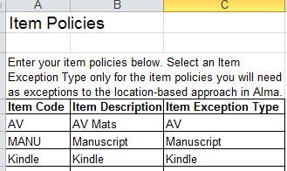
Item Exceptions
In Fulfillment Tab, indicate the Item Exception Types
In Item Policies Tab, translate Item Code and Item Description to the Exception
In TOU Tab, enter the lending policies

Slide 16
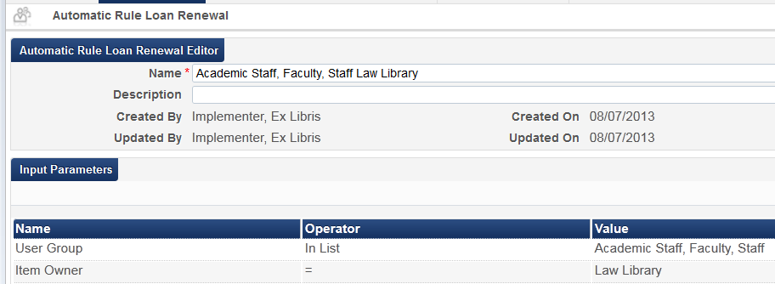
Auto Renew
Defined by library, user group &/or combination
General Tab “auto_renew_loan_days” enter number of days before due date when courtesy notice is generated or auto renewal occurs

Slide 17
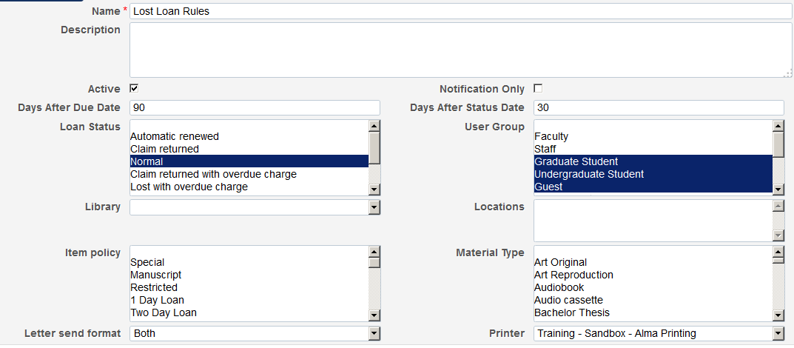
Overdue & Lost Loan Rules
Defines if and when loans are automatically marked as lost
Can define multiple profiles by library, patron type, or combination of both
Each profile determines when notification is sent or item is changed to lost, and how patron is notified

Slide 18
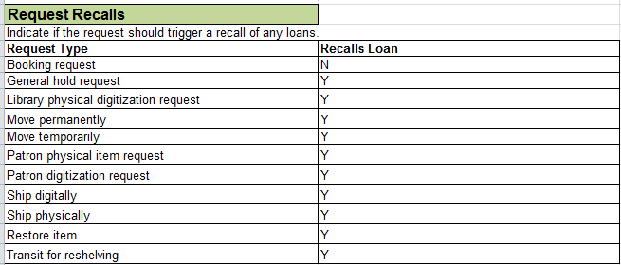
Request Recalls
Indicate which system actions should trigger a recall if a requested item is currently on loan.

Slide 19
Block Preferences
Define whether system generated blocks may be overridden (and by whom) or handled automatically

Slide 20
Request Pickup Configuration
Defines which request types :
show in the “Pick From Shelf” list
Are considered missing when they expire
How long a request can be on the Pick From Shelf list

Slide 21
Libraries tab
1. Libraries
Code and Name must be present
Prepopulated from Migration Form
Fill in address only if library needs an additonal address

Slide 22
Libraries Tab (cont.)
Tips:
Watch the yyyy-mm-dd date format!
Enter in military time format
2a. Standard open hours for every library (including “Empty”) – must have or you can’t circ!
2b. Exceptional open dates/hours = days/hours you’ll be open when you’re normally closed
2c. Exceptional closed days/hours = days/hours you’re closed when normally open – closed all day, enter just the date
2d. Enter any dates that you want to use as fixed due dates (e.g. End of Term)

Slide 23
Libraries Tab (cont.)
3. Circulation relationships between libraries
(used in multi-library institutions)
By default, a library can deliver to and circulate for all other libraries
Enter library code for any library whose materials can only be checked out and returned at that library

Slide 24
Printers Tab
Alma supports printing via e-mail
In Alma “printing” = emailing
Each printer is configured with its own unique e-mail address.
Populates the Printer drop-down lists on the Circ Desks Tab
Note: For printers without email addresses, can use Namtuk or Outlook printing rules to route emails for physical printing
Need help? Best source is Alma-L

Slide 25
Circ Desks Tab
At circulation desks, items can be checked-in (returned), checked-out (loaned), and re-shelved
Best practice recommendation: use the default circulation desk (keep code & name) as the main circulation desk for each library
If required, define additional circulation desks for each library in this tab
See “Circ Desks Tab” section of the Configuration Form Guide for details on each option
Automatic (Pick Slip) Printing Rules: fill in if you want individual Pick From Shelf slips to print automatically (instead of using list) – one row for each circ desk

Slide 26
Locations tab
All locations must be represented – including those to be deleted
Prepopulated from Migration Form
The first four columns are mandatory:
A. Library code
B. Location code
C. Location Name
D. Location Type (becomes Fulfillment Unit – must match Location Types defined in Fulfillment Tab)

Slide 27
Locations Tab, cont.
Define:
External name of location
Circ desk
Check out, check in, reshelve
Remote storage (defined lower in the tab)
If serves as a default acquisitions location
Suppression
Call number type
Accession placement
Remote storage facilities (optional)
Define code, name, transit scheme and if digitization happens at the remote storage location

Slide 28
Users Tab
Combines patron groups into the Patron Types defined on the Fulfillment Tab
Used in fulfillment policies
Patron Limits
Defined by patron type
Used to block loans and/or renewals

Slide 29
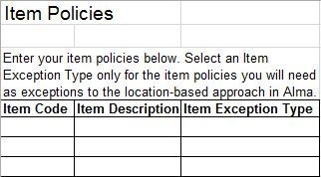
Item Policies Tab
Prepopulated from Migration Form/Item Type Tab
Assign exception type (if using)
Exceptions apply to all user groups

Slide 30
Policies, TOU & Rules tab
Policies, TOU & Rules Tab defines your fulfillment rules (lending/circulation policies) for physical items
Covers the various settings related to loans and requests
Think about consolidating lending rules (Note: good time to evaluate and condense rules)
Must fill in each cell in default line!
Each Location Type must be represented in Section 2
Section 2: if value for a cell matches default – leave cell blank

Slide 31
Policies, TOU & Rules: Important Definitions
Exact Days vs. Days:
“Exact Days” will use the system time from when the item is checked out as the due time.
e.g. a 7 days item
loaned at 10:15 am on Tuesday, Dec. 1
Due at 10:15 am on Tuesday, Dec. 8
“Days” gives the user until closing time on the due date
Max Renew Length:
Equals the total amount of time user may have item
Includes length of original loan
Example:
7 day loan + 2 renewals = max renewal length of 21 days

Slide 32
Policies, TOU & Rules (cont.)
Exceptions
Enter the policies for any exceptions you established
One line for each exception defined on Fulfillment tab
Out going Requests to Other Institutions (you as borrower) – define if managing ILL via Alma
Incoming Requests from Other institutions (you as lender) – define if managing ILL via Alma

Slide 33
Booking Tab
Defines rules for booking physical resources
Allows patrons to reserve resources for their use at a specified time in the future
Example: use for reserving study rooms
Complete only if you intend to manage booking of resources within Alma
Can be set up later
Similar arrangement & entry method as the TOU Tab – establish default – configure exceptions

Slide 34
Additional Res Share Libraries Tab
Used only if more than one library is needed for Resource Sharing
Default line must be completely filled in
Governs rules for borrowing and lending

Slide 35
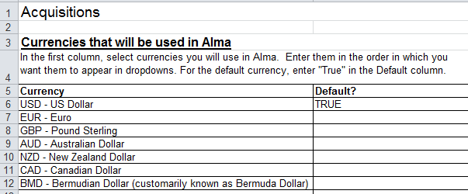
Acquisitions tab
Must set one currency as your default

Slide 36
Acquisitions Tab (cont.)
Acquire For: defines which library can acquire material on behalf of other libraries
Used in multi-library institutions
Code = Library Code for each library that orders for other libraries
2nd column is the library on whose behalf orders are placed
3rd column enter Y = orders for or N = doesn’t order for
Served Libraries: defines which library can receive materials on behalf of other libraries

Slide 37
Acquisitions Tab (cont.)
General Purchasing Behavior: Establishes the if and when manual review/approval of orders and invoices occurs
Alma designed to automate review & approval processes
Y = manual review/approval required

Slide 38
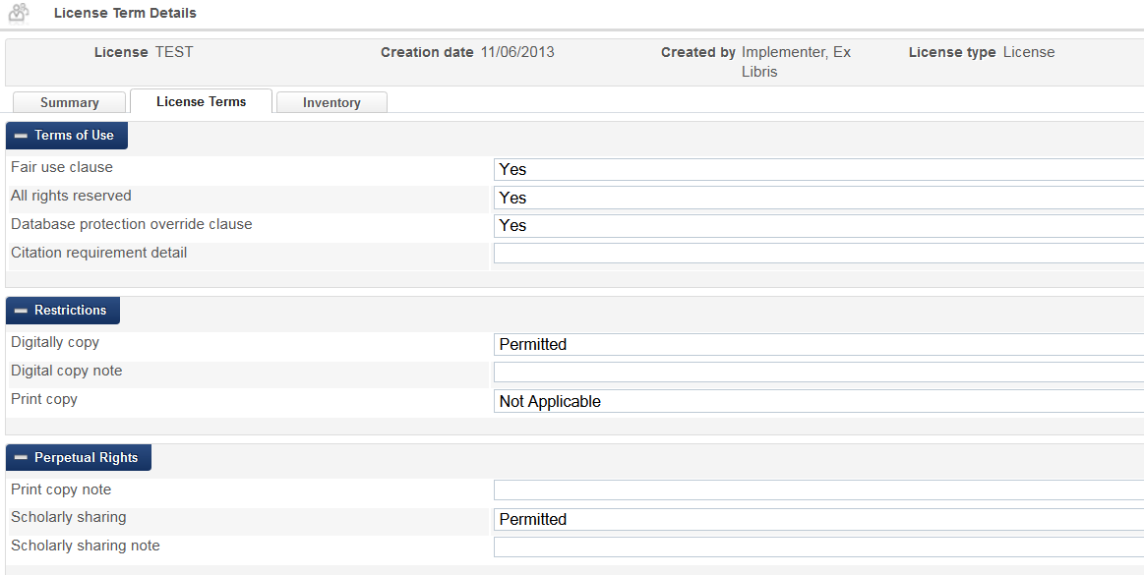
Licensing Tab
Defines: the license terms to use in Alma, the order in which the sections of the license display, which license terms display in each section, and which terms display to the public

Slide 39
Work Orders Tab
In Alma, work orders…
Are internal, item level requests
Used to send materials from one department to another for work
Allows tracking of items when not on shelf
Allow communication of status to staff & patrons
Example: an item is sent to Bindery department with “Bindery prep” status > moves to “sent to bindery” status > moves to “physical processing” status > when work is done returns to shelf
Leave blank if you don’t want to establish work orders at this time
You can create work orders at any time

Slide 40
Resource Management Tab
Barcode Generation
Optional automatic generation of barcodes for new items
Enter a generation routine or select “None” in the dropdown
Local 9XX fields to index
Enter 9XX field(s) to index and the index name

Slide 41
Resource Management Tab (cont.)
Call Number Parsing
Used for spine label printing
Routines listed in Config Form Guide/Resource Management Tab section pages 63-68
Brief Record Definition
Permits tagging of bib records as brief for easily identification
Template specifics listed in Config Form Guide pages 67 – 68

Slide 42
Resource Management Tab (cont.)
Active Metadata Registry
Alma supports MARC21, UNIMARC, and KORMARC bib formats
Activate format(s) used (can’t activate both UNIMARC and KORMARC)
Mark preferred (becomes default)
More than one active permits selection of format when creating a bib
Publishing to OCLC
Use only if publishing/synchronizing your records with OCLC
Enter institution symbol & OCLC project number (obtained from OCLC)
Setup is optional at this time

Slide 43
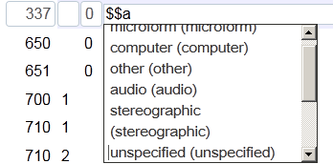
Controlled Vocabulary Tabs
Two tabs work together
Used when entering bib records
Predefined fixed values for specific field(s)
Establishes drop-down menu for use in Alma’s MD Editor
Example: the 337a (media type)
Controlled Vocabulary creates text - Assign Controlled Vocabulary Tab connects to metadata profile & subfield
041a, 245h, 310a and 655a fields come predefined

Slide 44
General Tab
Mandatory:
“time_zone”
“system_date_format”
Of note:
“force_location_selection_on_login”: True = “Currently At” dialog box appears for any user with roles at more than one circ desk or work order department
“multi_campus_inventory_management” used with inventory network groups to manage e-resource access
Acquisitions settings govern rules for review of purchase orders and invoices, the use of VAT, pro rata, prefixes for PO lines and POs

Slide 45
General Tab (cont.)
Of Note (cont.)
Acquisitions setting “invoice_skip_erp” will be set to “True” until ready to test export to ERP (if using)
Resource management options control: matching profiles, subfield indicators
Resource management option “working_copy_lock_timeout” releases record for editing after set time (if you forget to release it)
Fulfillment options control: when auto renewal occurs, assessing of fines for lost items
Anonymizing loans and borrowing requests – True = weekly process removes info – False = info is not removed from transactions
Viewing historical loans in Primo – True = patrons can see historical loan info via Primo

Slide 46
Data Validity Checks Tab
Run it!
Finds common errors and points you to them
Same concept as validity checking in the Migration Form
Fix errors found
Re-run until errors are corrected
Have problems – Ask!

Slide 47
Agenda
Introduction to Configuration Form & Process
Configuration Form
Other Topics, Documentation & Next Steps

Slide 48
3rd Party Integrations
Chapter 22 of the Configuration Guide
We will discuss in a later meeting (TBD)
Look through & think about how to prioritize
Setups done during implementation are retained at cutover!
Best to test integrations as much as possible during implementation
Don’t wait until go live to configure and test essential integrations!
Need setup done – let us (Svetlana or Megan) know!

Slide 49
Documentation
Alma Configuration Form Guide posted on Basecamp
Sample form sent out to all institutions by Brandon
Knowledge Center Migration Form Tutorials
Introduction to Alma Configuration
Alma Configuration Form
http://knowledge.exlibrisgroup.com/Alma/Training/Implementation_Tutorials/02_Configuration_During_Implementation

Slide 50
Next Steps
CalS – start working on your selections
CalS – Draft Config Form due 5/11/16
ExL will proof & discuss observations with each institution
CalS Institutions update Form as needed
CalS – Final Config Form due 5/25/16
ExL – Loads Config Form upon receipt of test load Please upload the Configuration Form to SalesForce!

Slide 51
Questions?

Slide 52
THANK YOU
megan.drake@exlibrisgroup.com

