Slide 1
Welcome to
MARC for Non-Catalogers
California State University
May 24, 2016
To check your audio setting, go to:
Tools > Audio > Audio Setup Wizard

Slide 2
MARC for Non-Catalogers
Webinar
presented by
Luiz Mendes

Slide 3
Goals
Webinar is…
A basic introduction to MARC 21 Format for Bibliographic Data
  structure of the MARC record
  description of fields (data elements)
  input conventions
A brief review of display of records in online library systems
Webinar is not…
An introduction to MARC format for authority or holdings data
An introduction to cataloging or descriptive cataloging standards (RDA: Resource Description and Access, etc.)
A detailed step-by-step procedure on how to create MARC bibliographic records

Slide 4
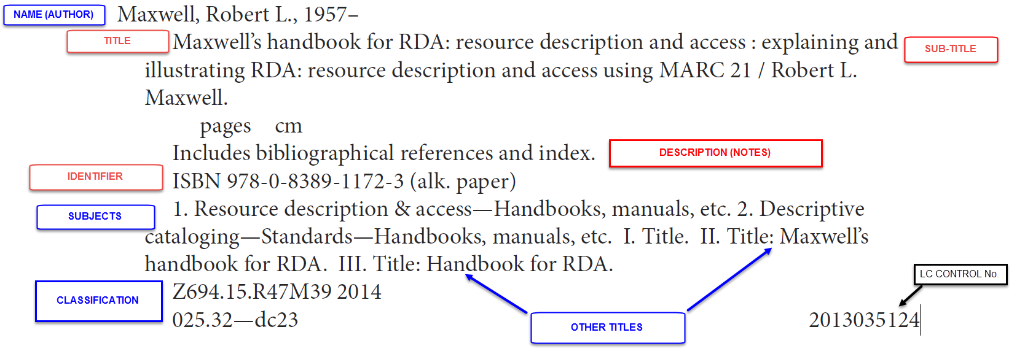
A Record

Slide 5
Definition
MARC (MAchine-Readable Cataloging) is a standard for the representation and communication of bibliographic information (data) in machine-readable form.
  data encoding standard
  data exchange format
  MARC Standards http://www.loc.gov/marc/

Slide 6
Components of the MARC Record
Leader
  Type of record (language material (e.g., books), sound recording, kit, etc.)
  Bibliographic level (monograph, serial, etc.)
Variable control fields, including Fixed-Length Data Elements
  Control fields (e.g., control number, identifiers, etc.)
  Fixed fields (e.g., date, language, etc.)
Variable data fields
  Data elements (title, edition, physical description, notes, etc.)

Slide 7
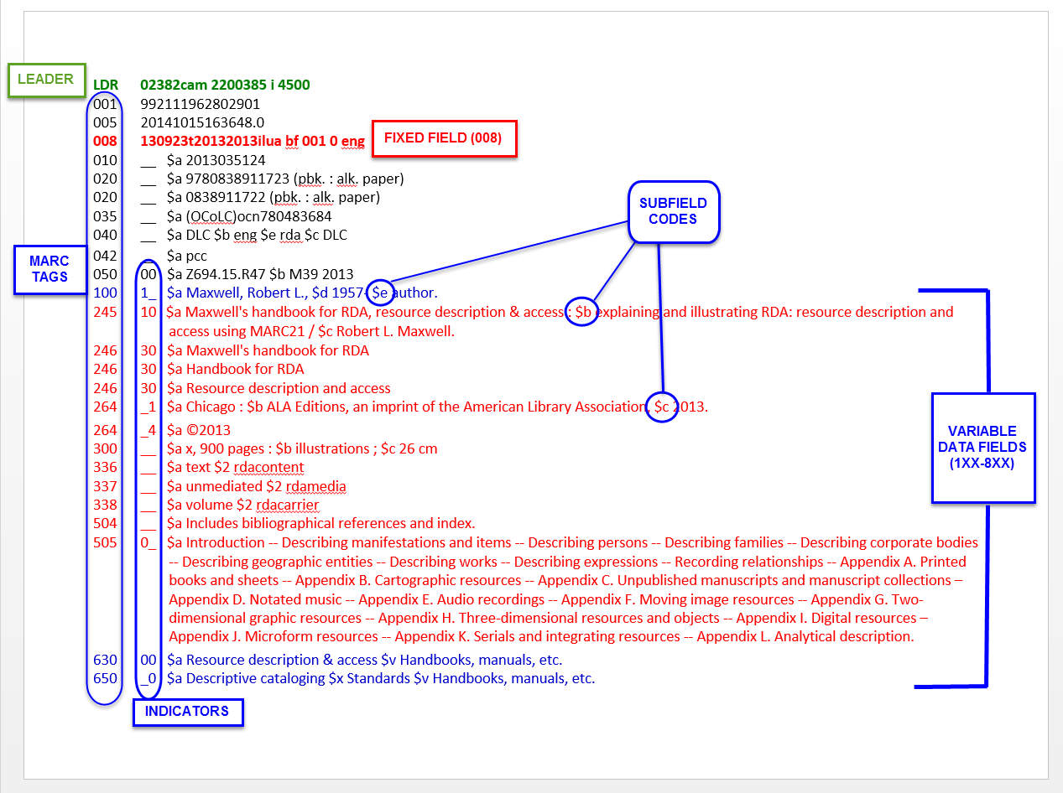
MARC Bibliographic Record

Slide 8
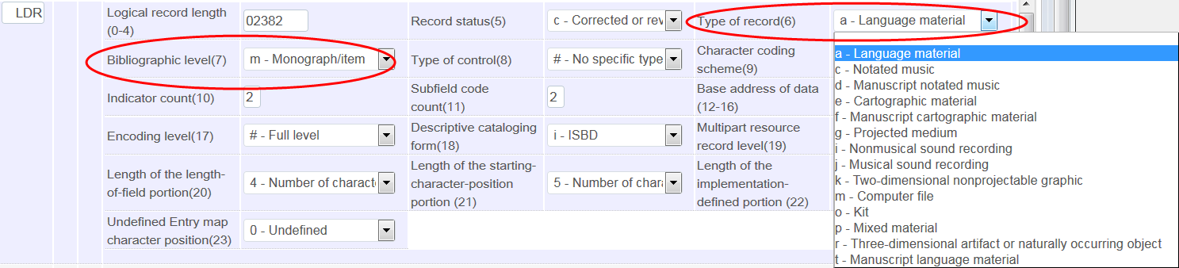
Leader (LDR)
Expanded View
Note:
  Type of record (language material (e.g., books), maps, sound recordings, etc.)
  Bibliographic level (monograph, serial, etc.)
  Monograph (= m) → Books
  Serial (= s) → Journals

Slide 9
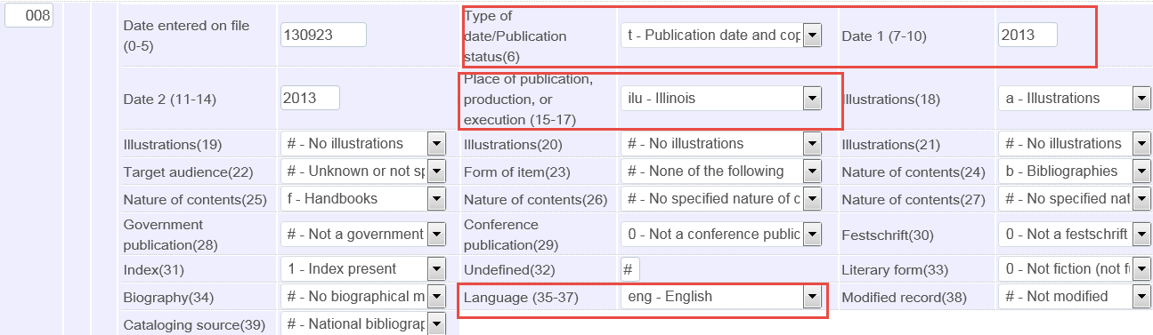
Fixed Field (008)
Expanded View
Data fields indicate:
Date of publication
Place of publication
Language of the resource, etc.

Slide 10
Variable Control Fields (0XX)
  001 Control number
  006 Fixed-Length Data Elements - Additional Material Characteristics
  007 Physical Description Fixed Field
  010 Library of Congress Control Number
  020 International Standard Book Number (ISBN)
  022 International Standard Serial Number (ISSN)

Slide 11
Variable Data Fields (1XX-8XX)
Descriptive & access points fields:
    1XX Principal author
    245 Title
    Variant titles
    250 Edition statement
    26X Publication information
    3XX Physical description, etc.
    49X Series statements
    5XX Notes
    59X Local notes
    6XX Subject access points
    7XX Additional authors, contributors ; linking fields
    8XX Series access point
    9XX Local fields

Slide 12
Display of MARC Records
Online Library Catalogs:
MARC display is often available from online library catalogs.
Library of Congress: https://lccn.loc.gov/2013035124
Discovery Systems:
MARC display is *not* available
But, in Primo record is stored in XML (PNX record = Primo normalized XML record)
To view the record and detailed data elements, add
&showPnx=true
to the end of URL of record.

Slide 13
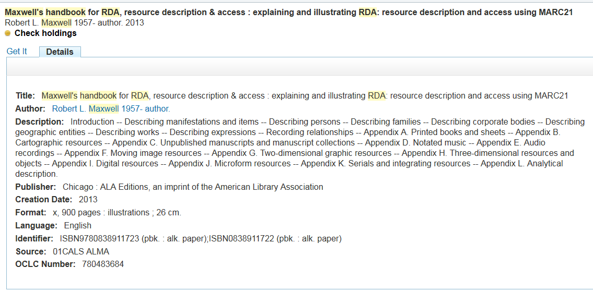
Display of Record (Primo)

Slide 14
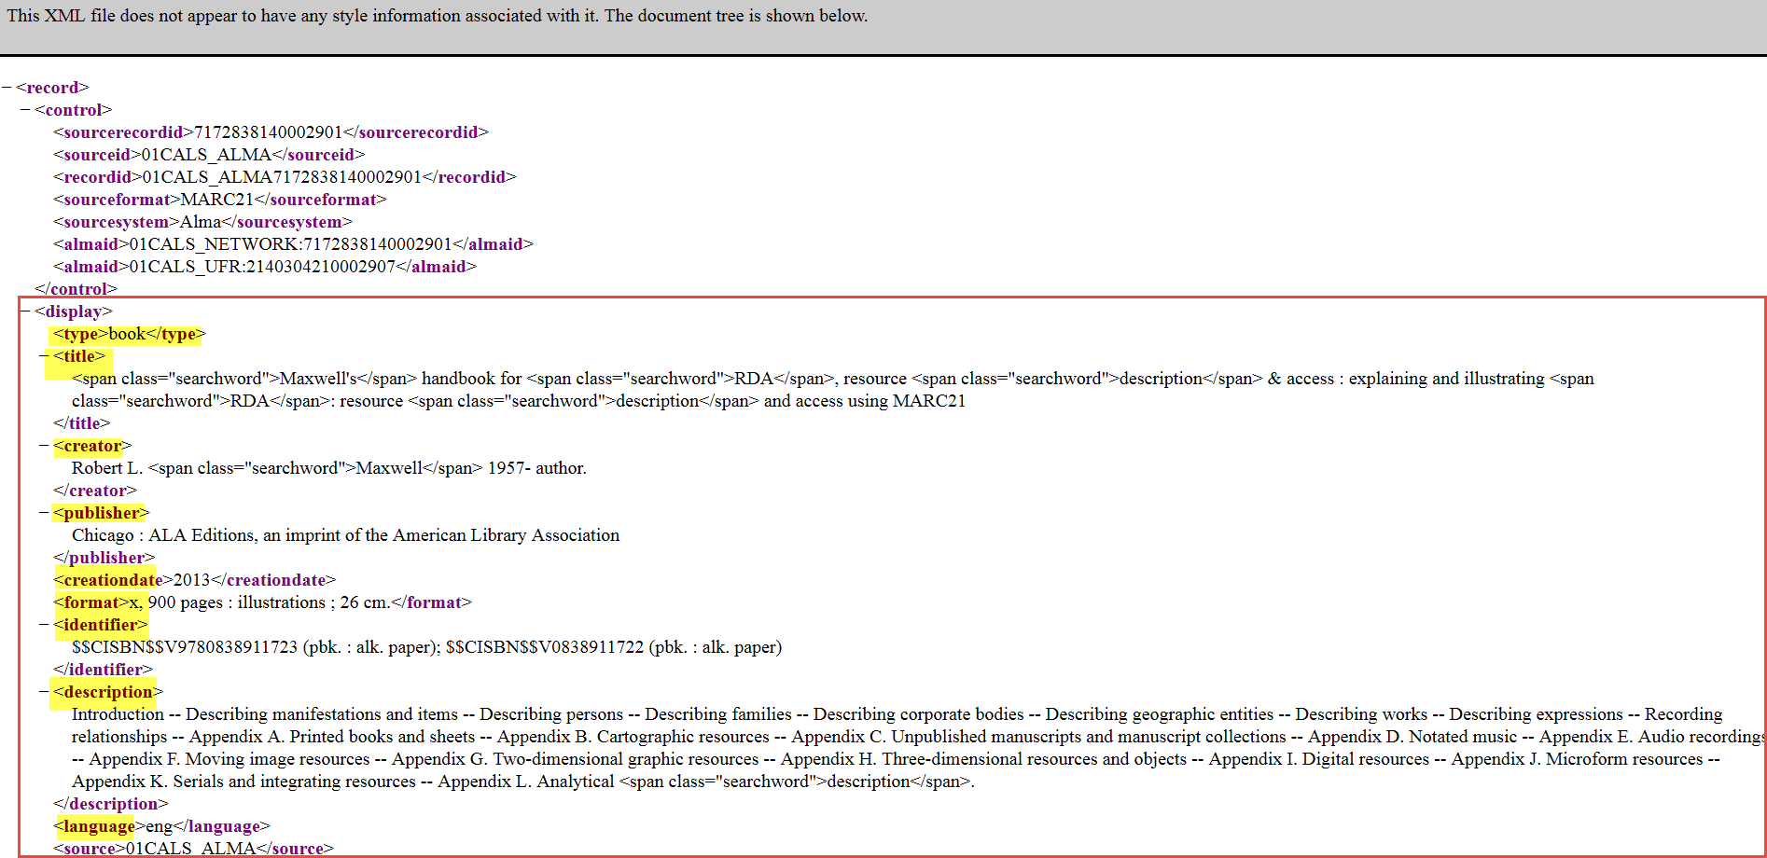
Primo (PNX Record)

Slide 15
Resources
MARC Standards
http://www.loc.gov/marc/
MARC 21 Format for Bibliographic Data
http://www.loc.gov/marc/bibliographic/
Understanding MARC Bibliographic: Machine-Readable Cataloging
http://www.loc.gov/marc/umb/

Slide 16
Q&A Session
Questions?

Slide 17
Thank you!

